Slide 1
Chapter 3.2: Operating Systems Security

Slide 2
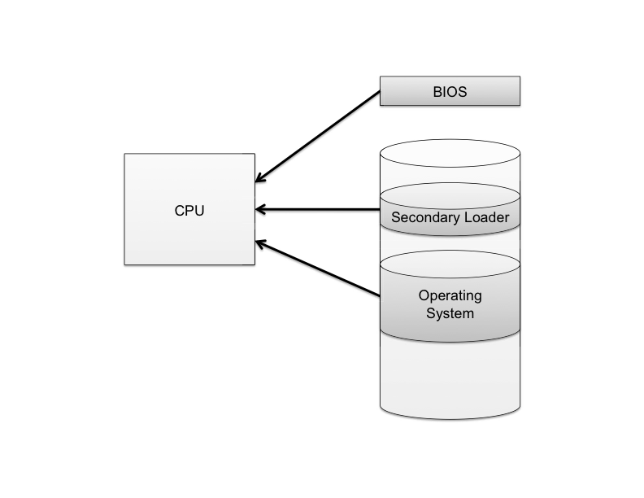
The Boot Sequence
The action of loading an operating system into memory from a powered-off state is known as booting or bootstrapping.
When a computer is turned on, it first executes code stored in a firmware component known as the BIOS (basic input/output system).
On modern systems, the BIOS loads into memory the second-stage boot loader, which handles loading the rest of the operating system into memory and then passes control of execution to the operating system.

Slide 3
BIOS Passwords
A malicious user could potentially seize execution of a computer at several points in the boot process.
To prevent an attacker from initiating the first stages of booting, many computers feature a BIOS password that does not allow a second-stage boot loader to be executed without proper authentication.

Slide 4
Hibernation
Modern machines have the ability to go into a powered-off state known as hibernation.
While going into hibernation, the OS stores the contents of machine’s memory into a hibernation file (such as hiberfil.sys) on disk so the computer can be quickly restored later.
But… without additional security precautions, hibernation exposes a machine to potentially invasive forensic investigation.
1. User closes a laptop computer,
putting it into hibernation.
2. Attacker copies the hiberfil.sys
file to discover any unencrypted
passwords that were stored
in memory when the computer
was put into hibernation.

Slide 5
Event Logging
Keeping track of
what processes are running,
what other machines have interacted with the system via the Internet, and
if the operating system has experienced any unexpected or suspicious behavior
can often leave important clues not only for troubleshooting ordinary problems, but also for determining the cause of a security breach.

Slide 6
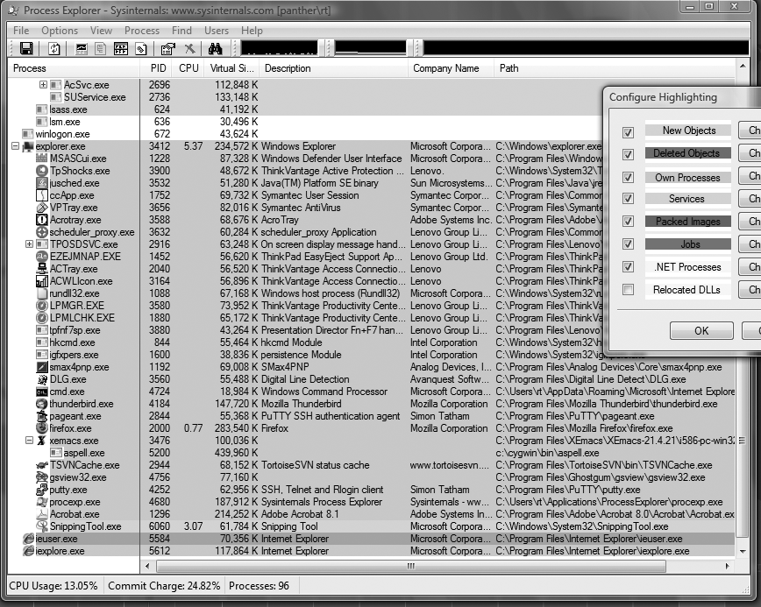
Process Explorer

Slide 7
Seeing Processes
On Windows, ctrl/alt/del ➔ choose task manager ➔ select processes
On Linux, ps lists your processes. Various switches allow access to system wide processes.
For example,
ps –e
lists all processes on the machine.

Slide 8
Memory and Filesystem Security
The contents of a computer are encapsulated in its memory and filesystem.
Thus, protection of a computer’s content has to start with the protection of its memory and its filesystem.
These are often protected by passwords and encryption.

