Slide 1
Chapter 5
Computer Networks

Slide 2
Circuit and Packet Switching
Circuit switching
Legacy phone network
Single route through sequence of hardware devices established when two nodes start communication
Data sent along route
Route maintained until communication ends
Packet switching
Internet
Data split into packets
Packets transported independently through network
Each packet handled on a best efforts basis
Packets may follow different routes

Slide 3
Packet Switching
B
F
A
3
2
1
D
C
D

Slide 4
Packet Switching
B
F
1
A
3
2
D
C
D

Slide 5
Packet Switching
B
F
1
2
A
3
D
C
D

Slide 6
Packet Switching
B
F
1
2
3
A
D
C
D

Slide 7
Protocols
A protocol defines the rules for communication between computers
Protocols are broadly classified as connectionless and connection oriented
Connectionless protocol
Sends data out as soon as there is enough data to be transmitted
E.g., user datagram protocol (UDP)
Connection-oriented protocol
Provides a reliable connection stream between two nodes
Consists of set up, transmission, and tear down phases
Creates virtual circuit-switched network
E.g., transmission control protocol (TCP)

Slide 8
Encapsulation
A packet typically consists of
Control information for addressing the packet: header and footer
Data: payload
A network protocol N1 can use the services of another network protocol N2
A packet p1 of N1 is encapsulated into a packet p2 of N2
The payload of p2 is p1
The control information of p2 is derived from that of p1
Header
Header
Payload
Footer
Footer
Payload

Slide 9
Network Layers
Network models typically use a stack of layers
Higher layers use the services of lower layers via encapsulation
A layer can be implemented in hardware or software
The bottommost layer must be in hardware
A network device may implement several layers
A communication channel between two nodes is established for each layer
Actual channel at the bottom layer
Virtual channel at higher layers

Slide 10
Computer Networks

Slide 11
Internet Layers
Application
Application
Transport
Transport
Network
Network
Network
Network
Link
Link
Link
Link
Ethernet
Fiber Optics
Wi-Fi
Physical Layer

Slide 12
Intermediate Layers
Link layer
Local area network: Ethernet, WiFi, optical fiber
48-bit media access control (MAC) addresses
Packets called frames
Network layer
Internet-wide communication
Best efforts
32-bit internet protocol (IP) addresses in IPv4
128-bit IP addresses in IPv6
Transport layer
16-bit addresses (ports) for classes of applications
Connection-oriented transmission layer protocol (TCP)
Connectionless user datagram protocol (UDP)

Slide 13
Internet Packet Encapsulation
Application Packet
Application Layer
TCP
Header
TCP Data
Transport Layer
IP
Header
IP Data
Network Layer
Frame
Header
Frame Data
Frame
Footer
Link Layer

Slide 14
Internet Packet Encapsulation
Data link frame
IP packet
TCP or UDP packet
Application packet
Data link header
IP header
TCP or UDP header
Application packet
Data link footer

Slide 15
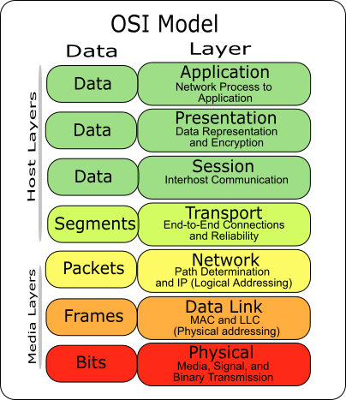
The OSI Model
The OSI (Open System Interconnect) Reference Model is a network model consisting of seven layers
Created in 1983, OSI is promoted by the International Standard Organization (ISO)

Slide 16
Network Interfaces
Network interface: device connecting a computer to a network
Ethernet card
WiFi adapter
A computer may have multiple network interfaces
Packets transmitted between network interfaces
Most local area networks, (including Ethernet and WiFi) broadcast frames
In regular mode, each network interface gets the frames intended for it
Traffic sniffing can be accomplished by configuring the network interface to read all frames (promiscuous mode)

Slide 17
MAC Addresses
Most network interfaces come with a predefined MAC address
A MAC address is a 48-bit number usually represented in hex
E.g., 00-1A-92-D4-BF-86
The first three octets of any MAC address are IEEE-assigned Organizationally Unique Identifiers
E.g., Cisco 00-1A-A1, D-Link 00-1B-11, ASUSTek 00-1A-92
The next three can be assigned by organizations as they please, with uniqueness being the only constraint
Organizations can utilize MAC addresses to identify computers on their network
MAC address can be reconfigured by network interface driver software
Notes:
MAC addresses can be permanently burned in (BIA), or be a locally administered address (LAA) set by an administrator. A MAC address starting out with 00-08-74 for instance is assigned by Dell, while one starting out with 00-0a-95 is assigned by Apple. Despite the IEEE limitations on LAAs, most OSs allow you to specify an arbitrary MAC for an interface.

Slide 18
Combining Switches
Switches can be arranged into a tree
Each port learns the MAC addresses of the machines in the segment (subtree) connected to it
Fragments to unknown MAC addresses are broadcast
Frames to MAC addresses in the same segment as the sender are ignored

Slide 19
Switch
A switch is a common network device
Operates at the link layer
Has multiple ports, each connected to a computer
Operation of a switch
Learn the MAC address of each computer connected to it
Forward frames only to the destination computer

Slide 20
MAC Address Filtering
A switch can be configured to provide service only to machines with specific MAC addresses
Allowed MAC addresses need to be registered with a network administrator
A MAC spoofing attack impersonates another machine
Find the MAC address of target machine
Reconfigure MAC address of rogue machine
Turn off or unplug target machine
Countermeasures
Block port of switch when machine is turned off or unplugged
Disable duplicate MAC addresses

Slide 21
Viewing and Changing MAC Addresses
Viewing the MAC addresses of the interfaces of a machine
Linux: ifconfig
Windows: ipconfig /all
Changing a MAC address in Linux
Stop the networking service: /etc/init.d/network stop
Change the MAC address: ifconfig eth0 hw ether <MAC-address>
Start the networking service: /etc/init.d/network start
Changing a MAC address in Windows
Open the Network Connections applet
Access the properties for the network interface
Click “Configure …”
In the advanced tab, change the network address to the desired value
Changing a MAC address requires administrator privileges
Notes:
In other derivatives like FreeBSD, MacOSX and others stopping the network service is not required, and the hw flag is dropped, leading to a single command ifconfig eth0 ether <MAC-address>

Slide 22
ARP
The address resolution protocol (ARP) connects the network layer to the data layer by converting IP addresses to MAC addresses
ARP works by broadcasting requests and caching responses for future use
The protocol begins with a computer broadcasting a message of the form
who has <IP address1> tell <IP address2>
When the machine with <IP address1> or an ARP server receives this message, its broadcasts the response
<IP address1> is <MAC address>
The requestor’s IP address <IP address2> is contained in the link header
Notes:
IPv6 does not use ARP, and ARP is instead replaced by Neighbor Discovery Protocol.

Slide 23
ARP
The Linux and Windows command
arp - a displays the ARP table
Internet Address Physical Address Type
128.148.31.1 00-00-0c-07-ac-00 dynamic
128.148.31.15 00-0c-76-b2-d7-1d dynamic
128.148.31.71 00-0c-76-b2-d0-d2 dynamic
128.148.31.75 00-0c-76-b2-d7-1d dynamic
128.148.31.102 00-22-0c-a3-e4-00 dynamic
128.148.31.137 00-1d-92-b6-f1-a9 dynamic

Slide 24
ARP Spoofing
The ARP table is updated whenever an ARP response is received
Requests are not tracked
ARP announcements are not authenticated
Machines trust each other
A rogue machine can spoof other machines

Slide 25
ARP Poisoning (ARP Spoofing)
According to the standard, almost all ARP implementations are stateless
An arp cache updates every time that it receives an arp reply… even if it did not send any arp request!
It is possible to “poison” an arp cache by sending gratuitous arp replies
Using static entries solves the problem but it is almost impossible to manage!

Slide 26
Telnet Protocol (RFC 854)
Telnet is a protocol that provides a general, bi-directional, not encrypted communication
telnet is a generic TCP client that
Allows a computer to connect to another one
Provides remote login capabilities to computers on the Internet
Sends whatever you type
Prints whatever comes back
Useful for testing TCP servers (ASCII based protocols)
Notes:
One computer can connect to another to use its services

Slide 27

Wireshark
Wireshark is a packet sniffer and protocol analyzer
Captures and analyzes frames
Supports plugins
Usually required to run with administrator privileges
Setting the network interface in promiscuous mode captures traffic across the entire LAN segment and not just frames addressed to the machine
Freely available on www.wireshark.org

Slide 28
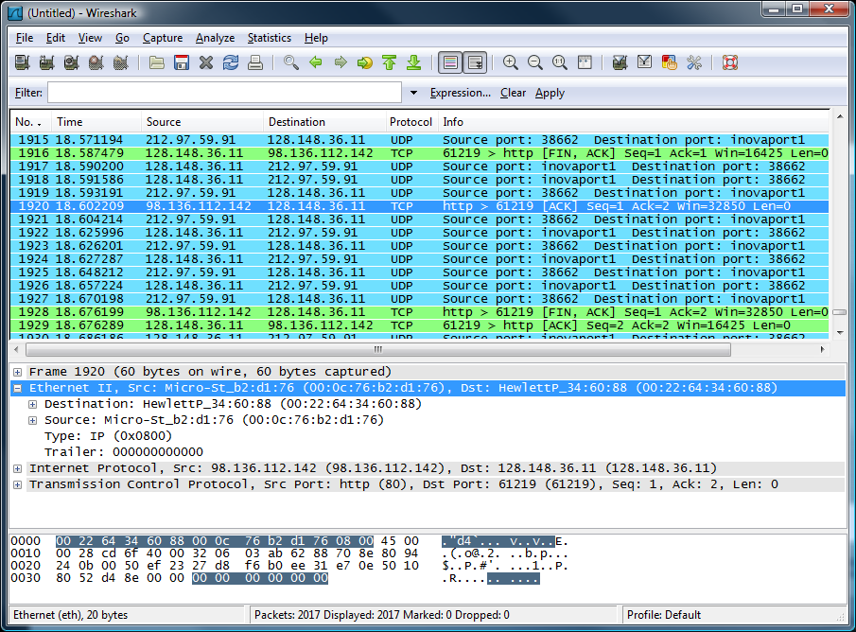
⬅ menu
⬅ main toolbar
⬅ filter toolbar
⬅ packet list pane
⬅ packet details pane
⬅ packet bytes pane
⬅ status bar

Slide 29
DEMO 1: Configuration using Telnet
CLIENT
LAN: 192.168.1.x
SERVER
<< link >>
<< link >>
switch
Alice
Bob
.10
and sends its MAC address
to Alice.
.100
<< link >>
This is stored in Alice’s ARP cache
Alice sends an ARP request to all network machines asking who has a specific IP address.
If IP address is on network, machine replies “here I am”
Cracker
Ethernet UTP
.1
RJ 45

Slide 30
DEMO 1: ARP Spoofing
CLIENT
LAN: 192.168.1.x
SERVER
Regular traffic
switch
Alice
Using arp poisoning
Bob
.10
.100
MAC: 00:0A:E4:2E:9B:11
MAC: 00:0A:E4:3B:47:7E
gratuitous arp reply
Bob’s IP→ Cracker’s MAC
arpspoof 192.168.1.10 192.168.1.100
gratuitous arp reply
Alice’s IP→ Cracker’s MAC
arpspoof 192.168.1.100 192.168.1.10
victim ip
gateway ip
victim ip
gateway ip
Cracker
MAC: 00:22:64:34:60:88
.1

Slide 31
DEMO 1: catch telnet password
CLIENT
LAN: 192.168.1.x
SERVER
Regular traffic
switch
Alice
Using arp poisoning
Bob
.10
.100
With dsniff, we catch the passwords used to log in to a telnet service:
dsniff -n
Acts as a router
Cracker
.1

Slide 32
ARP Caches
IP: 192.168.1.1
MAC: 00:11:22:33:44:01
IP: 192.168.1.105
MAC: 00:11:22:33:44:02
Data
192.168.1.1 is at 00:11:22:33:44:01
192.168.1.105 is at 00:11:22:33:44:02
ARP Cache
192.168.1.105 | 00:11:22:33:44:02
ARP Cache
192.168.1.1 | 00:11:22:33:44:01

Slide 33
Poisoned ARP Caches
192.168.1.106
00:11:22:33:44:03
Data
Data
192.168.1.105 is at 00:11:22:33:44:03
192.168.1.1 is at 00:11:22:33:44:03
192.168.1.1
00:11:22:33:44:01
192.168.1.105
00:11:22:33:44:02
Poisoned ARP Cache
192.168.1.105 | 00:11:22:33:44:03
Poisoned ARP Cache
192.168.1.1 | 00:11:22:33:44:03

Slide 34
DEMO 2: network DOS using ARP
Ping 192.168.1.101
switch
192.168.1.101
192.168.1.102
Cable Loop
ping
arp request
Broadcast storm
How can it be avoided?

Slide 35
Networks: IP and TCP

Slide 36
Internet Protocol
Connectionless
Each packet is transported independently from other packets
Unreliable
Delivery on a best effort basis
No acknowledgments
Packets may be lost, reordered, corrupted, or duplicated
IP packets
Encapsulate TCP and UDP packets
Encapsulated into link-layer frames
Data link frame
IP packet
TCP or UDP packet

Slide 37
IP Addresses and Packets
IP header includes
Source address
Destination address
Packet length (up to 64KB)
Time to live (up to 255)
IP protocol version
Fragmentation information
Transport layer protocol information (e.g., TCP)
IP addresses
IPv4: 32-bit addresses
IPv6: 128-bit addresses
Address subdivided into network, subnet, and host
E.g., 128.148.32.110
Broadcast addresses
E.g., 128.148.32.255
Private networks
not routed outside of a LAN
10.0.0.0/8
172.16.0.0/12
192.168.0.0/16
v
length
fragmentation info
TTL
prot.
source
destination

Slide 38
IP Address Space and ICANN
Hosts on the internet must have unique IP addresses
Internet Corporation for Assigned Names and Numbers
International nonprofit organization
Incorporated in the US
Allocates IP address space
Manages top-level domains
Historical bias in favor of US corporations and nonprofit organizations
Examples
003/8 May 94 General Electric
009/8 Aug 92 IBM
012/8 Jun 95 AT&T Bell Labs
013/8 Sep 91 Xerox Corporation
015/8 Jul 94 Hewlett-Packard
017/8 Jul 92 Apple Computer
018/8 Jan 94 MIT
019/8 May 95 Ford Motor
040/8 Jun 94 Eli Lily
043/8 Jan 91 Japan Inet
044/8 Jul 92 Amateur Radio Digital
047/8 Jan 91 Bell-Northern Res.
048/8 May 95 Prudential Securities
054/8 Mar 92 Merck
055/8 Apr 95 Boeing
056/8 Jun 94 U.S. Postal Service

Slide 39
A Typical University’s IP Space
Most universities separate their network connecting dorms and the network connecting offices and academic buildings
Dorms
Class B network 138.16.0.0/16 (64K addresses)
Academic buildings and offices
Class B network 128.148.0.0/16 (64K addresses)
CS department
Several class C (/24) networks, each with 254 addresses

Slide 40
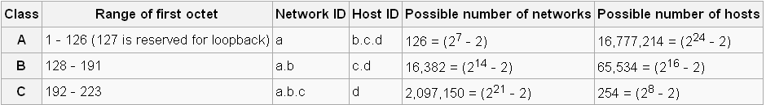
The IP Address Provides Some Information About the Possible Network Size
Currently, three classes of networks are used.
If a.b.c.d is the IP address, the chart below shows the relationship between the address and the possible size of a network.
Note: cs.hiram.edu is 206.57.41.44
home.hiram.edu is 143.206.107.71
http://en.wikipedia.org/wiki/IP_address

Slide 41
IP Routing
A router bridges two or more networks
Operates at the network layer
Maintains tables to forward packets to the appropriate network
Forwarding decisions based solely on the destination address
Routing table
Maps ranges of addresses to LANs or other gateway routers

Slide 42
Internet Routes
Internet Control Message Protocol (ICMP)
Used for network testing and debugging
Simple messages encapsulated in single IP packets
Considered a network layer protocol
Tools based on ICMP
Ping: sends series of echo request messages and provides statistics on roundtrip times and packet loss
Traceroute: sends series ICMP packets with increasing TTL value to discover routes

Slide 43
ICMP Attacks
Ping of death
ICMP specifies messages must fit a single IP packet (64KB)
Send a ping packet that exceeds maximum size using IP fragmentation
Reassembled packet caused several operating systems to crash due to a buffer overflow
Smurf
Ping a broadcast address using a spoofed source address

Slide 44
Smurf Attack
Amplifying
Network
echo response
echo request
echo response
Attacker
echo response
Victim

Slide 45
IP Vulnerabilities
Unencrypted transmission
Eavesdropping possible at any intermediate host during routing
No source authentication
Sender can spoof source address, making it difficult to trace packet back to attacker
No integrity checking
Entire packet, header and payload, can be modified while en route to destination, enabling content forgeries, redirections, and man-in-the-middle attacks
No bandwidth constraints
Large number of packets can be injected into network to launch a denial-of-service attack
Broadcast addresses provide additional leverage

Slide 46
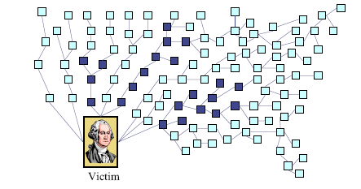
Denial of Service Attack
Send large number of packets to host providing service
Slows down or crashes host
Often executed by botnet
Attack propagation
Starts at zombies
Travels through tree of internet routers rooted
Ends at victim
IP source spoofing
Hides attacker
Scatters return traffic from victim
Source:
M.T. Goodrich, Probabalistic Packet Marking for Large-Scale IP Traceback, IEEE/ACM Transactions on Networking 16:1, 2008.

Slide 47
IP Traceback
Problems
How to identify leaves of DoS propagation tree?
Howwto find routers next to attacker?
Issues
There are more than 2M internet routers
Attacker can spoof source address
Attacker knows that traceback is being performed
Approaches
Filtering and tracing (immediate reaction)
Messaging (additional traffic)
Logging (additional storage)
Probabilistic marking

Slide 48
Probabilistic Packet Marking
Method
Random injection of information into packet header
Changes seldom used bits
Forward routing information to victim
Redundancy to survive packet losses
Benefits
No additional traffic
No router storage
No packet size increase
Can be performed online or offline

Slide 49
Transmission Control Protocol
TCP is a transport layer protocol guaranteeing reliable data transfer, in-order delivery of messages and the ability to distinguish data for multiple concurrent applications on the same host
Most popular application protocols, including WWW, FTP and SSH are built on top of TCP
TCP takes a stream of 8-bit byte data, packages it into appropriately sized segment and calls on IP to transmit these packets

Slide 50
Transmission Control Protocol
Delivery order is maintained by marking each packet with a sequence number
Every time TCP receives a packet, it sends out an ACK to indicate successful receipt of the packet.
TCP generally checks data transmitted by comparing a checksum of the data with a checksum encoded in the packet

Slide 51
Checksum
A checksum is a count of the number of bits in a transmission unit that is included with the unit so that the receiver can check to see whether the same number of bits arrived
. If the counts match, it's assumed that the complete transmission was received.
Both TCP and UDP communication layers provide a checksum count and verification as one of their services.

Slide 52
Ports
TCP supports multiple concurrent applications on the same server
Accomplishes this by having ports, 16 bit numbers identifying where data is directed
The TCP header includes space for both a source and a destination port, thus allowing TCP to route all data
In most cases, both TCP and UDP use the same port numbers for the same applications

Slide 53
Ports
Ports 0 through 1023 are reserved for use by known protocols.
Ports 1024 through 49151 are known as user ports, and should be used by most user programs for listening to connections and the like
Ports 49152 through 65535 are private ports used for dynamic allocation by socket libraries

Slide 54
TCP Packet Format
Bit Offset | 0-3 | 4-7 |  | 8-15 | 16-18 | 19-31
0 | Source Port |  |  |  | Destination Port
32 | Sequence Number
64 | Acknowledgment Number
96 | Offset | Reserved | Flags |  | Window Size
128 | Checksum |  |  |  | Urgent Pointer
160 | Options
>= 160 | Payload

Slide 55
Establishing TCP Connections
TCP connections are established through a three way handshake.
The server generally has a passive listener, waiting for a connection request
The client requests a connection by sending out a SYN packet
The server responds by sending a SYN/ACK packet, indicating an acknowledgment for the connection
The client responds by sending an ACK to the server thus establishing connection
SYN
Seq = x
SYN-ACK
Seq = y
Ack = x + 1
ACK
Seq = x + 1
Ack = y + 1

Slide 56
SYN Flood
Typically DOS attack, though can be combined with other attacks such as TCP hijacking
Rely on sending TCP connection requests faster than the server can process them
Attacker creates a large number of packets with spoofed source addresses and setting the SYN flag on these
The server responds with a SYN/ACK for which it never gets a response (waits for about 3 minutes each)
Eventually the server stops accepting connection requests, thus triggering a denial of service.
Can be solved in multiple ways
One of the common way to do this is to use SYN cookies
Notes:
SYN cookies: Instead of allocating space on the connection table, the sequence number on the SYN/ACK packet is a carefully calculated hash of the connection requestors details, and when the server receives a response it adds the connection to the connection table after verifying information in the cookie.

Slide 57
TCP Data Transfer
During connection initialization using the three way handshake, initial sequence numbers are exchanged
The TCP header includes a 16 bit checksum of the data and parts of the header, including the source and destination
Acknowledgment or lack thereof is used by TCP to keep track of network congestion and control flow and such
TCP connections are cleanly terminated with a 4-way handshake
The client which wishes to terminate the connection sends a FIN message to the other client
The other client responds by sending an ACK
The other client sends a FIN
The original client now sends an ACK, and the connection is terminated
Notes:
Sequence numbers are 32 bit numbers, wrapping to 0. ACKs include sequence number for the received package so sender can keep track of packets received by the receiver.

Slide 58
TCP Data Transfer and Teardown
Data seq=x
Fin seq=x
Ack seq=x+1
Ack seq=x+1
Fin seq=y
Data seq=y
Ack seq=y+1
Ack seq=y+1
Client
Server
Client
Server

Slide 59
TCP Congestion Control
During the mid-80s it was discovered that uncontrolled TCP messages were causing large scale network congestion
TCP responded to congestion by retransmitting lost packets, thus making the problem worse
What is predominantly used today is a system where ACKs are used to determine the maximum number of packets which should be sent out
Most TCP congestion avoidance algorithms, avoid congestion by modifying a congestion window (cwnd) as more cumulative ACKs are received

Slide 60
TCP Congestion Control
Lost packets are taken to be a sign of network congestion
TCP begins with an extremely low cwnd and rapidly increases the value of this variable to reach bottleneck capacity
At this point it shifts to a collision detection algorithm which slowly probes the network for additional bandwidth
TCP congestion control is a good idea in general but allows for certain attacks.

Slide 61
Optimistic ACK Attack
An optimistic ACK attack takes advantage of the TCP congestion control
It begins with a client sending out ACKs for data segments it hasn’t yet received
This flood of optimistic ACKs makes the servers TCP stack believe that there is a large amount of bandwidth available and thus increase cwnd

Slide 62
Optimistic ACK Attack
This leads to the attacker providing more optimistic ACKs, and eventually bandwidth use beyond what the server has available
This can also be played out across multiple servers, with enough congestion that a certain section of the network is no longer reachable
There are no practical solutions to this problem

Slide 63
Session Hijacking
Also commonly known as TCP Session Hijacking
A security attack over a protected network
Attempt to take control of a network session
Sessions are server keeping state of a client’s connection
Servers need to keep track of messages sent between client and the server and their respective actions
Most networks follow the TCP/IP protocol
IP Spoofing is one type of hijacking on large network

Slide 64
IP Spoofing
IP Spoofing is an attempt by an intruder to send packets from one IP address that appear to originate at another
If the server thinks it is receiving messages from the real source after authenticating a session, it could inadvertently behave maliciously
There are two basic forms of IP Spoofing
Blind Spoofing
Attack from any source
Non-Blind Spoofing
Attack from the same subnet

Slide 65
Blind IP Spoofing
The TCP/IP protocol requires that “acknowledgement” numbers be sent across sessions
Makes sure that the client is getting the server’s packets and vice versa
Need to have the right sequence of acknowledgment numbers to spoof an IP identity
Notes:
Used to be that programs such as Rlogin used extremely predictable patterns of acknowledgment numbers
Simply by sending packets to the server and getting responses, one could decode the pattern of acknowledgment numbers
Once an intruder had the acknowledgment number algorithm, it was a simple matter of sending packets with the correct numbers to spoof a client
Most modern systems make acknowledgment sequences random so this cannot be done

Slide 66
Non-Blind IP Spoofing
IP Spoofing without inherently knowing the acknowledgment sequence pattern
Done on the same subnet
Use a packet sniffer to analyze the sequence pattern
Packet sniffers intercept network packets
Eventually decodes and analyzes the packets sent across the network
Determine the acknowledgment sequence pattern from the packets
Send messages to server with actual client's IP address and with validly sequenced acknowledgment number

Slide 67
Packet Sniffers
Packet sniffers “read” information traversing a network
Packet sniffers intercept network packets, possibly using ARP cache poisoning
Can be used as legitimate tools to analyze a network
Monitor network usage
Filter network traffic
Analyze network problems
Can also be used maliciously
Steal information (i.e. passwords, conversations, etc.)
Analyze network information to prepare an attack
Packet sniffers can be either software or hardware based
Sniffers are dependent on network setup

Slide 68
Detecting Sniffers
Sniffers are almost always passive
They simply collect data
They do not attempt “entry” to “steal” data
This can make them extremely hard to detect
Most detection methods require suspicion that sniffing is occurring
Then some sort of “ping” of the sniffer is necessary
It should be a broadcast that will cause a response only from a sniffer

Slide 69
Detecting Sniffers
Another solution on switched hubs is ARP watch
An ARP watch monitors the ARP cache for duplicate entries of a machine
If such duplicates appear, raise an alarm
Problem: false alarms
Specifically, DHCP networks can have multiple entries for a single machine

Slide 70
Port Knocking
Broadly port knocking is the act of attempting to make connections to blocked ports in a certain order in an attempt to open a port
Port knocking is fairly secure against brute force attacks since there are 65536^{k} combinations, where k is the number of ports knocked
Port knocking however if very susceptible to replay attacks. Someone can theoretically record port knocking attempts and repeat those to get the same open port again
One good way of protecting against replay attacks would be a time dependent knock sequence.
Notes:
Port knocking proceeds as follows:
Client wants to connect to port n on server, port n on server is blocked
Client tries to connect to ports a, b, c and d, not receiving any response while doing so, since the firewall blocks all responses
A port knocking daemon on the server keeps track of all the attempts
Once the correct knocking sequence is received it opens port n.

Slide 71
User Datagram Protocol
UDP is a stateless, unreliable datagram protocol built on top of IP, that is it lies on level 4
It does not provide delivery guarantees, or acknowledgments, but is significantly faster
Can however distinguish data for multiple concurrent applications on a single host.

Slide 72
User Datagram Protocol
A lack of reliability implies applications using UDP must be ready to accept a fair amount of error packages and data loss. Some application level protocols such as TFTP build reliability on top of UDP.
Most applications used on UDP will suffer if they have reliability. VoIP, Streaming Video and Streaming Audio all use UDP.
UDP does not come with built in congestion protection, so while UDP does not suffer from the problems associated with optimistic ACK, there are cases where high rate UDP network access will cause congestion.

Slide 73
Network Address Translation
Introduced in the early 90s to alleviate IPv4 address space congestion
Relies on translating addresses in an internal network, to an external address that is used for communication to and from the outside world
Notes:
Whenever the router encounters a datagram it translates the address depending on what way the packet is headed
Usually any given internal IP address is bound to one of many IP addresses dynamically when it creates a session
NAT often needs to handle certain protocols like FTP in a special manner
While most NAT routers can handle popular protocols well, even when they need special attention, well, there are protocols which these routers cannot handle, and hence not all applications can run transparently through NAT.

Slide 74
Network Address Translation
NAT is usually implemented by placing a router in between the internal private network and the public network.
Saves IP address space since not every terminal needs a globally unique IP address, only an organizationally unique one
While NAT should really be transparent to all high level services, this is sadly not true because a lot of high level communication uses things on IP

Slide 75
Translation
Router has a pool of private addresses 192.168.10.0/24
private realm
global realm
s=192.168.10.237 d=128.148.36. 11
s=128.148.36.179
d=128.148.36.11
s=128.148.36.11
d=192.168.10.237
s=128.148.36.11
d=128.148.36.179
192.168.10.237
128.148.36.11
NAT route

Slide 76
IP Packet Modifications
0
31
vers
len
type of service
total length
Computed
ident
flags
fragment offset
Modified on output
time to live
proto
header checksum
source IP address
destination IP address
Modified on input
options
padding
data
????

Slide 77
Computer Security Goals & Networks – C.I.A.
Confidentiality
No requirement for this in any of layers.
Encryption must be handled at the application layer or with alternate protocols at lower layers
Integrity
Checksums give a small amount of integrity, but not true integrity
Must handle at the application layer or with alternate protocols at lower layers

Slide 78
Computer Security Goals & Networks - C.I.A.
Availability
The Internet was configured to minimize the impact of routers or hosts.
The Internet does not scale well with increases in amount of traffic.
Some attacks have actually crashed the Internet

Slide 79
Computer Security Goals & Networks – A.A.A.
Assurance
By default., any packet can travel between any source and any destination.
Outside objects must be introduced to control the flow – for example – firewalls
Authenticity
There is no concept of an owner of a packet.
Must handle at the application layer or with alternate protocols at lower layers

Slide 80
Computer Security Goals & Networks – A.A.A.
Anonymity
As there is no owner identified in a packet, it looks like anonymity is achieved.
But, software exists that allow a packet’s source to be determined so anonymity doesn’t exist,

Slide 81
PROXY SERVERS

Slide 82
What is a Proxy Server?
A proxy server is a server on a network which services the requests of its clients by forwarding requests to other servers.
A client connects to the proxy server, requesting some service, such as a file, connection, web page, or other resource, available from a different server.
The proxy server provides the resource by connecting to the specified server or to another proxy server and, eventually, requesting the service on behalf of the client.

Slide 83
There Are Many Kinds of Proxy Servers
We're concerned here with the following:
Anonymous proxy server
An anonymous proxy server (sometimes called a web proxy) generally attempts to provide a certain degree of anonymous web surfing.
These can easily be overridden by site administrators, and thus rendered useless in some cases.

Slide 84
Hostile proxy server
Proxies can be installed by online criminals, in order to eavesdrop upon the dataflow between the client machine and the web.
All accessed pages, as well as all forms submitted, can be captured and analyzed by the proxy operator.
For this reason, passwords to online services should be changed if an unauthorized proxy is detected.

Slide 85
Transparent proxy server
A transparent proxy is a proxy that does not modify the request or response beyond what is required for proxy authentication and identification.
Some providers of proxy server listings specify additional modifying words such as high anonymous proxy server or elite anonymous proxy server.
There is are clear definitions for these.

Slide 86
Some of the Reasons for Using a Proxy
It helps provide a way to hide your identity from the sites which can see your personal information.
It can provide you greater flexibility to control your network.
It can give access to sites which are blocked in your area.
Some times it increases the browsing speed by storing frequently used pages in cache.
Since an identity can be hid, a cracker can enter sites without revealing who they are.

Slide 87
Where are Some of the Proxy Servers?
There are many lists available:
http://www.proxy4free.com/page1.html
http://samair.ru/proxy/
Tor is both a network of proxy servers and software that allow access to the network which is run by volunteers.
The free software for accessing Tor can be found at http://www.torproject.org/index.html.en
I do not guarantee that these are secure.

Slide 88
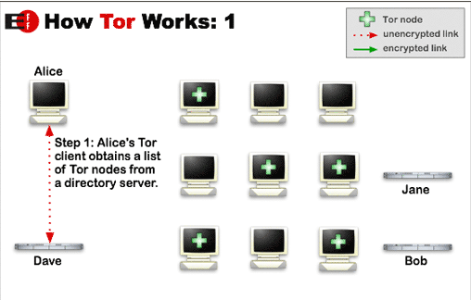
How Tor Works
Tor helps to reduce the risks of traffic analysis by distributing transactions over several places on the Internet, so no single point can link source to destination.
http://www.torproject.org/overview.html.en

Slide 89
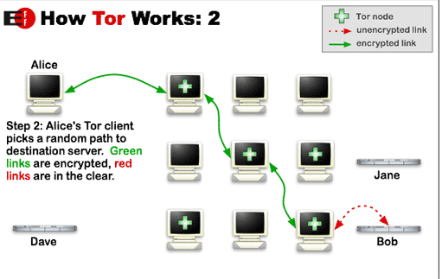
The user's software or client incrementally builds a circuit of individually negotiated encrypted connections through relays on the network.
The circuit is extended one hop at a time.
Each relay along the way knows only which relay gave it data and which relay it is giving data to.
No individual relay ever knows the complete path that a data packet has taken.

Slide 90
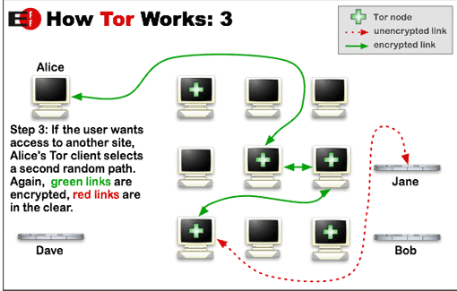
Once a circuit has been established, data can be exchanged and some software applications can be deployed over the Tor network.
Each relay sees only one hop in the circuit.
For efficiency, the Tor software uses the same circuit for connections that happen within the same ten minutes or so.
Later requests are given a new circuit, to prevent the linking of earlier actions to the new ones.

Slide 91
Risks With Some Proxy Servers
A malicious proxy server can record everything sent to it: including unencrypted logins and passwords.
By chaining proxies which do not reveal data about the original requester, it is possible to obfuscate activities from the eyes of the user's destination.
However, then more traces will be left on the intermediate hops, which could be used to trace the user's activities.

Slide 92
Risks With Some Proxy Servers
If the policies and administrators of these other proxies are unknown, the user may fall victim to a false sense of security just because those details are out of sight and mind.
Be wary when using proxy servers, and only use proxy servers of known integrity.
If there is no choice but to use unknown proxy servers, do not pass any private information (unless it is properly encrypted) through the proxy.

Slide 93
Risks With Some Proxy Servers
In what is more of an inconvenience than a risk, proxy users may find themselves being blocked from certain Web sites, as numerous forums and Web sites block IP addresses from proxies known to have spammed or trolled the site.
There is still another problem to overcome when you wish to make an anonymous connection.
Your browser broadcasts a lot of information about you.

Slide 94
Unfortunately, the IP Address Provides More Than the Network Size
Many websites and most hackers use IP addresses to monitor your personal business
If your IP address is known, there is a lot of information immediately available about your computer configuration
Your home address and other personal information about you can be retrieved once your IP address is known

Slide 95
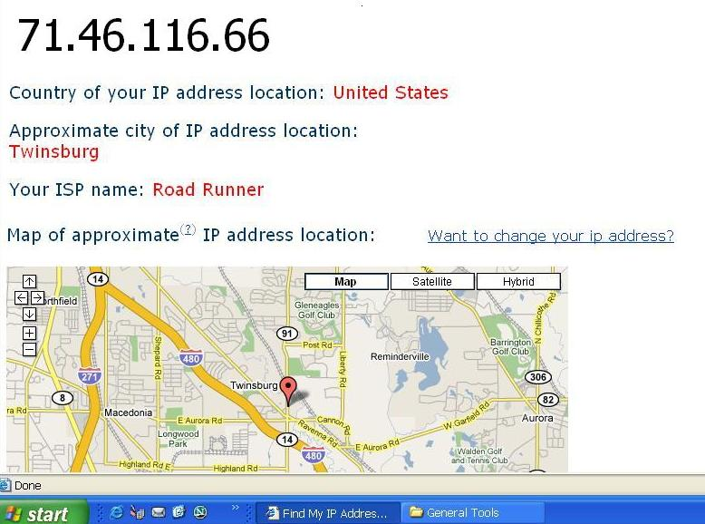
Before IP Address Is Hidden

Slide 96
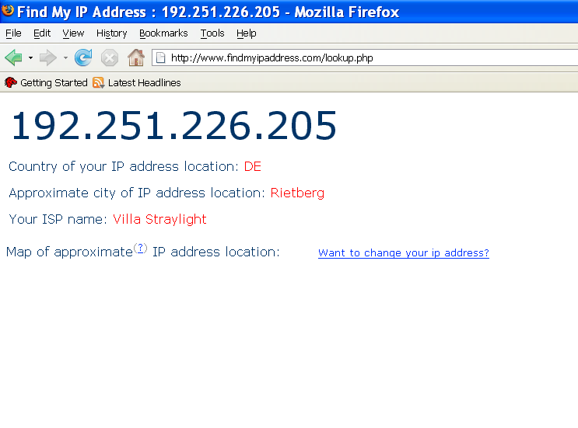
After Using Proxy Servers

Slide 97
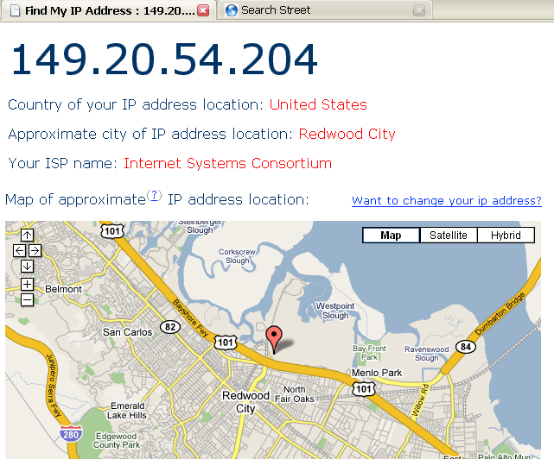
Another Session With Proxy Servers

Slide 98
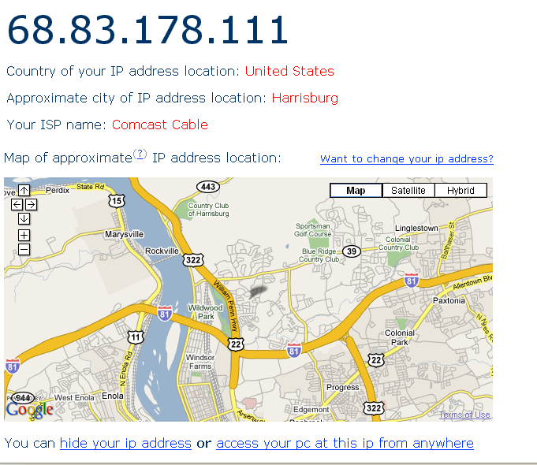
And, One More

Slide 99
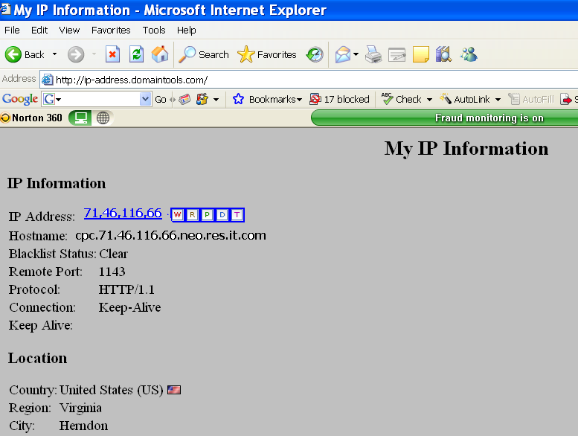
This Website Shows Even More for the IP Address

Slide 100
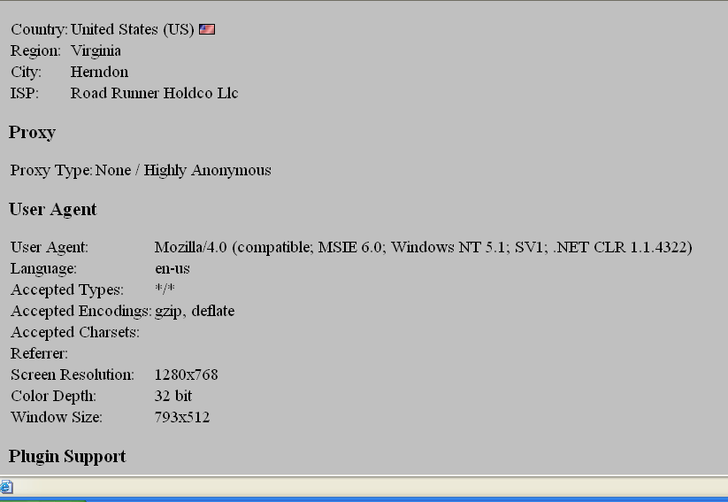
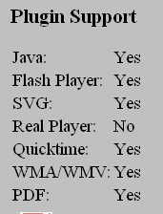

Slide 101
What is the Concern About Knowing This Information?

Slide 102
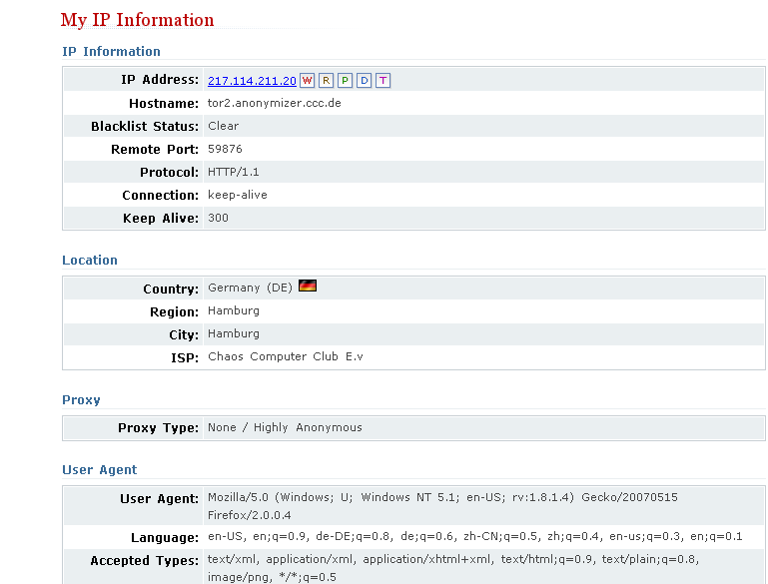
Using the Tor Network

Slide 103
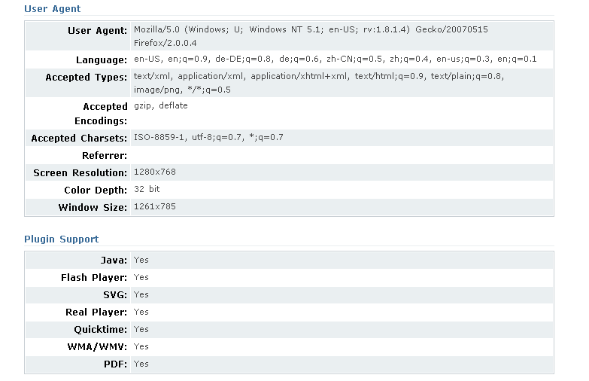

Slide 104
How Can You Net Surf Somewhat Anonymously?
Download software such as the Tor software (free) and use that network of proxies.
Torbutton is a Firefox plugin that allows you to access the Tor network seamlessly.
http://www.torproject.org/download.html.en
Change your IP address when you surf.
There are many free and low cost services available for doing this.
(free) http://www.computerhope.com/issues/ch000784.htm
(low cost - changes IP and automatically uses Tor)- $29.95 http://www.hide-my-ip-address.com/hideip/?pu=false&srec=true

Slide 105
There Are Many Web Sites That Will Check Your IP Address
http://ip-address.domaintools.com/
http://www.findmyipaddress.com/lookup.php
http://www.findmyip.com/
http://www.hide-my-ip.com/
and many others exist!
Note: You should ALWAYS hide your IP address and use proxies if you decide to cruise hacker sites!!!

Slide 106
Pitfalls Still Exist When Using Proxy Networks Like Tor
Tor only protects Internet applications that are configured to send their traffic through Tor — it doesn't magically anonymize all your traffic just because you install it.
Browser plugins such as Java, Flash, ActiveX, RealPlayer, Quicktime, Adobe's PDF plugin, and others can be manipulated into revealing your IP address.
You should probably uninstall your plugins (go to "about:plugins" to see what is installed), or investigate QuickJava, FlashBlock, and NoScript if you really need them.

Slide 107
Pitfalls
Consider removing extensions that look up more information about the websites you select (like Google toolbar), as they may bypass Tor and/or broadcast sensitive information.
Some people use two browsers (one for Tor, one for unsafe browsing).
Beware of cookies: if you ever browse without Tor and Privoxy and a site gives you a cookie, that cookie could identify you even when you start using Tor again.
You should clear your cookies frequently. CookieCuller can help protect any cookies you do not want to lose.

Slide 108
Pitfalls
Tor anonymizes the origin of your traffic, and it encrypts everything inside the Tor network, but it can't encrypt your traffic between the Tor network and its final destination.
If you are communicating sensitive information, you should use as much care as you would on the normal scary Internet — use HTTPS or other end-to-end encryption and authentication.
While Tor blocks attackers on your local network from discovering or influencing your destination, it opens new risks: malicious or misconfigured Tor exit nodes can send you the wrong page, or even send you embedded Java applets disguised as domains you trust.

