Slide 1
Social Engineering

Slide 2
Social Engineering Defined
Social engineering is the art of manipulating people into performing actions or divulging confidential information.
While similar to a confidence trick or simple fraud, the term typically applies to trickery for information gathering or computer system access and in many cases the attacker never comes face-to-face with the victim.
Surprisingly, few security textbooks speak to this technique, but hackers claim it is one of the most effective.
http://en.wikipedia.org/wiki/Social_engineering_(computer_security)

Slide 3
Typical Software Engineering Techniques
(Not Mutually Exclusive)
Pretexting is the act of creating and using an invented scenario (the pretext) to persuade a target to release information or perform an action.
Phishing is a technique of sending email to fraudulently obtain private information by tricking the receiver.
IVR/phone phishing uses a rogue interactive voice response (IVR) system to recreate a legitimate sounding copy of a bank or other institution's IVR system.
Technique classification outlined at: http://en.wikipedia.org/wiki/Social_engineering_(computer_security)

Slide 4
More Techniques
Gimmes take advantage of the victims' curiosity or greed to deliver malware.
  A Road Apple variation of a gimme uses physical media and relies on the curiosity of the victim. The name is taken from a euphemism for horse manure.
Other miscellaneous techniques exist which don't classify easily.

Slide 5
Social Engineering Techniques- Pretexting
Pretexting is the act of creating and using an invented scenario (the pretext) to persuade a target to release information or perform an action.
It is often done over the telephone.
It's more than a simple lie as it most often involves some prior research or set up and the use of pieces of known information (e.g. for impersonation: date of birth, Social Security Number, last bill amount) to establish legitimacy in the mind of the target.
http://en.wikipedia.org/wiki/Social_engineering_(computer_security

Slide 6
Pretexting
Pretexting is one technique used to impersonate co-workers, police, bank, tax authorities or insurance investigators — or any other individual who could have perceived authority or right-to-know in the mind of the target.
The pretexter must simply prepare answers in advance to questions that might be asked by the target or be very nimble on making up answers when confronted.
In some cases all that is needed is an earnest tone and an ability to think on one's feet.

Slide 7
Phishing
Typically, the phisher sends an email that appears to come from a legitimate business — a bank, or credit card company — requesting "verification" of information and warning of some dire consequence if it is not done.
The email usually contains a link to a fraudulent web page that looks legitimate — with company logos and content — and has a form requesting private information.

Slide 8
IVR/Phone Phishing
An IVR system recreates a legitimate sounding copy of a bank or other institution's IVR system.
The victim is prompted (typically via a phishing email) to call in to the "bank" via a provided (ideally toll free) number and verify information.
A typical system will continually reject logins ensuring the victim enters PINs or passwords multiple times, often revealing several different passwords.
More advanced systems will even transfer the victim to the attacker posing as a customer service agent for further questioning.

Slide 9
Gimmes
Gimmes take advantage of the victims' curiosity or greed to deliver malware.
An example of a gimme might be an "email virus" which arrives as an email attachment promising something which might be of interest to a large number of people.
Since naive users might unthinkingly click on an attachment without considering legitimacy, the technique can be quite effective (for example the "I Love YOu virus).
Gimmes are also called Trojan Horses.

Slide 10
Road Apple
In a road apple attack, the attacker leaves a malware infected floppy disc, CD ROM or USB flash drive in a location sure to be found (bathroom, elevator, sidewalk, parking lot), gives it a legitimate looking and curiosity-piquing label, and simply waits.
For example, an attacker might create a disk featuring a corporate logo, readily available off the target's web site, and write "Executive Salary Summary Q1 2008" on the front.
The attacker would then leave the disk on the floor of an elevator or somewhere in the lobby of the target company.

Slide 11
An unknowing employee might find it and subsequently insert the disk into a computer to satisfy their curiosity, or a good samaritan might find it and turn it in to the company.
In either case as a consequence of merely inserting the disk to see the contents, the user would unknowingly install malware on their computer, likely giving an attacker unfettered access to the victim's PC and perhaps the target company's internal computer network.
Unless other controls block the infection, PCs set to "autorun" inserted media may be compromised as soon as a rogue disk is inserted.

Slide 12
Kevin Mitnick
Reformed computer criminal and security consultant Kevin Mitnick popularized the term social engineering, pointing out that it's much easier to trick someone into giving you a password for a system than to spend the effort to hack in.
He has written 2 delightful books that show blow-by-blow how social engineering works:
  The Art of Deception (2002) (Co-authors William L. Simon and Steve Wozniak), which focuses on social engineering, and
  The Art of Intrusion (2005) (Co-author William L. Simon), focusing on real stories of security exploits many of which use social engineering.

Slide 13
Kevin Mitnick
Mitnick claims that social engineering was the single most effective method in his arsenal.
He feels it is still the most effective attack method, but that few businesses train people to recognize this type of attack.
Mitnick served five years in prison, of which four and a half years were pre-trial, and eight months were in solitary confinement.
There are many exploits attributed to Mitnick which he claims he did not do.
He claims that most of his hacks were not technical in nature, but mainly needed a cool head and the ability to lie effectively,

Slide 14
Mitnick claims his success was the result of building inside knowledge, developing trust relationships, and a lot of patience.
To get information needed to complete a hack, Mitnick spent days
  Learning internal company lingo
  Developing emotional connections with key people
    Such as security personnel and tech administrators

Slide 15
Ajay Gupta - Co-author of "Hack IT" and Owner of Gsecurity- a consulting firm
According to Gupta a talented social hacker can cause more harm to a network with a phone than a whole team of script kiddies armed with the latest exploits.
There are many different ways of running these scams, but one of the most popular methods goes a little something like this:
  A stranger obtains critical employee contact information sifting through the company's trash or through clever guesswork and makes a seemingly innocent call to the HR department.
http://www.processor.com/editorial/article.asp?article=articles%2Fp2607%2F32p07%2F32p07.asp

Slide 16
  This stranger calls the employee posing as a technical support employee with information that his or her system is working improperly.
  In order to fix the problem, the stranger says that he'll need the employee's login and password.
  "It is amazing how well and how often this works," Gupta says.
  His consultancy works with clients to determine how susceptible their organizations are to social engineering scams.
  Part of this involves pulling social engineering jobs on these companies' employees to see just how much information his team can get from them.

Slide 17
How Bad is It?
"At one company that we tested, we managed to get 17 out of 30 employees to give us their passwords over the phone," Gupta says.
"That is very scary, considering that one out of 30 is one too many."

Slide 18
Well Known 2003 Phishing Scam
Users received e-mails supposedly from eBay claiming that the user’s account was about to be suspended unless a provided link was followed and credit card information was updated.
It is relatively simple to make a Web site look like a legitimate organizations site by mimicking the HTML code.
The scam counted on people being tricked into thinking they were actually being contacted by eBay and were subsequently going to eBay’s site to update their account information.

Slide 19
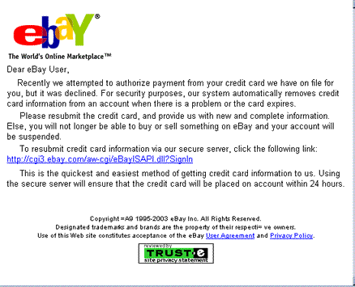
Copy of Letter Received
http://www.millersmiles.co.uk/identitytheft/latest-spoof-ebay-email.htm

Slide 20
By spamming large groups of people, the “phisher” counted on the e-mail being read by a reasonably high percentage of people who actually had listed credit card numbers with eBay legitimately and even a small number of responders would make the phishing productive.
Variations of this theme occur periodically.

Slide 21
An (Slightly Modified) Example
Discussed in PC Magazine, June 7, 2005, pg. 102.
Stickley's firm, Trace Security, Inc., is a white hat firm.
He was hired to test the security of a target.
He wants to sends out email saying to expect a visitor (for example an exterminator or computer center employee).
First a list of some employees is compiled:
    Found on the internet
    By walking in and looking at badges or desk placards
    Calling and asking to speak to someone with a typical title, but say you forget their name.
    Hunt through trash.

Slide 22
  Then determine the format of email addresses at the target.
    Again, try the internet.
    Call and ask someone for a specific person's email address where you had determined the person's name earlier.
    Send various formats such as johnsmith@..., john_smith@..., and ask for a quick reply.
      You'd be surprised at how many answer to something like saying you are Mary Jones who went to high school with the person and would like to reconnect.
      Many will just delete the email, but some will reply to be helpful and say they didn't know a Mary Jones - namely that the email sender had the wrong person.

Slide 23
Send an email to several department heads saying to expect someone to come by to set rodent traps, look at their computer, or whatever.
  The return address can be spoofed or even come from a newly registered domain that looks sort of right - for example, nationa1.com instead of national.com
  It's best if sent supposedly from someone in authority.
Show up (and carry with you a letter of introduction in case you are challenged.)
Do something nasty -
  Install spyware
  Copy files onto a USB flash drive

Slide 24
Another approach, a la Mitnick's scenarios
  Obtain names as before.
  Set up a web site which will capture usernames and passwords when logging in
  Call the target and say you are developing a new interface.
  Ask the target to log into the site with their usual name and password (and capture these).
  This approach has the advantage that the hacker and the target need not ever come face-to-face.

Slide 25
A surprising number of employees give away sensitive information
  Most successful are calls to employees
  Examples are:
    Call the help desk as a “new” employee for help with a particular task
    An angry manager calls a lower level employee because his password has suddenly stopped working
    A system administrator calls an employee and tells her to install some new software on her system requires using her password

Slide 26
Social Engineering Works Simply Because It Exploits Our Human Vulnerabilities
  Desire to help
  Hope for a reward
  Fear of making a mistake
  Fear of getting in trouble
  Fear of getting someone else in trouble
  Feeling sorry for someone who has a problem
  Wanting to not be rude to others

Slide 27
Case Study – Passwords for Candy
More than 70% of people would reveal their computer password in exchange for a bar of chocolate, a British survey has found
The survey also showed that 34% of respondents volunteered their password when asked without even needing to be bribed.
A second survey found that 79% of people unwittingly gave away information that could be used to steal their identity when questioned.
http://news.bbc.co.uk/2/hi/technology/3639679.stm

Slide 28
How Easy Is It?
A survey was undertaken by the organizers of Infosecurity Europe 2003 in a quest to find out how security conscious workers are with company information stored on computers.
Workers were asked a series of questions which included: What is your password? Three in four (75 per cent) of people immediately gave their password.
If they initially refused they were asked which category their password fell into and then asked a further question to find out the password.

Slide 29
Another 15 per cent were then prepared to give over their passwords, after the most rudimentary of social engineering tricks were applied.
One interviewee said, "I am the CEO, I will not give you my password - it could compromise my company's information".
A good start, but then the company boss blew it. He later said that his password was his daughter's name.
What is your daughters name, the interviewer cheekily asked.
He replied without thinking: "Tasmin".
Of the 152 office workers surveyed many explained the origin of their passwords.

Slide 30
The most common password was "password" (12 per cent) and the most popular category was their own name (16 per cent) followed by their football team (11 per cent) and date of birth (8 per cent).
Two thirds of workers have given their password to a colleague and three quarters knew their co-workers passwords.
In addition to using their password to gain access to their company information two thirds of workers use the same password for everything, including their personal banking, website access, etc.
Using the same password makes them more vulnerable to financial fraud, personal data loss or even identity theft, the InfoSecurity team notes.

Slide 31
Tamar Beck, Director of InfoSecurity Europe 2003, said: "Employees are sometimes just naïve, poorly trained or are not made aware of the security risk.
Employers therefore need to create a culture of protecting their information and reputation with policies on information security backed up with training to support the security technology".
http://www.theregister.co.uk/2003/04/18/office_workers_give_away_passwords/

Slide 32
Another Example
A group of strangers walked into a large shipping firm and walked out with access to the firm’s entire corporate network.
How did they do it?
By obtaining small amounts of access, bit by bit, from a number of different employees in that firm.
First, they did research about the company for two days before even attempting to set foot on the premises.
They learned key employees’ names by calling HR.
Next, they pretended to lose their key to the front door, and a man let them in.

Slide 33
Then they "lost" their identity badges when entering the third floor secured area, smiled, and a friendly employee opened the door for them.
The strangers were able to enter the CFO office and obtain financial data off his unlocked computer.
They dug through the corporate trash, finding all kinds of useful documents.
They asked a janitor for a garbage pail in which to place their contents and carried all of this data out of the building in their hands.
The strangers had studied the CFO's voice, so they were able to phone, pretending to be the CFO, in a rush, desperately in need of his network password

Slide 34
From there, they used regular technical hacking tools to gain super-user access into the system.
In this case, the strangers were network consultants performing a security audit for the CFO without any other employees' knowledge.
They were never given any privileged information from the CFO but were able to obtain all the access they wanted through social engineering.
This story was recounted by Kapil Raina, a security expert at Verisign and co-author of mCommerce Security: A Beginner's Guide, based on an actual workplace experience with a previous employer.
http://www.securityfocus.com/infocus/1527

Slide 35
And Then There Was Hiram!
I knew from past experience that most people don’t believe that they could be tricked easily.
In August, I proposed to Mr. Frank Ventura and Mr. Bryan Drennen an experiment I wanted to run in the Computer Security class.
Breaking the class into six teams of three, each team was to try and obtain passwords from people at Hiram by trickery or obtain permission to put a memory stick or CD in a computer to which someone was logged in.

Slide 36
There Were Some Rules ---
Mr. Frank Ventura insisted that at the beginning of the semester he would remind everyone by email that under no circumstances should a password be shared, written down, or compromised in any way.
If you read the article in The Advance and my follow up letter-to-the editor, you know what happened ….

Slide 37
In their words,
  “Mass email reached the entire campus
  Email addresses were easily copied and pasted from a campus directory
  A scare tactic involving a fictional virus was used to induce minor panic and stall critical thinking
  The team posed as a fictional computer help center to gain trust
  There were clues in the email that this was bogus!”

Slide 38
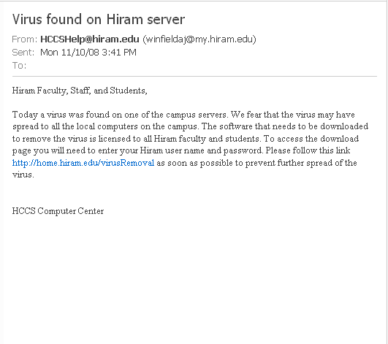

Slide 39


Slide 40
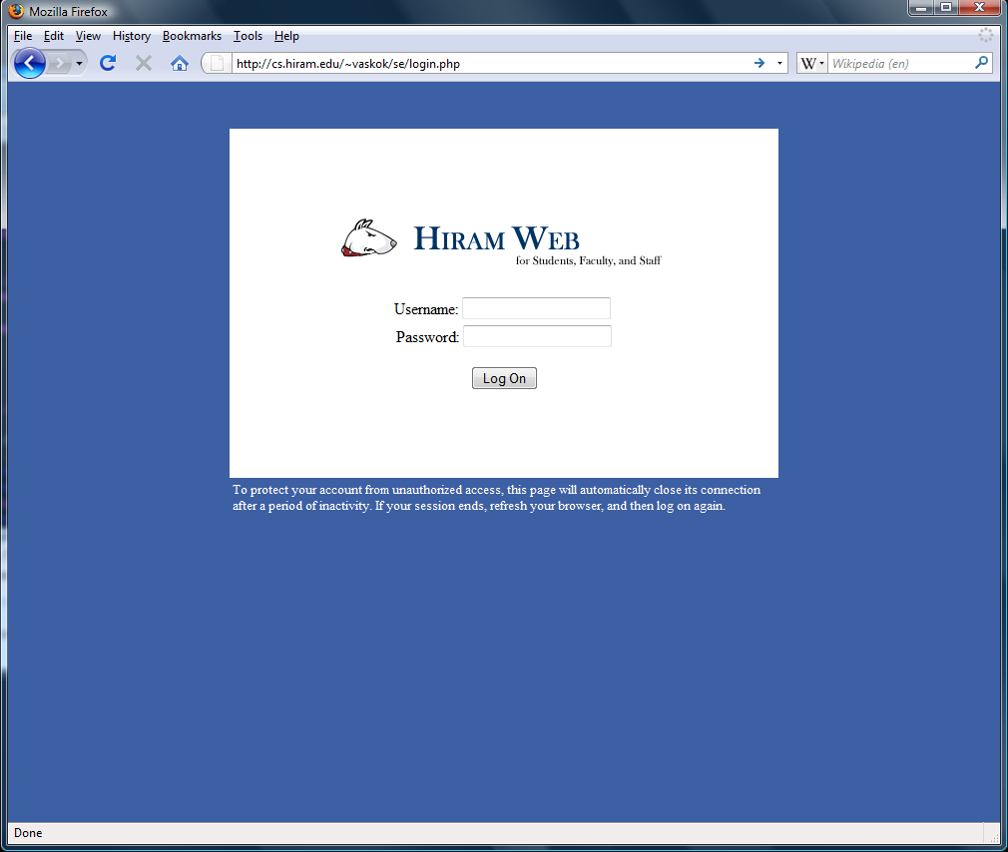
The Trap

Slide 41
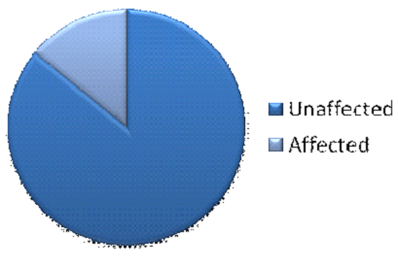
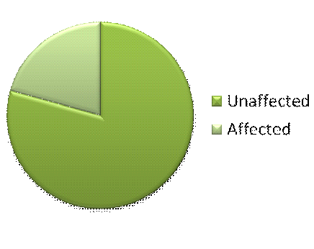
The Results
14.07%
20.67%

Slide 42
The Results – Only Ran For 1 Hour 10 Minutes
Students – 1237 total
Faculty and Staff – 208 total
14.07%
20.67%

Slide 43
After the Pharming Attack Code Was Disabled and an Alert Was Sent Out Across the Campus:
Several people wrote Andrew Winfield telling him the link was broken and would he reinstate it!
There were other attacks - Most were done after a warning from the helpdesk went out.
Teams wandered in the dorms, KC lab, library, staff offices, KC Welcome desk, KC Common Room and various offices.
Most who agreed to supply passwords or access to their computers were students, and many were strangers to the attacker in these tests.

Slide 44
51 Additional People Were Compromised:
1) Asked friends to insert a CD or memory stick
2) Claimed to have forgotten a password and needed to print pictures
3) Claimed to be doing a frequency count on types of passwords
4) Kit-Kats offered for password
5) Claimed to have a survey on a memory stick they needed to answer for a class
6) Claimed flash drive was broken and needed data on memory stick
7) Described a virus in a (real) notice from Norton and offered to allow a CD from Norton to be used to eradicate the virus
8) Claimed they had to obtain data on a USB drive and didn’t have a working one
9) Claimed to need a computer quickly to print something for a class

Slide 45
How to Defend Against Social Engineering
User awareness is critical
All employees must be trained to not give out any sensitive information
Show how seemingly harmless information can be strung together to provide harmful information. (Mitnick's books are a good resource on how this is done.)
A security awareness program should inform employees about social engineering attacks and how they often work.

Slide 46
  Periodically run penetration scenarios to see if everyone is very sensitive to the need to keep knowledge hidden.
  Review what is placed on web pages at your business.
  Stress that there is no reason why a system administrator ever needs you to provide your password
  Help desk should have a way to verify the identify of any user requesting help
  You'd be surprised as to how many people use poor passwords and how many place their password on a post-it note on their monitor or in their top drawer.

Slide 47
How to Defend Against Social Engineering
Control Physical Reconnaissance
  Usually easy to look like an intruder belongs to an organization if they do their homework
    Can sometimes just walk through the door
    Can pose as someone related to an employee to gain access
    Often there is nothing to keep legitimate users from trying to gain entrance to restricted areas
      Temps, contractors, customers and suppliers
  Some business (i.e. colleges) want to have open access.

Slide 48
Physical Reconnaissance
    Once inside, an intruder may have access to a lot of information
    Physical access to internal networks
      Passwords, user information, internal telephone numbers
Defending against physical reconnaissance
  Use badges and biometric information
  Educate people against letting people into buildings.
    Just asking will sometimes allow people into sensitive areas.
    We often are polite and even hold a door open for a visitor.

Slide 49
Dumpster Diving
    Variation of physical reconnaissance
    Go through someone’s trash or recycle bins
    Recover copies of credit card receipts, floppies, passwords, usernames and other sensitive information
Defending against dumpster diving
    Shred all paper including post-it notes
    Don’t throw away floppies or other electronic media without erasing them or shredding them.

Slide 50
Dumpster Diving Originated by Phone Phreaks
Back in AT&T's monopoly days, before paper shredders became common office equipment, phone phreaks used to organize regular dumpster runs against phone company plants and offices
Discarded and damaged copies of AT&T internal manuals taught them much

Slide 51
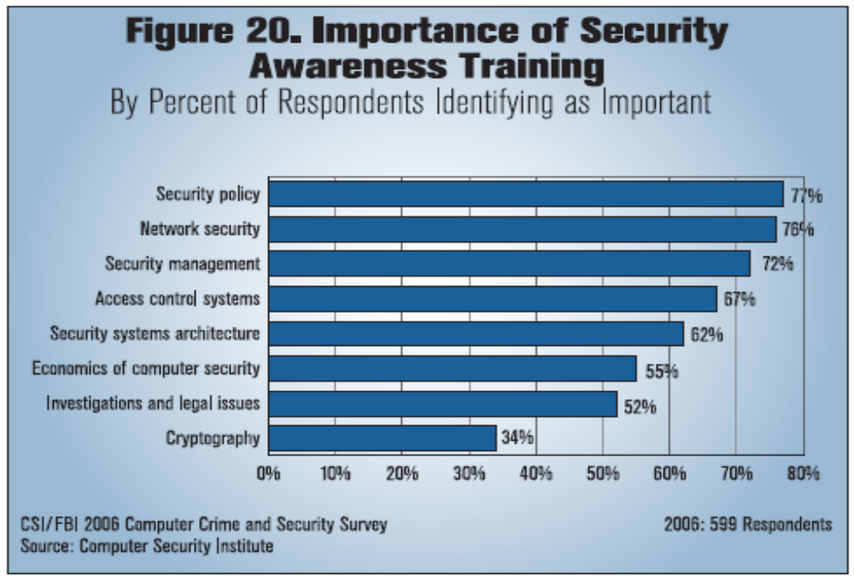
Note: Social engineering techniques are not even listed!

Slide 52
An Example of Social Engineering with a High Tech Company X
Company X
  Multi-billion dollar organization, spends millions on hardware and security
  Only does the minimum of what’s necessary to keep its assets secure
Company X's physical (building) security includes badges for all employees, locked doors, security guards, and restricted access.
Social Engineering Reloaded
http://www.securityfocus.com/infocus/1860/1

Slide 53
Employees, however, tend to hold doors open for others and don't tend to check the photos on IDs when doing so.
Dumpster areas are gated but unlocked, leaving them open to potential dumpster divers
Phone security is standard, allowing internal transfers and outgoing calls with blocked IDs.
Remote access is through a VPN with SecureID, requires permission from superior, inactive accounts are suspended within 30 days
Wireless access points in the buildings also fall under these restrictions.

Slide 54
Software comes standard for each machine
  Screen savers are password protected, but not always locked.
Most machines are open to Internet access with the exception of some site blocking
Email suffers from frequent server problems
  Webmail is not always secure,
  IM use internally is rampant

Slide 55
In areas where social engineering prevention could be most useful … barely anything is done
  Employee phone Help Desk
    No standard authentication questions are asked by either the Help Desk staff or the employee being helped
  Security training is available for home network usage and basic encryption,
    No standard training for new employees, leaving organization open

Slide 56
What could Company X do to prevent attacks on the social engineering level?
  Training, training, training!!!
  Training, training, and more training!!!
  New employee training, repeat training, regular updates, and fun security tips can keep the security education process “fresh and lively”
  What else?

