Slide 1
Chapter 2.1 Authentication: Passwords

Slide 2
Password File in Ubuntu Linux
The password file is /etc/passwd, and it is the database file for all users on the system. The format of each line is as follows:
username:password:uid:gid:gecos:homedir:shell
The gecos field is for miscellaneous information about the user, such as the users’ full name, office location, office and home phone numbers, and possibly a brief text message.
We will concentrate on Ubuntu Linux.
Other operating systems, while sharing many of the same properties as Ubuntu, need to be researched for specific information for them.

Slide 3
A Sample Password File
http://cs.hiram.edu/~obie/cpsc35200/slides/passwd file EX.txt

Slide 4
The Gecos Field
For security and privacy reasons, the gecos field is little used now.
However, a system administrator should be aware of its existence because the gecos field is used by traditional UNIX programs such as finger and mail.
For that reason, it is commonly referred to as the finger information field.
The data in this field is comma delimited.
The gecos field can be changed with the cgfn (change finger) command.

Slide 5
A colon separates all fields in the /etc/passwd file.
If no information is available for a field, that field is empty, but all the colons remain.
If an asterisk appears in the password field, that user will not be permitted to log on.
Why does this feature exist? (Don’t peek on next slide!)

Slide 6
When is the an Asterisk Used?
So that a user can be easily disabled and (possibly) reinstated later without having to be created all over again.
The system administrator manually edits this field, which is the traditional UNIX way of accomplishing this task.
Ubuntu provides improved functionality with the passwd -l command i.e. an account can be locked.

Slide 7
Pseudo-users
Several services run as pseudo-users, usually with root permissions.
These are usually called the system, or logical, users .
You would not want these accounts available for general login for security reasons, so they are assigned /sbin/nologin as their shell, which prohibits any logins from those “users.”

Slide 8
Shadow Passwords
Note that all the password fields do not show a password, but contain an x.
The x in each record specifies these are shadow passwords, a useful security enhancement to Linux.
The file /etc/passwd must be readable in order to allow certain operations to take place.
But, then anyone with read access can run a cracking program on the file and obtain the passwords with little trouble.
In addition to the /etc/passwd file which is readable, a shadow file is kept.

Slide 9
Shadow Passwords
Shadow passwords are used so that only an x appears in the password field of /etc/passwd.
The real passwords are kept in /etc/shadow, a file that can only be read or written to by the sysadmin.
Special versions of the traditional password and login programs must be used to enable shadow passwords.
Shadow passwords are automatically enabled during the installation phase of the operating system on Ubuntu systems.

Slide 10
Sample Shadow File (companion to previous passwd file)
http://cs.hiram.edu/~obie/cpsc35200/slides/shadow file EX.txt
The fields are separated by colons and are, in order:
The user’s login name.
The encrypted password for the user.
The number of days since January 1, 1970 that the password was last changed. This date is known in UNIX circles as the epoch.

Slide 11
The number of days before the password can be changed (prevents changing a password and then changing it back to the old password right away—a dangerous security practice).
The number of days after which the password must be changed. This can be set to force the change of a newly issued password known to the system administrator.
The number of days before the password expiration that the user is warned it will expire.
The number of days after the password expires that the account is disabled (for security).
The number of days since January 1, 1970 that account has been disabled.
The final field is a “reserved” field and is not currently allocated for any use.
The number of days before the password can be changed (prevents changing a password and then changing it back to the old password right away—a dangerous security practice).
The number of days after which the password must be changed. This can be set to force the change of a newly issued password known to the system administrator.
The number of days before the password expiration that the user is warned it will expire.
The number of days after the password expires that the account is disabled (for security).
The number of days since January 1, 1970 that account has been disabled.
The final field is a “reserved” field and is not currently allocated for any use.

Slide 12
Password expiration dates and warnings are disabled by default in Ubuntu. These features are not used on home systems and usually not used for small offices. It is the sysadmin’s responsibility to establish and enforce password expiration policies.
The permissions on the /etc/shadow file should be set so that it is not writable or readable by regular users: The permissions should be 600.

Slide 13
File Permissions in Linux
Sample output produced by 'ls -l' :
drwx------ 2 richard staff 2048 Jan 2 1997 private
drwxrws--- 2 richard staff 2048 Jan 2 1997 admin
-rw-rw---- 2 richard staff 12040 Aug 20 1996 admin/userinfo
drwxr-xr-x 3 richard user 2048 May 13 09:27 public
Field 1: a set of ten permission flags. Field 2: link count Field 3: owner of the file Field 4: associated group for the file Field 5: size in bytes Field 6-8: date of last modification (format varies, but always 3 fields) Field 9: name of file (possibly with path, depending on how ls was called)

Slide 14
The permission flags are read as follows (left to right)
position | Meaning
1 | directory flag, 'd' if a directory, '-' if a normal file, something else occasionally may appear here for special devices.
2,3,4 | read, write, execute permission for User (Owner) of file
5,6,7 | read, write, execute permission for Group
8,9,10 | read, write, execute permission for Other
value | Meaning
- | in any position means that flag is not set
r | file is readable by owner, group or other
w | file is writeable. On a directory, write access means you can add or delete files
X | file is executable (only for programs and shell scripts - not useful for data files). Execute permission on a directory means you can list the files in that directory
S | in the place where 'x' would normally go is called the set-UID or set-groupID flag.
Thus, 600 on shadow file means
Owner can read and write, but no one else can because 600 = 110 (base 2)
i.e. bits 2 and 3 are set.

Slide 15
Hacker – Mixed Meanings
Traditionally, it was believed that hackers liked to
tinker with software or electronic systems.
explore and learn how computer systems operate.
discover new ways to work — both mechanically and electronically.
i.e. they were super programmers and systems people.
In recent years, hacker has taken on a new meaning — someone who maliciously breaks into systems for personal gain.
Technically, these criminals are crackers (criminal hackers).
Crackers break into, or crack, systems with malicious intent.
They are out for personal gain, fame, profit, or even revenge.
They modify, delete, and steal critical information, often making other people miserable.

Slide 16
Hacker – Mixed Meanings
The good hackers (white hats) don’t like being in the same category as the bad hackers (black hats).
Note: The white hat and black hat terms were used in old Western TV and film shows in which the good guys wore white cowboy hats and the bad guys wore black cowboy hats.
Gray hat hackers are a little bit of both.
Whatever the case, most people have a negative
connotation for the word hacker.

Slide 17
Many malicious hackers claim that they don’t cause damage but instead help others by finding security problems.
In reality, many of the holes are already known.
Without permission from owners to hack their systems, malicious hackers are viewed by the law as electronic thieves.

Slide 18
Malicious users are typically a rogue employee, contractor, intern, or other user who abuses his or her privileges.
It is a common term used in security circles and in headlines about information breaches.
A long-standing statistic states that insiders carry out 80% of all security breaches.

Slide 19
Malicious users often don’t have to hack their systems.
They obtain privileges because they are, say, an intern or temporary employee, or they shoulder surfed another person with privileges.
Don’t forget that here is the ignorant insider also whose intent is not malicious but who still causes security problems by moving, deleting, or corrupting sensitive information.

Slide 20
Ethical Hacking
One defense against a hacker is to be, to become, or hire an ethical hacker.
An ethical hacker possesses the skills, mindset, and tools of a hacker, but is completely trustworthy.
Ethical hackers perform hacks as security tests for by permission based on how hackers might work.

Slide 21
Terminology – not Standardized
Hackers (or external attackers) try to compromise computers and sensitive information for ill-gotten gains — usually from the outside — as an unauthorized user.
Hackers go for almost any system they think they can compromise.
Some prefer prestigious, well-protected systems, but hacking into anyone’s system increases an attacker’s status in hacker circles.

Slide 22
Terminology – not Standardized
Malicious internal users (or internal attackers) try to compromise computers and sensitive information from the inside as authorized and “trusted” users.
Malicious users go for systems they believe they can compromise.
They typically hack for financial gains or revenge.
Malicious attackers are, generally speaking, both hackers and malicious users.
For the sake of simplicity, we will refer to both as hackers and specify hacker or malicious user only when I need to distinguish.

Slide 23
Terminology – not Standardized
Ethical hackers hack systems to discover vulnerabilities to protect against unauthorized access, abuse, and misuse.
They have the permission of the owner of a system to hack it.

Slide 24
Cracking or Password Hacking
Cracking is one of the easiest and most common high tech methods used by hackers to obtain unauthorized computer or network access.
Strong passwords are easy to create and maintain, but many users often neglect them
So, passwords are one of the weakest links in the security chain.
Passwords rely on secrecy – once compromised for one use, the hacker has physical access to a sytem.

Slide 25
Obtaining Passwords
There are many low tech ways to obtain passwords and a hacker will often try several of them:
Social engineering
Shoulder surfing
Inference or guessing
Weak authentication on older systems like Windows 9x and Me which didn’t require passwords
Bypassing authentication – some older systems let an ESC suffice for a password.
Password cracking software on a local system.
Remote cracking software for cracking over a network.

Slide 26
Password Vulnerabilities
Normally, considering the cost and value of the to be protected information, the combination of the username and password is adequate.
However, passwords give a false sense of security.
One problem is that many users share their passwords. So, the sys admin may not even know who is using the account.
Before the Internet, one added measure of protection was that computers were physically locked up.

Slide 27
Password Vulnerabilities
Today, the following are viewed as password vulnerabilities:
Organizational or end user vulnerabilities
i.e. lack of password awareness by end users
i.e. lack password policies that are strictly enforced.
Technical vulnerabilities
Weak encryption methods
Insecure storage of passwords on the computer

Slide 28
Organizational Password Vulnerabilities
Unless a policy is formulated and enforced, many users will choose passwords that are
Weak and easy to guess
Seldom changed
Reused for other systems
Written in nonsecure places

Slide 29
Technical Password Vulnerabilities
Software that stores passwords in memory or easily accessed databases
End user applications that display passwords on the screen
Unencrypted email giving you your username and password for an account
See a data base of vulnerabilities.

Slide 30
Password Cracking Thrills Many
Unfortunately.
It fuels hackers’ sense of exploration and puzzle solving.
Interestingly, most hackers are males.
Start your hack by obtaining a password on the system you are attacking.
Start with the hardest to obtain – root’s
Look for a guest or user account.
Try for the root password or passwords for individuals on the system that can use su – i.e. go superuser
But, any user/password pair will do.

Slide 31
High-tech Password Cracking
Uses a cracking program that tries to guess a password by determining all password combinations.
They can be configured to try to crack in a certain order that the user defines, based on some local knowledge – i.e. only the first 8 characters of a password are checked.

Slide 32
Cracking Software
A hacker would try to crack your organization's operating system and application passwords with various password cracking tools:
pwdump3 (www.openwall.com/passwords/dl/pwdump/) extracts Windows password hashes from the SAM database.
john the Ripper (www.openwall.com/john) cracks hashed UNIX and Windows passwords.
Proactive Password Auditor (www.elcomsoft.com/ppa.html) runs brute‐force, dictionary, and rainbow cracks against extracted LM and NTLM password hashes.
Cain and Abel (www.oxid.it/cain.html) cracks LM and NT LanManager (NTLM) hashes, Windows PWL passwords, Cisco IOS and PIX hashes, VNC passwords, RADIUS hashes, and more.

Slide 33
RainbowCrack (www.antsight.com/zsl/rainbowcrack) cracks LanManager (LM) and MD5 hashes very quickly by using rainbow tables.
Elcomsoft Distributed Password Recovery (www.elcomsoft.com/edpr.html) cracks Microsoft Office, PGP, and PKCS passwords in a distributed fashion using up to 2,500 networked computers at once.
Proactive System Password Recovery (www.elcomsoft.com/pspr.html) recovers practically any locally stored Windows password, such as logon passwords, WEP/WPA passphrases, SYSKEY passwords, RAS/dialup/VPN passwords, and more.
chknull (www.phreak.org/archives/exploits/novell) checks for Novell NetWare accounts with no password.
Pandora (www.nmrc.org/project/pandora) cracks Novell NetWare passwords online and offline.

Slide 34
Some of these tools require physical access to the systems being tested.
If a hacker can obtain physical access to your systems and password files, don’t you have more than just basic information security problems to worry about?
But this kind of access is entirely possible! What about a summer intern, a disgruntled employee, or an outside consultant with malicious intent?
Of course a legit use would be for the sys admin to check for poor passwords on the system.

Slide 35
Password‐cracking utilities take a set of known passwords and run them through a password hashing algorithm.
The resulting encrypted hashes are then compared at lightning speed to the password hashes extracted from the original password database.
When a match is found between the newly generated hash and the hash in the original database, the password has been cracked.
It's that simple.

Slide 36
What are Rainbow Table Cracks?
A rainbow table is a precomputed table for reversing cryptographic hash functions, usually for cracking password hashes.
Tables are usually used in recovering the plaintext password, up to a certain length consisting of a limited set of characters.
It is a form of time-memory tradeoff, using less CPU at the cost of more storage. Functions employ salt to make this attack infeasible.

Slide 37
Use of salts
A salt consists of random bits, as one of the inputs to a one-way function. The other input is usually a password or passphrase. The output of the one-way function can be stored rather than the password, and still be used for authenticating users.
Certain passwords such as those in Linux have a “salt” value added to them to create a degree of randomness. Why?
This prevents the same password from being used by two different people having the same hash value.

Slide 38

Salting the Password Table
Password table contains:
Salt value = plre
h(password+salt) = h(baseballplre) = FSXMXFNB

Slide 39
Salting the Password Table (cont)
User enters username and password
The operating system combines the password and the salt and hashes the result
The operating system compares the result to the entry in the table
Match = user is assigned the corresponding uid
Advantages:
Password table does not have to be protected
Dictionary attacks are much harder

Slide 40
Other password cracking programs simply attempt to log on using a predefined set of user IDs and passwords.
This is how many dictionary‐based cracking tools, such as Brutus
(http://securitylab.ru/_tools/brutus-aet2.zip)
and SQLPing2 (www.sqlsecurity.com/Tools/FreeTools/tabid/65/Default.aspx), work.
We will cover cracking Web application and database password cracking later.
Passwords that are subjected to cracking tools eventually lose.
These tools can be used for both legitimate audits and malicious attacks.
You want to audit your passwords before the hackers do.

Slide 41
Encryption
Passwords are typically encrypted when they're stored on a computer, using an encryption or one‐way hash algorithm such as DES or MD5.
Hashed passwords are then represented as fixed‐length encrypted strings that always represent the same passwords with exactly the same strings.
These hashes are irreversible for all practical purposes, so, in theory, passwords can never be decrypted.

Slide 42
Password Storage Locations Windows
These vary by operating system:
Windows usually stores passwords in these locations:
Security Accounts Manager (SAM) database (c:\winnt\system32\config)
Active Directory database file that's stored locally or spread across domain controllers (ntds.dit)
Windows sometimes stores passwords in either a backup of the SAM file in the c:\winnt\repair directory or on an emergency repair disk.
Some Windows applications store passwords in the Registry or as plain‐text files on the hard drive!

Slide 43
Password Storage Locations Unix Variants
Linux and other UNIX variants typically store passwords in these files:
/etc/passwd (readable by everyone)
/etc/shadow (accessible by the system and the root account only)
/etc/security/passwd (accessible by the system and the root account only)
/.secure/etc/passwd (accessible by the system and the root account only)

Slide 44
Attacks on Passwords
Attacker could…
Target one particular account
Target any account on system
Target any account on any system
Attempt denial of service (DoS) attack
Common attack path
Outsider → normal user → administrator
May only require one weak password!

Slide 45
Types of Attacks
There are three high‐tech password‐cracking methods
dictionary attacks,
brute‐force attacks, and
rainbow attacks.

Slide 46
Dictionary Attacks
Dictionary attacks quickly compare a set of known dictionary‐type words — including many common passwords — against a password database.
This database is a text file with hundreds if not thousands of “dictionary” words typically listed in alphabetical order.
For instance, suppose that you have a dictionary file that you downloaded from one of the sites in the list specified latter..
The English dictionary file at the Purdue site contains one word per line starting with 10th, 1st . . . all the way to zygote.

Slide 47
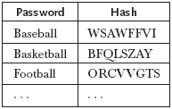
A Dictionary Attack
An attacker can compile a dictionary of several thousand common words and compute the hash for each one:
Look for matches between the dictionary and the password table
Example: WSAWFFVI tells us Bob’s password is baseball

Slide 48
WordLists
Many password‐cracking utilities can use a separate dictionary that you create or download from the Internet. Here are some popular sites that house dictionary files and other miscellaneous word lists:
ftp://ftp.cerias.purdue.edu/pub/dict
ftp://ftp.ox.ac.uk/pub/wordlists
packetstormsecurity.nl/Crackers/wordlists
www.outpost9.com/files/WordLists.html

Slide 49
Dictionary Attacks (cont)
Dictionary attacks are a serious problem:
Costs an intruder very little to send tens of thousands of common words through the one-way function and check for matches
Between 20 and 40 percent of the passwords on a typical system can be cracked in this way
Solution #1: don’t allow users to select their own passwords
System generates a random password for each user
Drawback:
Many people find system-assigned passwords hard to remember and therefore they write them down
Example: L8f#n!.5rH’
You can find huge numbers of post-it notes on screens, under keyboards, and in top drawers of desks that contain passwords!

Slide 50
You'll may need to try many lists to increase your chances of cracking the password.
Don't forget to use other language files as well, such as Spanish and Klingon.
Dictionary attacks are only as good as the dictionary files you supply your password‐cracking program.
Most dictionary attacks are good for weak (easily guessed) passwords.
However, some special dictionaries have common misspellings or alternate spellings of words — such as pa$$w0rd (password) and 5ecur1ty (security) — non‐English words, and thematic words from religions, politics, or Star Trek.

Slide 51
Password Cracking
Attack any of 1024 passwords in file
With dictionary
Probability at least one password is in dictionary is 1 - (3/4)¹⁰²⁴ = 1
We ignore case where no pwd is in dictionary
If no salt, work is about 2¹⁹/2¹⁰ = 2⁹
If salt, expected work is less than 2²²
Note: If no salt, we can precompute all dictionary hashes and amortize the work
Notes:
Calculation for salted case:
Number the passwords in file, pwd1, pwd2, …,pwd1024
Consider checking each pwd in turn. The probability pwd1 is in the dictionary is 1/4 and, if so, expected work (no. of hashes) is 2^19. If pwd1 is not in dictionary but pwd2 is, we do 2^20 hashes (for pwd1) plus an expected 2^19 hashes for pwd2. The probability of this is (3/4)(1/4). Continuing, we find the expected work factor is
(1/4)*(2^19) + (3/4)*(1/4)*(2^20+2^19) + (3/4)^2*(1/4)*(2*2^20+2^19)+…+ + (3/4)^1023*(1/4)(1023*2^20+2^19) < 2^22

Slide 52
Dictionary Attacks (cont)
Dictionary attacks are a serious problem:
Costs an intruder very little to send tens of thousands of common words through the one-way function and check for matches
Between 20 and 40 percent of the passwords on a typical system can be cracked in this way
Solution #1: don’t allow users to select their own passwords
System generates a random password for each user
Drawback:
Many people find system-assigned passwords hard to remember and therefore they write them down
Example: L8f#n!.5rH’
You can find huge numbers of post-it notes on screens, under keyboards, and in top drawers of desks that contain passwords!

Slide 53
Combating Dictionary Attacks
Solution #2: password checking
Allow users to choose their own passwords
Do not allow them to use passwords that are in a common dictionary
Solution #3: salt the password table
A salt is a random string that is concatenated with a password before sending it through the one-way hash function
Random salt value chosen by system
Example: plre
Password chosen by user
Example: baseball

Slide 54
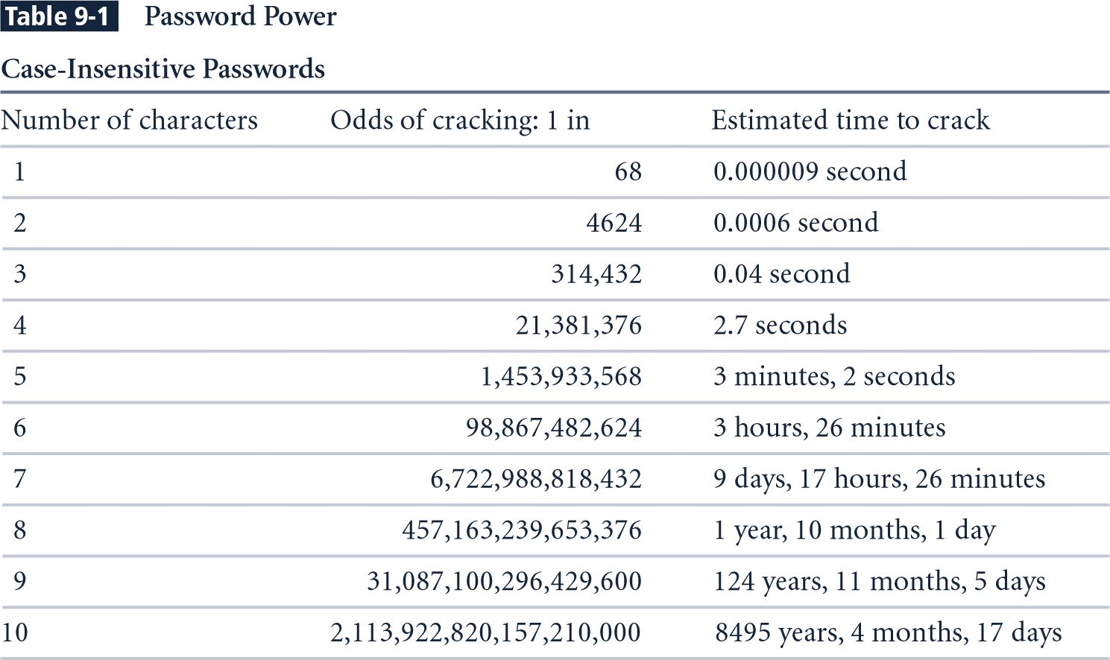
Brute Force Tries-Pentium 4 performing 8 million guesses per second
Notes:
Estimated Time to Crack is based on a Pentium 4 computer performing 8 million guesses per second. The estimates take into consideration all keyboard characters, some of which are not allowed by some systems.

Slide 55
Brute-force Attacks
Brute‐force attacks can crack practically any password, given sufficient time.
Brute‐force attacks try every combination of numbers, letters, and special characters until the password is discovered.
Many password‐cracking utilities let you specify such testing criteria as the character sets, password length to try, and known characters (for a “mask” attack).

Slide 56
Password Retry
Suppose system locks after 3 bad passwords. How long should it lock?
5 seconds
5 minutes
Until SA restores service
What are +’s and -’s of each?

Slide 57

Using Passwords and One-Way Functions
User’s password is not stored in the table
A one-way hash* of the password, h(password), is stored in the table
h(dumptruck) = JFNXPEMD
h(baseball) = WSAWFFVI
* hash is just a fancy word for a function or method that has few collisions and cannot be reversed. – i.e. no inverse function exists.

Slide 58
Using Passwords and One-Way Functions
User’s password is not stored in the table
A one-way hash* of the password, h(password), is stored in the table
h(dumptruck) = JFNXPEMD
h(baseball) = WSAWFFVI
* hash is just a fancy word for a function or method that has few collisions and cannot be reversed. – i.e. no inverse function exists.

Slide 59
Locked Accounts After X Tries
Smart hackers attempt logins slowly or at random times so the failed login attempts aren't as predictable or obvious in the system log files.
Some malicious users may even call the IT help desk to attempt a reset of the account they've just locked out.
This social‐engineering technique could be a major issue, especially if the organization has no or minimal mechanisms in place to verify that locked‐out users are who they say they are.

Slide 60
After a password is changed, the cracking must start again if the hacker wants to test all the possible combinations.
This is one reason why passwords must be changed periodically.
Shortening the change interval can reduce the risk of passwords being cracked unless users write down the changed ones because they can’t remember all of them.

Slide 61
Most passwords are fairly weak.
Even minimum password requirements, such as a password length, can help you in your testing. You may be able to discover security policy information by using other tools and techniques to hack operating systems) and configure your cracking programs with more defined cracking parameters, which often generates faster results.

Slide 62
Rainbow Attacks
A rainbow password attack uses rainbow tables — as previously described .
There was an experiment, “A case study in Windows password vulnerabilities with Philippe Oechslin”, — to crack various password hashes for LM, NTLM, Cisco PIX, MD5, and others much more quickly and with extremely high success rates (near 100%).
Password‐cracking speed is increased in a rainbow attack because the hashes are precalculated and, thus, don't have to be generated individually on the fly as they are with dictionary and brute‐force cracking methods.

Slide 63
Security Files and Utilities
Linux provides several methods for safeguarding or controlling the login process:
The root user can only log in from terminals that are listed in the file /etc/securetty
If the /etc/nologin file exists, only root can log in at that time and when this file is deleted, all users can log in again
Executable files can have a special file permission set (the Set UID bit, or SUID) that causes them to take on the permissions of the user who owns the file rather than the user who executed the file

Slide 64
Security Files and Utilities
Linux provides several methods for safeguarding or controlling the login process:
The root user can only log in from terminals that are listed in the file /etc/securetty
If the /etc/nologin file exists, only root can log in at that time and when this file is deleted, all users can log in again
Executable files can have a special file permission set (the Set UID bit, or SUID) that causes them to take on the permissions of the user who owns the file rather than the user who executed the file

Slide 65
Security Files and Utilities
More Linux-provided security methods:
The Linux file systems support a number of attributes that can be set on any file
The PAM module pam_time can be used with the login program to limit when a user can log in
If the standard bash shell for Linux is running, an environment variable can be set which will log a user out after a certain number of idle seconds
In the tsch shell, an environment variable accomplishes the same thing, but in a matter of minutes, not seconds

Slide 66
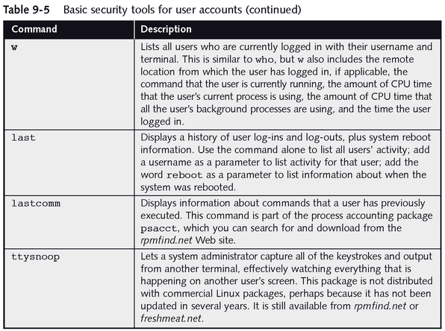
Seeing Who Is Using Linux

Slide 67
Password Experiment
A passphrase is a plain-language phrase, typically longer than a password, from which a virtual password is derived
Example: Alice loves Bob and Bob loves Trudy!
AlBaBlT!
Three groups of users --- each group advised to select passwords as follows
Group A: At least 6 chars, 1 non-letter
Group B: Password based on passphrase
Group C: 8 random characters
Results
Group A: About 30% of pwds easy to crack
Group B: About 10% cracked
Passwords easy to remember
Group C: About 10% cracked
Passwords hard to remember
winner →

Slide 68
Password Experiment
A passphrase is a plain-language phrase, typically longer than a password, from which a virtual password is derived
Example: Alice loves Bob and Bob loves Trudy!
AlBaBlT!
Three groups of users --- each group advised to select passwords as follows
Group A: At least 6 chars, 1 non-letter
Group B: Password based on passphrase
Group C: 8 random characters
Results
Group A: About 30% of pwds easy to crack
Group B: About 10% cracked
Passwords easy to remember
Group C: About 10% cracked
Passwords hard to remember
winner →

Slide 69
Password Experiment
User compliance hard to achieve
In each case, 1/3rd did not comply (and about 1/3rd of those easy to crack!)
Assigned passwords sometimes best
If passwords not assigned, best advice is
Choose passwords based on passphrase
Use pwd cracking tool to test for weak pwds
Require periodic password changes.

Slide 70
Password Experiment
User compliance hard to achieve
In each case, 1/3rd did not comply (and about 1/3rd of those easy to crack!)
Assigned passwords sometimes best
If passwords not assigned, best advice is
Choose passwords based on passphrase
Use pwd cracking tool to test for weak pwds
Require periodic password changes?

Slide 71
Passwords
The bottom line
Password cracking is too easy!
One weak password may break security
Users choose bad passwords
Social engineering attacks, etc.
The bad guy has all of the advantages
All of the math favors bad guys
Passwords are a big security problem

Slide 72
Just Announced Sept 13
IDG News Service - Nearly seven months after Intel shelled out $7.68 billion for antivirus vendor McAfee, the two companies are offering a glimpse of their future.
At the Intel Developer Forum in San Francisco Tuesday, McAfee providde an early look of its new effort to build security protections outside of the OS, using Intel's chip-level hooks that allow McAfee's Endpoint Protection Software to get a better look at malicious software such as rootkits.

