Slide 1
Some History
1967: People starting to publish papers on computer security
1970: Influential (in some circles!) RAND report: “Security Controls for Computer Systems”
– Originally classified – declassified in 1979
Mid-70’s: Many influential papers published in open literature
Mid-70’s: Cryptography takes off in public research
1985: Department of Defense publishes “Trusted
Computer System Evaluation Criteria” (Orange Book)
1994: Publication of “Common Criteria for Information Technology Security Evaluations”
2003: Publication of “The National Strategy to Secure Cyberspace”
1

Slide 2
Some History – The Other Side
1970’s: Age of phone phreaking
1980’s: BBSes, Legion of Doom, and Chaos Computer Club
1983: War Games movie comes out
1984: 2600 (The Hacker Quarterly) publication starts
1986: First PC virus in the wild (the “Brain virus”)
1988: The “Morris worm”
– Automated spreading across the Internet
– Exploited several bugs, including the first highly-visible “buffer overflow” exploit (of fingerd)
– Around 6000 computers affected – 10% of the Internet at the time!
– Morris convicted in 1990
– CERT created largely because of this

Slide 3
Some History – The Other Side (cont’d)
  CERT is Carnegie Mellon University's Computer Emergency Response Team.
  This is one of the most active groups for studying security issues.
  See: http://www.cert.org/
  There is now a US-CERT group - United States Computer Emergency Readiness Team
Early 1990’s: Kevin Mitnick (“Condor”) years
– Arrested several times and went “underground” in 1992.
– Caught in Raleigh, NC in 1995
– Well-known for “social engineering” skill

Slide 4
Some History – The Other Side (cont’d)
1993: Kevin Poulsen hacks phones so he wins radio station contests (Porches, trips, cash, …)
1999 – present: Widespread worms/viruses
– 1999: Melissa (Word macro virus/worm)
– 2000: Love Letter (VBScript – did damage!)
– 2001: Nimda (hit financial industry very hard)
– 2001: Code Red (designed to DoS the White House, but hard-coded IP address so defeated!)
– 2003: “Slammer” (spread astoundingly fast!)
1999: DDoS networks appear
– 2000: Big attacks on Yahoo, eBay, CNN, …
– Today: “Bot-nets” with 10’s of thousands of bots

Slide 5
How Bad is it?
September 2001 - Nimbda worm spread nationwide in less than an hour and attacked 86,000 computers
January 2003 – Sapphire/Slammer SQL worm was able to spread nationwide in less than 10 minutes, doubling in size every 8.5 seconds. At its peak (3 minutes after its release) it scanned at over 55 million IP addresses per second, infecting 75,000 victims

Slide 6
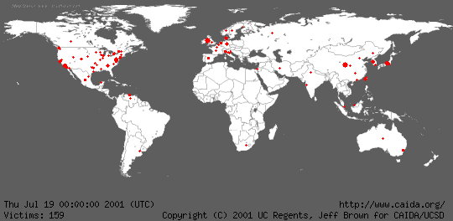
Geographic Spread of Code Red Worm

Slide 7
Why is it So Bad?
Computers are everywhere
Internet has become a mission-critical infrastructure for business, government, and financial institutions
Today’s networks are very heterogeneous, highly critical applications run side by side with noncritical systems
Cyber attacks against non-critical services may produce unforeseen side-effects of devastating proportions

Slide 8
Why is it So Bad?
Home users increase vulnerabilities
Today most homes are connected, particularly with the advent of DSL and cable modems
Most home users:
– are unaware of vulnerabilities
– don’t use firewalls
– think they have nothing to hide or don’t care if others get their data
– don’t realize their systems can serve as jump off points for other attacks (zombies)

Slide 9
Why is it So Bad?
Computer security is predominately reactive
– usually reacting to latest attack
– offense is easier than defense
Security is expensive both in dollars and in time
There is not now, and never will be, a system with perfect security (unless you put it in a vault , don't connect to any networks, and never turn it on!)

Slide 10
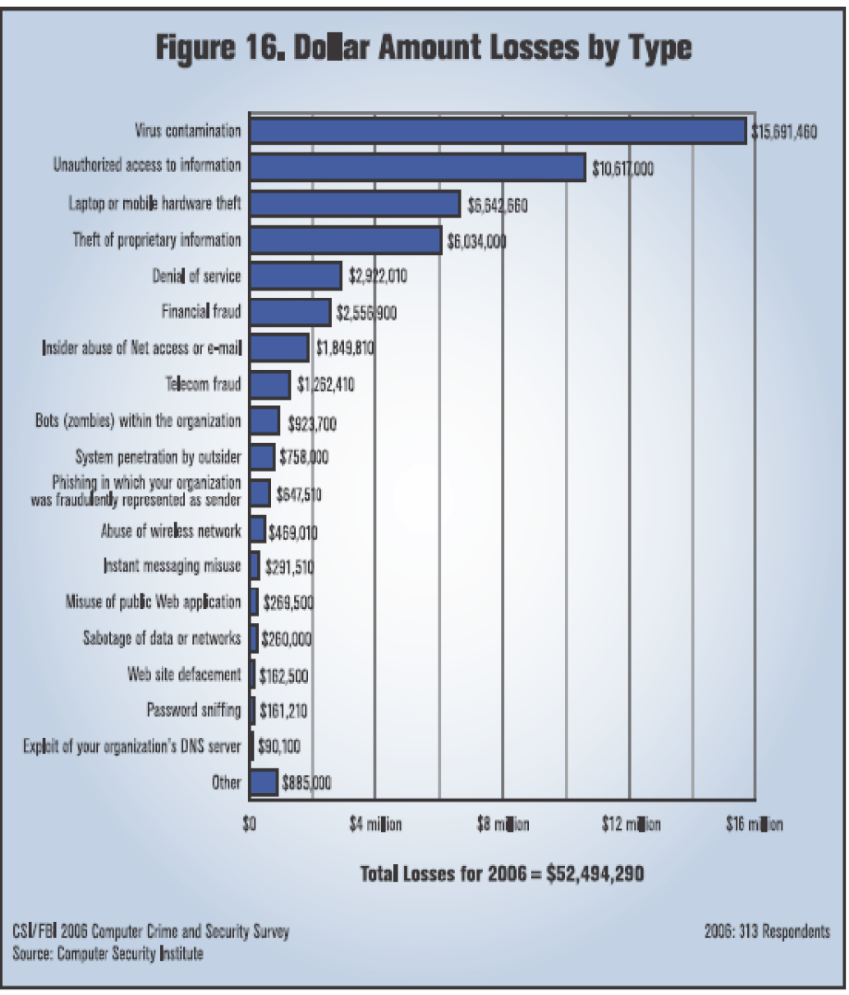
Damage Done
Average total loss per
respondent: $203,606
But a wide range of
respondent organization
sizes:
• 22% revenue <$10 million
• 34% revenue >$1 billion

Slide 11
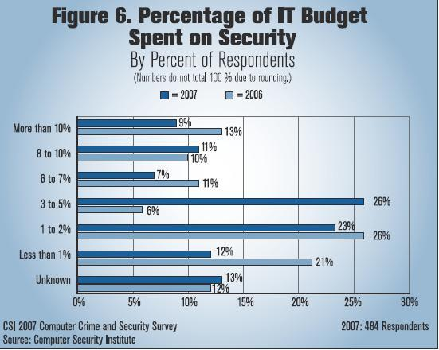

Slide 12
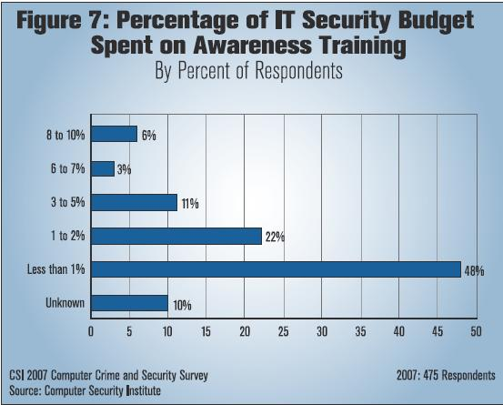

Slide 13
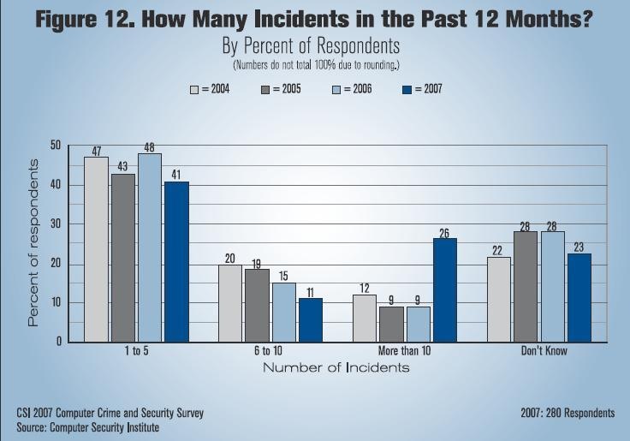

Slide 14
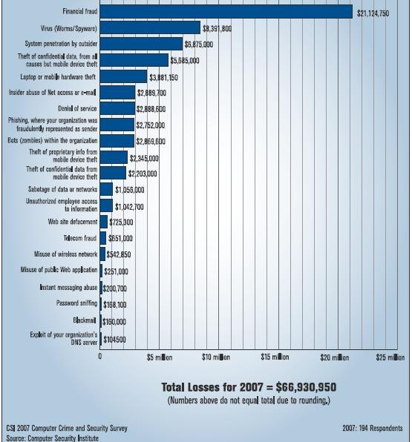

Slide 15
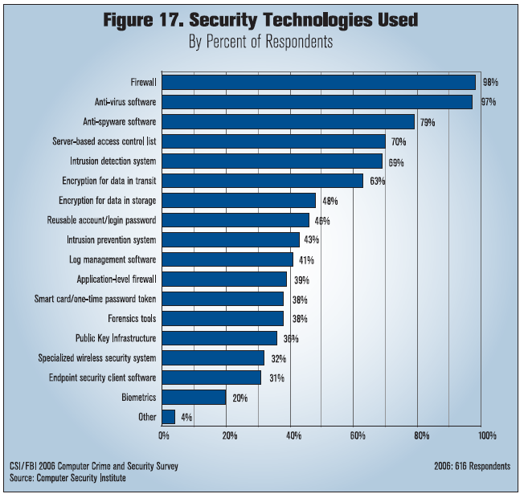

Slide 16
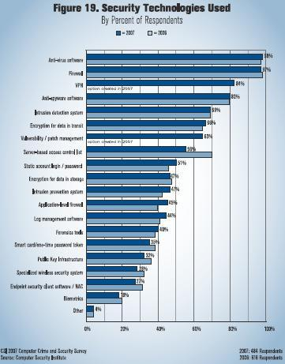

Slide 17
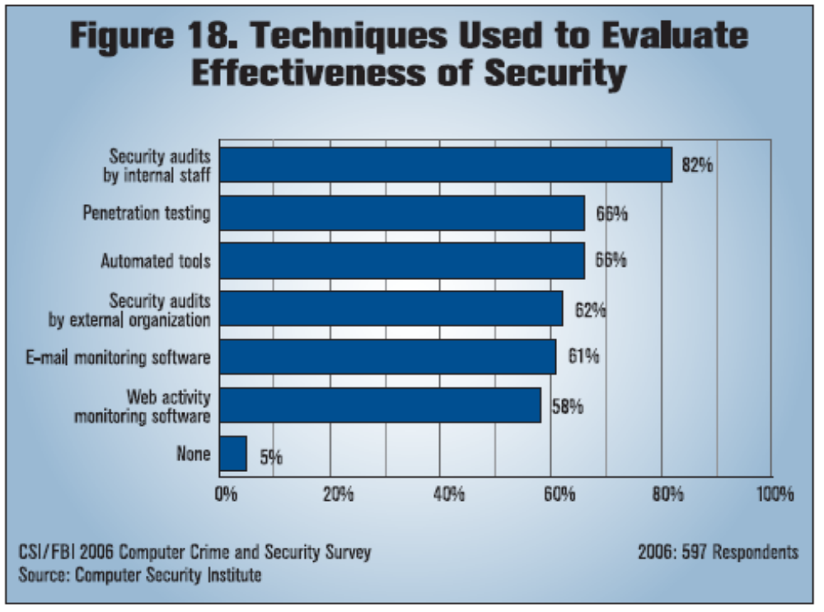

Slide 18
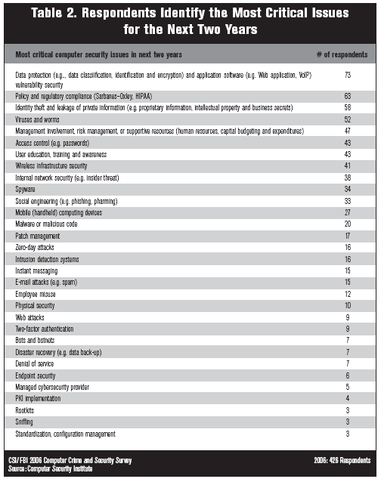

Slide 19
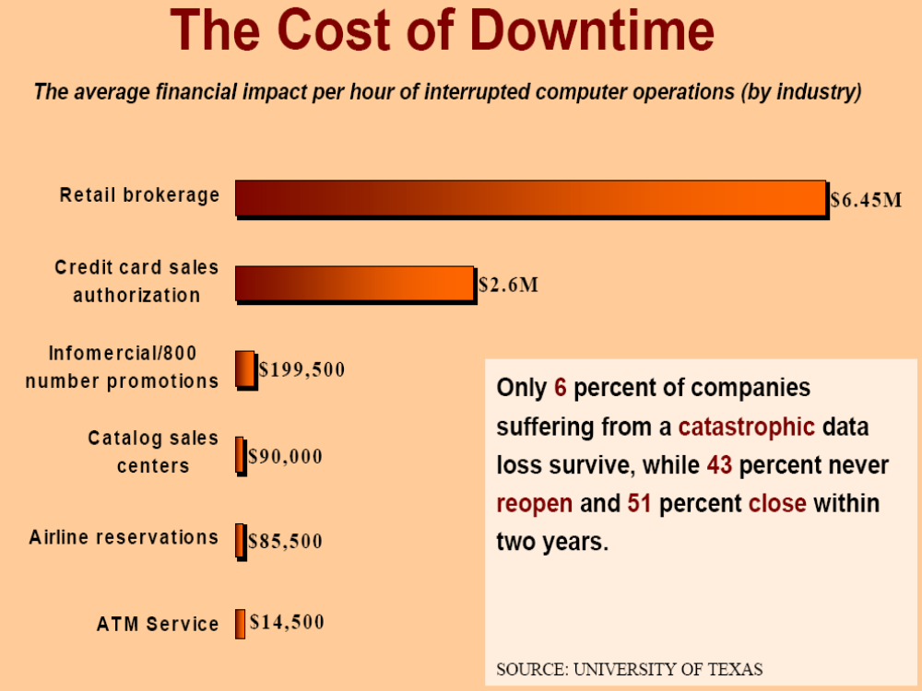
(1996 Cost of Downtime Study – by Contingency Planning Research)

Slide 20
Vulnerabilities, Threats, Controls, and Attacks
  Vulnerability = a weakness in a security system
  Threat = circumstances that have a potential to cause harm
  Controls = means and ways to block a threat, which tries to exploit one or more vulnerabilities
    Most of the course discusses various controls and their effectiveness

Slide 21
An Example
Example - New Orleans disaster (Hurricane Katrina)
  Q: What were city vulnerabilities, threats, and controls?
  A: Vulnerabilities: location below water level, geographical location in hurricane area, …
  Threats: hurricane, dam damage, terrorist attack, …
  Controls: dams and other civil infrastructures, emergency response plan, …

Slide 22
Attacks
Attack (materialization of a vulnerability/threat combination) = an exploitation of one or more vulnerabilities by a threat; tries to defeat controls
    Attack may be:
      Successful (a.k.a. an exploit)
        resulting in a breach of security, a system penetration, etc.
      Unsuccessful
        when controls block a threat trying to exploit a vulnerability

Slide 23
Threats and Attacks
A threat is a “potential” violation of security
  The violation need not actually occur
  The fact that the violation might occur makes it a threat
  It is important to guard against threats and be prepared for the actual violation
The actual violation of security is called an attack

Slide 24
Some Common Threats/Attacks
Interruption, delay, denial of receipt or denial of service
  System assets or information become unavailable or are rendered unavailable
Interception or snooping
  Unauthorized party gains access to information by browsing through files or reading communications
Modification or alteration
  Unauthorized party changes information in transit or information stored for subsequent access

Slide 25
Some Common Threats/Attacks
Repudiation of origin
  False denial that an entity did (send/create) something
Fabrication, masquerade, or spoofing
  Spurious information is inserted into the system or network by making it appear as if it is from a legitimate entity

Slide 26
Some Computer Security Threats
Browsing
Searching through main and secondary memory for residue information
Leakage
Transmission of data to an unauthorized user from a process that is allowed to access the data
Inference
Deducing confidential data about an individual by
correlating unrelated statistics about groups of
individuals

Slide 27
Some Computer Security Threats
Tampering - Making unauthorized changes to the value of information
Accidental Data Destruction - Unintentional modification of information
Masquerading - Gaining access to the system under another user's account
Denial of Service - Prevention of authorized access to computer resources or the delaying of time-critical operations

Slide 28
Threats and Vulnerabilities
A vulnerability is a weakness in a security system.
– Can be in design, implementation, or procedures
A threat is a set of circumstances that has the potential to cause loss or harm.
– Threats can be
Accidental (natural disasters, human error, …)
Malicious (attackers, insider fraud, …)
– NSA “major categories of threats”:
fraud, hostile intelligence service (HOIS), malicious logic, hackers, environmental and technological hazards, disgruntled employees, and careless employees

Slide 29
Threats to Confidentiality
Interception/Eavesdropping/Wiretapping (sniffers)
– Used to be commonly installed after a system break-in
– Can (could?) capture passwords, sensitive info, ...
– Some resurgence with wireless networks
– Has always been a problem with wireless transmission!
– Electromagnetic emanations (TEMPEST security)
Illicit copying (proprietary information, etc.)
– Copied company documents, plans, ...
– Copied source code for proprietary software
– Non-electronic: “dumpster diving”, social engineering

Slide 30
Threats to Integrity
Modification
– Changing data values (database)
– Changing programs (viruses, backdoors, trojan horses, game cheats, ...)
– Changing hardware (hardware key capture, ...)
– Can be accidental corruption (interrupted DB transaction)
– Many small changes can be valuable (e.g., salami attack)
Fabrication
– Spurious transactions
– Replay attacks
Identity spoofing
– Somewhat related: fake web sites and “phishing”

Slide 31
Threats to Availability
Denial of Service (DoS)
– Commonly thought of as network/system flooding
– Can be more basic: disrupting power
– Deleting files
– Hardware destruction (fire, tornado, etc.)
Latest: Distributed Denial of Service (DDoS)
– Bot-nets of zombie machines that can be commanded to flood and disable “on-command”
– Discovery of botnets with 10-100 systems is a daily occurrence; 10,000 system botnets are found almost weekly; and one botnet with 100,000 hosts has even been found (according to Johannes Ullrich, CTO of the Internet Storm Center).

Slide 32
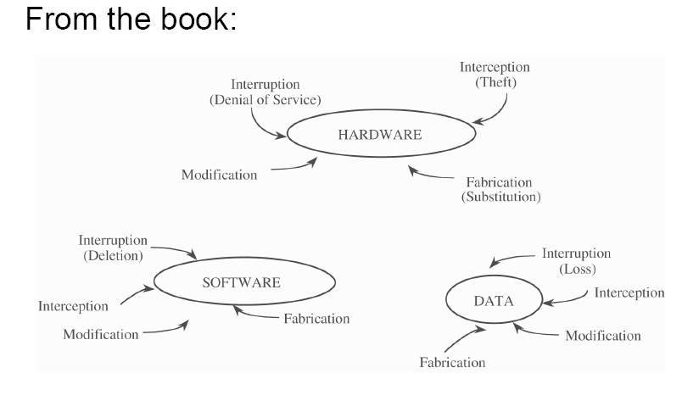
Vulnerabilities

Slide 33
Attacks and Attackers
An attack is when a vulnerability is exploited to realize a threat
– Typical attack actions were discussed in previous threats/attack slides
An attacker is a person who exploits a vulnerability
Attackers must have Means, Opportunity, and Motive (MOM)
– Means: Often just an Internet connection!
– Opportunity: Presence of vulnerabilities
– Motive may be complex, or not what you think!

Slide 34
Attackers – Motives
Intellectual challenge
– Some people see it as a game
Espionage (government or corporate)
Financial reward
– Credit card numbers sold, spam-nets rented, fraud, ...
Revenge
Showing off
– DoS (Denial of Service) attacks on CNN, eBay, Yahoo, etc.
Civil disobedience
– Basic vandalism
– “Hactivism”

Slide 35
Who are the Attackers?
Amateurs
  Are often just ordinary users exploiting a weakness found in a system
  Often these are accidental discoveries
  Normally does not require any technical skill.
  However, the damage done can be considerable.
  Insiders
  Are legitimate system users who access data that they have no rights to access

Slide 36
Who are the Attackers?
Script kiddies
  Download malicious software from hacker web sites
  Do mischief with scripts and rootkits written by others, often without understanding what they are using.
  Have limited technical expertise
  Use easy-to-operate, pre-configured, and/or automated tools to conduct disruptive activities against networked systems.
  Since most of these tools are fairly well-known by the security community, the adverse impact of such actions is usually minimal.

Slide 37
Who are the Attackers?
Hackers
  "Hacker" originally just meant someone who was very savvy about computers because that person could "hack bits" and understand computers at a deep level.
  Now viewed as one who tries to prove to peers that they can compromise a specific system sooner and better than others.
  A person who delights in having an intimate understanding of the internal workings of a system, computers, programming, and computer networks.

Slide 38
Hackers (Continued)
  Believe that information-sharing is a powerful positive good, and that it is an ethical duty of hackers to share their expertise by writing open-source code and facilitating access to information and to computing resources wherever possible.
  Believe that system-cracking for fun and exploration is ethically OK as long as the cracker commits no theft, vandalism, or breach of confidentiality.

Slide 39
Black, White, and Gray Hats
Black hats are any who attack a system for fun or profit.
White hats are any who attack on the invitation of a company to test their security.
  Note: They do not attack without permission and then inform a company of the vulnerabilities.
The term gray hats has been applied recently to those involved in security research.
The last two are often called ethical hackers.

Slide 40
Others
Government/military information warfare security experts
  This would include personnel at, for example,
    NSA (National Security Agency)
    The FBI cybercrime specialists
    Special units in the armed services.

