Slide 1
Sections 2.1 Physical Protection and Attacks 2.2 – Locks and Keys
Digital security often begins with physical security…

Slide 2
Physical Protections and Attacks
Define physical security: the use of physical measures to protect valuables, information, or access to restricted resources.
Computer science views this as the following:
Protection by location
Physical intrusion detection
Hardware attacks
Eavesdropping
Physical interface attacks.

Slide 3
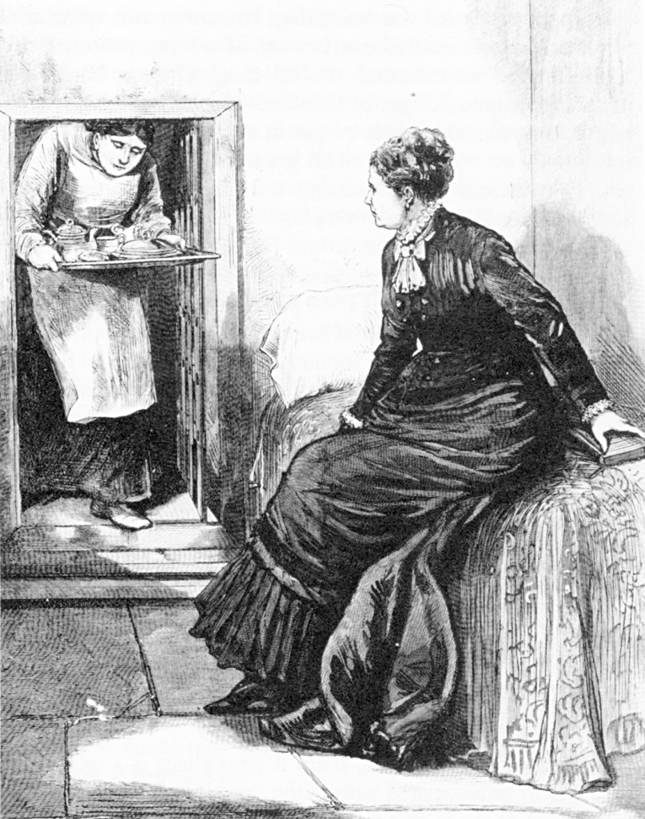
Legal Notice
Laws regarding lock picking vary significantly state-by-state
In most states the purchase and possession of dedicated lock picking tools is legal
But, penalties are raised significantly if you get caught using them in the commission of a crime
Public domain image from http://commons.wikimedia.org/wiki/File:Madame_Restell_in_jail.jpg

Slide 4
What Is Physical Security?
Any physical object that creates a barrier to unauthorized access
This includes, but is not limited to: locks, latches, safes, alarms, guards, guard dogs, doors, windows, walls, ceilings, floors, fences, door strikes, door frames and door closers

Slide 5
Is Physical Security An IT Concern?
You have been working hard to secure your network from cyber attacks
Redundant layers of antivirus programs, firewalls and intrusion detection systems should protect against every possible electronic method of entry
But what if an attacker gains access to the server room or network wiring closet ...
Is you network still safe?

Slide 6
Destructive vs. Nondestructive Entry
Destructive entry
Involves using force to defeat physical security
Methods involve crowbars, bolt cutters and sledge hammers
Negative impact on IT resources is apparent
Remediation steps also obvious
Nondestructive entry
Compromises security without leaving signs of a breach
Defeats intrusion detection
Greater and long-term threat

Slide 7
Compromising Locks
For centuries, the lock has been one of the cornerstones of physical security
We rely on dozens of them every day to protect people and assets
The trust most people place in locks is unwarranted
Most locks can be easily compromised with nondestructive methods
Sometimes within seconds and with readily available tools
“Locks keep honest people honest”

Slide 8
Lock Picking
Lock picking had been the exclusive art of locksmiths, professional thieves, spies and magicians for hundreds of years
However, with the advent of the Internet, information about lock picking methods and tools has become readily available
E.g., YouTube has many lock picking videos
Try google with “Lock picking”. You get ~ 3,760,000 entries.

Slide 9
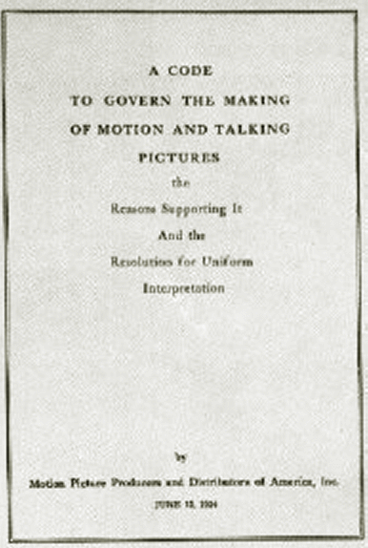
Lock Picking in Movies
Genuine lock picking in movies used to be prohibited
Before 1967, the Hays code (Motion Picture Production Code) required censorship of Hollywood movies
“All detailed (that is, imitable) depiction of crime must be removed, such as lock picking or mixing of chemicals to make explosives”
Public domain image from http://commons.wikimedia.org/wiki/File:Motion_Picture_Production_Code.gif

Slide 10

TSA Lock
The U.S. government has established a set of rules for the inspection of baggage without the presence of passengers
Special TSA-approved locks allow both inspection and some protection against theft
An important element is that the inspection must be easily verifiable by the user
Public domain government image
Do the TSA locks keep your belongings safe?

Slide 11
Pick vs. Bypass
Breaking open a lock in a nondestructive manner can be achieved either through:
Picking: acting on the lock mechanism simulating the operation of the key
Bypassing: manipulation of the bolt without using the lock

Slide 12
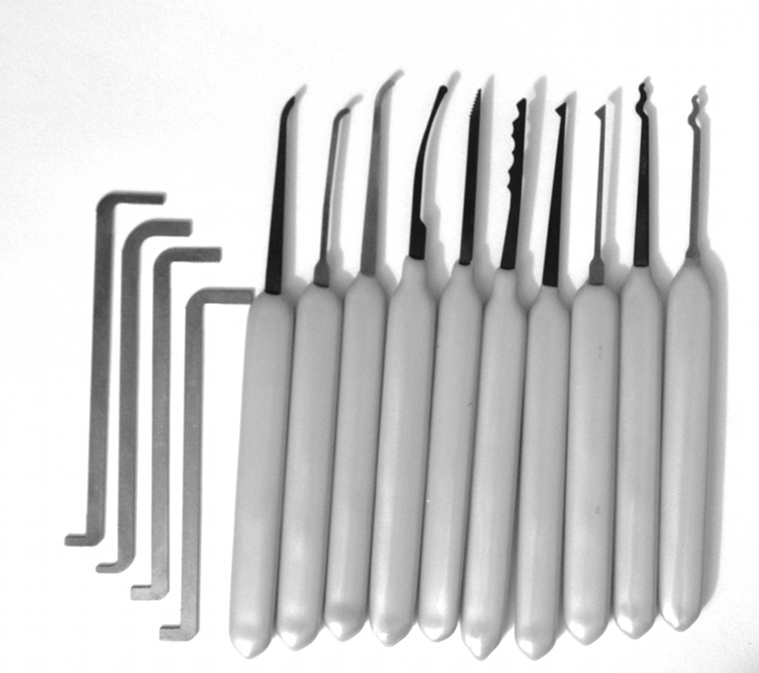
Lockpicking Tools
Feelers
Scrubbers
Tension tools
Photo by Jennie Rogers included with permission.

Slide 13
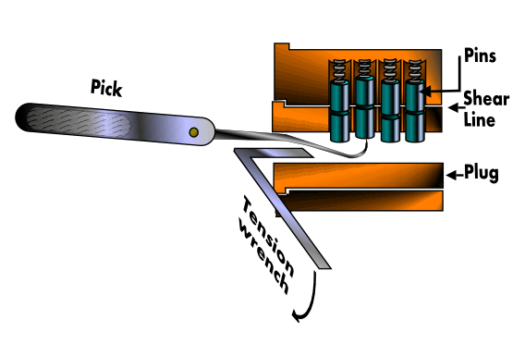
Feeler Picking
Apply light tension
Lift one pin at a time
Identify binding pin
Lift binding pin until it reaches the shear line
Setting the binding pin will rotate the lock slightly
Find next pin and repeat the process
Image from http://commons.wikimedia.org/wiki/File:Pin_and_tumbler_lock_picking.PNG used with permission under Gnu Free Documentation License 1.2

Slide 14
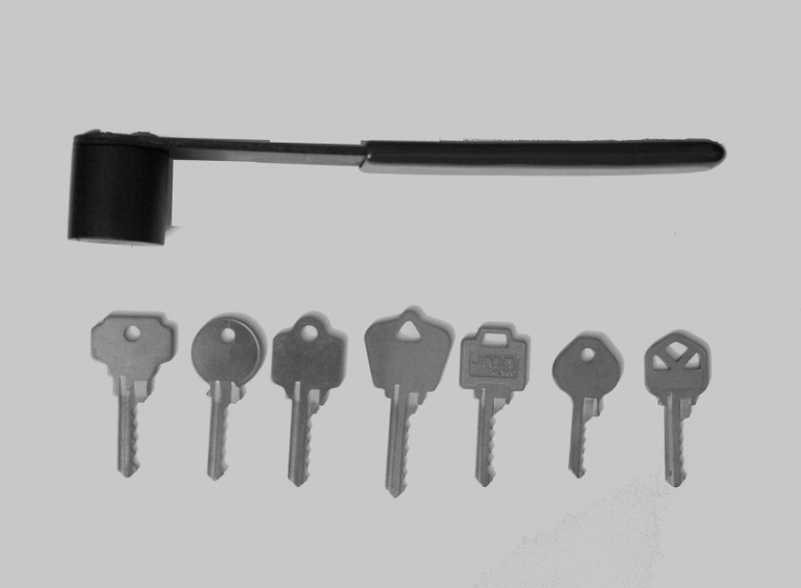
Bumping
A different way of picking locks
Virtually all traditional Yale and similar locks can be opened by bumping
What lock pickers say about bumping:
RELIABLE
REPEATABLE
SIMPLE TO LEARN
Photo by Jennie Rogers included with permission.

Slide 15
Bump Keys
Driver pins “jump” higher than the cylinder just for an instant
If a light rotational force is applied, the cylinder will turn
Lock bumping is a very fast method for opening the lock
The lock is not damaged in any way
Few key-pin locks cannot be bumped
Photo by Jennie Rogers included with permission.

Slide 16
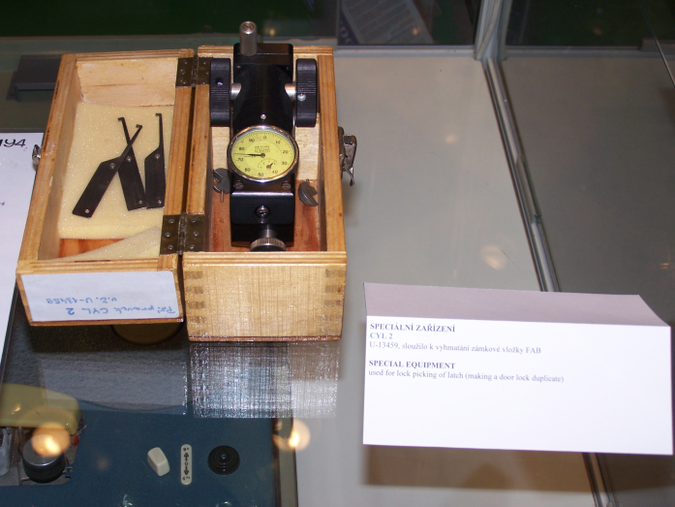
Pick Gun
Manual and electronic pick guns are a popular method for quick and easy ways of opening up doors
The pick gun is used in a similar way but usually has a trigger that creates an upward movement that must be repeated rapidly to open the lock
Public domain image from http://en.wikipedia.org/wiki/File:IDET2007_lock_picking_device.jpg

Slide 17
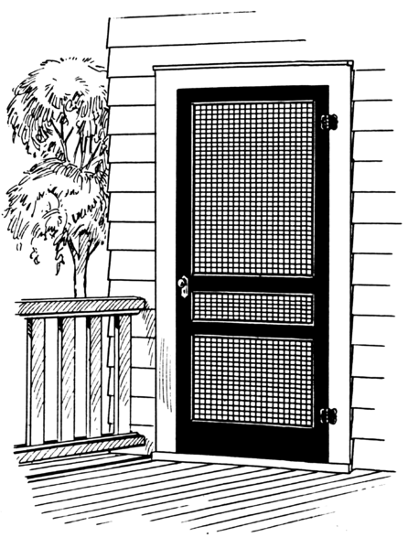
Side Channel Attacks
Cheap hinges
Rather than attempting to directly bypass security measures, an attacker instead goes around them by exploiting other vulnerabilities not protected by the security mechanisms.
Side channel attacks are sometimes surprisingly simple to perform.
High security lock
Public domain image by Pearson Scott Foresman from http://en.wikipedia.org/wiki/File:Screen2_%28PSF%29.png

