Slide 1
Computer Forensics

Slide 2
What is Computer Forensics?
Scientific process of preserving, identifying, extracting, documenting, and interpreting data on a computer
Used to obtain potential legal evidence

Slide 3
Computer Forensics Procedures
The Forensic Paradigm
Identification
Collection
Analysis and
Evaluation
Reporting
Identify specific objects that store important data for the case analysis
Establish a chain of custody and document all steps to prove that the collected data remains intact and unaltered
Determine the type of information stored on digital evidence and conduct a thorough analysis of the media
Prepare and deliver an official report

Slide 4
Identification: Common Mistakes …
You are the investigator, which objects do you think will be useful for investigations?
Computer (case and power supply)
Just the hard drive (without computer)
Monitor
Keyboard and mouse
Media (CD, DVD, USB drives, etc.)
Printer
Digital forensics does not replace traditional forensic analysis
Any action that modifies the crime scene could invalidate evidence in court

Slide 5
Collection
To collect computer evidence, care must be taken not to change the evidence
Imaging media using a write-blocking tool to ensure the suspect device is not be modified
Establishing and maintaining the chain of custody
Documenting everything that has been done
Using only tools and methods that have been tested and evaluated to validate their accuracy and reliability

Slide 6
Forensic Constraints
Chain of custody
Maintain possession of all objects
Must be able to trace evidence back to source
“Prove” source integrity
Priority by volatility
Some data is more volatile
RAM > swap > disk > CDs/DVDs
Idea: capture more volatile evidence first

Slide 7
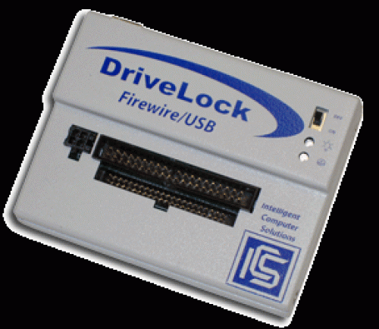
Image Evidence: Laptop
USB ADAPTER
DATA CABLE
LAPTOP at Crime Scene
EVIDENCE DISK

Slide 8
Why Use Images
Information on digital media is easily changed.
Once changed it is usually impossible to detect that a change has taken place (or to revert the data back to its original state) unless other measures have been taken
A common practice is calculate a cryptographic hash to establish a check point
Examining a live file system changes state of the evidence
The computer/media is the “crime scene”
Protecting the crime scene is paramount as once evidence is contaminated, it cannot be decontaminated
Really only one chance to do it right!

Slide 9
Collection: Common Mistakes …
What is the first step to collect evidence, when you find:
A computer turned on
A computer turned off
A computer on a crime scene should be considered fully adversarial

Slide 10
Analysis and Evaluation
Know where evidence can be found
Understand techniques used to hide or “destroy” digital data
Toolbox of techniques to discover hidden data and recover “destroyed” data
Cope with HUGE quantities of digital data…
Ignore the irrelevant, target the relevant
Thoroughly understand circumstances which may make “evidence” unreliable
If you have a hard drive with a broken sector that gives different result, what happens when you hash the entire drive?

Slide 11
Where is the Evidence?
Undeleted files, expect some names to be incorrect
Deleted files
Windows registry
Print spool files
Hibernation files
Temp files (all those .TMP files in Windows!)
Slack space
Swap files
Internet browsing histories
Alternate or “hidden” partitions
On a variety of removable media (USB drives, backup tapes, …)

Slide 12
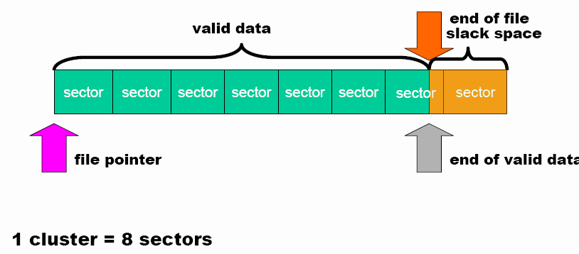
Hidden Data in the Hard Drive Slack Space
Slack space is the space between
The logical end of the file (i.e., the end of the data actually in the file) and
The physical end of the file (i.e., the end of the last sector devoted to the file).

Slide 13
Digital Forensics Tools
Forensics tools are typically command line tools that are guaranteed not to alter the disk:
HELIX a live cd with a plenty of forensic tools ready to be used
ENCASE a series of proprietary forensic software products produced by Guidance Software
…

Slide 14

Open Source vs. Closed Source
Commercial products such as EnCase are recognized by law. What is the best approach?
21/01/2008
14 di 7
Notes:
14

Slide 15
How to Hide Data?
Cryptography
Steganography
The process of hiding data inside other data (e.g. image files).
Change file names and extensions
E.g. rename a .doc file to a .tmp file
Hidden tracks
most hard disks have # of tracks hidden (i.e. track 0)
They can be used to hide/read data by using a hex editor
Deleted Files
not truly deleted, merely marked for deletion.
During Forensic is important to do not use any tools that write to the disk

Slide 16
Why Create a Duplicate Image?
A file copy does not recover all data areas of the device for examination
Working from a duplicate image
Preserves the original evidence
Prevents inadvertent alteration of original evidence during examination
Allows recreation of the duplicate image if necessary
Notes:
Never do anything that might inadvertently cause something to be written to the suspect’s original media.

Slide 17
Bitstream vs. Backups
Forensic copies (Bitstream)
Bit for bit copying captures all the data on the copied media
Including hidden and residual data (e.g., slack space, swap, residue, unused space, deleted files etc.)
Often the “smoking gun” is found in the residual data.
Logical vs. physical image

Slide 18
Reporting
Accurately describe the details of an incident
Be understandable to decision makers
Be able to withstand legal scrutiny
Be unambiguous and not open to misinterpretation
Be easily referenced
Contain all information required to explain the conclusions
Offer valid conclusions, opinions, or recommendations when needed
Create report in a timely manner

Slide 19
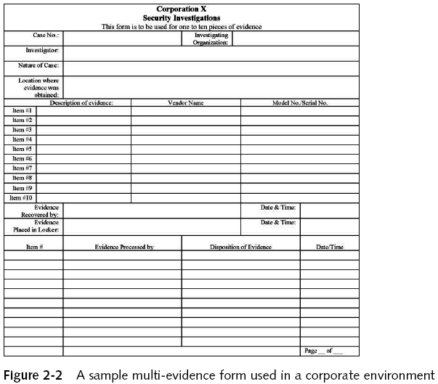

Slide 20
Anti-Forensic and Data Security
Anti-forensic techniques try to frustrate forensic investigators and their techniques
Securely deleting data, so that it cannot be restored with forensic methods
Prevent the creation of certain data in the first place
Data which was never there, obviously cannot be restored with forensic methods.

Slide 21
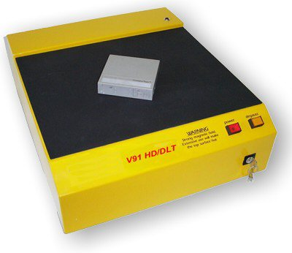
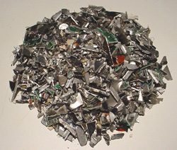
Privacy Through Media Destruction
thermite…
or
or
Degausser Magnetic Field
shredder

Slide 22
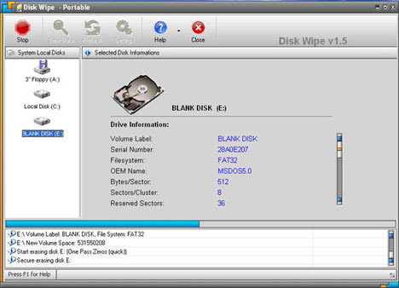
Disk Wiping
Simple erase
The data is still on the drive but the segment has been marked as available
Next time data is written to the drive it MAY overwrite the segment
Destructive erase
First overwrites all data in the file with random data
Next marks the segment as available
It may be possible to find ghost images of what was previously on the disk surface
Overwriting Hard Drive Data: The Great Wiping Controversy, ICISS 2008

