Slide 1
CHAPTER 6
TESTING

Slide 2
Overview
Quality issues
Non-execution-based testing
Execution-based testing
What should be tested?
Testing versus correctness proofs
Who should perform execution-based testing?
When testing stops

Slide 3
Testing
There are two basic types of testing
  Execution-based testing
  Non-execution-based testing
“V & V”
  Verification
    Determine if the workflow was completed correctly
  Validation
    Determine if the product as a whole satisfies its requirements
Warning
  The term “verify” is also used for all non-execution-based testing

Slide 4
6.1 Software Quality
Not “excellence”
The extent to which software satisfies its specifications
Every software professional is responsible for ensuring that his or her work is correct
  Quality must be built in from the beginning

Slide 5
6.1.1 Software Quality Assurance
The members of the SQA group must ensure that the developers are doing high-quality work
  At the end of each workflow
  When the product is complete
In addition, quality assurance must be applied to
  The process itself
    Example: Standards

Slide 6
6.1.2 Managerial Independence
There must be managerial independence between
  The development group
  The SQA group
Neither group should have power over the other

Slide 7
Managerial Independence (contd)
More senior management must decide whether to
  Deliver the product on time but with faults, or
  Test further and deliver the product late
The decision must take into account the interests of the client and the development organization

Slide 8
6.2 Non-Execution-Based Testing
Underlying principles
  We should not review our own work
  Group synergy works
Most common methods:
  Walkthroughs
  Inspections

Slide 9
6.2.1 Walkthroughs
A walkthrough team consists of from four to six members
It includes representatives of
  The team responsible for the current workflow
  The team responsible for the next workflow
  The SQA group
The walkthrough is preceded by preparation
  Lists of items
    Items not understood
    Items that appear to be incorrect

Slide 10
6.2.2 Managing Walkthroughs
The walkthrough team is chaired by the SQA representative
In a walkthrough we detect faults, not correct them
  A correction produced by a committee is likely to be of low quality
  The cost of a committee correction is too high
  Not all items flagged are actually incorrect
  A walkthrough should not last longer than 2 hours
  There is no time to correct faults as well

Slide 11
Managing Walkthroughs
A walkthrough must be document-driven, rather than participant-driven
Verbalization leads to fault finding
A walkthrough should never be used for performance appraisal

Slide 12
6.2.3 Inspections
An inspection has five formal steps
  Overview
  Preparation, aided by statistics of fault types
  Inspection
  Rework
  Follow-up
Inspections are more formal than walkthroughs.
First proposed in 1976 by Fagan.

Slide 13
Inspections
An inspection team has four members
  Moderator
  A member of the team performing the current workflow
  A member of the team performing the next workflow
  A member of the SQA group
Special roles are played by the
  Moderator
  Reader
  Recorder

Slide 14
Fault Statistics
Faults are recorded by severity
  Example:
    Major or minor
Faults are recorded by fault type
  Examples of design faults:
    Not all specification items have been addressed
    Actual and formal arguments do not correspond

Slide 15
Fault Statistics
For a given workflow, we compare current fault rates with those of previous products
We take action if there are a disproportionate number of faults in an artifact
  Redesigning from scratch is a good alternative
We carry forward fault statistics to the next workflow
  We may not detect all faults of a particular type in the current inspection

Slide 16
Statistics on Inspections
IBM inspections showed up
  82 percent of all detected faults (1976)
  70 percent of all detected faults (1978)
  93 percent of all detected faults (1986)
Jet Propulsion Laboratory
Managed for NASA by the California Institute of Technology, JPL is the leading US center for robotic exploration of the solar system.
  Four major faults, 14 minor faults per 2 hours (1990)
  Savings of $25,000 per inspection
  The number of faults decreased exponentially by phase (1992)

Slide 17
Statistics on Inspections (contd)
Warning
Fault statistics should never be used for performance appraisal
  “Killing the goose that lays the golden eggs”

Slide 18
6.2.4 Comparison of Inspections and Walkthroughs
Walkthrough
  Two-step, informal process
    Preparation
    Analysis
Inspection
  Five-step, formal process
    Overview
    Preparation
    Inspection
    Rework
    Follow-up

Slide 19
6.2.5 Strengths and Weaknesses of Reviews
Reviews can be effective
  Faults are detected early in the process
Reviews are less effective if the process is inadequate
  Large-scale software should consist of smaller, largely independent pieces
  The documentation of the previous workflows has to be complete and available online

Slide 20
6.2.6 Metrics for Inspections
Inspection rate (e.g., design pages inspected per hour)
Fault density (e.g., faults per KLOC inspected)
Fault detection rate (e.g., faults detected per hour)
Fault detection efficiency (e.g., number of major, minor faults detected per hour)

Slide 21
Metrics for Inspections (contd)
Does a 50 percent increase in the fault detection rate mean that
  Quality has decreased? Or
  The inspection process is more efficient?

Slide 22
6.3 Execution-Based Testing
Organizations spend up to 50 percent of their software budget on testing
  But delivered software is frequently unreliable
Dijkstra (1972)
  “Program testing can be a very effective way to show the presence of bugs, but it is hopelessly inadequate for showing their absence”

Slide 23
6.4 What Should Be Tested?
Definition of execution-based testing
  “The process of inferring certain behavioral properties of the product based, in part, on the results of executing the product in a known environment with selected inputs”
This definition has troubling implications

Slide 24
6.4 What Should Be Tested?
“Inference”
  We have a fault report, the source code, and — often — nothing else
“Known environment”
  We never can really know our environment
“Selected inputs”
  Sometimes we cannot provide the inputs we want
  Simulation is needed

Slide 25
6.4 What Should Be Tested?
We need to test correctness (of course), and also
  Utility
  Reliability
  Robustness, and
  Performance

Slide 26
6.4.1 Utility
The extent to which the product meets the user’s needs
  Examples:
    Ease of use
    Useful functions
    Cost effectiveness

Slide 27
6.4.2 Reliability
A measure of the frequency and criticality of failure
  Mean time between failures
  Mean time to repair
  Time (and cost) to repair the results of a failure

Slide 28
6.4.3 Robustness
A function of
  The range of operating conditions
  The possibility of unacceptable results with valid input
  The effect of invalid input

Slide 29
6.4.4 Performance
The extent to which space and time constraints are met
Real-time software is characterized by hard real-time constraints
If data are lost because the system is too slow
  There is no way to recover those data

Slide 30
6.4.5 Correctness
A product is correct if it satisfies its specifications

Slide 31
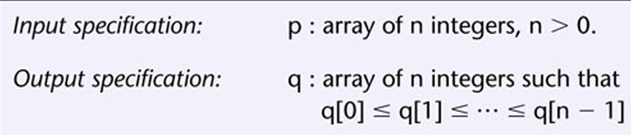
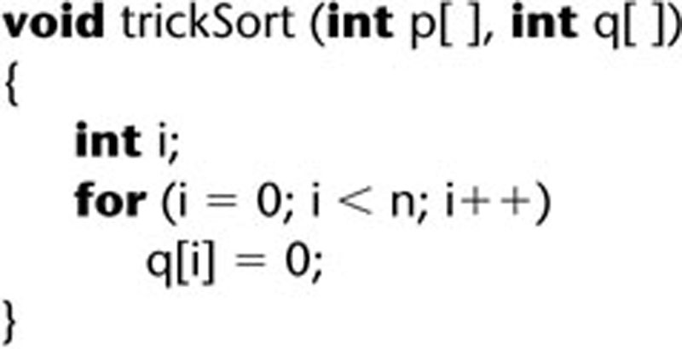
Correctness of Specifications
Incorrect specification for a sort:
Function trickSort which satisfies this specification:

Slide 32
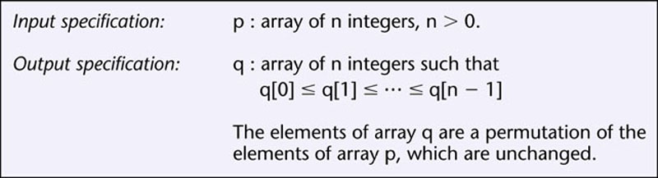
Correctness of Specifications
Incorrect specification for a sort:
Corrected specification for the sort:
Figure 6.3

Slide 33
Correctness
Technically, correctness is
Not necessary
  Example: C++ compiler
  Compiler is fast, very efficient, easy to use, etc. BUT prints an error message when compiling that doesn’t really flag an error or stop the production of good, executable code.
Not sufficient
  Example: trickSort

Slide 34
6.5 Testing Versus Correctness Proofs
A correctness proof is an alternative to execution-based testing
There is a fair amount of work in this area
It is related to automatic theorem proving – i.e. using a computer to construct proofs
We would like to automate the correctness proof process, but most proofs of correctness now are done manually.

Slide 35
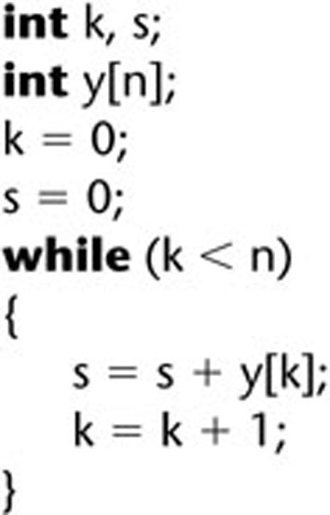
6.5.1 Example of a Correctness Proof
The code segment to be proven correct
Figure 6.4

Slide 36
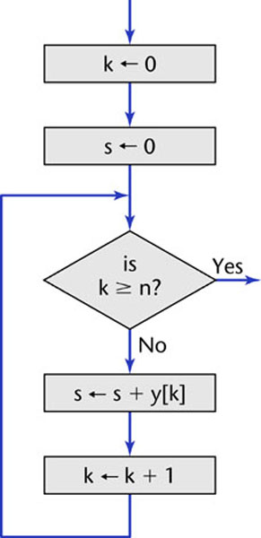
Example of a Correctness Proof (contd)
A flowchart equivalent of the code segment
Figure 6.5

Slide 37
Example of a Correctness Proof
We add to the flowchart:
  Input specifications
  Output specifications
  Loop invariants – A loop invariant is a mathematical expression that is true at a given point in a loop irrespective of whether the loop has been executed 0, 1, or many times.
  Assertions – statements that must be true at the specified point in the flowchart.
(See next slide) The first three types of statements are named on the slide. The assertions are all the others.

Slide 38
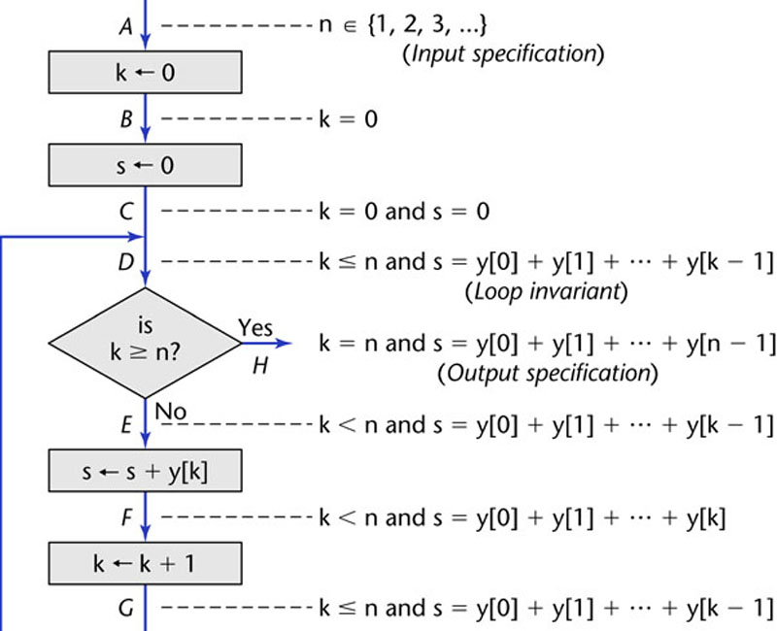
Example of a Correctness Proof
Figure 6.6

Slide 39
Example of a Correctness Proof
An informal proof (using induction to prove the loop invariant holds) appears in Section 6.5.1
Induction is a technique for proving theorems about all integers greater than or equal to some integer. In this case, that integer is 0.
So, what is being proved is that for all integers k greater than or equal to 0 and any integer n, k <= n and s = y[0] + y[1] + ... + y[k-1] at the point marked in the loop.

Slide 40
Reading the Proof
Those of you that have had experience with induction proofs should be able to follow the reasoning on pages 154-155.
Otherwise, just read through it to obtain a sense of what is involved.
Note, however, the amount of work needed to prove a rather simple piece of code!
Now you can appreciate why we seek to automate this process.

Slide 41
6.5.2 Correctness Proof Mini Case Study
Dijkstra (1972):
  “The programmer should let the program proof and program grow hand in hand”
“Naur text-processing problem” (1969)

Slide 42
Naur Text-Processing Problem
Given a text consisting of words separated by a blank or by newline characters, convert it to line-by-line form in accordance with the following rules:
Line breaks must be made only where the given text contains a blank or newline ;
Each line is filled as far as possible, provided:
No line will contain more than maxpos characters

Slide 43
Episode 1
Naur constructed a 25-line procedure
He informally proved its correctness

Slide 44
Episode 2
1970 — Reviewer in Computing Reviews
  The first word of the first line is preceded by a blank unless the first word is exactly maxpos characters long
It was pointed out that this is a trivial fault, but could have been detected if testing had been done also.
But, worst was to come ...

Slide 45
Episode 3
1971 — London finds 3 more faults
Including:
  The procedure does not terminate unless a word longer than maxpos characters is encountered
London claimed to correct the faults and formally proved that the procedure was correct.
Recall, Naur had only done an informal proof.

Slide 46
Episode 4
1975 — Goodenough and Gerhart find three further faults that London’s correctness proof did not detect
Including:
  The last word will not be output unless it is followed by a blank or newline
Again, reasonable choices for test data would have detected this.

Slide 47
Correctness Proof Mini Case Study
These people were solid mathematicians and knew how to do proofs.
Lesson:
Even if a product has been proved correct, it must STILL be tested.

Slide 48
Three Myths of Correctness Proving
Software engineers do not have enough mathematics for proofs
  Most computer science majors either know or can learn the mathematics needed for proofs
Proving is too expensive to be practical
  Economic viability is determined from cost–benefit analysis
Proving is too hard
  Many nontrivial products have been successfully proved
  Tools like automatic theorem provers can assist us

Slide 49
Automatic Theorem Provers
Take as input
  a product
  input and output specifications
  loop invariants
Using various techniques, the theorem prover mathematically proves that for input meeting the input specifications, the output satisfies the output specifications.
  One technique is resolution.

Slide 50
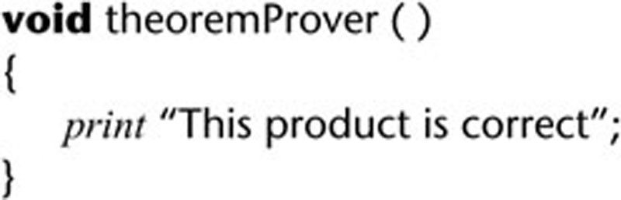
Difficulties with Correctness Proving
But, how can we be sure a theorem prover is correct?
Can we trust a theorem prover ?
  Suppose it prints that “This product is correct”. Can we believe it?
How do we find input–output specifications, loop invariants?
What if the specifications are wrong?
We can never be sure that specifications or a verification system are correct

Slide 51
Correctness Proofs and Software Engineering
Correctness proofs are a vital software engineering tool, where appropriate:
  When human lives are at stake
  When indicated by cost–benefit analysis
  When the risk of not proving is too great
Also, informal proofs can improve the quality of the product
  Use the assert statement
  Which languages allow this?
  How is it used?
  Explore these questions and find answers to them.

Slide 52
6.6 Who Should Perform Execution-Based Testing?
Programming is constructive
Testing is destructive
  A successful test finds a fault
So, programmers should not test their own code artifacts

Slide 53
Who Should Perform Execution-Based Testing?
Solution:
  The programmer does informal testing
  The SQA group then does systematic testing
  The programmer debugs the module
All test cases must be
  Planned beforehand, including the expected output, and
  Retained afterwards

Slide 54
6.7 When Testing Stops
Only when the product has been irrevocably discarded – i.e. retired.

