Slide 1
Inheritance and Polymorphism
Chapter 9

Slide 2
Inheritance
Organizes objects in a top-down fashion from most general to least general
Inheritance defines a “is-a” relationship
  A mountain bike “is a” kind of bicycle
  A SUV “is a” kind of automobile
  A border collie “is a” kind of dog
  A laptop “is a” kind of computer

Slide 3
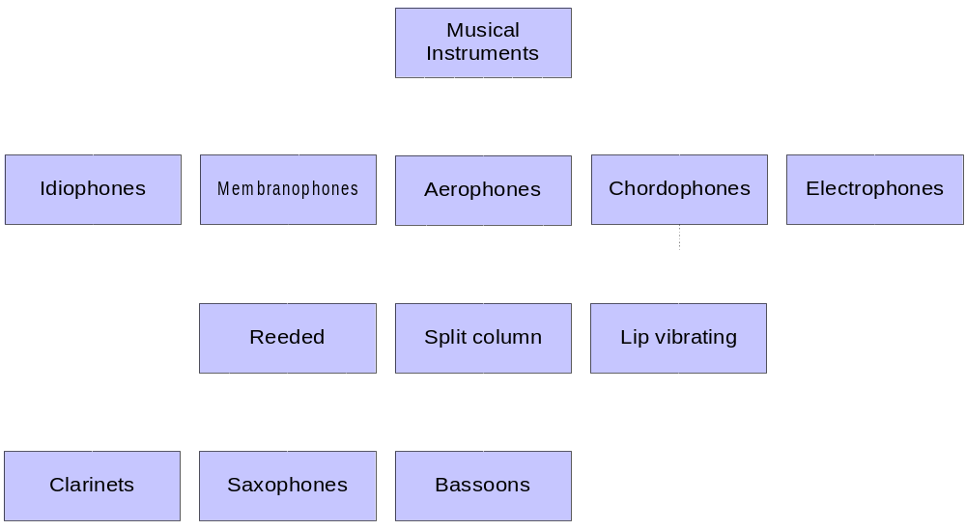
Musical instrument hierarchy
Notes:
Idiophones: Solid instruments that are intrinsically sonorous, e.g., bell and cymbal;
Membranophones: Instruments with taut membranes, e.g., drum and kazoo;
Aerophones: Instruments that enclose and free masses of air, e.g., clarinet and whistle;
Chordophones: Instruments with stretched strings, e.g., lyre and violin;
Electrophones: Instruments with oscillating electric circuits, e.g. synthesizer and electric piano.

Slide 4
Musical instrument hierarchy
The hierarchy helps us understand the relationships and similarities of musical instruments
  A clarinet “is a” kind of reeded instrument
  Reeded instruments “are a” kind of aerophone
The “is-a” relationship is transitive
  A clarinet “is a” kind of reeded instrument
  A reeded instrument “is a” kind of aerophone
  A clarinet “is a” kind of aerophone

Slide 5
Object-oriented terminology
In object-oriented programming languages, a class created by extending another class is called a subclass
The class used for the basis is called the superclass
Alternative terminology
  The superclass is also referred to as the base class
  The subclass is also referred to as the derived class

Slide 6
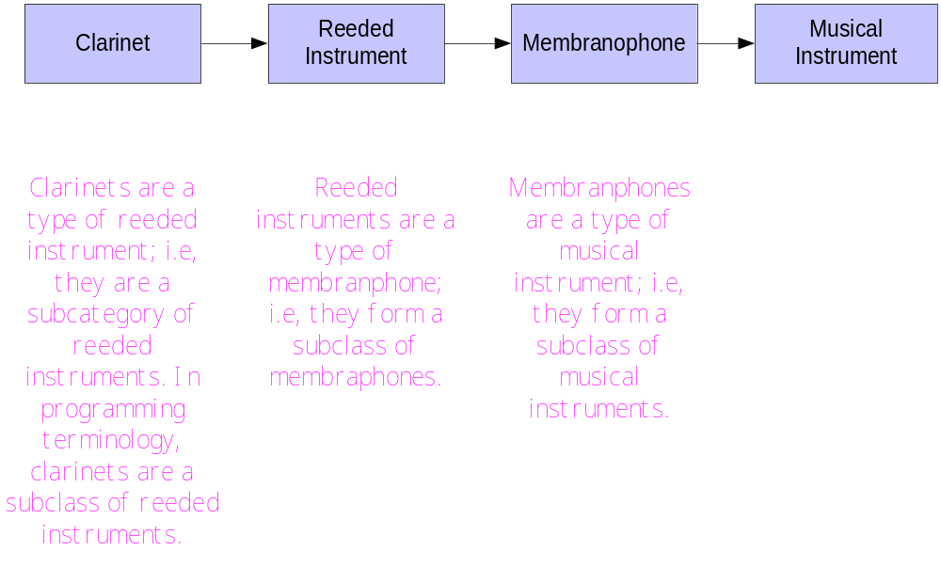

Slide 7
ThreeDimensionalPoint
Build a new class ThreeDimensionalPoint using inheritance:
  ThreeDimensionalPoint extends the awt class Point
    Point is the superclass (base class)
    ThreeDimensionalPoint is the subclass (derived class)
  ThreedimensionalPoint extends Point by adding a new property to Point – i.e. a
  z-coordinate

Slide 8
Packages
A package allows definitions to be collected together into a single entity.
We will add ThreeDimensionalPoint to a package called geometry.
Programmers use packages for basically two reasons:
  1) They provide a better organization for users as “like” classes are put together
  2) They allow a controlled access to members of the package

Slide 9
Packages
  Classes and names in the same package are stored in the same folder
  Classes in a package go into their own namespace and therefore the names in a particular package do not conflict with other names in other packages
  For example, a package called Graph might have a different definition of ThreeDimensionalPoint
  When defining members of a class or (later interfaces when we discuss them), Java does not require an explicit access specification. The implicit specification is known as default access. Members of a class with default access can be accessed only by members of the package.
  If a Java file does not begin with the package statement, all definitions in the file are considered to be part of a package (not named) to that file.

Slide 10
Class ThreeDimensionalPoint
(See listing 9.1 pg 465-6 for details)
package geometry;
import java.awt.*;
public class ThreeDimensionalPoint extends Point {
// private class constant
private final static int DEFAULT_Z = 0;
// private instance variable
public int z = DEFAULT_Z;
Keyword extends indicates
that ThreeDimensionalPoint
is a subclass of Point
New instance variable

Slide 11
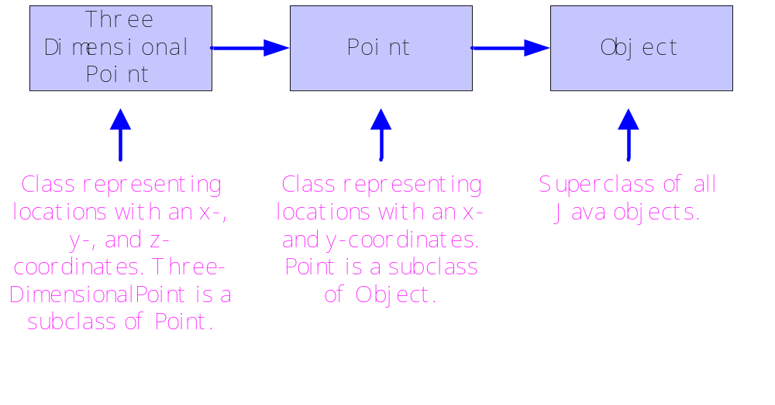
Java’s Mother-of-all-objects—Class Object
Notes:
Class Object provides basic versions of several methods. In particular, it has methods toString(), equals(), and clone(). It also has methods finalize(), getClass(), hashCode(), notify(), notifyAll(), and wait(). These are all inherited by the subclasses of Object.

Slide 12
ThreeDimensionalPoint
ThreeDimensionalPoint a =
new ThreeDimensionalPoint(6, 21, 54);
// invocation of superclass translate()
a.translate(1, 1);
// invocation of subclass translate()
a.translate(2, 2, 2);
Java determines which method to use based on the number of parameters in the invocation
After the first call to translate, what is the value of a?
After the second call to translate, what is the value of a?

Slide 13
ThreeDimensionalPoint
Methods toString(), equals() , and clone() should not have different signatures from the Point versions as we want the new subclass methods to be used.
ThreeDimensionalPoint c = new ThreeDImensionalPoint(1, 4, 9);
ThreeDimensionalPoint d = (ThreeDimensionalPoint) c.clone();
String s = c.toString();
boolean b = c.equals(d);
The cast is necessary for clone as the return type of subclass method clone() will be Object

Slide 14
ThreeDimensionalPoint
Constructors
// ThreeDimensionalPoint():default constructor
public ThreeDimensionalPoint() {
super(); //x,y set by point- z defined
//to be zero (see earlier slide)
}
// ThreeDimensionalPoint():specific constructor
public ThreeDimensionalPoint(int a, int b, int c) {
super(a, b);
setZ(c);
}
Constructor of superclass Point

Slide 15
ThreeDimensionalPoint
Accessors and mutators
// getZ(): z-coordinate accessor
public double getZ() {
return z;
}
// setZ(): y-coordinate mutator
public void setZ(int value) {
z = value;
}
Note: getX, setX, getY, setY are defined in superclass.

Slide 16
ThreeDimensionalPoint
Facilitators
// translate(): shifting facilitator
public void translate(int dx, int dy, int dz) {
translate(dx, dy);
int zValue = (int) getZ();
setZ(zValue + dz);
}
Example: If the object is (1,2,3), then
translate(3,4,2) would move the object to
(4,6,5).

Slide 17
ThreeDimensionalPoint
Facilitators
// toString(): conversion facilitator
public String toString() {
int a = (int) getX();
int b = (int) getY();
int c = (int) getZ();
return getClass() +
"[" + a + ", " + b + ", " + c + "]";
}

Slide 18
ThreeDimensionalPoint
Facilitators
// equals(): equality facilitator
public boolean equals(Object v) {
if (v instanceof ThreeDimensionalPoint) { ThreeDimensionalPoint p =
(ThreeDimensionalPoint) v;
int z1 = (int) getZ();
int z2 = (int) p.getZ();
return super.equals(p) && (z1 == z2);
}
else return false;
}

Slide 19
ThreeDimensionalPoint
Facilitators
// clone(): clone facilitator
public Object clone() {
int a = (int) getX();
int b = (int) getY();
int c = (int) getZ();
return new ThreeDimensionalPoint
(a, b, c);
}

Slide 20
ColoredPoint
Suppose an application calls for the use of colored points.
We can naturally extend class Point to create ColoredPoint
Class ColoredPoint will be added to package geometry
package geometry;
import java.awt.*;
public class ColoredPoint extends Point {
// instance variable
Color color;

Slide 21
ColoredPoint
Constructors
// ColoredPoint(): default constructor
public ColoredPoint() {
super();
setColor(Color.blue);
}
// ColoredPoint(): specific constructor
public ColoredPoint(int x,int y,Color c) { super(x, y);
setColor(c);
}

Slide 22
ColoredPoint
Accessors and mutators
// getColor(): color property accessor
public Color getColor() {
return color;
}
// setColor(): color property mutator
public void setColor(Color c) {
color = c;
}

Slide 23
ColoredPoint
Facilitators
// clone(): clone facilitator
public Object clone() {
int a = (int) getX();
int b = (int) getY();
Color c = getColor();
return new ColoredPoint(a, b, c);
}

Slide 24
ColoredPoint
Facilitators
// toString(): string representation //facilitator
public String toString() {
int a = (int) getX();
int b = (int) getY();
Color c = getColor();
return getClass() +
"[" + a + ", " + b + ", " + c + "]";
}

Slide 25
ColoredPoint
Facilitators
// equals(): equal facilitator
public boolean equals(Object v) {
if (v instanceof ColoredPoint) {
Color c1 = getColor();
Color c2 =
((ColoredPoint) v).getColor();
return super.equals(v) && c1.equals(c2);
}
else return false;

Slide 26
Colored3DPoint
Suppose an application needs a colored, three-dimensional point.
Can we create such a class by extending both ThreeDimensionalPoint and ColoredPoint?
  No. Java does not support multiple inheritance
  Java only supports single inheritance
package Geometry;
import java.awt.*;
public class Colored3DPoint extends ThreeDimensionalPoint {
// instance variable
Color color;

Slide 27
Colored3DPoint
Constructors
// Colored3DPoint(): default constructor
public Colored3DPoint() {
setColor(Color.blue);
}
// Colored3DPoint(): specific constructor
public Colored3DPoint(int a, int b, int c, Color d) {
super(a, b, c);
setColor(d);
}

Slide 28
Colored3DPoint
Accessors and mutators
// getColor(): color property accessor
public Color getColor() {
return color;
}
// setColor(): color property mutator
public void setColor(Color c) {
color = c;
}

Slide 29
Colored3DPoint
Facilitators
// clone(): clone facilitator
public Object clone() {
int a = (int) getX();
int b = (int) getY();
int c = (int) getZ();
Color d = getColor();
return new Colored3DPoint(a, b, c, d);
}

Slide 30
Colored3DPoint
Facilitators
// toString(): string representation //facilitator
public String toString() {
int a = (int) getX();
int b = (int) getY();
int c = (int) getZ();
Color d = getColor();
return getClass() +
"[" + a + ", " + b + ", " + c + ", " + d + "]";
}

Slide 31
Colored3DPoint
Facilitators
// equals(): equal facilitator
public boolean equals(Object v) {
if (v instanceof Colored3DPoint) {
Color c1 = getColor();
Color c2 =
((Colored3DPoint) v).getColor();
return super.equals(v) && c1.equals(c2);
}
else return false;
}

Slide 32
Polymorphism
A code expression can invoke different methods depending on the types of objects being manipulated
Example: function overloading similar to the method min() from java.lang.Math
  The method invoked depends on the types of the actual arguments:
    int a, b, c;
    double x, y, z;
    …
    c = min(a, b); // invokes integer min()
    z = min(x, y); // invokes double min

Slide 33
Polymorphism
Two types of polymorphism
  Syntactic polymorphism —Java can determine which method to invoke at compile time
    Efficient
    Easy to understand and analyze
    Also known as primitive polymorphism
  Pure polymorphism —the method to invoke can only be determined at execution time
So far, we have looked at syntactic polymorphism where the signatures are different.

Slide 34
Pure Polymorphism Example
public class PolymorphismDemo {
// main(): application entry point
public static void main(String[] args) {
Point[] p = new Point[4];
p[0] = new Colored3DPoint(4, 4, 4, Color.BLACK);
p[1] = new ThreeDimensionalPoint(2, 2, 2);
p[2] = new ColoredPoint(3, 3, Color.RED);
p[3] = new Point(4, 4);
for (int i = 0; i < p.length; ++i) {
String s = p[i].toString();
System.out.println("p[" + i + "]: " + s);
}
return;
}
}

Slide 35
Inheritance nuances
When a new object that is a subclass is constructed, the constructor for the superclass is always called.
  Constructor invocation may be implicit or explicit
  We will extend class B and see what happens.
  Remember throughout this- construction is a 2 step process.
public class B {
// B(): default constructor
public B() {
System.out.println("Using B's default constructor");
}
// B(): specific constructor
public B(int i) {
System.out.println("Using B's int constructor");
}
}

Slide 36
Inheritance nuances
public class C extends B {
// C(): default constructor
public C() {
System.out.println("Using C's default constructor");
System.out.println();}
// C(int a): specific constructor
public C(int a) {
System.out.println("Using C's int constructor");
System.out.println();}
// C(int a, int b): specific constructor
public C(int a, int b) {
super(a + b);
System.out.println("Using C's int-int
constructor");
System.out.println();
}

Slide 37
What happens when main executes?
// main(): application entry point
public static void main(String[] args) {
C c1 = new C();
C c2 = new C(2);
C c3 = new C(2,4);
return;}
Each of the variables, ci, is consturcted using a different C constructor.
The first step for each is the construction of the object C with the superclass attributes.
The second step for each constructs the subclass view of the object.

Slide 38
What happens when main executes?
C c1 = new C();
This invokes the superclass default constructor and then C’s default constructor because the superclass constructor is not mentioned.
Thus, the following is written:
Using B’s default constructor
Using C’s default constructor

Slide 39
What happens when main executes?
C c2 = new C(2);
This invokes the superclass default constructor and then C’s constructor for an int parameter because the superclass constructor is not mentioned.
Thus, the following is written:
Using B’s default constructor
Using C’s int constructor

Slide 40
What happens when main executes?
C c3 = new C(2,4);
This invokes the superclass int constructor because super(a+b) is in the code and then C’s int-int constructor.
Thus, the following is written:
Using B’s int constructor
Using C’s int-int constructor

Slide 41
Inheritance nuances
Output Summary for main
Using B's default constructor
Using C's default constructor
Using B's default constructor
Using C's int constructor
Using B's int constructor
Using C's int-int constructor

Slide 42
Controlling access
So far, every member variable and method has either been public or private.
public – no restrictions on access to it
private – can be used only the class that defines that member
What about subclasses?
  With respect to these two access rights, subclasses are treated the same as other classes – i.e. they can access the public members, but not the private members of the superclass.
But, we might want subclasses to have a bit more privileges than arbitrary classes, as they are, after all, in some way more connected to the superclass.
Thus, Java allows more access rights to be specified.

Slide 43
Another access right
protected – can be granted to member variables and methods
Besides being accessible in its own class, a protected variable or method can be used by subclasses of its class.
This introduces a lot more interactions between the various components which we will investigate with examples and then summarize the various access rights.

Slide 44
Controlling access - superclass
package demo;
public class P {
// instance variable
private int data;
// P(): default constructor
public P() {
setData(0);}
// getData(): accessor
public int getData() {
return data;}
// setData(): mutator
protected void setData(int v) {
data = v;}
// print(): facilitator //note: default access
void print() {
System.out.println(getData());}
}

Slide 45
Controlling access - subclass Q
import demo.P;
public class Q extends P {
// Q(): default constructor
public Q() {
super();
}
// Q(): specific constructor
public Q(int v) {
setData(v);
}
Q can access superclass’s public
default constructor
Q can access superclass’s protected
mutator

Slide 46
Controlling access - subclass Q
// toString(): string facilitator
public String toString() {
int v = getData();
return String.valueOf(v);
}
// invalid1(): illegal method
public void invalid1() {
data = 12;
}
// invalid2(): illegal method
public void invalid2() {
print();
}}
Q can access superclass’s
public accessor
Q cannot access superclass’s
private data field
Q cannot directly access superclass’s default access method print()

Slide 47
Summary for subclass Q
Q extends P.
But, Q is not part of package demo where P is defined – it was imported.
Therefore, Q can invoke
  P’s default constructor which is public
  P’s accessor getData() which is public
  P’s mutator setData() which is protected
However, Q cannot directly access
  P’s instance variable data which is private
  P’s default access method print()

Slide 48
Controlling access – class R
package demo; //R is in same package as P
public class R {
// instance variable
private P p;
// R(): default constructor
public R() {
p = new P();
}
// set(): mutator
public void set(int v) {
p.setData(v);
}
R can access P’s public
default constructor
R can access P’s protected
mutator

Slide 49
Controlling access
// get(): accessor
public int get() {
return p.getData();
}
// use(): facilitator
public void use() {
p.print();
}
// invalid(): illegal method
public void invalid() {
p.data = 12;
}
R can access P’s public
accessor
R can access P’s default
access method
R cannot directly access P’s
private data

Slide 50
Summary for subclass R
R does not extend P
But, R is part of package demo where P is defined.
Therefore, R can invoke
  P’s default constructor which is public
  P’s accesspr getData() which is public
  P’s mutator setData() which is protected
  P’s default access faciliator print()
However, R cannot directly access
  P’s instance variable data which is private

Slide 51
Controlling access
import demo.P; //not in class demo
public class S { //note- just a class
// instance variable
private P p;
// S(): default constructor
public S() {
p = new P();
}
// get(): inspector
public int get() {
return p.getData();
}
S can access P’s public default
constructor
S can access P’s public accessor

Slide 52
Controlling access
// illegal1(): illegal method
public void illegal1(int v) {
p.setData(v);
}
// illegal2(): illegal method
public void illegal2() {
p.data = 12;
}
// illegal3(): illegal method
public void illegal3() {
p.print();
}
}
S cannot access P’s protected
mutator
S cannot access directly P’s
private data field
S cannot access directly P’s
default access method print()

Slide 53
Summary for subclass S
S does not extend P
S is not a part of package demo where P is defined as it is imported
Therefore, S can invoke only
  P’s default constructor which is public
  P’s accesspr getData() which is public
S cannot invoke
  P’s mutator setData() which is protected
  P’s default access faciliator print()
  P’s instance variable data which is private

Slide 54
Controlling access –
Class access rights summary
Member Restriction | this | Subclass | Package | General
public | ✓ | ✓ | ✓ | ✓
protected | ✓ | ✓ | ✓ | ⎯
default | ✓ | ⎯ | ✓ | ⎯
private | ✓ | ⎯ | ⎯ | ⎯

Slide 55
Data fields
A superclass’s instance variable can be hidden by a subclass’s definition of an instance variable with the same name
public class D { //will be a superclass
// D instance variable
protected int d; //classes extending D have direct
//access to d (which is 0 initially)
// D(): default constructor
public D() {
d = 0;}
// D(): specific constructor
public D(int v) {
d = v; }
// printD(): facilitator
public void printD() {
System.out.println("D's d: " + d);
System.out.println();}
}

Slide 56
Data fields
public class E extends D {
// E(): specific constructor
public E(int v) {
d = v;
super.d = v*100; }
// printD(): facilitator
public void printE () {
System.out.println("D's d: " + super.d);
System.out.println(“E's d: " + this.d);
System.out.println();}
}
For class E, both d an super.d access superclass instance variable d
Note: This class does not redefine the instance variable d of D. So this prints the same value twice i.e.
E e = new E(1) sets d to 100

Slide 57
Data fields
Class F extends D and introduces a new instance variable named d.
F’s definition of d hides D’s definition.
public class F extends D {
// F instance variable
int d;
// F(): specific constructor
public F(int v) {
d = v;
super.d = v*100;}
// printF(): facilitator
public void printF() {
System.out.println("D's d: " + super.d);
System.out.println("F's d: " + this.d);
System.out.println();}
Modification of this’s d
Modification of superclass’s d
Note: F f = new F(2)
sets different values for D’s d (200) and F’s d (2)

Slide 58
Summary for D, E, and F
A main program containing the code segment:
  E e = new E(1);
  F f = new F(2);
  e.printE();
  f.printF();
would produce
  D’s d: 100
  E’s d: 100
  D’s d: 200
  F’s d: 2

Slide 59
Inheritance and types
public class X {
// default constructor
public X() {
// no body needed }
// isX(): class method
public static boolean isX(Object v) {
return (v instanceof X);}
// isObject(): class method
public static boolean isObject(X v) {
return (v instanceof Object);}
}
isX and isObject are boolean class methods for X

Slide 60
Inheritance and types
public class Y extends X {
// Y(): default constructor
public Y() {
// no body needed }
// isY(): class method
public static boolean isY(Object v) {
return (v instanceof Y);
}
Again, we will look at a program and try to predict what will happen.

Slide 61
Inheritance and types
public static void main(String[] args) {
X x = new X();
Y y = new Y();
X z = y;
System.out.println("x is an Object: " +
X.isObject(x));
System.out.println("x is an X: " + X.isX(x));
System.out.println("x is a Y: " + Y.isY(x));
System.out.println("y is an Object: " +
X.isObject(y));
System.out.println("y is an X: " + X.isX(y));
System.out.println("y is a Y: " + Y.isY(y));
System.out.println("z is an Object: " +
X.isObject(z));
System.out.println("z is an X: " + X.isX(z));
System.out.println("z is a Y: " + Y.isY(z));
return;
}}
All are true except the 3rd one.

Slide 62
Inheritance and types
The exact program output is the following:
  x is an Object: true
  x is an X: true
  x is a Y: false
  y is an Object: true
  y is an X: true
  y is a Y: true
  z is an Object: true
  z is an X: true
  z is a Y: true

Slide 63
Polymorphism and late binding
public class L {
// L(): default constructor
public L() {
}
// f(): facilitator
public void f() {
System.out.println("Using L's f()");
g();
}
// g(): facilitator
public void g() {
System.out.println("using L's g()");
}
}
We now define class M that extends L.

Slide 64
Polymorphism and late binding
public class M extends L {
// M(): default constructor
public M() {
// no body needed }
// g(): facilitator
public void g() {
System.out.println("Using M's g()");}
// main(): application entry point
public static void main(String[] args) {
L l = new L();
M m = new M();
l.f();
m.f();
return;
}
Outputs:
  Using L's f()
  using L's g()
  Using L's f()
  Using M's g()

Slide 65
Finality
A final class is a class that cannot be extended.
  Developers may not want users extending certain classes
  Makes tampering via overriding more difficult
final public class U {
// U(): default constructor
public U() {
}
// f(): facilitator
public void f() {
System.out.println("f() can’t be “ + "overridden: U is final");
}
}

Slide 66
Finality
A final method is a method that cannot be overridden.
public class V {
// V(): default constructor
public V() {
}
// f(): facilitator
final public void f() {
System.out.println("Final method f() " + "can’t be overridden");
}
}

Slide 67
Abstract base classes
Allows the creation of classes with methods that correspond to an abstract concept (i.e., there is not an implementation)
Why would we want this?
  We might want a superclass where there are no reasonable definitions for the methods, but we want to exploit Java’s polymorphic capabilities.
  An example should clarify this need.

Slide 68
Abstract base class
Suppose we wanted to create a class GeometricObject with two data fields:
  Point position
  Color color
  Reasonable concrete methods migt include
    getPosition()
    setPosition()
    getColor()
    setColor()
    paint()
  For all but paint(), we can create implementations.
  For paint(), we must know what kind of object is to be painted. Is it a square, a triangle, etc? – i.e. it is shape-specific.
  Method paint() should be an abstract method.
  We will also make the class abstract which will mean that it can’t be instantiated – i.e. we can’t create a GeometricObject.

Slide 69
Abstract base classes
import java.awt.*;
abstract public class GeometricObject {
// instance variables
Point position;
Color color;
// getPosition(): return object position
public Point getPosition() {
return position;
}
// setPosition(): update object position
public void setPosition(Point p) {
position = p;
}
Makes GeometricObject an
abstract class

Slide 70
Abstract base classes
// getColor(): return object color
public Color getColor() {
return color;
}
// setColor(): update object color
public void setColor(Color c) {
color = c;
}
// paint(): render the shape to graphics context g
abstract public void paint(Graphics g);
}
Indicates that an
implementation of method
paint() will not be supplied

Slide 71
So what can you do with an abstract class?
Define more specific classes that extend GeometricObject.
For example, we could define Box and Circle as subclasses of GeometricObject.
Obviously, we would want to define paint for these subclasses as we would certainly want to instantiate Box and Circle objects.
Of course, by inheritance they would inherit from GeometricObject its instance variables and its defined methods so we do not have to duplicate code!

Slide 72
Interfaces
An interface is a template that specifies what must be in a class that implements the interface
  An interface is not a class itself, but it is a Java type and can be used in ways that classes can be used as types.
Am interface differs from an abstract class in several ways:
  An interface cannot specify any method implementations
  All the methods of an interface are public
  All the variables defined in an interface are public, final, and static

Slide 73
Interfaces
An interface for a colorable object
public interface Colorable {
// getColor(): return the color of the object
public Color getColor();
// setColor(): set the color of the object
public void setColor(Color c);
}
Now the interface can be used to create classes that implement the interface

Slide 74
Interfaces
import java.awt.*;
public class ColorablePoint extends Point implements Colorable {
// instance variable
Color color;
// ColorablePoint(): default constructor
public ColorablePoint() {
super();
setColor(Color.blue);
}
See Listing 9.9 in the text for more details.
Class ColorablePoint must provide
implementations of getColor() and
setColor()

