Slide 1
CHAPTER 9
PLANNING AND ESTIMATING

Slide 2
Overview
Planning and the software process
Estimating duration and cost
Components of a software project management plan
Software project management plan framework
IEEE software project management plan
Planning testing
Planning object-oriented projects
Training requirements
Documentation standards
CASE tools for planning and estimating
Testing the software project management plan

Slide 3
Planning and Estimating
Before starting to build software, it is essential to plan the entire development effort in detail
Planning continues during development and then postdelivery maintenance
  Initial planning is not enough
  Planning must proceed throughout the project
  The earliest possible time that detailed planning can take place is after the specifications are complete

Slide 4
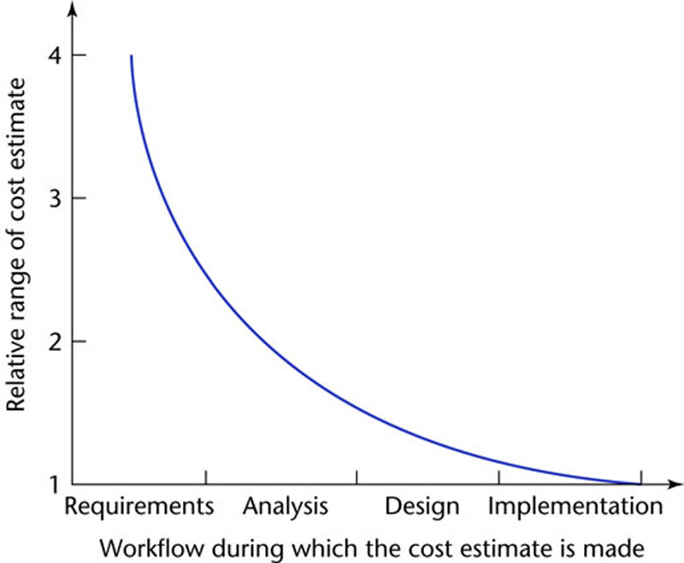
9.1 Planning and the Software Process
Figure 9.1
The accuracy of estimation increases as the process proceeds

Slide 5
Planning and the Software Process (contd)
Example
  Cost estimate of $1 million during the requirements workflow
    Likely actual cost is in the range ($0.25M, $4M)
  Cost estimate of $1 million in the middle of the analysis workflow
    Likely actual cost is in the range ($0.5M, $2M)
  Cost estimate of $1 million at the end of the analysis workflow (earliest appropriate time)
    Likely actual cost is in the range ($0.67M, $1.5M)

Slide 6
Planning and the Software Process (contd)
This model is old (1976)
  Estimating techniques have improved
  But the shape of the curve is likely to be similar

Slide 7
9.2 Estimating Duration and Cost
Accurate duration estimation is critical
Accurate cost estimation is critical
  Internal, external costs
There are too many variables for accurate estimate of cost or duration

Slide 8
Human Factors
Sackman (1968) measured differences of up to 28 to 1 between pairs of programmers
  He compared matched pairs of programmers with respect to
    Product size
    Product execution time
    Development time
    Coding time
    Debugging time
Critical staff members may resign during the project

Slide 9
9.2.1 Metrics for the Size of a Product
Lines of code (LOC, KDSI, KLOC)
FFP
Function Points
COCOMO

Slide 10
Lines of Code (LOC)
Alternate metric
  Thousand delivered source instructions (KDSI)
Source code is only a small part of the total software effort
Different languages lead to different lengths of code
LOC is not defined for nonprocedural languages (like LISP)

Slide 11
Lines of Code (contd)
It is not clear how to count lines of code
  Executable lines of code?
  Data definitions?
  Comments?
  JCL statements?
  Changed/deleted lines?
Not everything written is delivered to the client
A report, screen, or GUI generator can generate thousands of lines of code in minutes

Slide 12
Lines of Code (contd)
LOC is accurately known only when the product finished
Estimation based on LOC is therefore doubly dangerous
  To start the estimation process, LOC in the finished product must be estimated
  The LOC estimate is then used to estimate the cost of the product — an uncertain input to an uncertain cost estimator

Slide 13
Metrics for the Size of a Product (contd)
Metrics based on measurable quantities that can be determined early in the software life cycle
  FFP
  Function points

Slide 14
FFP Metric
For cost estimation of medium-scale data processing products
The three basic structural elements of data processing products
  Files
  Flows
  Processes

Slide 15
FFP Metric (contd)
Given the number of files (Fi), flows (Fl), and processes (Pr)
  The size (S), cost (C) are given by
  S = Fi + Fl + Pr
  C = b × S
The constant b (efficiency or productivity) varies from organization to organization

Slide 16
FFP Metric (contd)
The validity and reliability of the FFP metric were demonstrated using a purposive sample
  However, the metric was never extended to include databases

Slide 17
Function Points
Based on the number of inputs (Inp), outputs (Out), inquiries (Inq), master files (Maf), interfaces (Inf)
For any product, the size in “function points” is given by
    FP = 4 × Inp + 5 × Out + 4 × Inq + 10 × Maf + 7 × Inf
This is an oversimplification of a 3-step process

Slide 18
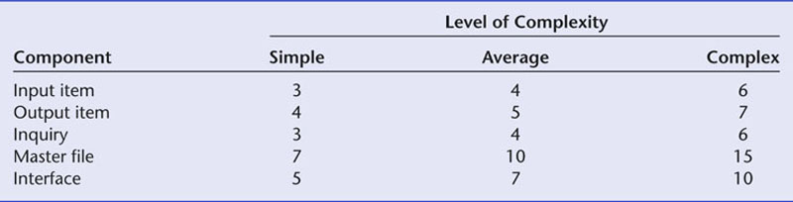
Function Points (contd)
Step 1. Classify each component of the product (Inp, Out, Inq, Maf, Inf) as simple, average, or complex
  Assign the appropriate number of function points
  The sum gives UFP (unadjusted function points)
Figure 9.2

Slide 19
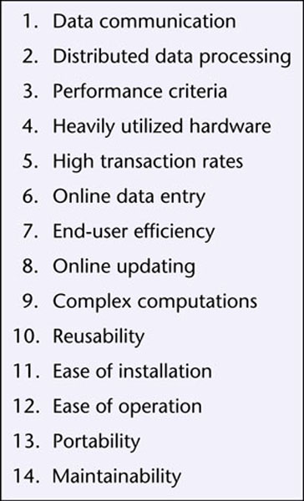
Function Points (contd)
Step 2. Compute the technical complexity factor (TCF)
  Assign a value from 0 (“not present”) to 5 (“strong influence throughout”) to each of 14 factors such as transaction rates, portability
Figure 9.3

Slide 20
Function Points (contd)
Add the 14 numbers
  This gives the total degree of influence (DI)
    TCF = 0.65 + 0.01 × DI
The technical complexity factor (TCF) lies between 0.65 and 1.35

Slide 21
Function Points (contd)
Step 3. The number of function points (FP) is then given by
    FP = UFP × TCF

Slide 22
Analysis of Function Points
Function points are usually better than KDSI — but there are some problems
“Errors in excess of 800% counting KDSI, but only 200% in counting function points” [Jones, 1987]

Slide 23
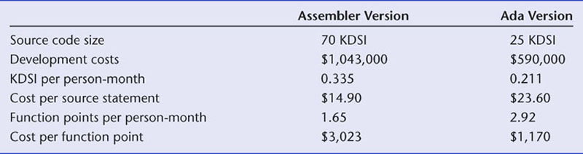
Analysis of Function Points
We obtain nonsensical results from metrics
  KDSI per person month and
  Cost per source statement
Cost per function point is meaningful
Figure 9.4

Slide 24
Analysis of Function Points
Like FFP, maintenance can be inaccurately measured
It is possible to make major changes without changing
  The number of files, flows, and processes; or
  The number of inputs, outputs, inquiries, master files, and interfaces
In theory, it is possible to change every line of code without changing the number of lines of code

Slide 25
Mk II function points
This metric was put forward to compute UFP more accurately
We decompose software into component transactions, each consisting of input, process, and output
Mark Ii function points are widely used all over the world

Slide 26
9.2.2 Techniques of Cost Estimation
Expert judgment by analogy
Bottom-up approach
Algorithmic cost estimation models

Slide 27
Expert Judgment by Analogy
Experts compare the target product to completed products
  Guesses can lead to hopelessly incorrect cost estimates
  Experts may recollect completed products inaccurately
  Human experts have biases
  However, the results of estimation by a broad group of experts may be accurate
The Delphi technique is sometimes needed to achieve consensus

Slide 28
Bottom-up Approach
Break the product into smaller components
  The smaller components may be no easier to estimate
  However, there are process-level costs
When using the object-oriented paradigm
  The independence of the classes assists here
  However, the interactions among the classes complicate the estimation process

Slide 29
Algorithmic Cost Estimation Models
A metric is used as an input to a model to compute cost, duration
  An algorithmic model is unbiased, and therefore superior to expert opinion
  However, estimates are only as good as the underlying assumptions
Examples
  SLIM Model
  Price S Model
  COnstructive COst MOdel (COCOMO)

Slide 30
9.2.3 Intermediate COCOMO
COCOMO consists of three models
  A macro-estimation model for the product as a whole
  Intermediate COCOMO
  A micro-estimation model that treats the product in detail
We examine intermediate COCOMO

Slide 31
Intermediate COCOMO (contd)
Step 1. Estimate the length of the product in KDSI

Slide 32
Intermediate COCOMO (contd)
Step 2. Estimate the product development mode (organic, semidetached, embedded)
Example:
  Straightforward product (“organic mode”)
  Nominal effort = 3.2 × (KDSI)^{1.05} person-months

Slide 33
Intermediate COCOMO (contd)
Step 3. Compute the nominal effort
Example:
  Organic product
  12,000 delivered source statements (12 KDSI) (estimated)
  Nominal effort = 3.2 × (12)^{1.05} = 43 person-months

Slide 34
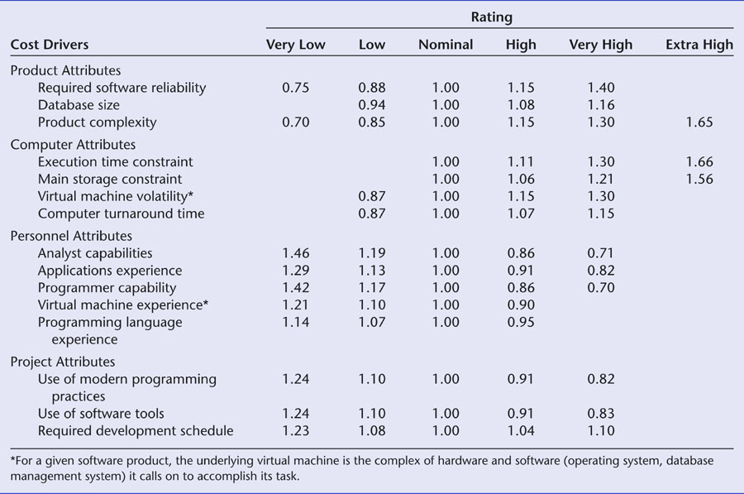
Intermediate COCOMO (contd)
Step 4. Multiply the nominal value by 15 software development cost multipliers
Figure 9.5

Slide 35
Intermediate COCOMO (contd)
Example:
  Microprocessor-based communications processing software for electronic funds transfer network with high reliability, performance, development schedule, and interface requirements
Step 1. Estimate the length of the product
  10,000 delivered source instructions (10 KDSI)
Step 2. Estimate the product development mode
  Complex (“embedded”) mode

Slide 36
Intermediate COCOMO (contd)
Step 3. Compute the nominal effort
  Nominal effort = 2.8 × (10)^{1.20} = 44 person-months
Step 4. Multiply the nominal value by 15 software development cost multipliers
  Product of effort multipliers = 1.35 (see table on next slide)
  Estimated effort for project is therefore 1.35 × 44 = 59 person-months

Slide 37
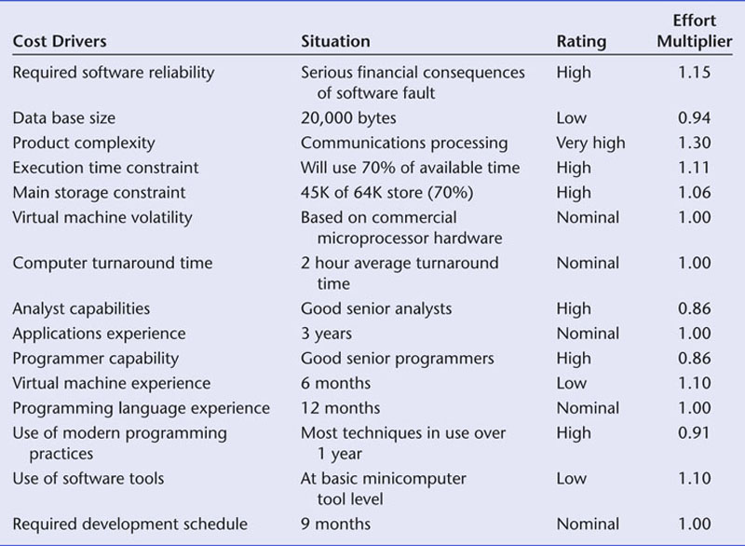
Intermediate COCOMO (contd)
Software development effort multipliers
Figure 9.6

Slide 38
Intermediate COCOMO (contd)
Estimated effort for project (59 person-months) is used as input for additional formulas for
  Dollar costs
  Development schedules
  Phase and activity distributions
  Computer costs
  Annual maintenance costs
  Related items

Slide 39
Intermediate COCOMO (contd)
Intermediate COCOMO has been validated with respect to a broad sample
Actual values are within 20% of predicted values about 68% of the time
  Intermediate COCOMO was the most accurate estimation method of its time
Major problem
  If the estimate of the number of lines of codes of the target product is incorrect, then everything is incorrect

Slide 40
9.2.4 COCOMO II
1995 extension to 1981 COCOMO that incorporates
  Object orientation
  Modern life-cycle models
  Rapid prototyping
  Fourth-generation languages
  COTS software
COCOMO II is far more complex than the first version

Slide 41
COCOMO II (contd)
There are three different models
  Application composition model for the early phases
    Based on feature points (similar to function points)
  Early design model
    Based on function points
  Post-architecture model
    Based on function points or KDSI

Slide 42
COCOMO II (contd)
The underlying COCOMO effort model is
effort = a (size)^{b}
  Intermediate COCOMO
    Three values for (a, b)
  COCOMO II
    b varies depending on the values of certain parameters
COCOMO II supports reuse

Slide 43
COCOMO II (contd)
COCOMO II has 17 multiplicative cost drivers (was 15)
  Seven are new
It is too soon for results regarding
  The accuracy of COCOMO II
  The extent of improvement (if any) over Intermediate COCOMO

Slide 44
9.2.5 Tracking Duration and Cost Estimates
Whatever estimation method used, careful tracking is vital

Slide 45
9.3 Components of a Software Project Management Plan
The work to be done
The resources with which to do it
The money to pay for it

Slide 46
Resources
Resources needed for software development:
  People
  Hardware
  Support software

Slide 47
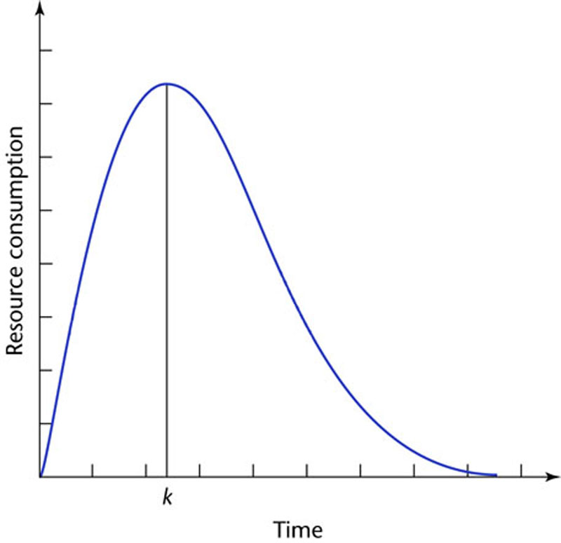
Use of Resources Varies with Time
Rayleigh curves accurately depict resource consumption
The entire software development plan must be a function of time
Figure 9.7

Slide 48
Work Categories
Project function
  Work carried on throughout the project
  Examples:
    Project management
    Quality control

Slide 49
Work Categories
Activity
  Work that relates to a specific phase
  A major unit of work,
  With precise beginning and ending dates,
  That consumes resources, and
  Results in work products like the budget, design, schedules, source code, or users’ manual

Slide 50
Work Categories (contd)
Task
  An activity comprises a set of tasks (the smallest unit of work subject to management accountability)

Slide 51
Completion of Work Products
Milestone: The date on which the work product is to be completed
It must first pass reviews performed by
  Fellow team members
  Management
  The client
Once the work product has been reviewed and agreed upon, it becomes a baseline

Slide 52
Work Package
Work product, plus
  Staffing requirements
  Duration
  Resources
  The name of the responsible individual
  Acceptance criteria for the work product
  The detailed budget as a function of time, allocated to
    Project functions
    Activities

Slide 53
9.4 Software Project Management Plan Framework
There are many ways to construct an SPMP
One of the best is IEEE Standard 1058.1
  The standard is widely accepted
  It is designed for use with all types of software products
  It supports process improvement
    Many sections reflect CMM key process areas
  It is ideal for the Unified Process
    There are sections for requirements control and risk management

Slide 54
Software Project Management Plan Framework (contd)
Some of the sections are inapplicable to small-scale software
  Example: Subcontractor management plan

Slide 55
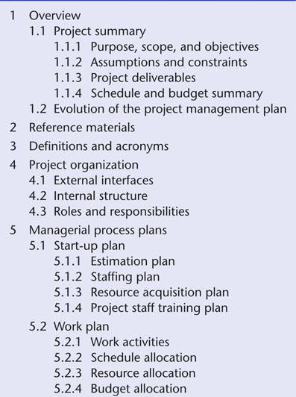
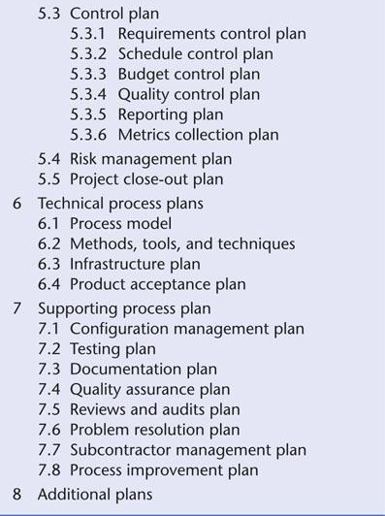
9.5 IEEE Software Project Management Plan
Figure 9.8

Slide 56
9.6 Planning Testing
The SPMP must explicitly state what testing is to be done
Traceability is essential
All black box test cases must be drawn up as soon as possible after the specifications are complete

Slide 57
9.7 Planning Object-Oriented Projects
An object-oriented product consists of largely independent pieces
Consequently, planning is somewhat easier
The whole is more than the sum of its parts
We can use COCOMO II (or modify Intermediate COCOMO estimators)

Slide 58
Planning of Object-Oriented Projects (contd)
However, reuse induces errors in cost and duration estimates
  Reuse of existing components during development
  Production of components for future reuse
These work in opposite directions
Newer data: The savings outweigh the costs

Slide 59
9.8 Training Requirements
“We don’t need to worry about training until the product is finished, and then we can train the user”
Training is generally needed by the members of the development group, starting with training in software planning
A new software development method necessitates training for every member of the group

Slide 60
Training Requirements (contd)
Introduction of hardware or software tools of any sort necessitates training
Programmers may need training in the operating system and/or implementation language
Documentation preparation training may be needed
Computer operators require training

Slide 61
9.9 Documentation Standards
How much documentation is generated by a product?
  IBM internal commercial product (50 KDSI)
    28 pages of documentation per KDSI
  Commercial software product of the same size
    66 pages per KDSI
  IMS/360 Version 2.3 (about 166 KDSI)
    157 pages of documentation per KDSI
  [TRW] For every 100 hours spent on coding activities, 150–200 hours were spent on documentation-related activities

Slide 62
Types of Documentation
Planning
Control
Financial
Technical
Source code
Comments within source code

Slide 63
Documentation Standards
Reduce misunderstandings between team members
Aid SQA
Only new employees have to learn the standards
Standards assist maintenance programmers
Standardization is important for user manuals

Slide 64
Documentation Standards (contd)
As part of the planning process
  Standards must be set up for all documentation
In a very real sense, the product is the documentation

Slide 65
9.10 CASE Tools for Planning and Estimating
It is essential to have
  A word processor; and
  A spreadsheet
Tools that automate intermediate COCOMO and COCOMO II are available
Tools that automate function point calculations are available.
Management tools assist with planning and monitoring
  MacProject
  Microsoft Project – more on this soon

Slide 66
On Line Function Point Calculator
http://www.engin.umd.umich.edu/CIS/course.des/cis525/js/f00/harvey/FP_Calc.html#FPCalc
FAQ on Function Points
http://ourworld.compuserve.com/homepages/softcomp/fpfaq.htm

Slide 67
COCOMO MODEL
There are many explanations of this popular model. The last one is for the original COCOMO model, but it is still handy for quick estimates.
http://www.cs.unc.edu/~stotts/COMP145/cocomo.html
http://www.codeproject.com/gen/design/cocomo2.asp
http://sunset.usc.edu/research/COCOMOII/index.html
http://www.jsc.nasa.gov/bu2/COCOMO.html
An expert system version is available at:
http://sunset.usc.edu/research/COCOMOII/index.html
Scroll down to COCOMO II Web-based Software.

Slide 68
Some comparisons:
1. Unlike FP, COCOMO assumes that as the project progresses, programmers and developers will become more productive.
2. Instead of FP’s linear regression model, COCOMO uses a logarithmic regression model.
3. FP counts inputs, outputs, inquiries, files, and interfaces while COCOMO counts only LOC.
4. Both adjust the original count by further characteristic considerations.
There is much debate about which method is best !

Slide 69
COCOMO is Widely Used
See:
http://www.softstarsystems.com/cocomo20.htm
And, you can always purchase it!
http://www.softstarsystems.com/?referrer=ad1

Slide 70
9.11 Testing the Software Project Management Plan
We must check the SPMP as a whole
  Paying particular attention to the duration and cost estimates

