Slide 1
Some Features of SimProject Software

Slide 2
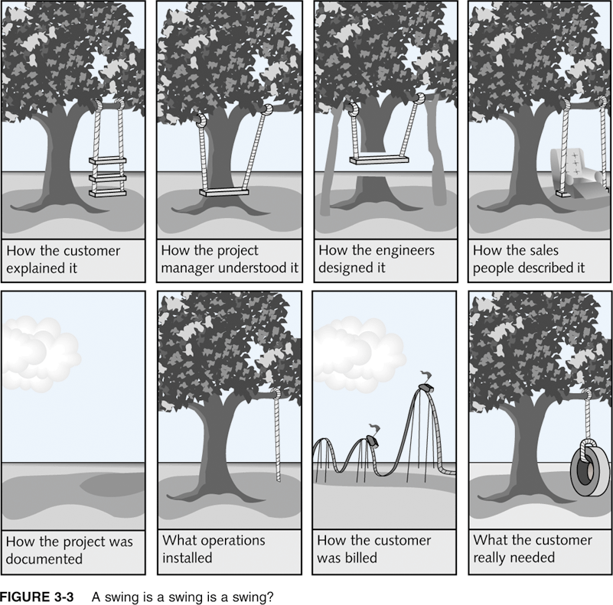
Figure 3-3. A Swing is a Swing is a Swing? – pg 83, Intro to Project Management

Slide 3
Reports in SimProject
Bar Chart – project timetable, task status
Network Diagram – task dependencies/sequence
PPI – Project Performance Index: % budget spent/% project complete
EAC – Estimate at Completion: cost
Estimated Project Completion: schedule
Quality – number of “open” defect reports
Earned Value – comparison of planned earned value (what you planned to have accomplished), actual cost, and earned value (what you have actually accomplished)
Project History – a report of each week’s decisions and results

Slide 4
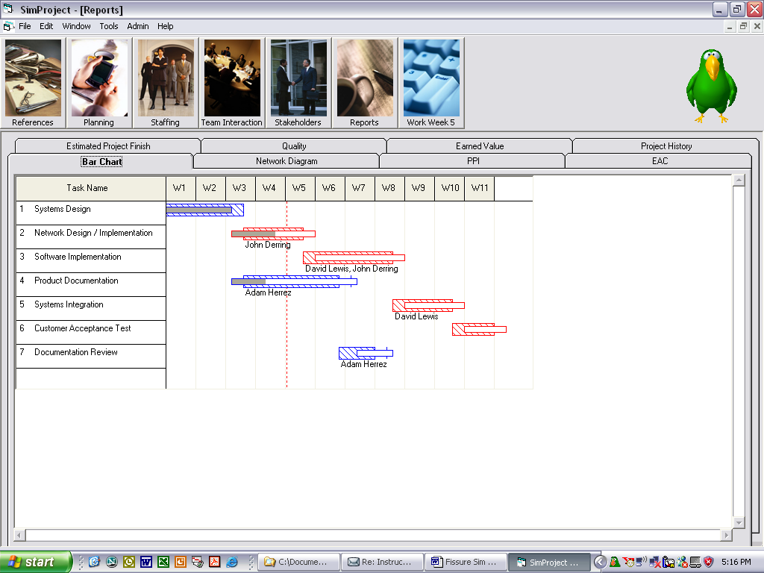
Bar Chart – project timetable, task status

Slide 5
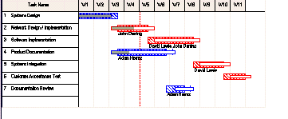
What do the following mean?
Gray bars?
Part of tasks completed
Hatched bars?
Original projection of time needed.
Unfilled bars?
Projected time based on what has been completed to date.

Slide 6
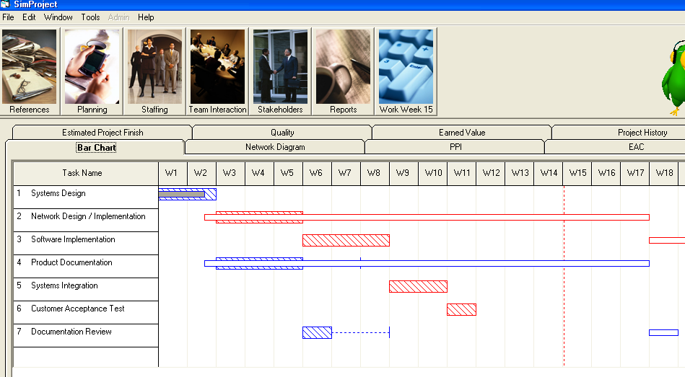
What can you say about this project?

Slide 7
Gantt Charts
The Bar Chart in SimProject is a cut down version of the Gantt Charts used in Microsoft Project and other management software.
Gantt Charts provide more data in one chart.
For example:
In MS Project, the next slide shows work completed.
The following slide shows work still to be done.
Note the coloring that is used.

Slide 8
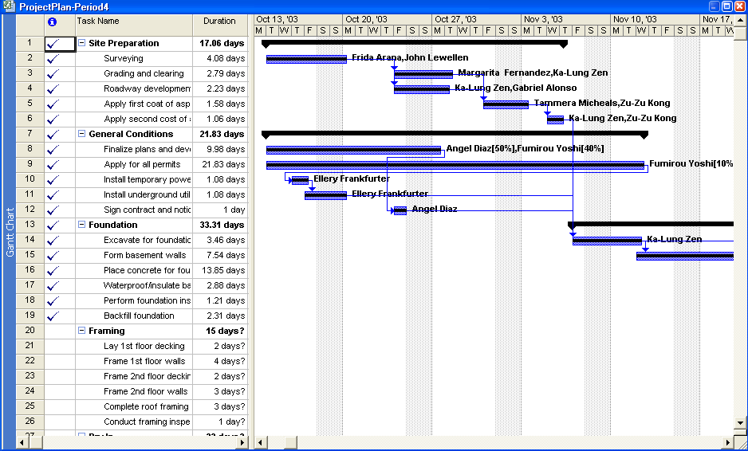

Slide 9
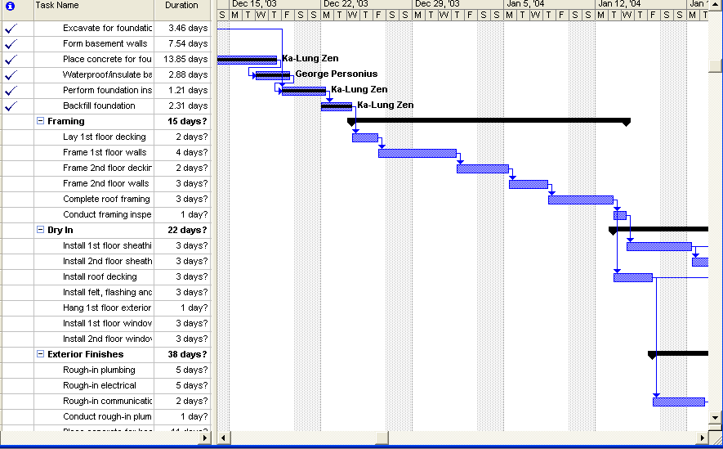

Slide 10
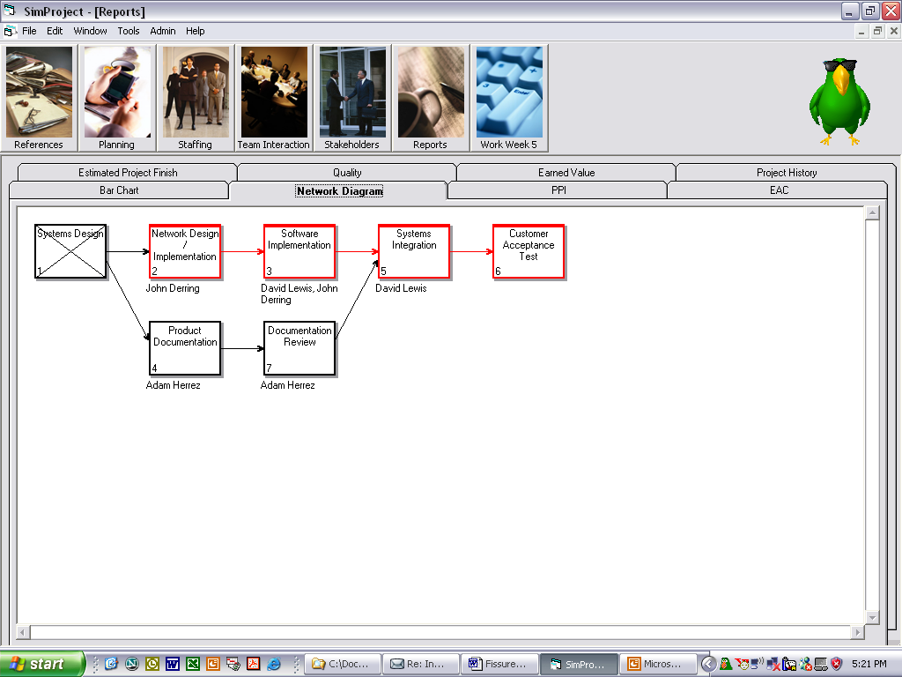
Network Diagram – task dependencies/sequence

Slide 11
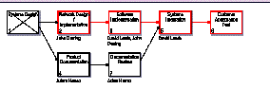
What does it mean?
X means task is
complete.
Red means task is
on the critical path.
Being on the critical path means
any slippage in time, the project completion date will be delayed.
What do you do with work on the critical path?
Give priority to these tasks for resources so they can complete on time.

Slide 12
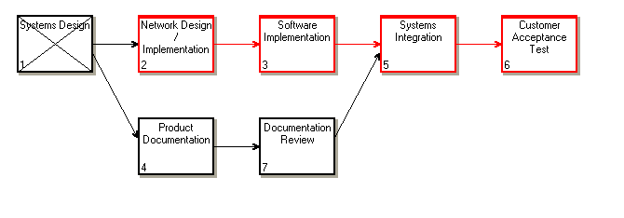
Interpret

Slide 13
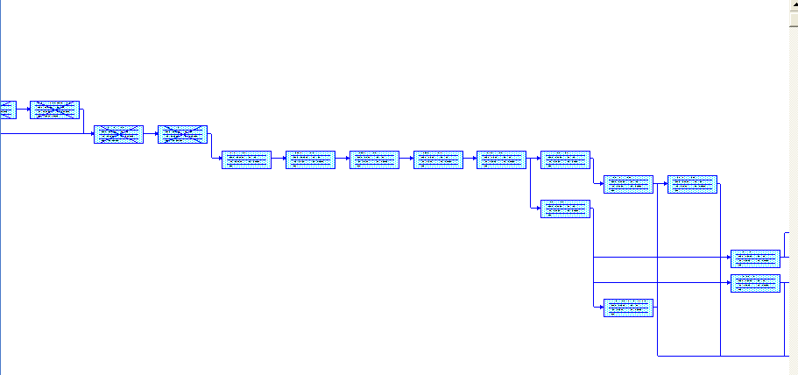
MS Project – Is Similar
Again, critical path tasks are shown in red.
There are none here.

Slide 14
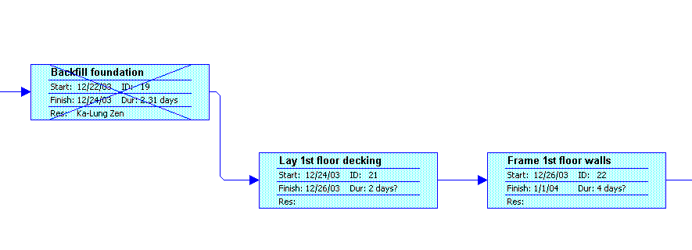
More detail is shown in MS Project for each task
Note the difference in the duration numbers for completed tasks and non-completed tasks.

Slide 15
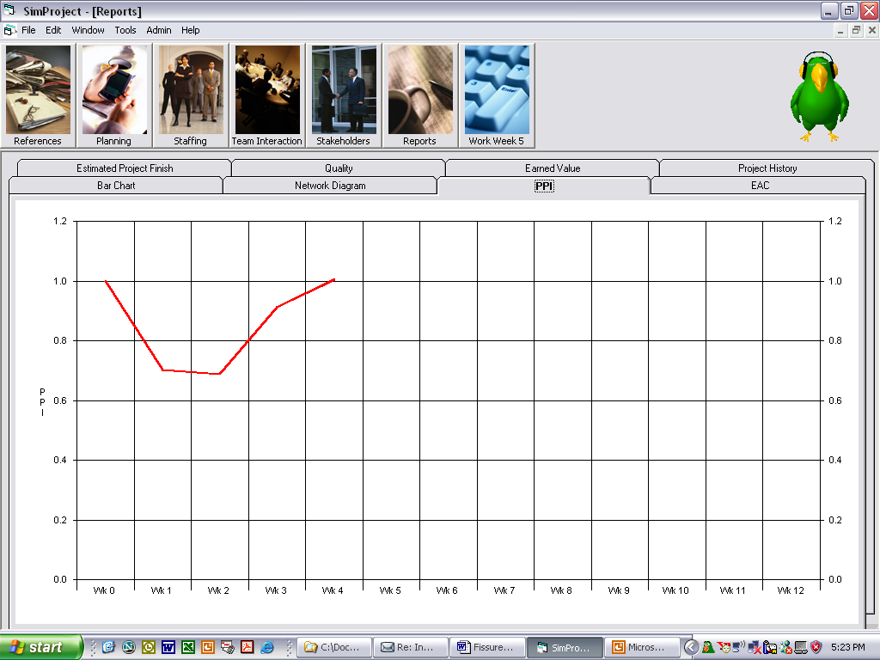
PPI – Project Performance Index:
% budget spent/% project complete
Interpret?

Slide 16
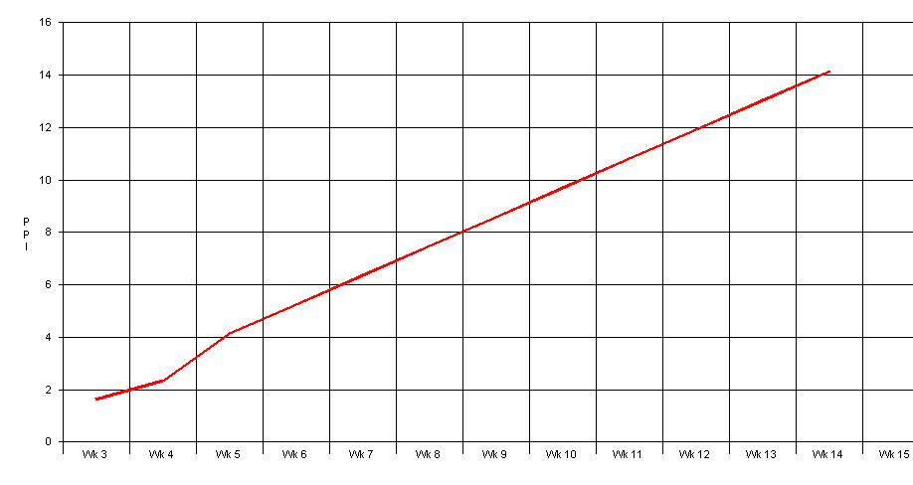
Interpret PPI - % budget spent/% project complete?

Slide 17
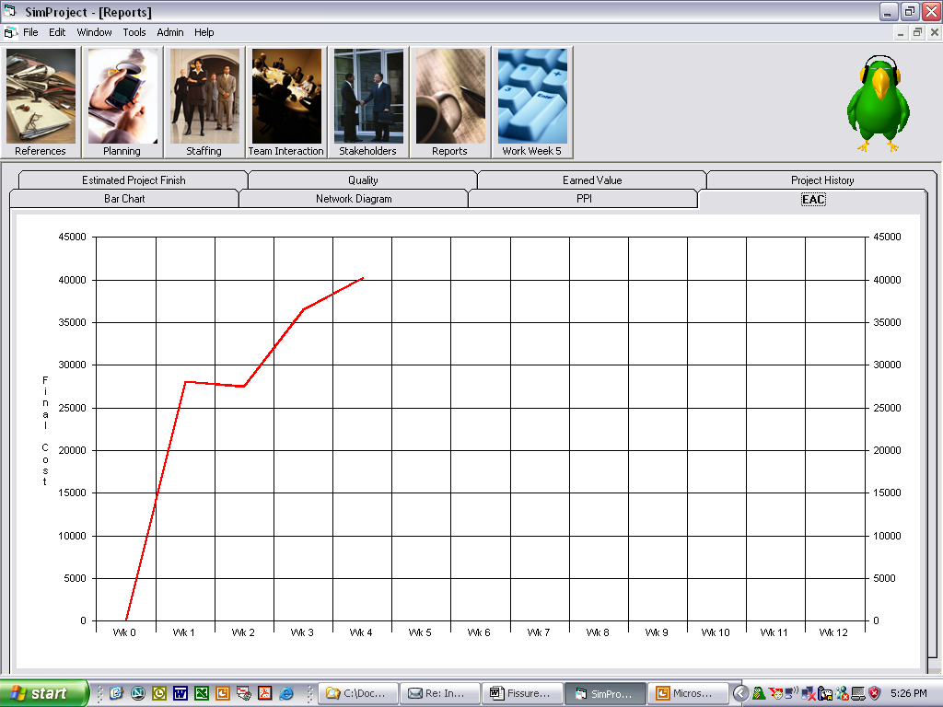
EAC – Estimate at Completion: cost

Slide 18
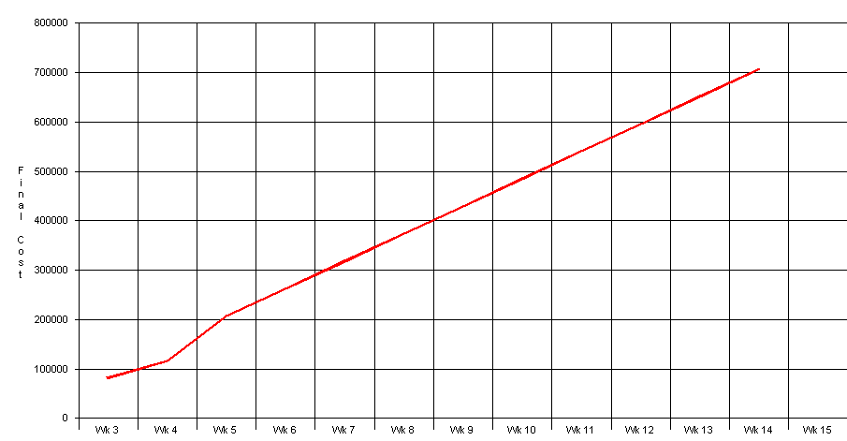
Interpret for current project you are doing

Slide 19

Estimated Project Completion: schedule – interpret?

Slide 20
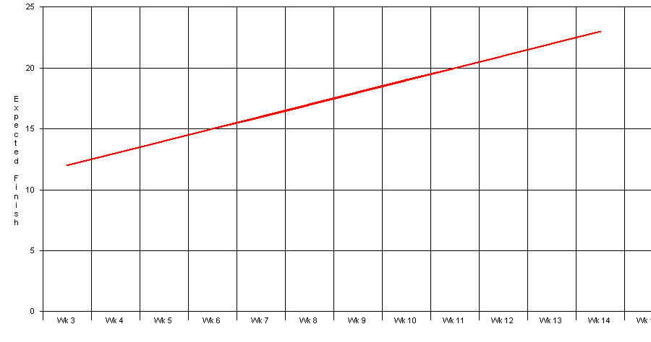
Interpret?

Slide 21
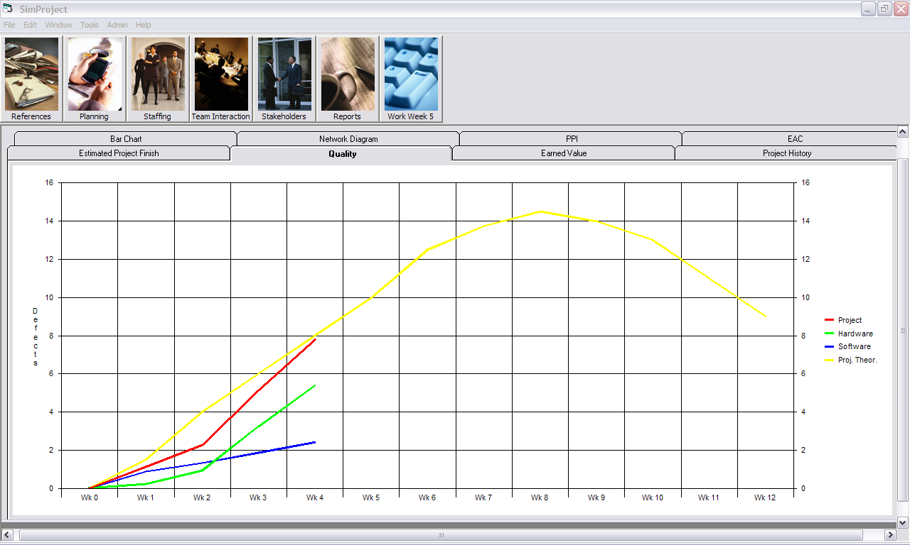
Quality – number of “open” defect reports

Slide 22
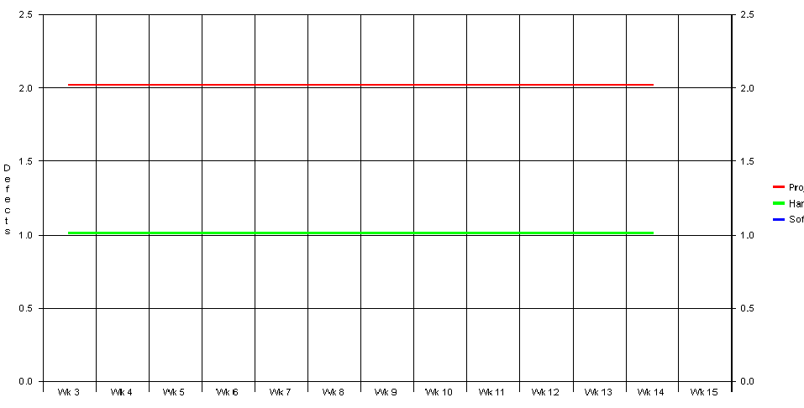
Interpret?

Slide 23
Earned Value
Earned Value – comparison of planned earned value (what you planned to have accomplished), actual cost, and earned value (what you have actually accomplished)

Slide 24
Monitoring and Controlling Tasks for Project Integration Management
Main tasks include:
  Monitoring and controlling project work, which involves collecting, measuring, and disseminating performance information as well as assessing measurements and analyzing trends to determine what process improvements can be made.
  Performing integrated change control, which involves identifying, evaluating, and managing changes throughout the project’s life cycle.

Slide 25
Forecasting With Earned Value Management
Earned value management (EVM) is a project performance measurement technique that integrates scope, time, and cost data.
Given a baseline, project managers and their teams can determine how well the project is meeting scope, time, and cost goals by entering actual information and then comparing it to the baseline.
The baseline information includes:
  Scope data -WBS (Work Breakdown Structure) tasks
  Time data (start and finish estimates for each task)
  Cost data (cost estimates for each task)
Note that you can use earned value management at either a detailed or a summary level.

Slide 26
Earned Value Terms
The planned value (PV) is that portion of the approved total cost estimate planned to be spent on an activity during a given period.
The actual cost (AC) is the total direct and indirect costs incurred in accomplishing work on an activity during a given period.
The earned value (EV) is an estimate of the value of the physical work actually completed. It is based on the original planned costs for the activity and the rate at which the team is completing work on the activity to date.
The rate of performance (RP) is the ratio of actual work completed to the percentage of work planned to have been completed at any given time.

Slide 27
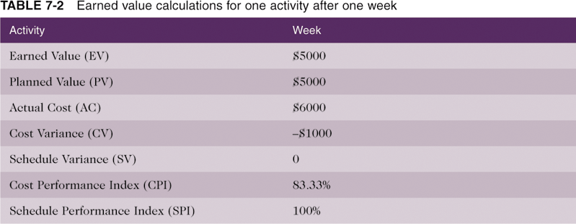
Table 7-2. Earned Value Calculations for One Activity After One Week
Formulas for these appear on the next slide.

Slide 28
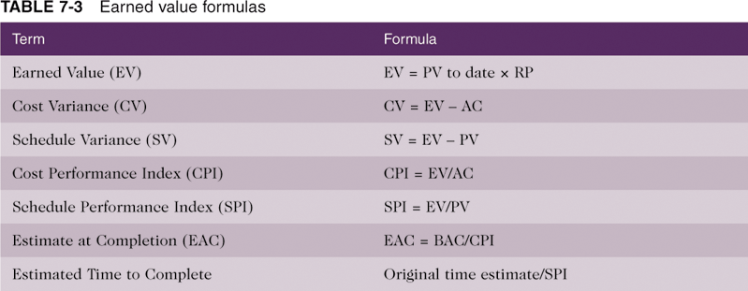
Table 7-3. Earned Value Formulas
EV = $5000 * 100% = $5000
CV = $5000 - $6000 = -$1000
SV = $5000 - $5000 = 0
CPI = $5000/$6000 = 83.33%
SPI = $5000/$5000 = 100%

Slide 29
Interpreting Earned Value Numbers
In general, negative numbers for cost and schedule variance indicate problems in those areas.
Negative numbers mean the project is costing more than planned or taking longer than planned.
Likewise, CPI and SPI less than one or less than 100 percent indicate problems.

Slide 30
Forecasting with Earned Value
The budget at completion (BAC) , or the approved total budget for the project, can be divided by the cost performance index to calculate the estimate at completion (EAC) , which is a forecast of how much the project will cost upon completion.
Likewise, the approved time estimate for the project can be divided by the schedule performance index to calculate when the project will be completed.
  CPI = $700,000/$750,000 = .933333
  SPI = $700,000/$689,500 = 1.015228
  EAC = $1000,000/.933333 = $1,071,429
  New time estimate = 12 months/.933333 = 11.82 months
Earned value, therefore, provides an excellent way to monitor project performance and provide forecasts based on performance to date.

Slide 31
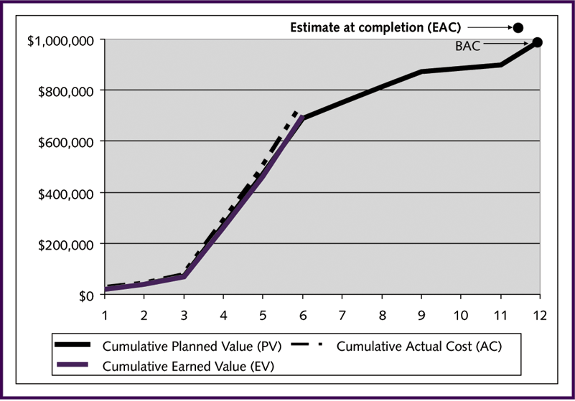
Figure 7-1. Sample Earned Value Chart

Slide 32
What It Means
EAC says project time will be 11.82 months and BAC is $1,071,429.
This is projected based on what happened in the first six months of the project.
Note the actual cost line is right on or above the earned value line which says costs are equal to or only slightly more than planned.
The planned value line is quite close to the earned value line. This says the project has been right on or slightly ahead of schedule in six months.

Slide 33
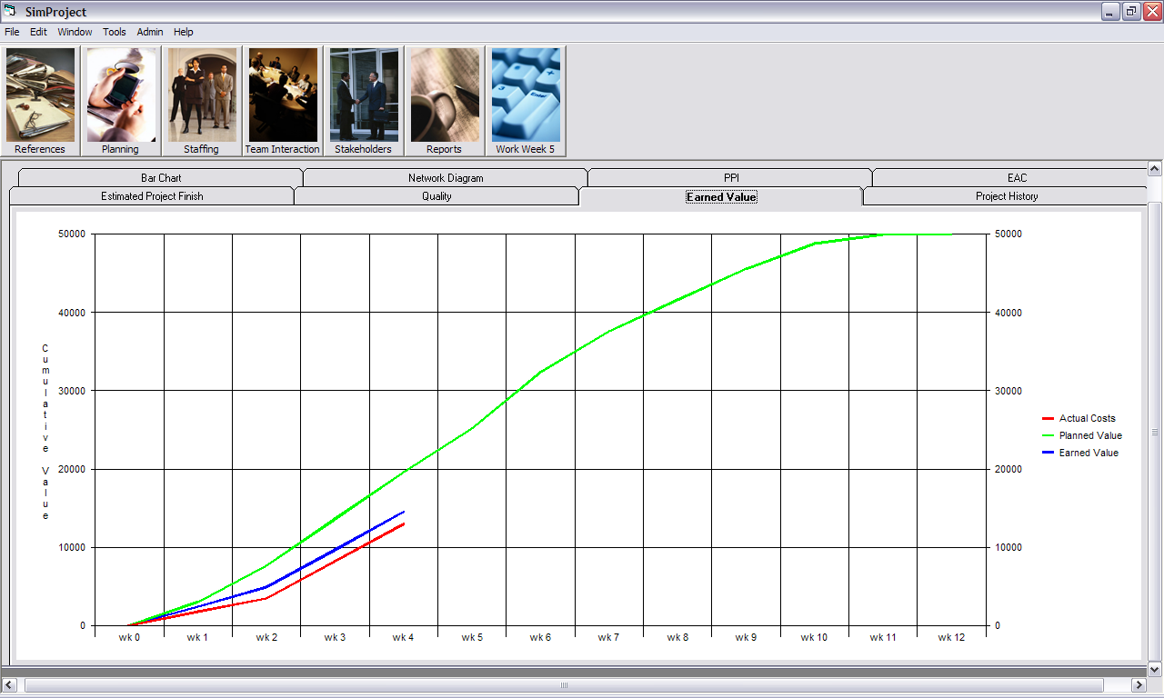
In SimProject – interpret?

Slide 34
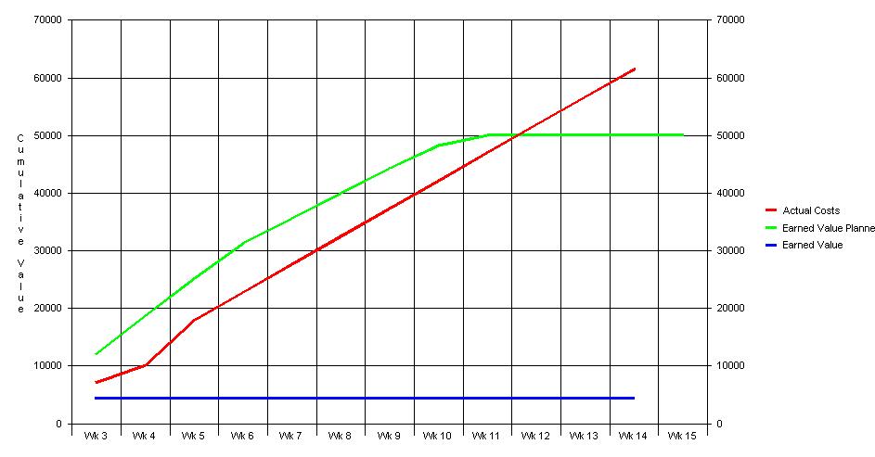
Interpret?

Slide 35
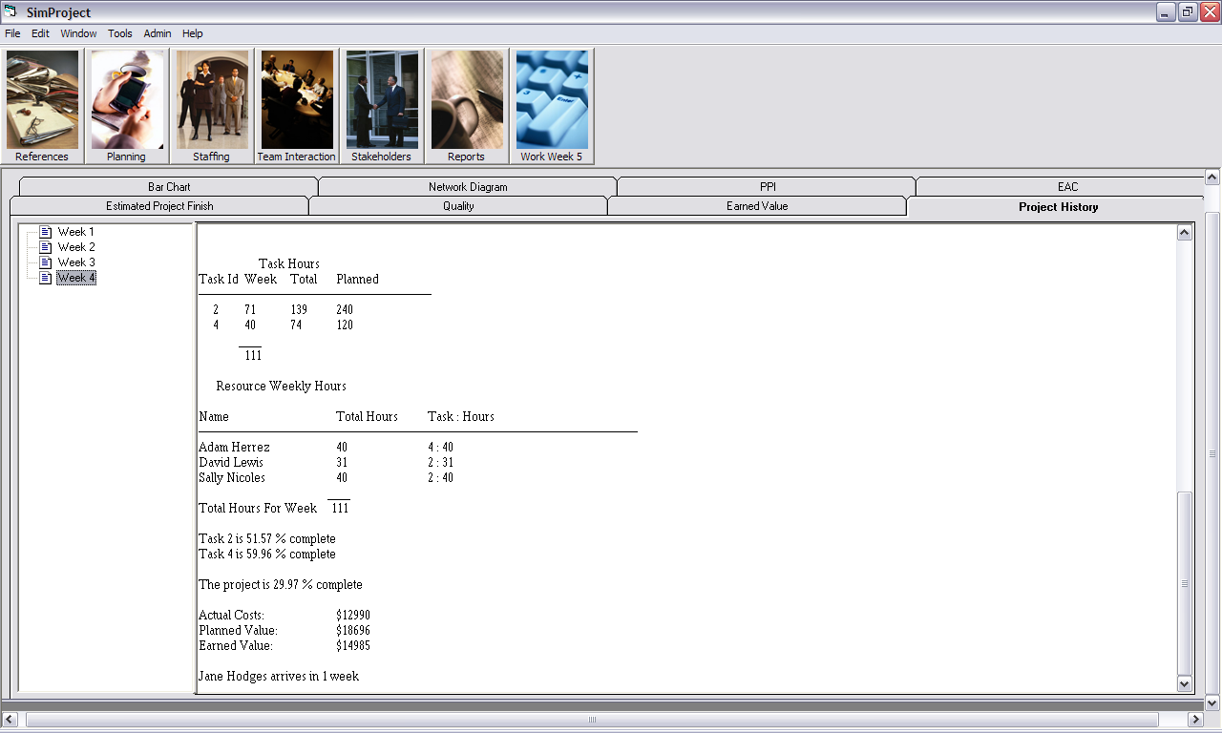
Project history

Slide 36
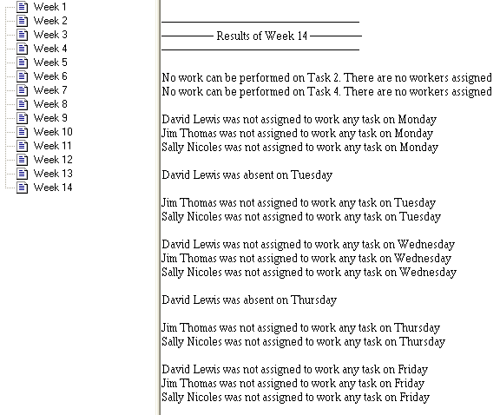
Interpret? – 2 slides

Slide 37
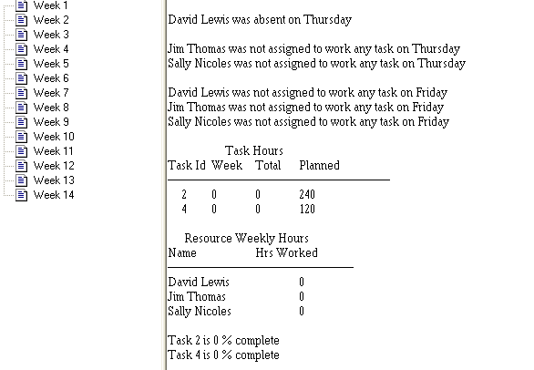

Slide 38
Some of the latter graphs in SimProject
Are not in MS Project.
But, it provides a wealth of reports and other tools which allow you to obtain the same data – it’s just more complicated to set up.
For example, the Tracking Gantt Chart provides some of the information SimProject does.

Slide 39
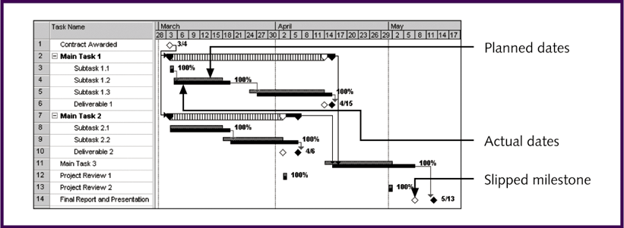
Sample Schedule Performance Measurement Using a Tracking Gantt Chart

Slide 40
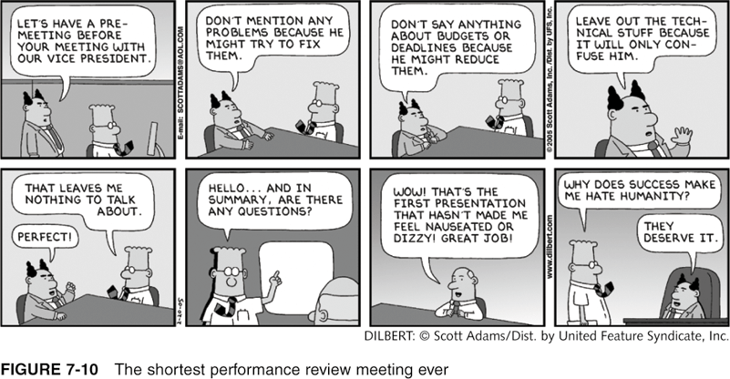
The Shortest Performance Review Meeting Ever
Unlike the managers found in Dilbert cartoons, most senior managers do want
to review pertinent information at status review meetings and discuss problems,
issues, and forecasts!

Slide 41
Use the Graphs on Your Project
To identify problems
To show where you are making good choices.
Be sure to reflect on your choices! Why did you make them the way you did? Were they good choices? What didn’t you anticipate?

