Slide 1
CHAPTER 3
THE SOFTWARE
PROCESS

Slide 2
Chapter Overview
The Unified Process
Iteration and incrementation within the object-oriented paradigm
The requirements workflow
The analysis workflow
The design workflow
The implementation workflow
The test workflow

Slide 3
Overview (contd)
Postdelivery maintenance
Retirement
The phases of the Unified Process
One- versus two-dimensional life-cycle models
Improving the software process
Capability maturity models
Other software process improvement initiatives
Costs and benefits of software process improvement

Slide 4
The Software Process
It is the way we produce software.
It incorporates the methodology used with the underlying software life-cycle, the techniques and tools utilized, and the individuals building the software.
Different organizations have different software processes.
For example, some organizations use procedures that provide self-documenting code; others require extensive external documentation.
However, there are some common elements to all the processes in practice – all are structured around the workflows of requirements, analysis (specification), design, implementation, and testing.
In this chapter we will explore these in more detail.

Slide 5
3.1 The Unified Process
Methodology is one component of a software process.
Over the years, many methodologies have been conceived, tried, analyzed, and often discarded.
Until recently, three of the most successful object-oriented methodologies for software development were
  Booch’s Method
  Jacobson’s Objectory
  Rumbaugh’s OMT
Booch, Jacobson, and Rumbaugh are practioners/ researchers very active in the software engineering community.

Slide 6
The Unified Process
In 1999, Booch, Jacobson, and Rumbaugh published a complete object-oriented analysis and design methodology that unified their three separate methodologies
  Original name: Rational Unified Process (RUP)
  Next name: Unified Software Development Process (USDP)
  Name used today: Unified Process (for brevity)

Slide 7
The Unified Process
The Unified Process is not a series of steps for constructing a software product
  No such single “one size fits all” methodology could exist
  There is a wide variety of different types of software
The Unified Process is an adaptable methodology
  It has to be modified for the specific software product to be developed

Slide 8
3.2 Iteration and Incrementation within the Object-Oriented Paradigm
The Unified Process is a modeling technique
  A model is a set of UML diagrams that represent various aspects of the software product we want to develop
UML stands for unified modeling language
  UML is the tool that we use to represent (model) the target software product when we use the Unified Process
  We will introduce it formally in Part 2, Chapter 10

Slide 9
UML
The Unified Modeling Language (UML)
  UML is graphical
  A picture is worth a thousand words
UML diagrams enable software engineers to communicate quickly and accurately
There are other graphical languages available for communicating software engineering ideas, but this one is the newest and probably will become the most used at least for a while.
We’ll see some other tools later.
See the next slide for two examples of UML diagrams which we will not explain yet.

Slide 10
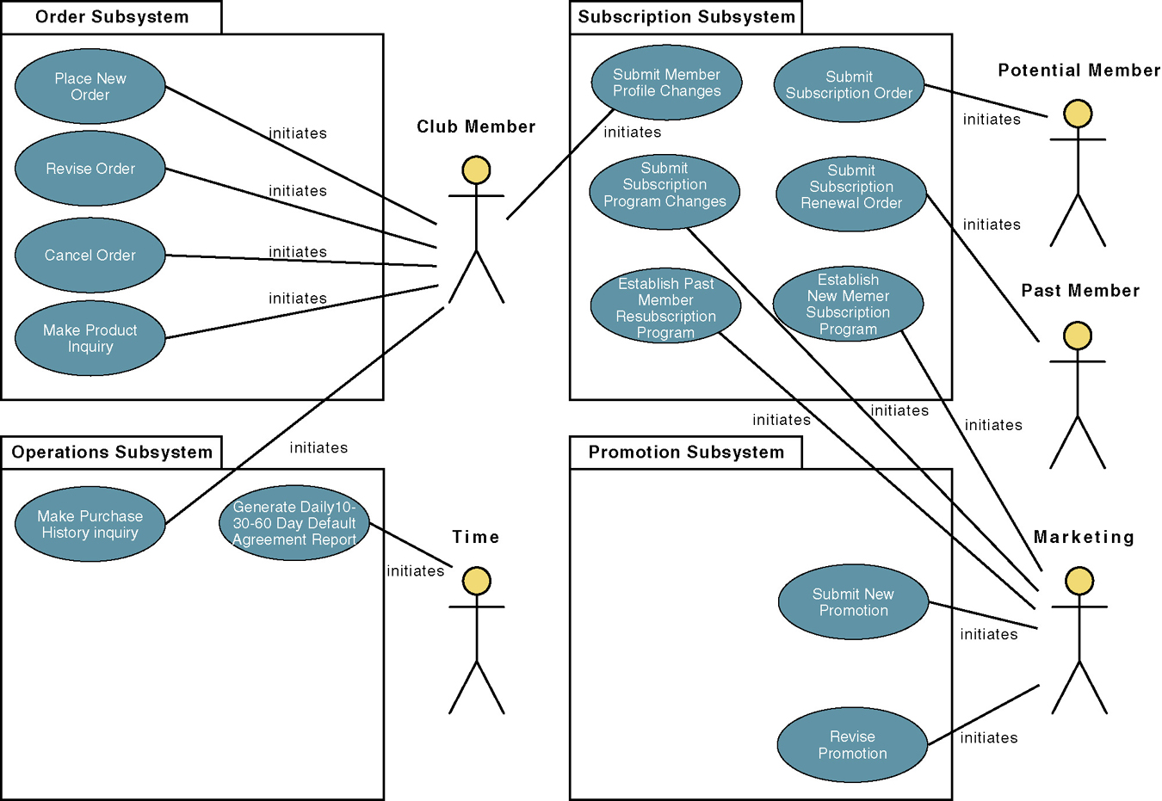
An Example of a UML Diagram
A Use-Case Model

Slide 11
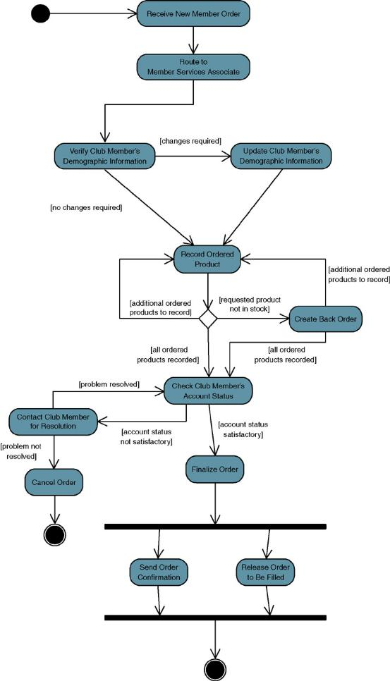

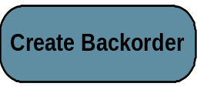
Example of an Activity Diagram in UML
Start Process
Task
Trigger
Synchronize
Notes:
No additional notes.

Slide 12
Iteration and Incrementation within the Object-Oriented Paradigm
The object-oriented paradigm is iterative and incremental in nature
  There is no alternative to repeated iteration and incrementation until the UML diagrams are satisfactory
The version of the Unified Process in this book is for Software products small enough to be developed by a team of three students during the semester or quarter
However, the modifications to the Unified Process for developing a large software product are also discussed

Slide 13
Iteration and Incrementation within the Object-Oriented Paradigm
The goals of this book include:
  A thorough understanding of how to develop smaller software products
  An appreciation of the issues that need to be addressed when larger software products are constructed
We cannot learn the complete Unified Process in one semester or quarter
  Extensive study and unending practice are needed
  The Unified Process has too many features to handle it and everything else in 12 weeks
  A case study of a large-scale software product is huge

Slide 14
Iteration and Incrementation within the Object-Oriented Paradigm
In this book, we therefore cover much, but not all, of the Unified Process
  The topics covered are adequate for smaller products
To work on larger software products, experience is needed
  This must be followed by training in the more complex aspects of the Unified Process

Slide 15
3.3 The Requirements Workflow
The aim of the requirements workflow
  To determine the client’s needs
First, gain an understanding of the application domain (or domain, for short)
  That is, the specific business environment in which the software product is to operate
Second, build a business model
  Use UML to describe the client’s business processes
  If at any time the client does not feel that the cost is justified, development terminates immediately

Slide 16
Overview of the Requirements Workflow
It is vital to determine the client’s constraints
  Deadline
    Nowadays software products are often mission critical
  Parallel running
  Portability
  Reliability
  Rapid response time
  Cost
    The client will rarely inform the developer how much money is available
    A bidding procedure is used instead

Slide 17
Overview of the Requirements Workflow
The aim of this concept exploration is to determine
  What the client needs, and
  Not what the client wants
This is perhaps the hardest part of the process to do right.

Slide 18
3.4 The Analysis Workflow
The aim of the analysis workflow
  To analyze and refine the requirements
Why not do this during the requirements workflow?
  The requirements artifacts must be totally comprehensible by the client
The artifacts of the requirements workflow must therefore be expressed in a natural (human) language
  All natural languages are imprecise
  But, often we make the artifacts even more imprecise by poor language choices.

Slide 19
The Analysis Workflow
Example from a manufacturing information system:
  “A part record and a plant record are read from the database. If it contains the letter A directly followed by the letter Q, then calculate the cost of transporting that part to that plant”
To what does it refer?
  The part record?
  The plant record?
  Or the database?

Slide 20
The Analysis Workflow (contd)
Two separate workflows are needed
  The requirements artifacts must be expressed in the language of the client, but made as precise as possible.
  The analysis artifacts must be precise, and complete enough for the designers to use.
  In fact, as the analysis artifacts become part of contracts, the specifications must be stated so they can be tested.
    How do you test this?
      The system must be user-friendly.

Slide 21
The Specification Document
Specification document (“specifications”)
  Constitutes a contract
  It must not have imprecise phrases like “optimal,” or “98 percent complete
Having complete and correct specifications is essential for
  Testing, and
  Maintenance
The specification document must not have
  Contradictions
  Omissions
  Incompleteness

Slide 22
Software Project Management Plan (SPMP)
Once the client has signed off the specifications, detailed planning and estimating begins
We draw up the software project management plan, including
  Cost estimate
  Duration estimate
  Deliverables
  Milestones
  Budget
This is the earliest possible time for the SPMP

Slide 23
3.5 The Design Workflow
The aim of the design workflow is to refine the analysis workflow until the material is in a form that can be implemented by the programmers
  Many nonfunctional requirements need to be finalized at this time, including
    Choice of programming language
    Reuse issues
    Portability issues
Retain design decisions and why they were made
  To use when a dead-end is reached, and
  To prevent the maintenance team reinventing the wheel

Slide 24
Classical Design
Architectural design
  Decompose the product into modules
Detailed design
  Design each module:
    Data structures
    Algorithms

Slide 25
Object-Oriented Design
Classes are extracted during the object-oriented analysis workflow, andd esigned during the design workflow
Accordingly
  Classical architectural design corresponds to part of the object-oriented analysis workflow
  Classical detailed design corresponds to part of the object-oriented design workflow

Slide 26
3.6 The Implementation Workflow
The aim of the implementation workflow is to implement the target software product in the selected implementation language
  A large software product is partitioned into subsystems
  The subsystems consist of components or code artifacts

Slide 27
3.7 The Test Workflow
The test workflow is the responsibility of
  Every developer and maintainer, and
  The quality assurance group
Traceability of artifacts is an important requirement for successful testing

Slide 28
Reviews
Every item in the analysis artifacts must be traceable to an item in the requirements artifacts
  Similarly for the design and implementation artifacts
The analysis artifacts should be checked by means of a review
  Representatives of the client and analysis team must be present
The SPMP must be similarly checked
  Pay special attention to the cost, duration, and personnel estimates
Design reviews are essential
  A client representative is not usually present

Slide 29
3.7.4 Implementation Artifacts
Each component is tested as soon as it has been implemented
  Unit testing
At the end of each iteration, the completed components are combined and tested
  Integration testing which includes regression testing
When the product appears to be complete, it is tested as a whole
  Product testing
Once the completed product has been installed on the client’s computer, the client tests it
  Acceptance testing

Slide 30
Implementation Artifacts
COTS software is released for testing by prospective clients
  Alpha release
  Beta release
There are advantages and disadvantages to being an alpha or beta release site
  One of the main advantages is that you see new products early in their production and you can help tailor the product by your feedback
  The main disadvantage is the time and effort you must invest to test the product and provide feedback.

Slide 31
3.8 Postdelivery Maintenance
Postdelivery maintenance is an essential component of software development
  More money is spent on postdelivery maintenance than on all other activities combined
Problems can be caused by
  Lack of documentation of all kinds
Two types of testing are needed
  Testing the changes made during postdelivery maintenance
  Regression testing
All previous test cases (and their expected outcomes) need to be retained

Slide 32
3.9 Retirement
Software can be unmaintainable because
  A drastic change in design has occurred
  The product must be implemented on a totally new hardware/operating system
  Documentation is missing or inaccurate
  Hardware is to be changed—it may be cheaper to rewrite the software from scratch than to modify it
These are usually instances of maintenance (rewriting of existing software)
True retirement is a rare event
It occurs when the client organization no longer needs the functionality provided by the product

Slide 33
3.10 The Phases of the Unified Process
There are four increments labeled
  Inception phase
  Elaboration phase
  Construction phase
  Transition phase
The phases of the Unified Process are the increments
Each workflow essentially goes through the four phases, although in some workflows little is done for some of the phases.

Slide 34
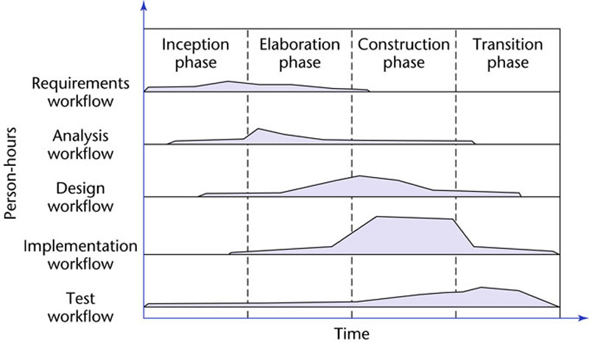
3.10 The Phases of the Unified Process with Person-hours Involved
The increments are identified as phases
Figure 3.1

Slide 35
The Phases of the Unified Process
In theory, there could be any number of increments
  In practice, development seems to consist of four increments
Every step performed in the Unified Process falls into
  One of the five core workflows and also
  One of the four phases
Why does each step have to be considered twice?
  Workflow : Technical context of a step
  Phase : Business context of a step

Slide 36
3.10.1 The Inception Phase
The aim of the inception phase is to determine whether the proposed software product is economically viable. We need to:
1. Gain an understanding of the domain
2. Build the business model
3.Delimit the scope of the proposed project by focusing on the subset of the business model that is covered by the proposed software product
4. Begin to make the initial business case

Slide 37
The Inception Phase : The Initial Business Case
Questions that need to be answered include:
  Is the proposed software product cost effective?
  How long will it take to obtain a return on investment?
  Alternatively, what will be the cost if the company decides not to develop the proposed software product?
  If the software product is to be sold in the marketplace, have the necessary marketing studies been performed?
  Can the proposed software product be delivered in time?
  If the software product is to be developed to support the client organization’s own activities, what will be the impact if the proposed software product is delivered late?

Slide 38
The Inception Phase: The Initial Business Case
What are the risks involved in developing the software product, and
How can these risks be mitigated?
  Does the team that will develop the proposed software product have the necessary experience?
  Is new hardware needed for this software product?
  If so, is there a risk that it will not be delivered in time?
  If so, is there a way to mitigate that risk, perhaps by ordering back-up hardware from another supplier?
  Are software tools (Chapter 5) needed?
  Are they currently available?
  Do they have all the necessary functionality?

Slide 39
The Inception Phase: The Initial Business Case
Answers are needed by the end of the inception phase so that the initial business case can be made
There are three major risk categories in this phase:
  Technical risks
    See earlier slide
  The risk of not getting the requirements right
    Mitigated by performing the requirements workflow correctly
  The risk of not getting the architecture right
    The architecture may not be sufficiently robust

Slide 40
The Inception Phase: Risks
To mitigate all three classes of risks
  The risks need to be ranked so that the critical risks are mitigated first
This concludes the steps of the inception phase that fall under the requirements workflow

Slide 41
The Inception Phase: Analysis, Design Workflows
A small amount of the analysis workflow may be performed during the inception phase
  Information needed for the design of the architecture is extracted
Accordingly, a small amount of the design workflow may be performed, too

Slide 42
The Inception Phase: Implementation Workflow
Coding is generally not performed during the inception phase
However, a proof-of-concept prototype is sometimes build to test the feasibility of constructing part of the software product
For example, if database access speed is critical, can we test that out with a piece of software just written for this purpose?

Slide 43
The Inception Phase: Test Workflow
The test workflow commences almost at the start of the inception phase
  The aim is to ensure that the requirements have been accurately determined

Slide 44
The Inception Phase: Planning
There is insufficient information at the beginning of the inception phase to plan the entire development
  The only planning that is done at the start of the project is the planning for the inception phase itself
For the same reason, the only planning that can be done at the end of the inception phase is the plan for just the next phase, the elaboration phase

Slide 45
The Inception Phase: Documentation
The deliverables of the inception phase include:
  The initial version of the domain model
  The initial version of the business model
  The initial version of the requirements artifacts
  A preliminary version of the analysis artifacts
  A preliminary version of the architecture
  The initial list of risks
  The initial ordering of the use cases (Chapter 10)
  The plan for the elaboration phase
  The initial version of the business case (next slide)

Slide 46
The Inception Phase: The Initial Business Case
Obtaining the initial version of the business case is the overall aim of the inception phase
This initial version incorporates
  A description of the scope of the software product
  Financial details
  If the proposed software product is to be marketed, the business case will also include
    Revenue projections, market estimates, initial cost estimates
  If the software product is to be used in-house, the business case will include
    The initial cost–benefit analysis

Slide 47
3.10.2 Elaboration Phase
The aim of the elaboration phase is to refine the initial requirements
  Refine the architecture
  Monitor the risks and refine their priorities
  Refine the business case
  Produce the project management plan
The major activities of the elaboration phase are refinements or elaborations of the previous phase

Slide 48
The Tasks of the Elaboration Phase
The tasks of the elaboration phase correspond to:
  All but completing the requirements workflow
  Performing virtually the entire analysis workflow
  Starting the design of the architecture

Slide 49
The Elaboration Phase: Documentation
The deliverables of the elaboration phase include:
  The completed domain model
  The completed business model
  The completed requirements artifacts
  The completed analysis artifacts
  An updated version of the architecture
  An updated list of risks
  The project management plan (for the rest of the project)
  The completed business case

Slide 50
3.10.3 Construction Phase
The aim of the construction phase is to produce the first operational-quality version of the software product
  This is sometimes called the beta release

Slide 51
The Tasks of the Construction Phase
The emphasis in this phase is on
  Implementation, and
  Testing
    Unit testing of modules
    Integration testing of subsystems
    Product testing of the overall system

Slide 52
The Construction Phase: Documentation
The deliverables of the construction phase include:
  The initial user manual and other manuals, as appropriate
  All the artifacts (beta release versions)
  The completed architecture
  The updated risk list
  The project management plan (for the remainder of the project)
  If necessary, the updated business case

Slide 53
3.10.4 The Transition Phase
The aim of the transition phase is to ensure that the client’s requirements have indeed been met
  Faults in the software product are corrected
  All the manuals are completed
  Attempts are made to discover any previously unidentified risks
This phase is driven by feedback from the site(s) at which the beta release has been installed

Slide 54
The Transition Phase: Documentation
The deliverables of the transition phase include:
  All the artifacts (final versions)
  The completed manuals

Slide 55
Why a Two-Dimensional Model?
A traditional life cycle is a one-dimensional model
  Represented by the single axis on the next slide
    Example: Waterfall model
The Unified Process is a two-dimensional model
  Represented by the two axes on the next slide
The two-dimensional figure shows
  The workflows (technical contexts), and
  The phases (business contexts)

Slide 56
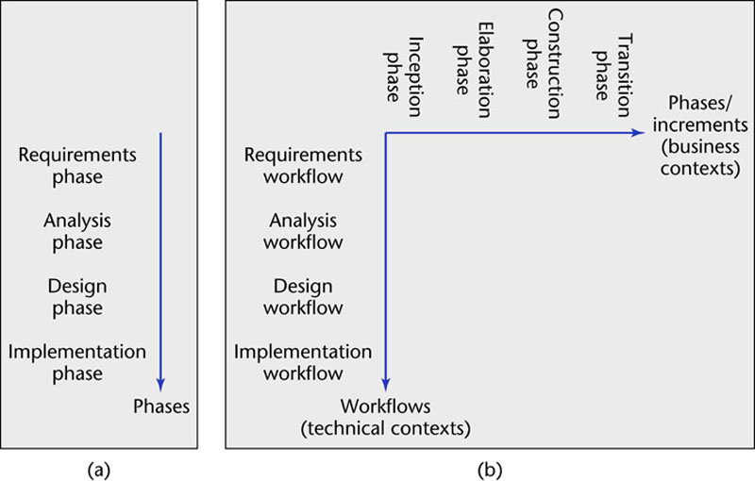
3.11 One- and Two-Dimensional Life-Cycle Models
Figure 3.2

Slide 57
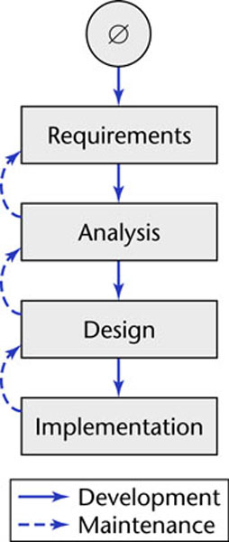
A One-Dimensional Model
The waterfall model
Figure 2.3 (again)

Slide 58
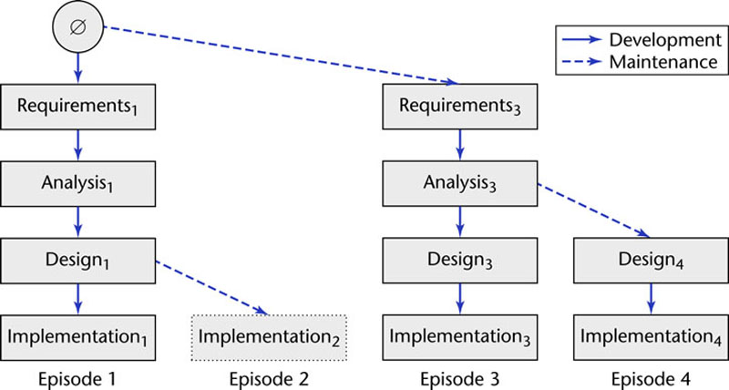
A Two-Dimensional Model
Evolution tree model
Figure 2.2 (again)

Slide 59
Why a Two-Dimensional Model?
Are all the additional complications of the two-dimensional model necessary?
  We answered this earlier, but the answer is so important it is repeated here.
In an ideal world, each workflow would be completed before the next workflow is started
In reality, most development tasks are too big for this
As a consequence of Miller’s Law
  The development task has to be divided into increments (phases)
  Within each increment, iteration is performed until the task is complete

Slide 60
Why a Two-Dimensional Model?
At the beginning of the process, there is not enough information about the software product to carry out the requirements workflow
  Similarly for the other core workflows
A software product has to be broken into subsystems
Even subsystems can be too large at times
  Modules may be all that can be handled until a fuller understanding of all the parts of the product as a whole has been obtained

Slide 61
Why a Two-Dimensional Model?
The Unified Process handles the inevitable changes well
  The moving target problem
  The inevitable mistakes
The Unified Process is the best solution found to date for treating a large problem as a set of smaller, largely independent subproblems
  It provides a framework for incrementation and iteration
  In the future, it will inevitably be superseded by some better methodology

Slide 62
3.12 Improving the Software Process
U.S. Department of Defense (DoD) initiative
  1987 report: “After two decades of largely unfulfilled promises about productivity, and quality gains from applying new software methodologies and technologies, industry and government organizations are realizing that their fundamental problem is the inability to manage the software process.”
  Founded at Carnegie Mellon the Software Engineering Institute (SEI)
  See their website: http://www.sei.cmu.edu/
  SEI was founded to advance the state of the practice of software engineering and to serve as a national resource in software engineering and technology.

Slide 63
Improving the Software Process
Software process improvement initiatives:
  Proposed by SEI:
    Capability maturity model (CMM)
  Proposed by the International Organization on Standards (ISO)
    ISO 9000-series
    ISO/IEC 15504
You will hear statements like this organization is
  “SW-CMM Level 3 compliant.”
  “ISO 9000 compliant.”
  etc.

Slide 64
3.13 Capability Maturity Models
Not a life-cycle model
Rather, a set of strategies for improving the software process
  SW–CMM for software
  P–CMM for human resources (“people”)
  SE–CMM for systems engineering
  IPD–CMM for integrated product development
  SA–for software acquisition
These strategies are unified into CMMI (capability maturity model integration)

Slide 65
SW–CMM
A strategy for improving the software process
put forward in 1986 by the SEI
Fundamental ideas:
  Improving the software process leads to
    Improved software quality
    Delivery on time, within budget
  Improved management leads to
    Improved techniques
Five levels of maturity are defined
  Maturity is a measure of the goodness of the process itself which can be described and measured
An organization advances stepwise from level to level

Slide 66
Level 1. Initial Level
Ad hoc approach
  The entire process is unpredictable
  Management consists of responses to crises
  The usual pattern is time and cost overruns even though some projects are successful.
  The processes used are dependent upon the current staff – if the staff changes, the process changes.
  Consequently, predictability is virtually nonexistent.
Unfortunately, most organizations world-wide are at level 1

Slide 67
Level 2. Repeatable Level
Basic software management
  Management decisions should be made on the basis of previous experience with similar products – hence the name “repeatable”
  Measurements (“metrics”) are made
  These can be used for making cost and duration predictions in the next project
  Problems are identified and immediate corrective action is taken

Slide 68
Level 3. Defined Level
The software process is fully documented
  Managerial and technical aspects are clearly defined
  Continual efforts are made to improve quality and productivity
  Reviews are performed to improve software quality
  CASE tools are applicable now (and not at levels 1 or 2)

Slide 69
Level 4. Managed Level
Quality and productivity goals are set for each project
  Quality and productivity are continually monitored
  Statistical quality controls are in place – for example, what are the number of faults detected per 1000 lines of code.
  The statistical quality controls are used to set objectives – for example, reduce the number of faults detected per 1000 lines of code

Slide 70
Level 5. Optimizing Level
Continuous process improvement
  Statistical quality and process controls
  Feedback of knowledge from each project to the next
  There is a steady improvement in productivity and quality in the software.

Slide 71
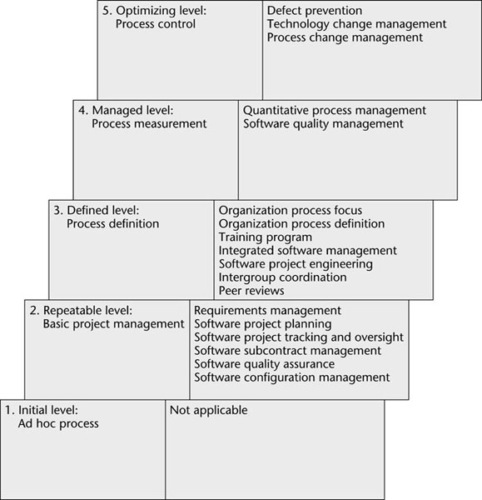
Summary 0f SW-CMM Levels and Their Key Process Areas
Figure 3.3

Slide 72
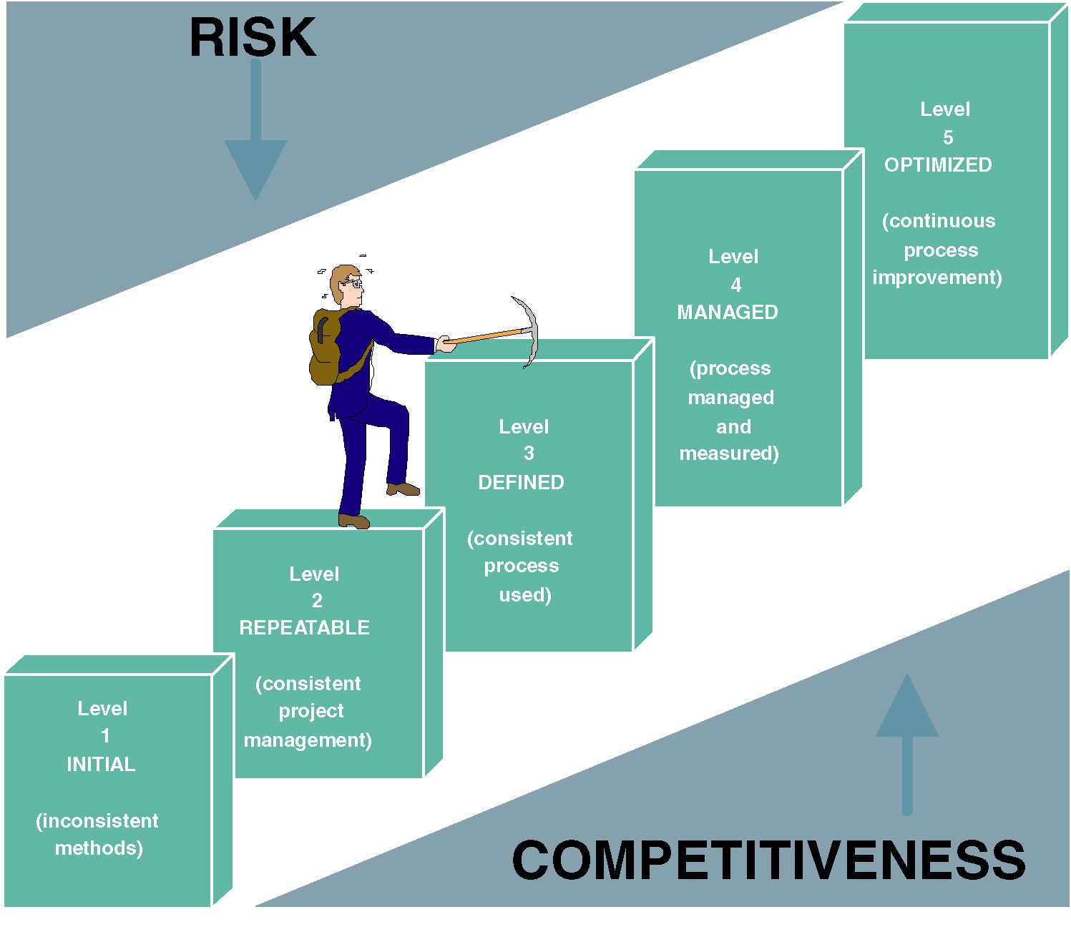
Capability Maturity Model (CMM)
Notes:
No additional notes

Slide 73
So, Are Many Companies Achieving High CMM Levels?
From a study made of 533 organizations 1992-1996. Still believed to be true essentially today . The percentage of organizations at that level.
Level 1: Ad hoc
62%
Level 2: Repeatable
23%
Level 3: Defined
13%
Level 4: Managed
2%
Level 5: Optimizing
    0.4%

Slide 74
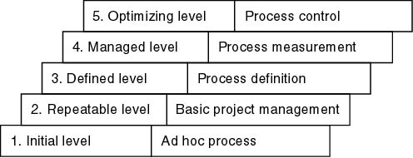
Summary
Keywords Characterizing the Levels

Slide 75
Key Process Areas
There are key process areas (KPAs) for each level specified by SEI that an organization should target in order to reach the next level. For example:
Level 2 KPAs include:
  Requirements management
  Project planning
  Project tracking
  Configuration management
  Quality assurance
Compare
  Level 2: Detection and correction of faults
  Level 5: Prevention of faults

Slide 76
Experience
It takes:
  3 to 5 years to get from level 1 to level 2
  1.5 to 3 years from level 2 to level 3
  SEI questionnaires highlight shortcomings, suggest ways to improve the process
Original idea: Defense contracts would be awarded only to capable firms – SEI was originally funded by the Department of Defense (DoD)

Slide 77
Goals
The U.S. Air Force stipulated that every Air Force contractor had to attain SW–CMM level 3 by 1998
  DoD subsequently issued a similar directive
The CMM has now gone far beyond the limited goal of improving DoD software and is used by many organizations to try and improve their software processes.

Slide 78
3.14 Other SPI Initiatives
Other software process improvement (SPI) initiatives:
  ISO 9000-series
  ISO/IEC 15504

Slide 79
ISO 9000 Standards
International Standards Organization (ISO) 9000 series standards:
  Series of five related standards applicable to a wide variety of industrial activities including design, development, production, installation, and servicing.
  It is not just a software standard.
  Within the 9000 series, technically standard ISO 9001 is the one often used for software development.

Slide 80
ISO 9000 Series vs CMM
ISO stresses documenting the process in both words and pictures to ensure consistency and comprehensibility.
ISO philosophy is that adherence to the standard does not guarantee a high-quality product but rather reduces the risk of a poor-quality product.
The standards have been adopted by over 60 countries.
To do business with a European client in EU, a U.S. software organization must be certified as ISO compliant.
More and more U.S. firms are requiring certification.
A certified registrar (auditor) has to examine the company’s process and certify that the process complies with the ISO standard.

Slide 81
ISO/IEC 15504
Original name: Software Process Improvement Capability dEtermination (SPICE)
  International process improvement initiative
  Started by British Ministry of Defense (MOD)
  Includes process improvement, software procurement
  Extends and improves CMM, ISO 9000
  Framework, not a method
    CMM, ISO 9000 conform to this framework
  Now referred to as ISO/IEC 15504
  Or just 15504 for short

Slide 82
Do Software Process Improvements Lead to Increased Productivity?
Many studies suggest that the answer is "Yes":
  Hughes Aircraft (Fullerton, CA) spent $500K (1987–90)
    Savings: $2M per year, moving from CMM level 2 to CMM level 3
  Raytheon moved from CMM level 1 in 1988 to CMM level 3 in 1993
    Productivity doubled
    Return of $7.70 per dollar invested in process improvement

Slide 83
Costs and Benefits of Software Process Improvement
Tata Consultancy Services (India) used ISO 9000 and CMM (1996–90)
  Errors in estimation decreased from 50% to 15%
  Effectiveness of reviews increased from 40% to 80%
Motorola GED has used CMM (1992–97)
  Results are shown in the next slide

Slide 84
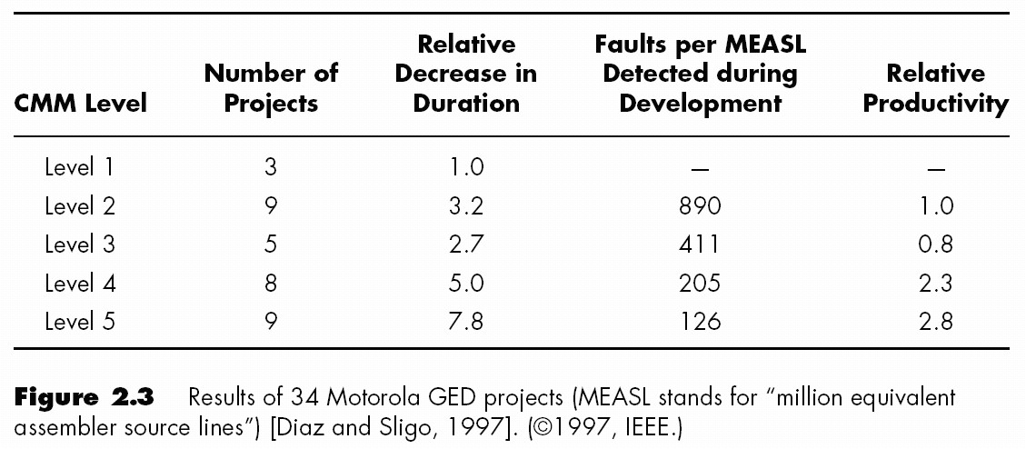
Process Improvement Data
Results of 34 Motorola projects reported in 1997
MEASL = faults per million equivalent assembler source lines
Motorola does not reveal productivity data
  Productivity is measured relative to that of a selected level-2 project
  No fault or productivity data available for level-1 projects (by definition)

Slide 85
Impact of System Development “Process” on Quality
CMM Project Statistics for a Project Resulting in 200,000 Lines of Code
Organization’s CMM Level | Project Duration (months) | Project Person-Months | Number of Defects Shipped | Median Cost ($ millions) | Lowest Cost ($ millions) | Highest Cost ($ millions)
1 | 30 | 600 | 61 | 5.5 | 1.8 | 100+
2 | 18.5 | 143 | 12 | 1.3 | .96 | 1.7
3 | 15 | 80 | 7 | .728 | .518 | .933
Clearly the higher the CMM level, the higher the improvement levels.
Notes:
Conversion Notes
This table was in the 5th edition text but not in the 5th edition PowerPoints.
Teaching Notes
This table dramatically illustrates the value of following a methodology. Note the drop in project duration, person-months, defects, and costs as a result of following a consistent methodology

Slide 86
Costs and Benefits of Software Process Improvement
There is interplay between
  Software engineering standards organizations, and
  Software process improvement initiatives
ISO/IEC 12207 (1995) is a full life-cycle software standard
In 1998, the U.S. version (IEEE/EIA 12207) was published that incorporated ideas from CMM
ISO 9000-3 now incorporates part of ISO/IEC 12207

