Slide 1
CHAPTER 6
Testing
Professor: Oberta A. Slotterbeck (Obie)
Computer Science Department
Hiram College
obie@hiram.edu

Slide 2
Overview
Quality issues
Non-execution-based testing
Execution-based testing
What should be tested?
Testing versus correctness proofs
Who should perform execution-based testing?
When testing stops

Slide 3
Testing
There are two basic types of testing
  Execution-based testing
    Often called black box testing - i.e. the testers don't look at the code.
  Non-execution-based testing
    Often called white box testing - i.e. the testers look at the code.

Slide 4
Testing (contd)
“V & V”
  Verification
    Determine if the workflow was completed correctly as spcified.
  Validation
    Determine if the product as a whole satisfies its requirements
Warning
  The term “verify” is also used for all non-execution-based testing

Slide 5
6.1 Software Quality
Not “excellence”
The extent to which software satisfies its specifications
Every software professional is responsible for ensuring that his or her work is correct
  Quality must be built in from the beginning

Slide 6
6.1.1 Software Quality Assurance
The members of the SQA group must ensure that the developers are doing high-quality work
  At the end of each workflow
  When the product is complete
In addition, quality assurance must be applied to
  The process itself
    Example: Standards

Slide 7
6.1.2 Managerial Independence
There must be managerial independence between
  The development group
  The SQA group
Neither group should have power over the other

Slide 8
Managerial Independence (contd)
More senior management must decide whether to
  Deliver the product on time but with faults, or
  Test further and deliver the product late
The decision must take into account the interests of the client and the development organization

Slide 9
6.2 Non-Execution-Based Testing
Underlying principles
  We should not review our own work
  Group synergy

Slide 10
6.2.1 Walkthroughs
A walkthrough team consists of from four to six members
It includes representatives of
  The team responsible for the current workflow
  The team responsible for the next workflow
  The SQA group
The walkthrough is preceded by preparation
  Lists of items
    Items not understood
    Items that appear to be incorrect

Slide 11
6.2.2 Managing Walkthroughs
The walkthrough team is chaired by the SQA representative
In a walkthrough we detect faults, not correct them
  A correction produced by a committee is likely to be of low quality
  The cost of a committee correction is too high
  Not all items flagged are actually incorrect
  A walkthrough should not last longer than 2 hours
  There is no time to correct faults as well

Slide 12
Managing Walkthroughs (contd)
A walkthrough must be document-driven, rather than participant-driven
Verbalization leads to fault finding
A walkthrough should never be used for performance appraisal

Slide 13
6.2.3 Inspections
An inspection has five formal steps
  Overview
  Preparation, aided by statistics of fault types
  Inspection
  Rework
  Follow-up

Slide 14
Inspections (contd)
An inspection team has four members
  Moderator
  A member of the team performing the current workflow
  A member of the team performing the next workflow
  A member of the SQA group
Special roles are played by the
  Moderator
  Reader
  Recorder

Slide 15
Fault Statistics
Faults are recorded by severity
  Example:
    Major or minor
Faults are recorded by fault type
  Examples of design faults:
    Not all specification items have been addressed
    Actual and formal arguments do not correspond

Slide 16
Fault Statistics (contd)
For a given workflow, we compare current fault rates with those of previous products
We take action if there are a disproportionate number of faults in an artifact
  Redesigning from scratch is a good alternative
We carry forward fault statistics to the next workflow
  We may not detect all faults of a particular type in the current inspection

Slide 17
Statistics on Inspections
IBM inspections showed up
  82% of all detected faults (1976)
  70% of all detected faults (1978)
  93% of all detected faults (1986)
Switching system
  90% decrease in the cost of detecting faults (1986)
JPL
  Four major faults, 14 minor faults per 2 hours (1990)
  Savings of $25,000 per inspection
  The number of faults decreased exponentially by phase (1992)

Slide 18
Statistics on Inspections (contd)
Warning
Fault statistics should never be used for performance appraisal
  “Killing the goose that lays the golden eggs”

Slide 19
6.2.4 Comparison of Inspections and Walkthroughs
Walkthrough
  Two-step, informal process
    Preparation
    Analysis
Inspection
  Five-step, formal process
    Overview
    Preparation
    Inspection
    Rework
    Follow-up

Slide 20
6.2.5 Strengths and Weaknesses of Reviews
Reviews can be effective
  Faults are detected early in the process
Reviews are less effective if the process is inadequate
  Large-scale software should consist of smaller, largely independent pieces
  The documentation of the previous workflows has to be complete and available online

Slide 21
6.2.6 Metrics for Inspections
Inspection rate (e.g., design pages inspected per hour)
Fault density (e.g., faults per KLOC inspected)
Fault detection rate (e.g., faults detected per hour)
Fault detection efficiency (e.g., number of major, minor faults detected per hour)

Slide 22
Metrics for Inspections (contd)
Does a 50% increase in the fault detection rate mean that
  Quality has decreased? Or
  The inspection process is more efficient?

Slide 23
6.3 Execution-Based Testing
Organizations spend up to 50% of their software budget on testing
  But delivered software is frequently unreliable
Dijkstra (1972)
  “Program testing can be a very effective way to show the presence of bugs, but it is hopelessly inadequate for showing their absence”

Slide 24
6.4 What Should Be Tested?
Definition of execution-based testing
  “The process of inferring certain behavioral properties of the product based, in part, on the results of executing the product in a known environment with selected inputs”
This definition has troubling implications

Slide 25
6.4 What Should Be Tested? (contd)
“Inference”
  We have a fault report, the source code, and — often — nothing else
“Known environment”
  We never can really know our environment
“Selected inputs”
  Sometimes we cannot provide the inputs we want
  Simulation is needed

Slide 26
6.4 What Should Be Tested? (contd)
We need to test correctness (of course), and also
  Utility
  Reliability
  Robustness, and
  Performance

Slide 27
6.4.1 Utility
The extent to which the product meets the user’s needs
  Examples:
    Ease of use
    Useful functions
    Cost effectiveness

Slide 28
6.4.2 Reliability
A measure of the frequency and criticality of failure
  Mean time between failures
  Mean time to repair
  Time (and cost) to repair the results of a failure

Slide 29
6.4.3 Robustness
A function of
  The range of operating conditions
  The possibility of unacceptable results with valid input
  The effect of invalid input

Slide 30
6.4.4 Performance
The extent to which space and time constraints are met
Real-time software is characterized by hard real-time constraints
If data are lost because the system is too slow
  There is no way to recover those data

Slide 31
6.4.5 Correctness
A product is correct if it satisfies its specifications

Slide 32
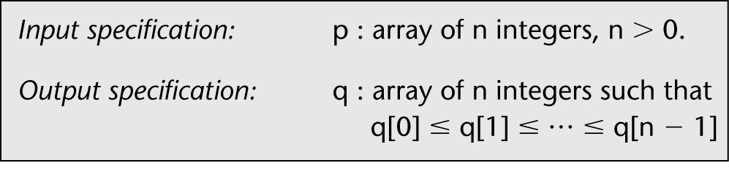
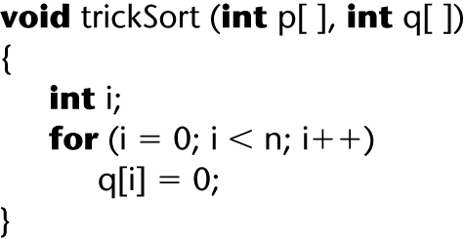
Correctness of specifications
Incorrect specification for a sort:
Function trickSort which satisfies this specification:
Figure 6.1
Figure 6.2

Slide 33
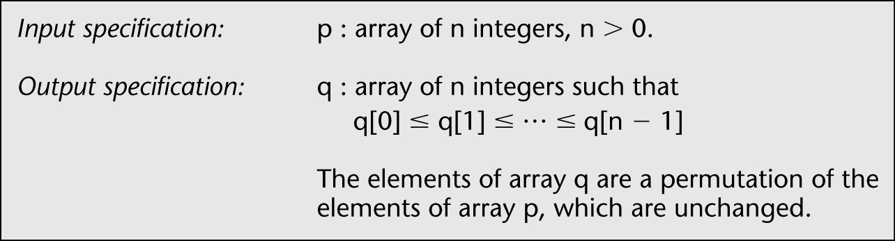
Correctness of specifications (contd)
Incorrect specification for a sort:
Corrected specification for the sort:
Figure 6.1 (again)
Figure 6.3

Slide 34
Correctness (contd)
Technically, correctness is
Not necessary
  Example: C++ compiler
Not sufficient
  Example: trickSort

Slide 35
6.5 Testing versus Correctness Proofs
A correctness proof is an alternative to execution-based testing

Slide 36
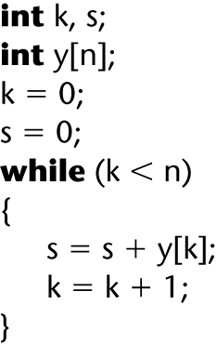
6.5.1 Example of a Correctness Proof
The code segment to be proven correct
Figure 6.4

Slide 37
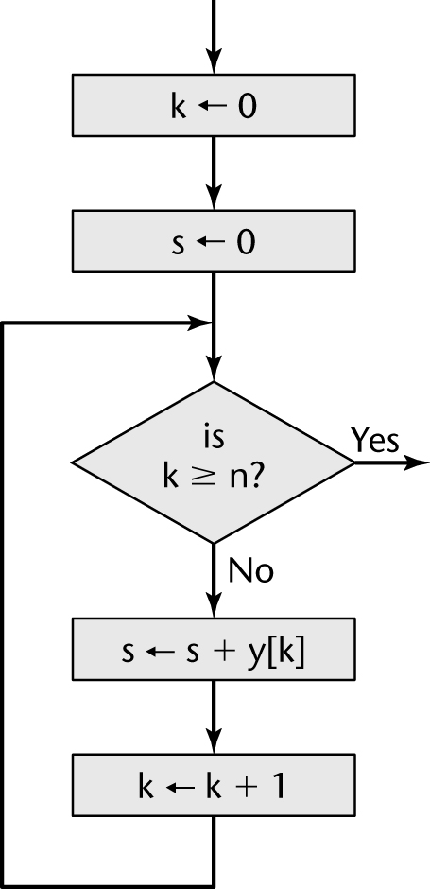
Example of a Correctness Proof (contd)
A flowchart equivalent of the code segment
Figure 6.5

Slide 38
Example of a Correctness Proof (contd)
Add
  Input specification - condition that holds before execution starts
  Output specification- condition that holds when execution reaches the terminal point
  Loop invariants - a mathematical expression that holds at a point D no matter how many times the loop is executed, 0, 1, 2, ...
  Assertions - (See next slide)

Slide 39
Assertions
Some languages support assertion checking.
At various points in the code, we insert something like
  assert (x > 0)
At that point in the execution, if x ≤ 0, the run terminates.
Java and Ada support it directly.
C and C++ have add on libraries that support it.

Slide 40
Assertions
At any point, the development team can turn off assertion checking.
At first, this seems like a good thing to do when it is believed the code is correct as assertion checking costs time and money.
However, read the case study in Box 6.3, pg 169.
  Bounds checking is a special case of assertion checking.
  As we saw in CPSC 352: Computer Security, hackers continually exploit buffer overflows which are not detected.

Slide 41
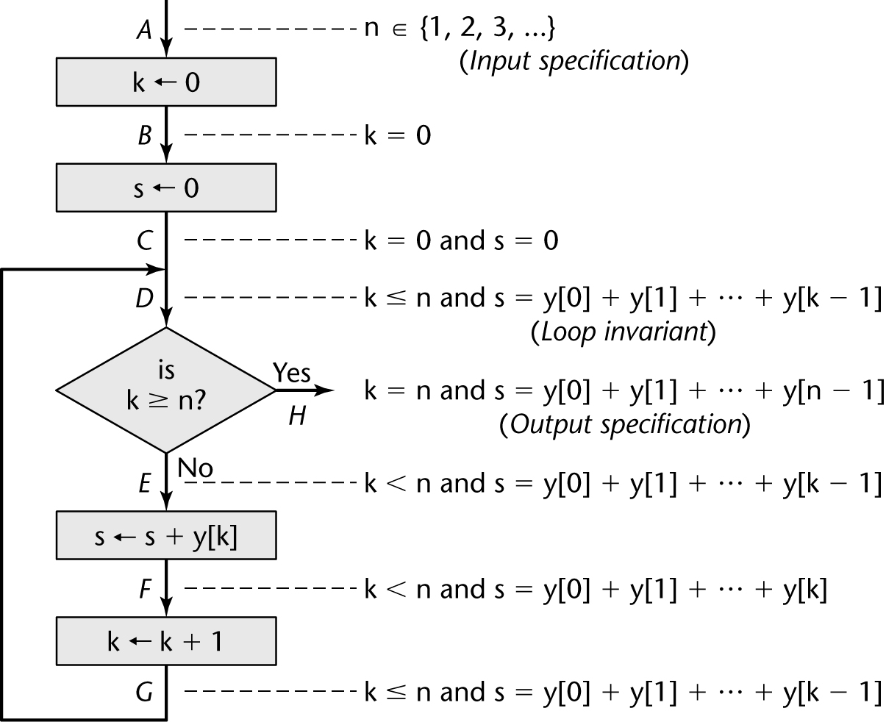
Example of a Correctness Proof (contd)
Figure 6.6

Slide 42
Quick Introduction to Proof by Induction
A property of integers (that is an axiom about integers) , allows us to prove statements that are thought to hold for all integers greater than some integer k0.
Induction: Suppose P[k] is a statement about integers that is to be shown true for P[k], 0 ≤ k ≤ n. If it can be shown that P[k0+1] is true if P[0] is true and P[k0+1] is true, then we can conclude P[k] is true for all integers k, 0 ≤ k ≤ n.
P[k0] is called the base case.
Consider the "ladder analogy" to see why this makes sense.

Slide 43
Example of a Correctness Proof (contd)
Note that an assertion is placed before and after each statement.
We need to prove that each of these assertions are correct.
The input specification is easy to check - variable n is a positive integer.
We might be tempted to just show for the output specification that s = Σ_{(i=0, n-1)}y[i]
But, you should always choose the strongest statement you can prove.
Try: k = n and s = Σ_{(i=0, n-1)}y[i]

Slide 44
Example of a Correctness Proof (contd)
We need to prove that if the input specification holds at point A (as the start), then the output specification will hold at point H (at the end).
Proof:
  First the assignment k <= 0 is executed . Control is now at point B where the assertion
    B: k=0
clearly holds.
(Note: we don't have to reassert the input specification about n being a positive integer as it holds throughout the proof.)
The second assignment statement (s <= 0) and the previous assertion, shows that the assertion at C is true, i.e.
C: k=0 and s=0

Slide 45
Example of a Correctness Proof (contd)
The next step is to assume the loop is entered and we need to consider the loop invariant which is a statement about integers:
As you can see by the proof on page 165, for this simple example, is still rather complicated (although if we took the time to walk through the proof, each step is quite obvious (with practice.
Moreover, nontrivial assertions have to be worded in what is called first-order or second-order predicate calculus.

Slide 46
Example of a Correctness Proof (contd)
By writing assertions with first or second order predicate calculus, automatic theorem provers can be used.
In addition, recent developments in this field require an understanding of temporal or other modal logics.
Correctness proving requires training in mathematical logic.
An automatic theorem prover takes the input and output specifications and the loop invariants and attempts to prove mathematically that the product meeting the input specifications will produce the output specification.

Slide 47
The previous reasons are why some software engineers feel correctness proving isn't effective.
But, realize it has been effectively used to prove life-critical software is correct.
There have been many products for which proof of correctness have been run.
Does this mean we don't have to test?

Slide 48
6.5.2 Correctness Proof Mini Case Study
Dijkstra (1972):
  “The programmer should let the program proof and program grow hand in hand”
“Naur text-processing problem” (1969)

Slide 49
Naur Text-Processing Problem
Given a text consisting of words separated by a blank or by newline characters, convert it to line-by-line form in accordance with the following rules:
Line breaks must be made only where the given text contains a blank or newline
Each line is filled as far as possible, as long as
No line will contain more than maxpos characters

Slide 50
Episode 1
Naur constructed a 25-line procedure
He informally proved its correctness

Slide 51
Episode 2
1970 — Reviewer in Computing Reviews
  Observed that for output: The first word of the first line is preceded by a blank unless the first word is exactly maxpos characters long
  Not a death-defining fault, but perhaps am undesirable output.

Slide 52
Episode 3
1971 — London finds 3 more faults
Including:
  The procedure does not terminate unless a word longer than maxpos characters is encountered

Slide 53
Episode 4
1975 — Goodenough and Gerhart find three further faults
Including:
  The last word will not be output unless it is followed by a blank or newline

Slide 54
Correctness Proof Mini Case Study (contd)
Lesson:
Even if a product has been proven correct, it must still be tested

Slide 55
Correctness Proofs and Software Engineering

Slide 56
Three Myths of Correctness Proving
Software engineers do not have enough mathematics for proofs
  Most computer science majors either know or can learn the mathematics needed for proofs
Proving is too expensive to be practical
  Economic viability is determined from cost–benefit analysis
Proving is too hard
  Many nontrivial products have been successfully proven
  Tools like theorem provers can assist us

Slide 57
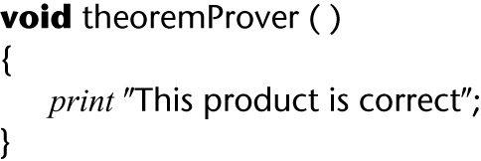
Difficulties with Correctness Proving
Can we trust a theorem prover ?
Figure 6.7

Slide 58
Difficulties with Correctness Proving (contd)
How do we find input–output specifications, loop invariants?
What if the specifications are wrong?
We can never be sure that specifications or a verification system are correct

Slide 59
Correctness Proofs and Software Engineering (contd)
Correctness proofs are a vital software engineering tool, where appropriate:
  When human lives are at stake
  When indicated by cost–benefit analysis
  When the risk of not proving is too great
Also, informal proofs can improve the quality of the product
  Use the assert statement

Slide 60
6.6 Who Should Perform Execution-Based Testing?
Programming is constructive
Testing is destructive
  A successful test finds a fault
So, programmers should not test their own code artifacts

Slide 61
Who Should Perform Execution-Based Testing? (contd)
Solution:
  The programmer does informal testing
  The SQA group then does systematic testing
  The programmer debugs the module
All test cases must be
  Planned beforehand, including the expected output, and
  Retained afterwards

Slide 62
6.7 When Testing Stops
Only when the product has been irrevocably discarded

