Slide 1
CHAPTER 8
REUSABILITY AND PORTABILITY

Slide 2
Overview
Reuse concepts
Impediments to reuse
Reuse case studies
Objects and reuse
Reuse during design and implementation
Reuse and postdelivery maintenance
Portability
Why portability?
Techniques for achieving portability

Slide 3
8.1 Reuse Concepts
Reuse is the use of components of one product to facilitate the development of a different product with different functionality

Slide 4
The Two Types of Reuse
Opportunistic (accidental) reuse
  First, the product is built
  Then, parts are put into the part database for reuse
Systematic (deliberate) reuse
  First, reusable parts are constructed
  Then, products are built using these parts

Slide 5
Why Reuse?
To get products to the market faster
  There is no need to design, implement, test, and document a reused component
On average, only 15% of new code serves an original purpose
  In principle, 85% could be standardized and reused
  In practice, reuse rates of no more than 40% are achieved
Why do so few organizations employ reuse?

Slide 6
8.2 Impediments to Reuse
Not invented here (NIH) syndrome
Concerns about faults in potentially reusable routines
Storage–retrieval issues
Memory of even the existence of the software is lost
The software has not been developed properly so documentation may be missing.

Slide 7
Impediments to Reuse (contd)
Cost of reuse
  The cost of making an item reusable
  The cost of reusing the item
  The cost of defining and implementing a reuse process
Legal issues (contract software only)
Lack of source code for COTS components
The first four impediments (on the last slide) can be overcome

Slide 8
8.3 Reuse Case Studies
The first case study took place between 1976 and 1982
Reuse mechanism used for COBOL design
  Identical to what we use today for object-oriented application frameworks

Slide 9
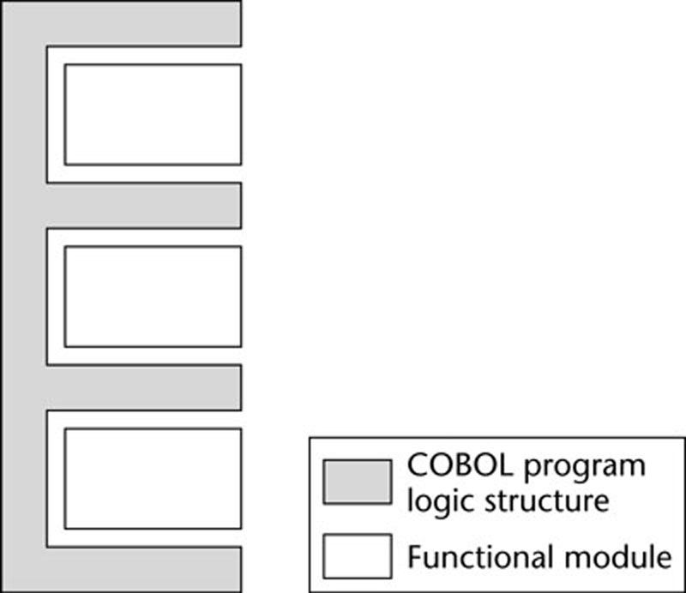
8.3.1 Raytheon Missile Systems Division
Data-processing software
Systematic reuse of
  Designs
    6 code templates
  COBOL code
    3200 reusable modules
Figure 8.1

Slide 10
Raytheon Missile Systems Division (contd)
Reuse rate of 60% was obtained
Frameworks (“COBOL program logic structures”) were reused
Paragraphs were filled in by functional modules
Design and coding were quicker

Slide 11
Raytheon Missile Systems Division (contd)
By 1983, there was a 50% increase in productivity
  Logic structures had been reused over 5500 times
  About 60% of code consisted of functional modules
Raytheon hoped that maintenance costs would be reduced 60 to 80%
Unfortunately, the division was closed before the data could be obtained

Slide 12
8.3.2 European Space Agency
Ariane 5 rocket blew up 37 seconds after lift-off in 1996
  Cost: $500 million
Reason: An attempt was made to convert a 64-bit integer into a 16-bit unsigned integer
  The Ada exception handler was omitted
The on-board computers crashed, and so did the rocket

Slide 13
The Conversion was Unnecessary
Computations on the inertial reference system can stop 9 seconds before lift-off
But if there is a subsequent hold in the countdown, it takes several hours to reset the inertial reference system
Computations therefore continue 50 seconds into the flight

Slide 14
The Cause of the Problem
Ten years before, it was mathematically proven that overflow was impossible — on the Ariane 4
Because of performance constraints, conversions that could not lead to overflow were left unprotected
The software was used, unchanged and untested, on the Ariane 5
  However, the assumptions for the Ariane 4 did not hold for the Ariane 5

Slide 15
European Space Agency (contd)
Lesson:
  Software developed in one context needs to be retested when integrated into another context
  This applies to COTS software as well as code developed in house.
  Never assume someone else has tested as well as you can!

Slide 16
8.4 Objects and Reuse
Classical composite-structured design (C/SD) claimed that
  An ideal module has functional cohesion
  It was thought to be the best choice for a module.
But, there are problems
  The data on which the module operates.
  Such modules are not self-contained or independent as the data can be changed elsewhere before reaching the module.

Slide 17
8.4 Objects and Reuse
This means we cannot reuse a module unless the data are identical,
If the data is different, the module has to be changed and it technically is not being reused.
Claim of CS/D:
  The next best type of module has informational cohesion
  This is an object (an instance of a class)

Slide 18
Objects and Reuse (contd)
An object comprises both data and action
This promotes reuse

Slide 19
8.5 Reuse During Design and Implementation
Various types of design reuse can be achieved
  Some can be carried forward into implementation

Slide 20
8.5.1 Design Reuse
Opportunistic reuse of designs is common when an organization develops software in only one application domain

Slide 21

Library or Toolkit
A set of reusable routines
Examples:
  Scientific software
  GUI class library or toolkit
The user is responsible for the control logic (white in figure)
Figure 8.2(a)

Slide 22

8.5.2 Application Framework
A framework incorporates the control logic of the design
The user inserts application-specific routines in the “hot spots” (white in figure)
Figure 8.2(b)

Slide 23
8.5.2 Application Framework
Faster than reusing a toolkit
  More of the design is reused
  The logic is usually harder to design than the operations
Example:
  IBM’s Websphere
    Formerly: e-Components, San Francisco
    Utilizes Enterprise JavaBeans (classes that provide services for clients distributed throughout a network)

Slide 24
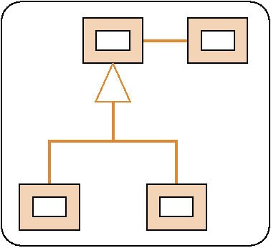
8.5.3 Design Patterns
A pattern is a solution to a general design problem
  In the form of a set of interacting classes
The classes need to be customized (white in figure)
Figure 8.2(c)

Slide 25
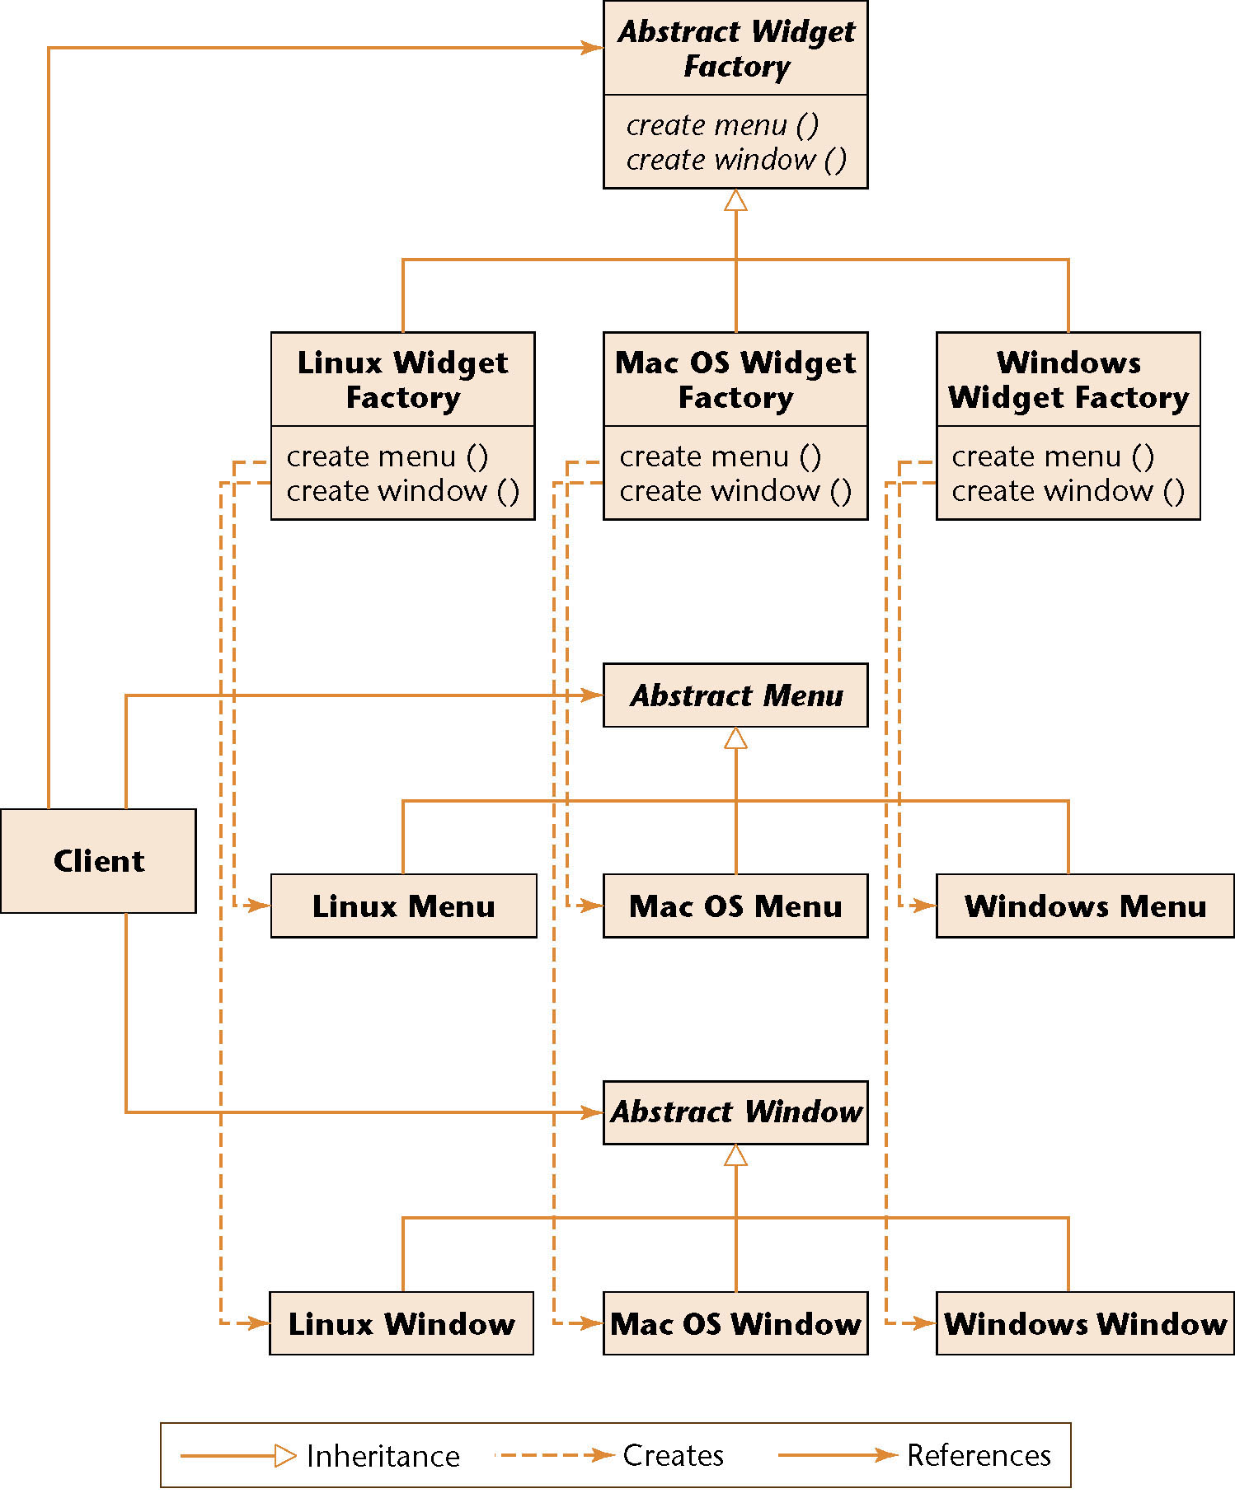
Widget Generator
We want a program that will generate widgets that can run under different operating systems
Figure 8.3

Slide 26
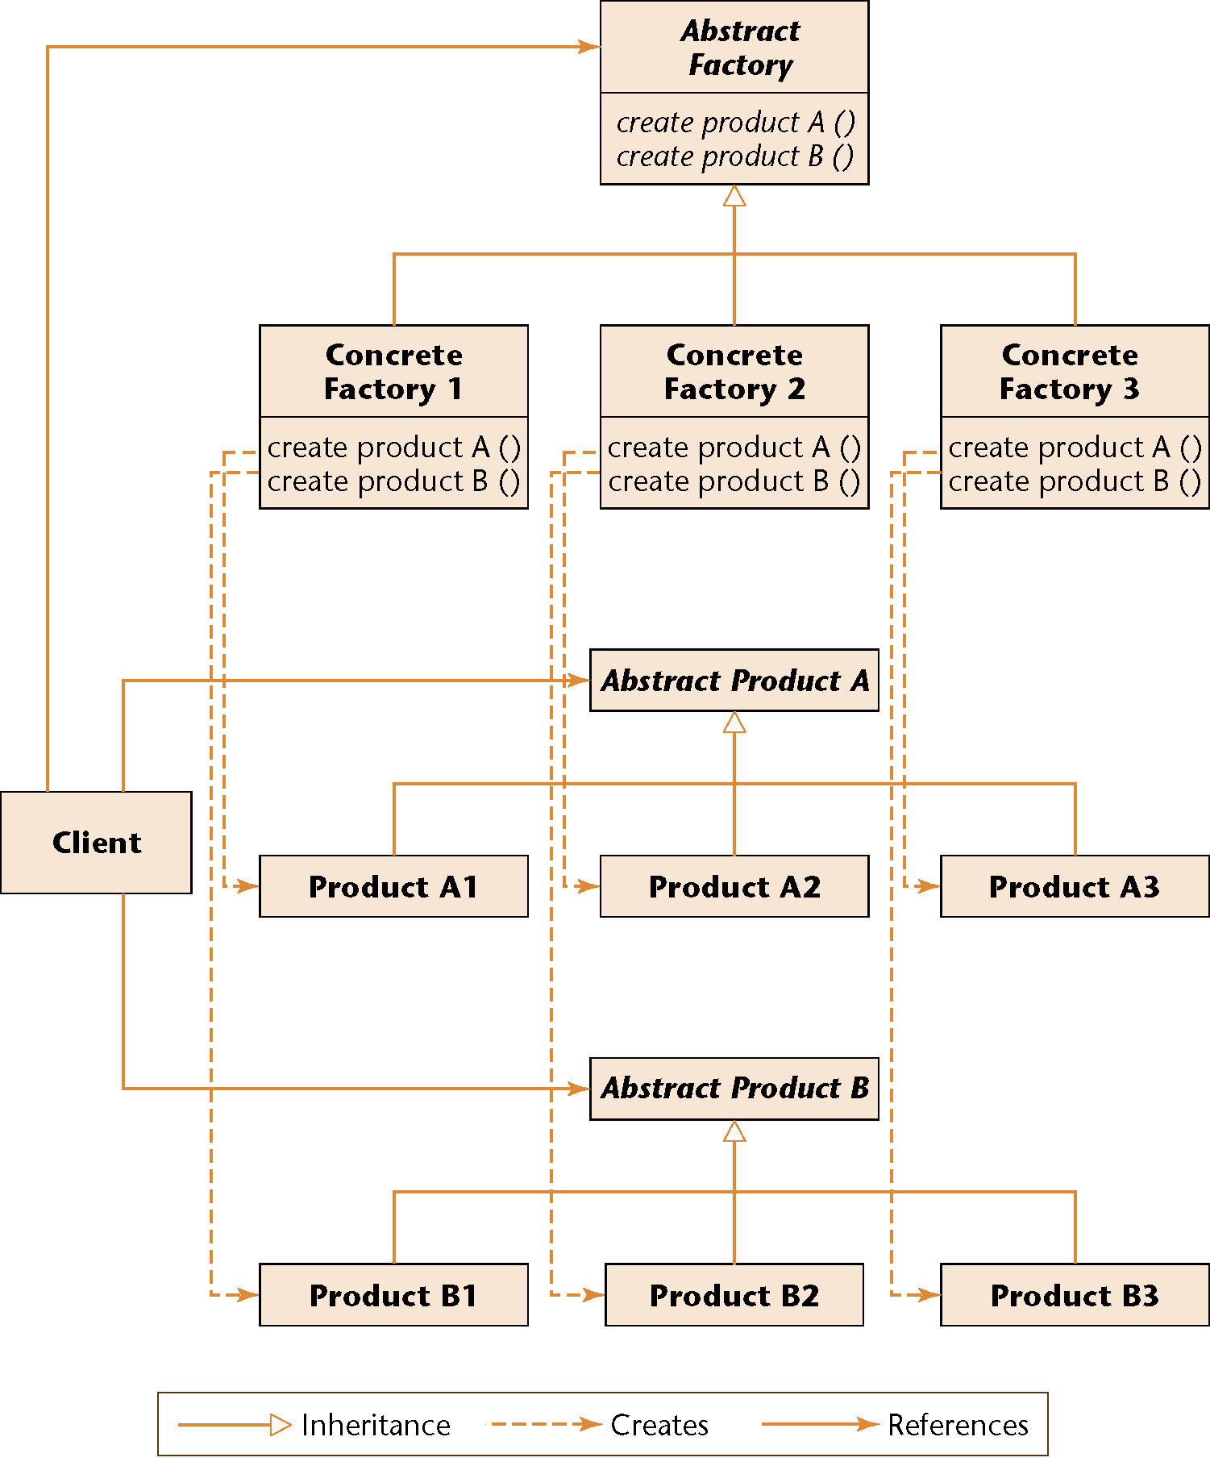
Abstract Factory Pattern
Abstract classes and abstract (virtual) methods
The interfaces between the client and the generator are abstract
The application program is uncoupled from the specific operating system
Figure 8.4

Slide 27
8.5.4 Software Architecture
Encompasses a wide variety of design issues, including:
  Organization in terms of components
  How those components interact

Slide 28
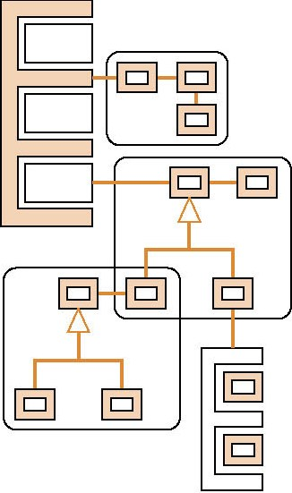
Software Architecture (contd)
An architecture consisting of
  A toolkit
  A framework, and
  Three design patterns
Figure 8.2(d)

Slide 29
Reuse of Software Architecture
Architecture reuse can lead to large-scale reuse
One mechanism:
  Software product lines
Case study:
  Firmware for Hewlett-Packard printers (1995-98)
    Person–hours to develop firmware decreased by a factor of 4
    Time to develop firmware decreased by a factor of 3
    Reuse increased to over 70% of components

Slide 30
8.6 Reuse and Maintenance
Reuse impacts maintenance more than development
Assumptions
  30% of entire product reused unchanged
  10% reused changed

Slide 31
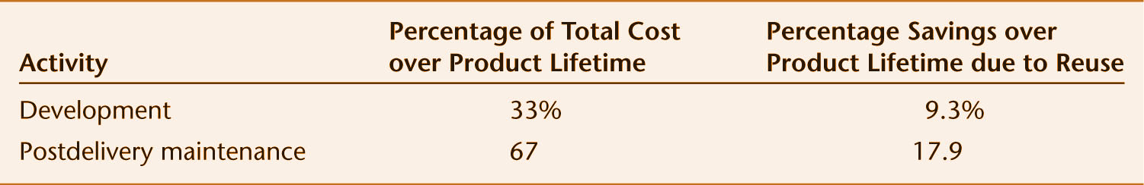
Results
Figure 8.5
Savings during maintenance are nearly 18%
Savings during development are about 9.3%

Slide 32
8.7 Portability
Product P
  Compiled by compiler C₁, then runs on machine M₁ under operating system O₁
Need product P', functionally equivalent to P
  Compiled by compiler C₂, then runs on machine M₂ under operating system O₂
P is portable if it is cheaper to convert P into P' than to write P' from scratch

Slide 33
8.7.1 Hardware Incompatibilities
Storage media incompatibilities
  Example: Zip vs. DAT
Character code incompatibilities
  Example: EBCDIC vs. ASCII
Word size

Slide 34
Hardware Incompatibilities (contd)
IBM System/360-370 series
  The most successful line of computers ever
  Full upward compatibility

Slide 35
8.7.2 Operating System Incompatibilities
Job control languages (JCL) can be vastly different
  Syntactic differences
Virtual memory vs. overlays

Slide 36
8.7.3 Numerical Software Incompatibilities
Differences in word size can affect accuracy
No problems with
  Java
  Ada

Slide 37
8.7.4 Compiler Incompatibilities
FORTRAN standard is not enforced
COBOL standard permits subsets, supersets
ANSI C standard (1989)
  Most compilers use the pcc front end
  The lint processor aids portability
ANSI C++ standard (1998)

Slide 38
Language Incompatibilities (contd)
Ada standard — the only successful language standard
  First enforced legally (via trademarking)
  Then by economic forces
Java is still evolving
  Sun copyrighted the name to ensure standardization

Slide 39
8.8 Why Portability?
Is there any point in porting software?
  Incompatibilities
  One-off software
  Selling company-specific software may give a competitor a huge advantage

Slide 40
Why Portability? (contd)
On the contrary, portability is essential
  Good software lasts 15 years or more
  Hardware is changed every 4 years
Upwardly compatible hardware works
  But it may not be cost effective
Portability can lead to increased profits
  Multiple copy software
  Documentation (especially manuals) must also be portable

Slide 41
8.9 Techniques for Achieving Portability
Obvious technique
  Use standard constructs of a popular high-level language
But how is a portable operating system to be written?

Slide 42
8.9.1 Portable System Software
Isolate implementation-dependent pieces
  Example: UNIX kernel, device-drivers
Utilize levels of abstraction
  Example: Graphical display routines

Slide 43
8.9.2 Portable Application Software
Use a popular programming language
Use a popular operating system
Adhere strictly to language standards
Avoid numerical incompatibilities
Document meticulously

Slide 44
8.9.3 Portable Data
File formats are often operating system-dependent
Porting structured data
  Construct a sequential (unstructured) file and port it
  Reconstruct the structured file on the target machine
  This may be nontrivial for complex database models

Slide 45
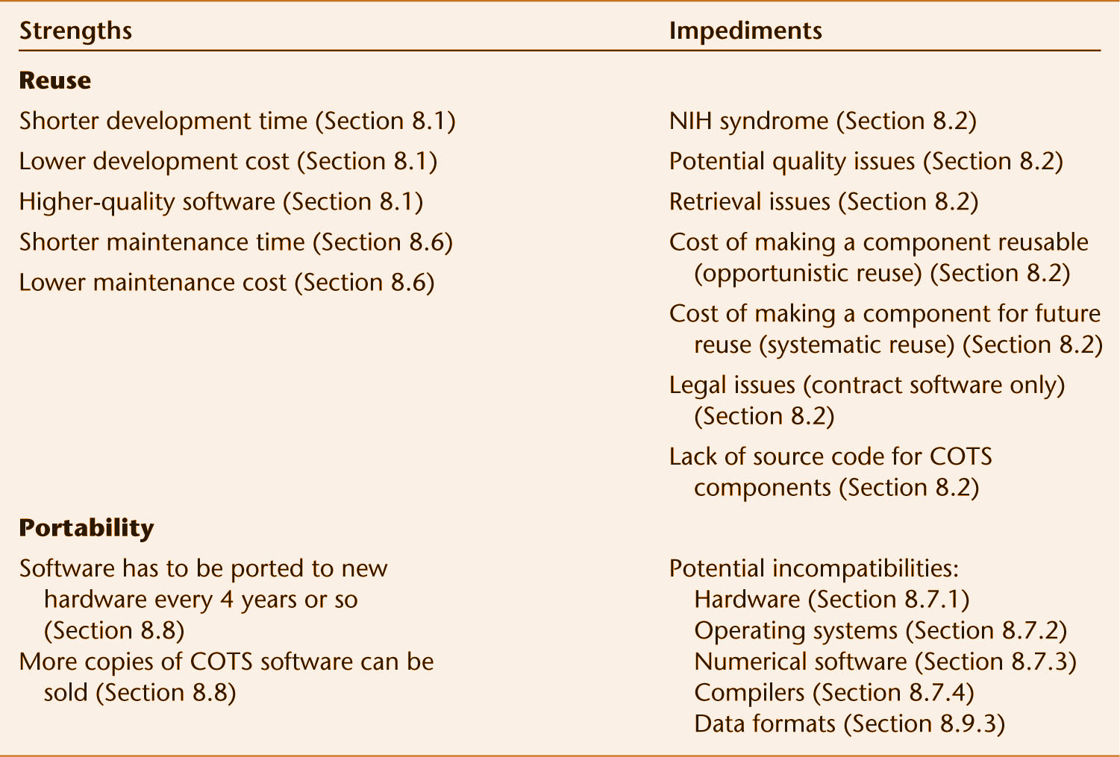
Strengths of and Impediments to Reuse and Portability
Figure 8.6

