Slide 1
CHAPTER 9
PLANNING AND ESTIMATING

Slide 2
Planning and Estimating
Before starting to build software, it is essential to plan the entire development effort in detail
Planning continues during development and then postdelivery maintenance
  Initial planning is not enough
  Planning must proceed throughout the project
  The earliest possible time that detailed planning can take place is after the specifications are complete

Slide 3
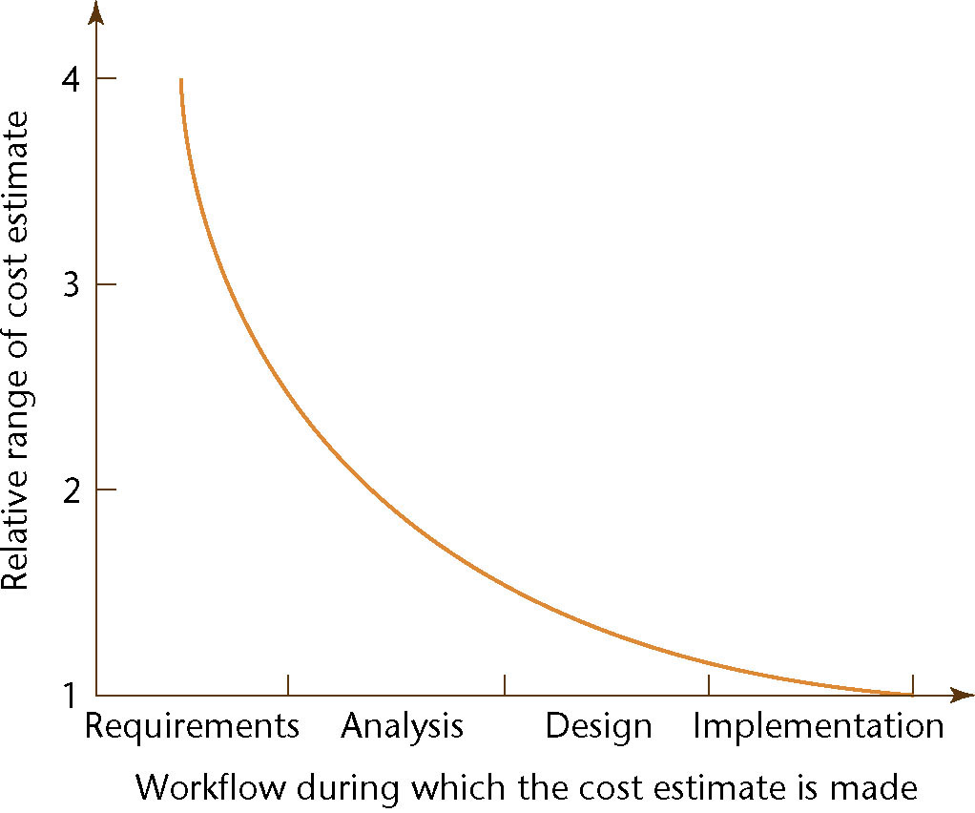
9.1 Planning and the Software Process
Figure 9.1
The accuracy of estimation increases as the process proceeds

Slide 4
Planning and the Software Process
Example
  Cost estimate of $1 million during the requirements workflow
    Likely actual cost is in the range ($0.25M, $4M)
  Cost estimate of $1 million at the end of the requirements workflow
    Likely actual cost is in the range ($0.5M, $2M)
  Cost estimate of $1 million at the end of the analysis workflow (earliest appropriate time)
    Likely actual cost is in the range ($0.67M, $1.5M)

Slide 5
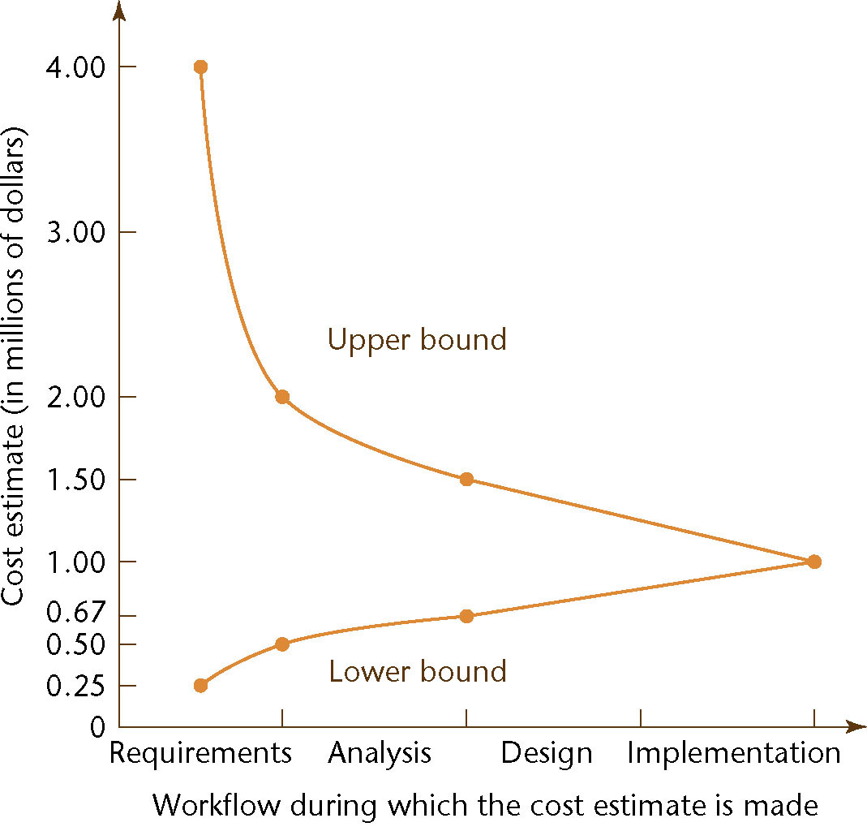
Planning and the Software Process (contd)
These four points are shown in the cone of uncertainty
Figure 9.2

Slide 6
Planning and the Software Process
This model on which the curve in the last slide is old (1976)
  Estimating techniques have improved
  But the shape of the curve is likely to be similar

Slide 7
9.2 Estimating Duration and Cost
Accurate duration estimation is critical
Accurate cost estimation is critical
  Internal, external costs
There are too many variables for accurate estimate of cost or duration

Slide 8
Human Factors
Sackman (1968) measured differences of up to 28 to 1 between pairs of programmers
  He compared matched pairs of programmers with respect to
    Product size
    Product execution time
    Development time
    Coding time
    Debugging time
Critical staff members may resign during the project

Slide 9
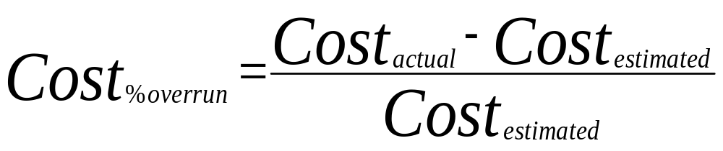
What is Cost Overrun?
Percent cost overrun can be calculated using:

Slide 10
Facts?
1984, 1988, 1992 cost average overruns were 33-34%^{1.}
1994 cost average overruns were 180%^{2.}
2002 cost average overruns were 43%^{2.}
Jenkins, Phan, and Bergeron (academic studies)
Standish Group CHAOS studies (questioned by academic
researchers)

Slide 11
Costs
Tangible – Easily measured in dollars (e.g. salaries, hardware, software etc.)
Intangible – Difficult to measure ( goodwill, prestige, learning, etc.)
Direct – directly related to the cost of the project
Indirect – examples include electricity, office space, furniture, etc.
Sunk costs – money that has been spent in the past

Slide 12
9.2.1 Metrics for the Size of a Product
Lines of code (LOC, KDSI, KLOC)
FFP
Function Points
Case Points
COCOMO - various models

Slide 13
Lines of Code (LOC)
Alternate metric
  Thousand delivered source instructions (KDSI)
Source code is only a small part of the total software effort
Different languages lead to different lengths of code
LOC is not defined for nonprocedural languages (like LISP, Prolog)

Slide 14
Lines of Code (contd)
It is not clear how to count lines of code
  Executable lines of code?
  Data definitions?
  Comments?
  JCL statements?
  Changed/deleted lines?
Not everything written is delivered to the client
A report, screen, or GUI generator can generate thousands of lines of code in minutes

Slide 15
Lines of Code (contd)
LOC is accurately known only when the product finished
Estimation based on LOC is therefore doubly dangerous
  But, to start the estimation process, LOC in the finished product must be estimated
  The LOC estimate is then used to estimate the cost of the product — an uncertain input to an uncertain cost estimator

Slide 16
Metrics for the Size of a Product (contd)
Metrics based on measurable quantities that can be determined early in the software life cycle
  FFP -File, Flow, Process
  Function points
  Case points

Slide 17
FFP Metric
For cost estimation of medium-scale data processing products
The three basic structural elements of data processing products are:
  Files
  Flows
  Processes

Slide 18
FFP Metric (contd)
Given the number of files (Fi), flows (Fl), and processes (Pr)
  The size (S), cost (C) are given by
  S = Fi + Fl + Pr
  C = b × S
The constant b (efficiency or productivity) varies from organization to organization and is updated as new projects are completed by an organization.

Slide 19
FFP Metric (contd)
The validity and reliability of the FFP metric was demonstrated using a purposive sample
  However, the metric was never extended to include systems that included databases

Slide 20
Function Points
Based on the number of inputs (Inp), outputs (Out), inquiries (Inq), master files (Maf), interfaces (Inf)
For any product, the size in “function points” is given by
    FP = 4 × Inp + 5 × Out + 4 × Inq + 10 × Maf + 7 × Inf
This is an oversimplification of a 3-step process

Slide 21
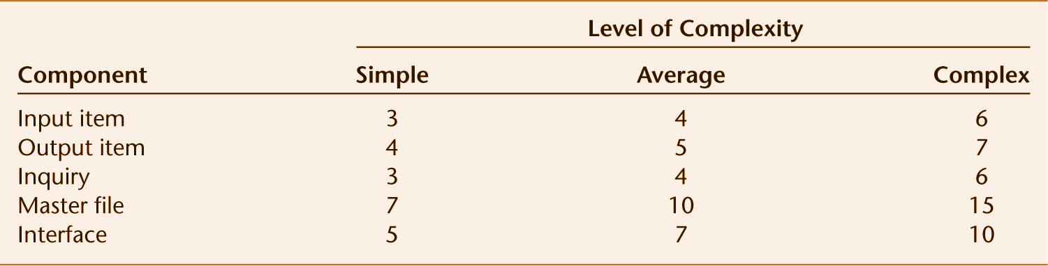
Function Points (contd)
Step 1. Classify each component of the product (Inp, Out, Inq, Maf, Inf) as simple, average, or complex
  Assign the appropriate number of function points
  The sum gives UFP (unadjusted function points)
Figure 9.3

Slide 22
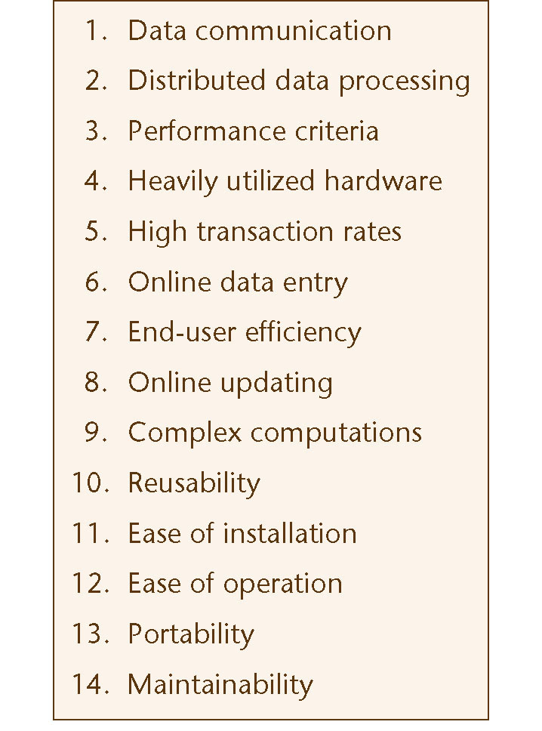
Function Points (contd)
Step 2. Compute the technical complexity factor (TCF)
  Assign a value from 0 (“not present”) to 5 (“strong influence throughout”) to each of 14 factors such as transaction rates, portability
Figure 9.4

Slide 23
Function Points (contd)
Add the 14 numbers
  This gives the total degree of influence (DI)
    TCF = 0.65 + 0.01 × DI
The technical complexity factor (TCF) lies between 0.65 and 1.35

Slide 24
Function Points (contd)
Step 3. The number of function points (FP) is then given by
    FP = UFP × TCF

Slide 25
Analysis of Function Points
Function points are usually better than KDSI — but there are some problems
“Errors in excess of 800% counting KDSI, but only 200% in counting function points” [Jones, 1987]

Slide 26
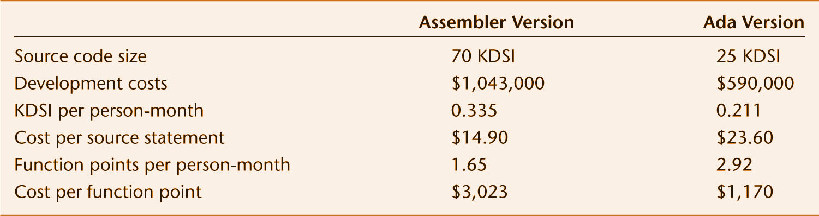
Analysis of Function Points
We obtain nonsensical results from metrics
  KDSI per person month and
  Cost per source statement
Cost per function point is meaningful
Figure 9.5

Slide 27
Analysis of Function Points
Like FFP, maintenance can be inaccurately measured
It is possible to make major changes without changing
  The number of files, flows, and processes; or
  The number of inputs, outputs, inquiries, master files, and interfaces
In theory, it is possible to change every line of code with changing the number of lines of code

Slide 28
Mark II Function Points
This metric was put forward to compute UFP more accurately
We decompose software into component transactions, each consisting of input, process, and output
Mark II function points are widely used all over the world

Slide 29
Function Points
Use the requirements to count the following, and to judge the complexity of their usage
Five basic components:
  input items
  output items (e.g. reports)
  internal data structures
  external files and interfaces
  inquiries

Slide 30
Function Points
Rate the components on their complexity as low, medium, or high
  So don’t necessarily count each field on an input screen, for example; count it as one input item, rated as “medium” or “high” complexity
FP has a formula using weights for each rating; multiply times count, add it up – yields unadjusted function points

Slide 31
Function Points
Now rate the project on 14 system characteristics
  essentially, these are factors that increase or decrease the estimate of development time
  each is again rated by complexity
A regression formula is used to produce Adjusted Function Points

Slide 32
General System Characteristics
Data Communications
Distributed Data Processing
Performance
Heavily Used Configuration
Transaction Rate
Online Data Entry
End User Efficiency
Online Update
Complex Processing
Reusability
Installation Ease
Operational Ease
Multiple Sites
Facilitate Change

Slide 33
Function Points
Adjusted Function Points are turned into a lines of code estimate by choosing an implementation language
  each language has an associated multiplier
  “hard” languages, like assembly or C, have larger multipliers; “easy” languages, like VB or SQL, have smaller ones
As with all algorithmic answers, consider doing low, medium, and high estimates
  one way to average them is (low + 4 medium + high)/ 6

Slide 34
Use Case Points
Similar to function points in that
  Each use case carries some weighted value based on perceived complexity
  Adjustments are made based on overall system characteristics
  Raw use case points can then be turned into something else, e.g. effort estimation

Slide 35
Use Case Points
From Karner:
  Weight each actor as simple, average, complex = 1, 2, 3; compute actor sum
    For example: A simple actor represents another system with a defined application programming interface, API, an average actor is another system interacting through a protocol such as TCP/IP, and the complex actor may be a person interacting through a GUI or a web page.
  Weight each regular use case as simple (3 or less scenarios), average (4 – 7 scenarios), or complex (8 or more scenarios) = 5, 10, 15; compute use case sum

Slide 36
Use Case Points
From Karner:
  Rate each technical factor from 0 to 5*, multiply by weight (see later slide), multiply by 0.1, add 0.6
  Rate each environmental factor form 0 to 5*, multiply by weight (see slide below), multiply by -0.3, add 1.4
  Unadjusted use case points = (actor sum + use case sum) * (technical factors) * (environmental factors)
  *0 – no influence, 3 - average, 5 - strong influence throughout

Slide 37
Technical Factors - Weights
distributed system 2
response or throughput performance objectives 1
end-user (online) efficiency 1
complex internal processing 1
code must be reusable 1
code must be easy to install 0.5
code must be easy to use 0.5
code must be portable 2
code must be easy to change 1
concurrency 1
special security features 1
provide direct access for third parties 1
special user training facilities are required 1

Slide 38
Environmental Factors - Weights
familiarity with rational unified process 1.5
application experience 0.5
OO experience 1
lead analyst capability 0.5
motivation 1
stable requirements 2
part-time workers -1
difficult programming language -2

Slide 39
Use Case Points
To calculate time estimate:
  Count the number of environmental factor that are rated below 3, and the number of negatively weighted environmental factors that are rated above 3
  If the count is 0, 1, or 2, use 20 man-hours per Unadjusted Use Case Points (UUCP)
  If the count is 3 or 4, use 28 man-hours per UUCP
  Otherwise, the project is at a high risk for failure, so try to improve the environment

Slide 40
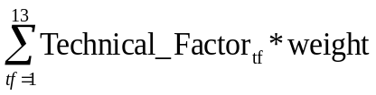
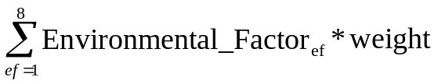
Putting it Together
Unadjusted actor weights (UAW)= (simple actors)+2( average actors)+3(complex actors)
Unadjusted use case weights (UUCW)=(simple cases)+2(average cases)+3(complex cases)
Unadjusted Use Case Points (UUCP)=UAW+UUCW
Technical Factor (TF)=
Technical Complexity Factor (TCF)=0.6+(0.01*Technical Factor)
Environmental Factor (EF)=
Adjusted use case points (UPC)=UUCP*TCF*EF
Karner proposed multiplying the UPC by 20 hours to obtain a project estimate. Experience has shown that the 15-30 hours is more appropriate.

Slide 41
9.2.2 Other Techniques of Cost Estimation
Expert judgment by analogy
Delphi method
Bottom-up approach
Algorithmic cost estimation models

Slide 42
Expert Judgment by Analogy
Experts compare the target product to completed products
  Guesses can lead to hopelessly incorrect cost estimates
  Experts may recollect completed products inaccurately
  Human experts have biases
  However, the results of estimation by a broad group of experts may be accurate
The Delphi technique is sometimes needed to achieve consensus

Slide 43
Delphi Technique
The Delphi technique was developed by the RAND Corporation in the late 1960's as a forecasting methodology.
Later, the U.S. government enhanced it as a group decision-making tool with the results of Project HINDSIGHT, which established a factual basis for the workability of Delphi.
That project produced a tool in which a group of experts could come to some consensus of opinion when the decisive factors were subjective, and not knowledge-based.

Slide 44
Delphi
Delphi is particularly appropriate when decision-making is required in a political or emotional environment, or when the decisions affect strong factions with opposing preferences.
The tool works formally or informally, in large or small contexts, and reaps the benefits of group decision making while insulating the process from the limitations of group decision-making; e.g., over-dominant group members, political lobbying, or "bandwagonism".
See "Prioritization Process Using Delphi Technique" by Alan Cline.
The following slides outline the process from the above paper. See the paper for more detail.

Slide 45
Delphi Prioritization Procedure
Pick a facilitation leader.
Select a panel of experts.
The panel identifies initial criteria for the project
Each panelist individually and anonymously ranks the criteria: 1 (very important), 2 (somewhat important), or 3 (not important).
For each item in the list, calculate the mean and deviation.
  Remove all items with a mean greater than or equal to 2.0.
  Place the criteria in rank order and show the (anonymous) results to the panel.
  Discuss reasons for items with high standard deviations.
  The panel may insert removed items back into the list after discussion.

Slide 46
Rank projects by constraint and preference.
  Each panelist ranks the projects first by the hard constraints. Which project is most important to that panelist?
  Some projects may be ignored.
  For example, if the total corporate budget is 100 million, the panelist allocates each project a budget, up to the maximum requested for that particular project, and such that the total of all budgets does not exceed the $100 million.
  Some projects may not be allocated any funding.
Each panelist spreads their preference points among the project list as desired.
Some projects may get 10 points, others may get none, but the total may not exceed a predefined maximum

Slide 47
Analyze the results and give feedback to panel.
  Find the median ranking for each project and distribute the projects into quartiles of 25, 50, and 75-percentiles (50-percentile being the median).
  Produce a table of ranked projects, with preference points, and show to the panel.
  Projects between the 25th and 75th quartile may be considered to have consensus (depending on the degree of agreement desired); projects in the outer-quartiles should be discussed.
  Once the reason for the large difference in ranking is announced, repeat the ranking process.

Slide 48
Rerank the projects until the results stabilize.
  After discussing why some people (minority opinion) ranked their projects as they did, repeat the rankings.
  Eventually the results will stabilize: projects will come to a consensus, or some will remain in tha outlier range.
  Not everyone may be persuaded to rank the same say, but discussion is unneassary when the opinions stay fixed.
  Present the ranking table to the decision makers, with the various preferences as options, for their final decision.

Slide 49
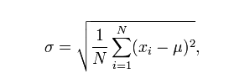
Recall the Statistics Needed for the Delphi Technique
Given values x₁ , x2 , x3... x_{N}
Mean = average = (Σx_{i} )/N
standard deviation is a simple measure of the variability or dispersion of a data set.
  A low standard deviation (σ) indicates that all of the data points are very close to the mean, while a high standard deviation indicates that the data are “spread out” over a large range of values where μ is the mean of the data set.

Slide 50
Bottom-up Approach
Break the product into smaller components
  Unfortunately, the smaller components may be no easier to estimate
  However, there are process-level costs
When using the object-oriented paradigm
  The independence of the classes assists here
  However, the interactions among the classes complicate the estimation process

Slide 51
Bottom Up Estimation
Work Breakdown Structure (WBS)
For each task:
  name, id, on critical path (defined shortly)
  description
  dependencies
  staffed by, skills needed, person responsible
  estimated time, start, end, duration
  resources required
  entry, exit criteria
  deliverables
  risks

Slide 52
WBS cont.
Completeness tests: when to stop the breakdown
  measurable status of task
  start and end of task are clearly defined
  deliverable is identified
  time, cost, and effort can be identified
  duration is reasonable
  assignment of task to team or person is independent

Slide 53
WBS cont.
Identifying the tasks
  goal-question-method approach:
    identify the high level goals
    questions are how we go about reaching this goal
    method tells what the deliverable will be

Slide 54
WBS cont.
Identifying the tasks
  example
    goal: build communication subsystem
    questions: what messages will be sent? what reliability is required? what synchronization is needed?
    methods: define message types and operations on them; detail the reliability needs – e.g. message tracing and acknowledgement; choose synchronization methods – e.g. message numbering and ordering

Slide 55
WBS cont.
Identifying the tasks
  verb analysis: design/build/test, recursively
  noun analysis: component parts approach
  organizational unit approach: by department, or by geography

Slide 56
Bottom-Up Estimation
PERT Chart (Program Evaluation Review Technique)
  given estimated time and dependencies
  draw dependency graph
  work forwards to compute Earliest Start Time: max{ pred(time) + pred(EST) }
  work backwards to compute Latest Start Time: min{ succ(LST) – time }

Slide 57
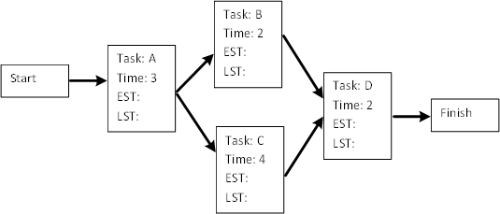
Bottom-Up Estimation

Slide 58
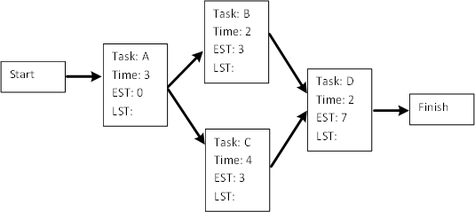
Bottom-Up Estimation
  Earliest Start Time: max{ pred(time) + pred(EST) }

Slide 59
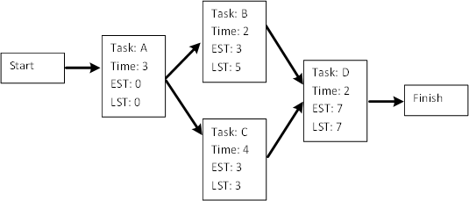
Bottom-Up Estimation
Latest Start Time: min{ succ(LST) – time }

Slide 60
Bottom-Up Estimation
  slack time = LST – EST
  critical path: path with every node’s slack time = 0 (not necessarily unique)

Slide 61
Bottom-Up Estimation
  slack time = LST – EST
  critical path: path with every node’s slack time = 0 (not necessarily unique

Slide 62
Bottom-Up Estimation
PERT (cont.)
  slack time = LST – EST
  critical path: path with every node’s slack time = 0 (not necessarily unique)
  critical path is the longest path in duration
  “near critical” nodes
  lengthening the critical path lengthens the project
  changes to critical path nodes must be monitored carefully
  changes on non-critical path nodes must still be monitored, for large changes

Slide 63
Gantt charts
Activity bar chart, showing time, activities, and (possibly) personnel
Shows duration of each activity, plus slack time
Tracks milestones and dependencies
Staffing chart: time versus staff; bars labeled with activities

Slide 64
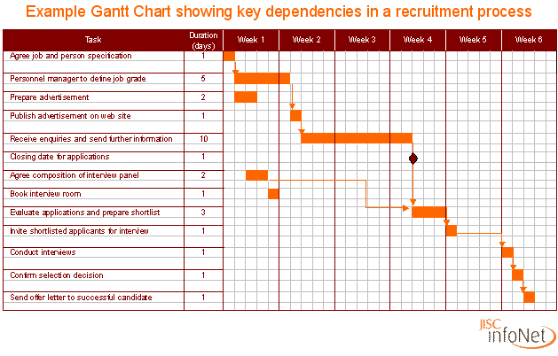

Slide 65
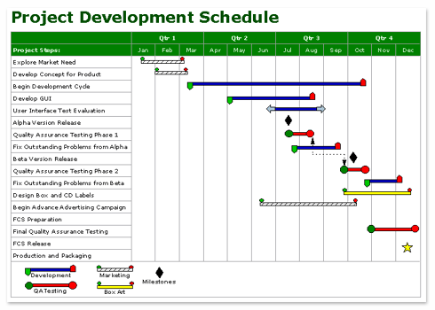

Slide 66
Tracking and Monitoring
Relatively short tasks allow for closer monitoring, remove “over the horizon” effect: deadline avoidance
Consistent collection and review is necessary
Critical path monitoring
Checkpoint deliverables at milestones

Slide 67
Algorithmic Cost Estimation Models
A metric is used as an input to a model to compute cost and duration
  An algorithmic model is unbiased, and therefore superior to expert opinion
  However, estimates are only as good as the underlying assumptions
Examples
  SLIM Model - we won't consider this one
  Price S Model - or this one
  COnstructive COst MOdel (COCOMO)

Slide 68
COCOMO
Boehm, 1981: COnstructive COst MOdel
Three levels: basic, intermediate, detailed
Supplanted by COCOMO II
Basic classes of software:
  organic mode: relatively small, familiar environment, little intergroup communication
  semi-detached mode: limited experience, mix of personnel
  embedded mode: strongly coupled to complex hardware; high validation costs; little experience

Slide 69
9.2.3 Intermediate COCOMO
COCOMO consists of three models
  A macro-estimation model for the product as a whole
  Intermediate COCOMO
  A micro-estimation model that treats the product in detail
We examine intermediate COCOMO in more detail

Slide 70
Intermediate COCOMO
Product attributes: reliability, database size, complexity
Constraints: execution time, storage, virtual machine, turnaround time
Personnel: analyst capability, programmer capability, vm experience, language experience, domain knowledge
Project: use of tools, methodologies, development schedule

Slide 71
COCOMO II
Produces different kind of estimates at three stages of development:
  application composition: application points
  early design: function points
  post-architecture: function points and LOC
Application Point – similar to function points, based on screens, reports, and 3GL components

Slide 72
COCOMO II
Application Point estimation:
  for each screen and report, estimate complexity
  assign weights, find sum, adjust for reuse
  estimate productivity rate based on developers’ capabilities and CASE maturity; divide AP by this value
Stage 2:
  calculate function points
  adjust for reuse, change, maintenance, developer experience, tool use

Slide 73
Intermediate COCOMO (contd)
Step 1. Estimate the length of the product in KDSI
Step 2. Estimate the product development mode (organic, semidetached, embedded)
Example:
  Straightforward product (“organic mode”)
  Nominal effort = 3.2 × (KDSI)^{1.05} person-months

Slide 74
Intermediate COCOMO (contd)
Step 3. Compute the nominal effort
Example:
  Organic product
  12,000 delivered source statements (12 KDSI) (estimated)
  Nominal effort = 3.2 × (12)^{1.05} = 43 person-months

Slide 75
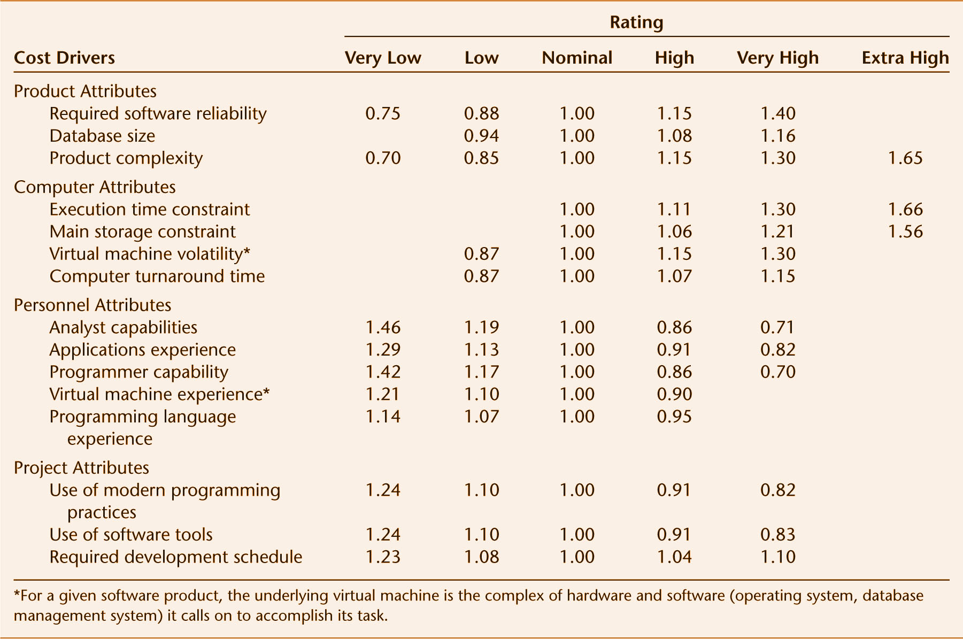
Intermediate COCOMO (contd)
Step 4. Multiply the nominal value by 15 software development cost multipliers
Figure 9.6

Slide 76
Intermediate COCOMO (contd)
Example:
  Microprocessor-based communications processing software for electronic funds transfer network with high reliability, performance, development schedule, and interface requirements
Step 1. Estimate the length of the product
  10,000 delivered source instructions (10 KDSI)
Step 2. Estimate the product development mode
  Complex (“embedded”) mode

Slide 77
Intermediate COCOMO (contd)
Step 3. Compute the nominal effort
  Nominal effort = 2.8 × (10)^{1.20} = 44 person-months
Step 4. Multiply the nominal value by 15 software development cost multipliers
  Product of effort multipliers = 1.35 (see table on next slide)
  Estimated effort for project is therefore 1.35 × 44 = 59 person-months

Slide 78
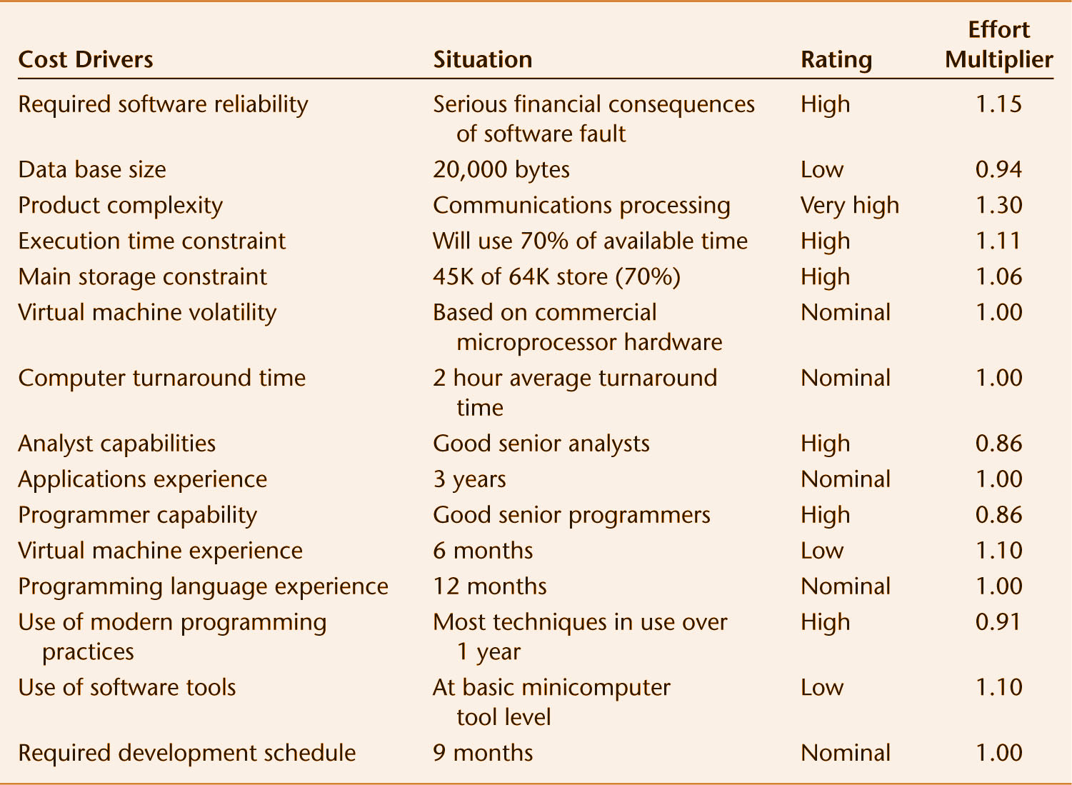
Intermediate COCOMO (contd)
Software development effort multipliers
Figure 9.7

Slide 79
Intermediate COCOMO (contd)
Estimated effort for project (59 person-months) is used as input for additional formulas for
  Dollar costs
  Development schedules
  Phase and activity distributions
  Computer costs
  Annual maintenance costs
  Related items

Slide 80
Intermediate COCOMO (contd)
Intermediate COCOMO has been validated with respect to a broad sample
Actual values are within 20% of predicted values about 68% of the time
  Intermediate COCOMO was the most accurate estimation method of its time
Major problem
  If the estimate of the number of lines of codes of the target product is incorrect, then everything is incorrect

Slide 81
9.2.4 COCOMO II
1995 extension to 1981 COCOMO that incorporates
  Object orientation
  Modern life-cycle models
  Rapid prototyping
  Fourth-generation languages
  COTS software
COCOMO II is far more complex than the first version

Slide 82
COCOMO II (contd)
There are three different models
  Application composition model for the early phases
    Based on feature points (similar to function points)
  Early design model
    Based on function points
  Post-architecture model
    Based on function points or KDSI

Slide 83
COCOMO II (contd)
COCOMO II has 17 multiplicative cost drivers (was 15)
  Seven are new
It is too soon for results regarding
  The accuracy of COCOMO II
  The extent of improvement (if any) over Intermediate COCOMO

Slide 84
9.2.5 Tracking Duration and Cost Estimates
Whatever estimation method used, careful tracking is vital

Slide 85
9.3 Components of a Software Project Management Plan
The work to be done
The resources with which to do it
The money to pay for it

Slide 86
Resources
Resources needed for software development:
  People
  Hardware
  Support software

Slide 87
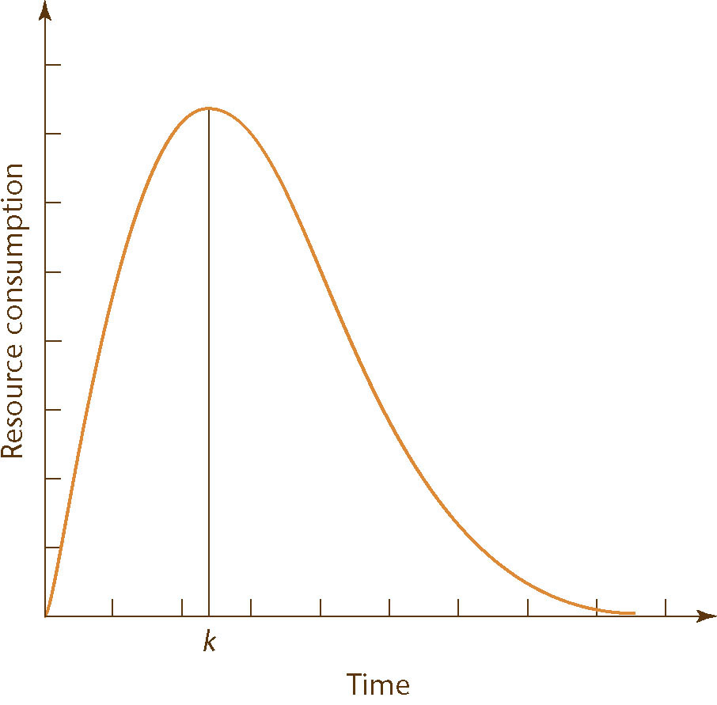
Use of Resources Varies with Time
Rayleigh curves accurately depict resource consumption
The entire software development plan must be a function of time
Figure 9.8

Slide 88
Work Categories
Project function
  Work carried on throughout the project
  Examples:
    Project management
    Quality control

Slide 89
Work Categories
Activity
  Work that relates to a specific phase
  A major unit of work,
  With precise beginning and ending dates,
  That consumes resources, and
  Results in work products like the budget, design, schedules, source code, or users’ manual
Task
  An activity comprises a set of tasks (the smallest unit of work subject to management accountability)

Slide 90
Completion of Work Products
Milestone: The date on which the work product is to be completed
It must first pass reviews performed by
  Fellow team members
  Management
  The client
Once the work product has been reviewed and agreed upon, it becomes a baseline

Slide 91
Work Package
Work product, plus
  Staffing requirements
  Duration
  Resources
  The name of the responsible individual
  Acceptance criteria for the work product
  The detailed budget as a function of time, allocated to
    Project functions
    Activities

Slide 92
9.4 Software Project Management Plan Framework
There are many ways to construct an SPMP
One of the best is IEEE Standard 1058.1
  The standard is widely accepted
  It is designed for use with all types of software products
  It supports process improvement
    Many sections reflect CMM key process areas
  It is ideal for the Unified Process
    There are sections for requirements control and risk management

Slide 93
Software Project Management Plan Framework (contd)
Some of the sections are inapplicable to small-scale software
  Example: Subcontractor management plan

Slide 94
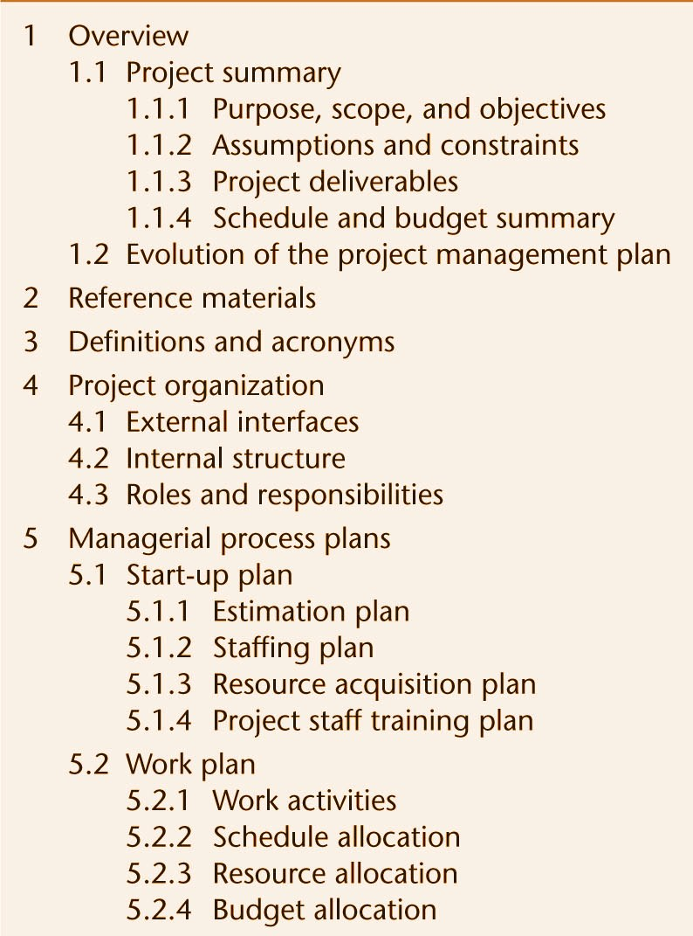
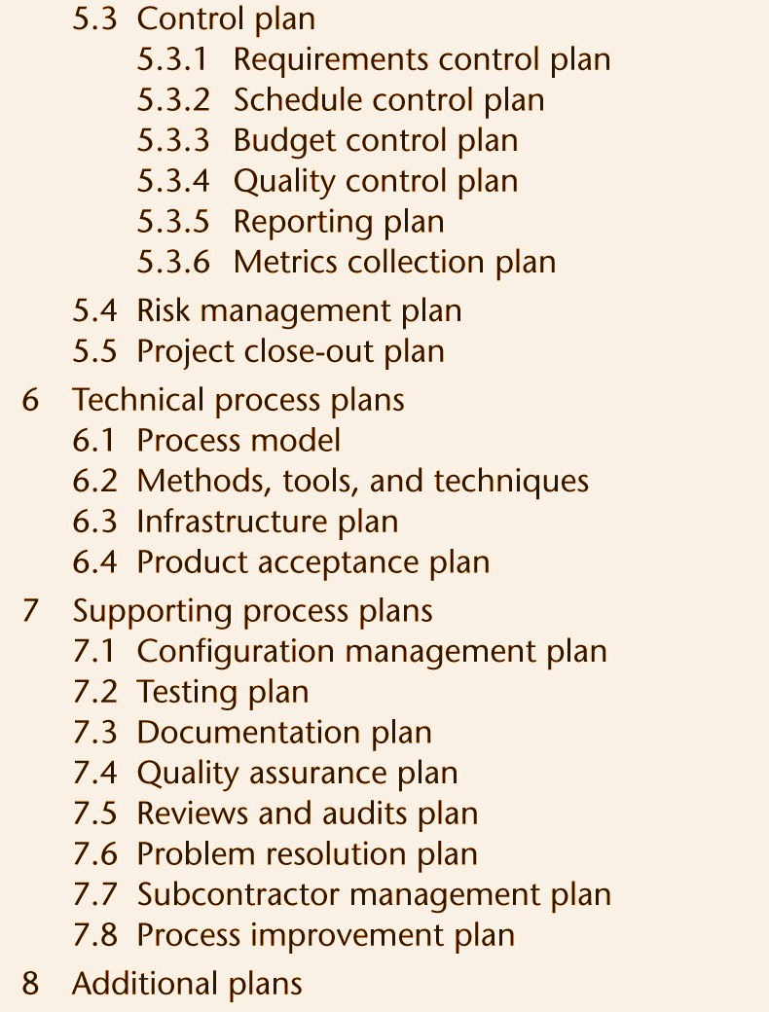
9.5 IEEE Software Project Management Plan
Figure 9.9

Slide 95
9.6 Planning Testing
The SPMP must explicitly state what testing is to be done
Traceability is essential
All black box test cases (i.e. checking output when executed without looking at the code) must be drawn up as soon as possible after the specifications are complete

Slide 96
9.7 Planning Object-Oriented Projects
An object-oriented product consists of largely independent pieces
Consequently, planning is somewhat easier
But, the whole is more than the sum of its parts
We can use COCOMO II (or modify Intermediate COCOMO estimators)

Slide 97
Planning of Object-Oriented Projects (contd)
However, reuse induces errors in cost and duration estimates
  Reuse of existing components during development
  Production of components for future reuse
These work in opposite directions
Newer data: The savings outweigh the costs

Slide 98
9.8 Training Requirements
“We don’t need to worry about training until the product is finished, and then we can train the user”
Training is generally needed by the members of the development group, starting with training in software planning
A new software development method necessitates training for every member of the group

Slide 99
Training Requirements (contd)
Introduction of hardware or software tools of any sort necessitates training
Programmers may need training in the operating system and/or implementation language
Documentation preparation training may be needed
Computer operators require training

Slide 100
9.9 Documentation Standards
How much documentation is generated by a product?
  IBM internal commercial product (50 KDSI)
    28 pages of documentation per KDSI
  Commercial software product of the same size
    66 pages per KDSI
  IMS/360 Version 2.3 (about 166 KDSI)
    157 pages of documentation per KDSI
  [TRW] For every 100 hours spent on coding activities, 150–200 hours were spent on documentation-related activities

Slide 101
Types of Documentation
Planning
Control
Financial
Technical
Source code
Comments within source code

Slide 102
Documentation Standards
Reduce misunderstandings between team members
Aid SQA
Only new employees have to learn the standards
Standards assist maintenance programmers
Standardization is important for user manuals

Slide 103
Documentation Standards (contd)
As part of the planning process
  Standards must be set up for all documentation
In a very real sense, the product is the documentation

Slide 104
9.10 CASE Tools for Planning and Estimating
It is essential to have
  A word processor; and
  A spreadsheet
Tools that automate intermediate COCOMO and COCOMO II are available as well as tools for function points.
Management tools assist with planning and monitoring
  MacProject
  Microsoft Project
Some of these will be demonstrated shortly.

Slide 105
9.11 Testing the Software Project Management Plan
We must check the SPMP as a whole
  Paying particular attention to the duration and cost estimates

Slide 106
CASE Tools for Cost Estimation
Function Point FAQ
Demo for Calculating Function Points (see next slide)
Demo of the Basic COCOMO model
Demo of the COCOMO 81 Intermediate model
Demo of the COCOMO II with Heuristic Risk Assessment

Slide 107
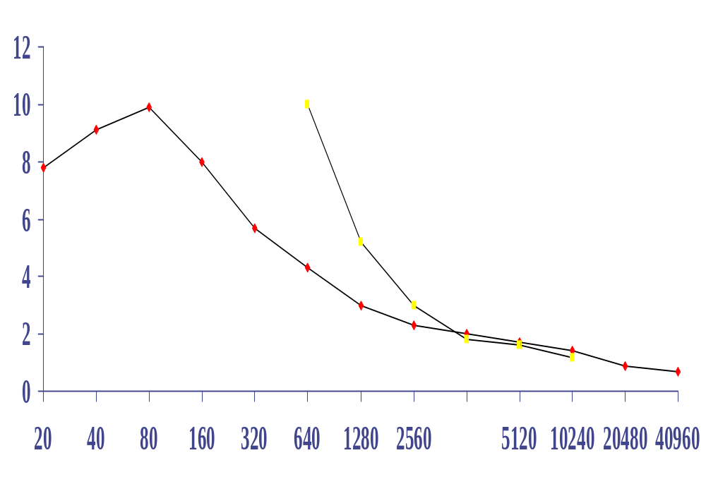
Productivity= f(size)
Bell Laboratories
data
Capers Jones data
Productivity (Function points / staff month)
Function Points

Slide 108
Reporting
Management role
Communicate overall status, especially to customers
Identify issues and evaluate their impact
Keep planning
Status report:
  accomplishments
  work in progress
  status of and changes to schedule and budget
  critical issues
  plans for next period

Slide 109
Parkinson’s Law
Work expands to fill all available time
Determine what resources you have to use on the project
  time
  personnel
  expertise
Estimate is time X personnel, in person-months, assuming expertise is sufficient

Slide 110
Price to Win
Try to figure out what the customer will spend, or …
… try to figure out what your competitors will bid
Actual work done depends on customer budget, not just on software characteristics!

