Slide 1
Review of Cohesion and Coupling

Slide 2
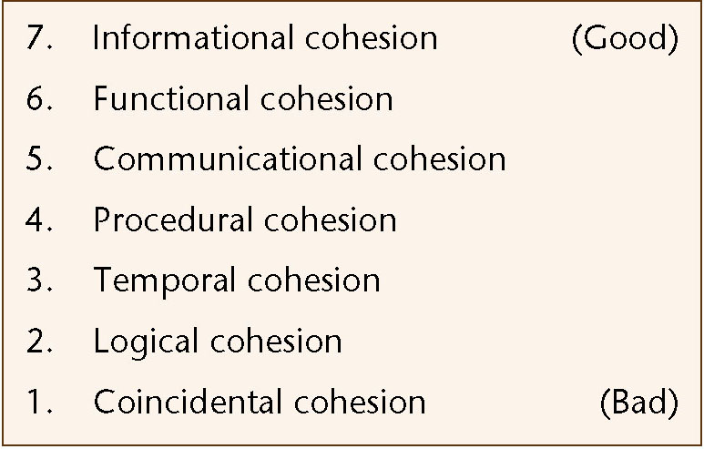
7.2 Cohesion
The degree of interaction within a module
Seven categories or levels of cohesion (non-linear scale)
Figure 7.4

Slide 3
7.2.1 Coincidental Cohesion
A module has coincidental cohesion if it performs multiple, completely unrelated actions
Example:
  print_next_line, reverse_string_of_characters_comprising_second_ parameter, add_7_to_fifth_parameter, convert_fourth_parameter_to_ floating_point
Such modules arise from rules like
  “Every module will consist of between 35 and 50 statements”

Slide 4
Why Is Coincidental Cohesion So Bad?
It degrades maintainability
A module with coincidental cohesion is not reusable
The problem is easy to fix
  Break the module into separate modules, each performing one task

Slide 5
7.2.2 Logical Cohesion
A module has logical cohesion when it performs a series of related actions, one of which is selected by the calling module

Slide 6
Logical Cohesion (contd)
Example 1:
function_code = 7;
new_operation (op code, dummy_1, dummy_2, dummy_3);
// dummy_1, dummy_2, and dummy_3 are dummy variables,
// not used if function code is equal to 7
Example 2:
  An object performing all input and output
Example 3:
  One version of OS/VS2 contained a module with logical cohesion performing 13 different actions. The interface contained 21 pieces of data!

Slide 7
Why Is Logical Cohesion So Bad?
The interface is difficult to understand
Code for more than one action may be intertwined
Difficult to reuse

Slide 8
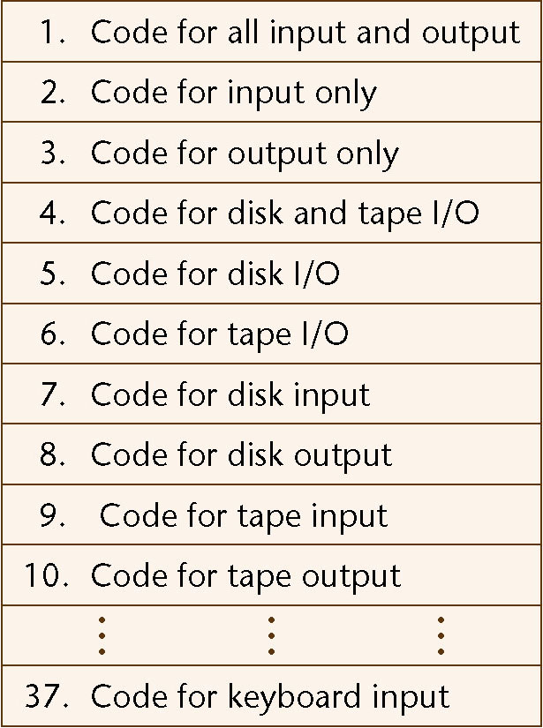
Why Is Logical Cohesion So Bad? (contd)
A new tape unit is installed
  What is the effect on the laser printer?
Figure 7.5

Slide 9
7.2.3 Temporal Cohesion
A module has temporal cohesion when it performs a series of actions related in time
Example:
  open_old_master_file, new_master_file, transaction_file, and print_file; initialize_sales_district_table, read_first_transaction_record, read_first_old_master_record (a.k.a. perform_initialization)

Slide 10
Why Is Temporal Cohesion So Bad?
The actions of this module are weakly related to one another, but strongly related to actions in other modules
  Consider sales_district_table
Not reusable

Slide 11
7.2.4 Procedural Cohesion
A module has procedural cohesion if it performs a series of actions related by the procedure to be followed by the product
Example:
  read_part_number_and_update_repair_record_on_master_file

Slide 12
Why Is Procedural Cohesion So Bad?
The actions are still weakly connected, so the module is not reusable

Slide 13
7.2.5 Communicational Cohesion
A module has communicational cohesion if it performs a series of actions related by the procedure to be followed by the product, but in addition all the actions operate on the same data
Example 1:
  update_record_in_database_and_write_it_to_audit_trail
Example 2:
  calculate_new_coordinates_and_send_them_to_terminal

Slide 14
Why Is Communicational Cohesion So Bad?
Still lack of reusability

Slide 15
7.2.6 Functional Cohesion
A module with functional cohesion performs exactly one action

Slide 16
7.2.6 Functional Cohesion
Example 1:
  get_temperature_of_furnace
Example 2:
  compute_orbital_of_electron
Example 3:
  write_to_diskette
Example 4:
  calculate_sales_commission

Slide 17
Why Is Functional Cohesion So Good?
More reusable
Corrective maintenance is easier
  Fault isolation
  Fewer regression faults
Easier to extend a product

Slide 18
7.2.7 Informational Cohesion
A module has informational cohesion if it performs a number of actions, each with its own entry point, with independent code for each action, all performed on the same data structure

Slide 19
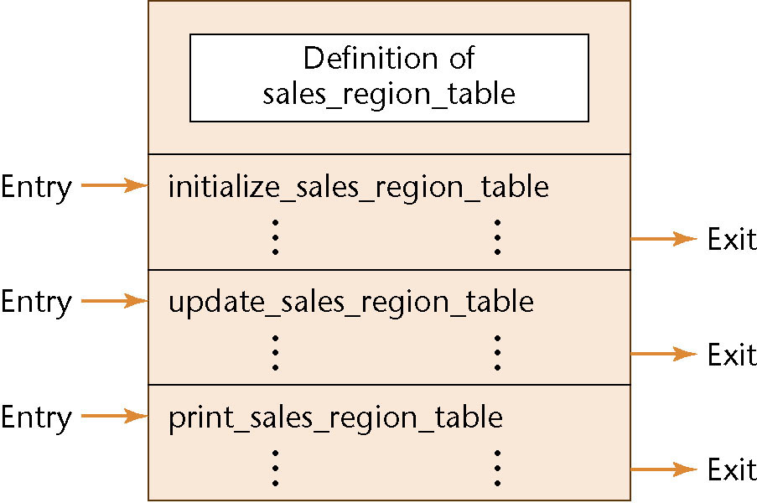
Why Is Informational Cohesion So Good?
Essentially, this is an abstract data type (see later)
Figure 7.6

Slide 20
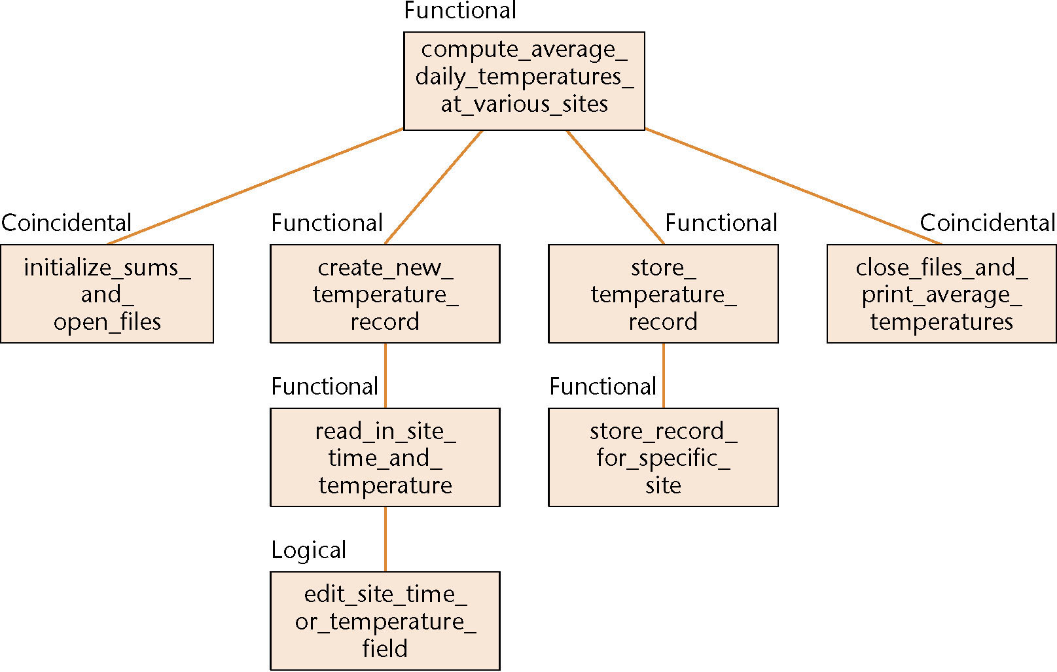
7.2.8 Cohesion Example
Figure 7.7

Slide 21
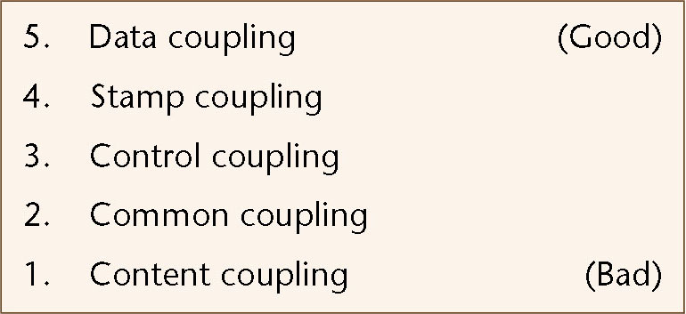
7.3 Coupling
The degree of interaction between two modules
  Five categories or levels of coupling (non-linear scale)
Figure 7.8

Slide 22
7.3.1 Content Coupling
Two modules are content coupled if one directly references contents of the other
Example 1:
  Module P modifies a statement of module Q
Example 2:
  Module P refers to local data of module Q in terms of some numerical displacement within Q
Example 3:
  Module P branches into a local label of module Q

Slide 23
Why Is Content Coupling So Bad?
Almost any change to module , even recompiling Q with a new compiler or Q assembler, requires a change to module P

Slide 24
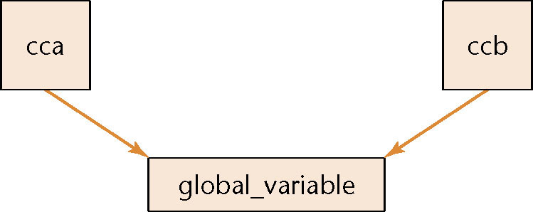
7.3.2 Common Coupling
Two modules are common coupled if they have write access to global data
Example 1
  Modules cca and ccb can access and change the value of global_variable
Figure 7.9

Slide 25
7.3.2 Common Coupling (contd)
Example 2:
  Modules cca and ccb both have access to the same database, and can both read and write the same record
Example 3:
  FORTRAN common
  COBOL common (nonstandard)
  COBOL-80 global

Slide 26
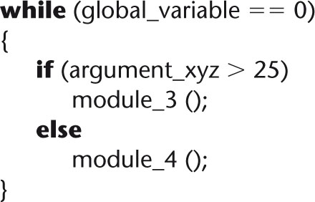
Why Is Common Coupling So Bad?
It contradicts the spirit of structured programming
  The resulting code is virtually unreadable
  What causes this loop to terminate?
Figure 7.10

Slide 27
Why Is Common Coupling So Bad? (contd)
Modules can have side-effects
  This affects their readability
  Example: edit_this_transaction (record_7)
  The entire module must be read to find out what it does
A change during maintenance to the declaration of a global variable in one module necessitates corresponding changes in other modules
Common-coupled modules are difficult to reuse

Slide 28
Why Is Common Coupling So Bad? (contd)
Common coupling between a module p and the rest of the product can change without changing p in any way
  Clandestine common coupling
  Example: The Linux kernel
A module is exposed to more data than necessary
  This can lead to computer crime

Slide 29
7.3.3 Control Coupling
Two modules are control coupled if one passes an element of control to the other
Example 1:
  An operation code is passed to a module with logical cohesion
Example 2:
  A control switch passed as an argument

Slide 30
Control Coupling (contd)
Module p calls module q
Message:
  I have failed — data
Message:
  I have failed, so write error message ABC123 — control

Slide 31
Why Is Control Coupling So Bad?
The modules are not independent
  Module q (the called module) must know the internal structure and logic of module p
  This affects reusability
Associated with modules of logical cohesion

Slide 32
7.3.4 Stamp Coupling
Some languages allow only simple variables as parameters
  part_number
  satellite_altitude
  degree_of_multiprogramming
Many languages also support the passing of data structures
  part_record
  satellite_coordinates
  segment_table

Slide 33
Stamp Coupling (contd)
Two modules are stamp coupled if a data structure is passed as a parameter, but the called module operates on some but not all of the individual components of the data structure

Slide 34
Why Is Stamp Coupling So Bad?
It is not clear, without reading the entire module, which fields of a record are accessed or changed
  Example
    calculate_withholding (employee_record)
Difficult to understand
Unlikely to be reusable
More data than necessary is passed
  Uncontrolled data access can lead to computer crime

Slide 35
Why Is Stamp Coupling So Bad? (contd)
However, there is nothing wrong with passing a data structure as a parameter, provided that all the components of the data structure are accessed and/or changed
Examples:
invert_matrix (original_matrix, inverted_matrix);
print_inventory_record (warehouse_record);

Slide 36
7.3.5 Data Coupling
Two modules are data coupled if all parameters are homogeneous data items (simple parameters, or data structures all of whose elements are used by called module)
Examples:
  display_time_of_arrival (flight_number);
  compute_product (first_number, second_number);
  get_job_with_highest_priority (job_queue);

Slide 37
Why Is Data Coupling So Good?
The difficulties of content, common, control, and stamp coupling are not present
Maintenance is easier

Slide 38
7.3.7 The Importance of Coupling
As a result of tight coupling
  A change to module p can require a corresponding change to module q
  If the corresponding change is not made, this leads to faults
Good design has high cohesion and low coupling
  What else characterizes good design? (see next slide)

