Slide 1
Chapter 2
Graphics Programming
OpenGL and GLUT

Slide 2
Objectives
Development of the OpenGL API
OpenGL Architecture
  OpenGL as a state machine
Functions
  Types
  Formats
Simple programs

Slide 3
OpenGL
OpenGL is an API (application programmer’s interface)
Many APIs exist
Forerunner of OpenGL was GL from Silicon Graphics, Inc.(SGI) designed for high end IRIS workstations which is optimized for display, has ultrafast matrix transformations, and support for depth buffering.
OpenGL was SGI’s attempt to improve graphics portability.

Slide 4
Early History of APIs
IFIPS (1973) formed two committees to come up with a standard graphics API
  Graphical Kernel System (GKS)
    2D but contained good workstation model
  Core
    Both 2D and 3D
  GKS adopted as IS0 and later ANSI standard (1980s)
GKS not easily extended to 3D (GKS-3D)
Far behind hardware development

Slide 5
PHIGS and X
Programmers Hierarchical Graphics System (PHIGS)
  Arose from CAD community
  Database model with retained graphics (structures)
X Window System
  DEC/MIT effort
  Client-server architecture with graphics
PEX combined the two
  Not easy to use (all the defects of each)

Slide 6
SGI and GL
Silicon Graphics (SGI) revolutionized the graphics workstation by implementing the pipeline in hardware (1982)
To use the system, application programmers used a library called GL
With GL, it was relatively simple to program three dimensional interactive applications

Slide 7
OpenGL
Introduced July 1, 1992 at first Win32 developers conference.
SGI demonstrated how OpenGL had been used for Terminator2 and medical imaging.
Although Microsoft distributes OpenGL with Windows version, it does not control it. There is an OpenGL Architecture Review Board which includes SGI, IBM, Intel, and Microsoft. Meetings are open, but you must obtain attendance approval in advance.
Version1.1 was released in Dec, 1995

Slide 8
DESCRIPTIVE vs PROCEDURAL
GRAPHICS LANGUAGE
Descriptive
  Describe the scene and how it should appear
Procedural
  Programmer actually describes the steps necessary to achieve a certain appearance or effect
OpenGL is a procedural graphics language
The steps involve calls to various commands and functions
These draw graphical primitives such as points, lines, and polygons in 3D

Slide 9
OPENGL
Can add lighting, shading, texture mapping, animation, curve drawing, and other special effects
As OpenGL is procedural, these additions must be specified by the programmer.
OpenGL does NOT include functions for window management, user interaction, I/0.
Each host environment has its own way of handing over to OpenGL the drawing and control of a window or bitmap.

Slide 10
OpenGL Evolution
Controlled by an Architectural Review Board (ARB)
  Members include SGI, Microsoft, Nvidia, HP, 3DLabs,IBM,…….
  Relatively stable (working on version 2.0, but not adopted yet)
    Evolution reflects new hardware capabilities
      3D texture mapping and texture objects
      Vertex programs
  Allows for platform specific features through extensions

Slide 11
OpenGL Libraries
OpenGL core library
  OpenGL32 on Windows
  GL on most unix/linux systems
OpenGL Utility Library (GLU)
  Provides functionality in OpenGL core but avoids having to rewrite code
Links with window system
  GLX for X window systems
  WGL for Widows
  AGL for Macintosh

Slide 12
GLUT
OpenGL Utility Library (GLUT)
  Provides functionality common to all window systems
    Open a window
    Get input from mouse and keyboard
    Menus
    Event-driven
  Code is portable but GLUT lacks the functionality of a good toolkit for a specific platform
    Slide bars

Slide 13

THE POSITIONING OF A GRAPHICS SYSTEM

Slide 14
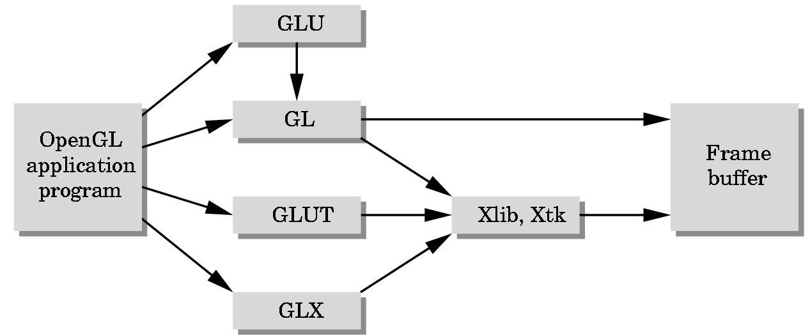
GLUT = GL Utility Toolkit
A library that acts as a common interface to different versions of
windowing environments such as
Microsoft’s
SIGs
X-windows etc.

Slide 15
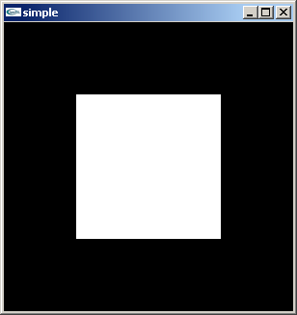
A Very Simple OpenGL/GLUT Program
Generate a square on a solid background

Slide 16
simple.c
#include <glut.h>
void mydisplay(){
glClear(GL_COLOR_BUFFER_BIT);
glBegin(GL_POLYGON);
glVertex2f(-0.5, -0.5);
glVertex2f(-0.5, 0.5);
glVertex2f(0.5, 0.5);
glVertex2f(0.5, -0.5);
glEnd();
glFlush();
}
void main(int argc, char** argv){
glutCreateWindow("simple");
glutDisplayFunc(mydisplay);
glutMainLoop();
}

Slide 17
Event Loop
Note that the program defines a display callback function named mydisplay
  Every glut program must have a display callback
  The display callback is executed whenever OpenGL decides the display must be refreshed, for example when the window is opened
  The main function ends with the program entering an event loop

Slide 18
2D vs 3D GRAPHICS
Until very recently, APIs (Application Programmer Interface) were predominately 2D-oriented with small extensions for 3D graphics:
  1977 CORE
  1985 GKS, GKS-3D
  1988 PHIGS, PHIGS+, X-Windows
  1992 OpenGL
    Windows NT 3.1 was in beta testing
    Silicon Graphics (SGI) developed OpenGL
    Marriage between the two to incorporate OpenGL in Windows NT 3.5
  Other APIs exist

Slide 19
Defaults
simple.c is too simple
It makes heavy use of state variable default values for
  Viewing
  Colors
  Window parameters
Next version will make the defaults more explicit

Slide 20
Recall to Compile on Windows
Visual C++
  Get glut.h, glut32.lib and glut32.dll from web
  Create a console application
  Add opengl32.lib, glut32.lib, glut32.lib to project settings (under link tab)

Slide 21
Our Objectives
Refine the first program
  Alter the default values
  Introduce a standard program structure
Simple viewing
  Two-dimensional viewing as a special case of three-dimensional viewing
Fundamental OpenGL primitives
Attributes

Slide 22
Program Structure
Most OpenGL programs have a similar structure that consists of the following functions
  main():
    defines the callback functions
    opens one or more windows with the required properties
    enters event loop (last executable statement)
  init(): sets the state variables
    viewing
    Attributes
  callbacks
    Display function
    Input and window functions

Slide 23
Simple.c revisited
In this version, we will see the same output but we have defined all the relevant state values through function calls with the default values
In particular, we set
  Colors
  Viewing conditions
  Window properties

Slide 24
main.c
includes gl.h
#include <GL/glut.h>
int main(int argc, char** argv)
{
glutInit(&argc,argv);
glutInitDisplayMode(GLUT_SINGLE|GLUT_RGB);
glutInitWindowSize(500,500);
glutInitWindowPosition(0,0);
glutCreateWindow("simple");
glutDisplayFunc(mydisplay);
init();
glutMainLoop();
}
define window properties
display callback
set OpenGL state
enter event loop

Slide 25
GLUT functions
glutInit allows application to get command line arguments and initializes system
gluInitDisplayMode requests properties of the window (the rendering context)
  RGB color
  Single buffering
  Properties logically ORed together
glutWindowSize in pixels
glutWindowPosition from top-left corner of display
glutCreateWindow create window with title “simple”
glutDisplayFunc display callback
glutMainLoop enter infinite event loop

Slide 26
init.c
black clear color
void init()
{
glClearColor (0.0, 0.0, 0.0, 1.0);
glColor3f(1.0, 1.0, 1.0);
glMatrixMode (GL_PROJECTION);
glLoadIdentity ();
glOrtho(-1.0, 1.0, -1.0, 1.0, -1.0, 1.0);
}
opaque window
fill with white
viewing volume

Slide 27
Coordinate Systems
The units of in glVertex are determined by the application and are called world or problem coordinates
The viewing specifications are also in world coordinates and it is the size of the viewing volume that determines what will appear in the image
Internally, OpenGL will convert to camera coordinates and later to screen coordinates

Slide 28
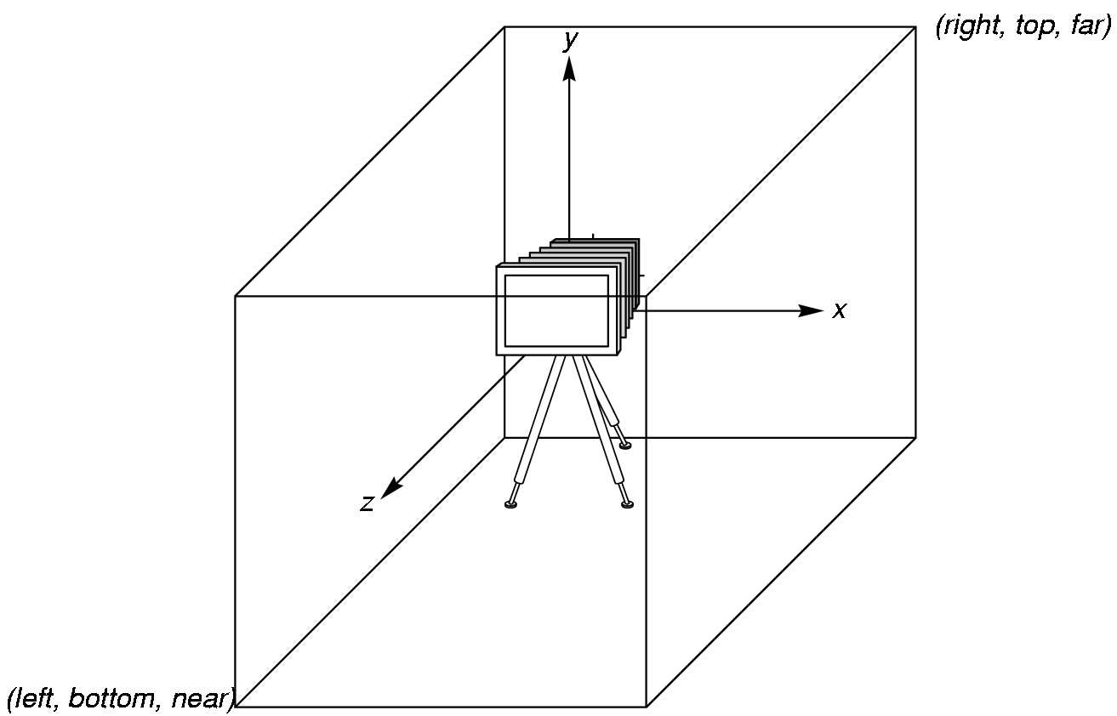
OpenGL Camera
OpenGL places a camera at the origin pointing in the negative z direction
The default viewing volume is a box centered at the origin with each side of
length 2

Slide 29
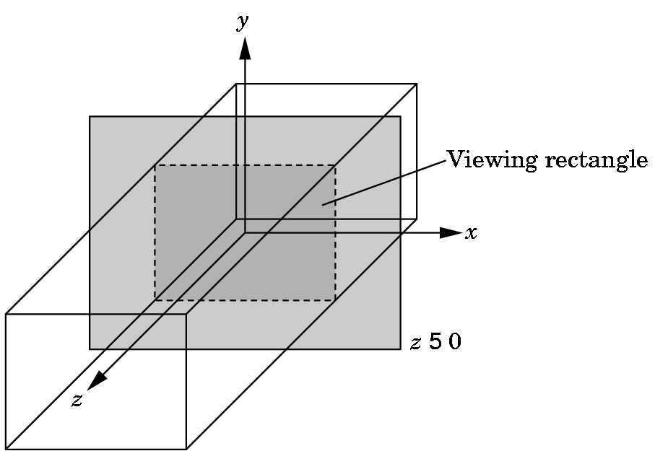
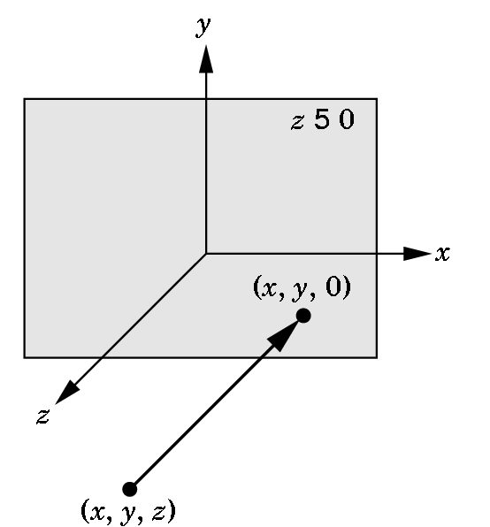
Orthographic Viewing
In the default orthographic view, points are
projected forward along the z axis onto the
plane z=0
z=0
z=0

Slide 30
Transformations and Viewing
In OpenGL, the projection is carried out by a projection matrix (transformation)
There is only one set of transformation functions so we must set the matrix mode first
glMatrixMode (GL_PROJECTION)
Transformation functions are incremental so we start with an identity matrix and alter it with a projection matrix that gives the view volume
glLoadIdentity ();
glOrtho(-1.0, 1.0, -1.0, 1.0, -1.0, 1.0);

Slide 31
Two- and three-dimensional viewing
In glOrtho(left, right, bottom, top, near, far) the near and far distances are measured from the camera
Two-dimensional vertex commands place all vertices in the plane z=0
If the application is in two dimensions, we can use the function
gluOrtho2D(left, right,bottom,top)
In two dimensions, the view or clipping volume becomes a clipping window

Slide 32
mydisplay.c
void mydisplay()
{
glClear(GL_COLOR_BUFFER_BIT);
glBegin(GL_POLYGON);
glVertex2f(-0.5, -0.5);
glVertex2f(-0.5, 0.5);
glVertex2f(0.5, 0.5);
glVertex2f(0.5, -0.5);
glEnd();
glFlush();
}

Slide 33
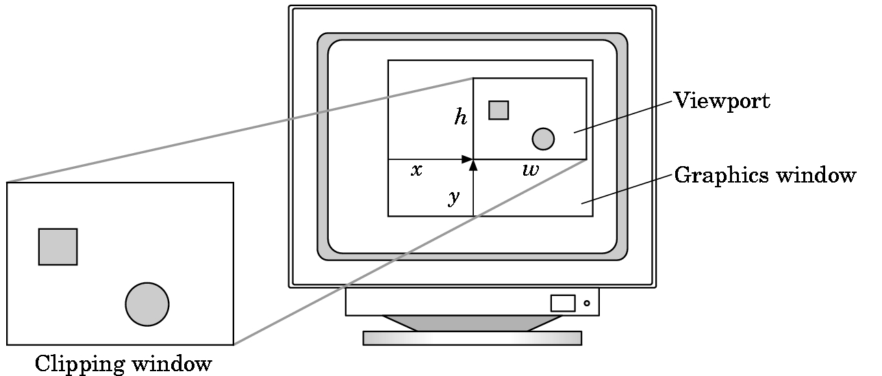
Viewports
We do not have use to the entire window for the image: glViewport(x,y,w,h)
Values in pixels (screen coordinates)

Slide 34
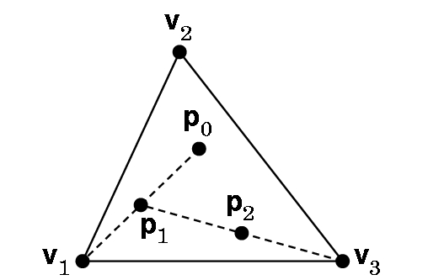
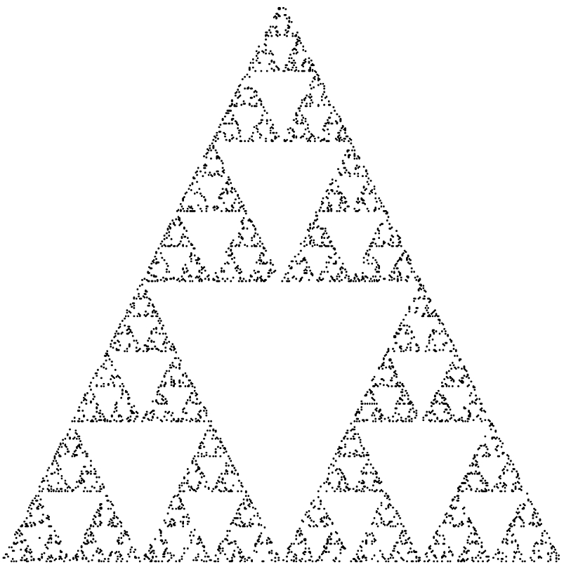
A More Interesting Example
A 2D Sierpinski Gasket
Construction: Start with 3 points forming vertices of an equilateral triangle.
Continue for a chosen number of points:
1. Randomly pick a point inside triangle
2. Randomly pick a vertex.
3. Find midpoint of the line segment between the vertex and point.
4. Display the new point.
5. Replace the initial point with the new point.
6. Return to 2 if the specified number of points have not been plotted,
2D Sierpinski Gasket

Slide 35
Waclaw Sierpinski
1882-1969
Famous Polish mathematician
For material on his life see:
http://wwwgap.dcs.stand.ac.uk/~history/Mathematicians/
Sierpinski.html
For material on the Sierpinski gasket see:
http://astronomy.swin.edu.au/~pbourke/fractals/gasket/

Slide 36
BEFORE WE CAN DEVELOP A
PROGRAM WE NEED TO ANSWER SOME QUESTIONS
How are points specified?
How are colors specified?
Where on the screen will the image appear?
How will the image be sized?
How is a window created for the image?
How much of the 2D drawing surface which represents the image will be displayed?
How long will the image remain on the screen?
What happens if another window is moved over the drawing window and then moved away from it?

Slide 37
First Steps
We now have the means of building the program.
Again, we can choose any coordinates we wish as our viewing choices will specify what is seen.
So we can build the 3 points for the 2D triangle as:
typedef Glfloat point2[2];
point2 vertices[3]={{0.0,0.0}, {250.0,500.0}, {500.0,0.0}}; // triangle
Why use these values for the points? No reason---they just make a
nice equilateral triangle. Remember, you can choose any world coordinates you wish.
Glfloat (and Glint) are special data structures in OpenGL. Use these instead of the usual C or C++ types. Watch the capitalization!

Slide 38
Want a program … main()
{initialize_the_system(); for (some_number_of_points)
{ generate_a_point(); display_the_point();
} cleanup();
}

Slide 39
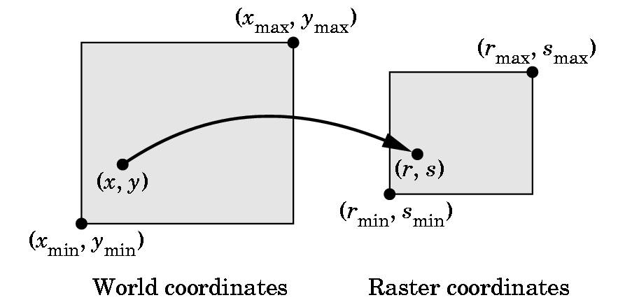
HOW DO WE SPECIFY POINTS?
What coordinates do we use?

Slide 40
VERTICES---i.e. Points
Logically, a point is a triple:
x
y
z
On the slides. I’ll use the notation [ x y z ], since it is easier to write, until we need some matrix formulas.
A vertex command specifies a data structure for a point:
Basic Format: glVertex*( arguments)
gl - specifies library GL
* - is nt or ntv where
n = 2,3, or 4 and specifies the number of argumetns
t = type and specifies i= integer
f = float
d = double
v = says we are defining as a pointer to an array

Slide 41
EXAMPLES
glVertex3f(a,b,c) specifies [a,b,c], where a,b, and c are float values
glVertex2i(x,y) specifies [x,y],where x and y are integers
Given
Glfloat vertex[3];
glVertex3fv(vertex) specifies
[vertex[0], vertex[1], vertex[2]]
glBegin and glEnd group points and, after setting up the necessary environment, they are used to plot various simple primitives. The glBegin is a function call with glEnd closing it.

Slide 42
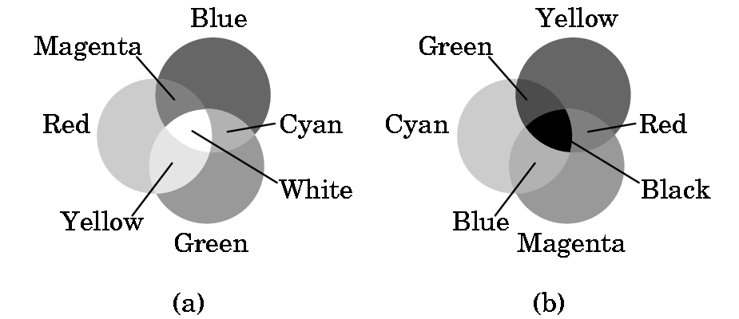
ALREADY TALKED SOME ABOUT COLOR
Color graphics is based on the three-color theory or the additive model of color
This model assumes we add 3 primary colors as if they were spotlights on a dark floor.
Printing uses the subtractive model.

Slide 43
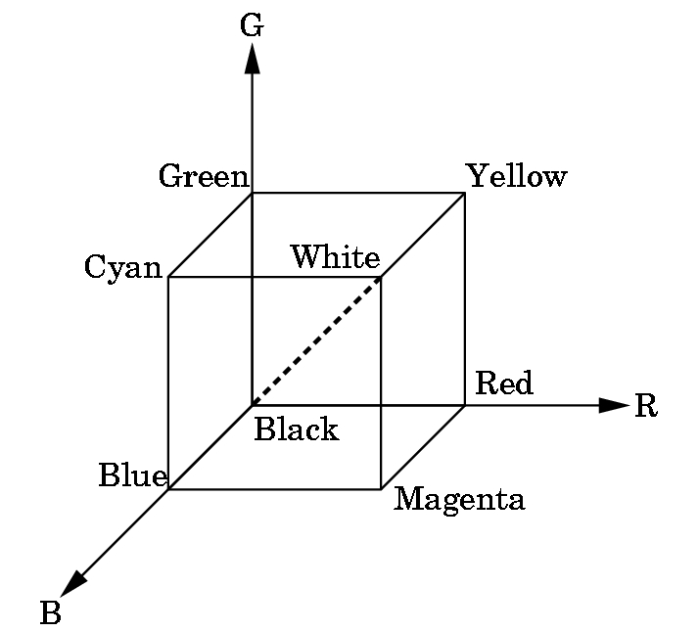
RGB & RGBA SYSTEMS in OpenGL
RGB uses the color cube as a model with intensities between 0.0 and 1.0.
Clear the window to white:
glClearColor(1.0, 1.0, 1.0, 0.0)
Produces white
Alpha component
Alpha component allows blending for special effects
such as translucence.
0.0 = opaque, no light through
1.0 = transparent
glColor3f(1.0,0.0,0.0)
Sets the drawing color to red, until changed.

Slide 44
SOME OTHER EXAMPLES OF RGB COLOR SETTINGS
R G B
dark gray .25 .25 .25
light gray .75 .75 .75
brown .60 .40 .12
pumpkin orange .98 .625 .12
pastel pink .98 .04 .70
purple .6 .4 .7
There are lists of these available (search web)
However, it suffices to just guess and see what you get!

Slide 45
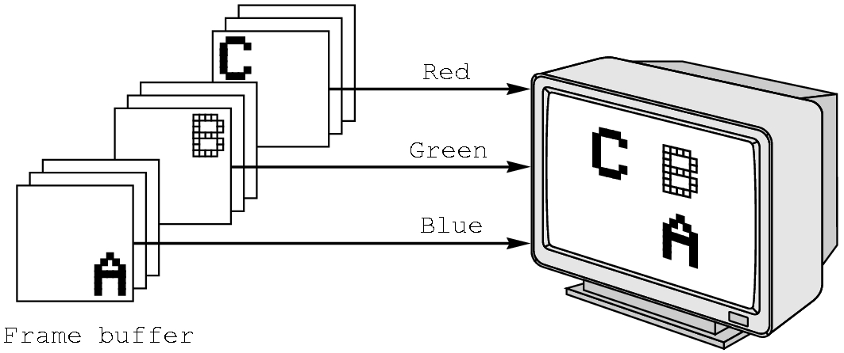
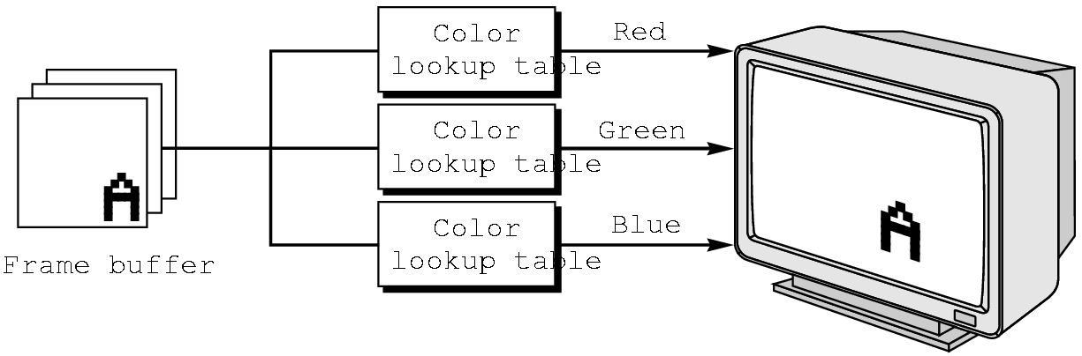
RGB vs INDEXED COLOR
RGB color is harder to support in some hardware due to the size needed in the frame buffer.
OpenGL favors RGB color, although exact reproduction across platforms or results for more color depth than the frame buffer supports are not guaranteed.
GLUT allows indexed color to be specified.

Slide 46
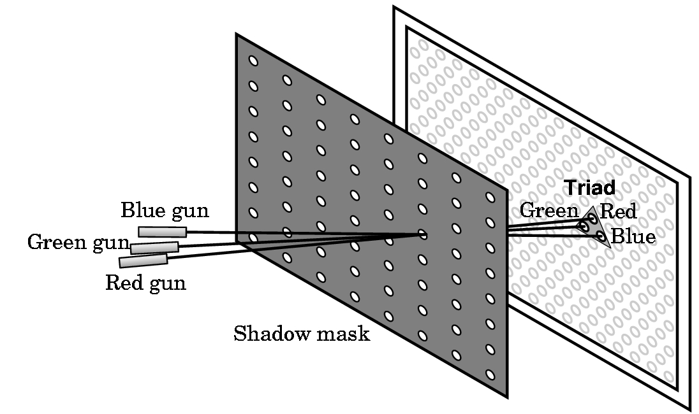
RGB (red-green-blue) shadow mask CRT

Slide 47
SIMPLEST WAY TO REPRESENT COLOR- a simple example
2 bits per gun
  00 dark or off
  01 1/3 brightness – i.e. dim
  10 2/3 brightness
  11 bright
Thus, a color of 011100 gives
  1/3 red + 1 green + 0 blue
  i.e. bright green and dim red
  i.e. perceived as yellow tint

Slide 48
LUT (or look up table)
If we say a device has 3-plane graphics or a 3-bit deep frame buffer, we are saying it is using a LUT with 2³= 8 entries:
index red green blue result
===============================================
0 00 00 00 black
1 10 00 00 medium red
2 11 00 10 reddish purple
.
.
.
7 11 11 11 white
Note: Different LUTs can be defined

Slide 49
The LUT size determines the number of colors that can be displayed simultaneously
Thus, a 3-plane graphics system has a 2³= 8 LUT size and can display only 8 colors simultaneously.
The palette of a device is the number of colors that can be displayed and is a function of the number of color bits stored per pixel.
In our example, 6 bits were used (2 bits per gun, so the palette is 2⁶= 64 colors.

Slide 50
MORE ON COLOR
Low end displays were typically 8-plane devices, i.e. could display only 256 colors simultaneously.
But, palettes typically exist for 8 bits/gun---i.e. have a palette of 2²⁴= 2⁴ * 2²⁰ = 16M of colors (what is called true color in Windows system)
Note: Number of bits/gun is what determines the size needed for the frame buffer as the frame buffer must hold a copy of the image internally

Slide 51
RGB color
Each color component stored separately in the frame buffer
Usually 8 bits per component in buffer
Note in glColor3f the color values range from 0.0 (none) to 1.0 (all), while in glColor3ub the values range from 0 to 255

Slide 52
Indexed Color
Colors are indices into tables of RGB values
Requires less memory
  indices usually 8 bits
  not as important now
    Memory inexpensive
    Need more colors for shading

Slide 53
Color and State
The color as set by glColor becomes part of the state and will be used until changed
  Colors and other attributes are not part of the object but are assigned when the object is rendered
We can create conceptual vertex colors by code such as
glColor
glVertex
glColor
glVertex

Slide 54
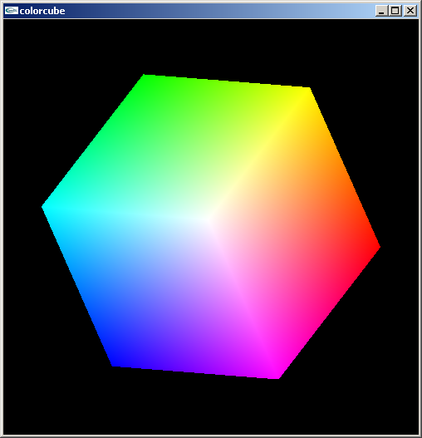
Smooth Color
Default is smooth shading
  OpenGL interpolates vertex colors across visible polygons
Alternative is flat shading
  Color of first vertex
  determines fill color
glShadeModel
  (GL_SMOOTH)
  or GL_FLAT

Slide 55
FRAME BUFFER SIZES
Let
  r = number of rows in display
  c = number of columns in display
  b = number of bits/pixel
Then need frame buffer size of r * c * b
i.e.,
  For r = c = 1024 and b = 24, need
  24 * 2¹⁰ * 2¹⁰ = 3 * 8 * 2²⁰ = 3 M bytes per picture
Most systems are at least double buffered for speed
High end workstations have higher numbers for r, c, and the number of frame buffers

Slide 56
HOW IS THE FRAME BUFFER USED?
Picture is created in frame buffer and scanned to the screen by deflection circuitry:
Refresh rate is given in hertz (Hz)
50-75 Hz required to avoid flicker
i.e. 50-75 scans per second
Inexpensive screens are interlaced on scan--- scan every other row for each refresh.

Slide 57
The algorithm will be coded basically as you would any algorithm with only a few OpenGL commands:
typedef GLfloat point2[2]
void display(void)
//compute and plot 5000 points
{ point2 vertices[3] = {{0.0,0.0}, {250.0,500.0},{500.0,0.0}} //a triangle
point2 p = {75.0, 50.0} //start with a point
int j, k, rand();
for (k=0; k< 5000; k++) { j=rand() %3; // pick a vertex, 0,1,2, at random
// Compute a point halfway between vertex and old point p[0] = (p[0] + vertices[j][0])/2.0; p[1] = (p[1] + vertices[j][1])/2.0;
//Plot new point - these are OpenGL commands glBegin(GL_POINTS); glVertex2fv(p); glEnd;}
glFlush(); //render as soon as possible }

Slide 58
PROJECTION AND VIEWING
We now have our world defined, but we have no display information.
Note that while our points seem to be 2D points, OpenGL views them as 3D points with the z axis settings as 0.
We must specify projection and viewing information (or defaults will be chosen by OpenGL and results will not be what we expect).
If we were just working with a 2D graphics system, we would only have to worry about viewing information.
But, a 3D world must be projected to a 2D plane.

Slide 59
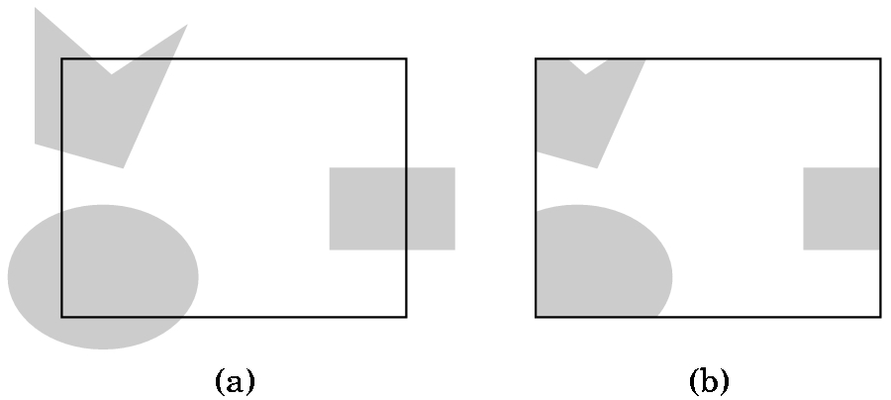
VIEWING AND CLIPPING, IF IN A 2D-GRAPHICS WORLD, IS SIMPLE
A) Shows the world with a 2D viewport outlined
B) Shows the world after clipping to the viewport
But, OpenGL views 2D graphics as
a special case of 3D graphics.
If we do nothing, OpenGL uses
a 2 x 2 x 2 viewing cube with
the origin at the center.
So, we must choose a projection
and then pick a viewing volume.

Slide 60
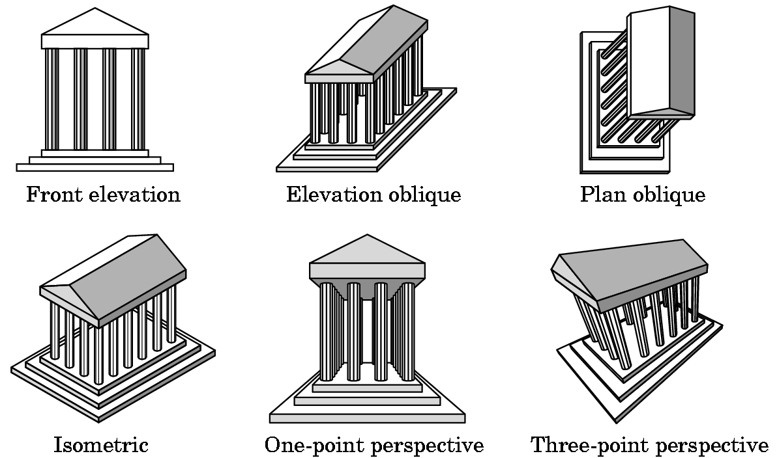
PROJECTIONS
There are many kinds which we will survey in Chapter 5.
Don't worry about definitions now.

Slide 61
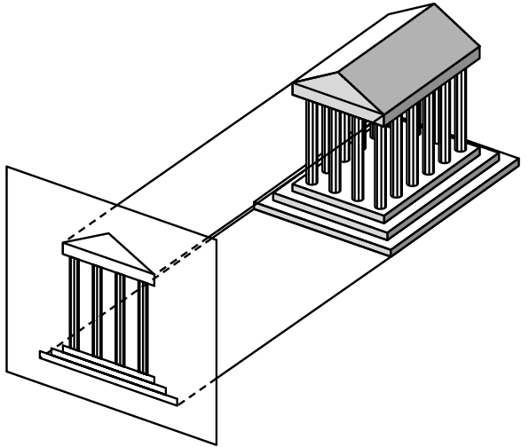

PROJECTION WE WILL USE INITIALLY
The simplest to use is orthographic although the results may look
strange to you as you are not used to looking at orthographic
projections.
3 views
How the projection
is obtained
Orthographic projection

Slide 62
SPECIFYING THE VIEWING VOLUME FOR AN ORTHOGRAPHIC PROJECTION IN OPENGL
near
We need to specify a right
parallelepiped viewing volume. Only objects inside the volume can be seen.
Normally, set 6 bounds- left, right, top
bottom, top, near, and far using an
OpenGL function glOrtho.
far
There is a special version of glOrtho that automatically sets near to -1.0 and far to 1.0. We'll use
gluOrtho2D(0.0,500.0,0.0,500.0);
which will allow us to see all of the triangle defined by
point2 vertices[3]={{0.0,0.0}, {250.0,500.0}, {500.0,0.0}};

Slide 63
THE CODE FOR SETTING THE VIEWING VOLUME
The shifting of coordinate systems (from world, to eye, etc.) is
done using linear algebra techniques that involve matrix multiplication. OpenGL maintains various matrices as part of its internal state. We will study how these work later and, for now, we just will use the necessary commands to manipulate the matrices:
glMatrixMode(GL_PROJECTION); //switch from default MODELVIEW
glLoadIdentity(); //start with identity matrix
gluOrtho2D(0.0,500.0,0.0,500.0); //form projection matrix
glMatrixMode(GL_MODELVIEW); //switch mode back
Note: 3 of these functions start with gl and 1 starts with glu.

Slide 64
WINDOWS
Define window:
1) (graphics) A rectangular area of our display measured in 2D screen or window coordinates in pixel units.
2) (workstation world) Part of a multiwindow enviroment managed and produced by an operating system (such as Microsoft 2000) or a windowing system (such as X-Windows).
A window in which the graphics window appears is one of the windows managed by the workstation world.
We use GLUT to specify information about our graphics window which will be used by the windowing system for the platform on which we are running ...

Slide 65
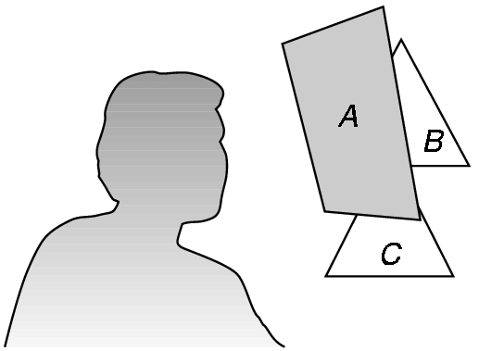
The Standard GLUT Initialization
(at least for now)
#include <glut.h>
void main(int argc, char** argv) {
glutInit(&argc,argv); //required, but not used now
glutInitDisplayMode(GLUT_SINGLE | GLUT_RGB); //actually, default
glutInitWindowsSize(500,500); //500 x 500 pixel window
glutInitWindowPosition(0,0); //place anchored at top left
glutCreateWindow("Sierpeinski Gasket"); //window title
glutDisplayFunc(display); /*display callback invoked when window opened,
when window is moved, or when front window is removed */
myinit(); //calls code to set attributes and viewing information
glutMainLoop(); //enter event loop- everything else invoked by events!
}
Some variations for the display mode:
GLUT_DOUBLE- double buffer for hidden-surface removal
GLUT_DEPTH- hidden surface removal
GLUT_INDEX - for indexed color

Slide 66
Now have the complete program (after adding a few commands to the computational part for windows):
Organization:
1) Header files and usual documentation of purpose of program, your name, class, and date
2) myinit function--- sets attributes and viewing parameters
3) display callback function--- automatically invoked when an event happens. Does the computational part.
4) main function--- standard GLUT initialization

Slide 67
// 2D Sierpinski Gasket---Program in the textbook
// in Appendix A1, page 630
#include <glut.h> //will work in the labs
//varies depending on location of file
void myinit(void) {
//attributes:
glClearColor(1.0, 1.0, 1.0, 1.0); //white background
glColor3f(1.0,0.0, 0.0); //red drawing
//set up projection and viewing volume
glMatrixMode(GL_PROJECTION);
glLoadIdentity();
gluOrtho2D(0.0,500.0,0.0,500.0);
glMatrixMode(GL_MODELVIEW);
}

Slide 68
void display(void) {
//define a point data type
typedef Glfloat point2[2];
//and the triangle
point2 vertices[3]={{0.0,0.0}, {250.0,500.0}, {500.0,0.0}};
//establish structures for the computation
int i, j, k; int rand(); point2 p={75.0, 50.0};
//OpenGL command added to clear the window
glClear(GL_COLOR_BUFFER_BIT);
//Now add all the computation code:

Slide 69
//Computational stuff from an earlier slide
//compute and plot 5000 points for (k=0; k< 5000; k++) { j=rand() %3; // pick a vertex at random
/*Compute a point halfway between vertex and old point */
p[0] = (p[0] + vertices[j][0])/2.0; p[1] = (p[1] + vertices[j][1])/2.0;
//Plot new point
glBegin(GL_POINTS); glVertex2fv(p); glEnd(); }
glFlush();
} //end display callback function

Slide 70
void main(int argc, char** argv) {
glutInit(&argc,argv);
glutInitDisplayMode(GLUT_SINGLE | GLUT_RGB);
glutInitWindowsSize(500,500);
glutInitWindowPosition(0,0);
glutCreateWindow("Sierpeinski Gasket");
glutDisplayFunc(display); //display callback
myinit(); //set attributes and viewing information
glutMainLoop(); //enter event loop- everything else invoked by events!
}

Slide 71
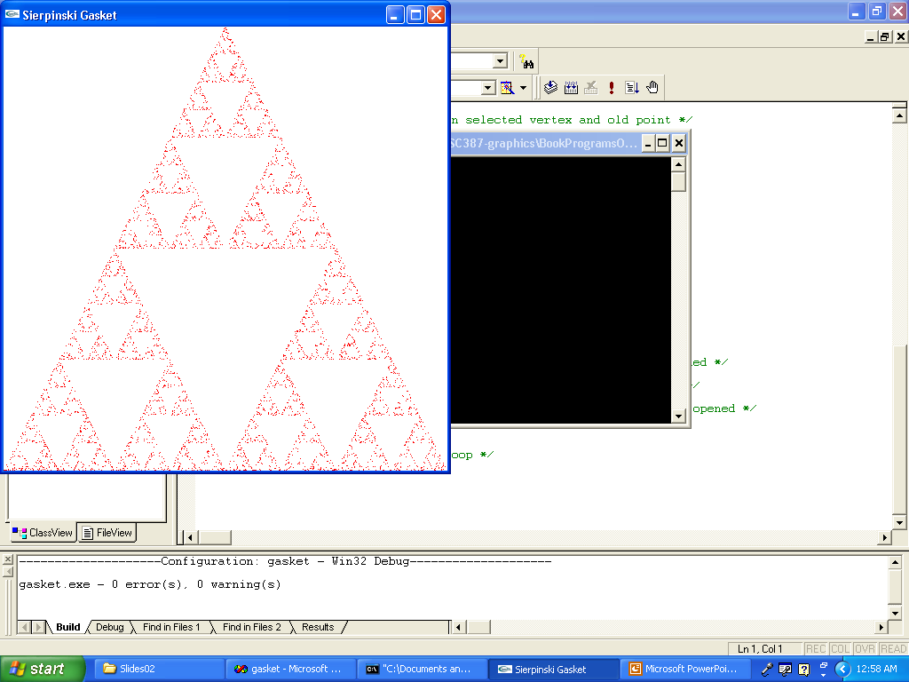
Running gasket.c

Slide 72
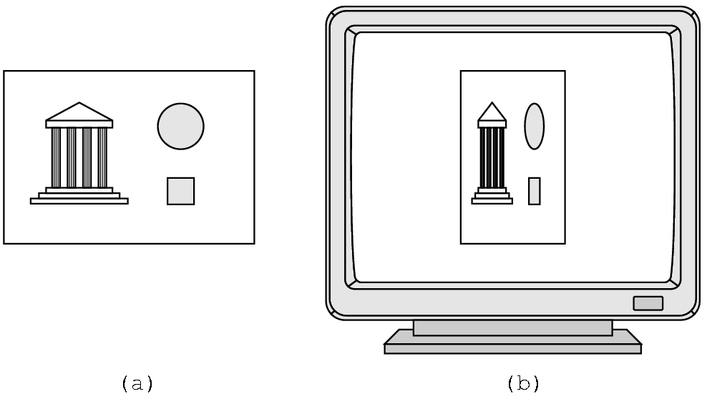
SOME CAUTIONS
Watch the aspect ratio (width/height)
Can choose a viewport
that is not the entire
window---see page 71
We'll look at this further in chapter 3.

Slide 73
3D Sierpinski Gasket
Direct Generalization of 2D version
Easy to extend if just generalize from 2D:
  Need an equivalent 3D model--- a tetrahedron
  point3 vertices [4] = { {0.0, 0.0, 0.0},
  {250.0, 500.0,100.0}, {500.0, 250.0, 250.0},
  {250.0, 100.0, 250.0}}
  A tetrahedron is convex. Therefore, same algorithm works as before
  point3 p = {250.0, 100.0, 250.0};
  Pick a random vertex using j = rand() % 4;
  For midpoint, same idea as before but add
  p[2] = (p[2] + vertices[j][2])/2.0;

Slide 74
Changing the color of the dots based on the placement in the tetrahedron adds some interest to the drawing:
glBegin(GL_POINTS);
glColor3f(p[0]/250.0, //red component p[1]/250.0, //green component p[2]/250.0); //blue component
glEnd;
Now we need a 3D clipping volume:
glOrtho(0.0, 500.0, 0.0, 500.0, -500.0, 500.0);
which sets the left, right, bottom, top, near, and far planes at
the values specified.
There is a slight variation of this code available as gasket3d.c or A.3 on pg 633. The changes are ...

Slide 75
RUNNING THE CODE FOR A.3 ON PAGE 633
Use only one include file, glut.h
Comment out the line in mouse that deals with the MIDDLE_BUTTON. The NULL may not be recognized or use #define NULL 0
We will use only 2 button mice
There are some slight changes from what I presented in class, namely:
  A typedef is used to build a structure so that records are used instead of arrays (hence the notation such as new.x etc.)
  Mouse actions are included which we haven't discussed yet (and may not compile).
  I set the color using a form of p[i]/250, as in the text discussion, but the code uses other settings (that are not equivalent, but are ok.) The idea is to distinguish locations.

Slide 76
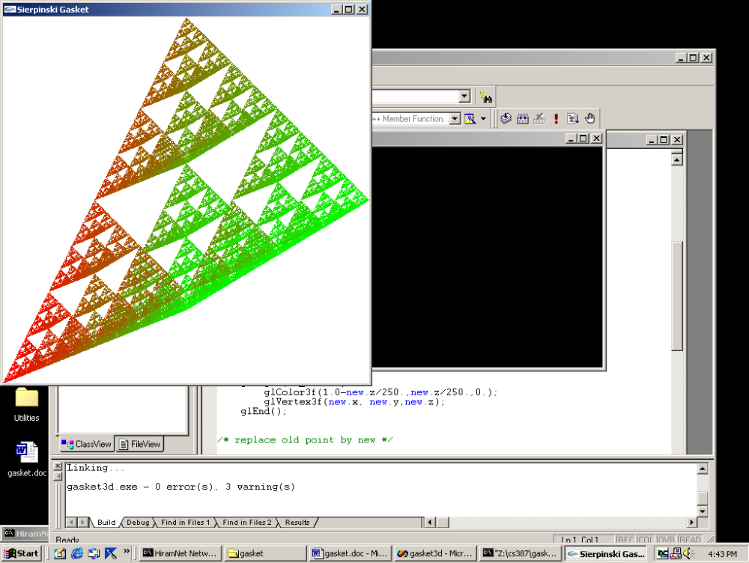
THE RESULT OF RUNNING gasket3d.c
Note: This plots until the right mouse is clicked.

Slide 77
ANOTHER ALGORITHM FOR THE SIERPINSKI GASKET
Recursively subdivide
Use polygons instead of points:
Recursively subdivide a triangle throwing away the center section each time.
When the triangles are small (the size of a pixel), draw them.
Fix the number of calls to make globally.
Note: with OpenGL we can't pass data to functions and callbacks easily.
Remove from
consideration

Slide 78
Some remarks about the function code in the 2D recursive gasket program, A.2, on page 632 of text:
triangle: Note that GL_TRIANGLES takes 3 points, forms the triangle, and fills the interior with color that is set.
divide_triangle:
  Recursive
  Initial call is in display function
  4th parameter controls the depth of recursive calls
  Called initially with the 3 original vertices.
display: Very simple as just clear color bit, do recursive call, and flush
myinit: As before, but in different order for no reason.
main:Very much as before, but need to change n=atoi(argv[1]) , which is a picking up a command line argument, to n = 5 (or some other small number). This is the number of recursive calls you desire.

Slide 79
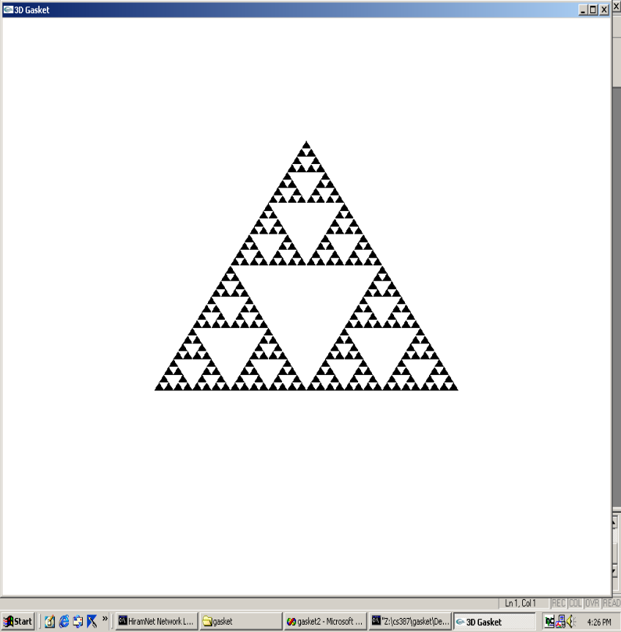
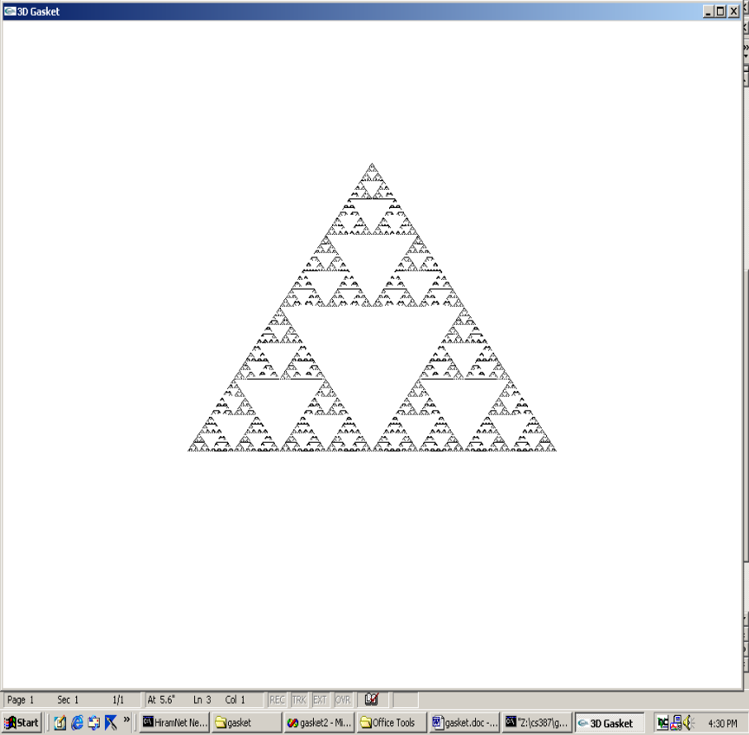
RUNNING gasket2.c AFTER RECURSIVE CALLS
5 CALLS
8 CALLS

Slide 80
3D RECURSIVE GASKET
In appendix
Available on CD
Not many changes --- some are as we did before
Some of changes are cosmetic--- for example, typedef defining a structure.
Some are changes we will ignore right now:
  glNormal3fv command
  and the myReshape command code I will just handwave for now
Otherwise …
Establish the tetrahedron inside the unit cube (why will become clear in a later chapter).

Slide 81
3D RECURSIVE GASKET
A4 in appendix, page 635
triangle- as before, draws and fills a 3D triangle
  the addition of glNormal3fv(a) establishes constant shading and this will be explained later
divide_triangle- exactly as before
tetrahedron- subdivides each face of tetrahedron into triangles and changes colors for each face (red, green, blue, and black)
display- We now want hidden surface removal using the z-value to determine which point is displayed. This requires more memory for the frame buffer. So,we add
  glClear(GL_COLOR_BUFFER_BIT | GL_DEPTH_BUFFER_BIT);

Slide 82
3D RECURSIVE GASKET
A4 in appendix, page 635
myReshape - the reshape command is called whenever the window is resized. As resizing can mess up the aspect ratio, the calculations here are to preserve the aspect ratio.
  We'll discuss this in a minute, but w is set automatically to the new window width and h to the new window height.
  In main, glutReshapeFunc(myReshape) registers this function as the reshape function.
main- as before, change atoi code. Also, for depth handling, include GLUT_DEPTH and GL_DEPTH_TEST and the appropriate places.

Slide 83
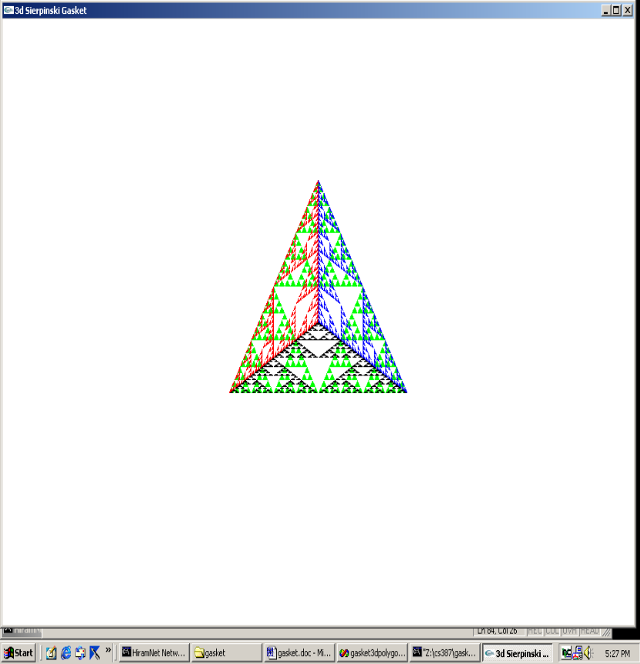
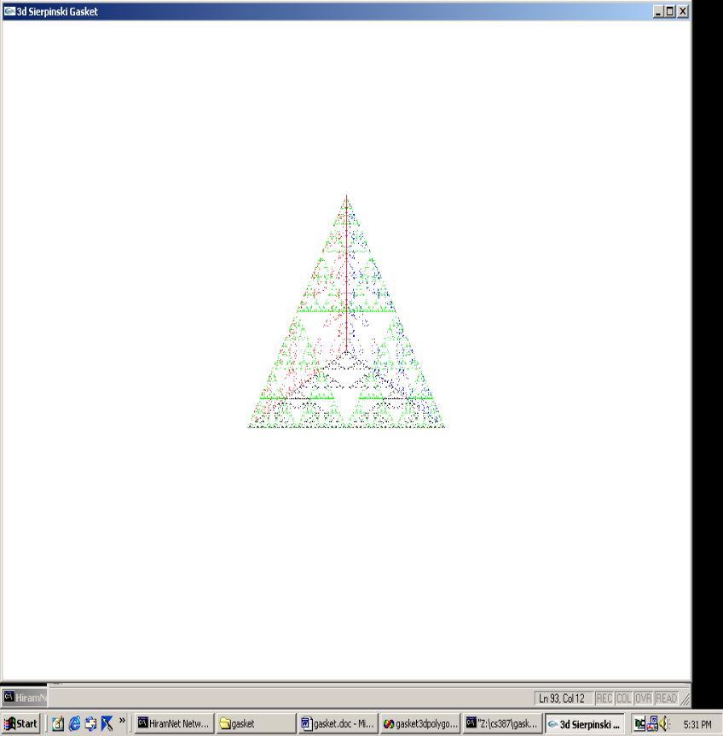
RUNNING tetra.c
AFTER RECURSIVE CALLS
n=5
n=10

Slide 84
THE RESHAPE CODE
void myReshape(int w, int h) //w= width of new window and h=height //set automatically when invoked with a new window size //set as the number of pixels
{ glViewport(0,0,w,h); //set a viewport in the display area of proper size
glMatrixMode(GL_PROJECTION); //switch matrices, as before
glLoadIdentity(); //always start fresh
if (w <= h) //choose a clipping rectangle with the same aspect ratio (w/h) as window
glOrtho(-2.0, 2.0, -2.0 * (GLfloat) h / (GLfloat) w,
2.0 * (GLfloat) h / (GLfloat) w, -10.0, 10.0); else...
EXAMPLE: w= 200 and h = 300 Then setting is
bottom = 3/2 * (-2) = -3 and top is 3/2 *2= 3.
The aspect ratio( of the window is 2:3 and the aspect ratio of the clipping rectangle is also 4:6 (which is also 2:3).
Note the w > h case is handled similarly with left and right being scaled appropriately.

Slide 85
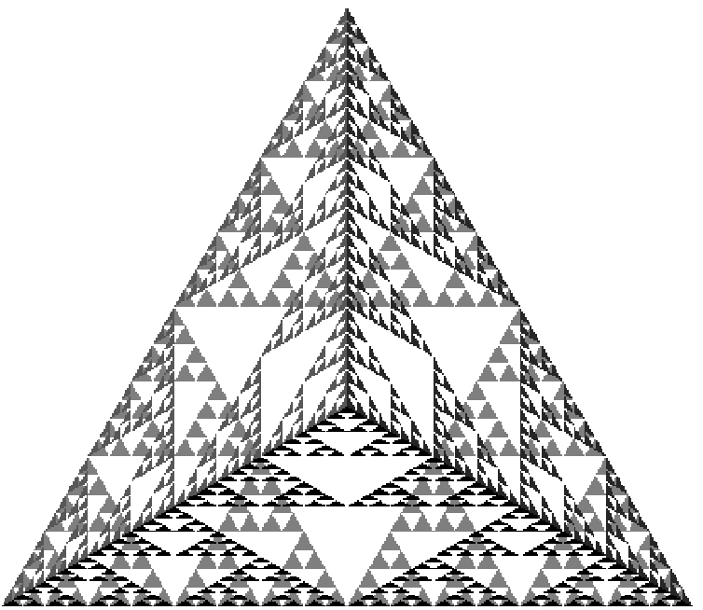
Which program, if any, produces this view?

Slide 86
Homework- open ended
Run the 4 gasket programs in the text. Start with the source code, not the executable code. Capture the last image you generate for each, and place the image in a .doc file.
Now play with different settings in the files. See if you can predict the results. Capture some screens and state what you saw. Did you predict the results before you ran the code?
I would suggest playing with different settings for
  Colors
  Locations of the planes in the glOrtho command.
Send the results to csgrader@hiram.edu as soon as possible.

Slide 87
Note: we have skipped some material, but we will return to it
Details on some of the primitives (Section 2.4). In particular:
  Polygon types
  Sphere drawing
  Text
  Curved objects
Read Chapter 3:
  Input and Interaction

