Slide 1
Chapter 2
Graphics Programming
OpenGL and GLUT

Slide 2
OpenGL
OpenGL is an API (application programmer’s interface)
Many APIs exist
Forerunner of OpenGL was GL from Silicon Graphics, Inc.(SGI) designed for high end IRIS workstations which is optimized for display, has ultrafast matrix transformations, and support for depth buffering.
OpenGL was SGI’s attempt to improve graphics portability.

Slide 3
OpenGL
Introduced July 1, 1992 at first Win32 developers conference.
SGI demonstrated how OpenGL had been used for Terminator2 and medical imaging.
Although Microsoft distributes OpenGL with Windows version, it does not control it. There is an OpenGL Architecture Review Board which includes SGI, IBM, Intel, and Microsoft. Meetings are open, but you must obtain attendance approval in advance.
Version1.1 was released in Dec, 1995

Slide 4
DESCRIPTIVE vs PROCEDURAL
GRAPHICS LANGUAGE
Descriptive
  Describe the scene and how it should appear
Procedural
  Programmer actually describes the steps necessary to achieve a certain appearance or effect
OpenGL is a procedural graphics language
The steps involve calls to various commands and functions (120+)
These draw graphical primitives such as points, lines, and polygons in 3D

Slide 5
OPENGL
Can add lighting, shading, texture mapping, animation, curve drawing, and other special effects
As OpenGL is procedural, these additions must be specified by the programmer.
OpenGL does NOT include functions for window management, user interaction, I/0.
Each host environment has its own way of handing over to OpenGL the drawing and control of a window or bitmap.

Slide 6

THE POSITIONING OF A GRAPHICS SYSTEM

Slide 7
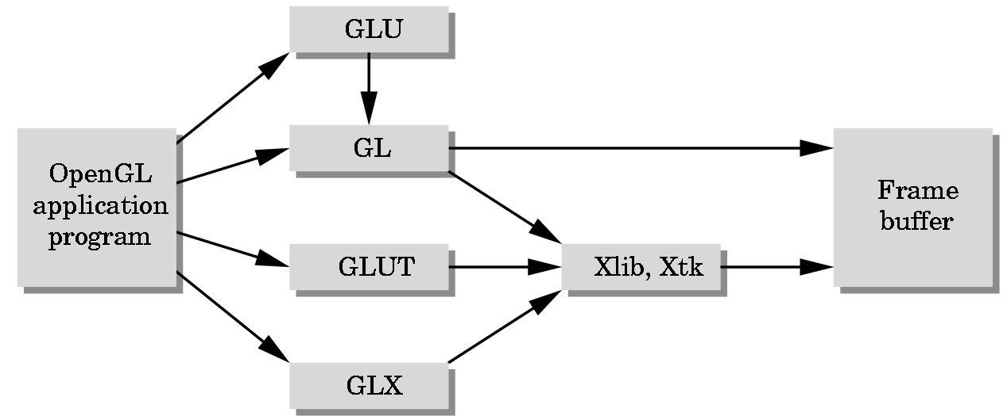
GLUT = GL Utility Toolkit
A library that acts as a common interface to different versions of
windowing environments such as
Microsoft’s
SIGs
X-windows etc.

Slide 8
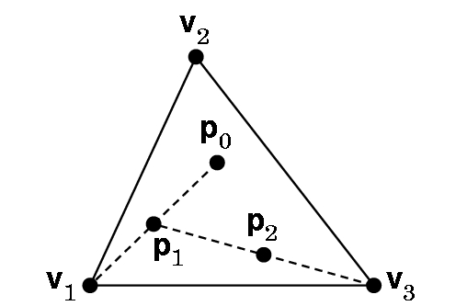
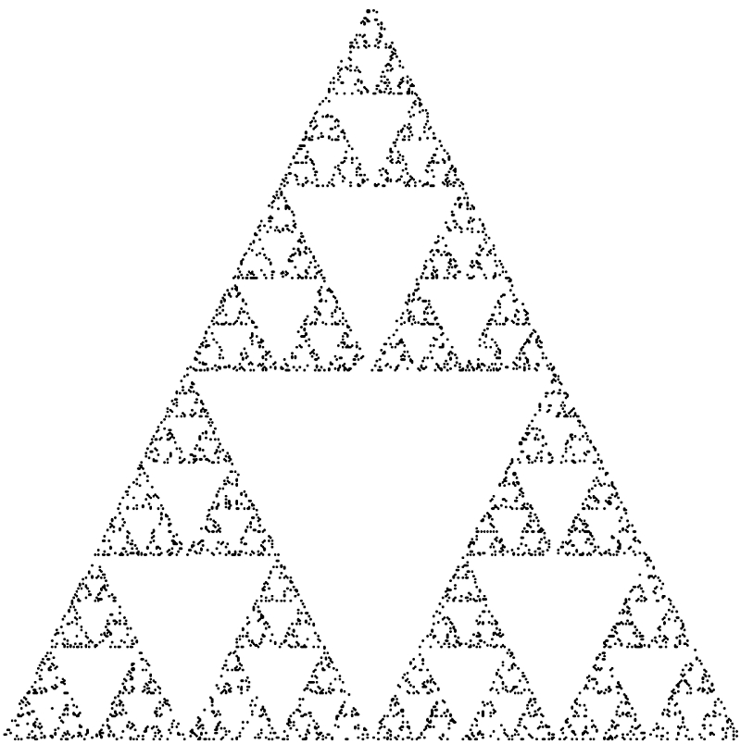
Our First Example
2D---but viewed in a 3D world
Construction: Start with 3 points forming vertices of an equilateral triangle.
Continue for a chosen number of points:
1. Randomly pick a point inside triangle
2. Randomly pick a vertex.
3. Find midpoint of the line segment between the vertex and point.
4. Display the new point.
5. Replace the initial point with the new point.
6. Return to 2 if the specified number of points have not been plotted,
2D Sierpinski Gasket

Slide 9
BEFORE WE CAN DEVELOP A
PROGRAM WE NEED TO ANSWER SOME QUESTIONS
How are points specified?
How are colors specified?
Where on the screen will the image appear?
How will the image be sized?
How is a window created for the image?
How much of the 2D drawing surface which represents the image will be displayed?
How long will the image remain on the screen?
What happens if another window is moved over the drawing window and then moved away from it?

Slide 10
Want a program … main()
{initialize_the_system(); for (some_number_of_points)
{ generate_a_point(); display_the_point();
} cleanup();
}

Slide 11
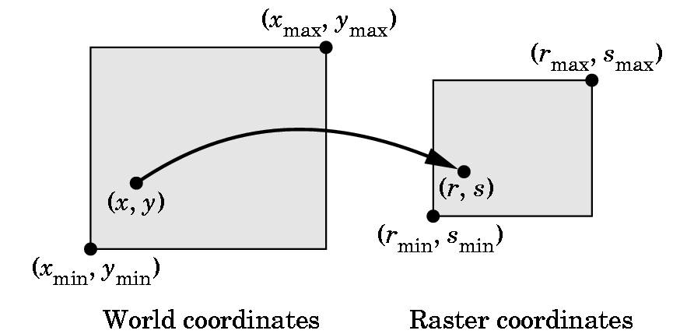
HOW DO WE SPECIFY POINTS?
What coordinates do we use?

Slide 12
VERTICES---i.e. Points
Logically, a point is a triple:
x
y
z
On the slides. I’ll use the notation [ x y z ], since it is easier to write, until we need some matrix formulas.
A vertex command specifies a data structure for a point:
Basic Format: glVertex*( arguments)
gl - specifies library GL
* - is nt or ntv where
n = 2,3, or 4 and specifies the number of argumetns
t = type and specifies i= integer
f = float
d = double
v = says we are defining as a pointer to an array

Slide 13
EXAMPLES
glVertex3f(a,b,c) specifies [a,b,c], where a,b, and c are float values
glVertex2i(x,y) specifies [x,y],where x and y are integers
Given
Glfloat vertex[3];
glVertex3fv(vertex) specifies [vertex[0], vertex[1], vertex[2]]
glBegin and glEnd group points and, after setting up the necessary environment, they are used to plot various simple primitives ...

Slide 14
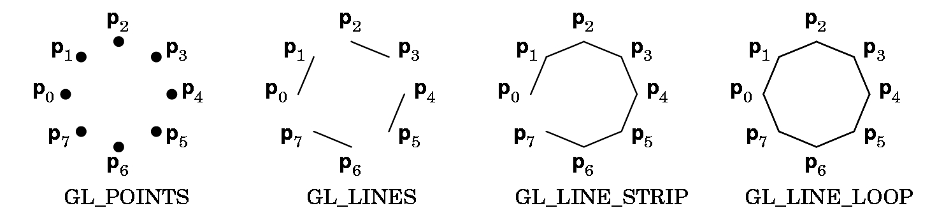
Example:
glBegin(GL-POINTS);
glVertex2f(2.0, 3.0);
glVertex2f(1.0,3.5);
glVertex2f(3.4, 5.4);
glEnd();
Plots 3 points (which may or may not be seen) as their display depends on the view.
The points are in world coordinates.

Slide 15
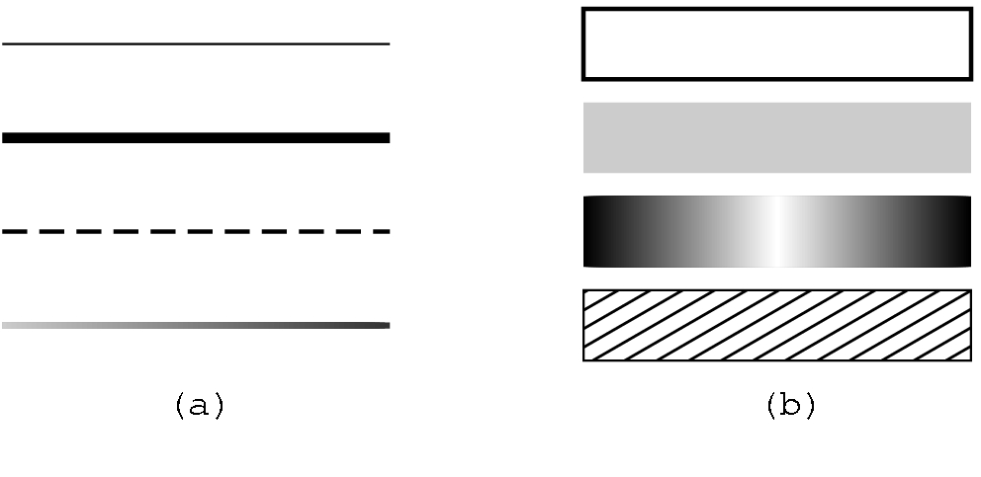
glBegin(Z);
glVertex2f(x1,y1);
glVertex2f(x2,y2);
glVertex2f(x3,y3);
glEnd();
Z is GL_POINTS: 3 points
Z is GL_LINES: one line segment as the points are chosen pairwise
Add a fourth point to the above,
glVertex2f(x4,y4);
Z is GL_STRIP: a polyline
Z is GL_LINE_LOOP: closes the loop in the polyline
Various line sizes and patterns can be specified.
glPointSize(2.0);
glLineWidth(2.0);

Slide 16
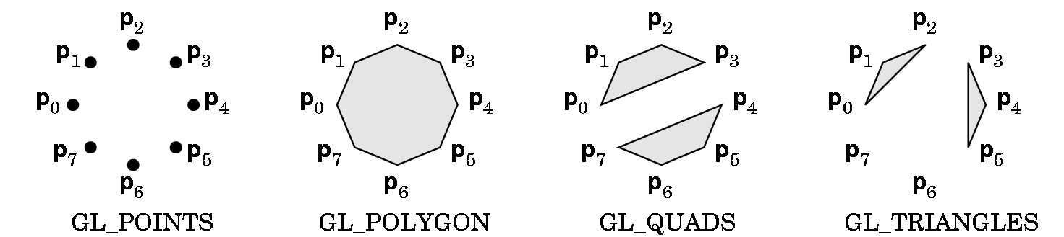
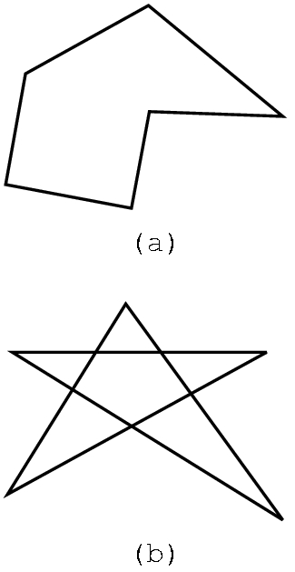
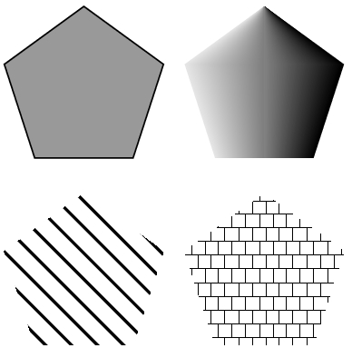
POLYGONS: Defined in a similar fashion.
GL_QUADS and GL_TRIANGLES are special cases.
Polygons play a special role in graphics as they can be
displayed rapidly
used to approximate curved lines
These can be filled with color or patterns.
But, results can be unpredictable for
polygons that are not simple.

Slide 17
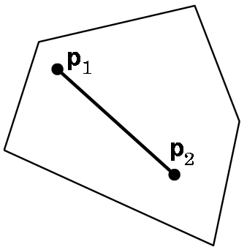
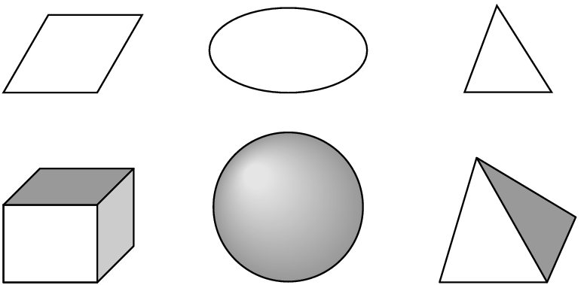
Most APIs work best with convex objects:
Definition: An object is convex if given any two
points p1 and p2 in the object, all points on a
line segment connecting p1 and p2 are in the
object.
Convex objects can be 2-dimensional,
3-dimensional (or, in fact, n-dimensional).

Slide 18
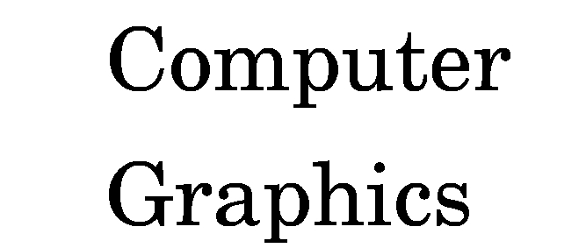
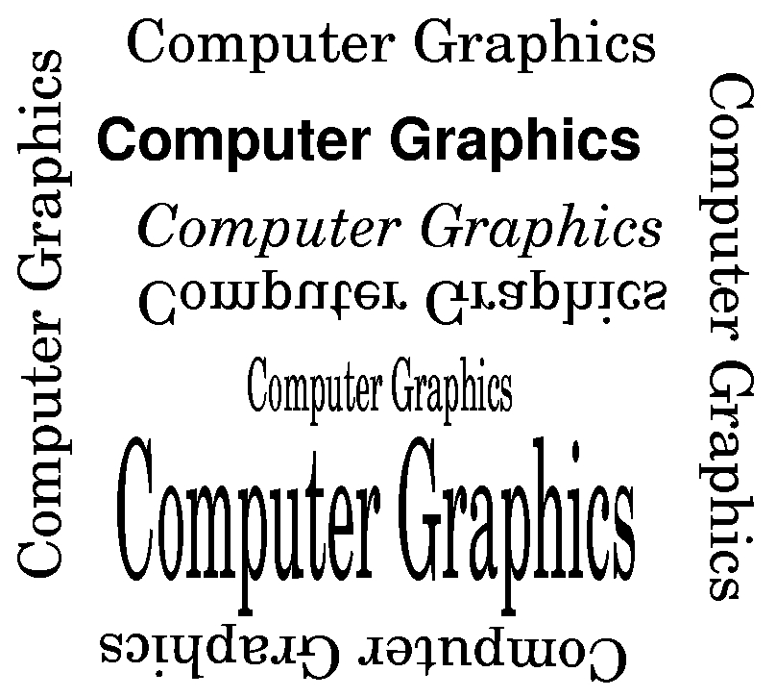
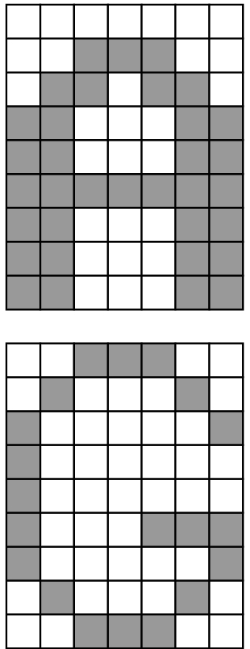
Text can be specified in multiple fonts and with various orientations:
Stroke text
Raster text
OpenGL does not have a text primitive.
GLUT provides several bitmap and stroke sets that can be used.

Slide 19
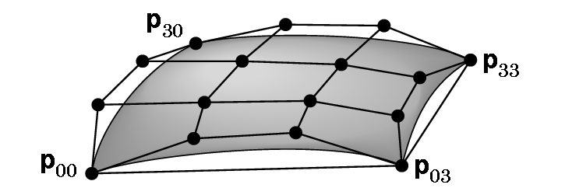
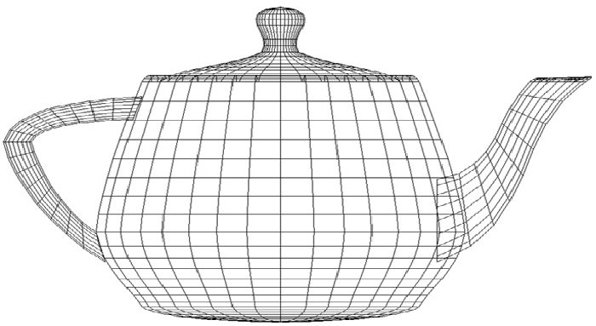
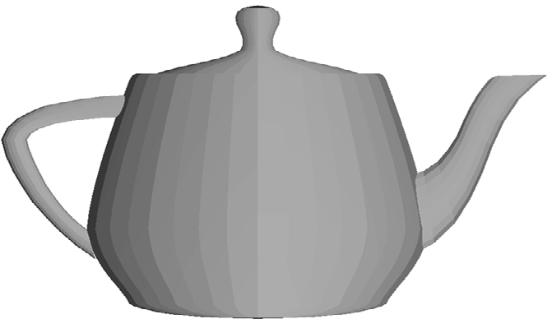
SOME CURVES ARE GENERATED BY MATHEMATICAL FUNCTIONS USING POINTS TO CONTROL THE SURFACES
An example of a Bezier patch
Famous
teapot

Slide 20
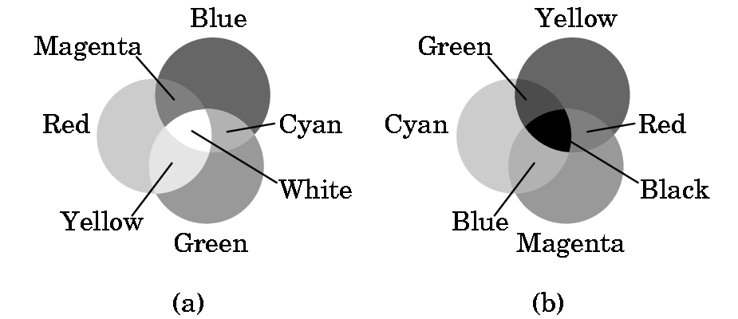
ALREADY TALKED SOME ABOUT COLOR
Color graphics is based on the three-color theory or the additive model of color
This model assumes we add 3 primary colors as if they were spotlights on a dark floor.
Printing uses the subtractive model.

Slide 21
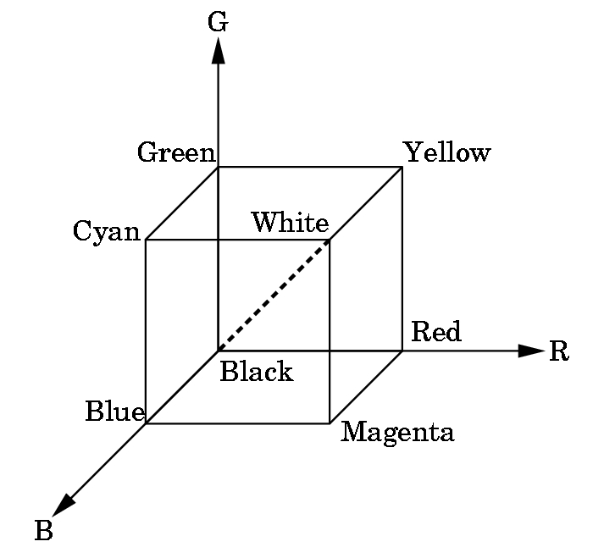
RGB & RGBA SYSTEMS in OpenGL
RGB uses the color cube as a model with intensities between 0.0 and 1.0.
Clear the window to white:
glClearColor(1.0, 1.0, 1.0, 0.0)
Produces white
Alpha component
Alpha component allows blending for special effects
such as translucense.
0.0 = opaque, no light through
1.0 = transparent
glColor3f(1.0,0.0,0.0)
Sets the drawing color to red, until changed.

Slide 22
SOME OTHER EXAMPLES OF RGB COLOR SETTINGS
R G B
dark gray .25 .25 .25
light gray .75 .75 .75
brown .60 .40 .12
pumpkin orange .98 .625 .12
pastel pink .98 .04 .70
purple .6 .4 .7
There are lists of these available (search web) or just guess and see what you get!

Slide 23
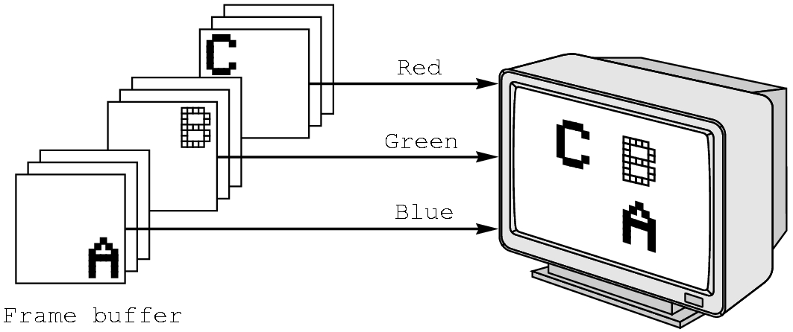
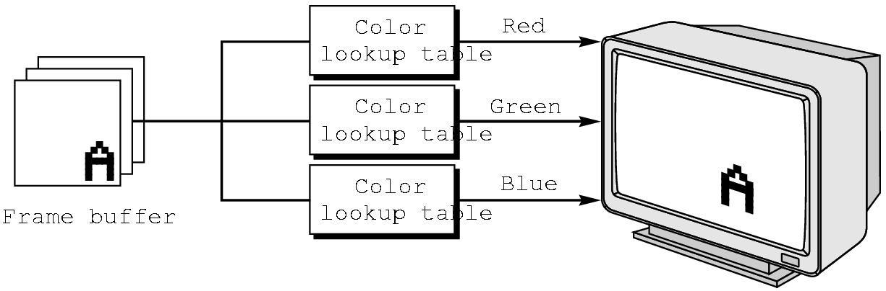
RGB vs INDEXED COLOR
RGB color is harder to support in some hardware due to the size needed in the frame buffer.
OpenGL favors RGB color, although exact reproduction across platforms or results for more color depth than the frame buffer supports are not guaranteed.
GLUT allows indexed color to be specified.

Slide 24
First Steps
We now have the means of building an object.
We can choose any coordinates we wish as our viewing choices will specify what is seen.
So we can build the 3 points for the 2D triangle as:
typedef Glfloat point2[2];
point2 vertices[3]={{0.0,0.0}, {250.0,500.0}, {500.0,0.0}}; // triangle
Glfloat (and Glint) are special data structures in OpenGL. Use these instead of the usual C or C++ types. Watch the capitalization!
Why use these values for the points? No reason---they just make a
nice equilateral triangle. You can choose any you wish.

Slide 25
The algorithm will be coded basically as you would any algorithm with only a few OpenGL commands:
int i, j, k; //i and j are point indices; k is looping variable int rand(); //C++ random number generator point2 p={75.0, 50.0}; //start somewhere
[A OpenGL command will go here in a minute for viewing]
/* compute and plot 5000 points */ for (k=0; k< 5000; k++) { j=rand() %3; // pick a vertex at random
/* Compute a point halfway between vertex and old point */ p[0] = (p[0] + vertices[j][0])/2.0; p[1] = (p[1] + vertices[j][1])/2.0;
/* Plot new point - these are OpenGL commands*/ glBegin(GL_POINTS); glVertex2fv(p); glEnd(); }

Slide 26
PROJECTION AND VIEWING
We now have our world defined, but we have no display information.
Note that while our points seem to be 2D points, OpenGL views them as 3D points with the z axis settings as 0.
We must specify projection and viewing information (or defaults will be chosen by OpenGL and results will not be what we expect).
If we were just working with a 2D graphics system, we would only have to worry about viewing information.
But, a 3D world must be projected to a 2D plane.

Slide 27
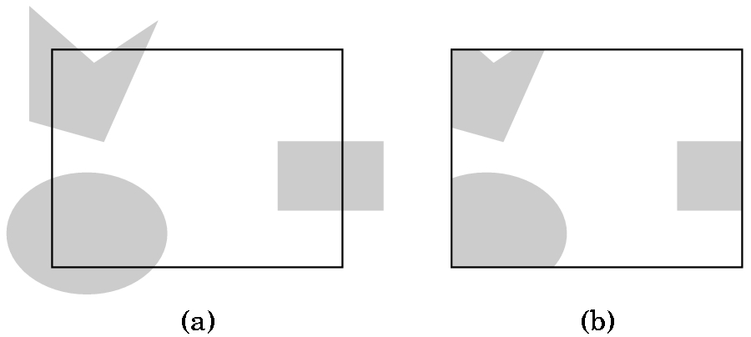
VIEWING AND CLIPPING, IF IN A 2D-GRAPHICS WORLD, IS SIMPLE
A) Shows the world with a 2D viewport outlined
B) Shows the world after clipping to the viewport
But, OpenGL views 2D graphics as
a special case of 3D graphics.
If we do nothing, OpenGL uses
a 2 x 2 x 2 viewing cube with
the origin at the center.
So, we must choose a projection
and then pick a viewing volume.

Slide 28
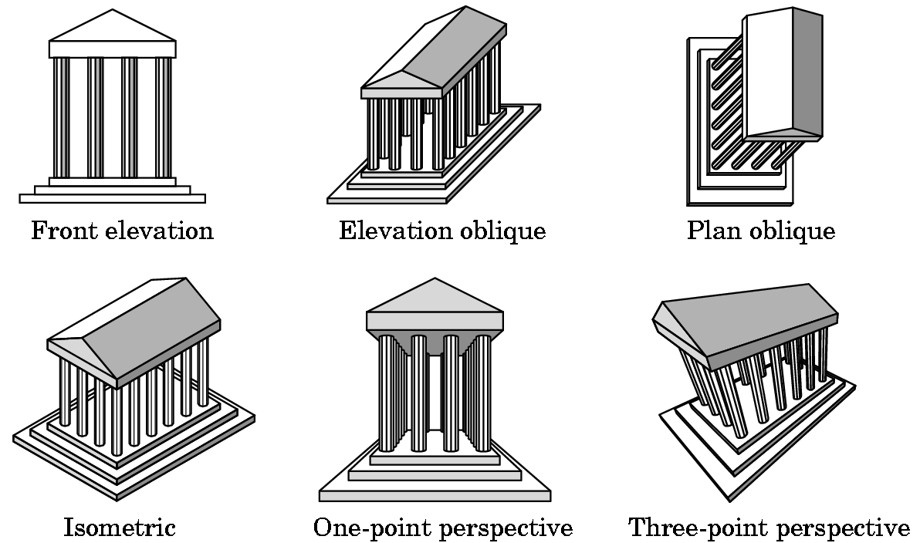
PROJECTIONS
There are many kinds which we will survey in Chapter 5.
Don't worry about definitions now.

Slide 29
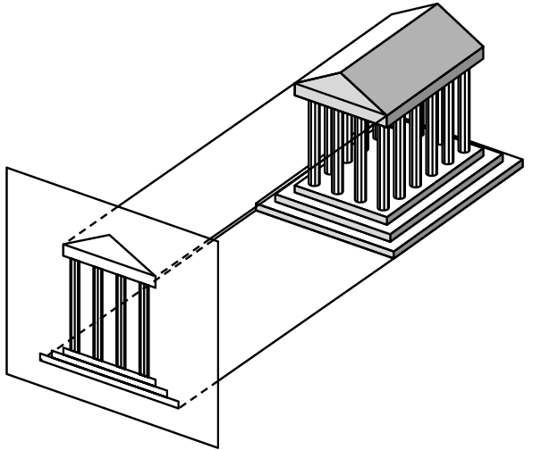
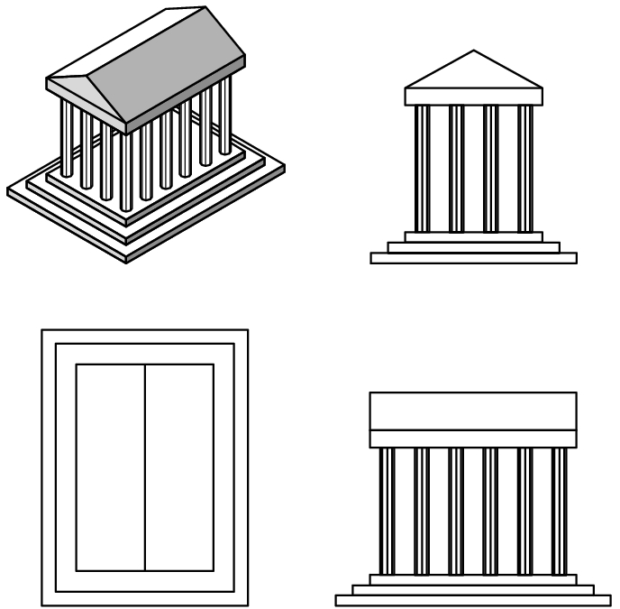
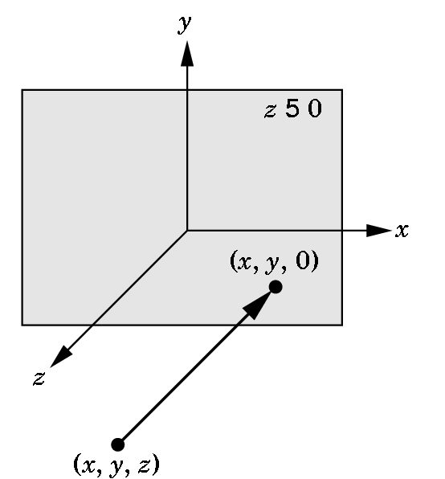
PROJECTION WE WILL USE INITIALLY
The simplest to use is orthographic although the results may look
strange to you as you are not used to looking at orthographic
projections.
3 views
How the projection
is obtained
Orthographic projection

Slide 30
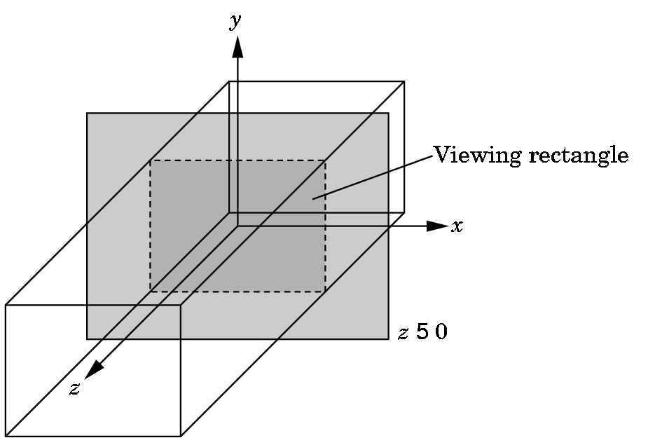
SPECIFYING THE VIEWING VOLUME FOR AN ORTHOGRAPHIC PROJECTION IN OPENGL
near
We need to specify a right
parallelepiped viewing volume. Only objects inside the volume can be seen.
Normally, set 6 bounds- left, right, top
bottom, top, near, and far using an
OpenGL function glOrtho.
far
There is a special version of glOrtho that automatically sets near to -1.0 and far to 1.0. We'll use
gluOrtho2D(0.0,500.0,0.0,500.0);
which will allow us to see all of the triangle defined by
point2 vertices[3]={{0.0,0.0}, {250.0,500.0}, {500.0,0.0}};

Slide 31
THE CODE FOR SETTING THE VIEWING VOLUME
The shifting of coordinate systems (from world, to eye, etc.) is
done using linear algebra techniques that involve matrix multiplication. OpenGL maintains various matrices as part of its internal state. We will study how these work later and, for now, we just will use the necessary commands to manipulate the matrices:
glMatrixMode(GL_PROJECTION); //switch from default MODELVIEW
glLoadIdentity(); //start with identity matrix
gluOrtho2D(0.0,500.0,0.0,500.0); //form projection matrix
glMatrixMode(GL_MODELVIEW); //switch mode back
Note: 3 of these functions start with gl and 1 starts with glu.

Slide 32
WINDOWS
Define window:
1) (graphics) A rectangular area of our display measured in 2D screen or window coordinates in pixel units.
2) (workstation world) Part of a multiwindow enviroment managed and produced by an operating system (such as Microsoft 2000) or a windowing system (such as X-Windows).
A window in which the graphics window appears is one of the windows managed by the workstation world.
We use GLUT to specify information about our graphics window which will be used by the windowing system for the platform on which we are running ...

Slide 33
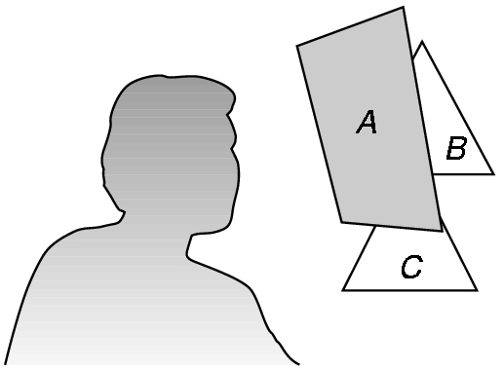
The Standard GLUT Initialization
(at least for now)
void main(int argc, char** argv) {
glutInit(&argc,argv); //required, but not used now
glutInitDisplayMode(GLUT_SINGLE | GLUT_RGB); //actually, default
glutInitWindowsSize(500,500); //500 x 500 pixel window
glutInitWindowPosition(0,0); //place anchored at top left
glutCreateWindow("Sierpeinski Gasket"); //window title
glutDisplayFunc(display); /*display callback invoked when window opened,
when window is moved, or when front window is removed */
myinit(); //calls code to set attributes and viewing information
glutMainLoop(); //enter event loop- everything else invoked by events!
}
Some variations for the display mode:
GLUT_DOUBLE- double buffer for hidden-surface removal
GLUT_DEPTH- hidden surface removal
GLUT_INDEX - for indexed color

Slide 34
Now have the complete program (after adding a few commands to the computational part for windows):
Organization:
1) Header files and usual documentation of purpose of program, your name, class, and date
2) myinit function--- sets attributes and viewing parameters
3) display callback function--- automatically invoked when an event happens. Does the computational part.
4) main function--- standard GLUT initialization

Slide 35
// 2D Sierpinski Gasket---Program in the textbook
// in Appendix A1, page 530
#include <glut.h> //will work in the labs
//varies depending on location of file
void myinit(void) {
//attributes:
glClearColor(1.0, 1.0, 1.0, 1.0); //white background
glColor3f(1.0,0.0, 0.0); //red drawing
//set up projection and viewing volume
glMatrixMode(GL_PROJECTION);
glLoadIdentity();
gluOrtho2D(0.0,500.0,0.0,500.0);
glMatrixMode(GL_MODELVIEW);
}

Slide 36
void display(void) {
//define a point data type
typedef Glfloat point2[2];
//and the triangle
point2 vertices[3]={{0.0,0.0}, {250.0,500.0}, {500.0,0.0}};
//establish structures for the computation
int i, j, k; int rand(); point2 p={75.0, 50.0};
//OpenGL command added to clear the window
glClear(GL_COLOR_BUFFER_BIT);
//Now add all the computation code:

Slide 37
/Computational stuff from an earlier slide
//compute and plot 5000 points for (k=0; k< 5000; k++) { j=rand() %3; // pick a vertex at random
/*Compute a point halfway between vertex and old point */
p[0] = (p[0] + vertices[j][0])/2.0; p[1] = (p[1] + vertices[j][1])/2.0;
//Plot new point
glBegin(GL_POINTS); glVertex2fv(p); glEnd(); }
glFlush(); //added- clear buffers
} //end display callback function

Slide 38
void main(int argc, char** argv) {
glutInit(&argc,argv);
glutInitDisplayMode(GLUT_SINGLE | GLUT_RGB);
glutInitWindowsSize(500,500);
glutInitWindowPosition(0,0);
glutCreateWindow("Sierpeinski Gasket");
glutDisplayFunc(display); //display callback
myinit(); //set attributes and viewing information
glutMainLoop(); //enter event loop- everything else invoked by events!
}

Slide 39
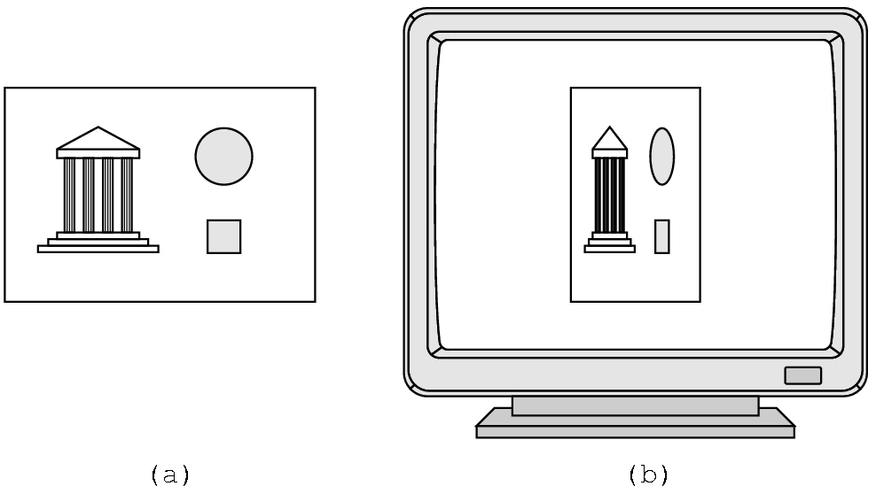
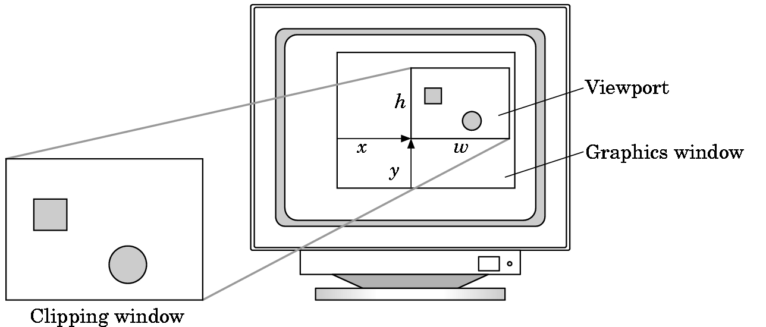
SOME CAUTIONS
Watch the aspect ratio
Can choose a viewport
that is not the entire
window---see page 67
We'll look at this further in chapter 3.

Slide 40
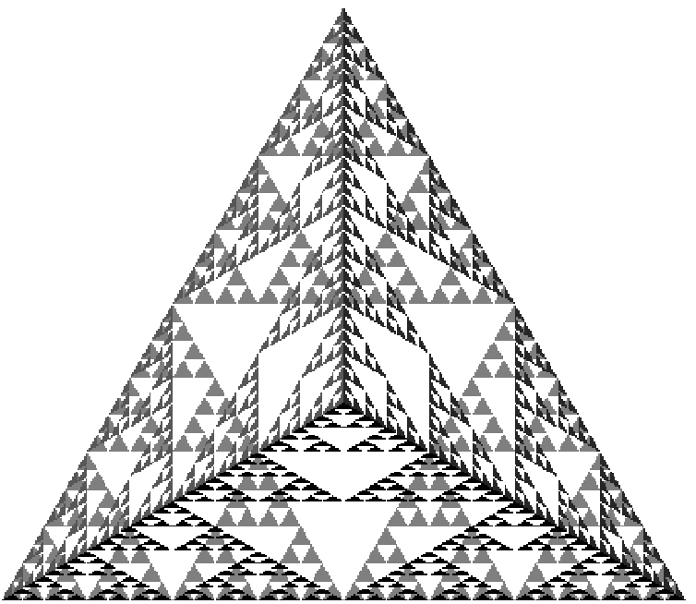

Slide 41
3D Sierpinski Gasket
Direct Generalization of 2D version
Easy to extend if just generalize from 2D:
  Need an equivalent 3D model--- a tetrahedron
  point3 vertices [4] = { {0.0, 0.0, 0.0},
  {250.0, 500.0,100.0}, {500.0, 250.0, 250.0},
  {250.0, 100.0, 250.0}}
  A tetrahedron is convex. Therefore, same algorithm works as before
  point3 p = {250.0, 100.0, 250.0};
  Pick a random vertex using j = rand() % 4;
  For midpoint, same idea as before but add
  p[2] = (p[2] + vertices[j][2])/2.0;

Slide 42
Changing the color of the dots based on the placement in the tetrahedron adds some interest to the drawing:
glBegin(GL_POINTS);
glColor3f(p[0]/250.0, //red component p[1]/250.0, //green component p[2]/250.0); //blue component
glEnd;
Now we need a 3D clipping volume:
glOrtho(0.0, 500.0, 0.0, 500.0, -500.0, 500.0);
which sets the left, right, bottom, top, near, and far planes at
the values specified.
There is a slight variation of this code available as gasket3d.c or A.3 on pg 534. The changes are ...

Slide 43
RUNNING THE CODE FOR A.3 ON PAGE 534 (This is the gasket3d.c code on the author's website)
Use only one include file, glut.h
Comment out the line in mouse that deals with the MIDDLE_BUTTON. The NULL is not recognized or use #define NULL 0
There are some slight changes from what I presented in class, namely:
  A typedef is used to build a structure so that records are used instead of arrays (hence the notation such as new.x etc.
  Mouse actions are included which we haven't discussed yet (and one won't compile in the lab).
  I set the color using a form of p[i]/250, as in the text discussion, but the code uses other settings (that are not equivalent, but are ok.) The idea is to distinguish locations.

Slide 44
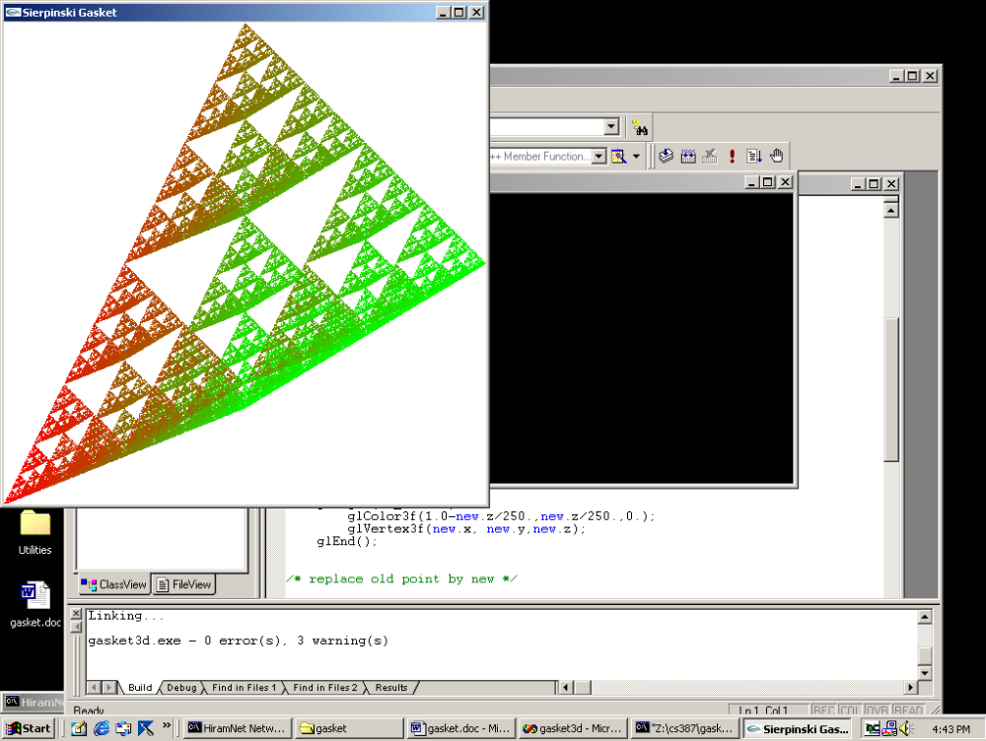
THE RESULT OF RUNNING A3 (or gasket3d.c) AFTER MODIFICATIONS
Note: This plots until the right mouse is clicked.

Slide 45
ANOTHER ALGORITHM FOR THE SIERPINSKI GASKET
Recursively subdivide
Use polygons instead of points:
Recursively subdivide a triangle throwing away the center section each time.
When the triangles are small (the size of a pixel), draw them.
Fix the number of calls to make globally.
Note: with OpenGL we can't pass data to functions and callbacks easily.
Remove from
consideration

Slide 46
Some remarks about the function code in 2D recursive gasket program, A.2, on page 532+ of text:
triangle: Note that GL_TRIANGLES takes 3 points, forms the triangle, and fills the interior with color that is set.
divide_triangle:
  Recursive
  Initial call is in display function
  4th parameter controls the depth of recursive calls
  Called initially with the 3 original vertices.
display: Very simple as just clear color bit, do recursive call, and flush
myinit: As before, but in different order for no reason.
main:Very much as before, but need to change n=atoi(argv[1]) , which is a picking up a command line argument, to n = 5 (or some other small number). This is the number of recursive calls you desire.

Slide 47
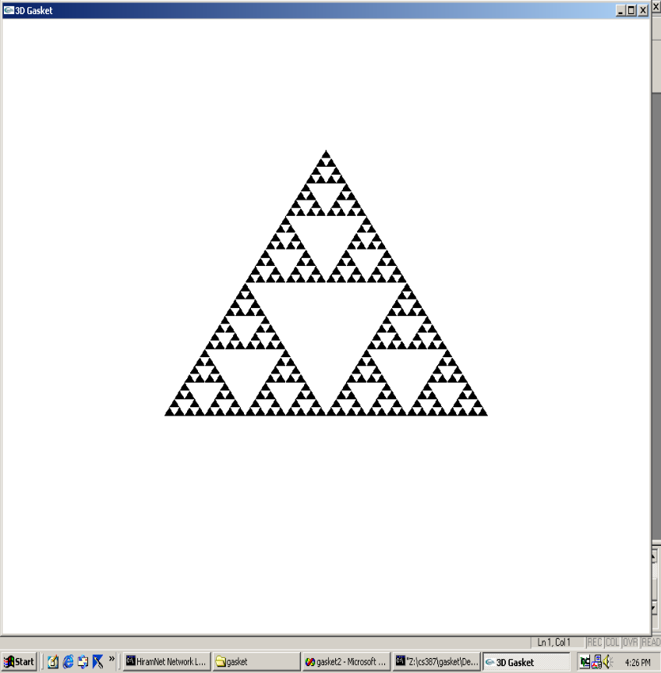
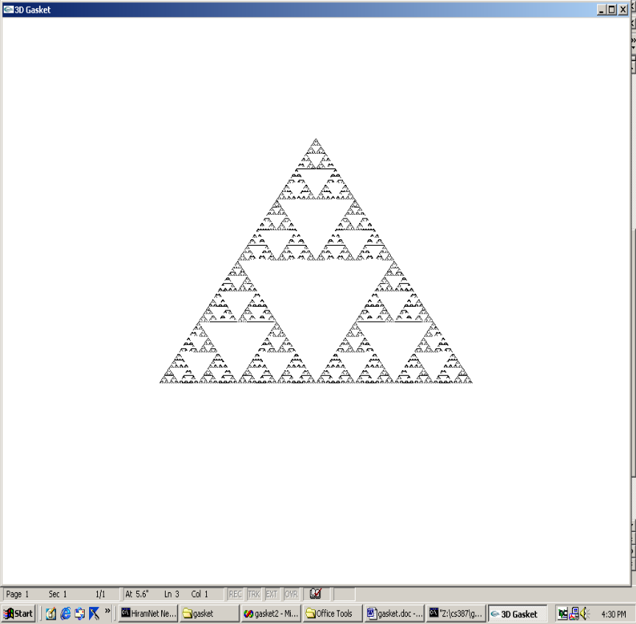
RUNNING A2 IN THE TEXT
AFTER RECURSIVE CALLS
5 CALLS
8 CALLS

Slide 48
3D RECURSIVE GASKET
In appendix
Available on CD
Not many changes --- some are as we did before
Some of changes are cosmetic--- for example, typedef defining a structure.
Some are changes we will ignore right now:
  glNormal3fv command
  and the myReshape command code I will just handwave for now
Otherwise …
Establish the tetrahedron inside the unit cube (why will become clear in a later chapter).

Slide 49
3D RECURSIVE GASKET
A4 in appendix, page 536
triangle- as before, draws and fills a 3D triangle
  the addition of glNormal3fv(a) establishes constant shading and this will be explained later
divide_triangle- exactly as before
tetrahedron- subdivides each face of tetrahedron into triangles and changes colors for each face (red, green, blue, and black)
display- We now want hidden surface removal using the z-value to determine which point is displayed. This requires more memory for the frame buffer. So,we add
  glClear(GL_COLOR_BUFFER_BIT | GL_DEPTH_BUFFER_BIT);

Slide 50
3D RECURSIVE GASKET
A4 in appendix, page 536
myReshape - the reshape command is called whenever the window is resized. As resizing can mess up the aspect ratio, the calculations here are to preserve the aspect ratio.
  We'll discuss this in a minute, but w is set automatically to the new window width and h to the the new window height.
  In main, glutReshapeFunc(myReshape) registers this function as the reshape function.
main- as before, change atoi code. Also, for depth handling, include GLUT_DEPTH and GL_DEPTH_TEST and the appropriate places.

Slide 51
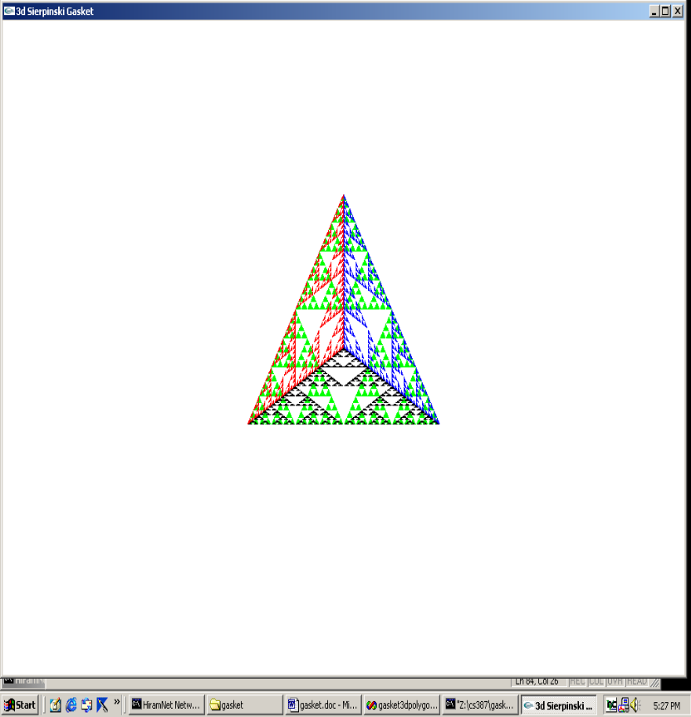
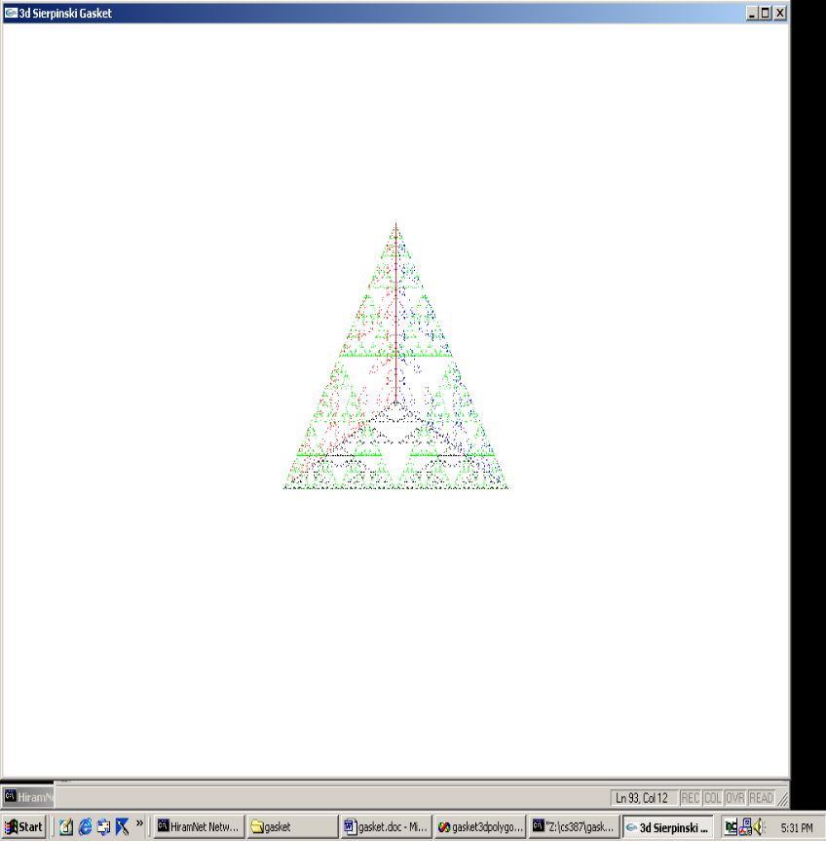
RUNNING A4 IN THE TEXT
AFTER RECURSIVE CALLS
n=5
n=10

Slide 52
THE RESHAPE CODE
void myReshape(int w, int h) //w= width of new window and h=height //set automatically when invoked with a new window size //set as the number of pixels
{ glViewport(0,0,w,h); //set a viewport in the display area of proper size
glMatrixMode(GL_PROJECTION); //switch matrices, as before
glLoadIdentity(); //always start fresh
if (w <= h) //choose a clipping rectangle with the same aspect ratio as window
glOrtho(-2.0, 2.0, -2.0 * (GLfloat) h / (GLfloat) w,
2.0 * (GLfloat) h / (GLfloat) w, -10.0, 10.0); else...
EXAMPLE: w= 200 and h = 300 Then setting is
bottom = 3/2 * (-2) = -3 and top is 3/2 *2= 3.
The aspect ratio of the window is 2:3 and the aspect ratio of the clipping rectangle is also 4:6 (which is also 2:3).
Note the w > h case is handled similarly with left and right being scaled appropriately.

Slide 53
Suggestions of things to do to check your understanding
Make the necessary changes to gasket3d.c (A3 in text) and run it with various settings for the color (in glColor3f calls).
Make the necessary changes to tetra.c (A4 in text) and run it with different color settings.
Make changes to glOrtho . See if you can predict the results. Remember, the projection is a parallel one, not a perspective one.
Show me what you did: capture the screens, state what you thought would happen before you ran the modified code, and include all in a DOC file sent to csgrader.

