Slide 1
GEOMETRIC OBJECTS AND TRANSFORMATIONS
(THE MATHEMATICS CHAPTER) Chapter 4
Scalars, Points, and Vectors
Section 4.1, Appendices B.2 and B.3

Slide 2
IDEAL BACKGROUND FOR ANIMATION IN GRAPHICS
Need concepts from
  analytical geometry
  trigonometry
  linear algebra
  vector analysis
Don't need memorized formulas, but intuitive concepts and a few basic formulas that can be understood visually.
We'll take a very pragmatic and utilitarian approach.
Approach will be similar to what we do all the time in computer science---deal with abstract data types

Slide 3
ABSTRACT DATA TYPE (ADT) APPROACH
Initially, don't worry about internal representations of a concept ---i.e. in computer science, we capture concepts using the notions of
  a class
  objects that are instantiated from the class
Concerned about attributes of class
Concerned about functions defined for the class
(Note: although many of you were introduced to these concepts while learning C++, the above notions existed before C++ was designed.)
REMEMBER- "class" here is not a C++ class!!!

Slide 4
MOTIVATION FOR ALL THIS
  We require a knowledge of vectors and matrices in order to understand animation, in particular:
    Motion
    Camera placement
    How to change between the different coordinate systems
  We require a knowledge of the representation of lines, planes, and normals in order to understand
    Rendering algorithms
    Lighting models

Slide 5
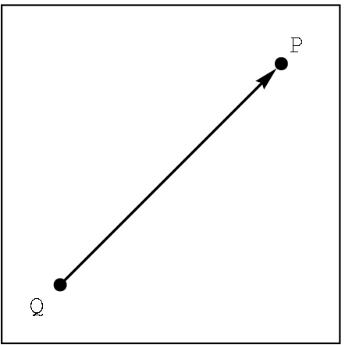
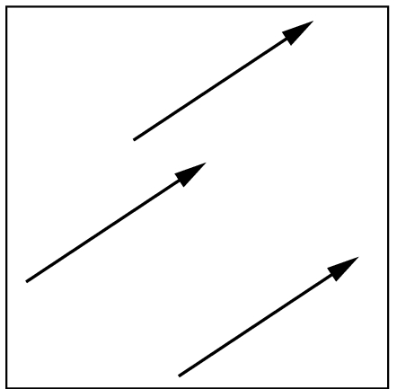
CLASSES- not defined, only described for our setting
scalar Notation: α, β, γ
  For this class, we will use real numbers.
    Define equality: just real number equality
point Notation: P, Q, R
  For this class, we just will use a location in 3D space.
    Define equality: identical locations
vector Notation: u, v , w or A, B, C
Two attributes: length- a scalar denoted by |v| direction in 3D space
Define equality: same length and direction
v

Slide 6
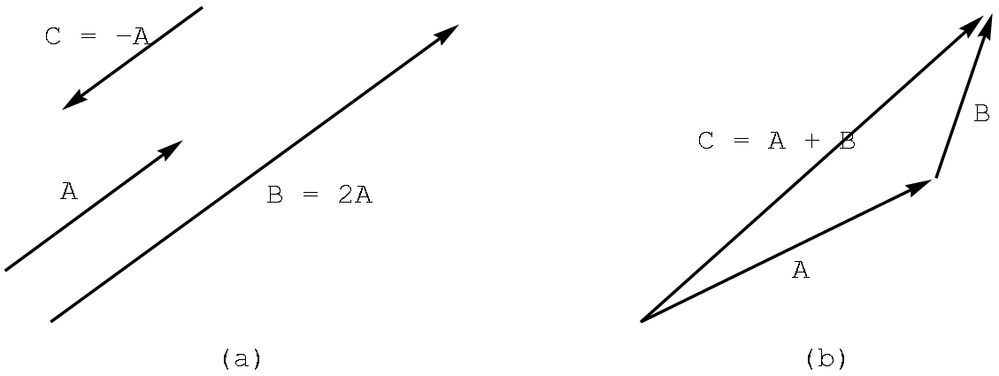
OPERATIONS ON CLASSES
Scalars: Assume the usual real number operations of +, - , *, /
Vectors: Defined in 3D space (as well as 2D)
scalar times vector
-A (i.e. -1A)
2A
vector plus vector
A + B

Slide 7
VECTOR OPERATIONS
Perform addition by the head-to-tail rule.
u
Note that u + v = v + u.
v
v+u
u+v
u
To perform subtraction, we need the zero vector- i.e. vector with zero length and no direction.
Note that v + (-v) = 0
v
-v

Slide 8
VECTOR OPERATIONS
To perform subtraction, given u and v, we define
u - v to be u + (-v):
u
u
-v
v
u - v
As you might suspect, u - v <> v - u
Note: We are NOT "computing"anything with numbers. Concentrate on the geometry.
For the moment, we are not using any reference system or coordinate system.

Slide 9
VECTOR OPERATIONS:A bit of trigonometry
There are two ways to measure the size of an angle:
degrees and radian measure
180º = Π radians
(cos θ, sin θ)
θ
Define u• v, the dot product, to be the scalar
|u| |v| cos Θ , 0 <= Θ < Π
and Θ is the angle between u and v
circle with radius 1
We are most often concerned with the sign of u• v as it tells us about the angle between two vectors:
u• v > 0 iff 0 <= Θ < 90º
u• v = 0 iff Θ = 90º
u• v < 0 iff Θ > 90º
Some useful trigonometric values:
Θ cos Θ sin Θ
0 1 0
Π /2 0 1
Π -1 0

Slide 10
VECTOR OPERATIONS:A bit of trigonometry
Define u X v, the cross product, to be the vector whose length is |u||v| sin Θ, 0 <= Θ < Π with Θ is the angle between u and v and whose direction is given by the right hand rule.
(cos θ, sin θ)
θ
Right hand rule:
1. With your right hand, make a gun with your index finger as the barrel, your thumb upright where the hammer would be, and your middle finger extended perpendicular to your palm.
2. Freeze those positions.
3. With u and v joined at the tail, lay the index finger along u and then the middle finger along v.
4. Your thumb will be in the direction of u X v.
circle with radius 1
u
u
v
u X v
Note that u X v <> v X u .
We are often only interested in the direction of u X v.

Slide 11
VECTOR OPERATIONS
Scalar times a vector( more details): Let α be a scalar and u a vector.
Define
αu to be the vector with length | α ||u|
with the direction
of u if α > 0
the opposite of u if α < 0
and, of course, if α = 0, the vector is the zero vector or a point.
u
2u
-3u

Slide 12
POINT OPERATIONS
Many operations are not defined, but a few are and they are useful:
1) We already know a vector + vector CAN be a point. (How?)
2) Given points P and Q, we can define P-Q as the vector given by
P
P-Q
Q
3) Consequently, given a vector v and a point Q there is a unique point P such that
P = v + Q
We can define addition between a vector and a point as above i.e, given Q and v "anchored" at Q, P is the point at the head of v.

Slide 13
SOME IMPORTANT 3D FORMULAS
We won't prove these, but you should understand them intuitively.
1) P(α) = αv + Q
Defines all points on a line through Q in the direction of v.
Also called a parametric equation of a line.
If the points are in 2D space, the line is in 2D space.
If the points are in 3D space, the line is in 3D space.
P(2)
Recall that the line segment between
Q and P(1) is defined by choosing
0 <= α <= 1
v
P(1)
Q = P(0)
P(-1)

Slide 14
DEFINING A RESTRICTED FORM OF POINT ADDITION
Start with
P= P(α) = αv + Q
Let v = R - Q for points R and Q, Then,
P = α (R-Q) + Q //substitute R-Q for v
= αR - αQ + Q //distribute α
= αR + (1- α)Q //regroup
So, we can define a restricted point addition as
P = α₁R +α₂Q , when α₁ + α₂= 1
P(α)
R
R-Q
Q

Slide 15
SOME IMPORTANT 3D FORMULAS
2) P(α) = αR + (1- α)Q
Defines all points on a line through Q and R.
We just derived this formula from (1). You should read the derivation, but I will not ask you to reproduce it!
Again, to obtain the line segment between R and Q, restrict α so that 0 <= α <= 1
P(2)
R = P(1)
R-Q
Q = P(0)
P(-1)

Slide 16
SOME IMPORTANT 3D FORMULAS
T(α,β) = P + β(1- α)(Q-P) + (1- β)(R-P)
defines all points on a plane, provided P, Q, and R are not collinear. But, this formula is not as useful as the next one.
3) T(α,β) = P + αu + βv , defines all points on the plane as a parametric equation.
R
u and v cannot be parallel vectors
v
Q
P
u
What happens if we restrict α and β ? to be between 0 and 1

Slide 17
SOME IMPORTANT 3D FORMULAS
4) Another important equation of a plane is given by
(u X v) • (P - P₀) = 0 where P is a point on the plane
v
P_{o}
u
The vector u X v is perpendicular, or orthogonal, to the plane and is called the normal to the plane.

Slide 18
REVIEW
We have defined the following as abstract objects
  scalars
  points
  vectors
And we have defined
  dot product
  cross product
  parametric equation of line
  parametric equation of plane
  normal to plane
  plane equation using the normal

Slide 19
NOTE THAT WE HAVEN'T
Seen how to “compute” anything
Haven't had a coordinate system involved.
These concepts are NOT required in order to visualize what is happening with scalars, points, and vectors.
Now, we have to add a coordinate system, but first we need some basic concepts from analytical geometry.

Slide 20
THE MATHEMATICS CHAPTER- continued
Coordinate Systems and Frames
Section 4.3 and Appendix C

Slide 21
MATRICES
Definition: A matrix is an n X m array of scalars, arranged conceptually in n rows and m columns, where n and m are positive integers.
If n = m, we say the matrix is a square matrix.
We often refer to a matrix with the notation
A = [a(i,j)]
where a(i,j) denotes the scalar in the ith row and the jth column
We'll use A, B, and C to denote matrices.
Note that the text uses the typical mathematical notation
where the i and j are subscripts. We'll use this alternative form as it is easier to type and it is more familiar to computer scientists.

Slide 22
MATRIX OPERATIONS
Definitions
Scalar-matrix multiplication:
αA = [α a(i,j)]
Matrix-matrix addition: A and B are both n X m
C = A + B = [a(i,j) + b(i,j)]
Matrix-matrix multiplication: A is n X r and B is r X m
r
C = AB = [c(i,j)] where c(i,j) = ∑ a(i,k) b(k,j)
k=1
Examples...

Slide 23
MATRIX OPERATIONS
Examples
Scalar-matrix multiplication:
αA = [α a(i,j)]
⎡ 3 -1 ⎤ ⎡ 15 -5 ⎤
5 ⎢ 7 2 ⎥ = ⎢ 35 10 ⎥
⎣ -1 6 ⎦ ⎣ -5 30 ⎦
Matrix-matrix addition: A and B are both n X m
C = A + B = [a(i,j) + b(i,j)]
⎡ 3 -1 ⎤ ⎡ 5 2 ⎤ ⎡ 8 1 ⎤
⎢ 7 2 ⎥ + ⎢ 3 -1 ⎥ = ⎢ 10 1 ⎥
⎣ -1 6 ⎦ ⎣ 4 0 ⎦ ⎣ 3 6 ⎦
Examples on the board were different.

Slide 24
MATRIX OPERATIONS
Examples
Matrix-matrix multiplication: A is n X r and B is r X m
r
C = AB = [c(i,j)] where c(i,j) = ∑ a(i,k) b(k,j)
k=1
For example,
⎡ 3 -1⎤ ⎡1 2 1 -1⎤ ⎡ 0 5 3 -1⎤ c(2,3)= a(2,1)b(1,3) +
⎢ 1 2⎥ ⎣3 1 0 -2⎦ = ⎢ 7 4 1 -5⎥ a(2,2)b(2,3)=
⎣ 0 1⎦ ⎣ 3 1 0 -2⎦ 1*1 + 2*0 = 1
must be the same
Note that the following is undefined:
⎡1 2 1 -1⎤ ⎡ 3 -1⎤ because a 2 X 4 matrix can't be
⎣3 1 0 -2⎦ ⎢ 1 2⎥ multiplied by a 3 X 2 matrix.
⎣ 0 1⎦ A 4 X m matrix is required.

Slide 25
MATRIX OPERATIONS
Definitions (Continued)
Transpose: A is n X m. Its transpose, A^{T}, is the m X n matrix
with the rows and columns reversed.
Inverse: Assume A is a square matrix, i.e. n X n.
The identity matrix, I_{n} has 1s down the diagonal and 0s elsewhere
The inverse A⁻¹ does not always exist. If it does, then
A⁻¹ A = A A⁻¹ = I
There are many algorithms for finding A⁻¹, but we won't worry
about them as the software will find the values.
However, given a matrix A and another matrix B, we can check
whether or not B is the inverse of A by computing AB and BA and seeing that AB = BA = I_{n}
More examples ...

Slide 26
MATRIX OPERATIONS
Examples
Transpose: A is n X m. Its transpose, A^{T}, is the m X n matrix
with the rows and columns reversed.
⎡1 2 1 4⎤^{T} = ⎡1 3⎤
⎣3 1 0 5⎦ ⎢2 1⎢
⎢1 0⎢
⎣4 5⎦
Inverse: Assume A is a square matrix, i.e. n X n. If A⁻¹ exists, then A⁻¹ A = A A⁻¹ = I
⎡1 0⎤⁻¹ ⎡ 1 0⎤
⎣2 3⎦ = ⎣-2/3 1/3⎦
because ⎡1 0⎤ ⎡ 1 0⎤ ⎡ 1 0⎤ ⎡1 0⎤ ⎡1 0⎤
⎣2 3⎦ ⎣-2/3 1/3⎦ = ⎣-2/3 1/3⎦ ⎣2 3⎦ = ⎣0 1⎦
THIS DOES NOT SHOW HOW TO FIND THE INVERSE!

Slide 27
BASIS
Definition: Any 3 vectors v₁, v₂, and v₃ that satisfy the two properties:
1) (linearly independence)
α₁v₁ + α₂v₂ + α₃v₃ = 0 if and only if α₁ = α₂ = α₃ = 0
2) (spanning)
Any vector v in the space can be represented uniquely as the linear combination of the basis vectors, i.e.
v =β ₁v₁ + β ₂v₂ + β ₃v₃
is called a basis for the space.
FACT: In 2D space, any basis needs 2 vectors.
In 3D space, any basis needs 3 vectors.

Slide 28
BASIS
Example:
1)
Linear independence:
the zero vector
αu + βv = 0 can happen only if α and β are 0
u
v
w
Any vector w can be written as a linear combination of u and v:
u
w = αu + βv
for some α and β
w
v

Slide 29
BASIS- Don't think the basis vectors must be perpendicular to each other
Example:
2)
Linear independence:
a point
αu + βv = 0 can happen only if α and β are 0
u
v
w
The vector w can be written as a linear combination of u and v:
w
u
w = αu + βv
for some α and β
v

Slide 30
FRAMES
Definition: A frame is
a point P₀ and
a basis v₁, v₂, and v₃
in 3D space. We can specify a frame as (v₁, v₂, v₃, P₀)
Given a frame, any point P can be represented in the frame as
P = α₁v₁ + α₂v₂ + α₃v₃ + P₀
and any vector v can be written as
v = β₁v₁ + β₂v₂ + β₃v₃ + 0·P₀
In the previous slides, the P₀ is just the point where the vectors are joined--- i.e. what we often call the origin (or the reference point) of the coordinate system.
We will now use matrices to represent some of these concepts.
We'll skip Sections 4.3.1 and 4.3.2 for a moment.

Slide 31
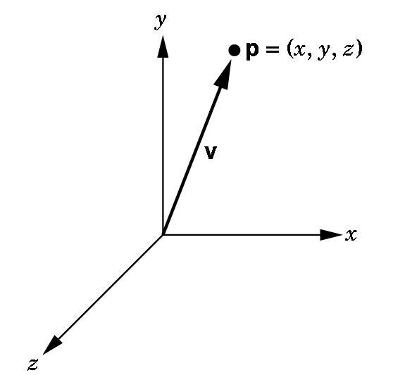
HOMOGENEOUS COORDINATES
In many textbooks, a vector is associated with a point (x, y, z) where the x, y, and z represent the coordinates in the standard coordinate system.
This only works if we assume the frame we are using has the point (0,0,0) as the origin and the vector is positioned at the origin:
This causes confusion as the
vector from (1,1,1) to (2,3,4)
is the same vector as the one from
(0,0,0) to (1,2,3) because the
vectors have the same length
and their directions are the same.

Slide 32
HOMOGENEOUS COORDINATES
In graphics,
  we wish to keep points and vectors as separate entities
  we wish to maintain frame information.
We use homogeneous coordinates to represent points and vectors.
A homogeneous coordinate is a 4D column or row matrix
(This can be defined in projective geometry, but we don't need the definition here- only the properties of a homogeneous coordinate--- it acts like any other matrix.)

Slide 33
HOMOGENEOUS COORDINATE REPRESENTATION OF A 3D POINT
We assume a frame is specified, (v₁, v₂, v₃, P₀), and, consequently any point P can be written uniquely as
P = α₁v₁ + α₂v₂ + α₃v₃ + P₀
If we agree to define 1 • P = P, we can write this formally as the matrix product:
P=[ α₁ α₂ α₃ 1]⎡v₁⎤. ⎢v₂⎢
⎢v₃⎢
⎣P₀⎦
So, we choose to represents a point P in a frame (v₁, v₂, v₃, P₀) as
column matrix:
[ α₁ α₂ α₃ 1]^{T}

Slide 34
HOMOGENEOUS COORDINATE REPRESENTATION OF A 3D POINT
We assume a frame is specified, (v₁, v₂, v₃, P₀), and, consequently any vector v can be written uniquely as
v = β₁v₁ + β₂v₂ + β₃v₃ + 0·P₀
If we agree to define 0• P₀ = 0, we can write this formally as the matrix product:
v=[ β₁ β₂ β₃ 0]⎡v₁⎤. ⎢v₂⎢
⎢v₃⎢
⎣P₀⎦
So, we choose to represents a point v in a frame (v₁, v₂, v₃, P₀) as
column matrix:
[ β₁ β₂ β₃ 0]^{T}

Slide 35
SO, POINTS AND VECTORS HAVE SIMILAR, BUT DIFFERENT REPRESENTATIONS!
Note the simplicity and similarity of the representations, given some frame:
  2 3 4 1]^{T} is a point in the frame.
  1 4 5 0]^{T} is a vector in the frame.
  Only the 4th component, the 1 or the 0, tells us whether we have a point or a vector.

Slide 36
WHY WORRY ABOUT ALL OF THIS?
We will define our objects in a physical frame.
The camera can be expressed in this frame, but it is more useful to switch to a camera frame where the origin is at the center of a projection.
Moreover,
it will be most useful if we can define our
objects in a frame that is handy to use for computational purposes
and then SWITCH frames to a more natural one.

Slide 37
MOTION OR ANIMATION IS JUST
A FRAME CHANGE.
You can think of motion as
holding the frame still
and moving the object
or
holding the object still
and moving the frame!

Slide 38
CHANGING FRAMES
Problem: Given a frame (v₁, v₂, v₃, P₀) and another frame (u₁, u₂, u₃, Q₀) ,
we need an easy way to
transfer the representation of a point or a vector in one frame
to the appropriate representation of the point or the vector in the other frame.
Recall: In the frame (v₁, v₂, v₃, P₀),
any point P can be written as α₁v₁ + α₂v₂ + α₃v₃ + P₀
and any vector v can be written as β₁v₁ + β ₂v₂ + β ₃v₃

Slide 39
CHANGING FRAME ALGORITHM
(A VERY, VERY IMPORTANT ALGORITHM!)
Given a frame X = (v₁, v₂, v₃, P₀)
and another frame Y= (u₁, u₂, u₃, Q₀)
1) Represent the basis vectors u_{i} and the point Q₀ of Y
in the frame X:
u₁ = γ₁₁v₁ + γ₁₂v₂ + γ₁₃v₃ + 0•P₀ where γ_{ij} is the scalar
u₂ = γ₂₁v₁ + γ₂₂v₂ + γ₂₃v₃ + 0•P₀ in the ith row
u₃ = γ₃₁v₁ + γ₃₂v₂ + γ₃₃v₃ + 0•P₀ and jth column.
Q₀ = γ₄₁v₁ + γ₄₂v₂ + γ₄₃v₃ + 1•P₀

Slide 40
2) Represent the equations as a matrix equation.
⎡u₁⎤ ⎡v₁⎤
⎢u₂⎥ ⎢v₂⎥
⎢u₃⎥ = M ⎢v₃⎥ where M is the matrix
⎣Q₀⎦ ⎣P₀⎦
⎡ γ₁₁ γ₁₂ γ₁₃ 0 ⎤
⎢ γ₂₁ γ₂₂ γ₂₃ 0 ⎢
⎢ γ₃₁ γ₃₂ γ₃₃ 0 ⎢
⎣ γ₄₁ γ₄₂ γ₄₃ 1 ⎦
This 4 X 4 matrix M is called the frame change matrix.
Note that it is unique.

Slide 41
3) We can use the matrix M to compute for any point or vector its new representation in frame Y or conversely.
Let a be either a point or vector in X. Then
a = M^{T} b (convert Y frame to X frame)
or
b= (M^{T})⁻¹ a (convert X frame to Y frame)
where b is the corresponding point or vector in Y.
Thus, M allows us to move back and forth between frames!
See the example on page 163 which handles the example on pg 159 in this manner.
Let’s do these... AN EXAMPLE – see your notes

Slide 42
THE DERIVATION OF THE FORMULAS
⎡u₁⎤ ⎡v₁⎤ ⎡ γ₁₁ γ₁₂ γ₁₃ 0⎤
⎢u₂⎥ ⎢v₂⎥ ⎢ γ₂₁ γ₂₂ γ₂₃ 0 ⎢
⎢u₃⎥ = M ⎢v₃⎥ where M is the matrix ⎢ γ₃₁ γ₃₂ γ₃₃ 0 ⎢
⎣Q₀⎦ ⎣P₀⎦ ⎣ γ₄₁ γ₄₂ γ₄₃ 1⎦
Let a and b be homogeneous coordinate representations of either a point or a vector in X = (v₁, v₂, v₃, P₀) and Y= (u₁, u₂, u₃, Q₀) respectively. Then,
b^{T}⎡u₁⎤ = b^{T}M ⎡v₁⎤ = a^{T}⎡v₁⎤
⎢u₂⎥ ⎢v₂⎥ ⎢v₂⎥ b^{T}M = a^{T} (b^{T}M)^{T} = (a^{T})^{T}
⎢u₃⎥ ⎢v₃⎥ ⎢v₃⎥
⎣Q₀⎦ ⎣P₀⎦ ⎣P₀⎦
a = M^{T}b (formula to convert Y to X)
(M^{T})⁻¹ a = (M^{T})⁻¹ M^{T}b = I_{n} b
b = (M^{T})⁻¹ a (formula to convert
X to Y)

