Slide 1
THE MATHEMATICS CHAPTER
Continued
Frames and Affine Transformations
Sections 4.3.5, 4.3.6, 4.5, 4.6-4.9

Slide 2
FRAMES IN OPENGL
We've seen that the representation of points and vectors are tied to frames.
OpenGL maintains two frames
  Camera frame
  World frame
Initially, the two frames are the same with the following orientation:
y
Camera is pointing along the
negative z axis.
This is a right-handed system.
x
z

Slide 3
BUT, WE WISH TO BE ABLE TO MOVE OBJECTS (OR MOVE FRAMES)
Hint: Imagine you are sitting so your eye is looking in the negative
z direction towards the origin (reference point) in each frame. Where
do you see the cube? To your left? In front of you? Does it appear
when you switch frames that the cube has moved?
y
y
new frame
x
z
x
z
original frame
Although each activity is the same, it is often easier to think that
you are moving objects. BUT, either visualization is fine!

Slide 4
MOTION OR ANIMATION IS JUST
A FRAME CHANGE.
You can think of motion as
holding the frame still
and moving the object
or
holding the object still
and moving the frame!

Slide 5
THE USUAL SCENARIO IN OPENGL
Define objects around the origin in the default setting.
We want the viewing conditions to be such that the camera sees only those objects we wish it to see.
So, we need to move
  1) the camera away from the objects or
  2) the objects away from the camera.
Or, equivalently, we move
  1)' the camera frame relative to the world frame or
  2)' the world frame relative to the camera frame.
Most people view the camera as fixed and move the objects.

Slide 6
THE IMPORTANT MODEL-VIEW MATRIX
This is the 4 X 4 frame change matrix that is required to transform between camera frame representations and world frame representations.
We can change the matrix by loading the necessary 16 scalars using glLoadMatrix.
But, computing the 16 scalars is not an easy task as we have seen.
It is easier, to equivalently move objects, using affine transformations.

Slide 7
AFFINE TRANSFORMATIONS
A transformation is a function that maps a point (or vector) into another point (or vector).
An affine transformation is a transformation that maps lines to lines.
Why are affine transformations "nice"?
  We can define a polygon using only points and
  the line segments joining the points.
  To move the polygon, if we use affine transformations,
  we only must map the points defining the polygon
  as the edges will be mapped to edges!
We can model many objects with polygons---
and should--- for the above reason in many cases.

Slide 8
AFFINE TRANSFORMATIONS
VERY IMPORTANT FACT: Any affine transformation can be obtained by applying, in sequence, transformations of the form
  Translate
  Scale
  Rotate- 3 different types
So, to move an object all we have to do is determine the sequence of transformations we want using the 3 types of affine transformations above.

Slide 9
FOR EACH AFFINE TRANSFORMATION WE NEED TO KNOW:
What does the transformation do?
What matrix can be used to transform the original points to the new points?
Recall--- moving an object is the same as changing a frame so we know we need a 4 X 4 matrix
It is important to remember the form of these matrices!!!

Slide 10
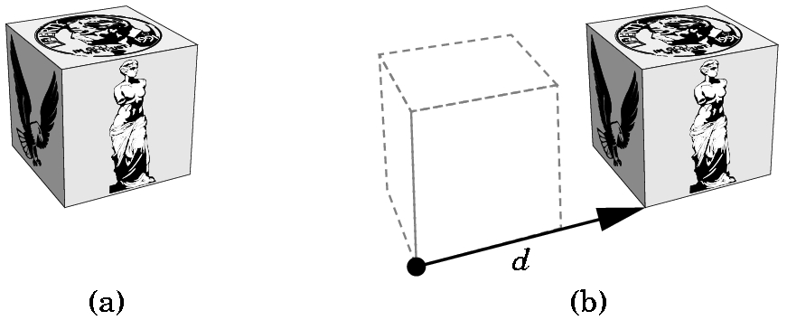
TRANSLATIONS
Each point p in the original frame becomes p' where
p'= p + d
p' = Tp where T = ⎡ 1 0 0 α_{x} ⎤
⎢ 0 1 0 α_{y} ⎢
⎢ 0 0 1 α_{z} ⎢
⎣ 0 0 0 1 ⎦
where α_{x} is the displacement in the x direction,
α_{y} is the displacement in the y direction, and
α_{z} is the displacement in the z direction.
Write T as T(α_{x}, α_{y}, α_{z})
Called the
translation
matrix

Slide 11
TRANSLATIONS
y
y
x
x
z
z
Keep the basis vectors the same, but move the reference point.
Keep remembering, frame changes can be viewed as moving the
frame or moving the object!
Note that a translation clearly has an inverse,
T(α_{x}, α_{y}, α_{z})⁻¹ = T(-α_{x}, - α_{y}, -α_{z})

Slide 12
TRANSLATIONS- 2D
2D translations just require the obvious 3 X 3 matrix:
Example:
What does T(2,-1) do to the line segment shown below if we map the points and then draw the line segment?
(-1,2) ---> (1,1)
(3,1) ---> (5,0) because
⎡ 1 0 2 ⎤⎡ x ⎤ ⎡x + 2⎤
⎢ 0 1 -1⎢⎢ y ⎢ = ⎢y - 1 ⎢
⎣ 0 0 1 ⎦⎣ 1⎦ ⎣ 1 ⎦
Old frame is in red.
New frame is in green.
View this as moving the frame or
moving the line segment!
(-1,2)
•
(3,1)
v₂
•
Q₀
v₁
v₂
P₀
v₁
Note the new origin was at (-2,1) before the translation T(2,-1)

Slide 13
TRANSLATIONS- 2D or 3D
Note that the mapping T(a,b) followed by the mapping
T(c,d) is the same as the mapping defined by the product of
the two matrices: T(a,b) T(c,d)
For example:
⎡1 0 2⎤ ⎡1 0 3⎤ ⎡x⎤ ⎡1 0 2⎤ ⎡x + 3⎤ ⎡x + 5⎤
⎢0 1 -1 ⎢ ⎢0 1 2 ⎢ ⎢y ⎢ = ⎢0 1 -1 ⎢ ⎢y + 2 ⎢ = ⎢y + 1 ⎢
⎣0 0 1⎦ ⎣0 0 1⎦ ⎣1⎦ ⎣0 0 1⎦ ⎣ 1 ⎦ ⎣ 1 ⎦
will yield the same result as multiplying the matrices first:
⎡1 0 2⎤ ⎡1 0 3⎤ ⎡x⎤ ⎡1 0 5⎤ ⎡x⎤ ⎡x + 5⎤
⎢0 1 -1 ⎢⎢0 1 2 ⎢ ⎢y ⎢ = ⎢0 1 1 ⎢ ⎢y ⎢ = ⎢y + 1 ⎢
⎣0 0 1⎦ ⎣0 0 1 ⎦ ⎣1⎦ ⎣0 0 1⎦ ⎣1⎦ ⎣ 1 ⎦
Moreover, geometrically it should be clear that
T(a,b) T(c,d) = T(c,d) T(a,b)

Slide 14
ROTATIONS- 2D
INITIALLY AROUND THE ORIGIN
y
If we rotate through angle ϕ, the point (x,y) is mapped to
x' = x cos ϕ - y sin ϕ
y' = x sin ϕ + y sin ϕ
(x',y')
•
ϕ
•
(x,y)
x
To derive these, you must use trigonometric identities for the
sum of two angles. (See the derivation on page 182).
We will accept the formulas as correct although those of you with
backgrounds in trigonometry should see that these are correct.
With a rotation, the reference point remains fixed.

Slide 15
ROTATIONS- 2D
INITIALLY AROUND THE ORIGIN
For the rotation through angle ϕ, centered at the origin, the point (x,y) is mapped to
x' = x cos ϕ - y sin ϕ
y' = x sin ϕ + y sin ϕ
so the 2D rotation matrix R(ϕ ) is
⎡ cos ϕ -sin ϕ 0 ⎤
⎢ sin ϕ cos ϕ 0 ⎢
⎣ 0 0 1 ⎦
Using the fact that cos(- ϕ) = cos ϕ and
sin(- ϕ) = - sin ϕ
we can show that R⁻¹(ϕ) = R^{T}(ϕ) = R(- ϕ)

Slide 16
ROTATIONS- 2D
AROUND AN ARBITRARY POINT
Problem: We wish to rotate a polygon φ degrees around an arbitrary point , say (α, β), in some frame. How can we do this when we only know the matrix for rotating about the origin?
Think of moving things around!
Move the point (α, β) to the origin by changing the frame.
Rotate around the new origin, changing the frame again.
Move the point (α, β) back to its original place by changing the frame.
i.e. For each vertex of the polygon, p, compute the matrix product:
T (α, β) R(φ) T (-α, -β) p
where p is the homogeneous representation of a point p.

Slide 17
IF SOMETHING ISN'T WHERE YOU WANT IT ….
MOVE THE FRAME
OR MOVE THE OBJECT

Slide 18
ROTATIONS- 3D
INITIALLY AROUND THE ORIGIN
3D rotations are a bit more complicated as there is not just one basic rotation around the origin.
There are 3 basic rotations:
1) Around the x axis.
2) Around the y axis.
3) Around the z axis.
We need to establish some conventions, however, that were ignored in the 2D case as the picture implied the answers to these questions?
1) How do we distinguish a positive angle from a negative angle?
2) How do we measure the angle?

Slide 19
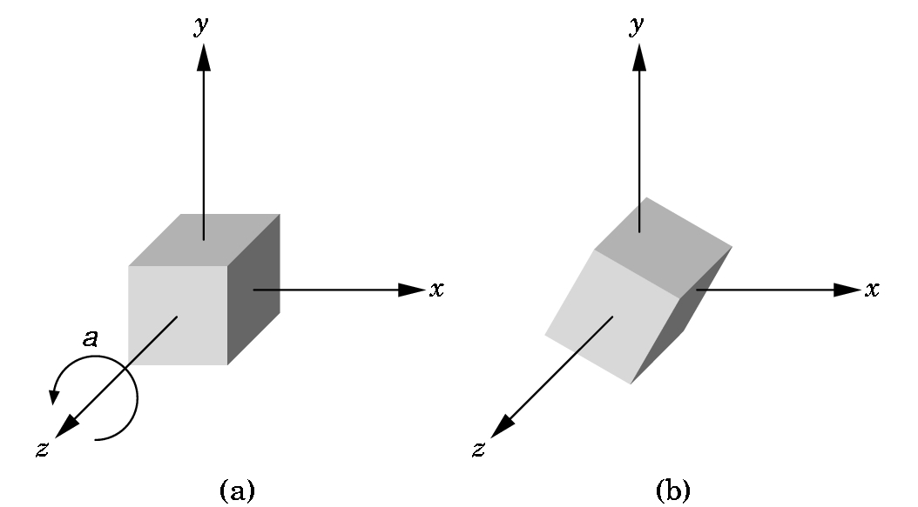
3D z-AXIS ROTATION AROUND ORIGIN
The picture shows a z-axis rotation around the origin in a positive angle, a, direction.
i.e. counterclockwise as you look down the z-axis towards the origin.
The angle is measured in the xy-plane from the x-axis, just as the 2D angle was measured.
It can be shown that a point (x,y,z)
is computed using the same formulas
for x' and y'.
Since z is not changed,
z' = z.
Thus, this rotation matrix is
computed in the same way as the 2D
matrix ...

Slide 20
3D z-AXIS ROTATION AROUND ORIGIN
a is the angle of rotation.
Shows the z-axis is
not moved
R_{z}(a) = ⎡ cos a -sin a 0 0 ⎤
⎢ sin a cos a 0 0 ⎢
⎢ 0 0 1 0 ⎢
⎣ 0 0 0 1 ⎦

Slide 21
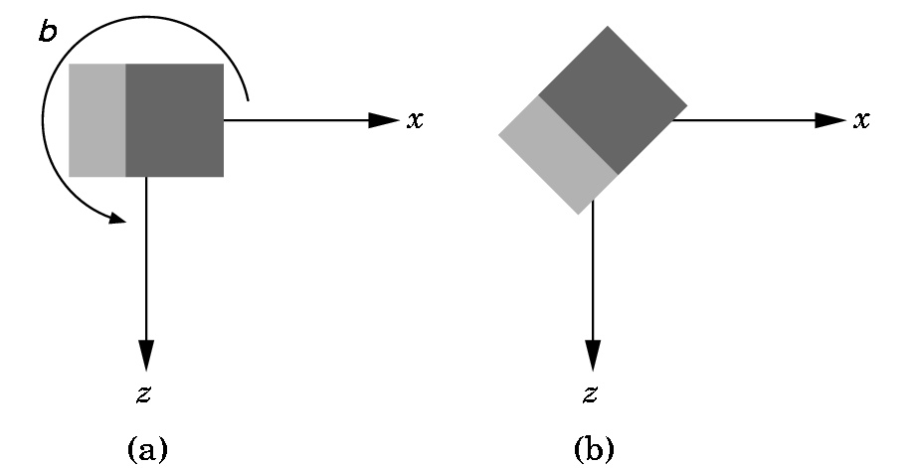
3D y-AXIS ROTATION AROUND ORIGIN
You are looking down the y-axis which is not shown.
A positive (counter-clockwise) angle is shown.
Again, the necessary rotation matrix can be defined:
R_{Y}(b) = ⎡ cos b 0 sin b 0 ⎤
⎢ 0 1 0 0 ⎢
⎢ -sin b 0 cos b 0 ⎢
⎣ 0 0 0 1 ⎦

Slide 22
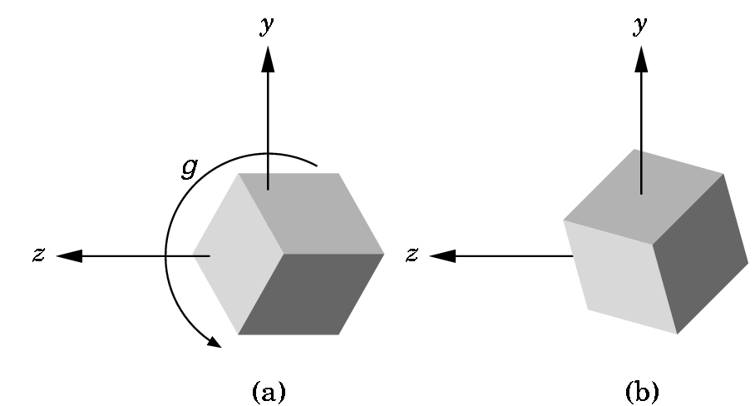
3D x-AXIS ROTATION AROUND ORIGIN
You are looking down the
x-axis which is not shown.
A positive (counter-
clockwise) angle is shown.
Again, the necessary rotation matrix can be defined:
R_{X}(g) = ⎡ 1 0 0 0 ⎤
⎢ 0 cos g -sin g 0 ⎢
⎢ 0 sin g cos g 0 ⎢
⎣ 0 0 0 1⎦

Slide 23
ARBITRARY ROTATIONS IN 3D SPACE
Some can be difficult to determine, but some aren't:
An easy example:
Rotate around the z-axis with P as a fixed point---
Very similar to the 2D situation:
Translate P to the origin T(-P)
Rotate around the z-axis. R_{Z}(Θ)
Translate P back. T(P)
and form the matrix product
T(P) R_{Z}(Θ) T(-P)
Note that the ordering is important on the matrix multiplication.
The multiplication order is right to left.

Slide 24
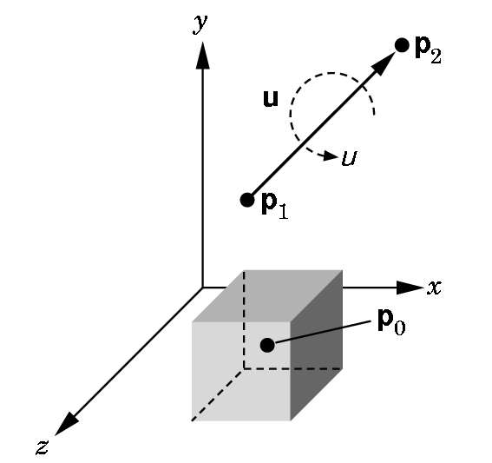
ARBITRARY ROTATIONS IN 3D SPACE
A harder example: (details of derivation are in 4.8.4)
Rotate around an arbitrary axis with an arbitrary fixed point.
Basic idea is simple, but determining the angles can be hard:
1) Translate P₀ to the origin.
2) Align the vector with the z-axis (z is always used) by rotating around the x-axis first and then the y-axis.
3) Rotate around the z-axis by the angle desired.
4) Undo (2) and then (1).

Slide 25
ARBITRARY ROTATIONS IN 3D SPACE
1) Translate P₀ to the origin.
--- Form T(- P₀ )
2) Align the vector with the z-axis (z is always used) by rotating around the x-axis and then the y-axis
---Determine the angle ϕ and form R_{X}(ϕ ) ---Determine the angle χ and form R_{Y}(χ). Determining the angles is the hard part.
3) Rotate around the z-axis by the angle desired.
---Form R_{Z}(μ) using the given angle μ.
Form the matrix to be used--- note how we undo the operations---WATCH THE ORDER!
M= T(P₀ ) R_{X} (-ϕ ) R_{Y}(-χ) R_{Z}(μ) R_{Y}(χ) R_{X}(ϕ ) T(P₀) NOTE HOW MUCH WORK IS INVOLVED!

Slide 26
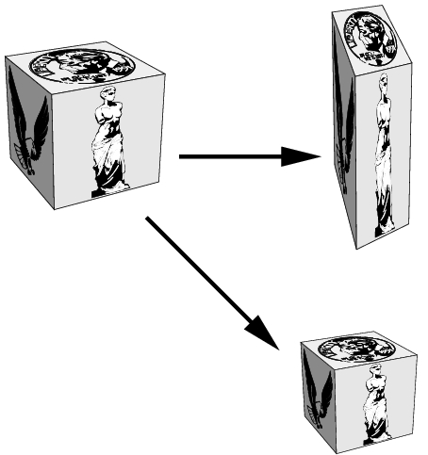
SCALING
Translations and rotations are rigid motions. Our third basic motion is not a rigid motion.
Scaling with respect to a fixed point can stretch or shrink an object and move it relative to that fixed point.

Slide 27
SCALING
The 3D scaling matrix with the origin as the fixed point is given by
S(α_{x,}, α_{y}, α_{z}) = ⎡ α_{x} 0 0 0⎤
⎢ 0 α_{y} 0 0 ⎢
⎢ 0 0 α_{z} 0 ⎢
⎣ 0 0 0 1⎦
The scaling is uniform if all the α are the same.
Each α can be different.
The inverse always exists:
S⁻¹(α_{x,}, α_{y}, α_{z}) = S(1/α_{x,}, 1/α_{y}, 1/α_{z}) unless α = 0. Then just use 0
instead.

Slide 28
2D SCALING EXAMPLES
Vertices are
(4,2), (10,2), (4,4), (10,4)
Scale x by 1/2 and y by 1:
Vertices are
(2,2), (5,2),(2,4),(5,4)
Not only has the rectangle shrunk in the x direction, but it has moved closer to the origin. The y dimension hasn't changed.

Slide 29
SCALING EXAMPLES
As before, to scale with an arbitrary point as a fixed point (x₀,y₀,z₀) we
1) Translate the fixed point to the origin.
2) Scale with respect to the origin
3) Translate the origin back to the original fixed point.
i.e. multiply every point p as below:
T(x₀,y₀,z₀)S(α_{X},α_{Y},α_{Z})T(-x₀,-y₀,-z₀)p

Slide 30
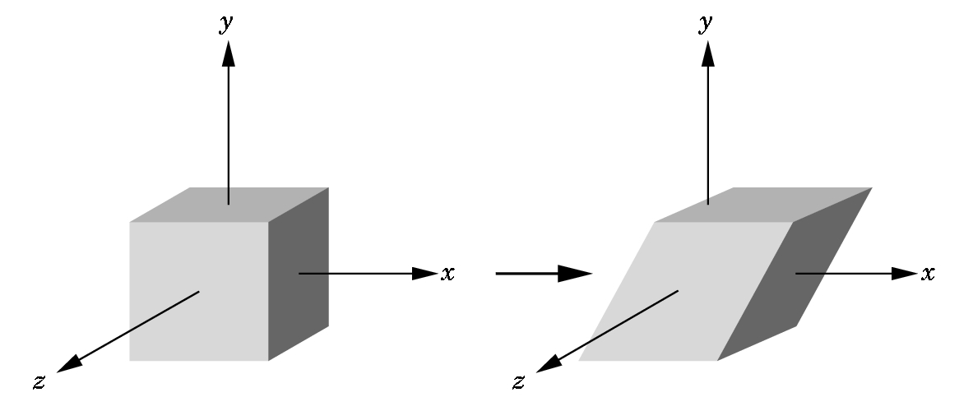
SHEARS
These are not basic affine transformations, but they are important so we deal with them separately:
Each shear is characterized by a single angle Θ which is the angle formed with the axis used for the shear.
In this case, we have an
x-shear. The x-shear matrix is:
x'= x + y cot Θ
y' = y
z' = z
⎡ 1 cot Θ 0 0⎤
H_{X}(Θ) = ⎢ 0 1 0 0⎢
⎢ 0 0 1 0 ⎢
⎣ 0 0 0 1⎦

Slide 31
A BETTER APPROACH TO SHEARS
Not in the text
The general shearing matrix is
⎡ 1 h_{YX} h_{ZX} 0⎤
⎢ h_{XY} 1 h_{ZY} 0 ⎢ where each h_{IJ} is a percentage
⎢ h_{XZ} h_{YZ} 1 0 ⎢
⎣ 0 0 0 1⎦
It can be shown that the matrix above can be obtained as a sequence of affine transformations, but it is usually simpler to load this in GL_MODELVIEW mode directly with
glMultMatrixf(m);
where we have predefined the matrix m using
glFloat m[] = {1.0, h_{YX} , h_{ZX} , 0.0, //row 1
h_{XY}, 1.0, h_{ZY}, 0.0, //row 2
…}
It is interesting to play with the different shears.

Slide 32
THE MATHEMATICS CHAPTER
Continued
Frames and OpenGL
Sections 4.4, 4.9.5-6,4.10

Slide 33
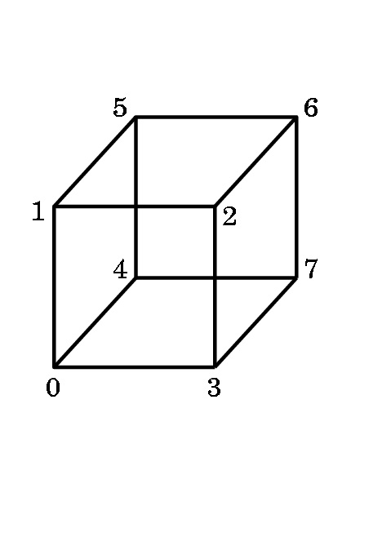
DOING ALL THESE NEAT THINGS IN OPENGL
Modeling a Rotating Cube
One of the simplest objects we can model is a cube.
We number the vertices so we can refer to them.
There are several decisions we must make.
1) Will we view this as a primitive object that we manipulate?
2) Will we view this as only a collection of 8 vertices that the hardware manipulates?
OpenGL programming tends to encourage a middle ground- we view this as made up of the six polygons that define the faces , or facets, of the cube.

Slide 34
Modeling a Rotating Cube
Define the cube centered around the origin as this makes calculations simpler:
3
2
7
6
0
1
4
5
GLfloat vertices[][3] = {{-1.0,-1.0,-1.0},{1.0,-1.0,-1.0}, {1.0,1.0,-1.0}, {-1.0,1.0,-1.0}, {-1.0,-1.0,1.0}, {1.0,-1.0,1.0}, {1.0,1.0,1.0}, {-1.0,1.0,1.0}};
But, we want to view this as more than a collection of vertices. We want to include the faces.

Slide 35
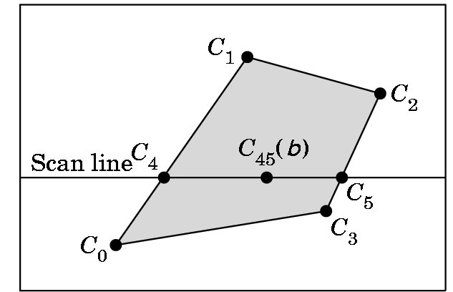
Modeling a Rotating Cube
3
2
7
6
0
1
We model the color cube by selecting colors for the vertices:
4
5
GLfloat colors[][3] = {{0.0,0.0,0.0},{1.0,0.0,0.0},{1.0,1.0,0.0}, {0.0,1.0,0.0}, {0.0,0.0,1.0}, {1.0,0.0,1.0}, {1.0,1.0,1.0}, {0.0,1.0,1.0}};
vertex 0 is black 4 is blue
1 is red 5 is magenta
2 is yellow 6 is white
3 is green 7 is cyan
OpenGL will interpolate the color between the vertices if we model the faces as polygons using a scan-line interpolation algorithm when it draws the polygon.

Slide 36
Modeling a Rotating Cube
5
6
1
We want to capture not only the geometry of the cube, but characteristics of it being a cube (i.e. its topology). So, we wish to convey what is inside and what is outside of the cube.
2
4
7
0
3
For each face, we could traverse the edges in one of two directions.
We will specify the outside of a face by a right hand rule:
7
6
7
6
Curl your right hand in the direction of the arrow. If your thumb is pointing out, you want that traversal in the definition.
4
5
4
5
So, 4,5,6,7 defines the correct side of the face as the outside face. (Or, 5,6,7,4 or 6,7,4,5 or 7,4,5,6 --- any of these will do.)

Slide 37
Modeling a Rotating Cube
Vertex normals (or Gouraud normals) are needed for shading or the interpolation of color.
Gouraud normals are the sum of the normals of the polygons intersecting at a point. For the cube centered at the origin, they are easy to calculate:
Each vector is positioned from the origin to the vertex of the cube---i.e.
GLfloat normals[][3] = {{-1.0,-1.0,-1.0},{1.0,-1.0,-1.0}, {1.0,1.0,-1.0}, {-1.0,1.0,-1.0}, {-1.0,-1.0,1.0},
{1.0,-1.0,1.0}, {1.0,1.0,1.0}, {-1.0,1.0,1.0}};
glNormal3fv(pointer_to_normal)
associates the normal with a vertex.

Slide 38
Modeling a Rotating Cube
Now we write a function to define each face and incorporate color into the face:
void polygon(int a, int b, int c , int d) /* draw a polygon via list of vertices */
{glBegin(GL_POLYGON);
glColor3fv(colors[a]); //change color for vertex a
glNormal3fv(normals[a]); //associate normal with vertex
glVertex3fv(vertices[a]); //draw the point
glColor3fv(colors[b]); //these are the same
glNormal3fv(normals[b]);
glVertex3fv(vertices[b]);
glColor3fv(colors[c]);
glNormal3fv(normals[c]);
glVertex3fv(vertices[c]);
glColor3fv(colors[d]);
glNormal3fv(normals[d]);
glVertex3fv(vertices[d]);
glEnd();
}

Slide 39
Modeling a Rotating Cube
Now we can create the cube as a collection of faces. The ordering
of the vertices in the polygon calls forces the inside-outside orientation on the cube.
void colorcube(void){ /* map vertices to faces */
polygon(0,3,2,1);
polygon(2,3,7,6);
polygon(0,4,7,3);
polygon(1,2,6,5);
polygon(4,5,6,7);
polygon(0,1,5,4);}

Slide 40
Modeling a Rotating Cube
We are only interested in rotation for this program, but the OpenGL affine transformation commands have the form:
  glTranslatef(Xdis, Ydis, Zdis);
  glScalef(Xscale, Yscale, Zscale);
  glRotatef(angle, x, y, z);
    rotates the angle specified around the vector from the origin to the point (x,y,z)
    positive is counterclockwise as you look from the vector to the origin.

Slide 41
A Note on the Rotate Command
glRotatef(angle, x, y, z);
  Rotates the angle specified around the vector from the origin to the point (x,y,z) Positive is counterclockwise as you look from the vector to the origin.
So, why did we do all that translate-rotate-undo mess when this last command is so simple?
  Because, OpenGL performs the calculation as we saw it specified, even though these commands look simple ---i.e. that is how much work is going on!

Slide 42
Modeling a Rotating Cube
Recall that OpenGL begins with the world frame and the camera frame the same.
Although you will write points as triples and vectors as triples (assuming the tail is at the origin), OpenGL will maintain them as homogeneous coordinates.
Frame changes are made by modifying the
current transformation matrix (CTM),
a 4 X 4 matrix in OpenGL that represents the cumulative effects of post-multiplying by frame change matrices.
Each affine transformation when invoked, forms the appropriate matrix and post-multiplies the CTM by that matrix ...

Slide 43
Modeling a Rotating Cube
For example, assume we want to do in the following order:
translate by +2, -3, +4,
rotate by 45⁰ around axis formed between origin and 1, 1, 1
scale with respect to the origin by 2 in each direction.
Our code would be
glMatrixMode(GL_MODELVIEW); //select correct mode
glLoadIdentity(); //start with identity
glScalef(2.0,2.0,2.0); //Note: Start with the LAST operation
glRotatef(45.0,1.0,1.0,1.0);
glTranslatef(2.0,-3.0, 4.0); //End with the FIRST operation
The matrix formed will be
C= I_{4X4} S(2,2,2) R(45,1,1,1) T(2,-3,4)
Any vertex p specified after C is specified will be transformed to
q = Cp

Slide 44
MOVING MORE THAN ONE OBJECT TO DIFFERENT LOCATIONS
The last matrix loaded into the current transformation matrix determines what is applied to subsequent points.
Example: Two objects are centered at the origin. Move one 10 units along the positive x-axis and one independently of the other 15 units along the negative y-axis.
Klutzy way:
translate 10 units in x
draw 1st object
translate back to origin
translate 15 in y
draw 2nd object
Better way: Use a stack
A stack is a data structure logically viewed as a list with a distinguished end called a top and several operations:
Push something- inserts something at the top into the stack
Pop- removes the top something from the stack and makes it the current transformation matrix

Slide 45
MOVING MORE THAN ONE OBJECT TO DIFFERENT LOCATIONS
The type of code needed- note this allows 2 objects to move independently of each other!:
glMatrixMode(GL_MODELVIEW); //Be sure of matrix
glPushMatrix(); //store old matrix
glLoadIdentity(); //Start fresh
glTranslatef(10.0,0.0,0.0);
//code to draw 1st object here
//glPushMatrix(); optional- only if want to use later
glLoadIdentity();
glTranslatef(0.0,15.0,0.0); //Can do more than one operation
//code to draw 2nd object here
glPopMatrix(); //May need more than one
//if you pushed the optional one
//Now you are back to the old matrix

Slide 46
Return to Modeling a Rotating Cube
The frame buffer is called the color buffer in OpenGL.
It's used to hold the image being displayed if single buffering is being used.
The depth buffer (or z-buffer) in OpenGL is used to store information needed to allow for hidden surface removal. (We'll see how this is done later).
With animation, we want double buffering and automatic depth
handling. So, we need in main:
glutInitDisplayMode(GLUT_DOUBLE | GLUT_RGB | GLUT_DEPTH);
glEnable(GL_DEPTH_TEST); // Enable hidden--surface--removal
and before drawing we need to clear the frames:
glClear(GL_COLOR_BUFFER_BIT | GL_DEPTH_BUFFER_BIT);

Slide 47
Modeling a Rotating Cube
Actual spin - at last!
Mouse click chooses axis of rotation:
void mouse(int btn, int state, int x, int y){
/* mouse callback, selects an axis about which to rotate */
if(btn==GLUT_LEFT_BUTTON && state == GLUT_DOWN) axis = 0; //x
if(btn==GLUT_MIDDLE_BUTTON && state == GLUT_DOWN) axis = 1; //y
if(btn==GLUT_RIGHT_BUTTON && state == GLUT_DOWN) axis = 2; //z
}
If you have only two buttons, you can change to keyboard control:
void keys(unsigned char key, int x, int y)
//added so middle button is not needed
{
if (key == 'x') axis = 0; // select x axis
if (key == 'y') axis = 1; // select y axis
if (key == 'z') axis = 2; // select z axis
display();
} //and don't forget to register keys

Slide 48
Modeling a Rotating Cube
The idle callback, spincube, sets
theta[axis] += 2.0;
and adjusts this if the angle becomes greater than 360 degrees.
Then the idle callback calls display which does the drawing.
Note that a callback function CAN be invoked explicitly by the
programmer ….
void spinCube(){
/* Idle callback, spin cube 2 degrees about selected axis */
theta[axis] += 2.0;
if( theta[axis] > 360.0 ) theta[axis] -= 360.0;
display(); }

Slide 49
Modeling a Rotating Cube
All that remains is the reshape function which we have seen before:
void myReshape(int w, int h){
glViewport(0, 0, w, h);
glMatrixMode(GL_PROJECTION);
glLoadIdentity();
if (w <= h)
glOrtho(-2.0, 2.0, -2.0 * (GLfloat) h / (GLfloat) w,
2.0 * (GLfloat) h / (GLfloat) w, -10.0, 10.0);
else
glOrtho(-2.0 * (GLfloat) w / (GLfloat) h,
2.0 * (GLfloat) w / (GLfloat) h, -2.0, 2.0, -10.0, 10.0);
glMatrixMode(GL_MODELVIEW);
}
Note- this is still an orthographic projection which looks fine.

Slide 50
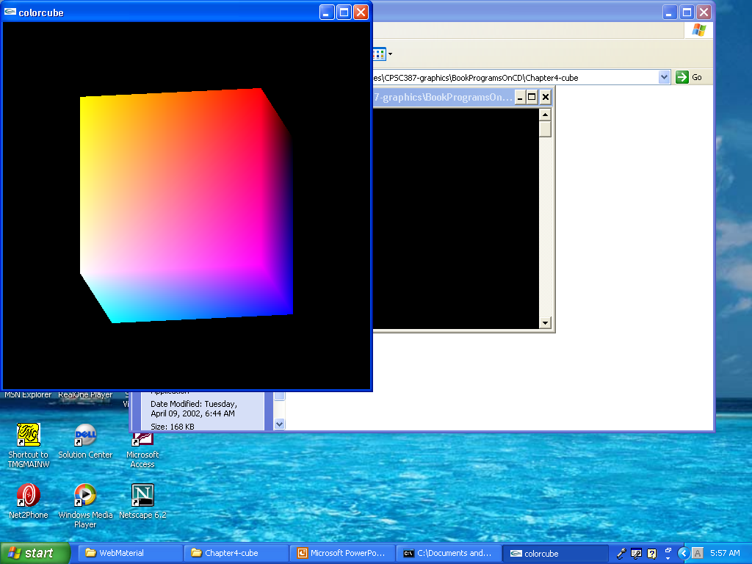
cube.c
The program we just built

Slide 51
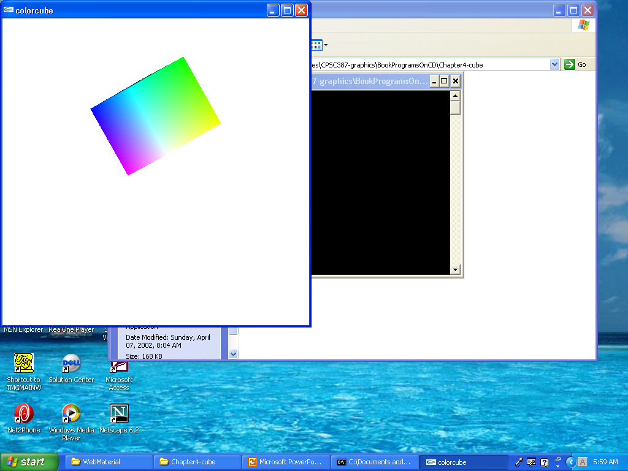
cubev.c
Similar to cube.c, but uses vertex arrays

Slide 52
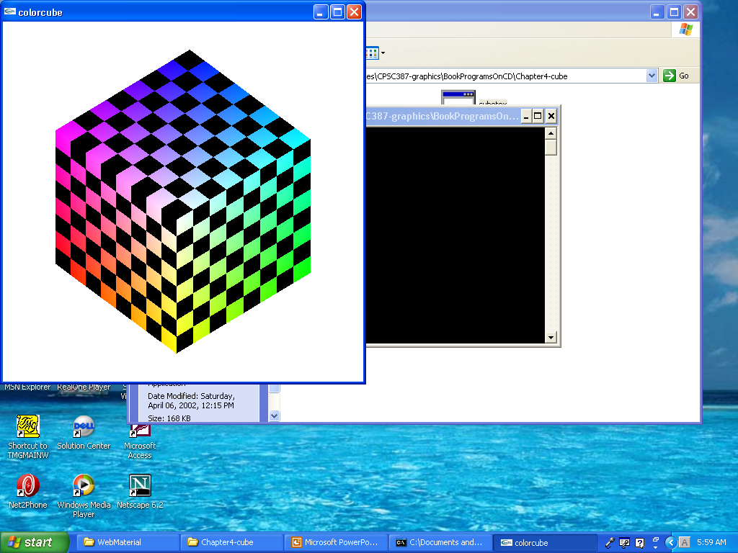
cubetex.c
Maps a texture onto the cube

Slide 53
cubeview.c
This will be used in Chapter 5 when we begin to move relative to the object.
But, first let’s explore the difference between cube.c and cubev.c.

Slide 54
Efficiency and Graphics
You should be realizing that graphics is very computationally intensive.
Every call to a function “costs” us in time due to the calling overhead (pushing and popping the environment on the system stack) and data transfer of parameters)—i.e. the usual for any function call.
Cube.c uses many, many function calls as the vertices are specified as vertex lists

Slide 55
Counting the Function Calls
Each face uses glBegin and glEnd plus 4 calls to glColor and 4 calls to glVertex.
As there are 6 faces, each rendering requires 6 x 10 = 60 function calls.
Even though the back of the cube isn’t drawn, work must be done to eliminate any unseen face.
In all, over 50 function calls are made per rendering!
Later we will specify different normals for each vertex, and that will produce more function calls.
Our cube is a simple structure and speed doesn’t seem to be an issue. But, many renderings involve thousands of faces, not just 6!

Slide 56
We can conclude ...
We chose a data structure that is fine for conceptualizing the cube as a 3D geometric object.
The code to draw such an object is not very efficient.
Is there a better way?
Yes, OpenGL provides a data structure called a vertex array which allows us to define the object using vertices and pass this structure to the implementation to be traversed efficiently.

Slide 57
3 Steps in Using Vertex Arrays
1) Enable the functionality of vertex arrays.
2) Tell OpenGL where and in what format the arrays are.
3) Render the object.
Steps 1 and 2 are typically part of the initialization.
Step 3 is typically part of the display callback.

Slide 58
OpenGL’s Vertex Arrays
What Kinds Are There?
There are 6 different possibilities, corresponding to each of the possible calls that can be placed between a glBegin and glEnd:
  vertex
  color
  color index
  normal
  texture coordinate
  edge flag
We will use only the yellow ones above on this program.

Slide 59
Step 1- Enabling
glEnableClientState(GL_COLOR_ARRAY);
glEnableClientState(GL_VERTEX_ARRAY);
The arrays are as before and can be set as globals:
  GLfloat vertices[] = ...
  GLfloat colors[] = ...

Slide 60
Step 2- Inform OpenGL Where and in What Format the Arrays Are
glVertexPointer(3, GL_FLOAT, 0, vertices);
glColorPointer(3, GL_FLOAT, 0, colors);
Recall vertices and colors are the arrays just defined.
Recall that arrays in C++ (and C) are pointers.
The 3 says these are 3-D vertices.
The 0 says they are stored contiguously in memory.

Slide 61
Step 2- continued
GLubyte cubeIndices[24] =
{0,3,2,1, 2,3,7,6, 0,4,7,3,
1,2,6,5, 4,5,6,7, 0,1,5,4};
This says the first face is defined by vertices 0,3,2,1, the second by 2,4,7,6, etc.
Note that outside facing polygons are specified.
This can be defined as a global.

Slide 62
Step 3- Render the Structure
The format is
glDrawElements(type, n, format, pointer);
One possibility:
for (i=0; i < 6; i++)
glDrawElements(GL_POLYGON,4,GL_UNSIGNED_BYTE, &cubeIndex[4*i]);
Another possibility: (Better- why?)
glDrawElements(GL_QUADS,24,GL_UNSIGNED_BYTE, CubeIndices);
Watch out for the different use of the value for n!!

Slide 63
Non-formal Assignment
Run cube.c and cubev.c and examine the code for each.
Run the tutorial transformation and observe what happens with the different settings.
Just as with the other tutorials, the more you play with these, the better your intuition becomes.

Slide 64
ASSIGNMENT
Read Chapter 5 in the text.
Test 1- Monday, October 7 in class.
Better finish the two assignments- gasket one and star one. There are more to come and some of you have an IRC to code!

