Slide 1
Chapter 5
Classical and Computer Viewing

Slide 2
MATRICES ALL OVER
Most OpenGL programmers quickly become familiar with the modelview and projection matrices.
The modelview matrix controls the viewing and modeling transformations for your scene.
The projection matrix defines the view frustum and controls how the 3D scene is projected into a 2D image.
The texture matrix is less used; it allows you to transform texture coordinates to accomplish effects such as projected textures or sliding a texture image across a geometric surface. We will look at it later.

Slide 3
MATRICES ALL OVER
A single set of matrix manipulation commands controls all types of OpenGL matrices: glScalef, glTranslatef, glRotatef, glLoadIdentity, glMultMatrixf, and several other commands.
For the efficient saving and restoring of a matrix state, OpenGL provides the glPushMatrix and glPopMatrix commands; each matrix type has its own stack of matrices.

Slide 4
MATRICES ALL OVER
None of the matrix manipulation commands have an explicit parameter to control which matrix they affect. Instead, OpenGL maintains a current matrix mode that determines which matrix type the previously mentioned matrix manipulation commands actually affects.
To change the matrix mode, use the glMatrixMode command.

Slide 5
MODEL TO SCREEN
All of the phases in moving from the model to the screen involve matrices, some of which the programmer specifies without realizing matrices are involved.
Many of the matrices are developed mathematically in Chapter 5, but we will not develop them right now. We will develop them later.
Be aware, however, that they exist at each stage of the viewing pipeline ...

Slide 6
We Have Already Seen Some of the Different Coordinate Systems Used in Graphics
World Coordinates- Used by programmer
Eye Coordinates- Used by camera
Screen Coordinates- Used by the screen
  and the following was implied
Clip Coordinates- Used after a projection from 3D space to 2D space
That last 2D space is not the screen, but
Normalized Device Coordinates- Used to represent an idealized screen (or other device) and not a specific screen.

Slide 7
Transformation
Pipeline
object
eye
clip
normalized
device
window
v
e
r
t
e
x
Modelview
Matrix
Projection
Matrix
Perspective
Division
Viewport
Transform
Modelview
Projection
other calculations here
  material ➔ color
  shade model (flat)
  polygon rendering mode
  polygon culling
Modelview
●
●
●
Notes:
The depth of matrix stacks are implementation-dependent, but the Modelview matrix stack is guaranteed to be at least 32 matrices deep, and the Projection matrix stack is guaranteed to be at least 2 matrices deep.
The material-to-color, flat-shading, and clipping calculations take place after the Modelview matrix calculations, but before the Projection matrix. The polygon culling and rendering mode operations take place after the Viewport operations.
There is also a texture matrix stack, which is outside the scope of this course. It is an advanced texture mapping topic.

Slide 8
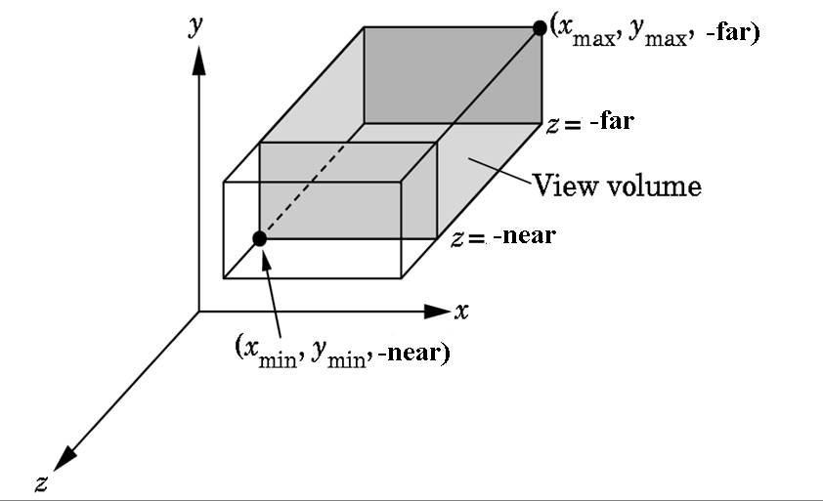
VIEWING VOLUME FOR ORTHOGRAPHIC PROJECTION
There is no restriction
on far and near other
than that far > near.
Set using
glOrtho(xmin, xmax,ymin,ymax,near,far);

Slide 9
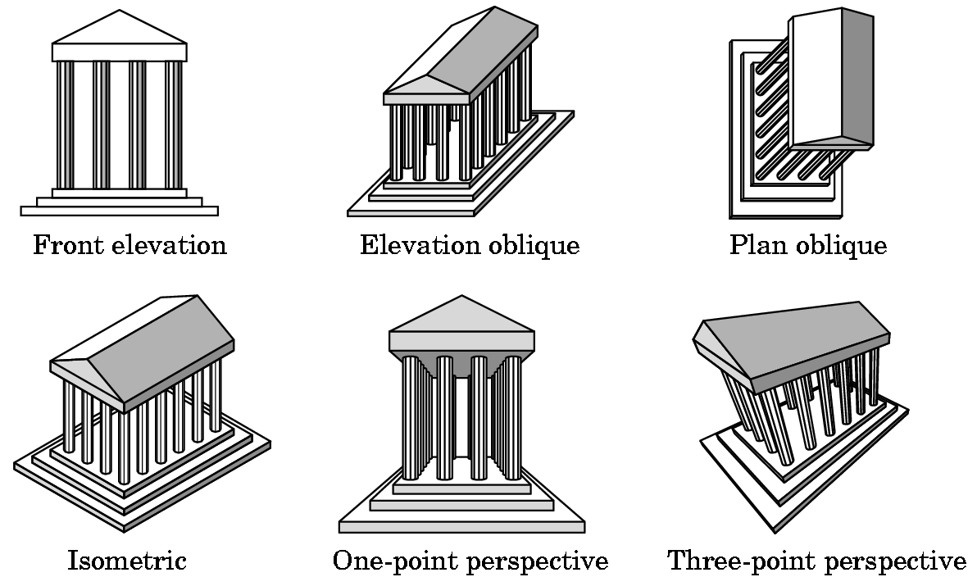
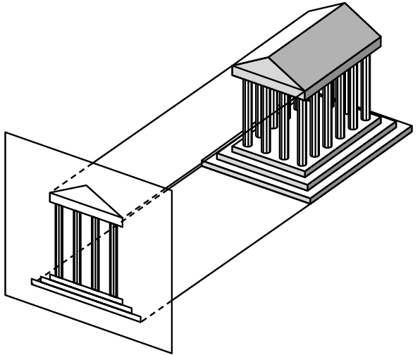
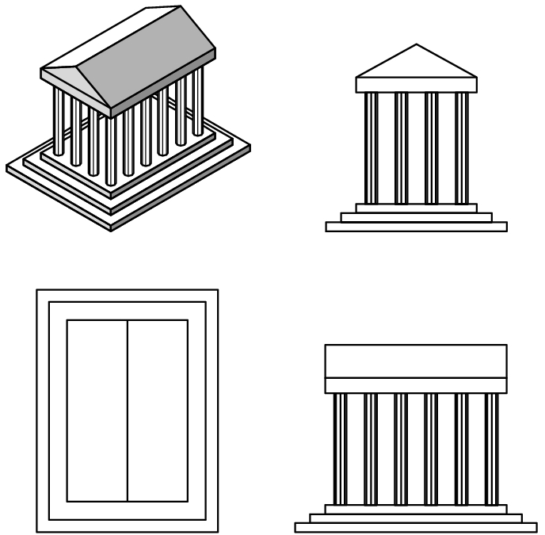
PROJECTION
Many kinds of projections exist. These can be developed in OpenGL, but only two kinds are supported directly:
orthographic
1-point perspective
We have been using the orthographic projection:

Slide 10
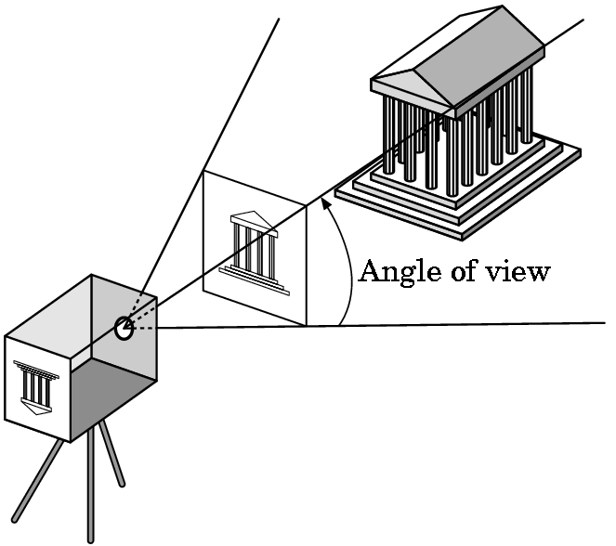
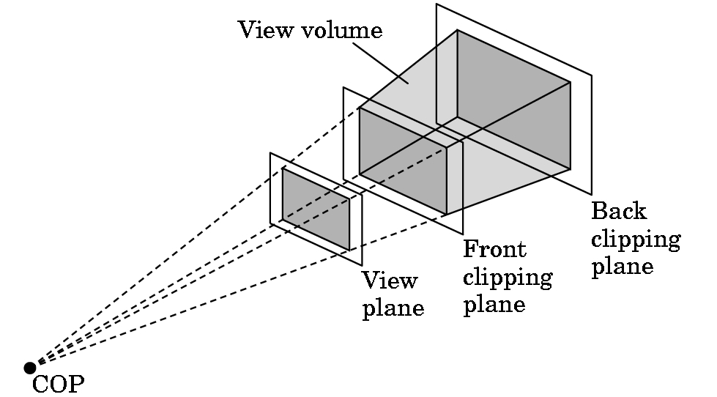
(1-point) PERSPECTIVE PROJECTION
Basic idea for defining the view volume:
Again, we have a front and back clipping plane:
COP = center of projection

Slide 11
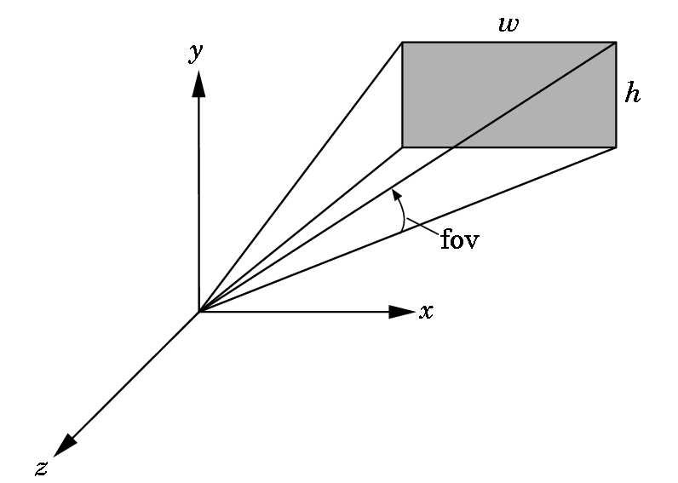
PERSPECTIVE PROJECTION
OpenGL has two functions for specifying perspective views.
The simplest one to use specifies the field of view (fov), the angle between the top and bottom planes:
The function is:
gluPerspective(fov, aspect, near, far);
Near and far are as with glOrtho.
The aspect ratio is the value of w/h.
Note the subtle change to a right-handed coordinate system.

Slide 12
gluPerspective(fov, aspect, near, far);
Typical values for field of view are between 60 to 30 degrees.
The larger the value, the greater the apparent depth effect.
Try experimenting with the value, however, as you can achieve some interesting effects with it---like changing the lens on a camera. A wide angle lens means a wide field of view.
Note that when the window is resized, the new width and height are provided so this function can easily be used to maintain the correct aspect ratio.

Slide 13
gluPerspective(fov, aspect, near, far);
Choosing values for near and far:
Don't choose these too far apart. Why?
The values in the depth buffer are normalized to the range 0.0 to 1.0.
The smaller the values that must be represented, the better differentiation that will occur in the calculated depth of objects.
If the far/near ratio isn't small, you might see round-off errors in the z-values. This produces z-fighting where pixels from various polygons that are close to the same depth are intermixed in the image.
But, if you don't see anything, spread your near and far apart. It is easy to choose wrong values.

Slide 14
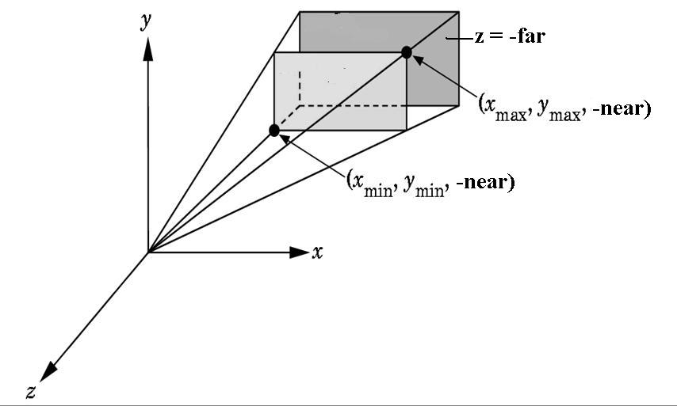
THE OTHER PERSPECTIVE COMMAND
The more powerful and more difficult to use command:
glFrustrum(xmin,xmax,ymin,ymax,near,far);
The near and far distances must be positive and are
measured from the COP to these planes, both of which must be parallel to the plane z = 0.

Slide 15
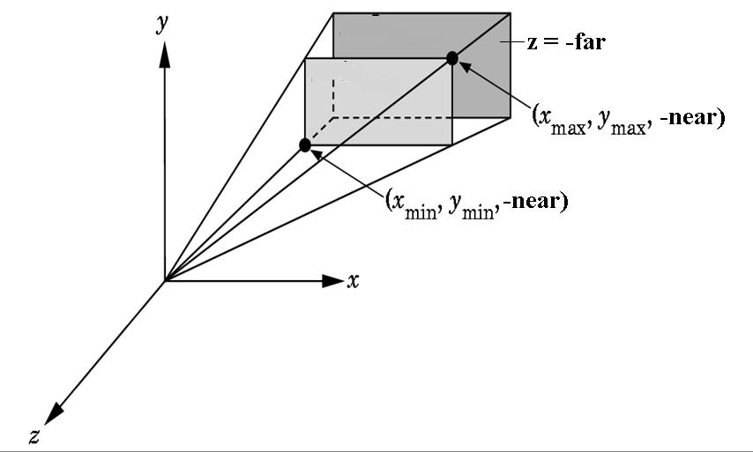
glFrustrum(xmin,xmax,ymin,ymax,near,far);
This is more powerful as you can have nonsymmetric viewing volumes.
Why is this more powerful?
For example, you might have the interior of a cockpit modeled, with two cockpit windows split by a vertical support.
Then you could have the left frustrum specify a distance -x as the left parameter and 0 as the right. The right frustrum could specify 0 as the left and x as the right. Then use two viewports to obtain the view.

Slide 16
WHEN DO WE SET THE PERSPECTIVE?
.
Changes to the modelview matrix move the world frame relative
to the camera.
These changes affect the camera's view of all objects defined afterwards as their vertices are specified relative to the repositioned world frame.
The projection and modelview matrices are part of the state.
When an object is drawn, the system uses the present state to obtain
the matrices to apply to it.
Thus, in reality, we change the state and then draw an object even though we might be imagining we are moving the object!

Slide 17
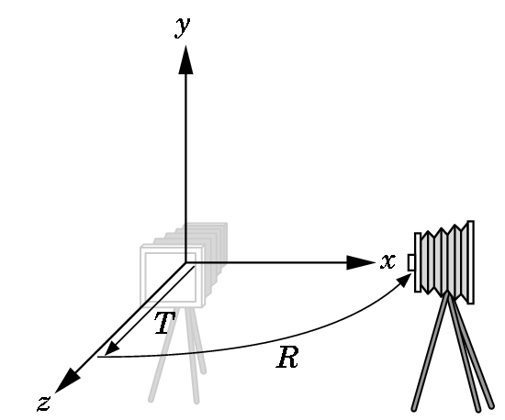
CAMERA POSITIONING
Example:
glLoadIdentity();
glTranslate(0.0, 0.0, -2.0);
glRotatef(-90.0, 0.0, 1.0, 0.0); render();
Rotates the world frame
relative to the camera frame
then moves them apart:
Figure 5.14 (above) on pg 229 is confusing as the frame is rotated first and then the translate moves backwards on the z-axis which was formerly the x-axis. I have drawn the new frame on the next slide which should make the movement clearer.

Slide 18
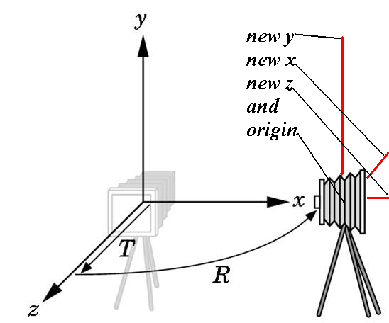
CAMERA POSITIONING
Example:
glLoadIdentity();
glTranslate(0.0, 0.0, -2.0);
glRotatef(-90.0, 0.0, 1.0, 0.0); render();

Slide 19
A TYPICAL SEQUENCE
glMatrixMode(GL_PROJECTION);
/* Now update the projection matrix. */
glLoadIdentity();
glFrustum(-3.0, 3.0, -3.0, 3.0, 1.0, 40.0);
glMatrixMode(GL_MODELVIEW);
/* Now update the modelview matrix. */
glPushMatrix(); //save old one
glLoadIdentity();
glTranslate(0.0, 0.0, -2.0); //we just went through this sequence
glRotatef(-90.0, 0.0, 1.0, 0.0);
render(); //a drawing routine
glPopMatrix();

Slide 20
MASTERING THE MOTIONS
Individually the transformations are easy to visualize.
Visualizing their interactions takes some practice.
Standard Example: Introduced in the original OpenGL Programming Guide (called the Red Book):
  We want to model part of the solar system.
  Place sun in the center.
  The earth will rotate around the sun in a circular orbit in 365 days.
  The earth will rotate around its own axis in 24 hours.
This can be generalized to do the following:
  The moon will rotate around its own axis, but it keeps its same side to the earth.
  The moon will rotate around the earth in a circular orbit in 1/12 of year.
  We want the plane of the elliptic to be tilted slightly.

Slide 21
We will sketch only the main ideas dealing with the motions
Implementing the entire system with all the planets and their main moons moving in correct orbits textured using NASA images, star maps using NASA information, and the ability to place the camera in any place in the entire solar system (including on the surface of any planet) constituted an IRC for this course by Aaron (Phil) Worley, Class of ’98.

Slide 22
SOLAR SYSTEM PROGRAM LAYOUT
Main- as usual
  Double buffer
  Set up window on screen with title
  Call the initialization routine
  Register callback functions
  Enter main event loop.
Initialization Routine
  Set shading model (which we haven't talked about yet)
  Set background color
  Set depth buffer
  Enable depth testing

Slide 23
BASIC IDEAS FOR PROGRAM
We use the same sphere-drawing routine to draw the planet, the sun, and the moon as wireframes.
We assume at the moment that such a routine exists called draw(radius) or we could use a sphere drawing routine provided by GLUT named glutWireSphere().
You should investigate the documentation on the web site to see how to use predefined objects provided by GLUT.

Slide 24
BASIC IDEAS- continued
We use glRotate*() for the revolution of the planet around the sun the moon around the planet, and the rotation of the planet, moon, and sun around their own axis.
glTranslate*() will move the planet and the moon out to the appropriate orbit, away from the origin of the solar system.

Slide 25
SOLAR SYSTEM PROGRAM LAYOUT
In RESHAPE
  Set viewport
  Set perspective
For example:
h = (h==0) ? 1 : h; //set defaults
w= (w==0) ? 1 : w; //always initialize!
glViewport(0,0,w,h);
glMatrixMode(GL_PROJECTION);
glLoadIdentity();
gluPerspective(45.0f,(GLfloat)w/(GLfloat)h, 1.0f, 20.0f);
// recall: fov, aspect, near, far are the parameters
glMatrixMode(GL_MODELVIEW);
//Be sure you have this matrix for the future

Slide 26
SOLAR SYSTEM PROGRAM
//animation values
static int HourOfDay=0, DayOfYear = 0;
static int AnimateIncrement = 24;
// can be sped up or slowed down by mouse buttons
// Changes animation speed
void mouse(int btn, int state, int x, int y){
if (btn==GLUT_LEFT_BUTTON &&
state == GLUT_DOWN)
{ AnimateIncrement *=2;
if (0 == AnimateIncrement) AnimateIncrement = 1; }
if (btn==GLUT_RIGHT_BUTTON &&
state == GLUT_DOWN)
AnimateIncrement /=2; }}

Slide 27
SOLAR SYSTEM PROGRAM the display function
// clear the frame and depth buffers
glClear(GL_COLOR_BUFFER_BIT | GL_DEPTH_BUFFER_BIT);
//update animation parameters
HourOfDay += AnimateIncrement;
//see a previous slide for values and use
DayOfYear += HourOfDay/24;
HourOfDay = HourOfDay % 24; //keep in bounds
DayOfYear = DayOfYear % 365;

Slide 28
SOLAR SYSTEM PROGRAM display continued
/* tilt the elliptic plane and back the camera off the origin*/
glLoadIdentity();
glTranslatef(0.0f, 0.0f,-5.0f); //watch the order
glRotatef(5.0f, 1.0f, 0.0f, 0.0f);
/*select color for sun and draw the sun as wireframe */
glColor3f(1.0f, 1.0f, 1.0f); //white sun
draw(1.0f)
//a routine for drawing a sphere with radius 1

Slide 29
SOLAR SYSTEM PROGRAM display continued
/* move coordinate system to the location of earth
and rotate in orbit */
glRotatef( (GL_float) (360.0*DayOfYear/365.0),
0.0f, 1.0f, 0.0f);
glTranslate(4.0f, 0.0f, 0.0f); //again, watch order
glPushMatrix(); //save so we can handle moon
//the modelview matrix doesn't change until the next line
//rotate the earth - note this is done first, then the above
glRotatef((GLfloat) 360.0*HourOfDay/24.0, 0.0f, 1.0f, 0.0f);

Slide 30
SOLAR SYSTEM PROGRAM display continued
//select color and draw earth
//predominately blue- touch of yellow
glColor3f(0.2f, 0.2f, 1.0f);
draw(0.2f);
//restore coordinate system for moon
glPopMatrix();

Slide 31
SOLAR SYSTEM PROGRAM display continued
//translate moon relative to earth and //rotate it before drawing
glRotatef((GLfloat)360.0*12.5*
DayOfYear/365.0, 0.0f, 1.0f, 0.0f);
glTranslate(0.5f, 0.0f, 0.0f);
//draw moon in grey color
glColor3f(0.3f, 0.3f, 0.3f); draw(0.05f);
//then flush pipeline and swap buffer.
//NOW all goes on screen

Slide 32
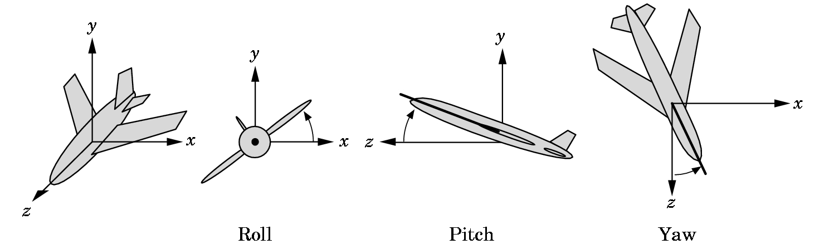
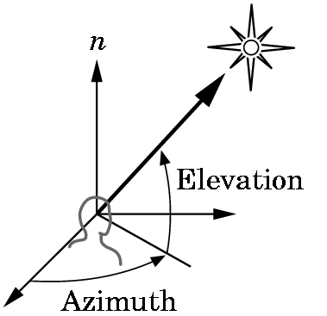
POSITIONING THE CAMERA
There are other ways to do this.
  Solar system example- an example of instance transformations that we discussed in Chapter 4 and are discussed further in Section 5.2
  LookAt vector method- handled shortly
  Two methods discussed in the problem set
    5.2 Motion in terms of roll, pitch, and yaw of an airplane
    5.3 Motion in terms of polar coordinates

Slide 33
POSITIONING THE CAMERA
OpenGL directly supports only some of the methods.
Other methods can be obtained if the programmer wishes to load the
necessary matrices directly.
We must be careful when doing animation. Where in a program we
define the position of the camera depends on which of the following we choose:
  Do we want to place the camera in a fixed position in a scene?
  Do we want the camera attached to a particular object?

Slide 34
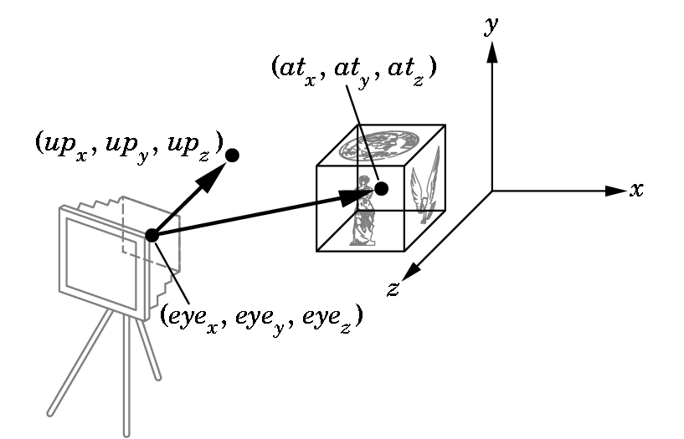
POSITIONING THE CAMERA with gluLookAt
The concept is simple and allows us to move our camera relative to an object:
gluLookAt(eyex, eyey, eyez, atx, aty, atz, upx, upy, upz);
alters the modelview matrix for a camera pointed along the given line.

Slide 35
Viewing Transformations
Position the camera/eye in the scene
  place the tripod down; aim camera
To “fly through” a scene
  change viewing transformation and
  redraw scene
gluLookAt( eye_{x}, eye_{y}, eye_{z},
at_{x}, at_{y}, at_{z},
up_{x}, up_{y}, up_{z} )
  up vector determines unique orientation
  careful of degenerate positions
tripod
Notes:
gluLookAt() multiplies itself onto the current matrix, so it usually comes after glMatrixMode(GL_MODELVIEW) and glLoadIdentity().
Because of degenerate positions, gluLookAt() is not recommended for most animated fly-over applications.
An alternative is to specify a sequence of rotations and translations that are concatenated with an initial identity matrix.
Note: that the name modelview matrix is appropriate since moving objects in the model front of the camera is equivalent to moving the camera to view a set of objects.

Slide 36
gluLookAt
IS PARTICULARLY GOOD FOR CAMERA MOTION
To pan along a scene:
  Take the At point to be in a particular place.
  Calculate the eye to be a distance from that point.
  Then vary the At point to produce the pan.
To walk through a scene:
  Example A.11 (or cubeview.c source code)
  In Chapter 4, the cube rotated about the origin.
  We used an orthographic projection so we just used the camera in a default direction.

Slide 37
cubeview.c
Now use perspective viewing and allow the viewer to move the camera by depressing the x, X, y, Y, z, and Z keys while pointing the camera always as the center of the cube using gluLookAt.
An array viewer[3] holds the camera position. Its contents are changed by keys in the text version:
void keys(unsigned char key, int x, int y){
/* Use x, X, y, Y, z, and Z keys to move viewer */
if(key == 'x') viewer[0] -= 1.0;
if(key == 'X') viewer[0] += 1.0;
if(key == 'y') viewer[1] -= 1.0;
if(key == 'Y') viewer[1] += 1.0;
if(key == 'z') viewer[2] -= 1.0;
if(key == 'Z') viewer[2] += 1.0;
display();}

Slide 38
cubeview.c
static GLfloat theta[] = {0.0,0.0,0.0};
static GLint axis = 2;
static GLdouble viewer[]= {0.0, 0.0, 5.0};
/* initial viewer location */
void display(void){
glClear(GL_COLOR_BUFFER_BIT | GL_DEPTH_BUFFER_BIT);
/* Update viewer position in modelview matrix */
glLoadIdentity();
//recall keys change by +1(caps) or -1 eye; origin is AT; y-axis is UP
gluLookAt(viewer[0],viewer[1],viewer[2], 0.0, 0.0, 0.0, 0.0, 1.0, 0.0);
/* rotate cube */
glRotatef(theta[0], 1.0, 0.0, 0.0);
glRotatef(theta[1], 0.0, 1.0, 0.0);
glRotatef(theta[2], 0.0, 0.0, 1.0);
colorcube();
glFlush();
glutSwapBuffers();}

Slide 39
cubeview.c
Reshape can select the perspective via glFrustrum or gluPerspective
void myReshape(int w, int h){
glViewport(0, 0, w, h);
/* Use a perspective view */
glMatrixMode(GL_PROJECTION);
glLoadIdentity();
if(w<=h) glFrustum(-2.0, 2.0, -2.0 * (GLfloat) h/ (GLfloat) w,
2.0* (GLfloat) h / (GLfloat) w, 2.0, 20.0);
else glFrustum(-2.0, 2.0, -2.0 * (GLfloat) w/ (GLfloat) h,
2.0* (GLfloat) w / (GLfloat) h, 2.0, 20.0);
/* Or we can use gluPerspective */
/* gluPerspective(45.0, w/h, -10.0, 10.0); */
glMatrixMode(GL_MODELVIEW);}

Slide 40
Run cubeview.c, cube.c, cubev.c, and cubetex.c and examine the code for each!
These are on your CD but also on the website by the names above.
Read Chapter 6, Light and Matter
Later we will come back and develop some of the matrices in Chapter 5 and do a few other things that were skipped.

