Slide 1
USING BEZIER CURVES AND SURFACES IN OPENGL and the
RENDERING PIPELINE OF OPENGL
Chapter 10- Overview
and
Some More from Chapter 7

Slide 2
EVALUATORS
OpenGL's 1D evaluators draw Bezier curves in 2 dimensions
OpenGL's 2D evaluators draw Bezier surfaces in 3 dimensions
Note that the kD, k = 1 or 2, refers to the number of parameters, not just the dimension in which the image is viewed.
You can use color or texture with the curves.
Recall that all the curves are positioned by the location of the control points as we have already demonstrated.

Slide 3
THE FORMAL DEFINITION OF A BEZIER CURVE
Let p_{k} = (x_{k}, y_{k}, z_{k)} be a control point for k = 0, 1, ...,n
n
P(u) = Σ C(n,k) u^{k} (1-u)^{n-k}p_{k} where C(n,k) = n!/ (k! (n-k)!)
k=0
C(n,k) are the binomial coefficients.
More simply, n
P(u) = Σ B_{k,n}(u) p_{k} where B_{k,n}(u) are called the
k=0 blending functions or
Bernstein polynomials

Slide 4
1. DEFINE THE CONTROL POINTS
Example:
GLint nNumPoints= 4; //this will produce cubic polynomials
//you may use more control points by adjusting the numbers below
GLfloat ctrlPoints [4][3] =
{{-4.0f, 0.0f, 0.0f}, //one endpoint ---i.e. the value at u = 0
{-6.0f, 4.0f, 0.0f},
{6.0f, -4.0f, 0.0f},
{4.0f, 0.0f, 0.0f}}; //the other endpoint---i.e. the value at u= 3
If you want to see the control points, you will need code like
void DrawPoints(void) {
int i;
glPointSize(5.0f);
glBegin(GL_POINTS);
for (i=0; i <nNumPoints; i++)
glVertex2fv(CtrlPoints[i];
glEnd();
}

Slide 5
2. Drawing the Curve
//Draw Curve
void Draw (void) {
int i;
glClear (GL_COLOR_BUFFER_BIT); //usual clear
//if the following is called only once, put this in Init:
glMap1f(GL_MAP1_VERTEX_3, //says generates 3-tuple *
0.0 f, //start of parameter range
100.0f, //ending parameter
3, //distance between points in pixels
nNumPoints, //number of control points
&CtrlPoints[0][0]); //array of control points
//enable evaluator
glEnable(GL_MAP1_VERTEX_3);
* GL_MAP1_COLOR_4 here allows R,G,B,alpha tuples to be produced.

Slide 6
2. Drawing the Curve (Con't)
//Use line strip to connect the data that is generated
glBegin(GL_LINE_STRIP);
for (i=0; i <= 100; i++)
{glEvalCoord1f((GLfloat) i);} //generate point
glEnd();
//If you want the control points shown:
DrawPoints();
//Flush drawing commands
glFlush();
} //end Draw
An alternate form that is handy when surfaces are drawn: Replace
with:
glEvalMapGrid1d(100,0.0,100.0);// 100 points from 0 to 100
glEvalMesh1(GL_LINE,0,100); //evaluate grid

Slide 7
DRAWING SURFACES --- SIMILAR COMMANDS
GLint nNumPoints =3; //define the control points
GLfloat ctrlPoints [3][3][3] =
{{{-4.0f, 0.0f, 4.0f}, //for v = 0
{-2.0f, 4.0f. 4.0f},
{4.0f, 0.0f,4.0f}},
etc. -4,0,0 -2,4,0 4,00 for v = 1
-4,0,-4 -2,4,-2 4,0,-4 for v = 2
The surface is given by control points p_{j,k} which are being specified above.
2 2
P(u,v) = Σ Σ p_{j,k} B_{j,2}(v)B_{k,2}(u) and the B_{i,2} are the polynomials defined
j=0 k=0 earlier

Slide 8
DRAWING SURFACES --- SIMILAR COMMANDS
The command similar to the glMap1f command is:
glMap2f(GL_MAP2_VERTEX_3, // says there are 2 parameters
0.0f, 10.0f, //lower value of u and upper value of u
3,3, //distance between points and number of control points in u
0,0f, 10.0f, //lower value of v and upper value of v
9,3, //distance between points and number of control points in v
&ctrlPoints[0][0][0]); //control point array location
Evaluators are objects so you can manipulate them just like other primitives...

Slide 9
EXAMPLE OF A SURFACE RENDER FUNCTION
void Render(void) {
int i;
glClear(GL_COLOR_BUFFER_BIT);
glMatrixMode(GL_MODELVIEW);
glPushMatrix();
//rotate so easier to see
glRotatef(45.0f, 0.0f, 1.0f, 0.0f);
glRotatef(60.0f, 1.0f, 0.0f, 0.0f);
//enable evaluator
glEnable(GL_MAP2_VERTEX_3);
//map to a grid and evaluate 100 points
glMapGrid2f(10, 0.0f, 10.0f, 10, 0.0f, 10.0f);
//evaluate grid using lines
glEvalMesh2(GL_LINE, 0,10, 0, 10); //see note *
glPopMatrix();
glFlush();
* By replacing this line with the 2 below, you can automatically generate normals
glEvalMesh2(GL_FILL, 0,10,0,10);
glEnable(GL_AUTO_NORMAL);

Slide 10
WHY ARE BEZIER CURVES AND SURFACES SO "NICE"
They are affine invariant --- i.e. mapping the control
points and then generating points is equivalent pictorially to mapping each point individually.
Changing a control point slightly affects only the local
area close to the control point ---i.e. there is local control.
We can piece the curves or surfaces together and obtain
smoothness at the joins (provided we place the endpoints properly).
Rendering is no more computationally expensive than
we would expect with the requirement to plot points.
Horner's method allows for a quick polynomial
evaluation.

Slide 11
WHY BEZIER CURVES AND SURFACES ARE SO "NICE"
We can visualize the shape of the curve enough that we can place the control points and have some idea where the curve will lie--- and, of course, we can tinker with it to obtain an exact shape.
Compared to other curve-surface computational methods,
Bezier curves are fairly simple to understand.
Only problem--- we can't obtain first derivative continuity without a bit of pain and second derivative continuity is next to impossible.
So, animation may look jerky due to non-smooth
velocity (1st derivative) or acceleration (2nd derivative).

Slide 12
BEYOND BEZIER CURVES
As you might expect, the properties of Bezier curves are so nice that many attempts have been made to find alternate ways of generating curves.
There are many other ways of generating curves:
  Parametric polynomials that exactly interpolate points. Problem: May not look particularly smooth especially for high degree polynomials that might be required.
  Bezier curves approximate Hermite curves which are better for interpolation, but Hermite curves require that the derivative be calculated.
  B-splines (Basis splines)- a class of curves that use control points and a set of values called knots to define curves and surfaces.

Slide 13
SPLINES
The book discusses many versions of these, namely
  General B-splines
  Recursively defined B-splines
  Uniform periodic B-splines
  Nonuniform Rational B-splines
and there are others that are not B-splines, namely
  Beta splines
  Rational splines
OpenGL supports NURBS (NonUniform Rational B-Splines).
But, we need some general concepts first.

Slide 14
SPLINES
Advantages over Bezier curves:
  Within certain limits, the degree of the polynomial can be set independent of the control points.
  Local control is better.
  Continuity at the joins for higher derivatives is easier to obtain.
The disadvantage of splines:
  They are more complex than Bezier curves to formulate and understand.

Slide 15
DEFINITIONS FOR B-SPLINES
Now, in addition to control points we have knots.
The knots, u₀, u₁, ..., u_{n} are the endpoints of intervals between u_{min} and u_{max}, where the curve is being defined.
The knots have the property that u_{min}= u₀<= u₁ <= ....<= u_{n}= u_{max}
Again, there are blending functions, B_{i,d}
These are defined by the Cox-deBoor recursion formulas on page 504-505.

Slide 16
PROPERTIES OF THE BLENDING FUNCTIONS- B_{i,d}
The B_{k,0} functions are constant over one interval and zero elsewhere.
The B_{k,1} functions are linear over each of two intervals and zero elsewhere.
The B_{k,2} functions are quadratic over each of three intervals and zero elsewhere.
In general, the B_{k,d} functions are nonzero over the d+1 intervals between u_{k} and u_{k+d+1} and is a polynomial of degree d in each of those intervals.

Slide 17
THE DEFINITION OF A B-SPLINE
Looks sort of like the Bezier definition, but remember the B_{i,d} functions are defined differently.
n
P(u) = Σ p_{k} B_{k,d}(u) for u_{min} <= u <= u_{max},
k=0 2 <=d <=n+1,
p_{k} are n+1 control points
Again, as with Bezier curves, the definition of B-splines
can be used to prove that certain important properties exist.
These properties tell us intuitively how curves are rendered, after we specify the control points and the knots

Slide 18
PROPERTIES OF B-SPLINES
The polynomial curve has degree d-1. Why is that important?
The curve has continuous d-2 derivatives over the range of u. Why is that important?
Any one control point can affect the shape of at most d curve sections. Why is that important?
The curve lies in the convex hull of at most d+1 control points so the curves are tightly bound to the control points --- i.e. it comes close to the control points.
We can choose the number of control points independent of the degree of the polynomial.
Interestingly, Bezier curves are just special cases of B-splines!

Slide 19
NURBS
These are special B-splines in which we can think of the knots as adding weight to a control point.
They are supported directly in OpenGL through the GLU library.
Important functions include ways of
  Defining a new NURBS object and saying how to render it:
    gluNewNurbsRenderer
    gluNurbsProperty
  Generating functions
    gluBeginNurbsSurface
    gluNurbsSurface
    gluEndNurbsSurface

Slide 20
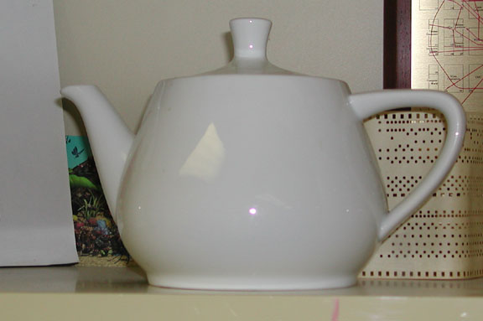
The Utah Teapot
Is there a real teapot?
The teapot was made by Melitta in 1974 and originally belonged to Martin Newell and his wife, Sandra - who purchased it from ZCMI, (a department store in Salt Lake City).
The teapot was donated to the Boston Computer Museum but now resides in the Ephemera collection of the Computer History Museum where it's catalogued as "Teapot used for Computer Graphics rendering" catalogue number X00398.1984.

Slide 21
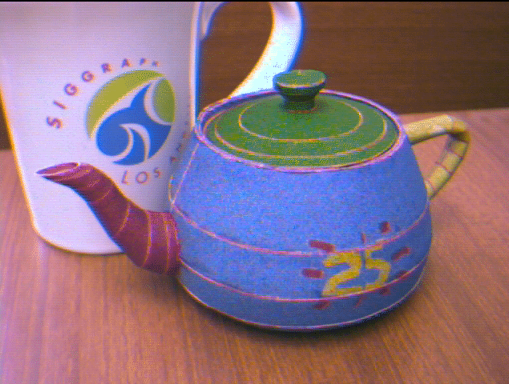
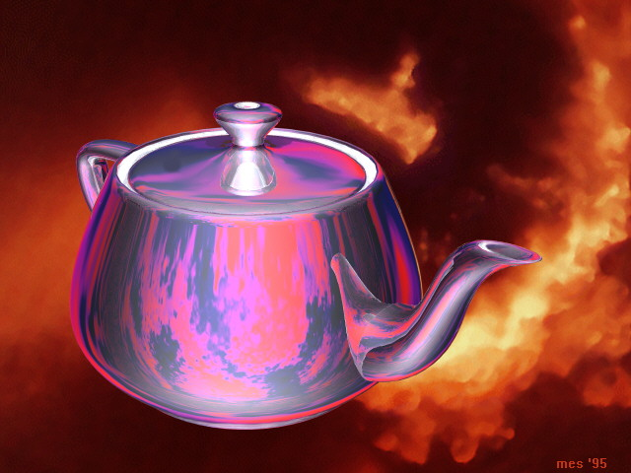
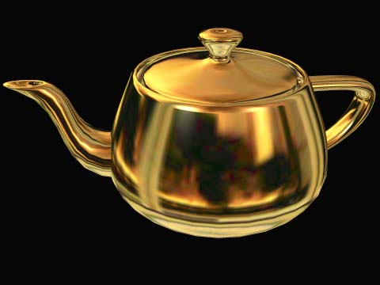
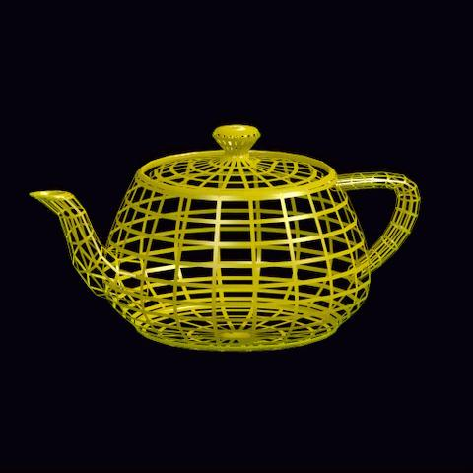
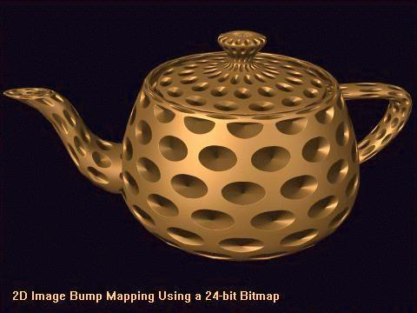
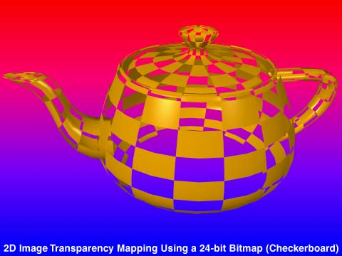
Many Versions of Teapots
From Steve Baker’s History of the Teapot site: http://www.sjbaker.org/teapot/index.html

Slide 22
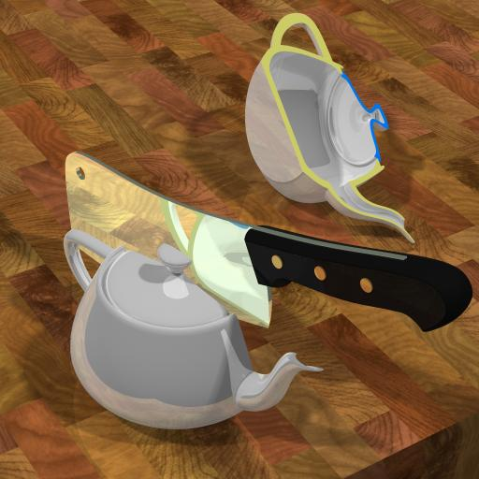
And the One I Like (Reflecting Newell’s View of Why He is Best Remembered for that %^$@ Teapot!)
From Steve Baker’s History of the Teapot site: http://www.sjbaker.org/teapot/index.html.

Slide 23
Mundane Objects Become Part of Graphics History
The idea for modeling the teapot was brought up over concerns that Martin Newell didn't have enough interesting computer models.
Sandra suggested modeling the tea service (they were sitting down to tea at the time).
Martin took some graph paper and a pencil, and he modeled the entire tea service freehand.
Then, he went back to the lab and edited Bezier control points on a Tektronix storage tube, again by hand.
Later he also digitized a spoon and a cup and saucer.

Slide 24
A FEW FOLKLORE FACTS ABOUT THE ORIGINAL TEAPOT
The real teapot is quite about 30% taller than the classic computer teapot see. Why?
  Jim Blinn was one of the early users of the Teapot data
    He was rendering on an Evans and Sutherland frame buffer.
    The pixels were not square, so he squashed the model rather than scaling the image.
    He chose to scale all the Z coordinates by dividing them by 1.3. His data was more widely distributed than the original and it has become the standard.
The original teapot data had no bottom.
  Some of the data sets that are out there have added a bottom - but that is definitely 'impure'.
  The one in the GLU and GLUT distributions is impure

Slide 25
WHY IS THE TEAPOT POPULAR?
In the early days, there were no 3D modeling packages
  Everything was digitized by hand or sketched on graph paper and the numbers entered by using a text editor.
  If you were working on texture mapping algorithms, ray tracing, lighting models, etc., then any source of free data was welcome.
Moreover, the teapot is a useful test object to test. It
  Is instantly recognizable
  Has complex topology
  Self-shadows
  There are hidden surface issues
  Has both convex and concave surfaces - as well as 'saddle points
  Doesn't take much storage space
Folklore says that some of the early pioneers of computer graphics could type the teapot from memory!

Slide 26
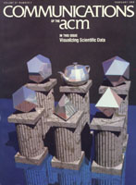
The image used for the February 1988
edition of the CACM is called
The Six Platonic Solids
So, some call
the teapot the
Teapotahedron

Slide 27
In the movie Toy Story, you can spot the teapot in the scene after Buzz loses his arm and has tea with the headless dolls.
Did the graphics folks insert that scene just so that a gratuitous Teapot could be seen?

Slide 28
Consider Four Programs
teapot.c- a wireframe version of the teapot
bteapot.c – a faceted shaded version of the teapot
teatex.c – a textured, rotating version of the teapot
These are on your CD
teapots.c – A Silicon Graphics’ program

Slide 29
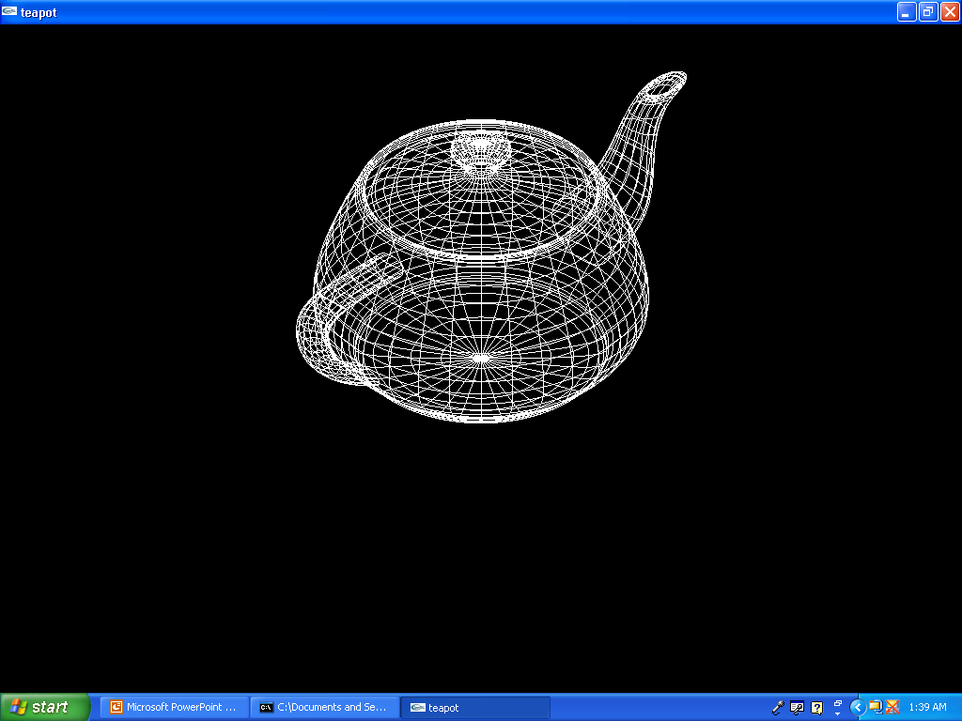
wireframe

Slide 30
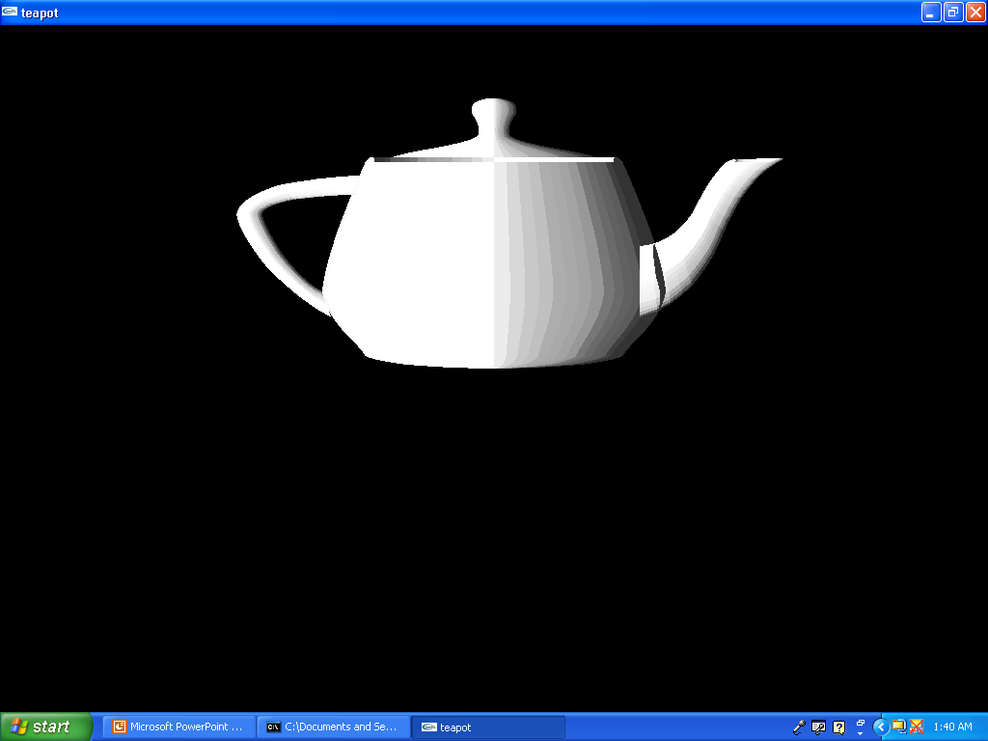
faceted shading

Slide 31
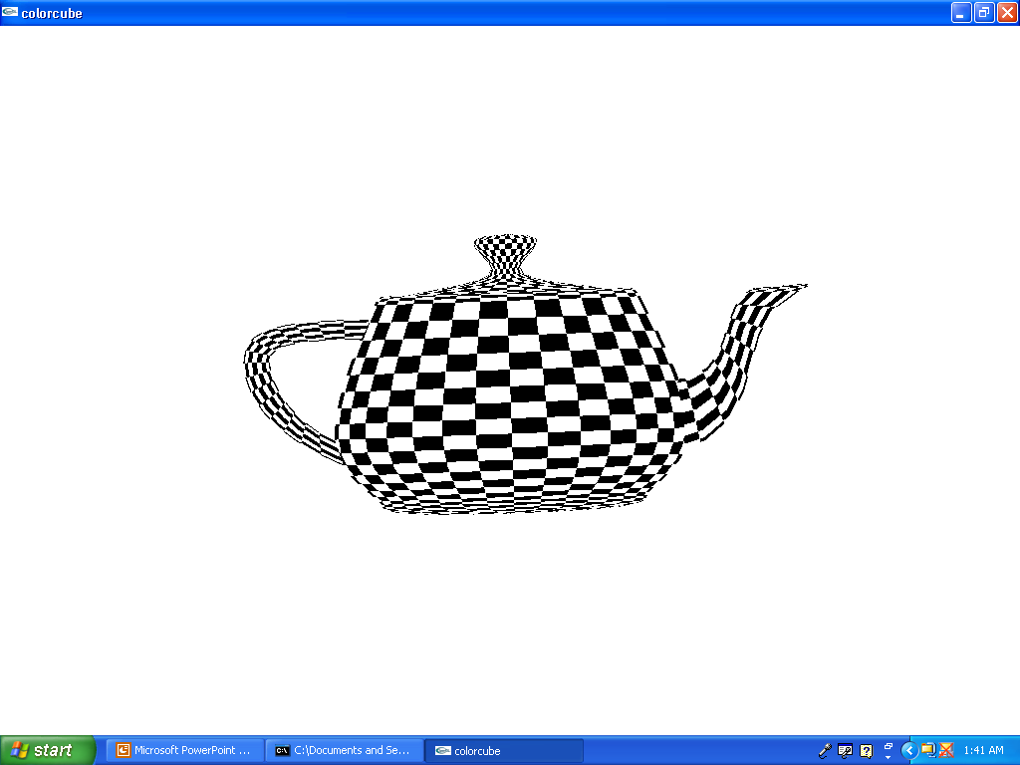
textured and rotating

Slide 32
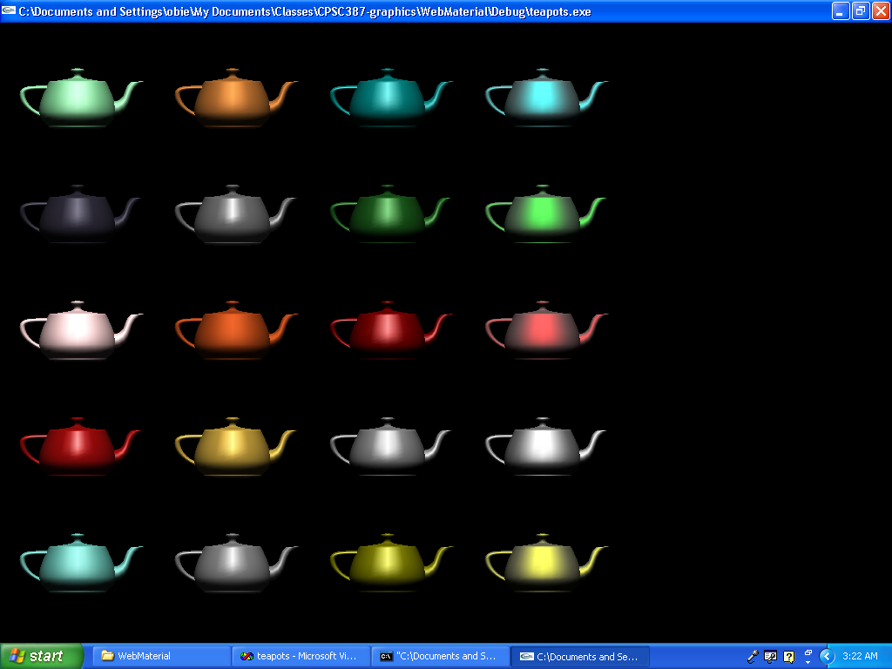
Multiple Teapots of Various Materials

