Slide 1
GRAPHICS PROGRAMMING
Chapter 2:Text
Chapter 1-2: OpenGL Primer

Slide 2
Objectives
Development of the OpenGL API
OpenGL Architecture
  OpenGL as a state machine
Functions
  Types
  Formats
Simple program

Slide 3
Early History of APIs
IFIPS (1973) formed two committees to come up with a standard graphics API
  Graphical Kernel System (GKS)
    2D but contained good workstation model
  Core
    Both 2D and 3D
  GKS adopted as IS0 and later ANSI standard (1980s)
GKS not easily extended to 3D (GKS-3D)
Far behind hardware development

Slide 4
PHIGS and X
Programmers Hierarchical Graphics System (PHIGS)
  Arose from CAD community
  Database model with retained graphics (structures)
X Window System
  DEC/MIT effort
  Client-server architecture with graphics
PEX combined the two
  Not easy to use (all the defects of each)

Slide 5
SGI and GL
Silicon Graphics (SGI) revolutionized the graphics workstation by implementing the pipeline in hardware (1982)
To use the system, application programmers used a library called GL
With GL, it was relatively simple to program three dimensional interactive applications

Slide 6
OpenGL
The success of GL lead to OpenGL (1992), a platform-independent API that was
  Easy to use
  Close enough to the hardware to get excellent performance
  Focus on rendering
  Omitted windowing and input to avoid window system dependencies

Slide 7
OpenGL Evolution
Controlled by an Architectural Review Board (ARB)
  Members include SGI, Microsoft, Nvidia, HP, 3DLabs,IBM,…….
  Relatively stable (working on version 2.0, but not adopted yet)
    Evolution reflects new hardware capabilities
      3D texture mapping and texture objects
      Vertex programs
  Allows for platform specific features through extensions

Slide 8
OpenGL Libraries
OpenGL core library
  OpenGL32 on Windows
  GL on most unix/linux systems
OpenGL Utility Library (GLU)
  Provides functionality in OpenGL core but avoids having to rewrite code
Links with window system
  GLX for X window systems
  WGL for Widows
  AGL for Macintosh

Slide 9
GLUT
OpenGL Utility Library (GLUT)
  Provides functionality common to all window systems
    Open a window
    Get input from mouse and keyboard
    Menus
    Event-driven
  Code is portable but GLUT lacks the functionality of a good toolkit for a specific platform
    Slide bars

Slide 10
Software Organization
application program
OpenGL Motif
widget or similar
GLUT
GLX, AGL
or WGL
GLU
X, Win32, Mac O/S
GL
software and/or hardware

Slide 11
OpenGL Architecture
Geometric
pipeline
Immediate Mode
Per Vertex
Operations &
Primitive
Assembly
Polynomial
Evaluator
CPU
Display
List
Rasterization
Per Fragment
Operations
Frame
Buffer
Texture
Memory
Pixel
Operations

Slide 12
OpenGL Functions
Primitives
  Points
  Line Segments
  Polygons
Attributes
Transformations
  Viewing
  Modeling
Control
Input (GLUT)

Slide 13
OpenGL State
OpenGL is a state machine
OpenGL functions are of two types
  Primitive generating
    Can cause output if primitive is visible
    How vertices are processes and appearance of primitive are controlled by the state
  State changing
    Transformation functions
    Attribute functions

Slide 14
Lack of Object Orientation
OpenGL is not object oriented so that there are multiple functions for a given logical function, e.g. glVertex3f, glVertex2i, glVertex3dv,…..
Underlying storage mode is the same
Easy to create overloaded functions in C++ but issue is efficiency

Slide 15
OpenGL function format
function name
glVertex3f(x,y,z)
x,y,z are floats
belongs to GL library
glVertex3fv(p)
p is a pointer to an array

Slide 16
OpenGL #defines
Most constants are defined in the include files gl.h, glu.h and glut.h
  Note #include <glut.h> should automatically include the others
  Examples
  glBegin(GL_PLOYGON)
  glClear(GL_COLOR_BUFFER_BIT)
include files also define OpenGL data types: Glfloat, Gldouble,….

Slide 17
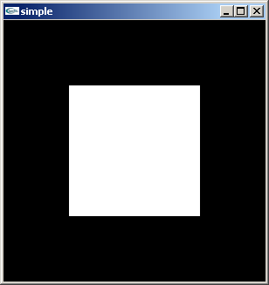
A Simple Program
Generate a square on a solid background

Slide 18
simple.c
#include <glut.h>
void mydisplay(){
glClear(GL_COLOR_BUFFER_BIT);
glBegin(GL_POLYGON);
glVertex2f(-0.5, -0.5);
glVertex2f(-0.5, 0.5);
glVertex2f(0.5, 0.5);
glVertex2f(0.5, -0.5);
glEnd();
glFlush();
}
int main(int argc, char** argv){
glutCreateWindow("simple");
glutDisplayFunc(mydisplay);
glutMainLoop();
}

Slide 19
Event Loop
Note that the program defines a display callback function named mydisplay
  Every glut program must have a display callback
  The display callback is executed whenever OpenGL decides the display must be refreshed, for example when the window is opened
  The main function ends with the program entering an event loop

Slide 20
Defaults
simple.c is too simple
Makes heavy use of state variable default values for
  Viewing
  Colors
  Window parameters
Next version will make the defaults more explicit

Slide 21
Notes on compilation
See website and ftp for examples
Unix/linux
  Include files usually in …/include/GL
  Compile with –lglut –lglu –lgl loader flags
  May have to add –L flag for X libraries
  Mesa implementation included with most linux distributions
  Check web for latest versions of Mesa and glut

Slide 22
Compilation on Windows
Visual C++
  Get glut.h, glut32.lib and glut32.dll from web
  Create a console application
  Add opengl32.lib, glut32.lib, glut32.lib to project settings (under link tab)
Borland C similar
Cygwin (linux under Windows)
  Can use gcc and similar makefile to linux
  Use –lopengl32 –lglu32 –lglut32 flags

Slide 23
Objectives
Refine the first program
  Alter the default values
  Introduce a standard program structure
Simple viewing
  Two-dimensional viewing as a special case of three-dimensional viewing
Fundamental OpenGL primitives
Attributes

Slide 24
Program Structure
Most OpenGL programs have a similar structure that consists of the following functions
  main():
    defines the callback functions
    opens one or more windows with the required properties
    enters event loop (last executable statement)
  init(): sets the state variables
    viewing
    Attributes
  callbacks
    Display function
    Input and window functions

Slide 25
Simple.c revisited
In this version, we will see the same output but have defined all the relevant state values through function calls with the default values
In particular, we set
  Colors
  Viewing conditions
  Window properties

Slide 26
main.c
includes gl.h
#include <GL/glut.h>
int main(int argc, char** argv)
{
glutInit(&argc,argv);
glutInitDisplayMode(GLUT_SINGLE|GLUT_RGB);
glutInitWindowSize(500,500);
glutInitWindowPosition(0,0);
glutCreateWindow("simple");
glutDisplayFunc(mydisplay);
init();
glutMainLoop();
}
define window properties
display callback
set OpenGL state
enter event loop

Slide 27
GLUT functions
glutInit allows application to get command line arguments and initializes system
gluInitDisplayMode requests properties of the window (the rendering context)
  RGB color
  Single buffering
  Properties logically ORed together
glutWindowSize in pixels
glutWindowPosition from top-left corner of display
glutCreateWindow create window with title “simple”
glutDisplayFunc display callback
glutMainLoop enter infinite event loop

Slide 28
init.c
black clear color
void init()
{
glClearColor (0.0, 0.0, 0.0, 1.0);
glColor3f(1.0, 1.0, 1.0);
glMatrixMode (GL_PROJECTION);
glLoadIdentity ();
glOrtho(-1.0, 1.0, -1.0, 1.0, -1.0, 1.0);
}
opaque window
fill with white
viewing volume

Slide 29
Coordinate Systems
The units of in glVertex are determined by the application and are called world or problem coordinates
The viewing specifications are also in world coordinates and it is the size of the viewing volume that determines what will appear in the image
Internally, OpenGL will convert to camera coordinates and later to screen coordinates

Slide 30
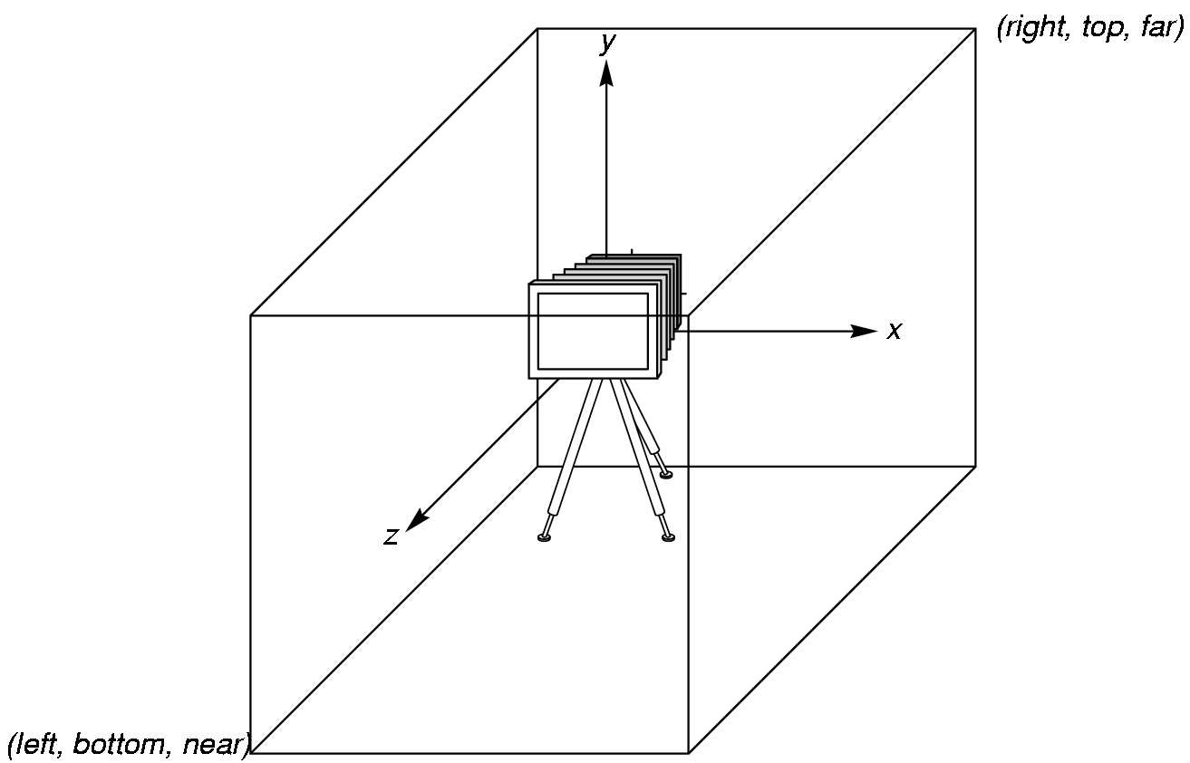
OpenGL Camera
OpenGL places a camera at the origin pointing in the negative z direction
The default viewing volume is a box centered at the origin with a side of
length 2

Slide 31
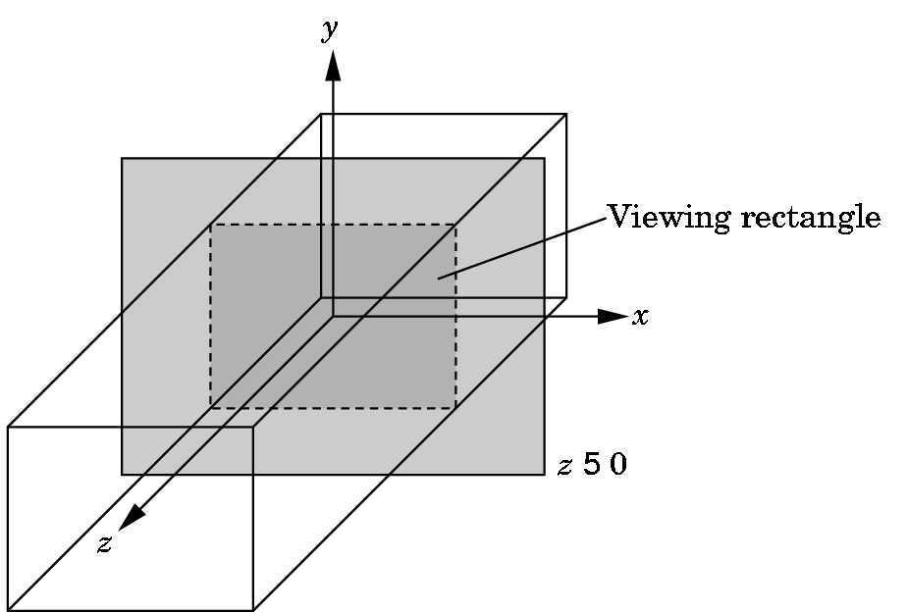
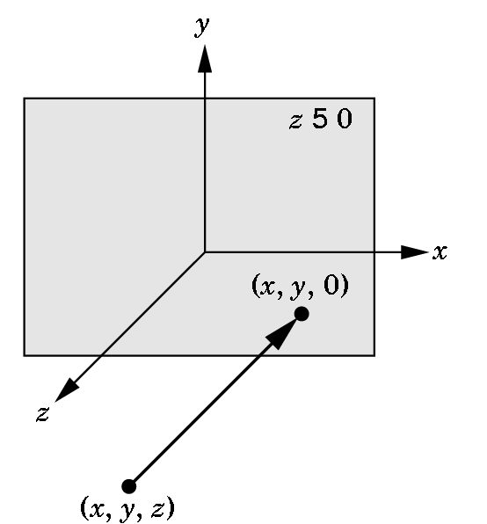
Orthographic Viewing
In the default orthographic view, points are
projected forward along the z axis onto the
plane z=0
z=0
z=0

Slide 32
Transformations and Viewing
In OpenGL, the projection is carried out by a projection matrix (transformation)
There is only one set of transformation functions so we must set the matrix mode first
glMatrixMode (GL_PROJECTION)
Transformation functions are incremental so we start with an identity matrix and alter it with a projection matrix that gives the view volume
glLoadIdentity ();
glOrtho(-1.0, 1.0, -1.0, 1.0, -1.0, 1.0);

Slide 33
Two- and three-dimensional viewing
In glOrtho(left, right, bottom, top, near, far) the near and far distances are measured from the camera
Two-dimensional vertex commands place all vertices in the plane z=0
If the application is in two dimensions, we can use the function
gluOrtho2D(left, right,bottom,top)
In two dimensions, the view or clipping volume becomes a clipping window

Slide 34
mydisplay.c
void mydisplay()
{
glClear(GL_COLOR_BUFFER_BIT);
glBegin(GL_POLYGON);
glVertex2f(-0.5, -0.5);
glVertex2f(-0.5, 0.5);
glVertex2f(0.5, 0.5);
glVertex2f(0.5, -0.5);
glEnd();
glFlush();
}

Slide 35
OpenGL Primitives
GL_POINTS
GL_POLYGON
GL_LINES
GL_LINE_STRIP
GL_LINE_LOOP
GL_TRIANGLES
GL_QUAD_STRIP
GL_TRIANGLE_STRIP
GL_TRIANGLE_FAN

Slide 36
Polygon Issues
OpenGL will only display polygons correctly that are
  Simple: edges cannot cross
  Convex: All points on line segment between two points in a polygon are also in the polygon
  Flat: all vertices are in the same plane
User program must check if above true
Triangles satisfy all conditions
nonsimple polygon
nonconvex polygon

Slide 37
Attributes
Attributes are part of the OpenGL and determine the appearance of objects
  Color (points, lines, polygons)
  Size and width (points, lines)
  Stipple pattern (lines, polygons)
  Polygon mode
    Display as filled: solid color or stipple pattern
    Display edges

Slide 38
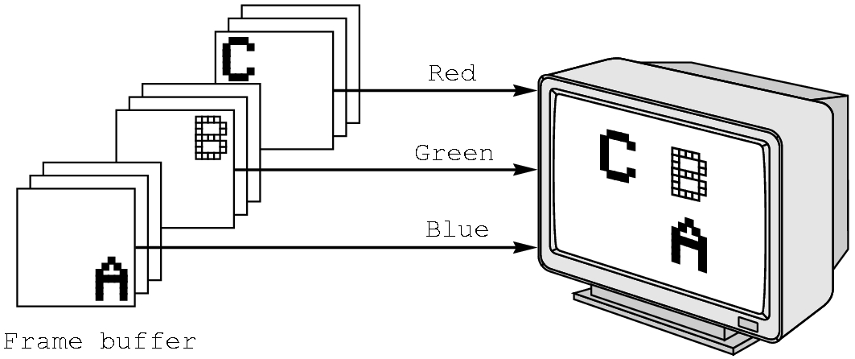
RGB color
Each color component stored separately in the frame buffer
Usually 8 bits per component in buffer
Note in glColor3f the color values range from 0.0 (none) to 1.0 (all), while in glColor3ub the values range from 0 to 255

Slide 39
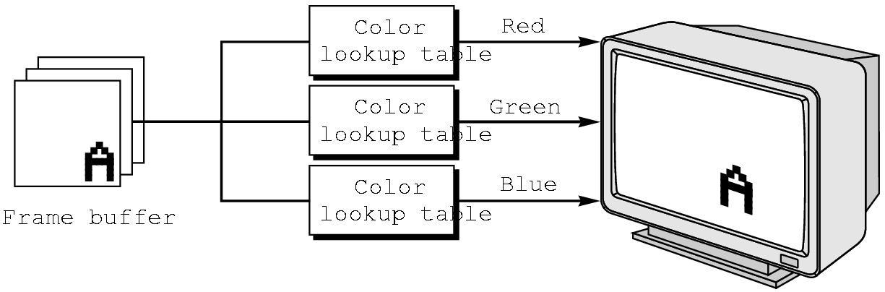
Indexed Color
Colors are indices into tables of RGB values
Requires less memory
  indices usually 8 bits
  not as important now
    Memory inexpensive
    Need more colors for shading

Slide 40
Color and State
The color as set by glColor becomes part of the state and will be used until changed
  Colors and other attributes are not part of the object but are assigned when the object is rendered
We can create conceptual vertex colors by code such as
glColor
glVertex
glColor
glVertex

Slide 41
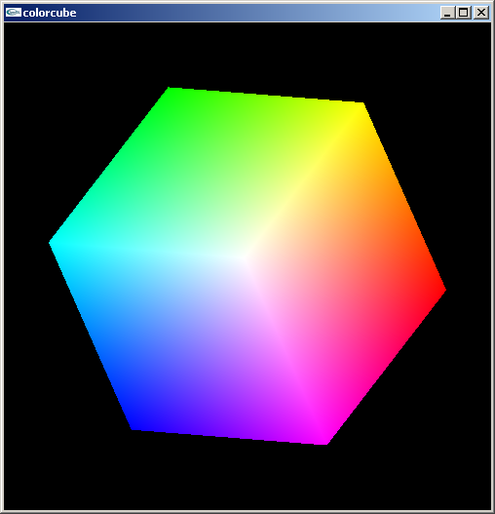
Smooth Color
Default is smooth shading
  OpenGL interpolates vertex colors across visible polygons
Alternative is flat shading
  Color of first vertex
  determines fill color
glShadeModel
  (GL_SMOOTH)
  or GL_FLAT

Slide 42
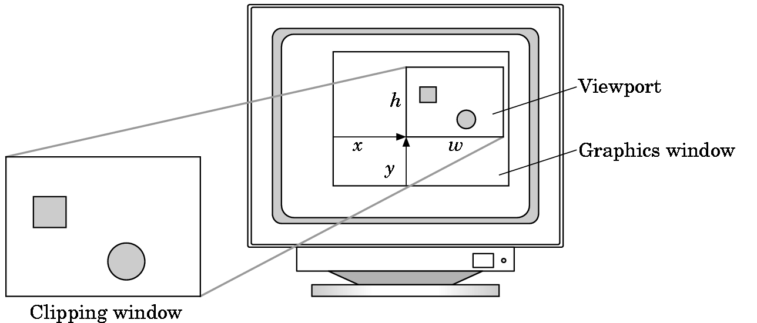
Viewports
Do not have use the entire window for the image: glViewport(x,y,w,h)
Values in pixels (screen coordinates)

