Slide 1
CHAPTER 6
SHADING MODELS

Slide 2
SHADING MODEL
A shading model dictates how light is scattered or reflected from a surface.
In graphics, we typical use two kinds of lights:
  point light sources - lights that shine on objects
  ambient light - light reflecting off of other surfaces
The amount of light reaching the synthetic camera must be calculated.

Slide 3
SHADING MODEL
The amount of light that reaches the eye is dependent upon many things:
  geometry of the surface specified, for example, by
    normal n to surface at a point p
    vector from p to viewer's eye
    vector s from p to light surface
  nature of the material
  the RGB components of the light

Slide 4
SHADING MODELS
Many have been proposed over the years.
Some are not supported in OpenGL:
  ray tracing
  radiosity - works with diffuse reflections only. Considers the radiant-energy interactions between all surfaces in scene. This is very computationally intensive.
Others are involved with the ways in which polygons are rendered:
    Constant shading
    Faceted shading
    Gouraud shading
    Phong shading
Shading models dictate how often the color computation is performed.

Slide 5
SHADING ALGORITHMS
Constant shading
  simplest, but not realistic
  give same color to every polygon
Faceted shading
  determine orientation
  do one color computation per polygon
Gouraud shading
  averages color over intersecting polygons
  blends color along the edges of polygons by interpolation
Phong shading
  does a color calculation for every pixel based on the lighting model used

Slide 6
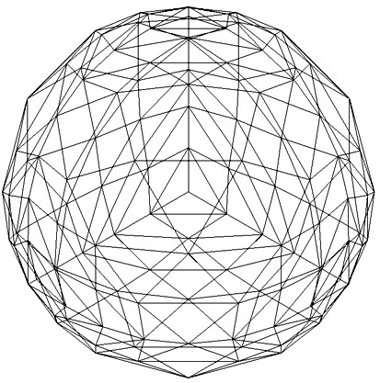
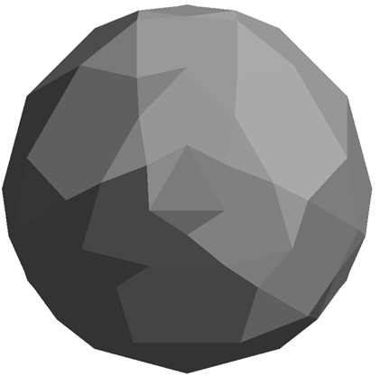
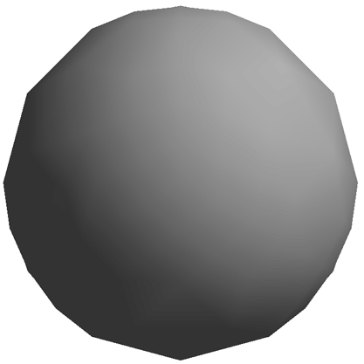
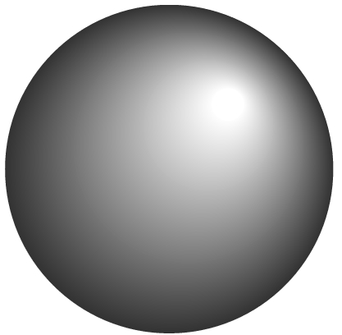
SHADING ALGORITHMS
wireframe
faceted
Phong
Gouraud

Slide 7
FACETED (OR FLAT) SHADING
For a given polygon, use the normal of one vertex to do the color calculations.
In OpenGL, specify with
glShadeModel(GL_FLAT);
OpenGL uses the first vertex encountered on the polygon for the calculation.

Slide 8
GOURAUD SHADING
x
Setting at
a is the average of settings at x and y;
b is the average of settings at y and z
w is the average of settings at a and b
a
w
•
b
y
z
Algorithm:
Compute the vertex normals (average of normals
of the intersecting faces).
Apply the model to each vertex to get the settings.
Linearly interpolate over the scan lines.
Specified in OpenGL by
glShadeModel(GL_SMOOTH);

Slide 9
PHONG SHADING
x
Algorithm:
1. Linearly interpolate the vertex
normals over the surface --i.e. normal calculations are done for each point.
2. Apply model along each scan line.
w
a
•
b
y
z
Equivalent to a point-by-point calculation.
More expensive, but more realistic.
Usually done off line.
Over the years, many modifications have been proposed to speed up the algorithm. For example, one approximates the calculations by Taylor series expansions.

Slide 10
NORMALS
Recall that a normal is a vector perpendicular to a plane. We also require it to be of length 1 (normalized)
Normals are used by OpenGL to calculate the amount of light that's hitting the surface of a polygon.
If the normal vector is pointing directly at the light source, then the full value of the light is hitting the surface.
As the angle between the light source and the normal increases, the amount of light striking the surface decreases.

Slide 11
NORMALS
We often approximate normals in graphics as the calculations, particularly for multi-surfaces, can be difficult.
Vertex normals are the averages of normals of intersecting surfaces.
Normals are usually defined along with the vertices of a model.
To use one of the shading models, you need to define normals:
flat shading: single polygon- last vertex determines
other primitives-last specified vertex
in each polygon
smooth shading: each vertex is used

Slide 12
CALCULATING NORMALS
For flat surface:
1. Choose 3 non-collinear points on outside face, oriented as before by using a curl on your right hand.
2. Generate two vectors with a common origin that lie in the plane.
3. Calculate the cross product of the vectors.
4. Normalize the cross product (or have OpenGL do it for you.) To normalize a vector, divide the vector by its length so the final vector has length 1.

Slide 13
CALCULATING NORMALS- an example
1. Choose 3 non-collinear points on outside face, oriented as before by using a curl on your right hand.
Let p0, p1, and p2 be the points.
p1
p0
In which direction will "the" normal go?
p2
2. Generate two vectors with a common origin that lie in the plane.
p2 - p0 and p1 - p0 are vectors lying in the plane with a common origin of p0.
(Recall from Chpt 4 that we defined P-Q as the vector from the point Q to the point P.)

Slide 14
CALCULATING NORMALS
Now, we must calculate p2- p0 and p1 - p0 . Before,
we did not use any actual numbers.
The calculation is easy, but just watch the order:
Example:
Suppose p0 is (1,2,3)
p1 is (-1,-1,4)
p2 is (0,-2,5)
p2 - p0 is the vector from (0,0,0) to
(0-1, -2-2,5-3) or (-1,-4,2)
p1 - p0 is the vector from (0,0,0) to (-2, -3, 1)
I.e., pk - p0 is the vector from (0,0,0) to
(pk[0]-p0[0], pk[1]-p0[1], pk[2]-p0[2])

Slide 15
CALCULATING NORMALS
3. Calculate the cross product of the vectors.
The cross product of p1-p0 and p2-p0
(be careful of the order--- why?)
is calculated as the determinant of a matrix:
| i j k |
| p1[0]-p0[0] p1[1]-p0[1] p1[2]-p0[2] |
| p2[0]-p0[0] p2[1]-p0[1] p2[2]-p0[2] |
where i, j, and k are basis vectors.
This is easier to calculate than it looks at first...

Slide 16
CALCULATING NORMALS
Continuing the previous example:
p2 - p0 is the vector from (0,0,0) to (-1,-4,2)
p1 - p0 is the vector from (0,0,0) to (-2, -3, 1)
So we must calculate:
| i j k | basis vectors
| -2 -3 1 | p1 - p0
| -1 -4 2 | p2 - p0
By definition, a determinant is calculated as follows:
| a b c |
| d e f | = + |e f | * a - | d f | * b + | d e | * c
| g h j | |h j | | g j | | g h |
and | x y | is x*w - z*y.
| z w|

Slide 17
THE DEFINITION LOOKS WORST THAN IT IS!
| i j k |
| -2 -3 1 | =
| -1 -4 2 |
to remember the smaller determinants:
+ ((-3)(2) - (-4)(1))i //cross out row 1, column 1
- ((-2)(2) - (-1)(1)) j //cross out row 1, column 2
+ ((-2)(-4) - (-1)(-3))k //cross out row 1, column 3
= (-6-(-4))i - (-4 -(-1))j + (8- 3)k
= -2i + 3j + 5k
i.e. the normal to the face in the outward direction

Slide 18
DEFINING THE NORMALS IN YOUR CODE
When you define your object, define the normals as GLfloat type:
GLfloat normals[][3] = {{-2.0,3.0,5.0},…..};
and associate with a vertex as
void polygon(int a, int b, int c , int d)
{ /* draw a polygon via list of vertices */
glBegin(GL_POLYGON);
glNormal3fv(normals[a]);
….
Only problem--- these are not unit vectors--- i.e. they haven't been normalized and the shading models require unit vectors.
You can calculate them directly: Divide each component by
sqrt(x² + y² + z² ) which is the length of the vector.

Slide 19
DO NORMALIZED VECTORS STAY NORMALIZED AFTER TRANSFORMATIONS?
Yes, if you use only rigid transformations-
rotations or translations
If you supply unit vectors and you use only uniform scaling, you can have OpenGL automatically normalize them after transformations by calling
glEnable(GL_RESCALE_NORMAL);
If you use shears, non-uniform scaling, or don't supply unit vectors, use
glEnable(GL_NORMALIZE);
but there is a cost to doing this.

Slide 20
IF YOUR SHADING LOOKS FUNNY IN OPENGL- Tips on Lighting
1. You must specify normals along with your geometry, or you must
generate them automatically with evaluators (which are used to draw
curves or supplied primitives), in order for lighting to work as expected.
2. Lighting does not work with the current color as set by glColor*().
It works with material colors. Set the material colors with glMaterial*().
3. Lighting is computed at each vertex (and interpolated across the
primitive, when glShadeModel() is set to GL_SMOOTH). This may
cause large surfaces to appear too dark, even though a light is centered
over the primitive. You can obtain more correct lighting with a higher
surface approximation ---i.e. more polygons.
4. To achieve a smooth shading effect, generally you need to specify a different normal at each vertex. If you have set the same normal at each vertex, the result, in most cases, will be a flat shading.

Slide 21
IF YOUR SHADING LOOKS FUNNY IN OPENGL
5. If your application doesn't call glNormal*(), then it uses the default
normal of (0.0, 0.0, 1.0) at every vertex.
OpenGL will then compute the same, or nearly the same, lighting
result at each vertex. This will cause your model to look flat and
lack shading. That is ok for development work initially!
6. If your shading is flat, be sure glShadeModel() is set to
GL_SMOOTH, which is the default value. If you haven't called
glShadeModel() at all, it's probably already set to GL_SMOOTH, and
something else is wrong.
7. Remember that a typical surface normal is perpendicular to the surface that you're attempting to approximate. You may just have done the arithmetic incorrectly. It is safer to write a program to do the normal calculation!

Slide 22
IF YOUR SHADING LOOKS FUNNY IN OPENGL
8. A light's position is transformed by the current ModelView matrix
at the time the position is specified with a call to glLight*(). This is
done in the same way that geometric vertices are transformed by the
current ModelView matrix when they are specified with a call to
glVertex*().
9. If you later change the ModelView matrix, such as when the view
changes for the next frame, the light position isn't automatically
re-transformed by the new contents of the ModelView matrix.
If you want to update the light’s position, you must again specify the
light position with a call to glLightfv(GL_LIGHT_POSITION,…).

Slide 23
IF YOUR SHADING LOOKS FUNNY IN OPENGL
10. When lighting is on, the color of a vertex is the cumulative effect of the material color AND the light that's shining on that vertex. When lighting is off, the color of a vertex is the effect of the color setting --- that is different from the material color.
11. Shading calculations are expensive and will affect the run-time of your application. Increasing the number of polygons and using flat shading might increase speed although there reaches a point of diminishing returns. You can toggle between flat and smooth shading.
12. Perhaps you should provide a default. Set a global light using
glLightModel*()
which can set an RGBA value for the global ambient light that is present independent of the other lights.

Slide 24
IF YOUR SHADING LOOKS FUNNY IN OPENGL
13. For the few of you who are already doing texturing in projects:
By default, texture mapping is applied AFTER lighting calculations.
This can result in specular highlights that are muted or the texturing may look funny.
Try using
glLightModel(GL_LIGHT_MODEL_COLOR_CONTROL,
GL_SEPARATE_SPECULAR_COLOR);
which will separate the two.
To restore the default,call the above with
GL_SINGLE_COLOR
as the second parameter.
(I'll explain when we discuss texturing why this should help.)

Slide 25
IF YOUR SHADING LOOKS FUNNY IN OPENGL
14. If colors are not a linear function of space, which they aren't in OpenGL, quads and polygons will shade differently depending on how OpenGL splits them into triangles. This causes trouble when part of the quad or polygon is off screen and clipping occurs. So, it is best to use triangles when modeling if you want better color results.
15. Color shifts can occur due to roundoff error if you are rotating an image or, sometimes, by just the clipping process!

