Slide 1
CPSC 387:GRAPHICS
12 Week, Fall, 2002
http://cs.hiram.edu/~obie/cs387
obie@hiram.edu
Offices: C-5 (for a while- until 12:30 pm, MWF)
C-111 (soon- until 12:30 pm, MWF)
H-137 (probably after 2:30pm and on Thursdays)

Slide 2
Administrative Details
20% ---Test 1
20% ---Test 2- during finals time
10% ---Pop quizzes- unannounced, short, designed to test terminology and basic concepts soon after they are presented in class
50% ---Programming exercises, homework exercises, or outside readings presented or discussed in class

Slide 3
TEXTBOOKS
1. Interactive Computer Graphics, third edition
Edward Angel, Addison Wesley, 2003
2. OpenGL: A Primer, Edward Angel, Addison Wesley, 2002

Slide 4
CLASS WEBSITE
Website: http://cs.hiram.edu/~obie/cpsc387-02
Be sure to check the site regularly as it will include links for:
1. The software being using in this class
OpenGL and GLUT or
Mesa and GLUT - if you wish to use a UNIX system
2. Errata for book, if and when anyone finds them
3. Code given in the text as examples
4. Answers to the odd-numbered exercises in the 2nd edition for each chapter
5. On-line manuals for OpenGL and GLUT
6. Assignments and class details
7. Additional resources

Slide 5
INTRODUCTION TO GRAPHICS
Part 1

Slide 6
Part 1: Introduction
  What is Computer Graphics?
  Application Areas
  History of Graphics
  Basics of Image Formation

Slide 7
Objectives
We explore what computer graphics is about and survey some application areas
But, we start with a historical introduction as that will provide us with some background terminology.

Slide 8
Computer Graphics
Computer graphics deals with all aspects of creating images with a computer
Hardware
  Software
  Applications

Slide 9
COMPUTER IMAGING
Deals with manipulating images with a computer after they have been input by some means --- digital camera, scanner, video camera etc.
Computer Vision techniques attempt to provide meaning to computer images.
Note: Many movies today use both graphics and imaging to achieve special effects.

Slide 10

Example
Where did this image come from?
What hardware/software did we need to produce it?

Slide 11
Preliminary Answer
Application: The object is an artist’s rendition of the sun for an animation to be shown in a domed environment (planetarium)
Software: Maya for modeling and rendering but Maya is built on top of OpenGL
Hardware: PC with graphics cards for modeling and rendering

Slide 12
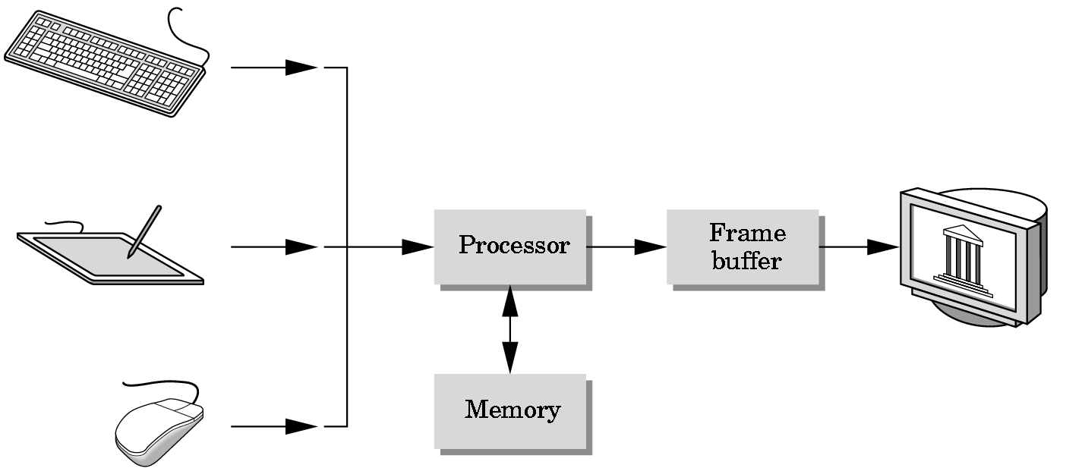
Basic Graphics System
Output device
Input devices
Image formed in FB

Slide 13
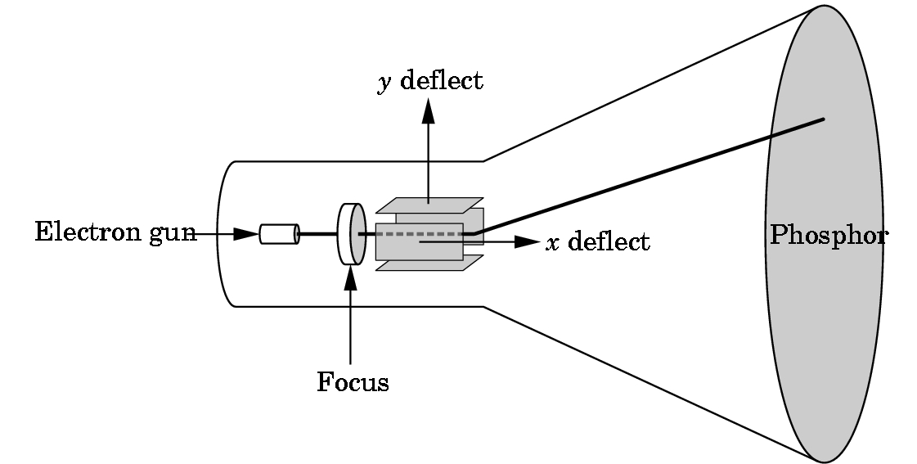
CRT
Can be used either as a line-drawing device (calligraphic) or to display contents of frame buffer (raster mode)

Slide 14
Computer Graphics:
1950-1960
Computer graphics goes back to the earliest days of computing
  Strip charts
  Pen plotters
  Simple displays using A/D converters to go from the computer to calligraphic CRT
Cost of refresh for CRT too high
  Computers slow, expensive, unreliable

Slide 15
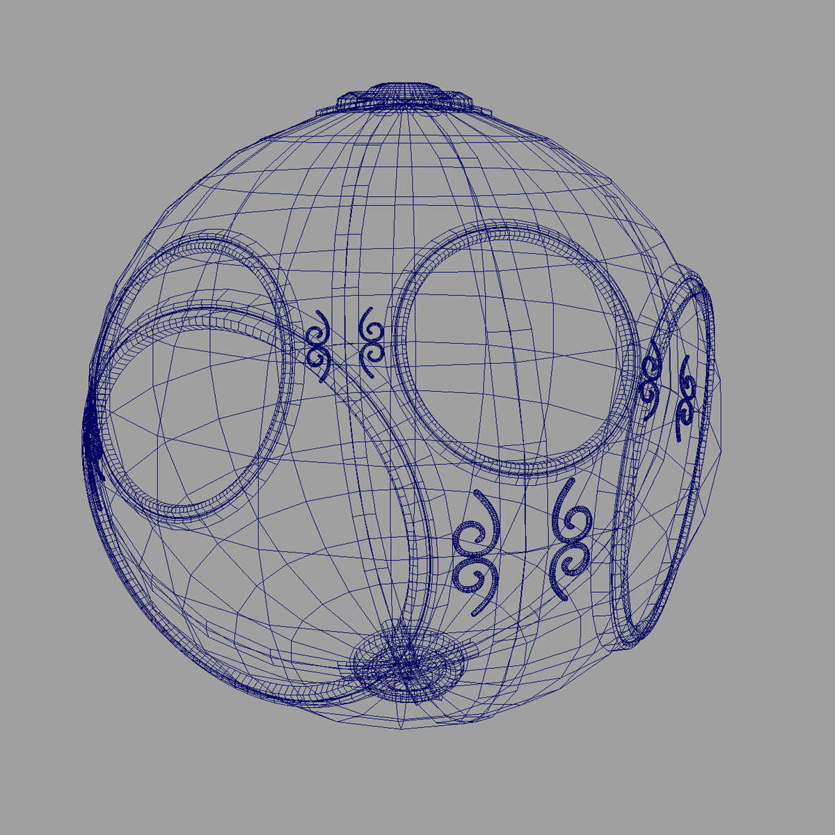
Computer Graphics:
1960-1970
Wireframe graphics
Project Sketchpad
Display Processors
Storage tube

Slide 16
Project Sketchpad
Ivan Sutherland’s PhD thesis at MIT
  Recognized the potential of human-machine interaction
  Loop
    Display something
    User moves light pen
    Computer generates new display
  Sutherland also created many of the now common algorithms for computer graphics

Slide 17
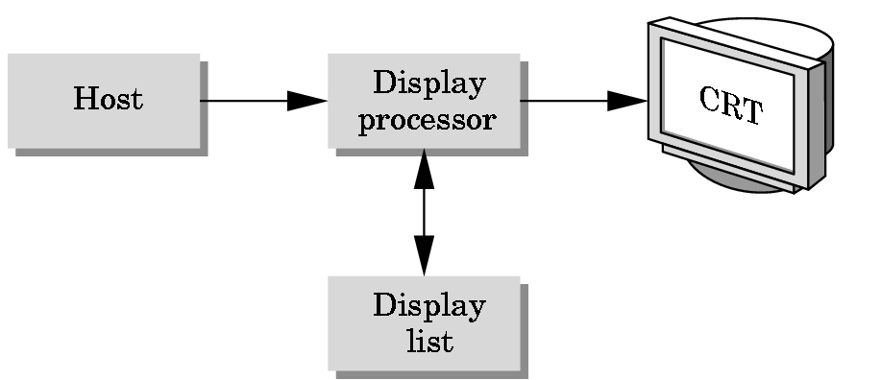
Display Processor
Rather than have a host computer try to refresh a display, use a special purpose computer called a display processor (DPU)
The graphics is stored in a display list (display file) on the display processor
The host compiles the display list and sends it to the DPU

Slide 18
Direct View Storage Tube
Created by Tektronix
  Did not require constant refresh
  Standard interface to computers
    Allowed for standard software
    Plot3D in Fortran
  Relatively inexpensive
    Opened the door to use computer graphics for the CAD community

Slide 19
Computer Graphics:
1970-1980
Raster Graphics
Beginning of graphics standards
  IFIPS
    GKS: European effort
      Becomes ISO 2D standard
    Core: North American effort
      3D but fails to become ISO standard
Workstations and PCs

Slide 20
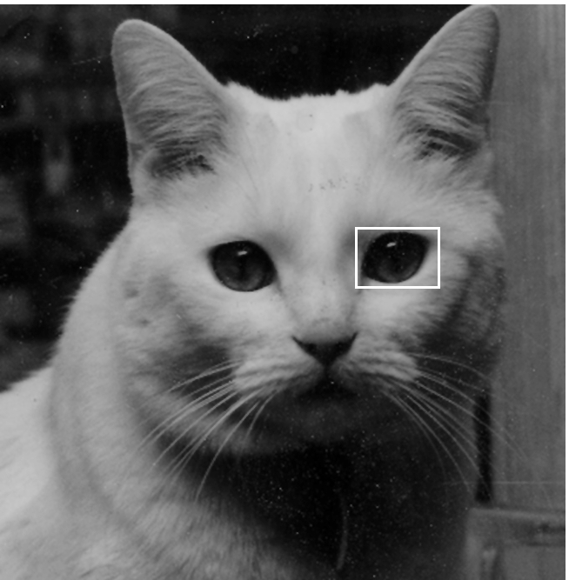
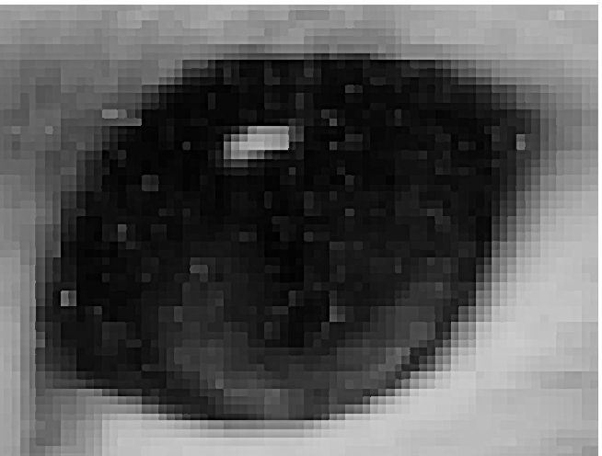
Raster Graphics
Image produced as an array (the raster) of picture elements (pixels) in the frame buffer

Slide 21
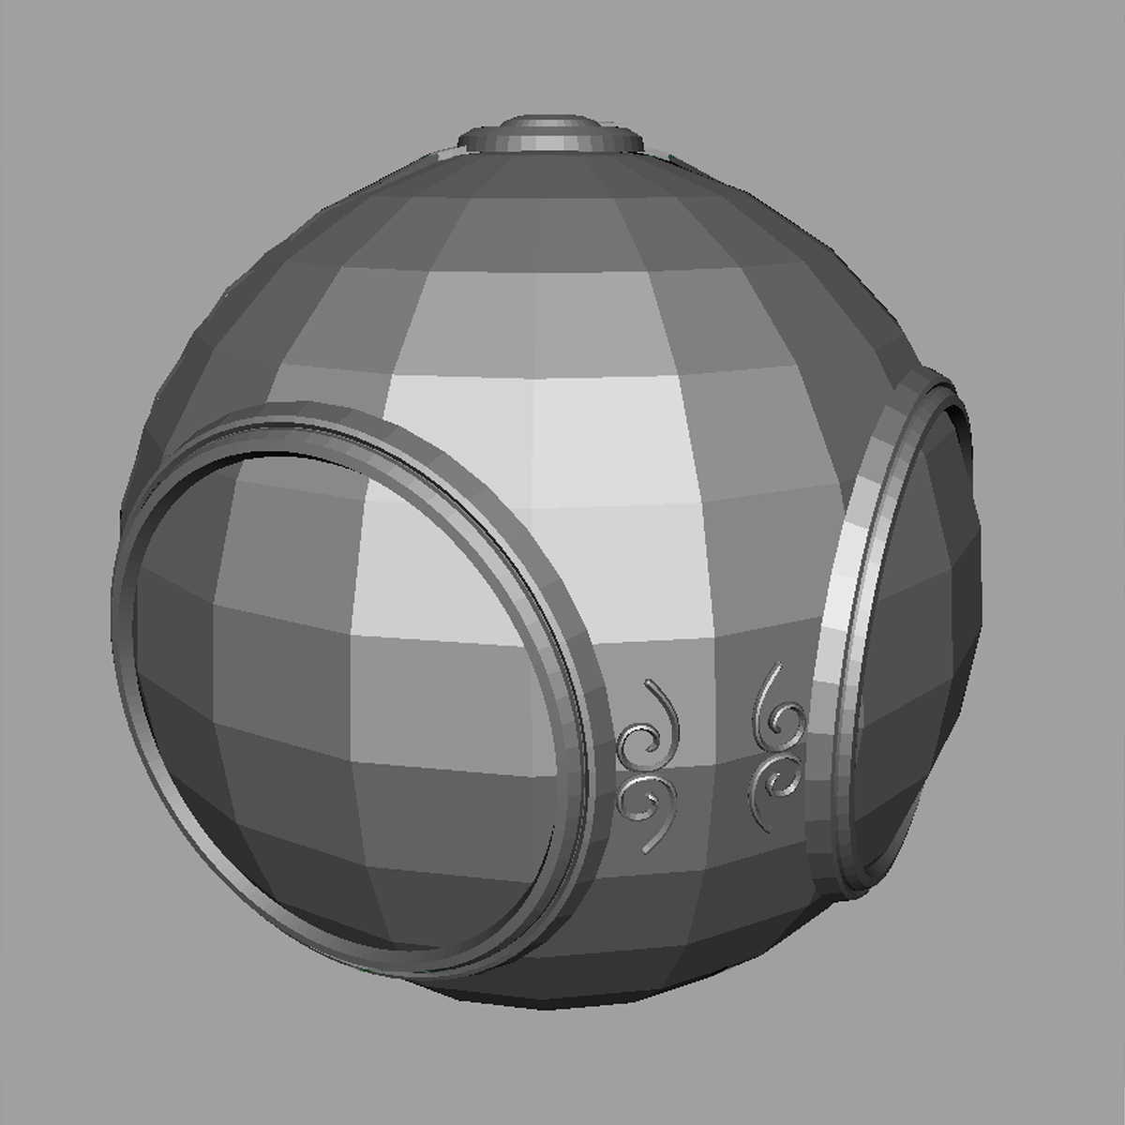
Raster Graphics
Allow us to go from lines and wireframes to filled polygons

Slide 22
PCs and Workstations
Although we no longer make the distinction between workstations and PCs, historically they evolved from different roots
  Early workstations were characterized by
    Networked connection: client-server
    High-level of interactivity
  Early PCs included the frame buffer as part of the user’s memory

Slide 23



Computer Graphics:
1980-1990
Realism comes to computer graphics
smooth shading
environmental
mapping
bump mapping

Slide 24
Computer Graphics:
1980-1990
Special purpose hardware
  Silicon Graphics geometry engine
    VLSI implementation of graphics pipeline
Industry-based standards
  PHIGS
  RenderMan
Networked graphics: X Window System
Human-Computer Interface (HCI)

Slide 25
Computer Graphics:
1990-2000
OpenGL API
Completely computer-generated feature-length movies (Toy Story) are successful
New hardware capabilities
  Texture mapping
  Blending
  Accumulation, stencil buffer

Slide 26
Computer Graphics:
2000-
Photorealism
Graphics cards for PCs dominate market
  Nvidia, ATI, 3DLabs
Game boxes and game players push the market
Computer graphics becoming routine in movie industry: Maya, Lightwave

Slide 27
Objectives of Image Formation
Look at the fundamental imaging notions
Consider the physical basis for image formation
  Light
  Color
  Perception
Introduce the synthetic camera model
Survey other models

Slide 28
Image Formation
In computer graphics, we form images which are generally two dimensional using a process analogous to how images are formed by physical imaging systems
  Cameras
  Microscopes
  Telescopes
  Human visual system

Slide 29
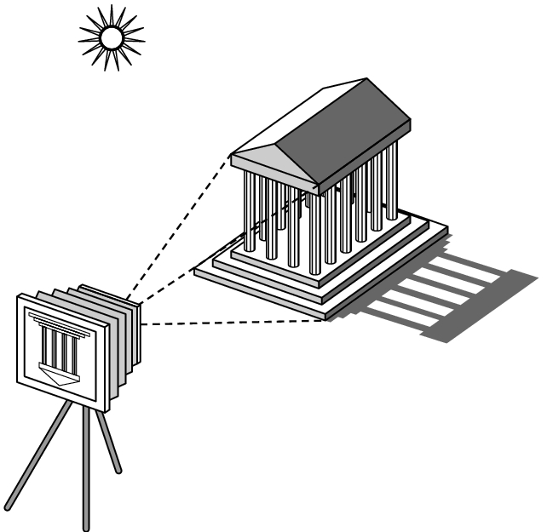
Elements of Image Formation
Objects
Viewer
Light source(s)
Attributes that govern how light interacts with the materials in the scene
Note the independence of the objects, viewer, and light source(s)

Slide 30
Light
Light is the part of the electromagnetic spectrum that causes a reaction in our visual systems
Generally these are wavelengths in the range of about 350-750 nm (nanometers)
Long wavelengths appear as reds and short wavelengths as blues

Slide 31
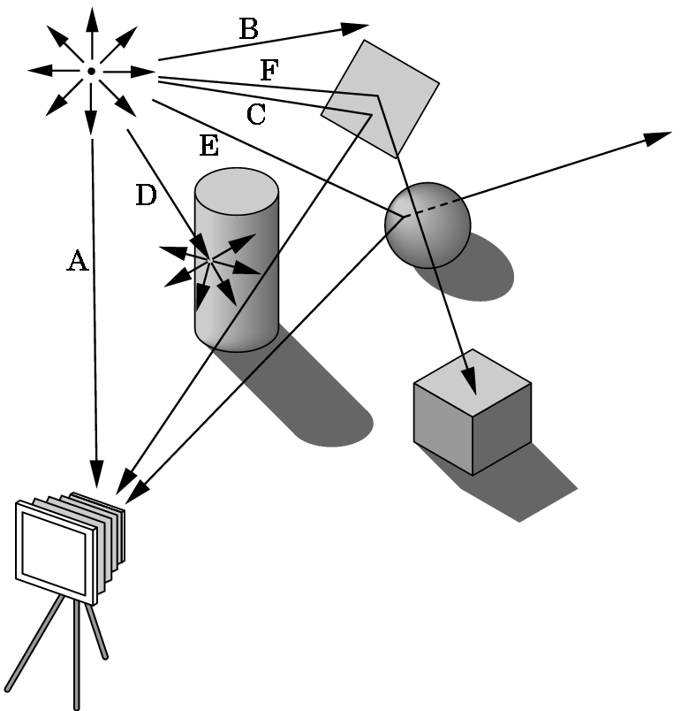
Ray Tracing and Geometric Optics
One way to form an image is to
follow rays of light from a
point source and determine
which rays enter the lens of
the camera.
However, each ray of light
may have multiple interactions
with objects before being absorbed
or going to infinity.

Slide 32
Luminance and Color Images
Luminance
  Monochromatic
  Values are gray levels
  Analogous to working with black and white film or television
Color
  Has perceptional attributes of hue, saturation, and lightness
  Do we have to match every frequency in visible spectrum? No!

Slide 33
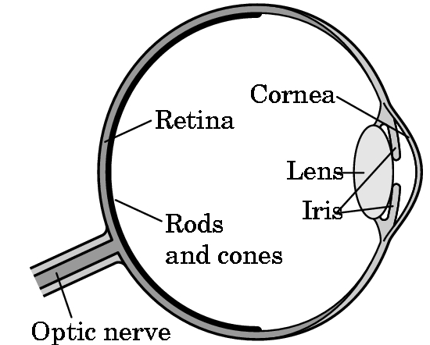
Three-Color Theory
Human visual system has two types of sensors
  Rods: monochromatic, night vision
  Cones
    Color sensitive
    Three types of cone
    Only three values (the
    tristimulus values) are
    sent to the brain
Need only match these three values
  Need only three primary colors

Slide 34
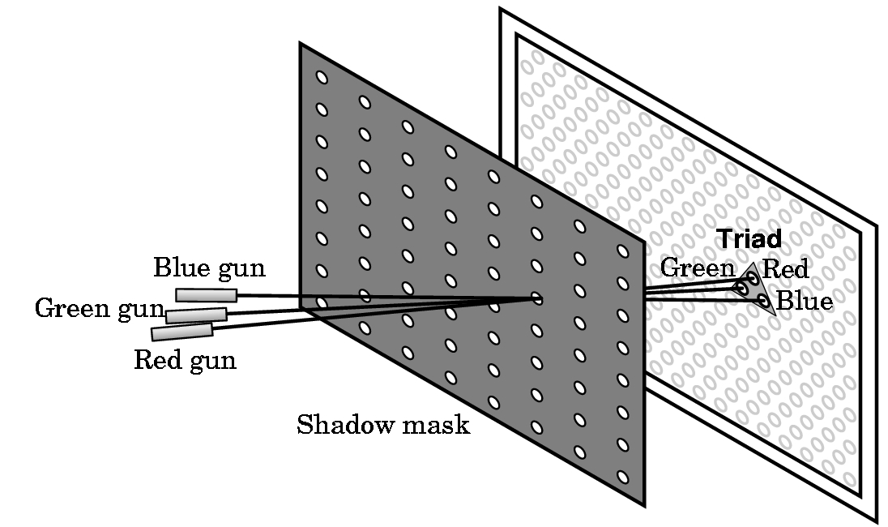
Shadow Mask CRT

Slide 35
Additive and Subtractive Color
Additive color
  Form a color by adding amounts of three primaries
    CRTs, projection systems, positive film
  Primaries are Red (R), Green (G), Blue (B)
Subtractive color
  Form a color by filtering white light with cyan (C), Magenta (M), and Yellow (Y) filters
    Light-material interactions
    Printing
    Negative film

Slide 36
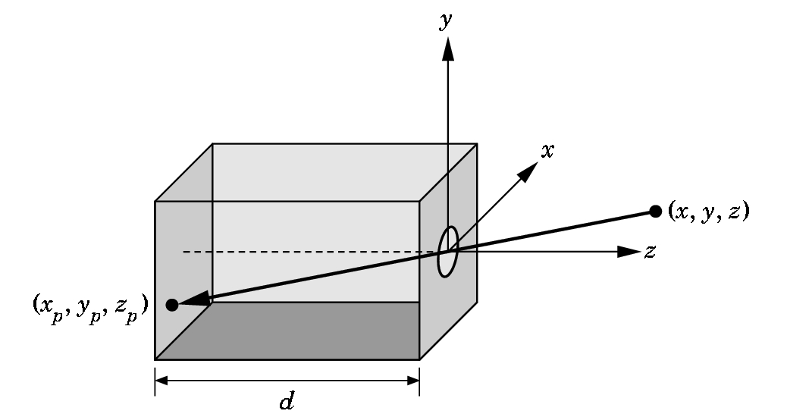
Pinhole Camera
Use trigonometry to find projection of a point
x_{p}= -x/z/d
y_{p}= -y/z/d
z_{p}= d
These are equations of simple perspective

Slide 37
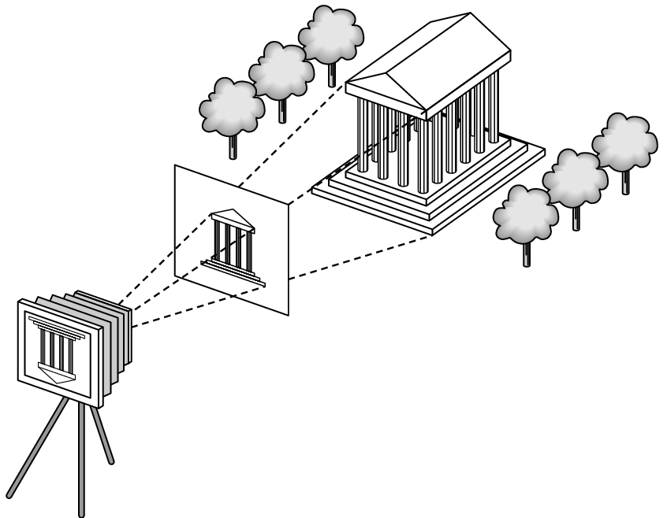
Synthetic Camera Model
projector
p
image plane
projection of p
center of projection

Slide 38
Advantages
Separation of objects, viewer, light sources
Two-dimensional graphics is a special case of three-dimensional graphics
Leads to simple software API
  Specify objects, lights, camera, attributes
  Let implementation determine image
Leads to fast hardware implementation

Slide 39
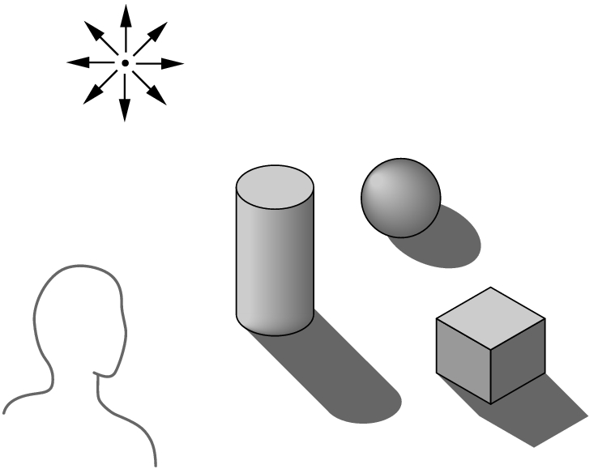
Global vs Local Lighting
Cannot compute color or shade of each object independently
  Some objects are blocked from light
  Light can reflect from object to object
  Some objects might be translucent

Slide 40
Why not ray tracing?
Ray tracing seems more physically based so why don’t we use it to design a graphics system?
Possible and is actually simple for simple objects such as polygons and quadrics with simple point sources
In principle, can produce global lighting effects such as shadows and multiple reflections but is slow and not well-suited for interactive applications

