Slide 1
Chapter 3
Under the Hood
Graphics Output Primitives

Slide 2
Overview of Algorithms in Chapter 3 We Will Examine
Line Drawing – Section 3-5
Setting Frame-Buffer Values – Section 3-7
Circle Drawing – Section 3-9
Pixel Addressing – Section 3-13
Fill Primitives – Section 3-14

Slide 3
Line Drawing
The best algorithms for this are not what you would first expect to use.
The most common form of the equation of a line is
  y = mx + b
where m = slope of line and b is the y-intercept.
For hand sketching a line, this is an easy formula to use.
For example,
to draw y = 2x + 3:
(0,3)

Slide 4
But, This is Not a Good Formula For Generating a Line on a Raster Device
First, y = mx +b is not the equation for all lines. Why not?
Second, depending on the slope, this may not generate a nice looking line. Let’s see why.
On raster devices, lines are plotted by changing the color of pixels.
We must sample a line at discrete positions and then determine the pixel that is nearest to the line at the sampled point.

Slide 5
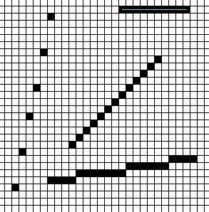
Let’s See What Happens With Different Slopes
Plot y = mx + b by sampling values for x
And this assumes square pixels!

Slide 6
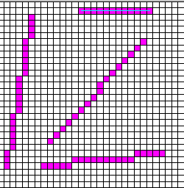
One Simple Improvement
If 0 <= m <=1, draw as before sampling with x changing.
If m >1, use the equation
x = (y-b)/m
and sample with y.
Negative slopes are handled in the obvious way.

Slide 7
Digital Differential Analyzer (DDA) Algorithm
Basically like the simple improvement algorithm, but gains speed by doing additions/subtractions instead of multiplications/divisions.
The basic idea is to step along the x-axis (or the y-axis) and instead of recalculating everything, just determine what needs to be incremented (or decremented) to get the next point.
For example, if 0 <= m <= 1, we sample at integer x intervals (x₀, x₁ = x₀ + 1, x₂ = x₁ + 1, ....) and compute successive y values as
y_{k+1} = y_{k} + m and round this to the nearest integer.
The pixel that will be drawn will be (x_{k+1}, round(y_{k+1})).

Slide 8
DDA
If 0 <= m and m > 1, we sample on integer y values, increasing by 1 each time, and calculate
x_{k+1} = x_{k} + 1/m, where 1/m is computed once.
Obviously, the algorithm has to be adjusted for negative slopes.
Each of the algorithms seen so far assumes that the line is going to be generated from left to the right, otherwise adjustments must be made.
With the DDA algorithm, there is a danger of rounding error causing drifting off the “true” calculated line.
Still, even with this algorithm, the algorithm is time consuming to run.

Slide 9
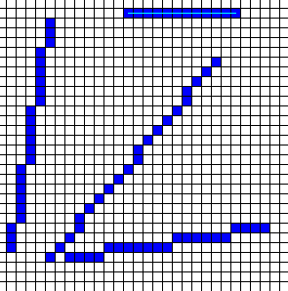
The DDA Algorithm Produces Results Similar to the Last Algorithm

Slide 10
Bresenham’s Line Drawing Algorithm
Jack Bresenham, an IBM employee, developed many nice algorithms for generating raster displays. He is particularly known for his line drawing and circle drawing algorithms.
The challenge was to produce a sequence of pixels
  That gave the best possible appearance of a line on a raster device.
  That worked for all possible lines.
  That worked quickly.
A major bottleneck in many graphics displays is the time required to scan-convert straight line segments. Most manufacturers use hardware based on Bresenham's line algorithm.

Slide 11
Bresenham’s Line Drawing Algorithm
Start with the left endpoint (red one) and assume a positive slope for now.
The goal is to determine quickly for the next sample position whether to plot the point adjacent to the current one (yellow one) or the next one up (pink one):

Slide 12
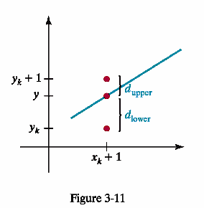
Bresenham’s Line Drawing Algorithm
Assume a positive slope with slope less than 1.0 for now and that we have determined that point (x_{k},y_{k}) is to be displayed.
Since y = m(x_{k}+1) + b for the next sample point on the x-axis, define
d_{lower} = y – y_{k}
= m(x_{k}+1) + b –y_{k}
and
d_{upper} = (y_{k}+1) – y
= u_{k} +1 –m(x_{k}+1) -b

Slide 13
Bresenham’s Line Drawing Algorithm
We set up an efficient test for which screen point to choose next.
First compute the difference:
d_{lower} - d_{upper} = 2m(x_{k}+1) – 2y_{k} + 2b -1
by substituting the previous expressions for the d values and rearranging.
Next, we manipulate the above calculation so it involves only integer calculations by substituting for m = Δy/Δx where Δy and Δx are the vertical and horizontal separations of the endpoint positions and we define:
p_{k} = Δx(d_{lower} – d_{upper})
=2(Δy)x_{k} – 2(Δx)y_{k} + c
where c is the constant 2Δy + Δx(2b-1)

Slide 14
Bresenham’s Line Drawing Algorithm
Some useful observations:
  1. The parameter c is a constant and has no influence on which point to choose next.
  2. For this case with Δx > 0, the value of p_{k} and d_{lower} - d_{upper} have the same sign.
  3. If the pixel at y_{k} is closer to the line path than the pixel at y_{k} + 1, then d_{lower} < d_{upper} and p_{k} is negative. In that case we plot the upper pixel. Otherwise, we plot the adjacent pixel!
  So, all we need to know is the sign of p_{k} (called the decision parameter) to know what to plot.
  Moreover, we can obtain the values of successive decision parameters by using only incremental integer calculations as we see next.

Slide 15
Bresenham’s Line Drawing Algorithm
At step k+1, the decision parameter is
p_{k+1} = 2(Δy)x_{k+1} – 2(Δx)y_{k+1} + c
Computing,
p_{k+1} - p_{k} = 2Δy(x_{k+1} – x_{k}) - 2Δx(y_{k+1} –y_{k})
Now, y_{k+1} – y_{k}is either 0 or 1, depending on the sign of p_{k} and x_{k+1} – x_{k} is always 1 in the case we are considering with positive, less than 1.0 slope.
Therefore,
p_{k+1} = p_{k} + 2Δy (when p_{k} < 0) or
p_{k+1} = p_{k} + 2Δy - 2Δx (otherwise)
Moreover, the parts in yellow are constants that only need be calculated once for the line being drawn!!!

Slide 16
Bresenham’s Line Drawing Algorithm
For |m| < 1.0 through points (x₀,y₀) and (x₁,y₁) with (x₀,y₀) the left endpoint.
Plot (x₀,y₀).
Calculate the constants
  Δx = x₁-x₀ , Δy = y₁ – y₀, 2Δy, and 2Δy – 2Δ and the starting position for the decision parameter as
  p₀ = 2Δy – Δx
Perform the following for each k = 1,2,... (Δx -1) times to plot (x_{k+1},y_{k+1}) where x_{k+1} = x_{k} + 1:
  If p_{k} < 0, set y_{k+1} = y_{k} and set p_{k+1} = p_{k} + 2Δy
  otherwise set y_{k+1} = y_{k} + 1 and set
  p_{k+1} = p_{k} + 2Δy - 2Δx

Slide 17
Bresenham’s Line Drawing Algorithm
The algorithm has to be generalized to lines with an arbitrary slope by using the symmetry of the various octants and quadrants of xy plane.
We step along the y direction as with the simple improved algorithm when m > 1.
The special cases of horizontal or vertical lines can be loaded directly into the frame buffer as these are detected when the constants are calculated.

Slide 18
Example 3-1 in text, page 97
Given points (20,10) and (30,18), plot the line segment between them.
Δx = 30-20=10 and Δy = 18-10 = 8
The slope is Δy/Δx = 8/10 = 0.8 so the case outlined applies.
p₀ = 2Δy – Δx = 16-10=6 and the increment for calculating the various decision parameters are
2Δy = 16 and 2Δy -2Δx = -4
Next, fill out a table for k, p_{k}, x_{k+1} and y_{k+1} using the sign of p_{k} to determine the value of y_{k+1} and p_{k+1}

Slide 19
Example 3-1 in text, page 97
Starts at (20,10)
k | p_{k} | x_{k+1} | y_{k+1}
0 | 6 | 21 | 11
1 | 2 | 22 | 12
2 | -2 | 23 | 12
3 | 14 | 24 | 13
4 | 10 | 25 | 14
5 | 6 | 26 | 15
6 | 2 | 27 | 16
7 | -1 | 28 | 16
8 | 14 | 29 | 17
9 | 10 | 30 | 18

Slide 20
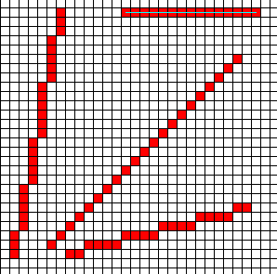
Bresenham’s Line Drawing Algorithm
DDA Draws as well – the power of this algorithm is its speed.
Again, with algorithms, to gain speed, we need a more complex algorithm than the usual ones we think to use first!

Slide 21
Line Drawing Algorithm Development Did Not Stop with Bresenham
For example, there is an excellent algorithm, developed in 1990 by J.G. Rokne, Brian Wyvill, and Xiaolin Wu.
http://portal.acm.org/citation.cfm?id=88572
In this paper an algorithm is developed based on the original Bresenham scan-conversion together with the symmetry first noted by Gardner and a recent double-step technique. This results in a speed-up of scan-conversion by a factor of approximately 4 as compared to the original Bresenham algorithm. Hardware implementations are simple and efficient since the property of using only shift and increment operations is preserved.

Slide 22
Circle-Generating Algorithms
The formula for a circle centered at (x_{c},y_{c}) with radius r in the plane is:
(x – x_{c})² + (y – y_{c})² = r²
By solving for r, we could try to use the formula for generating a circle:
____________
r = y_{c} ± √ r² – (x_{c} – x)²
but, obviously, there are some problems with this such as:
There is a lot of computation at each step.
The spacing between plotted positions is not uniform
There is a danger of undefined calculations being attempted.

Slide 23
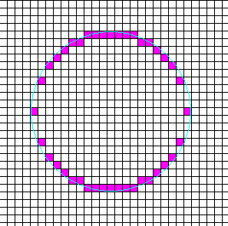
Simple Plotting Results

Slide 24
Circle-Generating Algorithms
Another approach: Use polar coordinates and a parametric equation in r and Θ, where r is the radius of the circle and Θ is the angle formed with the x-axis.
The equations to use are then:
x = x_{c} + r cosΘ
y = y_{c} + r sinΘ
where we step through Θ with a fixed size.
This handles the problem of unequal spacing, but the calculations are time consuming because of the trig calculations.

Slide 25
Circle-Generating Algorithms
Bresenham took the same basic ideas for his line drawing algorithm and modified it for circle drawing.
Again, a decision parameter is used to determine which pixel should be chosen next.
His algorithm compares pixel distances from a circular path by comparing the squares of the pixel separation distances.
But, his algorithm can be modified to form the midpoint circle algorithm which provides an even faster technique for drawing circles.

Slide 26
Midpoint Circle Algorithm
Sample at unit intervals and determine the closest pixel position to the specified circle path at each step.
We assume the circle is at the origin when we are plotting it.
After a point to plot is determined, we move it to its specified position for the circle centered off the origin by translating with x_{c} and y_{c}.
We take advantage of symmetry and develop the algorithm first for the one octant and then adjust it for the other seven octants.
As with Bresenham’s line drawing algorithm, we will define a decision parameter that will help us choose the next point to plot.

Slide 27
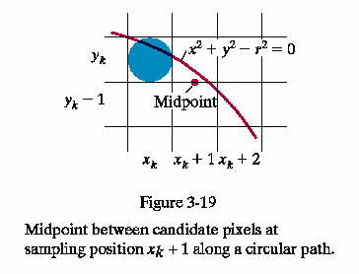
Midpoint Circle Algorithm
Define f_{circ}(x,y) = x² + y² – r²
Any point (x,y) on the boundary of the circle satisfies the equation
f_{circ}(x,y) = 0.
If the point is in the interior of the circle, the circle function is negative. If it it outside the circle, the function is positive.
This circle function is the
decision parameter we will
use and we will test midpoints
between two candidate pixels

Slide 28
We have plotted (x_{k},y_{k}).
We evaluate the circle function at the midpoint of the possible candidate pixels, (x_{k} + 1, y_{k} - 1/2).
If this is negative, the midpoint is inside the circle and the pixel at y_{k} is closer to the circle boundary. Therefore, let y_{k+1} = y_{k}. Otherwise, choose the pixel with y being y_{k} – 1.
As with the line drawing algorithm, successive decision parameters can be calculated easily. In fact, it is not necessary to square the radius!

Slide 29
Derivation Details are on pages 105-106
Generation of the pixel positions in the first octant using the Midpoint Circle Drawing Algorithm for a circle centered at (0,0) with radius r:
Plot (x₀,y₀) = (0,r) and set p₀ = 5/4 – r. If r is an integer, use 1 – r.
At each x_{k} starting at k = 0, test sign of p_{k}.
If p_{k} < 0, y_{k+1}= y_{k} and
p_{k+1} = p_{k} + 2x_{k+1} + 1.
Otherwise, y_{k+1} = y_{k} -1 and
p_{k+1} = p_{k} + 2x_{k+1} + 1 – 2y_{k+1}
where 2x_{k+1} = 2x_{k} + 2 and 2y_{k+1} = 2y_{k} -2.
After generating these for the first octant, the others are done by symmetry.

Slide 30
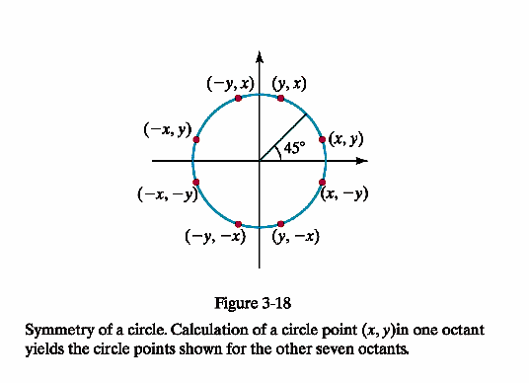
Using Symmetry for Other Octants

Slide 31
Example 3-2, page 1-7
Plot the circle with r = 10 using the midpoint circle algorithm for the first and second octants.
p0 = 1- r = -9 (since r is an integer)
Plot (0,10). The initial increment terms for calculating the decision parameters are 2x₀ = 0 and 2y₀ = 20. (Note: these must be recalculated for each step.)
We set up a table, just as for the line drawing algorithm, for each of the needed values.

Slide 32
Midpoint Circle Algorithm Example
k | p_{k} | x_{k+1} | y_{k+1} | 2x_{k+1} | 2y_{k+1}
0 | -9 | 1 | 10 | 2 | 20
1 | -6 | 2 | 10 | 4 | 20
2 | -1 | 3 | 10 | 6 | 20
3 | 6 | 4 | 9 | 8 | 19
4 | -3 | 5 | 9 | 10 | 18
5 | 8 | 6 | 8 | 12 | 16
6 | 5 | 7 | 7 | 14 | 14
Red is plotted from initial point and above table. Yellow is plotted by symmetry.

Slide 33
Other Curves
As an ellipse is an elongated circle, it should be obvious that efficient algorithms can be designed for generating ellipses.
Other interesting curves are the conics where various properties of A, B, C, D, E, and F determine the curve specified by
  Ax² + By² + Cxy + Dx + Ey + F = 0
In fact, algorithms similar to the midpoint circle algorithm can be derived for each of the curves and allow for efficient generation.
And, of course, we have already looked at splines and some of the methods used to generate them.

Slide 34
Fill-Area Primitives
A fill area is a picture component which can be filled with some solid color or a pattern.
Most graphics packages allowing fill regions, but often restrict them to polygons.
Of course, in 3D graphics, a set of designated polygon vertices may not lie exactly in one plane due to rounding errors, errors in selecting coordinate positions, or because they were generated as approximations to curves.
Moreover, as we have seen, convex polygons are often the only ones supported for fill operations, so many graphics packages automatically tessellate polygons into triangles.
OpenGL requires all fill polygons to be convex.

Slide 35
Identifying Concave Polygons
We can use the vector cross product to identify concave polygons.
Recall when we defined the cross product of two vectors – we did it intuitively, but the formula below was given also:
  V1 X V2 = |v1| |v2] sinΘ u, where u is the vector given by the right hand rule, and Θ is the angle between the vectors.
  |v1| and |v2| are the magnitudes of the vectors so they are always positive.
When dealing with polygon algorithms, we always assume that we do not have a degenerate polygon – i.e. some of the points are collinear.

Slide 36
V1 X V2 = |v1| |v2] sinΘ u
A concave polygon has at least one interior angle greater than 180 degrees.
If we walk around a polygon and form vectors of each of its edges, a concave polygon will have at least two of the pairwise cross products of opposite signs.
sign (E3 X E4) is negative
while all the other cross products are positive.
We can use this information to split the polygon into convex regions.

Slide 37
Determining If a Polygon is Concave or Convex
Assume polygon is in the xy plane. If not, move it there.
Assume the polygon is not degenerate.
Form the edge vectors between two consecutive vertex positions : E_{k} = V_{k+1} – V_{k}
Calculate the cross products of successive edge vectors in order around the polygon perimeter. Process in counterclockwise order (to have the calculations available for splitting a concave polygon later.)
If the cross products are all of the same sign, the polygon is convex; otherwise, it is concave.

Slide 38
Splitting a Concave Polygon Into Convex Polygons
Given a concave polygon determined by the method on the last slide, examine each cross product with a negative value.
If E_{i} X E_{i+1} is negative, extend the line segment E_{i} to split the polygon.
To do this computationally, we compute the slope of the green line segment, its y-intercept and determine its intersection with the polygon. (Assuming the slope exists – otherwise, handle as a special case.)

Slide 39
Other Methods For Splitting Polygons
Rotational method:
  Move counterclockwise around polygon edges, shift each vertex V_{k} onto the origin.
  Rotate the polygon in a clockwise direction so the next vertex V_{k+1}is on the x-axis.
  If V_{k+2} is below the x axis, the polygon is concave and should be split along the x-axis to form two new polygons.
  Repeat the test on the new polygons.

Slide 40
Rotational Example
Both polygons are now convex so we quit.
Note: The axis are displaced slightly so the work can be seen.
Another algorithm easily splits a convex polygon into a set of triangles (see pg 127) which provides a nice tessellation algorithm.

Slide 41
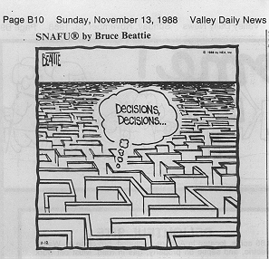
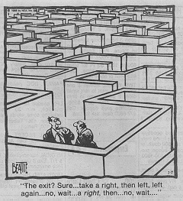
Inside-Outside Tests
Often we need to identify the interior regions of objects.
With simple objects, this is often not a problem.
But, with a complex collection of objects, how do we determine what is inside the object and what is outside?

Slide 42
Inside-Outside Tests
Odd-even rule (or odd-parity rule or even-odd rule): Determine if a point P is inside or outside a closed polyline.
  Draw a horizontal line from P to a point outside the coordinate extents of the closed polyline.
  Displace the figure if necessary so as to be sure the line does not go through any vertices.
  Count the number of segments crossed by this line.
  If the count is odd, P is considered an interior point. Otherwise, it is an exterior point.

Slide 43
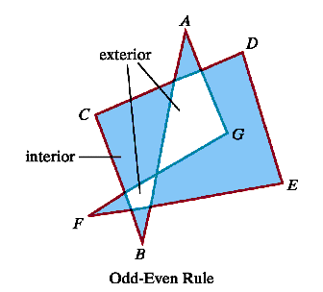
Odd-Even Rule
odd: interior
even: exterior

Slide 44
Nonzero Winding-Number Rule
The winding-number is defined for polygons with directional edges:
  Draw a horizontal line from P to a point outside the coordinate extents of the closed polyline.
  Displace the figure if necessary so as to be sure the line does not go through any vertices.
  Set the winding-number to 0. As we move along the line from P to the point outside, add 1 if we cross a line oriented from right to left. Subtract 1 otherwise.
  At the end, if the winding-number is nonzero, P is considered interior. Otherwise, it is exterior.

Slide 45
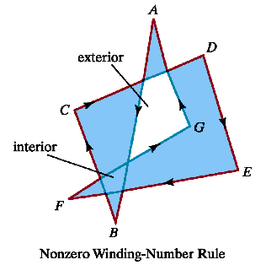
Winding-Number
+1: left to right
-1: right to left
nonzero: interior
zero: exterior
Note: the part marked interior here is designated differently for the Odd-Even Rule.

Slide 46
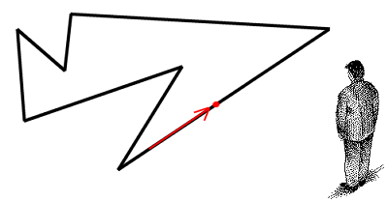
Another Way to Look at This
Imagine yourself watching a point traverse the boundary of the polygon in a counter-clockwise direction and pivoting so that you are always facing at it.
Your winding number is the number of full revolutions that you complete. If you winding number is 0 then you are outside of the polygon, otherwise you are inside.

Slide 47
Determining Which Type of Crossing (left to right or right to left) Occurs
Assume we are in the xy plane – otherwise move.
One method:
  Let E be the edge vector (as determined by the orientation) and u be the vector from the point P to the distant point.
  If u X E is in the direction of + z, the line crosses from right to left and add 1 to the winding number. Otherwise, subtract 1 from the winding number.
Another method: Uses the dot product of a vector perpendicular to u (and oriented a certain way) and the vector E, but the above method is the best for raster displays.

Slide 48
Other Uses of the Winding Number
In programs such as Bryce, boolean operations are defined on positive and negative objects.
For example, given an intersecting positive object A and a negative object B, the difference A – B is the object A with the part of b removed.
For 2D objects, the winding number can be used to define the union, intersection, and difference of two objects and what part of two 2D objects should be filled to represent the set.

Slide 49
Boolean Operations – Note the Orientations
Fill region with a positive value winding number = union
Fill region with a winding number greater than 1 = intersection
Fill region with a positive value for the winding number = difference

Slide 50
Drawing and Filling Polygons

Slide 51

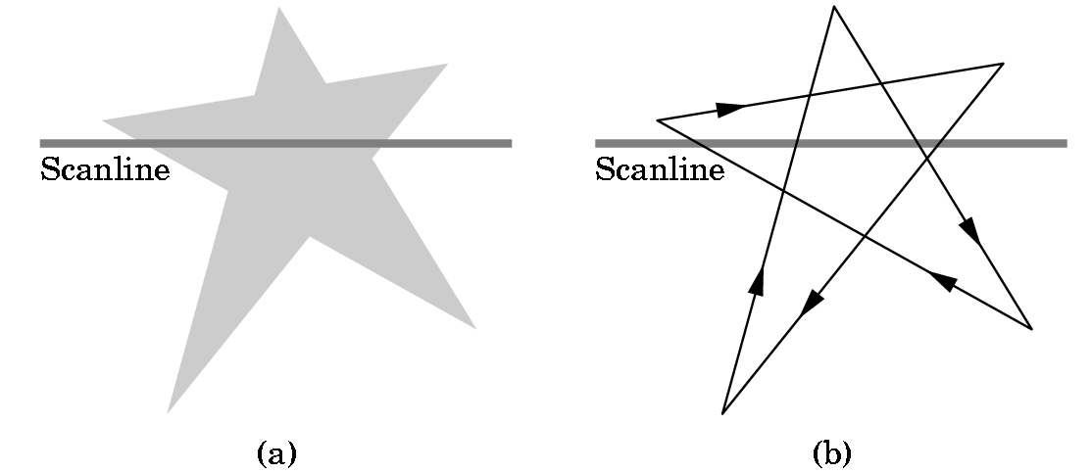
Drawing Polygons: Inside-Outside Tests
To fill a polygon determine if a point P is inside or outside
Crossing or Odd-Even Test:
  If P is inside then a ray emanating from P going to infinity will cross the polygon an odd number of times
Winding Test:
  Fill the inside of non-simple polygons
  Winding number = num times that a point is encircled by the edges of the polygon
  Inside = winding num > 0
Filling with the odd-even test

Slide 52
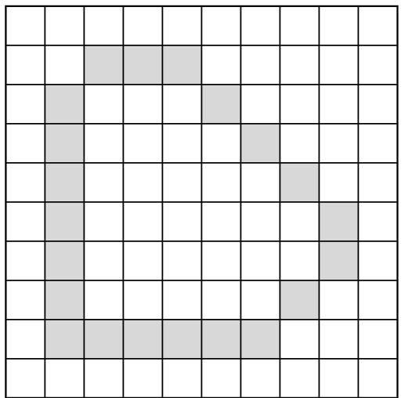
Drawing Polygons: Flood Fill
Draw edges of polygons into frame buffer
Assume background is WHITE and drawing colour is GREY
Grow coloring out from a seed point inside the polygon until an edge is encountered
Recursive Algorithm:
  flood_fill(int x, int y)
  { if(read_pixel(x, y) == WHITE)
  { write_pixel(x, y, BLACK);
  flood_fill(x-1, y);
  flood_fill(x+1, y);
  flood_fill(x, y-1);
  flood_fill(x, y+1);
  } }

Slide 53
Antialiasing

Slide 54
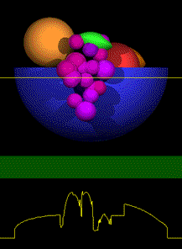
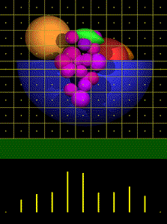
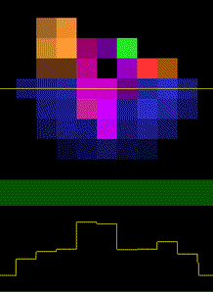
Aliasing
Occurs when the sampling inherent in rendering does not contain enough information for an accurate image.
Original Scene
Sampling Pixel Centers
Rendered Image
Scanline Luminosity
Sampled Signal
Luminosity Signal

Slide 55
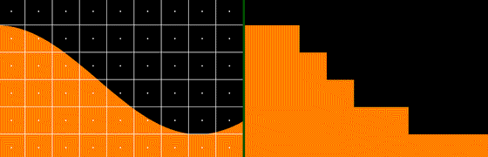
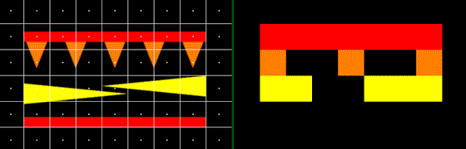
Effects of Aliasing
  Common aliasing errors (called artifacts) are: jagged profiles, disappearing or improper fine detail, and disintegrating textures.
Jagged Profiles
Loss of Detail

Slide 56
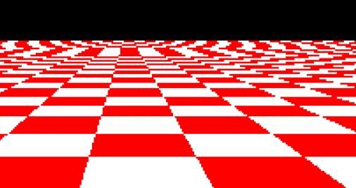
Disintegrating Textures
  The checkers on a plane should become smaller with distance.
  But aliasing causes them to become larger and/or irregular.
  Increasing resolution only moves the artifact closer to the horizon.

Slide 57
Antialiasing
Developed to combat aliasing
Applies to all types of aliasing
Prefiltering:
  Treat a pixel as an area. Calculate overlap of polygon with pixel.
  Color based on which color contributes most to the pixel.
  Costly

Slide 58
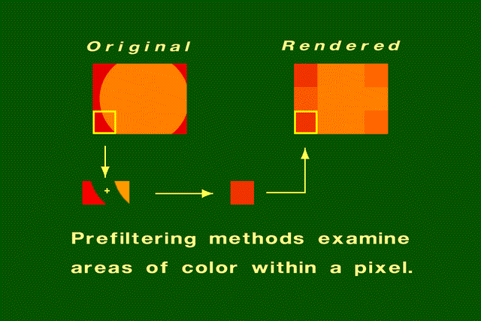
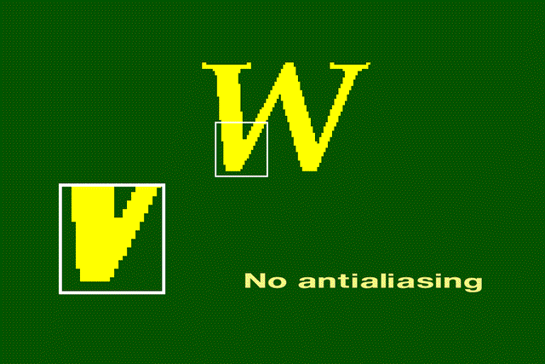
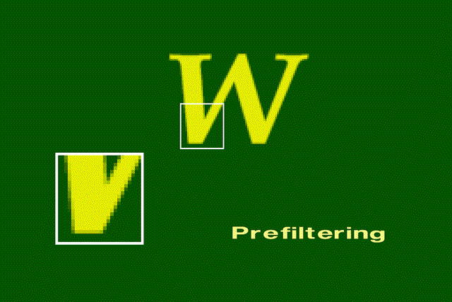
Prefiltering
No Antialiasing
Prefiltering

Slide 59
Antialiasing
Postfiltering (supersampling):
  Compute pixel color by averaging multiple samples. Preferred Method
  Sample the scene at n times the display resolution.
  For example, suppose the display resolution is 512x512. Sampling at three times the width and three times the height of the display resolution would yield 1536x1536 samples
  A filter provides the weights used to compute the average

Slide 60
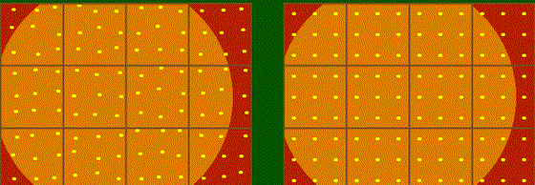
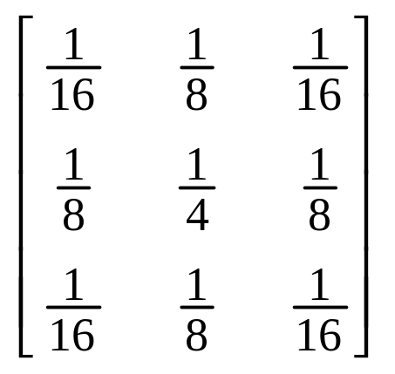
Postfiltering
Sampling: take n X n jittered, regular or random samples.
Averaging: use an n X n
filter to assign weights to
each sample. Sum all the
weighted samples to obtain
a pixel.
Jittered
Regular

Slide 61
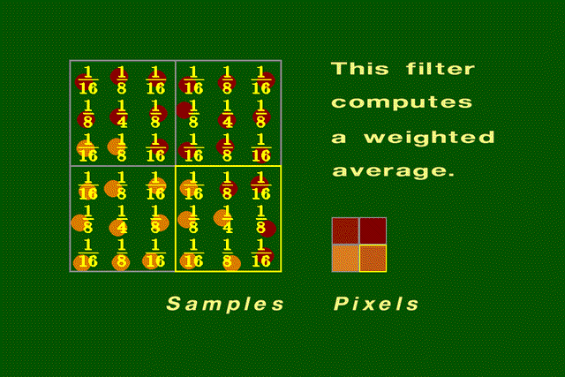
Filtering Example

Slide 62
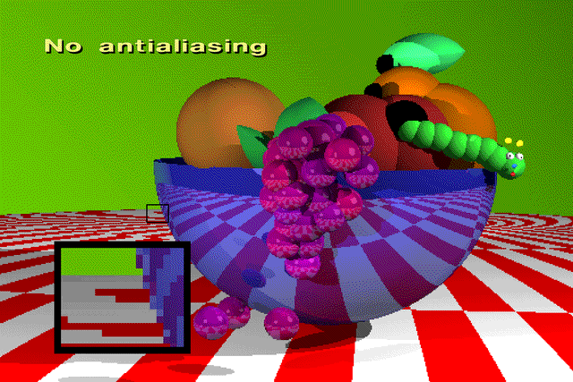
Antialiasing Examples

Slide 63
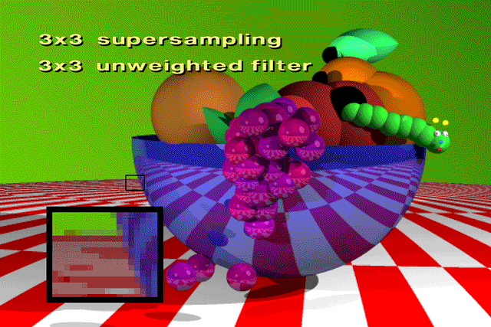

Slide 64


Slide 65


