Slide 1
Chapter 6
Under the Hood
The 2D Viewing Pipeline

Slide 2
Overview of Algorithms Considered
The 2D viewing pipeline – Section 6-1
The clipping window – Section 6-2
Normalization and viewport transformations – Section 6-3
Clipping algorithms –Section 6-5
2D point clipping – Section 6-6
2D Line Clipping – Section 6-7
(Cohen-Sutherland only in detail. Others in overview only.)

Slide 3
The Clipping Window
The section of a 2D scene selected for display is called a clipping window because all parts outside of it are “clipped” away.
Sometimes it is called the world window or the viewing window.
At one time, it was just called “the window”, but then operating systems starting referring to windows and the term was changed in graphics to the clipping window.

Slide 4
The Viewport
The section of a display window where scene is to be mapped is called a viewport.
The clipping window selects what we want to see; the viewport indicates where it is to be viewed on the output device.
Multiple viewports can be used to display different parts of a scene.
Although we didn’t look at multiple viewports, they are supported in OpenGL.

Slide 5
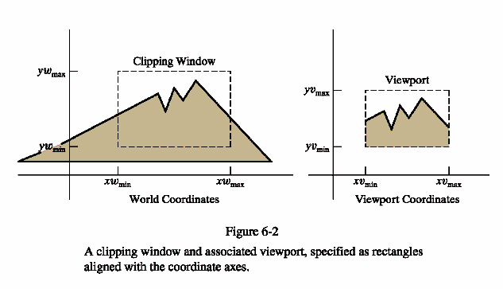

Slide 6
The Window to Viewport Mapping
Mapping a 2D, world-coordinate scene to device coordinates is called a 2D viewing transformation (or the window-viewport transformation or the windowing transformation.)
Although we are mainly interested in the pipeline for 3D scenes, the part we will do here will provide us with some of the background needed for the 3D work.

Slide 7
The 2D Viewing-Transformation Pipeline
World coordinate scene constructed from modeling coordinates
World coordinates converted to viewing coordinates
MC
WC
VC
NC
DC
Viewing coordinates converted to normalized coordinates
Map normalized coordinates to device coordinates

Slide 8
Clipping Window Characteristics
Technically, they can be of any size, shape, or orientation.
However, as you might suspect, clipping using a concave polygon as a clipping window or using nonlinear boundaries for the clipping window adds quite a bit of overhead to the process.
Consequently, most graphics packages support only clipping to a rectangle with the sides parallel to the x and y axis.
Any other clipping must be programmer implemented.

Slide 9
Specifying the Clipping Window and Viewport
In most graphics packages, it is specified in world coordinates.
A variety of approaches can be followed:
1) Define clipping window and the viewport in world coordinates.
  Choose an origin in the scene to display and a view up vector
  (or, alternately, an angle formed with the x or y axis)
  Define a rectangular clipping window in world coordinates.
  Using 2D transformations which are 3 X 3 matrices, translate the scene to the world origin and rotate the scene until the clipping window is aligned with the axis.
  Clip to the clipping window.

Slide 10
Specifying the Clipping Window and Viewport
2) Define the clipping window in world coordinates and the viewport in normalized coordinates.
A normalized window is a square window in the range 0.0 to 1.0.
  This approcach combines the normalization and window-to-viewport transformations
  Clipping can take place in either world coordinates or viewport coordinates.
  After clipping, the unit square containing the viewport is mapped to the output display device.

Slide 11
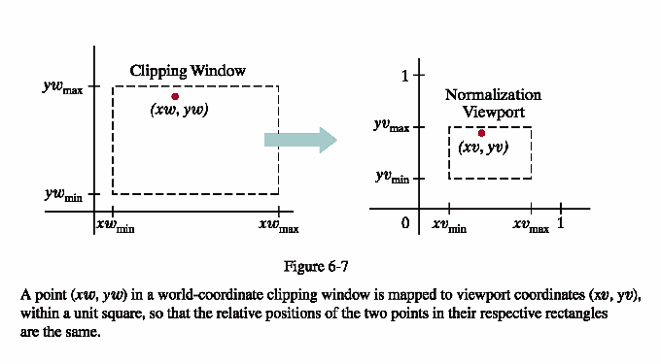
Approach 2
Scale the clipping window to the size of the viewport using a fixed point position of (xw_{min}, yw_{min})
Translate (xw_{min},yw_{min}) to (xv_{min},yv_{min})
The matrices are given on page 303.

Slide 12
Specifying the Clipping Window and Viewport
3) The viewport boundaries are specified in screen coordinates relative to the display-window position.
  Normalization and clipping is applied before the viewport transformation.
  Transfer the clipping window into a normalized square.
  Clip in normalized coordinates.
  Transfer the scene to the viewport.

Slide 13
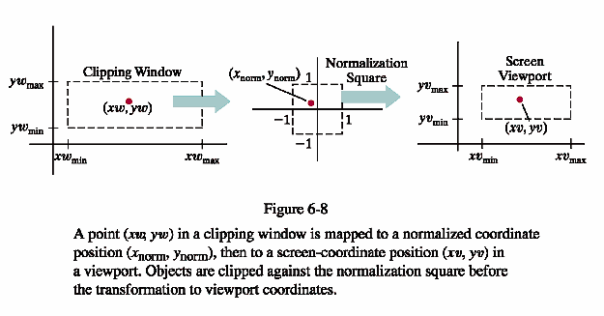
Approach 3
This has the advantage that everything outside of the normalized coordinates ± 1 are detected and removed from the scene.

Slide 14
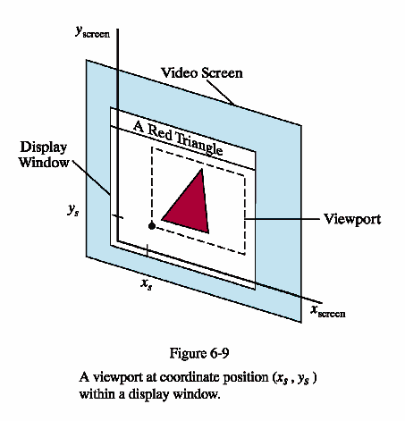

Slide 15
Clipping Objects

Slide 16
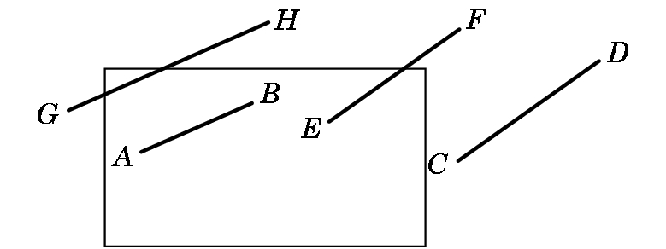
Line-Segment Clipping
Task: Decide which primitives will appear on the display
Clipping relationship between primitive and view volume:
  Accept if fits entirely inside
  Reject (cull) if falls entirely outside
  Clip if crosses the boundary

Slide 17
Placing Clipping in the Pipeline:
  Many possibilities –
    during modeling,
    in 3-D before projection,
    in 2-D after projection
  OpenGL clips in 3-D Normalized Device Coordinates before a final orthographic projection

Slide 18
Clipping Algorithms
Again, the wrong way to do this is the first way you would think to do it manually:
Calculate the equations for each line
Calculate the intersection with the window
Problems:
  Costly to do the calculations
  There are floating point number intersections

Slide 19
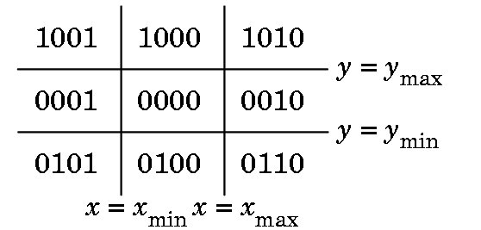
Cohen-Sutherland Clipping
Motivation:
  Many line segments can be trivially accepted/rejected. Want to avoid intersection calculation in these cases
  Seek to replace FP division with FP subs and bit ops
  Create algorithm extensible to 3-D
  We define outcodes for each region of the plane:

Slide 20
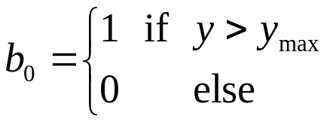
Cohen-Sutherland Clipping
Outcode:
  Extend clipping edges to divide space in and around the clipping rectangle into nine regions
  Each region has a unique 4-bit binary number o = b₀b₁b₂b₃
  If P = (x,y) then
  Likewise b₁ is y < y_{min}, b₂ is x > x_{max}, b₃ is x < x_{min}

Slide 21
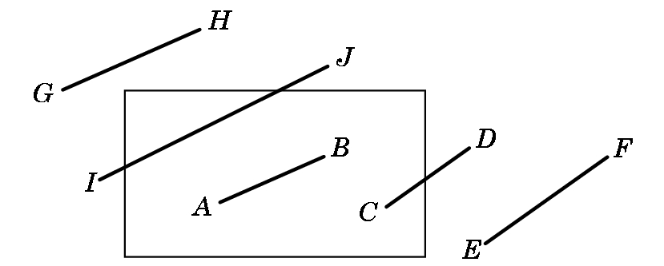
Cohen-Sutherland Clipping
Exercise: What are the outcodes for these points?
  A = 0000; B = 0000
  C = 0000; D = 0010
  E = 0010; F = 0010
  G = 1001; H = 1000
  I = 0001; J = 1000

Slide 22
Case 1
Cases (line segment with endpoint outcodes o₁, o₂):
  (o₁ = o₂ = 0) Both endpoints inside the window and no clipping occurs.

Slide 23
Case 2
  (o₁ ≠ 0, o₂ = 0; or vice versa) One endpoint inside, the other out. Nonzero outcode indicates endpoint that will require shortening of the line

Slide 24
Case 3
  (o₁ && o₂ ≠ 0) Do bitwise AND. If nonzero, both endpoints lie outside the same side → discard

Slide 25
Case 4
  (o₁ && o₂ = 0) Both endpoints outside but on different clipping edges. Cannot tell from outcodes alone whether to shorten or discard

Slide 26
3D Clipping

Slide 27
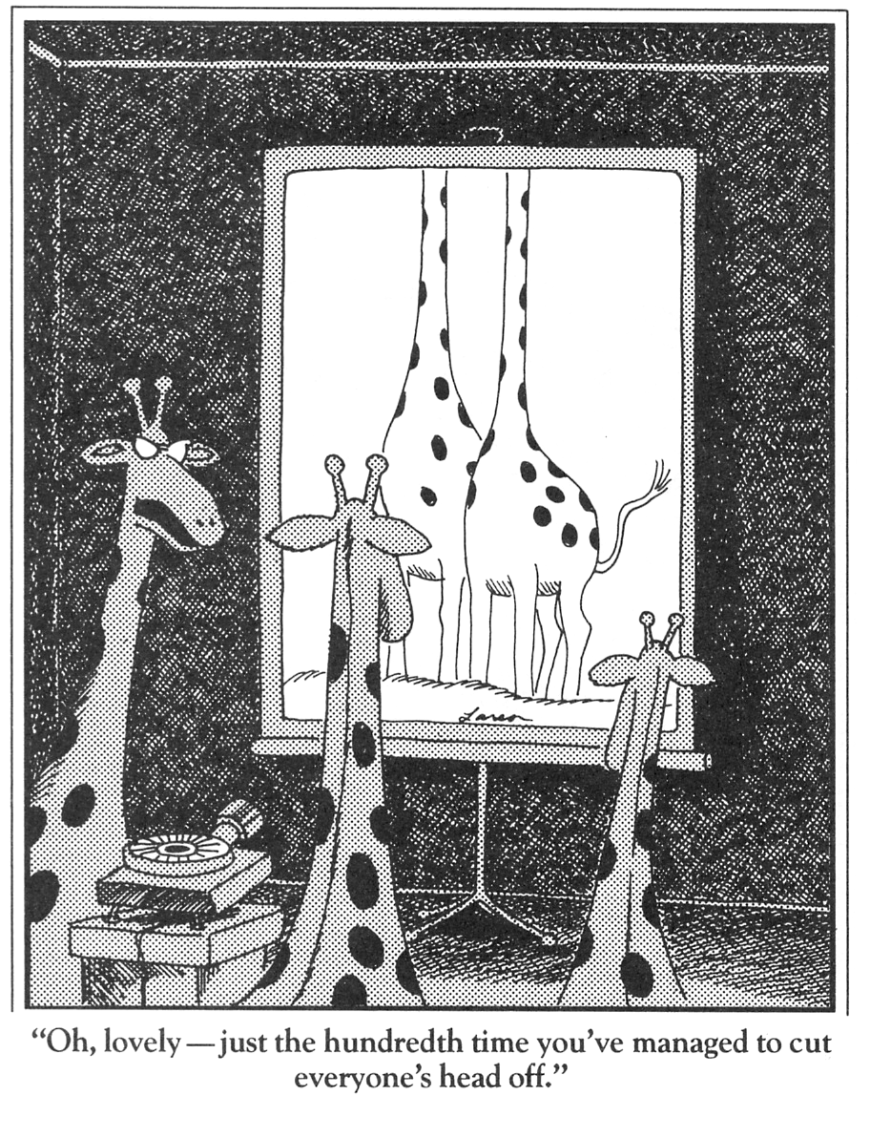
Clipping is Important!

Slide 28
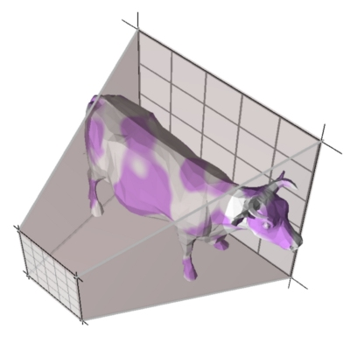
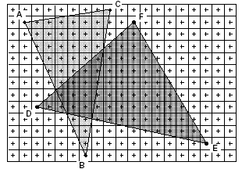
Concentrating on These Parts of Pipeline
Modeling
Transformations
Portions of the
object outside
the view
frustum
are removed
Rasterize
objects
into pixels
Illumination
(Shading)
Viewing Transformation
(Perspective / Orthographic)
Clipping
Projection
(to Screen Space)
Scan Conversion
(Rasterization)
Visibility / Display

Slide 29
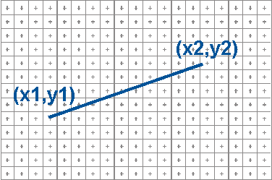
Framebuffer Model
Raster Display: 2D array of picture elements (pixels)
Pixels individually set/cleared (greyscale, color)
Window coordinates: pixels centered at integers
glBegin(GL_LINES)
glVertex3f(...)
glVertex3f(...)
glEnd();

Slide 30
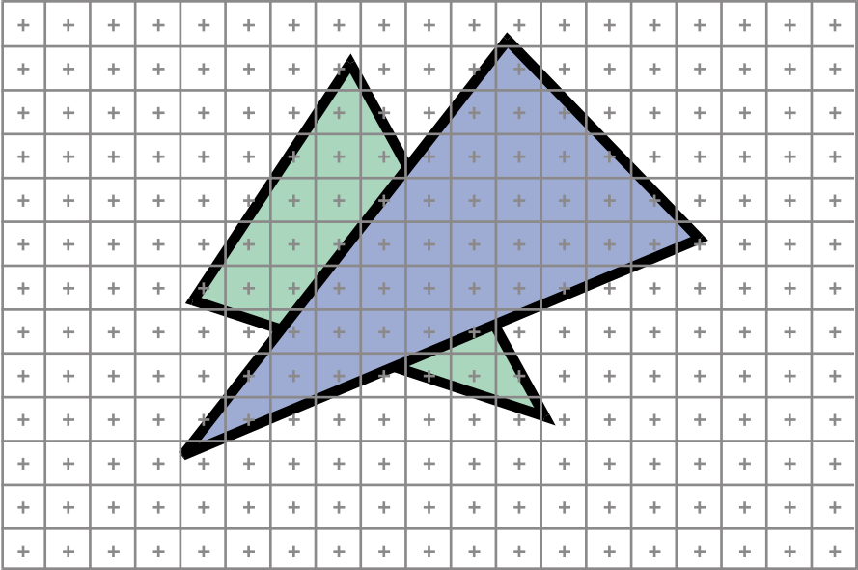
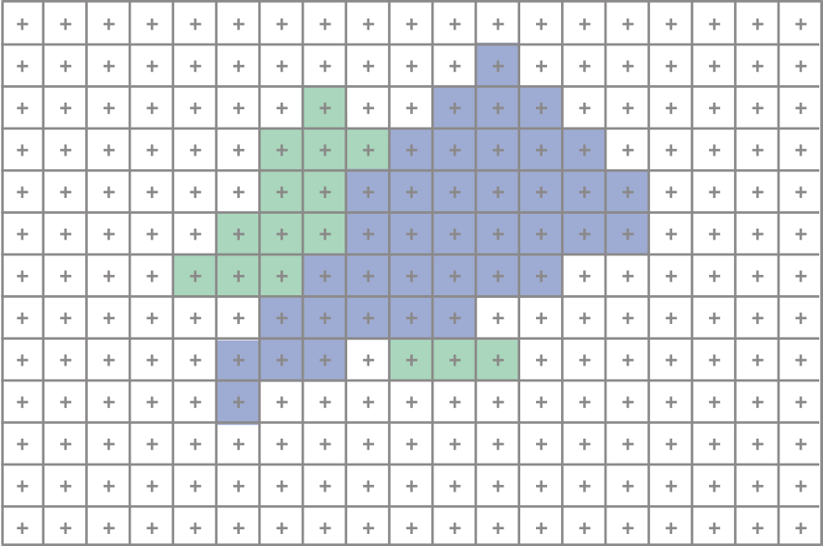
2D Scan Conversion
Geometric primitives
  (point, line, polygon, circle, polyhedron, sphere... )
Primitives are continuous; screen is discrete
Scan Conversion: algorithms for efficient generation of the samples comprising this approximation

Slide 31
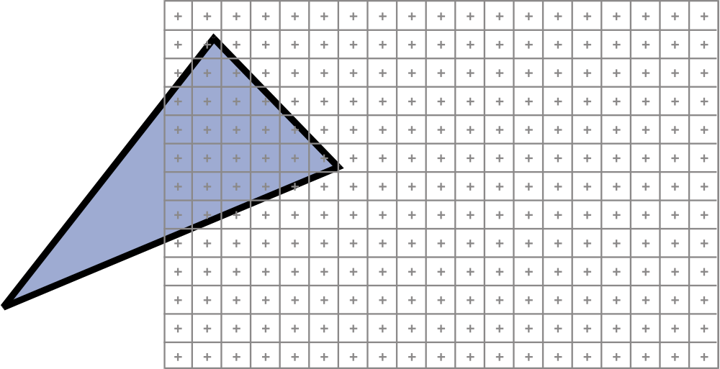
Clipping problem
How do we clip parts outside window?

Slide 32
The Graphics Pipeline
Modeling
Transformations
Former hardware relied on full clipping
Modern hardware mostly avoids clipping
  Only with respect to
  plane z=0
In general, it is useful to learn clipping because it is similar to many geometric algorithms
Illumination
(Shading)
Viewing Transformation
(Perspective / Orthographic)
Clipping
Projection
(to Screen Space)
Scan Conversion
(Rasterization)
Visibility / Display

Slide 33
Full Clipping
"clip" geometry to view frustum
z axis
(eye_{x}, eye_{y}, eye_{z})
image plane

Slide 34
One-plane clipping
"clip" geometry to near plane
z axis
(eye_{x}, eye_{y}, eye_{z})
image plane

Slide 35
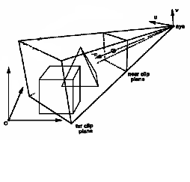
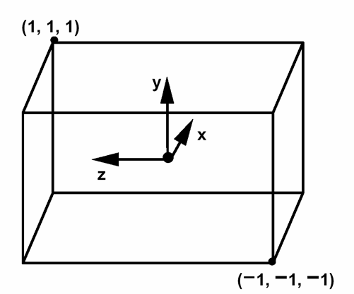
When to clip?
Before perspective transform
in 3D space
  Use the equation of 6 planes
  Most natural, not too degenerate
But, other ways exist:
In homogeneous coordinates after
perspective transform (Clip space)
  Before perspective divide
  (4D space, weird w values)
  Canonical,independent of camera
  The simplest to implement in fact
In the transformed 3D screen space
after perspective division
  Problem: objects in the plane of
  the camera

Slide 36
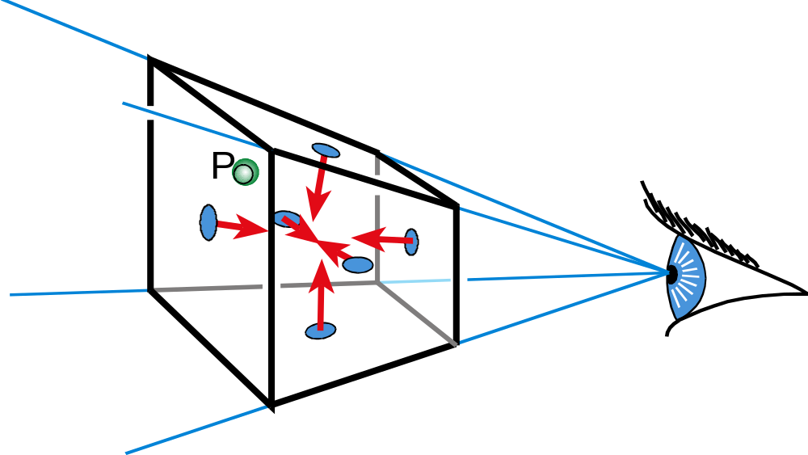
Clipping With Respect to View Frustum
Test against each of the 6 planes
  Normals oriented towards the interior
Clip (or cull or reject) point p

Slide 37
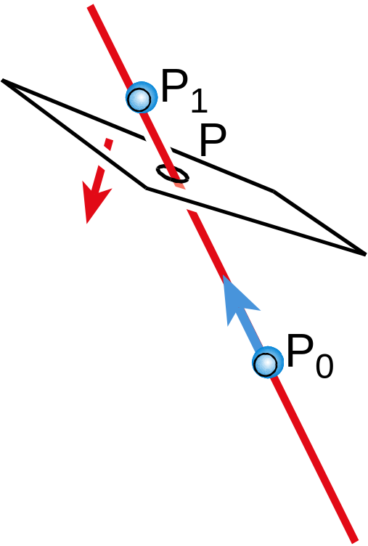
Clipping Lines: Line – Plane Intersection
Explicit (Parametric) Line Equation
  L(t) = P₀ + t * (P₁ – P₀)
  L(t) = (1-t) * P₀ + t * P₁
How do we intersect?
  Insert explicit equation of line into
  implicit equation of plane
Parameter t is used to
interpolate associated attributes
(color, normal, texture, etc.)
Is this efficient?

Slide 38
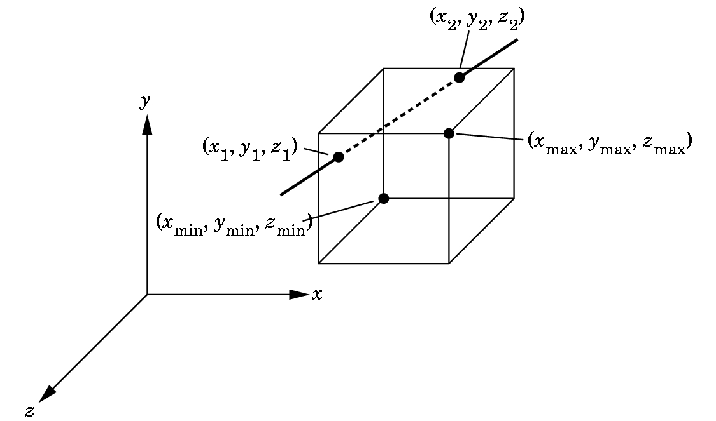
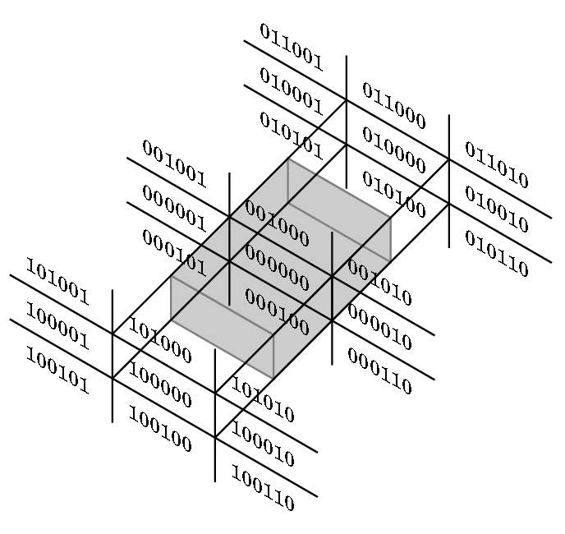
Clipping in 3-D
Cohen-Sutherland 2D clipping extends to 3-D
Perspective Viewing:
  Clip against the view frustum
  BUT, easier to clip against a parallelepiped aligned with the axes
  OpenGL: project to normalized orthographic view then clip
  Lesson: in pipelining, always consider the process as a whole
  Now the intersections are simple!

Slide 39
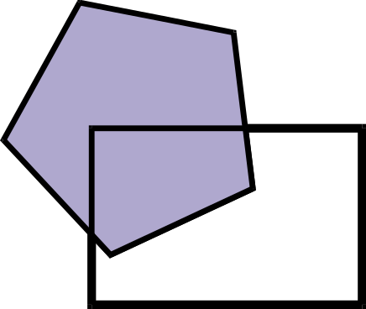
Polygon Clipping

Slide 40
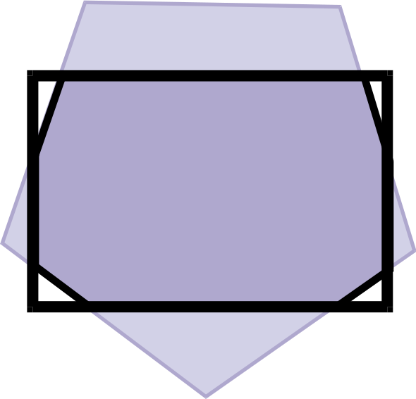
Polygon Clipping is Complex
Even when the polygons are convex

Slide 41
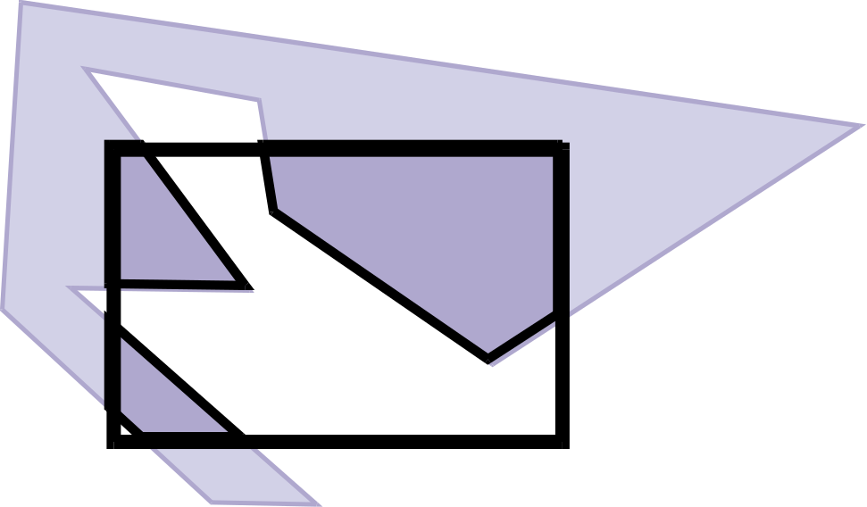
Polygon Clipping is Nasty
When the polygons are concave

Slide 42
Naïve Polygon Clipping?
N*m intersections
Then must link all segments
Not efficient and not even easy

Slide 43
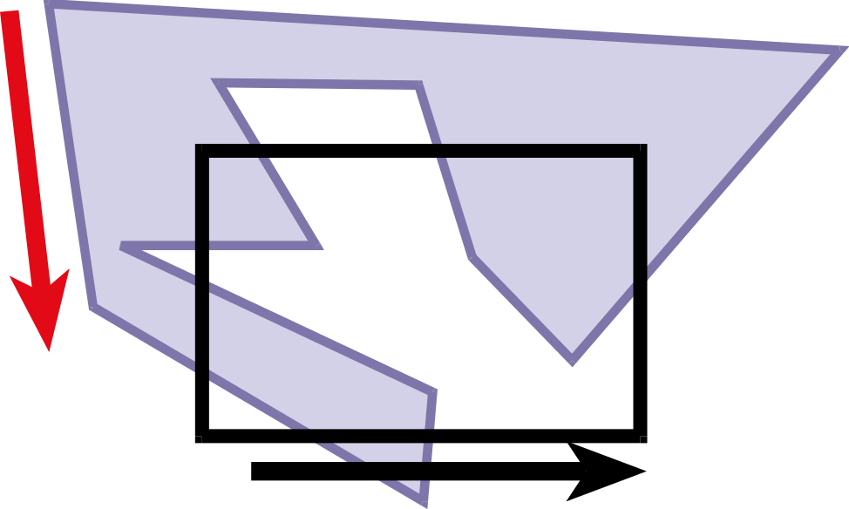
Weiler-Atherton Clipping
Strategy: “Walk" polygon/window boundary counterclockwise
Black is the clipping window

Slide 44
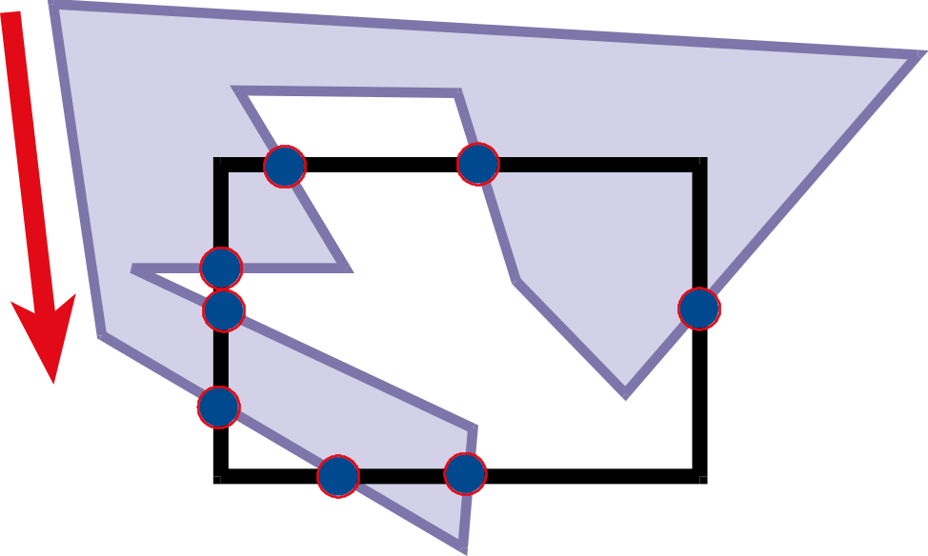
Weiler-Atherton Clipping
Compute intersection points

Slide 45
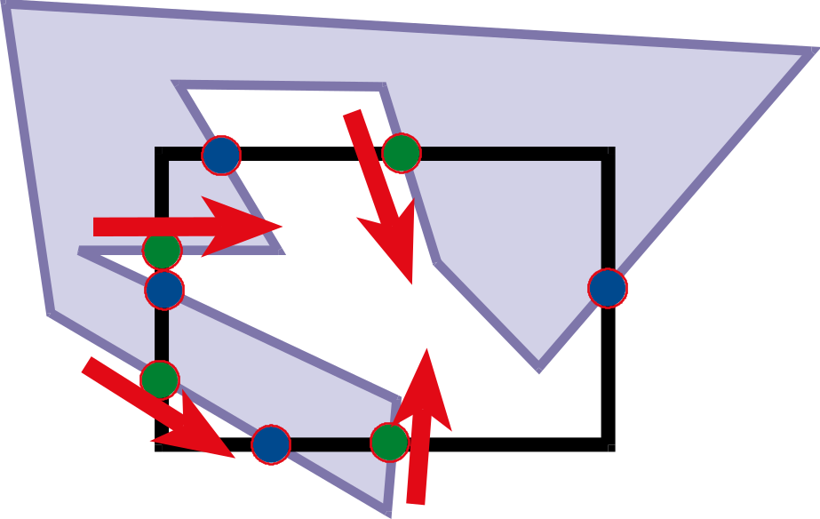
Weiler-Atherton Clipping
Compute intersection points
Mark points where polygon enters clipping window (green here) as the walk is taken along the polygon

Slide 46
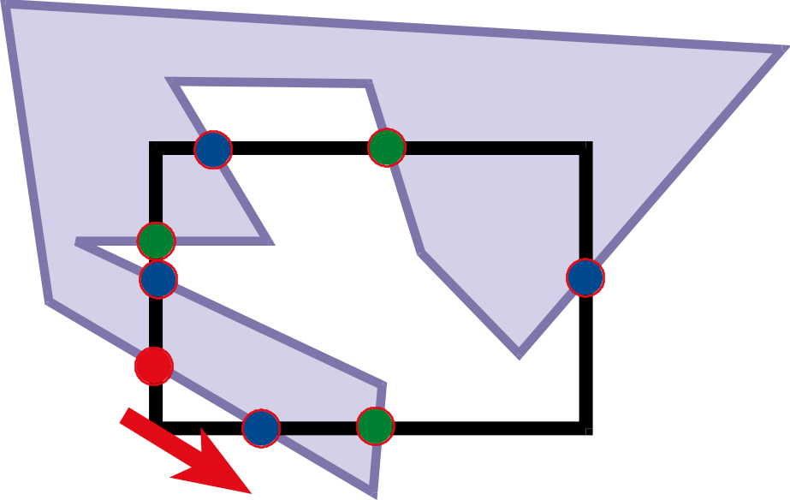
Clipping
While there is still an unprocessed entering intersection
Walk" polygon/window boundary

Slide 47
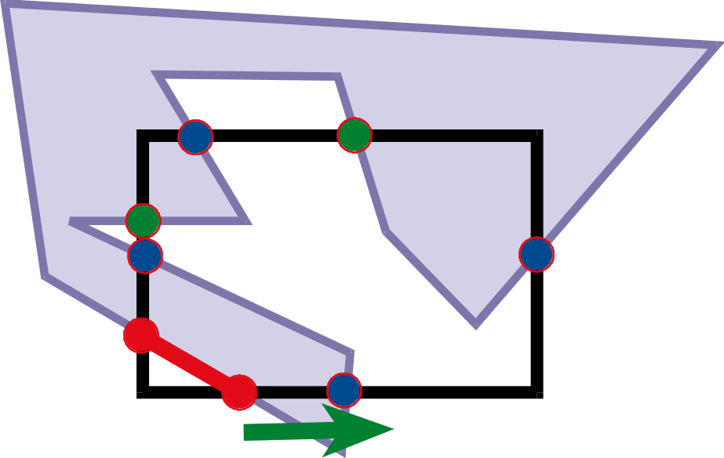
Walking Rules
Out-to-in:
  Record clipped point
  Follow polygon boundary
In-to-out:
  Record clipped point
  Follow window boundary

Slide 48
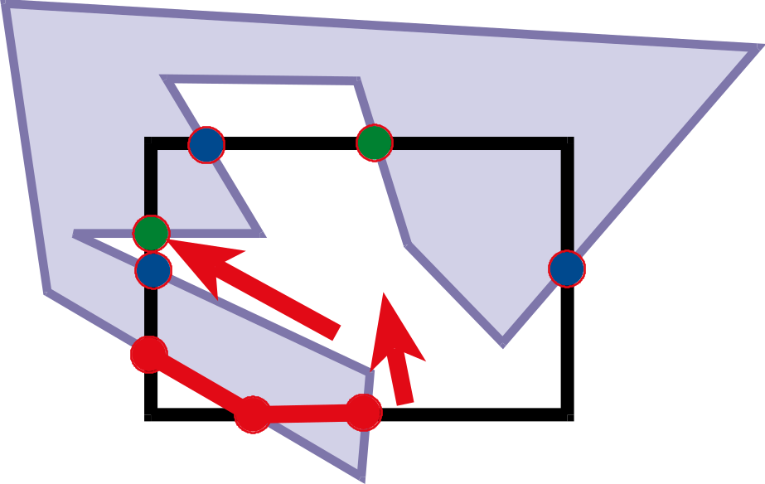
Walking Rules
Out-to-in:
  Record clipped point
  Follow polygon boundary
In-to-out:
  Record clipped point
  Follow window boundary

Slide 49
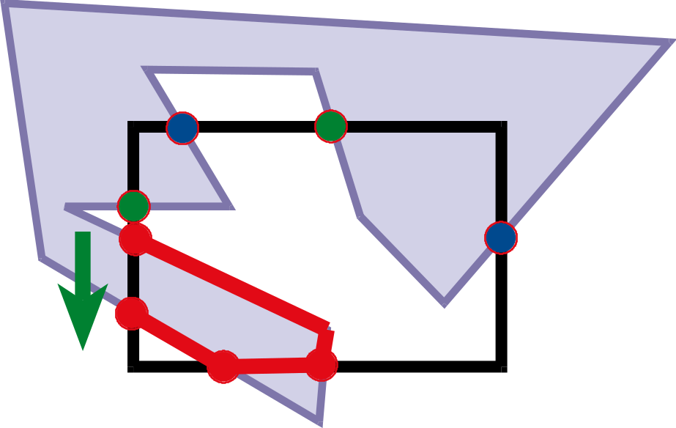
Walking Rules
Out-to-in:
  Record clipped point
  Follow polygon boundary
In-to-out:
  Record clipped point
  Follow window boundary

Slide 50
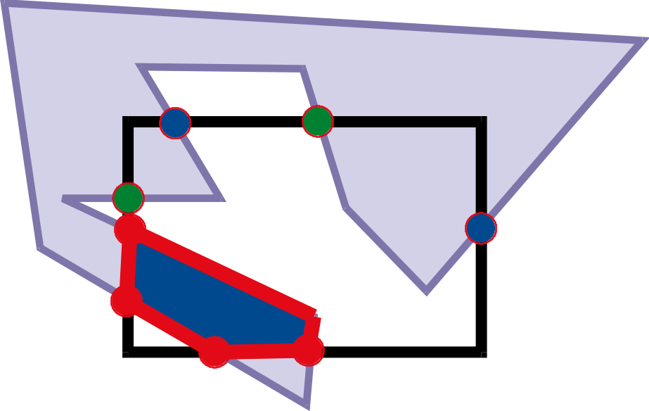
Walking Rules
Out-to-in:
  Record clipped point
  Follow polygon boundary
In-to-out:
  Record clipped point
  Follow window boundary

Slide 51
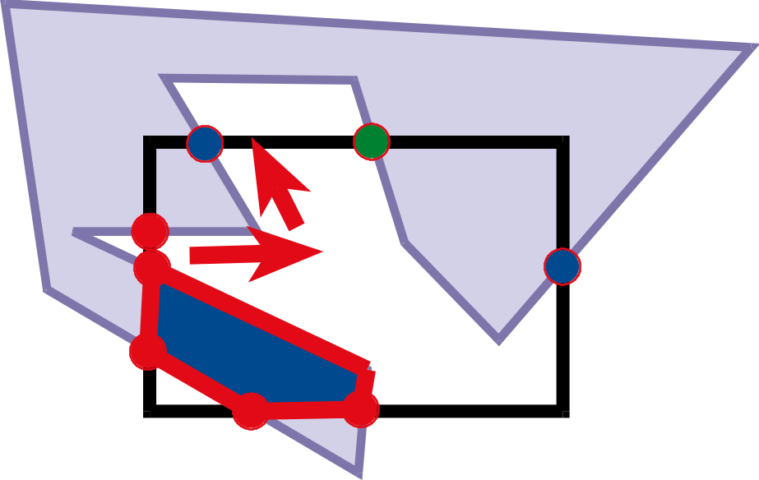
Walking Rules
While there is still an unprocessed entering intersection
Walk" polygon/window boundary

Slide 52
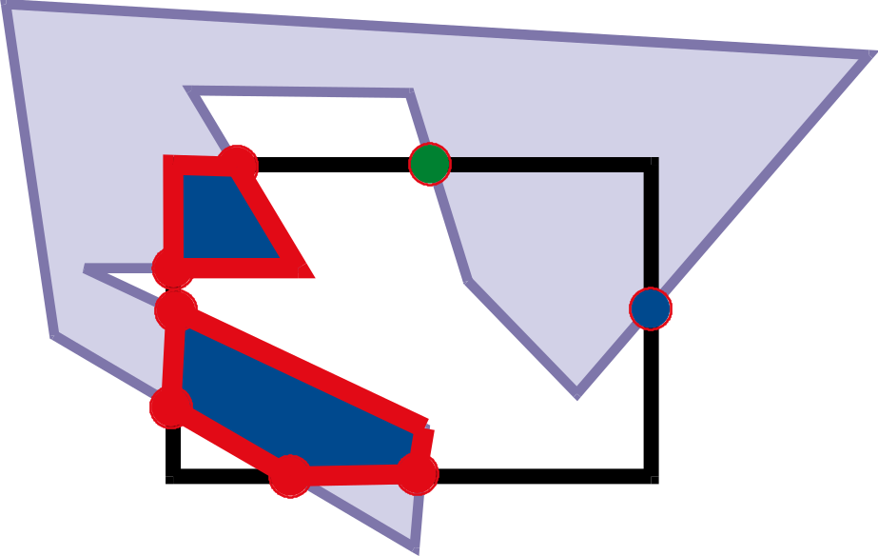
Walking rules
While there is still an unprocessed entering intersection
Walk" polygon/window boundary

Slide 53
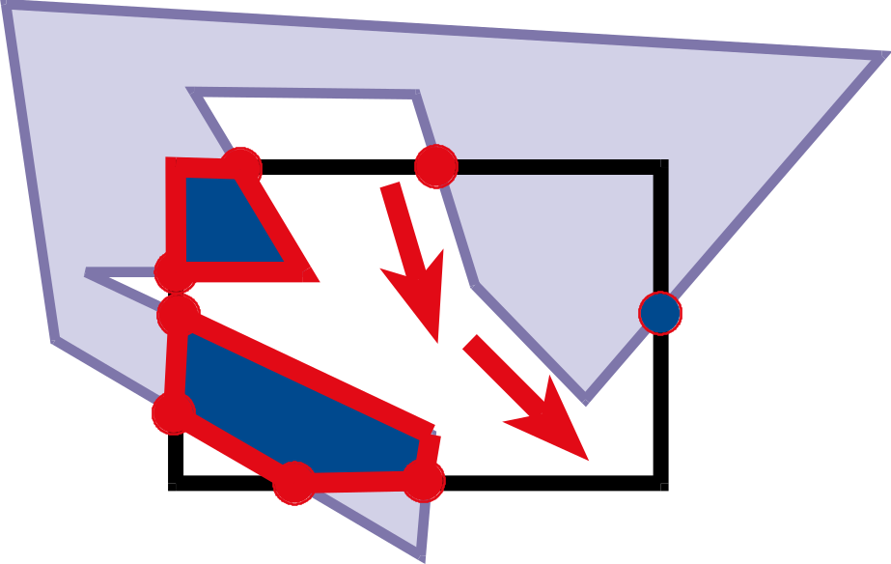
Walking rules
While there is still an unprocessed entering intersection
Walk" polygon/window boundary

Slide 54
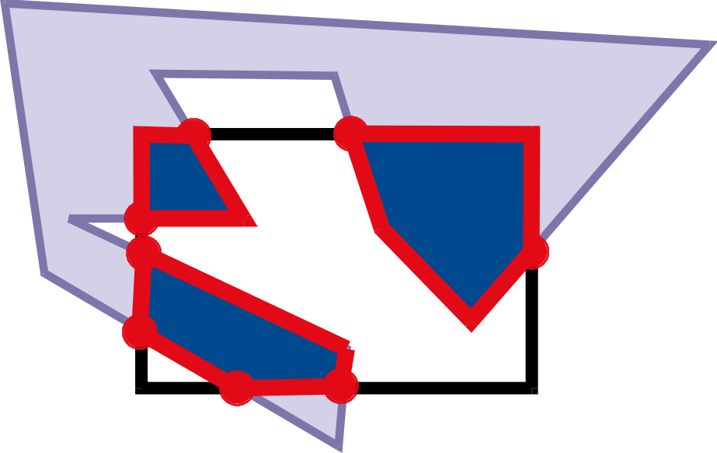
Walking rules
While there is still an unprocessed entering intersection
Walk" polygon/window boundary

Slide 55
Weiler-Atherton Clipping
Importance of good adjacency data structure
(Here we can simply list the oriented edges)

Slide 56
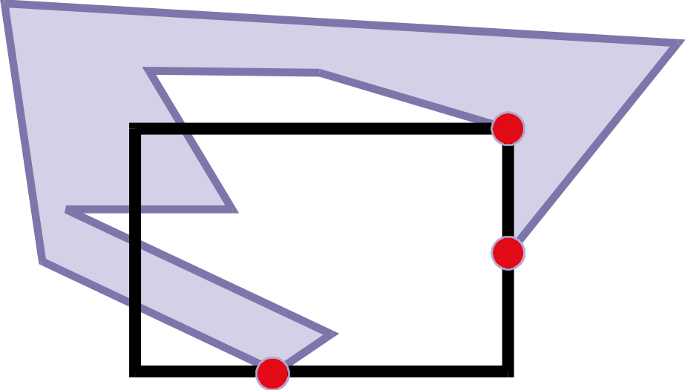
Robustness, Precision, Degenerate Cases
What if a vertex is on the boundary?
What happens if it is “almost” on the boundary?
  Problem with floating point precision
Welcome to the real world of geometry!

Slide 57
Some Observations
This algorithm works with convex or concave polygons for both the clipping window and the polygon.
The method was originally developed to identify visible surfaces in a 3D scene.
You need to know a few things however:
  How do you walk counterclockwise?
  Note: We usually store edges this way for lighting purposes.
  When are you inside a polygon?
  Use the odd-even rule or the nonzero winding number rule.

Slide 58
Clipping
There are many other clipping algorithms:
  Cyrus and Beck Line Clipping
  Liang-Barsky Line Clipping
  Nicholl-Lee-Nicholl Line Clipping
  Polygon Fill-area Clipping
  Sutherland-Hodgman Polygon Clipping
  Clipping against nonrectangular polygons
  Curve clipping
  Text clipping
Each has different characteristics and is used in different situations.

