Slide 1
Chapter 8
3-D Object Representations

Slide 2
We Have Already Considered Some 3D Representations
Polyhedra
OpenGL polyhedron functions
Quadric surfaces
Now we will look at some other representations :
Particle systems
Fractal geometry methods
Bezier and spline curves and surfaces
NURBS

Slide 3
Modeling Difficulties
Irregular, non-manufactured objects have been difficult to model with the standard methods of graphics.
We have already seen that texturing can help---
although, in a sense, there is something unsatisfying
about just pasting a scanned image onto an object to
make it look good---not that your first attempts are easy
It is true that texturing adds realism faster than most methods.

Slide 4
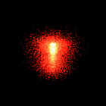
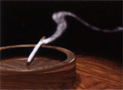
Particle Systems (8-25)
One modeling technique we will see in IRCs are particle
systems.
Particle systems are fluid and, consequently, a nice
choice for some non-solid objects.
An example of a particle system can be seen at
http://www.cs.unc.edu/~davemc/Particle/

Slide 5
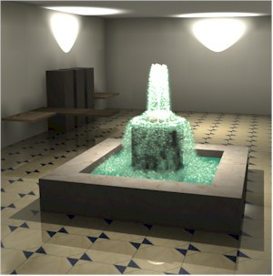

Slide 6
Particle Systems
Good for modeling
  irregularly shaped objects
  fluid-like objects
  objects that change over time
Examples are
  clouds waterfalls
  smoke water spray
  fire a tornado
  fireworks
Introduced dramatically in Star Trek II-Wrath of Khan
  Modeled the planet explosion and expanding wall of fire from the “genesis bomb”

Slide 7
BASIC IDEAS IN GENERATING
PARTICLE SYSTEMS
Some region of space is defined to constrain the system
Particles can be of any shape or color- i.e. circles, ellipsoids, etc.
Particles are generated randomly with parameters that may vary over time.
Deletions of particles may occur randomly.
Over the lifetime of the particle:
  Its path and surface characteristics can be changed, color-coded for display, and displayed.
  Random choices are often made for transparency, color, and movement.

Slide 8
Examples Of Choices
Bursting fireworks
  Generate in a spherical region
  Color code for temperature
Grass clumps
  Shoot particles up and let them fall down (producing a parabolic curve)
  Color code from green to yellow.
Waterfall over rocks
  Start at top generating particles
  As a particle hits a rock, deflect its path.
  Color code to look like cascading water.

Slide 9
Other Methods Of Generating Objects
But, some things are more solid, but still irregular:
shorelines,
mountains,
trees
clouds
Note: clouds can be modeled with particle systems also

Slide 10
Fractals
Typically are used to model objects with the
properties that they are:
Irregular
Randomly jagged, but constrained
Non-fluid
On zooming in, the shape becomes more irregular
On zooming out, the shape becomes less irregular

Slide 11
Fractals
Introduced mathematically to capture the notion that you can have a continuous curve that is nowhere differentiable---i.e. there is no point at which a derivative exists.
Intuitively, this means the curve is unbroken---i.e. smooth---but it is incredibly jagged.
Of course, when we draw a fractal we are drawing it at only one point in its generation, as many of these are defined as the limit of an iterative process.

Slide 12
KOCH CURVE- One of the Simplest Examples
Step 0: length = 1, seg = 1/3
Step 1: length = 4/3, seg = 1/9
This continues iteratively, where at each level, the
segments are divided into thirds and the same
pattern is repeated.
The definition of the curve requires that this be
repeated forever.

Slide 13
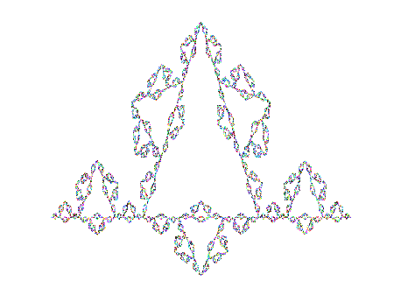
Koch Curve
At level k, the length is (4/3)^{k} so in the limit, the
length of the curve approaches infinity.

Slide 14
Fractals And Fractional Dimension
The topological dimension of an object is defined as the number of parameters needed to specify the location of a point on an object.
For fractals, this is not too useful as the specific location of a point is difficult to locate. Another definition of dimension used called the Hausdorff-Bisicovitch dimension or H-B dimension.
We will see in a minute how this is defined, but a fractal is defined to be a set of points whose H-B dimension is strictly larger than its topological dimension.

Slide 15
Fractals And Fractional Dimension
The H-B dimension can be defined formally, but this intuitive approach yields a better understanding for our purposes.
Suppose you want to measure a shoreline:
If you use a straight edge ruler of length 1 mile,
you might find the length to be 2.
But, if you use a straight edge ruler of length 1/8 mile, you would find the length to be different as you conform more to the bends and twists.

Slide 16
Fractals And Fractional Dimension
The Koch curve has the same kind of property:
The length is 1 if you use a ruler of length 1/3.
The length is 4/3 if you use a ruler of length 1/9.
The length is 16/9 if you use a ruler of length 1/27.
The Hausdorff-Besicovitch dimension is defined between two iterations where you obtain lengths len1 and len2 for rulers of length s1 and s2 as
log(len2/len1) / log(s1/s2)
In graphics, that number is called the ruggedness factor.

Slide 17
Fractals And Fractional Dimension
One property of fractals is self-similarity ---i.e. if the curve is enlarged, it is identical to the entire curve.
Every fractal that "sits" in 2D topological space has a fractional dimension between 1 and 2.
Every fractal that "sits" in 3D topological space has a fractional dimension between 2 and 3.
Natural landscapes - ~2.15
Rugged Alps - ~2.5

Slide 18
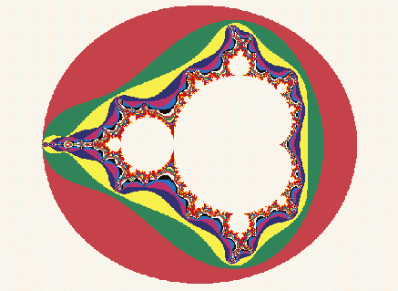
The Mandelbrot Set – A Well-Known Fractal
The Mandelbrot set is really the set of points in the
white interior.
Colors are selected to represent points outside of
the set that have different properties.

Slide 19
Methods Of Generating Fractals
Successive refinement
  Koch curve
  Sierpinski gasket (3D)
  Sierpinski arrowhead (2D)
Successive transformations
  Start with a point P₀ and a function F.
  Calculate P_{i+1} = F(P_{i}) for some fixed number of times.
  Not all functions, of course, produce fractals, but some do.

Slide 20
Generating The 2D Mendelbrot Set
  Start with a complex number z = z₀, where z = a + bi.
  Calculate
    z_{i+1} = z_{i}² + z₀
  Continue calculating until we can see if the sequence is diverging.
  In practice, we pick an upper bound MAX and calculate either MAX iterations or until the magnitude of the generated point exceeds 2.
  The magnitude of a + bi is a² + b².
  We pick different colors to show when the iteration stops.
  The boundary of the convergence region is technically the Mendelbrot Set.

Slide 21
The Word “Fractal”
Mandelbrot coined the term “fractal” from the Latin fractus meaning “fragmented” or “irregular, but it also suggests the term “factional dimension”.

Slide 22
This technique can be extended to 3D or 4D
The same ideas as for the 2D case are applied to quaternions
  q = a + bi + cj + dk where
  i² = j² = k² = -1
  For example, one that produces interesting 3D effects is
    f(q) = cq(1-q), where c=1.475+0.9061i

Slide 23
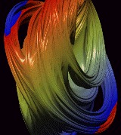
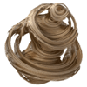
Quaternion generated Julian Sets in 3D space

Slide 24
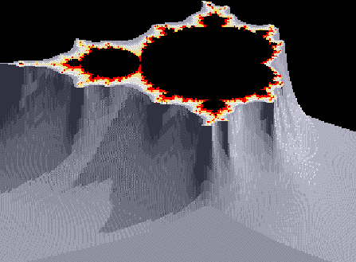
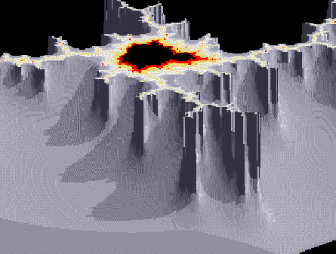
FRACTAL GENERATED GRAPHICS
These are close to the Mandelbrot set, but one of the values generated in the iteration is used to produce a height, and, consequently a rugged terrain.

Slide 25
Another Method For Generating Fractals
String productions (based on the LOGO turtle concept)
  F go forward 1 unit
  + turn angle A right
  - turn angle A left
  A rule is something like
    F -> F – F ++ F - F
  and means replace each F with right side.
What does repeated iteration of this rule produce?

Slide 26
Using This Generator
Draw K₁ by following: F – F ++ F - F with angle equal to 60 degrees:
Get the first generation of Koch curve:
Now, repeat this by applying the above rule again to get:
K₂ is (F-F++F-F) – (F-F++F-F) ++
(F-F++F-F) – (F-F++F-F)
Note the parenthesis are here only to help in reading the string.

Slide 27
Walking the Logo Turtle Using the K₂ String
We obtain the second generation of the Koch curve.
The following applet generates the Koch curve:
http://www.arcytech.org/java/fractals/koch.shtml
In the case of the Koch curve, we start with F and continue to expand it by the production rule.
The F is called the atom of the system.

Slide 28
We Can Extend The Rules By Allowing Multiple Strings
Example:
  F -> F
  X -> X + Y F +
  Y -> - F X – Y
  atom = FX
  This generates a dragon curve when A is 90 degrees.

Slide 29
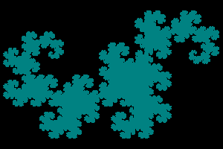
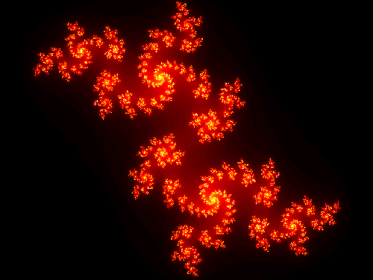

Various colorings of dragon curves

Slide 30
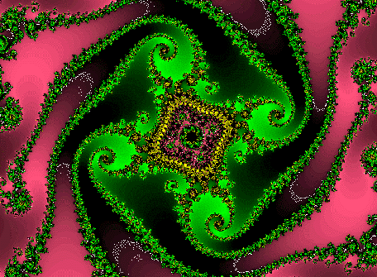
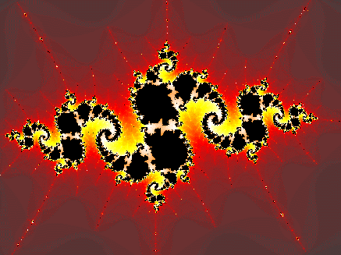
OTHER FRACTAL IMAGES
Each is produced by following a fractal generating algorithm and selecting colors to represent points with certain properties.

Slide 31
Drawing Bushes And Trees
One method is the following:
Extend the LOGO string production language to include
  [ save state
  ] restore the state
  where state is the turtle location and the turtle direction.
  Obviously, use a stack (or a recursive algorithm)

Slide 32
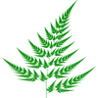
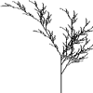
Generated by string productions.

Slide 33
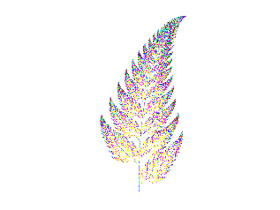
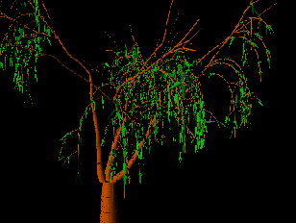
OTHER MODIFICATIONS PRODUCE

Slide 34
Fractal Like Methods
Shorelines, trees, mountains, etc. aren't really fractals, but we can use fractal like methods to model them.
Mandelbrot first used them in graphics to generate mountainous terrain, but Fournier, Fussell, and Carpenter in 1982 found a faster way to generate terrain.
Since then, the methods have been modified to produce trees, clouds, and ferns as well is mountains...

Slide 35
The Idea is Really Quite Simple
http://world.std.com/~bgw/applets/1.02/MtFractal/MtFractal.html

Slide 36
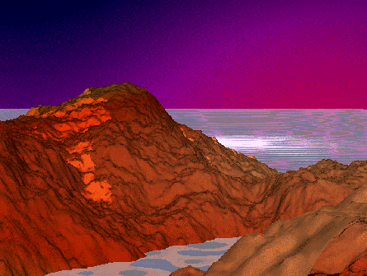
And Of Course We Can Produce Something Alien Such As

Slide 37
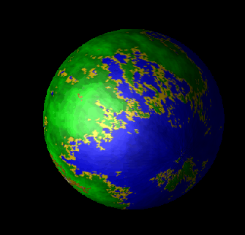
A Fractal Texture Mapped Onto A Sphere

Slide 38
Some Interesting Fractal Generation Sites
Mountain Generation
Fern Generation
Tree generation
Another tree generator
Unusual effects

Slide 39
Additional References
There are many references on the web.
Some fractal pictures were due to Derek Wills, U of Hull, UK
Also useful are several books other than our textbook with excellent sections on fractals and graphics in general:
  Hill, F.S., Computer Graphics using OpenGL, Prentice Hall
  Foley, van Dam, Feiner, and Hughes, Computer Graphics: Principles and Practice, Addison Wesley
  Rogers, Procedural Elements for Computer Graphics, McGraw Hill

Slide 40
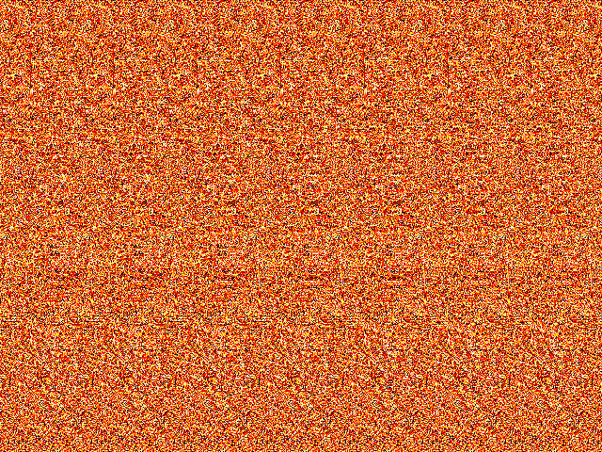
and, some interesting fractals in stereo-depth formats ...

Slide 41
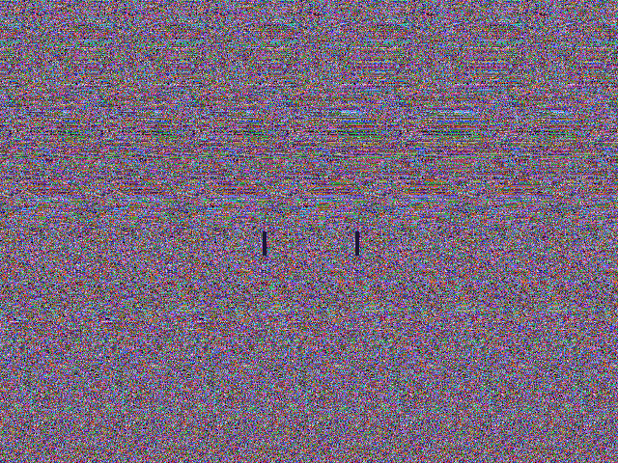

Slide 42
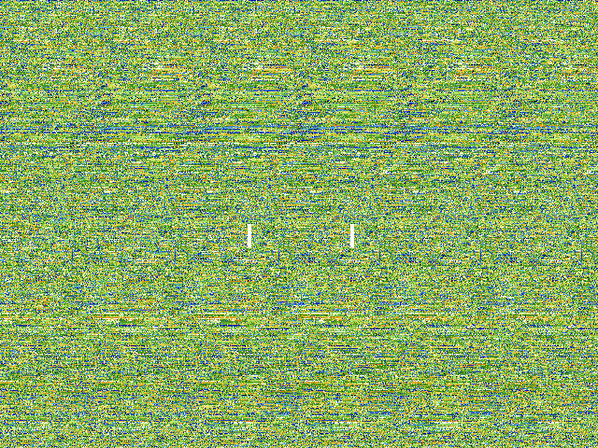

Slide 43
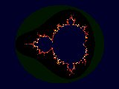
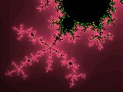
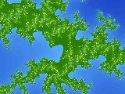
Stereo-depth views at this excellent fractal gallery
Basis for orange stereo-depth view
Basis for purple stereo-depth view
Basis for green stereo-depth view

