Slide 1
Chapter 8- Part 4
3D Object Representations
Various Others
Sections 8-19 through 8-22

Slide 2
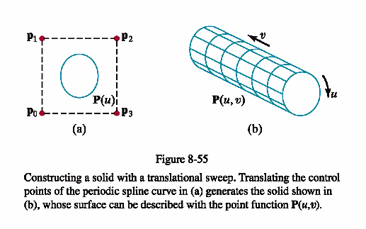
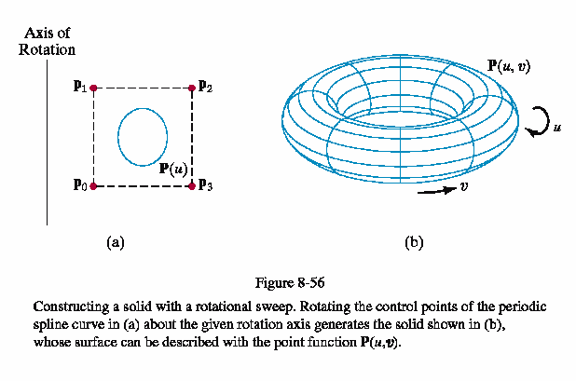
Sweep Representations
Idea is to define a 2D shape and then a sweep which will move the shape through 3D space to create a 3D object.

Slide 3
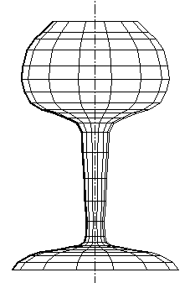
Sweep Representations
A sweep can follow any path.
The object being swept can vary in size along the path.
A simple 2D curve can
produce interesting
3D shapes.

Slide 4
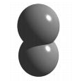

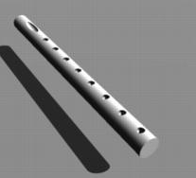
Constructive Solid-Geometry Methods
(CSG)
Given two 3D objects, create new ones with the set operations of
  union
  intersection
  difference
Top subtracted from bottom yields
A flute made from a cylinder, 1 ellipsoid and 8 circles where the ellipsoid and 8 circles are subtracted from the cylinder.

Slide 5
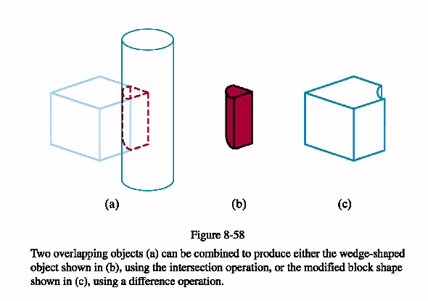
Contrasting Intersection and Differencing

Slide 6
Users of CSG Methods
Often find these implemented in modeling systems such as Bryce and Maya.
  A set of primitives are provided (such as sphere, cone, box, and even spline-defined objects) and complex objects can be built by the usual transformations (scaling, rotating, and translating) as well as grouped using set operations.
  Providing these in ray-tracing graphics packages is easy (although they are not limited to these) because the implementation is usually done by ray-casting as we will see.
CSG methods do not lend themselves to pipeline rendering.

Slide 7
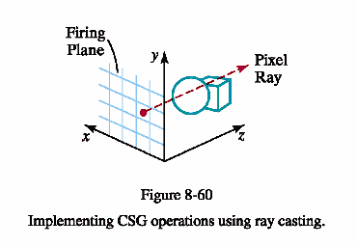
Ray-Casting Methods for CSG Operations
The objects are defined by boundary representations.
A ray parallel to the z axis
and in the z-axis direction is
sent out for each pixel in the
xy-plane (called the firing plane).
Calculate surface intersections along each ray path.
Sort the intersection points according to the distance from the firing plane.
The surface limits for the composite object are determined by which set operation is being performed.

Slide 8
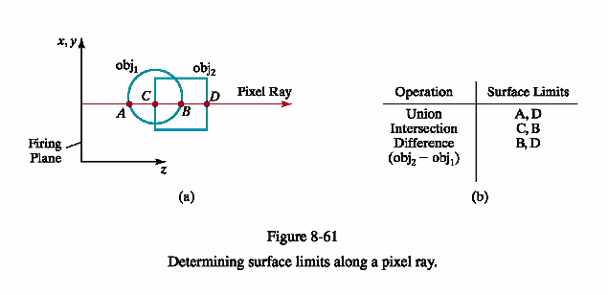
Example, pg 475

Slide 9
CSG Object Representations
One obvious one is a tree:
CSG
Object
oper1
oper2
obj1
obj5
obj2
obj6
obj3
obj4

Slide 10
Approximating Properties of CGI Objects
Pg 476 goes through some methods for approximating physical properties of these objects such as volume and mass, if those are needed.
Basically, the calculations are done along the rays.
For example, volume is approximated as the area of a pixel in the firing plane times the cross-sectional slice encountered by the ray.

Slide 11
Octrees
An octree is a hierarchical tree used to represent solid objects in some graphics systems.
Applications such as medical imaging systems that use a lot object cross sections often use these.
It is a generalization of a 2D representation scheme called a quadtree encoding.
The basic idea is to define nodes that represent successively divided quadrants until they are homogeneous in color.

Slide 12
Generating a Quadtree Representation
Divide a 2D regions, usually a square, into 4 quadrants and represent each quadrant by a node in a 1D array.
If the quadrant is homogeneous in color, the node stores that color and a flag is set to specify that situation.
If the quadrant is heterogeneous in color, then it is divided as above and the same action is taken.

Slide 13
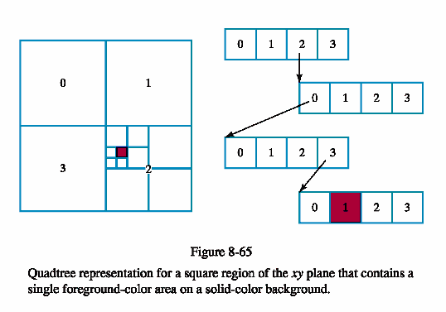
Quadtree Representation

Slide 14
Advantages of Quadtree Representation
Reduces the storage requirements for the objects if there are large areas of similar color.
Takes advantage of what is called spatial coherence – the tendency to have several pixels close to each other be the same color.
An octree-encoding is just a 3D generalization of the quadtree.
Individual subregions of the subdivided 3D space are called volume elements or voxels.

Slide 15
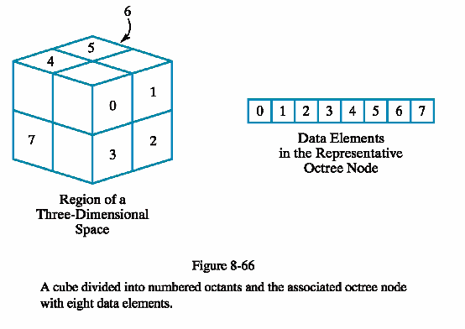
Octrees

Slide 16
What Else Can Quadtrees and Octrees Be Used For?
Handling Observer-Object Interactions
  Subdivide the quadtree/octree until each leaf’s region intersects only a small number of objects.
  Each leaf holds a list of pointers to objects that intersect its region.
  Find out which leaf the observer is in. We only need to test for interactions with the objects pointed to by that leaf.

Slide 17
What Else Can Quadtrees and Octrees Be Used For?
Inside/Outside Tests for Odd Shapes
  The root node represent a square containing the shape.
  If a node’s region lies entirely inside or entirely outside the shape, do not subdivide it.
  Otherwise, do subdivide (unless a predefined depth limit has been exceeded).
  Then the quadtree or octree contains information allowing us to check quickly whether a given point is inside the shape.
Sparse Arrays of Spatially-Organized Data
  Store array data in the quadtree or octree.
  Only subdivide if that region of space contains interesting data.

Slide 18
BSP Trees
Similar to octree encoding, but divide space into two partitions instead of eight at each step.
Divide by a plane that can be in any position and orientation as long as the region defined is convex.
Octrees always use three mutually perpendicular planes aligned with the coordinate planes.
BSP trees can provide more efficient representations as the depth of the tree might be reduced considerably.
They are useful for identifying visible surfaces.
They are used a lot in ray tracing algorithms.

Slide 19
Octrees and BSP Trees
Used a lot in computer games
  Visibility - What can I see?
  Ray intersections - What did the player just shoot?
  Collision detection - Did the player just hit a wall?
  Proximity queries - Where is the nearest power-up?

Slide 20
Basic Idea is to Speed Up Queries
Many geometric queries are expensive to answer precisely
The best way to reduce the cost is with fast, approximate queries that eliminate most objects quickly
  Trees with a containment property allow us to do this
  The cell of a parent completely contains all the cells of its children
  If a query fails for the cell, we know it will fail for all its children
  If the query succeeds, we try it for the children
  If we get to a leaf, we do the expensive query for things in the cell
As originally presented, the query is “What is the color of the pixel?”

