Slide 1
Chapter 10
Graphics Methods
Other Than the Synthetic Camera Model – Radiosity

Slide 2
Introduction
Approximating realistic lighting phenomenon in computer graphics scenes creates a more compelling and engrossing viewing experience
The human eye is very adept at pinpointing visual discrepancies, especially involving lighting
Lighting discrepancies can cause the viewer to lose their current suspension of disbelief when viewing computer generated scenes

Slide 3
Introduction
The intricate play between lights and the 3D surfaces in a scene is a computationally intensive process
The lighting process needs to be efficient while maintaining an acceptable depiction of the interaction between light and the 3D surfaces
There are many indirect lighting phenomenon that add realism to the scene

Slide 4
Background and Previous Work
There has been a lot of research in global illumination
The goal is to create realistic lighting depictions in complex scenes in the most efficient manner
There have been many techniques and modifications of techniques to optimize and capture all different types of lighting
One of the first lighting models: Phong
  Still used in interactive graphics
  What OpenGL uses.
  Major shortcoming: It computes local illumination!

Slide 5
Background and Previous Work
Whitted introduced ray tracing in the 80’s as a more realistic approximation of light interacting with surfaces, but it was originally ridiculed as being too slow.
Backwards ray tracing was introduced later by Arvo to deal with shadows and indirect illumination
Radiosity was developed as an alternative to the sharp images created by ray tracing
Many hybrids of the two techniques have been developed to compensate for the failings of each technique
Photon mapping was used by Jensen in ’96 to achieve global illumination with caustics.

Slide 6
Caustics
Recall what a caustic is.
  Distinct areas of high light intensity much brighter than the neighboring area
  A result of indirect lighting, adding more realism to the scene
  Created by light refraction and specular reflection
  Refraction – light bends when it encounters different mediums, focusing the light transmitted
  Specular reflection – light reflects form specular surfaces and illuminates diffuse surfaces
  Caustics are generally encountered in scenes with liquids and glass objects

Slide 7
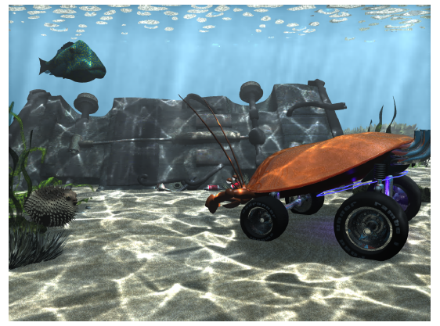
Caustics Example
Image from [Jensen98]

Slide 8
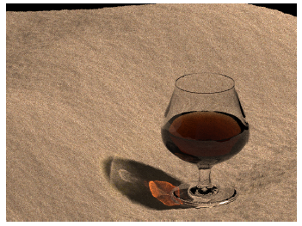
Caustics Example
Image from [Jensen96]

Slide 9
Global Illumination
There are many techniques that have been used for global illumination
  Radiosity
  Ray tracing
  Hybrid methods
  Photon mapping

Slide 10
Global Illumination
Radiosity
  Spread color “energy” throughout the scene until a stasis point is reached
  Only handles diffuse reflection, no specular reflections
  Large memory consumption
  Very realistic soft illumination images can be produced

Slide 11
Global Illumination
Ray tracing
  Handles specular reflections well
  Recursive, which can be very time consuming
  Captures shadows, reflections, and refractions
  Creates images that have a distinct synthetic “signature”
  Two methods –
    Forward – from the eye (view dependent)
    Backwards - from the light source to the objects

Slide 12
Global Illumination
Hybrid methods
  Incorporate diffuse and specular components into lighting models as well as capture indirect illumination
  Suffer from large storage requirements and computation time
Photon mapping
  An efficient hybrid method
  Combines photons (energy shooting) with ray tracing
  Achieves the different aspects of global illumination: caustics shadows, reflections, refraction, and diffuse color
  Accounts for direct and indirect illumination

Slide 13
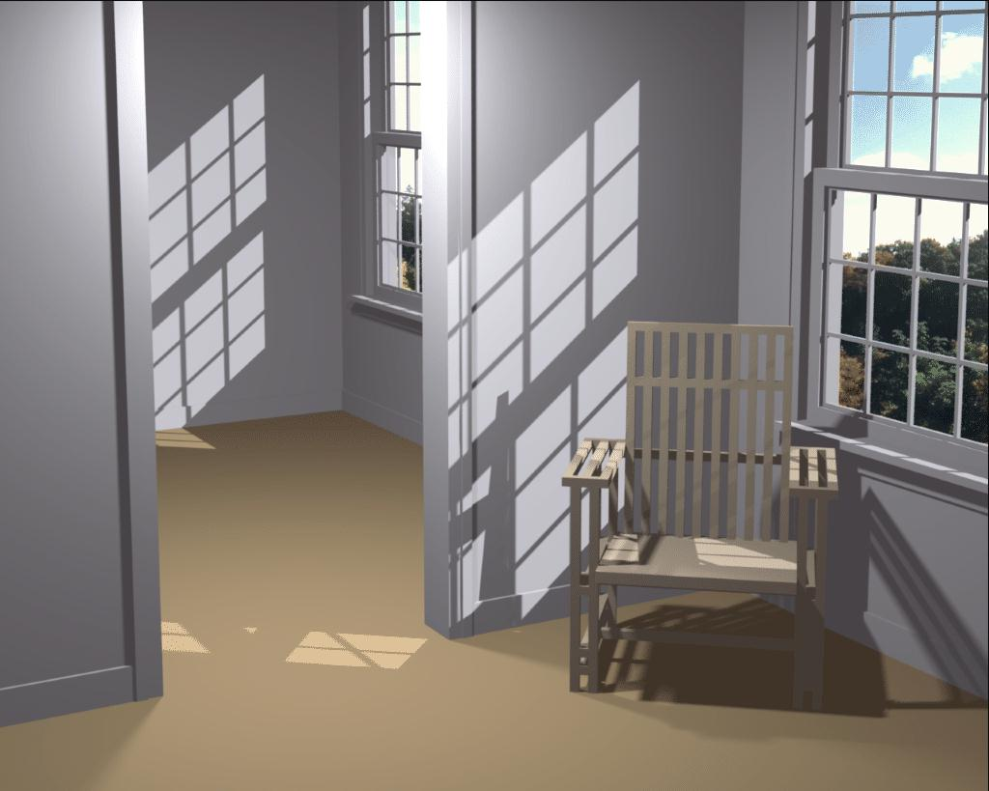
Example of a Scene Using
Radiosity Methods
From Cornell University graphics group

Slide 14
What is Radiosity?
A computer graphics technique for lighting
Two types of lighting algorithms:
  Local: easy, fast, but not realistic
  Global: slow, difficult, but highest quality
Radiosity is a global algorithm
Global algorithms try to take into account interreflections in scenes.

Slide 15
Radiosity in Real Time?
Local algorithms can easily run in real time, either in software or hardware.
Computational demands grow with number of surfaces and number of lights. 10⁶ surfaces is not unreasonable!
Most global algorithms take quadratic time in number of surfaces (all interactions!).

Slide 16
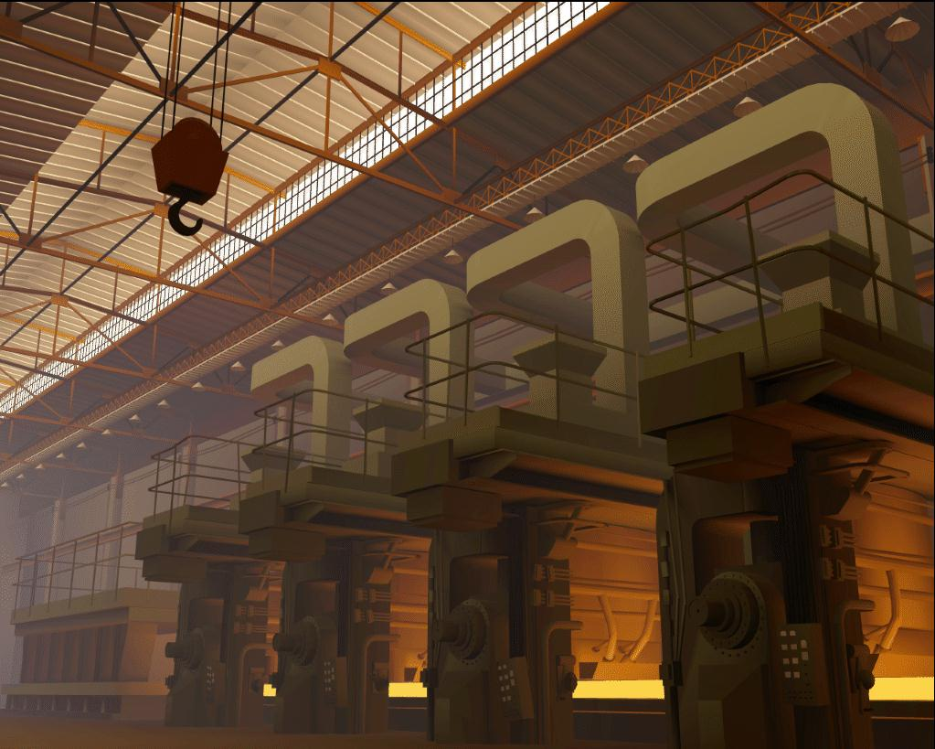
A Global Rendering
State-of-the-art radiosity rendering from 1988 (5 hours render time!)

Slide 17
Local Lighting Math
Consider a light source at some point in three-dimensional space, and a surface at some other location.
The techniques used by OpenGL determine how much light directly contribute to the brightness of the surface?
Note that global algorithms still need to do local lighting as a first step.

Slide 18
Approximations
OpenGL doesn’t compute the lighting formula (which is quite complex) at every pixel on the screen, but only at the vertices of the object instead.
Moreover, approximations are used to cut down on the various calculations.
Shadows are hard. At the cost of much realism, they can be omitted or faked.
  Draw a dark spot under an object instead
The ambient light is itself an approximation of real global illumination.

Slide 19
Radiosity
Radiosity is a global algorithm that handles diffuse lighting only.
The term “global illumination” refers to global algorithms that handle specular lighting also.
  Specular makes things much more difficult.

Slide 20
Radiosity Assumptions
All surfaces are perfectly diffuse
  Means that is doesn’t matter which way light hits or leaves a surface
Illumination is constant over a patch
  Can break the world up into a discrete number of pieces
  Problems at sharp illumination boundaries - shadows
  Ways around these problems, but less efficient and less able to manage scene complexity

Slide 21
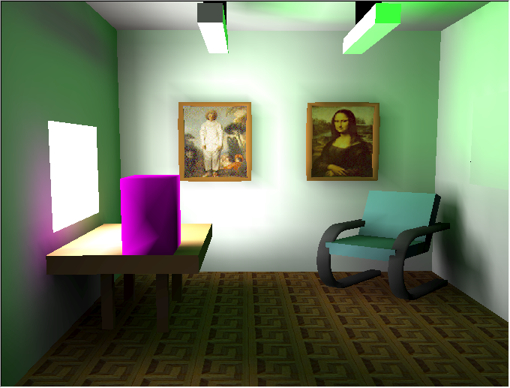
Radiosity Methods Can Produce Poor Pictures
Color bleeding is extreme in this example
Textures are applied after solving for illumination
Some meshing artifacts are visible - note the banding around the pictures on the wall
From Alan Watt, “3D Computer Graphics”

Slide 22
Radiosity
Basic idea: represent surfaces in environment as many discrete patches
A patch, or element, is a polygon over which light intensity is constant
Model light transfer between patches as a system of linear equations
Solving this system gives the intensity at each patch
Solve for R, G, B intensities and get color at each patch
Render patches as colored polygons in OpenGL.

Slide 23
Ray Tracing vs Radiosity
Ray tracing: ad hoc approach to simulating optics
  Deals well with specular reflection
  Trouble with diffuse illumination
Radiosity: theoretically rigorous simulation of light transfer
  Very realistic images
  But makes simplifying assumption: only diffuse interaction!

Slide 24
Ray Tracing vs Radiosity
Ray tracing:
  Computes a view-dependent solution
  End result: a picture
Radiosity:
  Models only diffuse interaction, so can compute a view-independent solution
  End result: a 3-D model

Slide 25
Fundamentals of Radiosity
Theoretical foundation: heat transfer
Need system of equations that describes surface interreflections
The radiosity of a surface is the rate at which energy leaves the surface
Radiosity = rate at which the surface emits energy + rate at which the surface reflects energy
  Notice: previous methods distinguish light sources from surfaces
  In radiosity all surfaces can emit light
  Thus: all emitters inherently have area

Slide 26
Basic Idea – But Equations are Complex
Everything in scene is modeled as a “patch”
Each patch starts off with an initial luminance value: all but luminaires (light sources) are probably zero
Iteratively determine how much luminance travels from each patch to each other patch until entire system converges to stable values

