Slide 1
Chapter 10
Graphics Methods
Other Than the Synthetic Camera Model – Ray Tracing

Slide 2
Ray Tracing

Slide 3
Basic Ray Tracing:
Introduction
In “normal” rendering:
  We deal with a series of objects, made of primitives.
  For each primitive, we determine which pixels it affects, if any.
Ray tracing turns this around:
  We deal with pixels, one by one.
  For each pixel, we ask what we see (which primitive?) when we look at it.

Slide 4
Basic Ray Tracing:
Tracing A Ray
The way we determine what we see when we look at a pixel is to draw an imaginary ray from the viewing position, through the pixel, into the scene.
  We ask which objects in the scene the ray hits.
  The first hit is the one that counts.
Image
Scene objects
Current pixel
First hit

Slide 5
Basic Ray Tracing:
Tracing A Ray
What do we do when we have a hit?
  We determine what color the object is at that point.
  Light sources and the object’s normal may affect the computation.
We can also do true specular reflection:
  Reflect the ray and do the ray tracing computation again.
We can also do true refraction, for translucent objects.

Slide 6
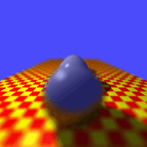
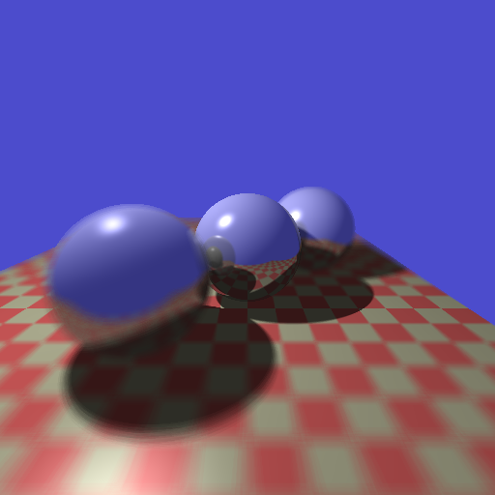
Raytracing
From Alan Watt, “3D Computer Graphics”

Slide 7
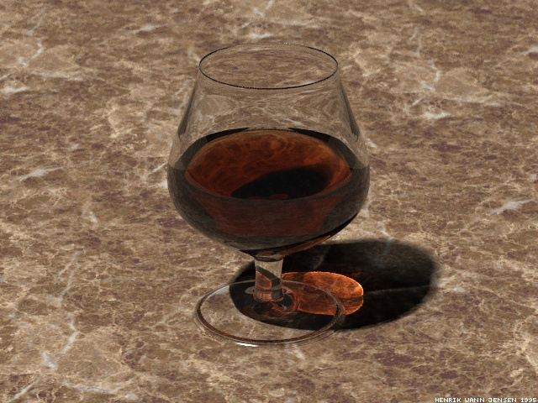
Refraction
Henrik wann Jensen, http://www.gk.dtu.dk/~hwj

Slide 8
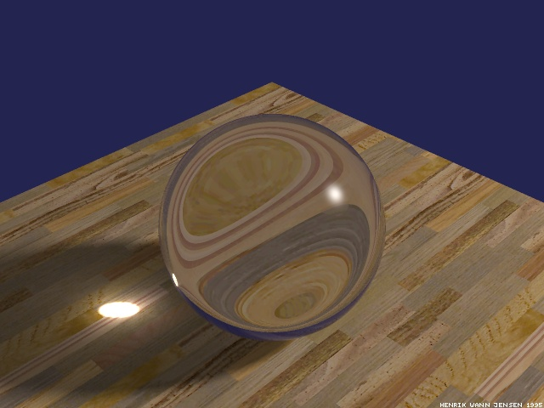
Refraction
Henrik wann Jensen, http://www.gk.dtu.dk/~hwj

Slide 9
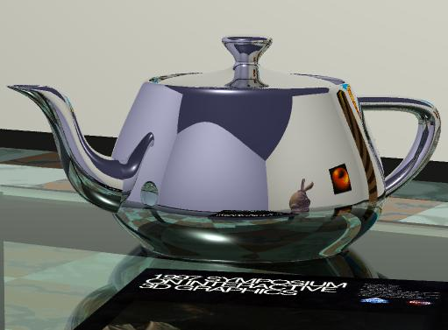
Reflections

Slide 10
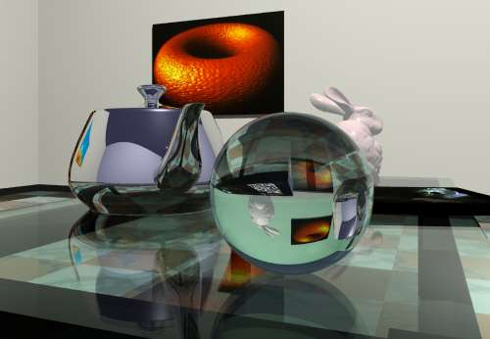
Complex Scenes

Slide 11

Complex Scenes

Slide 12
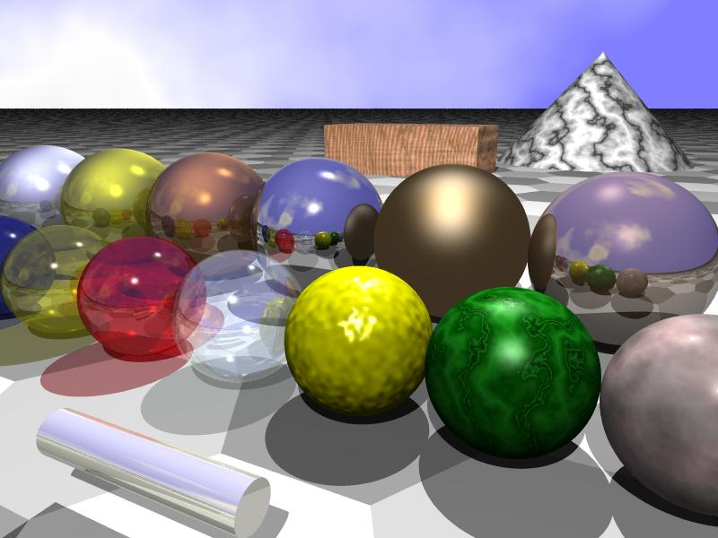
Many Interesting Features
http://math.hws.edu/eck/cs324/s04/lab6/starter.jpg

Slide 13
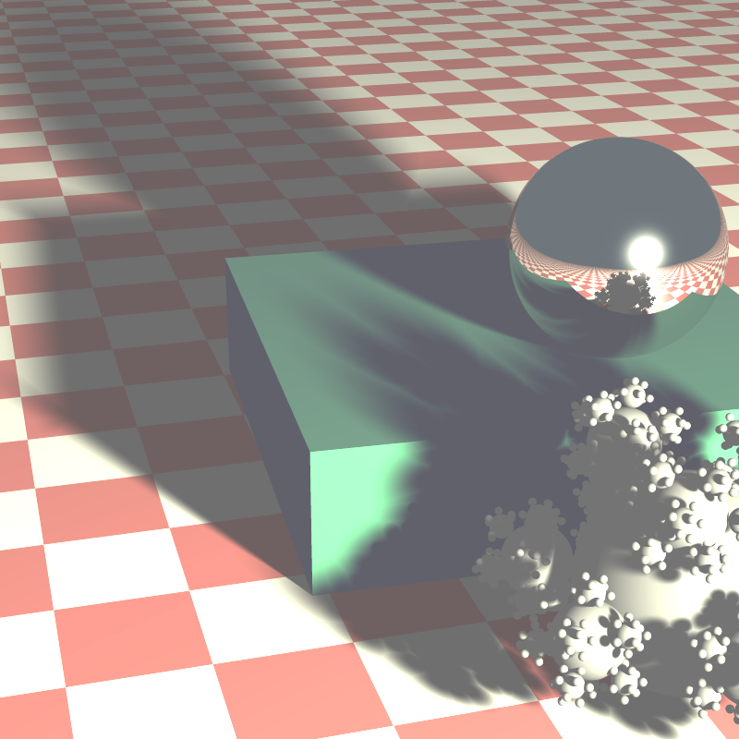
Soft Shadows

Slide 14
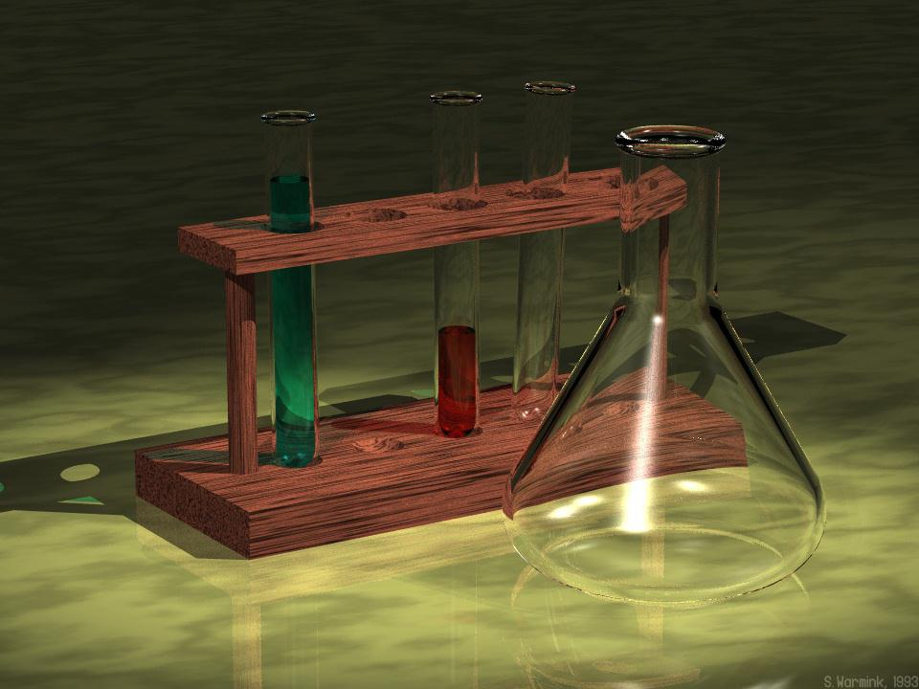

Slide 15
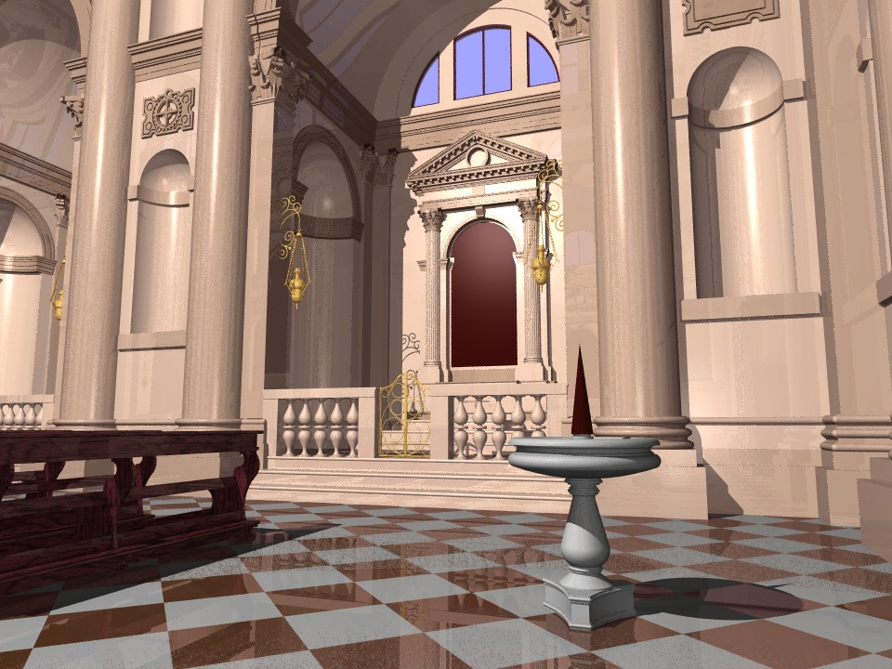

Slide 16
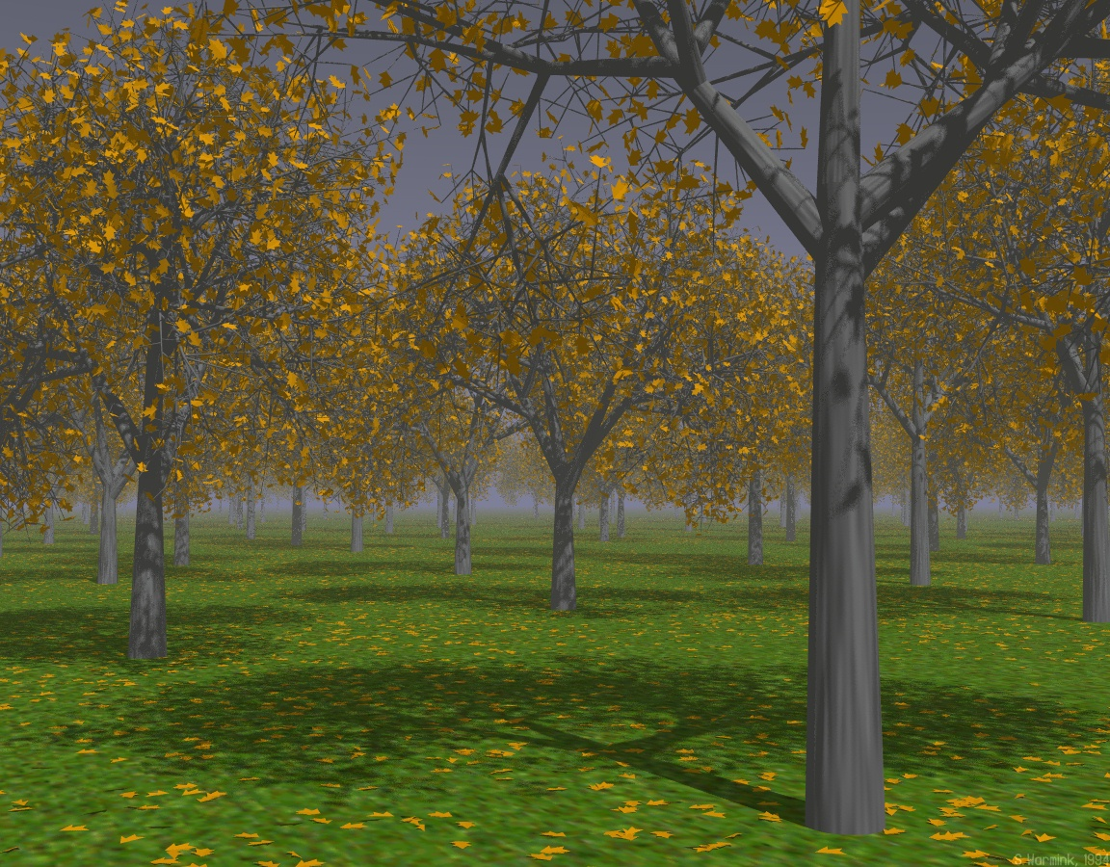

Slide 17
Ray Tracing Definitions
Eye Ray
  Ray from Eyepoint through a pixel on the viewing plane, used to determine visible points
Secondary Ray
  Ray generated from object surface at ray intersection point to gather information about environment effects on the surface
Shadow Ray
  Secondary ray toward a light source to determine if an object occludes light source

Slide 18
So What Is Ray Tracing?
Technique for rasterization
  For each pixel of the viewing plane
    Determine coordinates of pixel center
    Generate eyeray
    Check for intersection with objects
    Determine color at closest intersection
      Color
      Texture
      Shading
      Reflection
      Refraction
    Store color in raster

Slide 19
In More Detail…
Determine coordinates of pixel center
  Simple vector addition
Generate eyeray
  Simple point subtraction
Check for intersection with objects
  Common intersection tests range from 5-7 floating point operations to 15-20 ops for more complex tests (SIGGRAPH website)

Slide 20
The Rest of the Details…
Determine color at closest intersection
  Color: determined from object
  Texture: determined from object and texture
  Shading: generate secondary ray toward light sources
  Reflection: generate secondary ray at reflection angle outward from object
  Refraction: generate secondary ray at refraction angle through object
Combine information using surface’s lighting equation, and store in raster

Slide 21
Benefits of Ray Tracing
Clipping
  Other algorithms need a separate, rather costly, step to clip objects not in scene
  Ray tracing only needs to make sure object is not too near
Accurate reflection and refraction
  Accurately depicts mirrors, lenses, windows, etc.
  Other algorithms approximate reflections and refractions
Can represent any objects for which ray intersections can be determined.

Slide 22
Drawbacks of Ray Tracing
Slow due to many intersection testing operations
  640x480 resolution, objects with 10 ops/test, 3,072,000 ops required per object
    Does not include secondary rays
Not appropriate for most games as real-time rendering through ray tracing is nearly impossible with current techniques and hardware

Slide 23
Speeding Up Ray Tracing
Adaptive Depth Control
  Before a secondary ray is cast, test if its contribution is significant
Bounding Volumes
  Enclose objects and groups of objects in hierarchal spheres or boxes which have easy to compute ray intersections, test bounding objects from top-down to see which objects inside need be tested

Slide 24
Summary
Extremely accurate
  Lighting
  Reflections
  Refractions
  Texturing
Very slow
  Not appropriate for real-time rendering, such as in games
Can represent nearly any object

Slide 25
Recursive Ray Tracing
If an eye ray intersects an object:
  Cast shadow rays to each light source.
    diffuse illumination
    shadows
  Cast reflection ray, search for object intersection.
    ambient illumination
  Cast transmission ray, search for object intersection.
    Transparency
For each new reflection and transmission ray, repeat.
  Until no intersection
  Until N intersections (recursion depth) (3 ≤ N ≤ 7)

Slide 26
Reflection and Transmission
Light Source
R1
S5
R3
S6
Eye
Eye Ray
S3
S1
R2
T1
S2
S – shadow rays to light sources
R – reflection rays
T – transmission rays
S4
Light Source

Slide 27
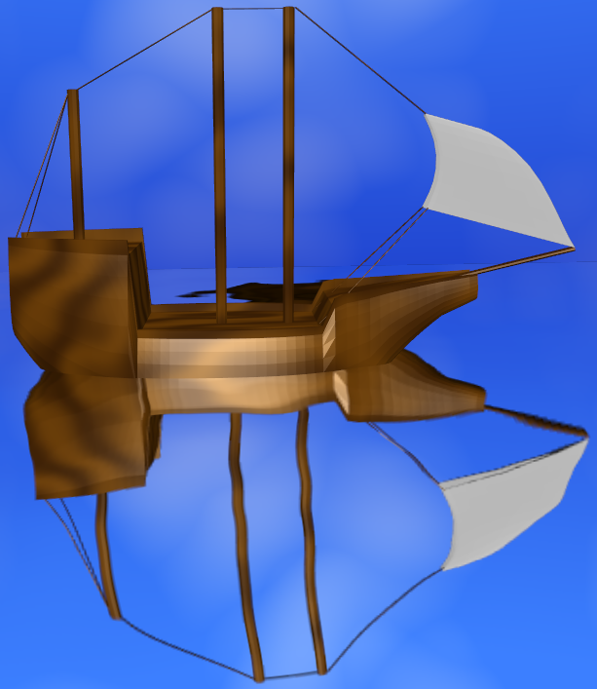
Compare to OpenGL’s Approach
OpenGL uses an environment map for reflections
Environment map assumes object infinitesimally small and reflections infinitely far away
Can simulate reflection from still water
But not wavy water (via bump map)
Boat reflected in wavy water rendered in OpenGL using an environment map
Can you find three things wrong with this picture?
Reflection behind the boat
Environment map magnified
Reflection doesn’t meet boat

Slide 28
Ray Tracing Can Have Problems Too
Ray/object intersection calculations become expensive with complex objects and more objects.
Light from other objects (other than pure reflection) is not modeled.
  Still use the constant ambient light component.
Shadows often appear too sharp
Surfaces can appear too glossy or smooth
Images take a long time to render; must recalculate for each new view
Have to tweak illumination model constants to get desired effects

Slide 29
Interactive Ray Tracing
Long considered an oxymoron or a joke
Has quickly become a generally accepted part of the future of interactive graphics
The big questions:
  Why do interactive ray tracing?
  How to do interactive ray tracing?

Slide 30
Interactive Ray Tracing:
Why do it?
Ray tracing has some definite advantages over traditional “forward” rendering:
  Complex shading
  Big data
  Decoupled sampling
Also disadvantages:
  Less well suited to hardware implementation
  Slow

Slide 31
Interactive Ray Tracing:
Advantages
Complex shading
  Easier to get global illumination effects
    Shadows, indirect illumination, color bleeding
    Reflections, refractions, caustics
  Easier to get lens and film effects
    Motion blur, depth of field
    flare, bloom
  Simpler model for programmable shading
  Flexible primitive definition

Slide 32
Interactive Ray Tracing:
Advantages
Big data
  Time complexity grows logarithmically with number of polygons
  Cliché, attributed (I believe) to Jim Kajiya:
  “For a complex enough scene,
  ray tracing will always be faster”
    Early termination
    Deferred shading
    Overhead (triangles as a vehicle for interpolation)

Slide 33
Interactive Ray Tracing:
Disadvantages
Time complexity grows linearly with the number of pixels
  And there’s a lot of pixels on today’s displays
    We rarely want to render a million polygons at interactive rates
    We often want to render a million pixels at interactive rates
  However, displays are growing more slowly than models

Slide 34
Interactive Ray Tracing:
Disadvantages
Recursive ray tracing is an elegant and simple algorithm
It’s also poorly suited to efficient hardware implementation
  Recursion == bad (in graphics)
  Poor memory coherence (especially for naive depth-first algorithm)

Slide 35
Interactive Ray Tracing:
Disadvantages
As a result there’s no real ray tracing hardware
  Some entrepreneurial stabs
  Some special markets
    Volume-rendering hardware
    Accelerated offline rendering hardware
  But nothing to compare with maturity and size of polygon rendering hardware market

Slide 36
Interactive Ray Tracing:
How
The good news:
  Ray tracing is embarrassingly parallel...
  if you can afford the memory
The bad news:
  The memory access patterns of ray tracing are not very friendly

Slide 37
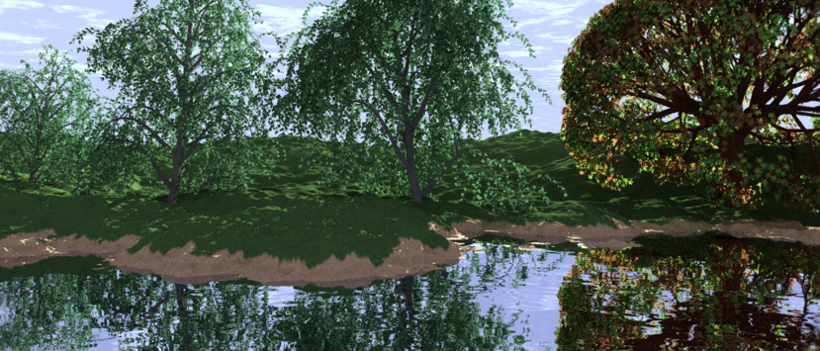
Recursive Ray Tracing:
An Example
Consider recursively traversing rays through a complex scene

Slide 38
Recursive Ray Tracing:
Memory Access
Consider recursively traversing rays through a complex scene
  Overlay an acceleration structure (say, a grid)
  What cells need to be in memory over time?
  How much coherence is there between adjacent pixels?
Lessons:
  Interactive ray tracing requires careful attention to memory coherence
  Naïve parallelization may not help

Slide 39
Brute Force:
Parker et al. (1999)
First true interactive ray tracing system: Parker et al, U. of Utah, 1999
  Brute force…
    Straightforward implementation
      Explicitly traces rays through every pixel
      Simple acceleration structure (uniform grid)
    Careful attention to optimizing system resources
  …on a $2.5 million supercomputer
    64 node SGI Origin “Reality Monster”
    CC-NUMA shared-memory multicomputer
      Fast interconnect
      Fine-grained message passing

Slide 40
Parker et al.
Parker et al demonstrated several advantages of ray tracing:
  Big data
  Sophisticated shading
  Direct rendering of multiple primitives
  Frameless rendering
Other contributions
  A clever soft shadows hack
  A clever ambient lighting hack

Slide 41
Parker et al.
Lessons Learned
A big enough hammer CAN do the job
Careful optimization is important…
  …but computation is often cheaper than communication
  …so optimize memory as well as CPU

Slide 42
Related Work:
Utah
Since then, the Utah group has done research on:
  Ray tracing dynamic scenes: incrementally updating acceleration data structures
  Ray tracing volumes: lots of acceleration techniques for volumes, e.g. MRI data
  A cute trick for improving the appearance of antialiased ray-traced images during motion
See some images and movies at:
http://www.cs.utah.edu/~sparker/images.html

Slide 43
Distributed Computing:
Wald & Slusallek
Ingo Wald, Philip Slusallek: the next big contributors; lots of publications
Basic idea: ray trace on standard PC hardware, scale to clusters
  On dual-PIII 800 MHz, report 1.6-3.6 fps on models from 40K-8M tris
  A cluster of 7 PCs achieves 5-10 fps on the 13 million triangle UNC Powerplant

Slide 44
Related Work:
Wald & Slusallek
Coherence: Restructure ray tracing computation to increase coherence
  “Partial breadth-first evaluation”
  Ray trace small bundles of rays
    Intersect all rays in bundle with every triangle, even if some have already terminated
    Good cache coherence, can use SIMD instructions

Slide 45
Wald & Slusallek
Scalability: use cluster of PCs with client-server architecture
  K-D tree acceleration structure
  Server hands out bundles to be rendered
  Clients cache geometry (not entire scene)
  System tries to allocate ray bundles to clients that already have needed geometry in cache

Slide 46
Designing a Simple Ray Tracer

Slide 47
Basic Ray Tracing:
Two Questions
When we do ray tracing, there are two basic questions that need to be answered repeatedly:
  Given a ray, does it hit an object in the scene, and, if so, which one does it hit first?
  If a ray hits an object, what color do we see when we look along the ray?
Designing code to answer these is an excellent application of object-oriented design principles.

Slide 48
Basic Ray Tracing:
What is a Ray?
A ray is half of a line. It has a starting point and a direction.
To store a ray, we need:
  A starting point: pos.
  A direction vector (unit vector): vec.
It is reasonable to implement a ray as a class.
  For convenience, rays can know how to reflect and refract themselves.

Slide 49
Basic Ray Tracing:
Ray-Object Intersection
The first question that needs to be answered is whether a ray hits any object in the scene.
  To answer this, test the ray against each object in turn.
    This test is called ray-object intersection.
  What class knows how to do this?
    Answer: The object’s class.
  Since every object class needs to be able to do ray-object intersection:
    Write an abstract base class for objects.
    Each object is derived from the base class.
    Ray-object intersection is a virtual function.

Slide 50
Basic Ray Tracing:
What Do Objects Do?
More generally, what do objects need to be able to do?
  Answer: They need to be able to answer the two questions, for themselves.
So, an object has two member functions:
  First, given a ray, test whether the ray hits the object, and, if so, how far from the start of the ray the hit lies.
    How far, so we can tell which hit comes first.
  Second, given a ray that hits the object, tell what color is seen along the ray.
And that is all!
  Except for administrative stuff: constructors, etc.

Slide 51
Basic Ray Tracing:Hits
In practice, to determine the color (question 2), an object needs to know where the ray hit and what the normal is.
These are almost always calculated during the ray-object intersection test (question 1).
Therefore, it is convenient to have a “hit” class. This holds:
  Whether the ray hit the object: bool.
  If so:
    How far along the ray: double.
    Where the hit is: pos.
    The object’s normal vector at this point: vec.
Again, this is not required, but will nearly always speed things up by avoiding repeating a computation.

Slide 52
Basic Ray Tracing:
Class Summary
So, in a simple ray tracer, we have:
  A ray class.
  An object base class.
    Various objects are derived from it.
    Virtual functions for ray-object intersection and color computation.
  A hit class.
This design is easily extended.
  Adding new objects works without changing other code.
  We can add features like multiple rays per pixel, etc.

Slide 53
Intersections
Ray tracing algorithms are dominated by intersection testing and determination
  Need efficient methods to test for intersection
    Does the eye ray or shadow ray intersect an object?
  Need efficient method to calculate intersection points and normal vectors (for lighting calculations).
Ray/Sphere
Ray/Plane
Ray/Polygon

Slide 54
Different Forms of Ray Tracing
Not All Ray Tracers behave the Same

Slide 55
Distributed Ray Tracing
Distributed ray tracing is an elegant technique that tackles many problems at once
  Stochastic ray tracing: distribute rays stochastically (i.e. randomly) across pixel
  Distributed ray tracing: distribute rays stochastically (i.e. randomly) across everything

Slide 56
Distributed Ray Tracing
Distribute rays stochastically across:
  Pixel for antialiasing
  Light source for soft shadows
  Reflection function for soft (glossy) reflections
  Time for motion blur
  Lens for depth of field
16 rays suffice for all of these

Slide 57
Backwards Ray Tracing
Traditional ray tracing traces rays from the eye, through the pixel, off of objects, to the light source
Backwards ray tracing traces rays from the light source, into the scene, into the eye
Why might this be better?

Slide 58
Backwards Ray Tracing
Backwards ray tracing can capture:
  Indirect illumination
  Color bleeding
  Caustics – Defined as “Of or relating to light emitted from a point source and reflected or refracted from a curved surface." (American Heritage Dictionary)
  Examples showing rendering with and without caustics are on the next slide.

Slide 59
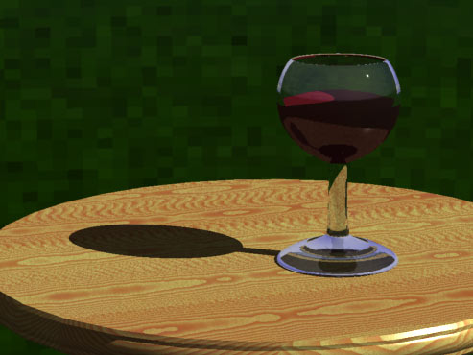
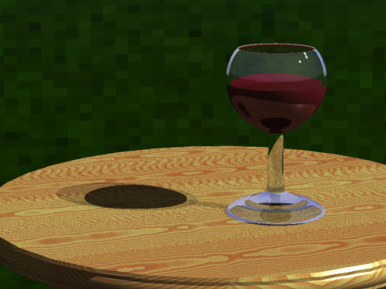
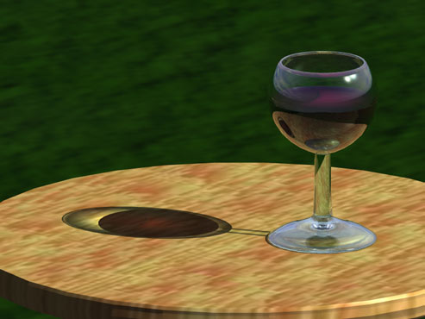
Rendered with no light through
transparency.
There is a solid black shadow.
Rendered with light through
transparency. The shadow is
mostly a uniform gray.
Rendered with caustics. Notice
how the light is concentrated in
the center of the shadow, due to
refraction.

Slide 60
Backwards Ray Tracing
Usually implies two passes:
  Rays are cast from light into scene
  Rays are cast from the eye into scene, picking up illumination showered on the scene from the first pass
Backwards ray tracing accounts for indirect illumination by considering more general paths from light to eye

Slide 61
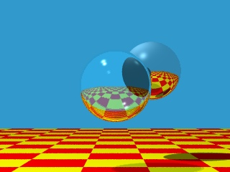
But, Remember- Ray Tracing Does Provide Spectacular Effects!

