Slide 1
Chapter 11
Interactive Input Methods and Graphical User Interfaces

Slide 2
INPUT PHYSICAL DEVICES
Physical devices: Should have read in text (Section 2-4) on features and characteristics of the following (and others)
  2D: mouse, trackball, data tablet, lightpen, joystick, pressure sensors, keyboard
  3D: spaceball, datagloves, laser-based structured lighting, virtual reality sensors
Our main concern here will be with logical input devices and how they can be supported by some of the physical devices.

Slide 3
LOGICAL DEVICES
Logical devices were introduced in GKS and continued in PHIGS.
Viewed as the "collective wisdom" of graphics experts as to what should be supported in a graphics environment in order to do input.
Today the following logical devices are suggested to be provided by graphics APIs:

Slide 4
Standard Logical Input Data Classifications
LOCATOR – Specifies one coordinate position
STROKE – Specifies a set of coordinate positions
STRING – Specifies text input
VALUATOR – Specify a scalar value
CHOICE – Select a menu option
PICK – Select a component of a picture
Some lists include
DIAL- provide analog input

Slide 5
Various Physical Devices Can Provide the Characteristics Needed for the Logical Input Devices
LOCATOR –
  Screen cursor can be positioned and clicked, but usually provides screen coordinates .
  Often want the coordinates to be in world coordinates.
    For example, a mouse click returns (x,y)- a screen coordinate
    Software can convert to world coordinates, although the calculations are not trivial
  Obviously, can also use joystick, mouse, trackball, spaceball, etc.
  Light pens or touch screens are other possibilities.
  Realize, even a keyboard can be used as a locator if the user inputs desired coordinates.

Slide 6
Providing Input Logical Devices
STROKE –
Many of the physical devices used for locator input are also used as stroke devices when continuous movement is performed.
For example, dragging a mouse, trackball, joystick.
The graphics tablet is an excellent example of a stroke input device.
One common approach is to use a button to put input into continuous mode and as the cursor is moved, a stream of coordinates returned to the program.
Paintbrush drawings and engineering systems use this type of input.

Slide 7
Providing Input Logical Devices
STRING –
The primary physical device providing string input is the keyboard.
A stroke device can be used to sketch individual characters which are then recognized by a pattern recognition program.

Slide 8
Providing Input Logical Devices
VALUATOR –
Obviously, a keyboard can be used.
Other possibilities include
  Dials
  Slides
  Buttons
  Menus
  Joysticks, trackballs, tablets that interpret pressures applied as scalars

Slide 9
Providing Input Logical Devices
CHOICE –
Typically select menu options using mouse, trackball, keyboard, touch panel, or buttons.
Keyboard is often used to make selections.
Voice input is used and becoming more accurate.
Can also use Use widgets (menus, scrollbars, graphical buttons) provided by the windowing environment

Slide 10
Providing Input Logical Devices
PICK –when the user picks an object, the identifier of the object is returned to the user program
This is one of the hardest devices to implement
One method of implementing is to click with a mouse and determine with software which object is the closest.
  Again, as with the locator device, the selection is made in screen coordinates and an inverse mapping of the pipeline transformations is needed to go back to world coordinates.

Slide 11
More on Pick
Another technique is to use a pick window which the user positions over the objects so that information for each object in the window can be generated and the user can choose.
Highlighting various objects successively and have the user accept or reject is another technique.
Naming components and providing the user with a list of names from which to choose is another technique although error prone as user may not remember unique names.

Slide 12
Older Graphics Packages and Other APIs Compared to OpenGL and GLUT
Some provided very extensive capabilities for logical devices.
For example, the X-window system has many widgets, buttons, sliders, and dials predefined.
OpenGL was designed to not worry about input.
However, GLUT provides some callback functions that can be used, with programming help, to implement any of the logical input devices.
The GLUT mouse and the keyboard callback functions provide ways of implementing logical input devices to be used in an OpenGL program.

Slide 13
GLUT also supports a spaceball, tablet functions, button-boxes, and dials.
OpenGL does provide menu capabilities which can be useful.
We’ll concentrate now on the mouse, keyboard, and menu capabilities.

Slide 14
ENTITIES DESCRIBING INPUT FROM DEVICES
measure of device- what is returned to a program when the device is activated
trigger of device- signal sent to the computer to do something
input mode- the relationship between the delivery of the measure and the trigger
  request mode- don't deliver measure until trigger occurs
  sample mode- immediate input
  event mode- each trigger places measure in an event queue. It is up to the user program to decide how to handle the events.

Slide 15
Callback Functions
The concepts of trigger and measure are useful also when discussing non-input callback functions.
Let’s explore in more detail some GLUT callback functions which will include some useful ways for implementing logical input devices.

Slide 16
Some Callback Functions In Glut
Display
  glutDisplayFunc (display);
Registers our name choice , display, for the display function in main
Defined as void display () { … }
Triggers: Open the window, uncover by moving a front window off of the window, resize the window
Measure: None

Slide 17
Reshape
glutReshapeFunc(myReshape);
Defined as void myReshape(int w, int h) { … }
w = width of resized window; h = height of it
Trigger: Window is resized ( It overrides Display for this event)
Measure: Returns the width and height in pixel to the program and passes them to the myReshape function as parameters w and h.

Slide 18
Mouse
glutMouseFunc (mymouse);
Trigger: Mouse event---one or more mouse buttons are depressed or released
Measure: Which button was involved, state of button (up or down) after the event, screen coordinates of mouse position
Definition:
void mymouse
(int button, //ex. GLUT_LEFT_BUTTON
int state, //ex. GLUT_DOWN
int x, int y); //screen coordinates

Slide 19
EXAMPLE:
if (button == GLUT_LEFT_BUTTON &&
state == GLUT_DOWN) exit(0);
//note parameter for exit
if (button == RIGHT_BUTTON &&
state == GLUT_DOWN) drawSquare(x,y); //need to define drawSquare obviously

Slide 20
Keyboard
glutKeyboardFunc (myKeyboard);
Trigger: Mouse is in window and key is depressed
Measures: ASCII code of depressed key and (x,y), the screen coordinates of the mouse location
Definition form:
void myKeyboard
(unsigned char key, //ASCII code int x, int y) //mouse location

Slide 21
Other Useful Callbacks
Some other useful callbacks (for the full range see GLUT site although some like a spaceball won't be particularly useful):
glutMotionFunc (drawSquare);
  Invoked when a mouse motion is detected by dragging the mouse
glutIdleFunc (myIdle);
Invoked when no events are happening
Often used to refresh something like a clock or to toggle between two states
We'll see some examples of this

Slide 22
Note That Interaction Can Be Tricky!
Normally the display function should handle the non-interactive output, at least initially.
If you change output, you need to hang onto the changes for window displays.
For example, if we write a program to print a square every time a mouse button is clicked,
  If we don't hang onto all of the positions, we can't reconstruct the entire sequence, only the current event.
  We will see how this is can be done shortly, but think about what is needed --- a data structure to record all the positions.

Slide 23
EXAMPLE: Demo of Stroking stroke.c
A window is cleared to black on every reshape call, which will include the initial display.
Each time the left button of the mouse is depressed and dragged,a sequence of squares, randomly filled with color, is drawn. Releasing the button stops output.
The right button of the mouse exits the program.
You can program these two buttons to trigger any actions you wish.

Slide 24
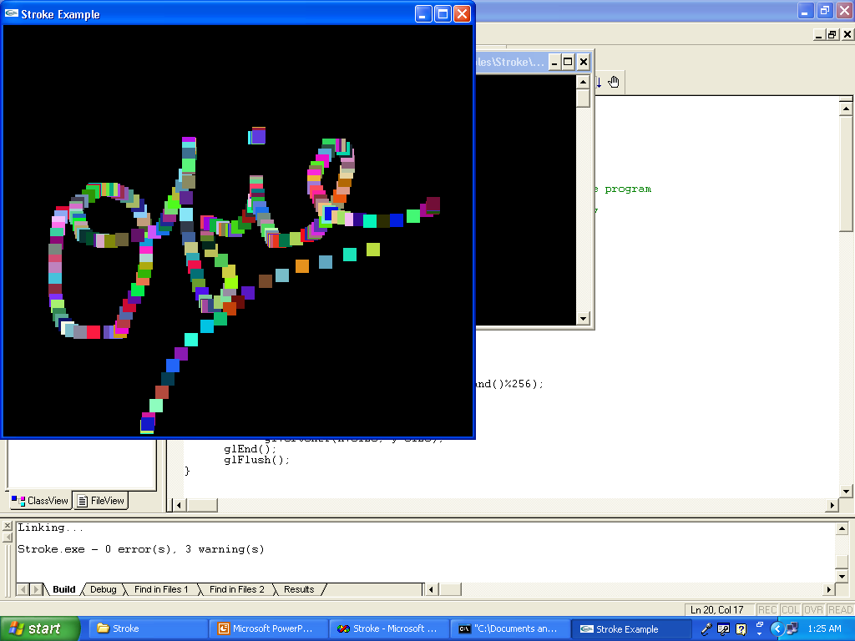
Sample Output From Stroke.c

Slide 25
Globals for Stroke.c
Normally we discourage the use of globals in a program, but in graphics we often use them to save parameter passing.
GLsizei wh = 500, ww=500;
pixel count with predefined global of initial window size
GLfloat size = 8.0
length of side of square to draw will be 16 pixels ---i.e. this is half the side

Slide 26
From Stroke.c
drawSquare(int x, int y)
    (x,y) is the center of the square to draw
    The function will be registered as a glutMotionFunc for the mouse and (x,y) will be the screen coordinates of the mouse when clicked and then moved
    y = wh -y; //flips from screen coordinates to //OpenGL coordinates
+x
⎨
wh
OpenGL
+y
screen

Slide 27
More Comments on Code in Stroke.c
glColor3ub( rand() % 256, …);
  Uses discrete values between 0 and 255 instead of intensities as with glColor3f. Just a variation.
Recall that GL_POLYGON fills
myReshape- just clears the window by setting everything to black. The clipping window and viewport are set to the same size.
myinit-
  Not a callback function
  Sets viewport, clipping window, and color
mouse-
  Should be obvious; note the parameter in exit--- exit(0)

Slide 28
Stroke.c
display-
  needed by GLUT 3.0+
  doesn't do anything except keep GLUT happy
main-
  standard stuff by now
    command line information, needed even if don't use
    single buffering and RGB color
    create window with a title
    call initialization routine
    register callbacks: reshape, mouse, motion, display
    start event loop

Slide 29
Now Illustrate Some Other Input Methods
Develop a simple painting program.
Given a choice of various shapes such as a line, triangle, etc. allow the user to select the shape by clicking with a mouse and then clicking in the drawing window to draw the shape.
Attribute changes such as color, size, etc. will be handled by menu choices.
Program is paint.c

Slide 30
MENUS
Most windowing systems provide a toolkit allowing the construction of widgets-
  slide bars
  dials
  buttons
  menus
GLUT directly supports only menus from the above --- i.e. to get the others, you have to create your own or use the the window-specific widgets of the operating system being used.
Menus act as CHOICE logical devices.
Next we’ll see how to implement menus in GLUT.

Slide 31
MENUS
Easy to define ---usually in main
Register the menu callback function with an int id
    c_menu = glutCreateMenu(myMenu);
Define entries in menu- All subsequent adds are assigned to the menu just created. The adds terminate with the attach command shown below or a new registration. (We'll see in a minute why this approach is taken).
    glutAddMenuEntry("Quit", 1);
    glutAddMenuEntry("Increase size", 2);
Link menu to a specific button
    glutAttachMenu(GLUT_RIGHT_BUTTON);

Slide 32
MENUS
Define a menu callback function:
void myMenu (int id)
{ if (id == 1) exit(0); //menu said "Quit"
else if (id == 2) size = 2* size;
//menu said "Increase size"
…
glutPostRedisplay(); //request a redisplay //event so the display function will be //called
It is easy to create hierarchical menus, but you need to plan carefully, especially if you have only two buttons for the mouse.

Slide 33
SUBMENUS
Suppose we've defined two menus:
c_menu = glutCreateMenu(color_menu);
glutAddMenuEntry("red", 1);
glutAddMenuEntry("green",2);
…
square_menu = glutCreateMenu(square_menu);
glutAddMenuEntry("increase square size",1);
glutAddMenuEntry("decrease square size", 2);
and attached both to right button:
glutAttachMenu(GLUT_RIGHT_BUTTON);

Slide 34
Submenus
Now we can make both come off of another menu with another button.
glutAddSubMenu("Colors", c_menu);
glutAddSubMenu(“Square size", square_menu);
glutAttachMenu(GLUT_LEFT_BUTTON);
THE ORDERING OF THE COMMANDS IS IMPORTANT!

Slide 35
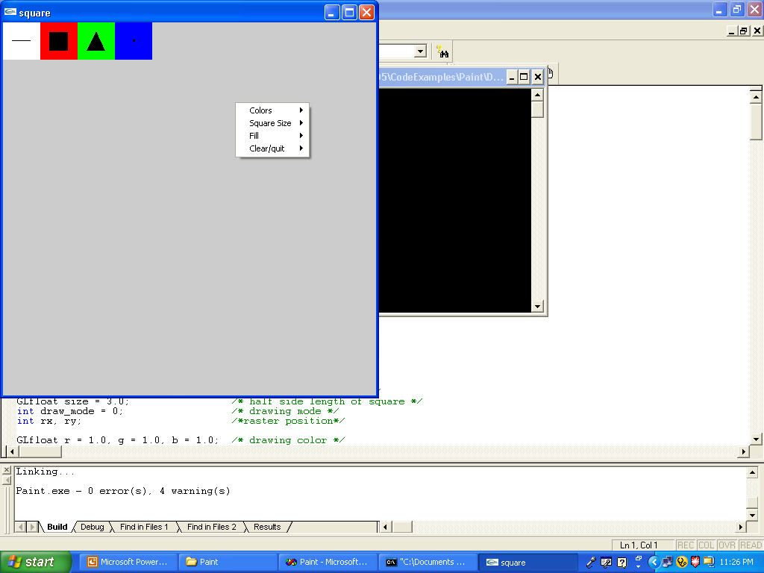
Paint.c’s Top Menu

Slide 36
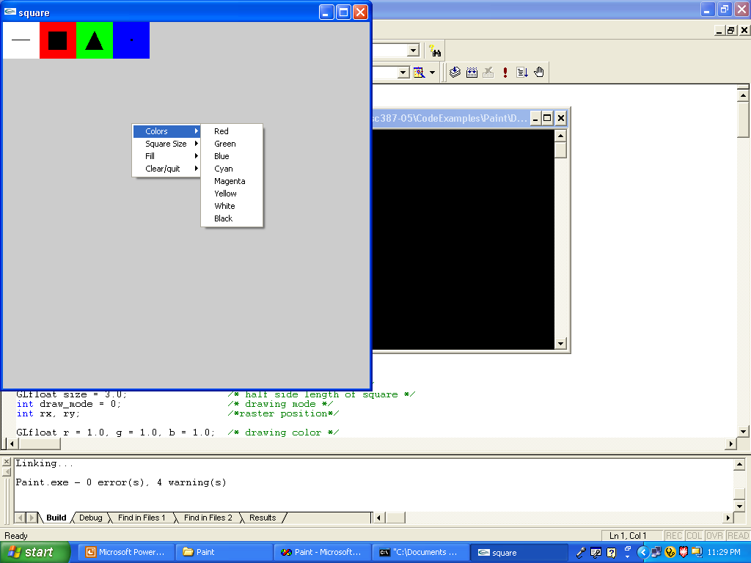
Paint.c – one of the Sub Menus

Slide 37
PICKING
In 3D work, this is harder as you have to map (backwards) from screen coordinates to world coordinates in order to identify an object.
In 2D world, often can use the mouse easily as a pick device by determining if the mouse has been clicked in the extent (or bounding rectangle) of an object.
extent- the smallest rectangle aligned with the coordinate axes that contains an object.
Normally an application program maintains a simple data structure to relate objects and their extents.
Note: This can be done in 3D also where a bounding box is used. The extent can be used for collision detection when animating objects.

Slide 38
Paint.c Uses Picking to S3lect the Shape to Draw
Initial screen with 4 pick areas:
Choose to draw line, box, triangle, or randomly colored boxes by clicking in the box which is labeled. Then ..
Line: 2 clicks
Box: 2 clicks on diagonal
Triangle: 3 clicks
Random boxes: any number of clicks

Slide 39
The Menus Act as Choice Devices
Menus are used to select:
drawing color
fill or not
increase or decrease square size
If resize, the screen is cleared.

Slide 40
Look at the code for Paint.c which is on the website.
Paint.c uses menus and submenus to choose
colors
the size to draw multiple squares
whether to fill or not
whether to clear the window or quit
Mouse clicks are used to pick which object should be drawn.

Slide 41
Keyboard – Useful to combine with menus
glutKeyboardFunc (myKeyboard);
Trigger: Mouse is in window and key is depressed
Measures: ASCII code of depressed key and (x,y), the screen coordinates of the mouse location
Definition form:
void myKeyboard
(unsigned char key, //ASCII code int x, int y) //mouse location

Slide 42
In KeyPaint.c, the color is selected by a key
void key(unsigned char k, int xx, int yy) //keys set the colors
{ switch (k)
{ case 'r': case 'R':
r = 1.0; g = 0.0; b = 0.0; //red
break;
case 'g': case 'G':
r = 0.0; g = 1.0; b = 0.0; //green
break;
case 'b': case 'B':
r = 0.0; g = 0.0; b = 1.0; //blue
break;
case 'c': case 'C':
r = 0.0; g = 1.0; b = 1.0; //cyan
break;
...
default: //use white as a default value
r = 1.0; g = 1.0; b = 1.0;
}
}

Slide 43
We are Using the Keyboard as a Choice Device
To do this, you will need to provide the user with instructions. How does the user know the hit ‘r’ for red?
Note, however, we are in a graphics window provided by the operating system's windowing system as requested by GLUT.
We are not in a normal console window where text requested by the executing C (or C++) program would be placed.
Thus, to write in the graphics window we need to have GLUT do the writing. The usual output functions of C or C++ won’t work properly.

Slide 44
Look at the code for KeyPaint.c which is on the website.
Paint.c uses menus and submenus to choose
the size to draw multiple squares
whether to fill or not
whether to clear the window or quit
Color selection is made by pressing a key
Mouse clicks are used to pick which object should be drawn.

Slide 45
at the cursor location whenever the left button

Slide 46
PROGRAMMING ASSIGNMENT #2
Write an OpenGl and GLUT program that opens a graphics window and clears it to white
Allow the user to draw by clicking with a mouse at the location
1) a 5-pointed star
2) A simple hut
3) Line segment (requiring 2 clicks)

Slide 47
PROGRAMMING ASSIGNMENT #2 (Con’t)
Allow the following attributes to be changed: (Lookup in the OpenGL documentation if not introduced here)
http://www.mevis.de/~uwe/opengl/
  Drawing color (one of 6 choices – your choice)
  Background color (one of 6 choices – your choice)
  Fill or not polygons in figures – be careful. Remember what I said about convexity!
  Increase or decrease line drawing width
  Perhaps choose a stipple pattern for drawing
  Any others you might decide to use

Slide 48
PROGRAMMING ASSIGNMENT #2 (Con’t)
Do not just mimic the Paint.c or the KeyPaint.c programs.
Allow for both
  menu and submenu selections
  choices made by key selections
and, of course, selecting where to draw by mouse clicks.
Organize what you plan to do before coding!
Provide with your code a short description of what the user needs to know to run your program.

Slide 49
PROGRAMMING ASSIGNMENT #2 (Con’t)
Code should be commented and your own work.
When you have testing successfully, prepare screen shots that show that the various options work correctly and drop them into a word processor document with comments about options shown. Send to cpscgrader@hiram.edu your source code and your word processor file.
You should be able to complete this in a week so this will be due Wednesday, Feb 2, at 11:59pm.

