Slide 1
Chapter 6
Under the Hood
The 2D Viewing Pipeline

Slide 2
Overview of Algorithms Considered
The 2D viewing pipeline – Section 6-1
The clipping window – Section 6-2
Normalization and viewport transformations – Section 6-3
Clipping algorithms –Section 6-5
2D point clipping – Section 6-6
2D Line Clipping – Section 6-7
(Cohen-Sutherland only in detail. Others in overview only.)

Slide 3
The Clipping Window
The section of a 2D scene selected for display is called a clipping window because all parts outside of it are “clipped” away.
Sometimes it is called the world window or the viewing window.
At one time, it was just called “the window”, but then operating systems starting referring to windows and the term was changed in graphics to the clipping window.

Slide 4
The Viewport
The section of a display window where scene is to be mapped is called a viewport.
The clipping window selects what we want to see; the viewport indicates where it is to be viewed on the output device.
Multiple viewports can be used to display different parts of a scene.
Although we didn’t look at multiple viewports, they are supported in OpenGL.

Slide 5
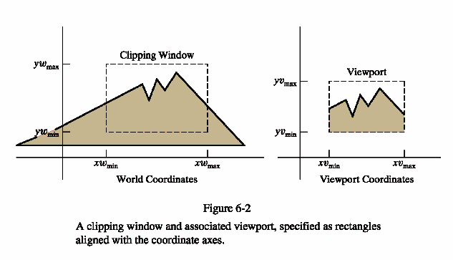

Slide 6
The Window to Viewport Mapping
Mapping a 2D, world-coordinate scene to device coordinates is called a 2D viewing transformation (or the window-viewport transformation or the windowing transformation.)
Although we are mainly interested in the pipeline for 3D scenes, the part we will do here will provide us with some of the background needed for the 3D work.

Slide 7
The 2D Viewing-Transformation Pipeline
World coordinate scene constructed from modeling coordinates
World coordinates converted to viewing coordinates
MC
WC
VC
NC
DC
Viewing coordinates converted to normalized coordinates
Map normalized coordinates to device coordinates

Slide 8
Clipping Window Characteristics
Technically, they can be of any size, shape, or orientation.
However, as you might suspect, clipping using a concave polygon as a clipping window or using nonlinear boundaries for the clipping window adds quite a bit of overhead to the process.
Consequently, most graphics packages support only clipping to a rectangle with the sides parallel to the x and y axis.
Any other clipping must be programmer implemented.

Slide 9
Specifying the Clipping Window and Viewport
In most graphics packages, it is specified in world coordinates.
A variety of approaches can be followed:
1) Define clipping window and the viewport in world coordinates.
  Choose an origin in the scene to display and a view up vector
  (or, alternately, an angle formed with the x or y axis)
  Define a rectangular clipping window in world coordinates.
  Using 2D transformations which are 3 X 3 matrices, translate the scene to the world origin and rotate the scene until the clipping window is aligned with the axis.
  Clip to the clipping window.

Slide 10
Specifying the Clipping Window and Viewport
2) Define the clipping window in world coordinates and the viewport in normalized coordinates.
A normalized window is a square window in the range 0.0 to 1.0.
  This approcach combines the normalization and window-to-viewport transformations
  Clipping can take place in either world coordinates or viewport coordinates.
  After clipping, the unit square containing the viewport is mapped to the output display device.

Slide 11
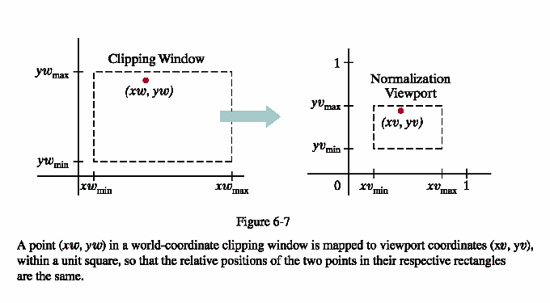
Approach 2
Scale the clipping window to the size of the viewport using a fixed point position of (xw_{min}, yw_{min})
Translate (xw_{min},yw_{min}) to (xv_{min},yv_{min})
The matrices are given on page 303.

Slide 12
Specifying the Clipping Window and Viewport
3) The viewport boundaries are specified in screen coordinates relative to the display-window position.
  Normalization and clipping is applied before the viewport transformation.
  Transfer the clipping window into a normalized square.
  Clip in normalized coordinates.
  Transfer the scene to the viewport.

Slide 13
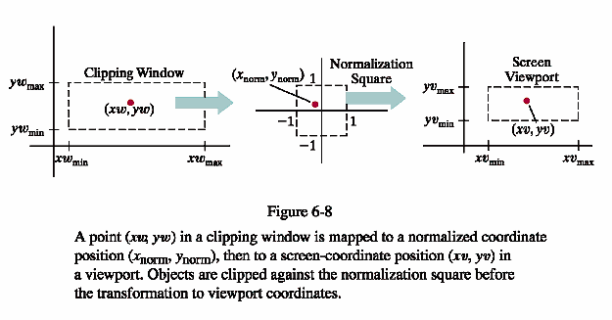
Approach 3
This has the advantage that everything outside of the normalized coordinates ± 1 are detected and removed from the scene.

Slide 14
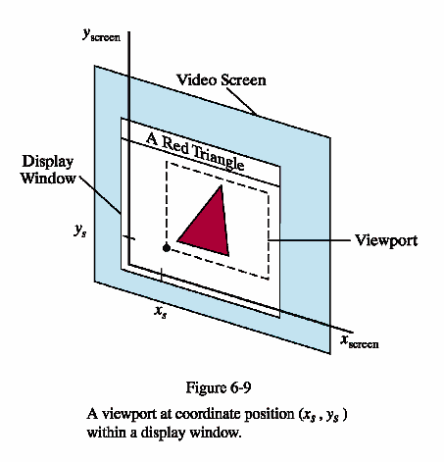

Slide 15
Clipping Objects

Slide 16
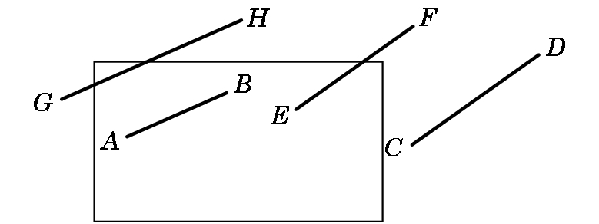
Line-Segment Clipping
Task: Decide which primitives will appear on the display
Clipping relationship between primitive and view volume:
  Accept if fits entirely inside
  Reject (cull) if falls entirely outside
  Clip if crosses the boundary

Slide 17
Placing Clipping in the Pipeline:
  Many possibilities –
    during modeling,
    in 3-D before projection,
    in 2-D after projection
  OpenGL clips in 3-D Normalized Device Coordinates before a final orthographic projection

Slide 18
Clipping Algorithms
Again, the wrong way to do this is the first way you would think to do it manually:
Calculate the equations for each line
Calculate the intersection with the window
Problems:
  Costly to do the calculations
  There are floating point number intersections

Slide 19
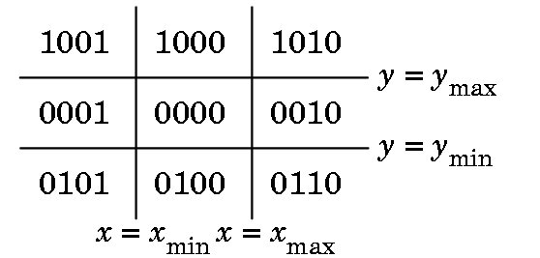
Cohen-Sutherland Clipping
Motivation:
  Many line segments can be trivially accepted/rejected. Want to avoid intersection calculation in these cases
  Seek to replace FP division with FP subs and bit ops
  Create algorithm extensible to 3-D
  We define outcodes for each region of the plane:

Slide 20
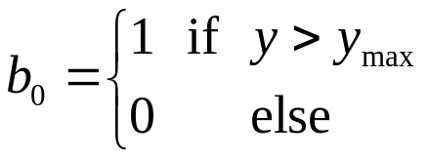
Cohen-Sutherland Clipping
Outcode:
  Extend clipping edges to divide space in and around the clipping rectangle into nine regions
  Each region has a unique 4-bit binary number o = b₀b₁b₂b₃
  If P = (x,y) then
  Likewise b₁ is y < y_{min}, b₂ is x > x_{max}, b₃ is x < x_{min}

Slide 21
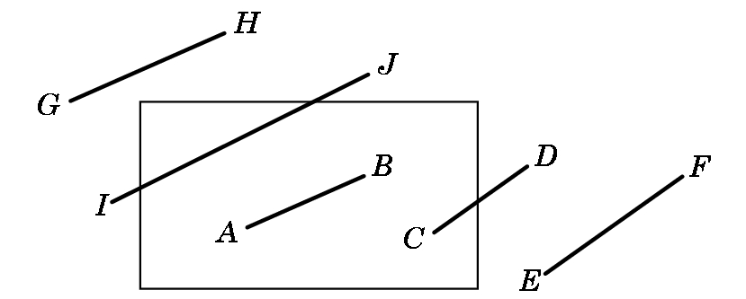
Cohen-Sutherland Clipping
Exercise: What are the outcodes for these points?
  A = 0000; B = 0000
  C = 0000; D = 0010
  E = 0010; F = 0010
  G = 1001; H = 1000
  I = 0001; J = 1000

Slide 22
Case 1
Cases (line segment with endpoint outcodes o₁, o₂):
  (o₁ = o₂ = 0) Both endpoints inside the window and no clipping occurs.

Slide 23
Case 2
  (o₁ ≠ 0, o₂ = 0; or vice versa) One endpoint inside, the other out. Nonzero outcode indicates endpoint that will require shortening of the line

Slide 24
Case 3
  (o₁ && o₂ ≠ 0) Do bitwise AND. If nonzero, both endpoints lie outside the same side → discard

Slide 25
Case 4
  (o₁ && o₂ = 0) Both endpoints outside but on different clipping edges. Cannot tell from outcodes alone whether to shorten or discard

Slide 26
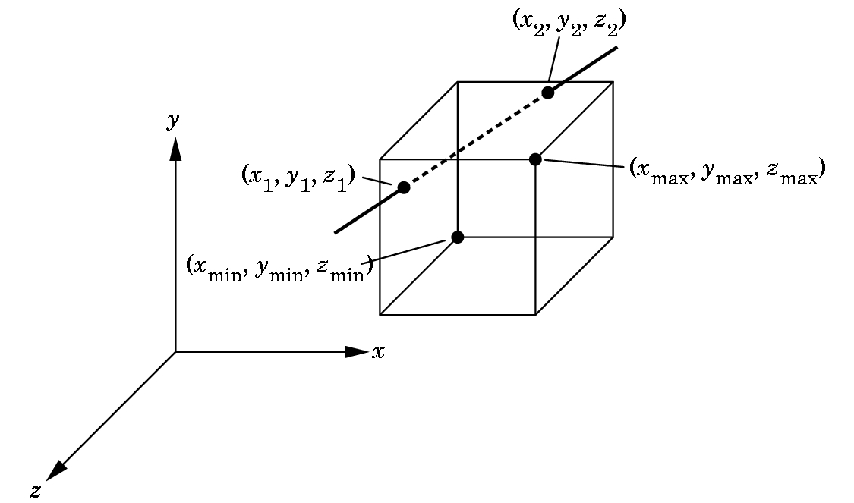
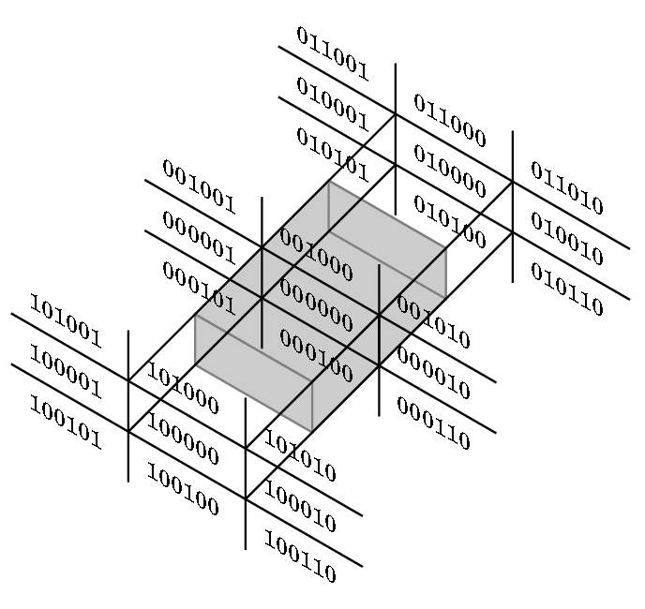
Clipping in 3-D
Clipping against a 3-D bounding volume rather than a 2-D bounding region
Cohen-Sutherland 2D clipping extends to 3-D
Perspective Viewing:
  Clip against the view frustum
  BUT, easier to clip against a parallelepiped aligned with the axes
  OpenGL: project to normalized orthographic view then clip
  Lesson: in pipelining, always consider the process as a whole

