Slide 1
CPSC 387:GRAPHICS
12 Week, Spring, 2005
http://cs.hiram.edu/~obie/cs387-05
obie@hiram.edu
Office: C-111

Slide 2
Administrative Details
20% ---Test 1- take home
20% ---Test 2- during finals time – take home
20% ---Pop quizzes- unannounced, short, designed to test terminology and basic concepts soon after they are presented in class
40% ---Programming exercises, homework exercises, in class exercise participation, and outside readings tp be discussed in class

Slide 3
TEXTBOOK
Computer Graphics with OpenGL (3rd edition), Donald Hearn and M. Pauline Bake r, Pearson/Prentice Hall, 2004.
Authors are with the Computer Science Department and Pervasive Technology Lab for Visualization and Interactive Spaces
Indiana University-Purdue University

Slide 4
INTRODUCTION TO GRAPHICS
An Overview of the Course
Part 1

Slide 5
Part 1: Introduction
  What is Computer Graphics?
  Application Areas
  History of Graphics
  Basics of Image Formation

Slide 6
Objectives
We explore what computer graphics is about and survey some application areas
But, we start with a historical introduction as that will provide us with some background terminology.

Slide 7
Computer Graphics
Computer graphics deals with all aspects of creating images with a computer
Hardware
  Software
  Applications

Slide 8
COMPUTER IMAGING
Deals with manipulating images with a computer after they have been input by some means --- digital camera, scanner, video camera etc.
Computer Vision techniques attempt to provide meaning to computer images.
Note: Many movies today use both graphics and imaging to achieve special effects.

Slide 9

Example
Where did this image come from?
What hardware/software did we need to produce it?

Slide 10
Preliminary Answer
Application: The object is an artist’s rendition of the sun for an animation to be shown in a domed environment (planetarium)
Software: Maya for modeling and rendering but Maya is built on top of OpenGL
Hardware: PC with graphics cards for modeling and rendering

Slide 11
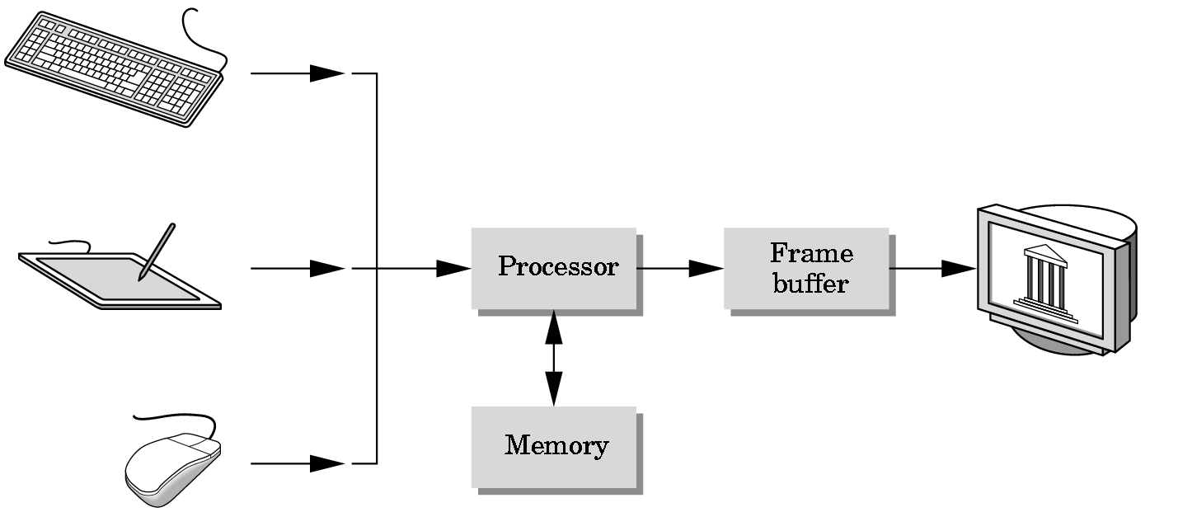
Basic Graphics System
Output device
Input devices
Image formed in Frame Buffer

Slide 12
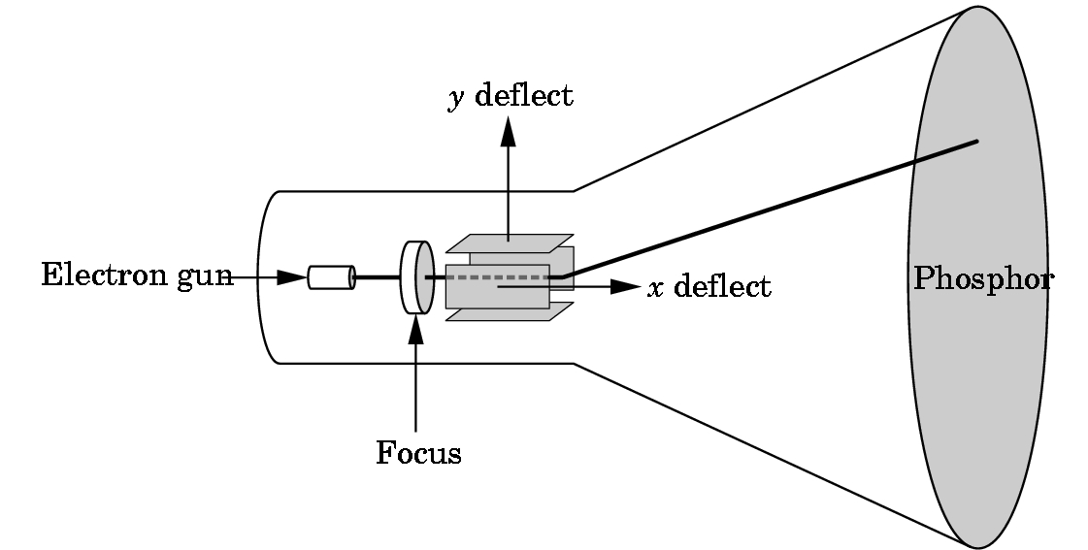
CRT
Can be used either as a line-drawing device (calligraphic) or to display contents of frame buffer (raster mode)

Slide 13
Computer Graphics:
1950-1960
Computer graphics goes back to the earliest days of computing
  Strip charts
  Pen plotters
  Simple displays using A/D converters to go from the computer to calligraphic CRT
Cost of refresh for CRT too high
  Computers slow, expensive, unreliable

Slide 14
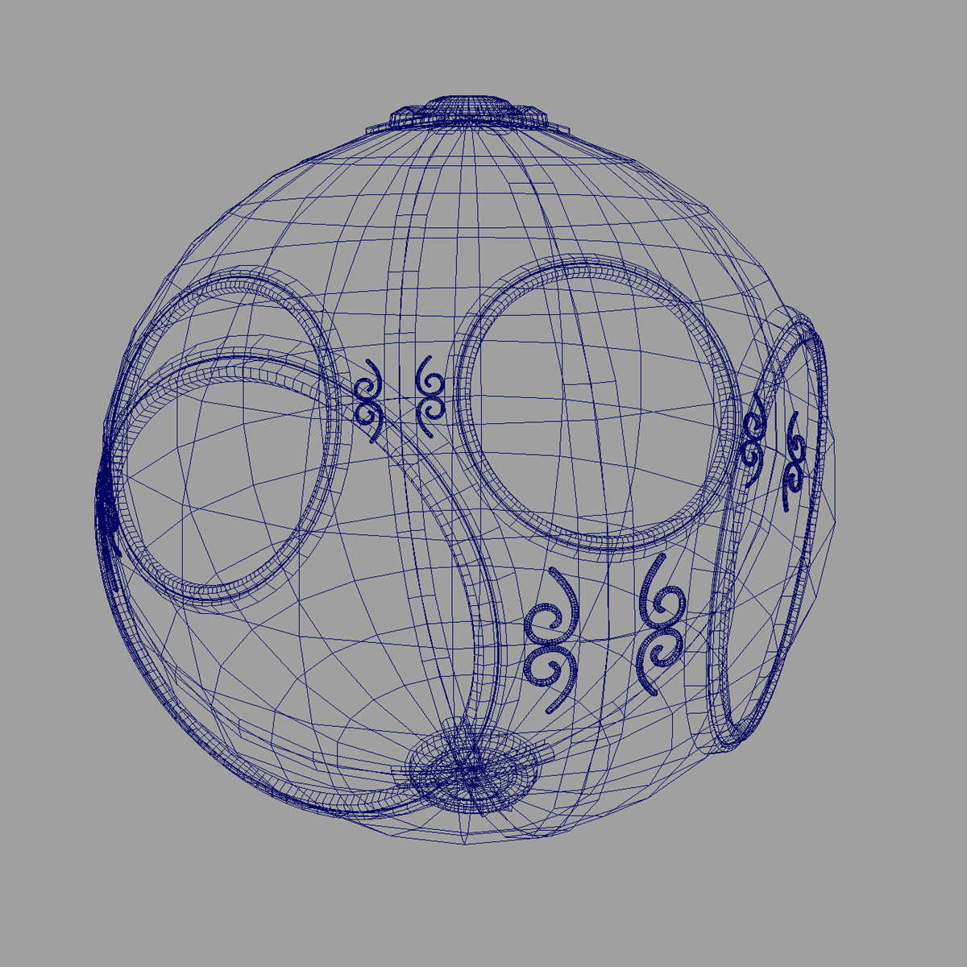
Computer Graphics:
1960-1970
Wireframe graphics
Project Sketchpad with I. Sutherland
Display Processors
Storage tubes

Slide 15
Project Sketchpad
Ivan Sutherland’s PhD thesis at MIT
  Recognized the potential of human-machine interaction
  Loop
    Display something
    User moves light pen
    Computer generates new display
  Sutherland also created many of the now common algorithms for computer graphics

Slide 16
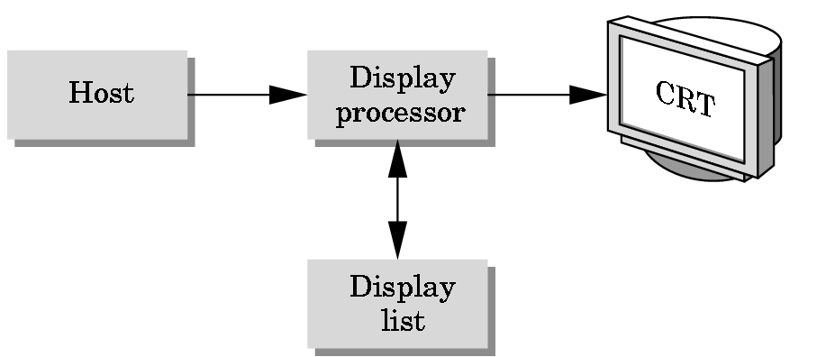
Display Processor
Rather than have a host computer try to refresh a display, use a special purpose computer called a display processor (DPU)
The graphics is stored in a display list (display file) on the display processor
The host compiles the display list and sends it to the DPU

Slide 17
Direct View Storage Tube
Created by Tektronix
  Did not require constant refresh
  Standard interface to computers
    Allowed for standard software
    Plot3D in Fortran
  Relatively inexpensive
    Opened the door to use computer graphics for the CAD/CAM community

Slide 18
Computer Graphics:
1970-1980
Raster Graphics
Beginning of graphics standards
  IFIPS
    GKS: European effort
      Becomes ISO 2D standard
    Core: North American effort
      3D but failed to become ISO standard
Workstations and PCs

Slide 19
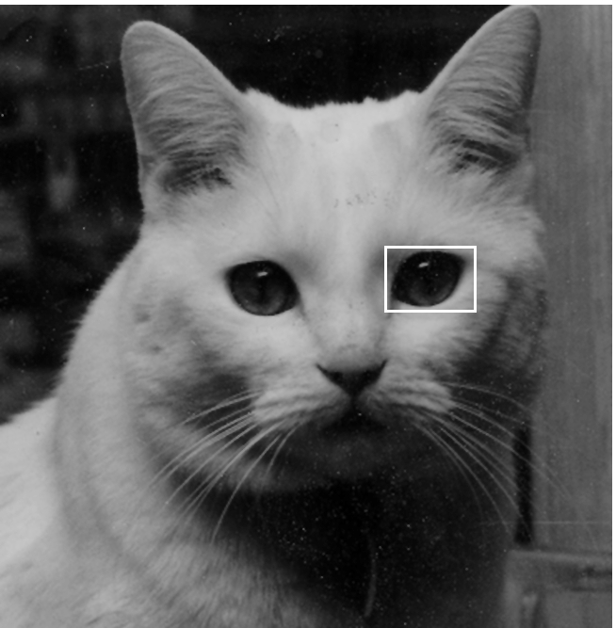
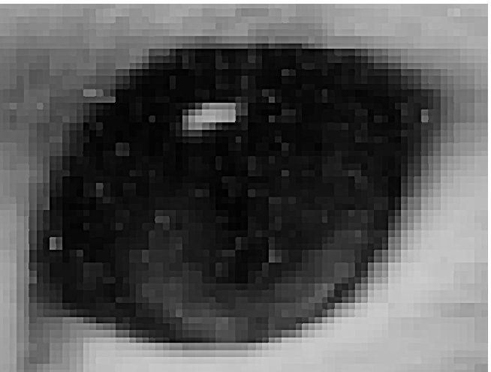
Raster Graphics
Image produced as an array (the raster) of picture elements (pixels) in the frame buffer

Slide 20
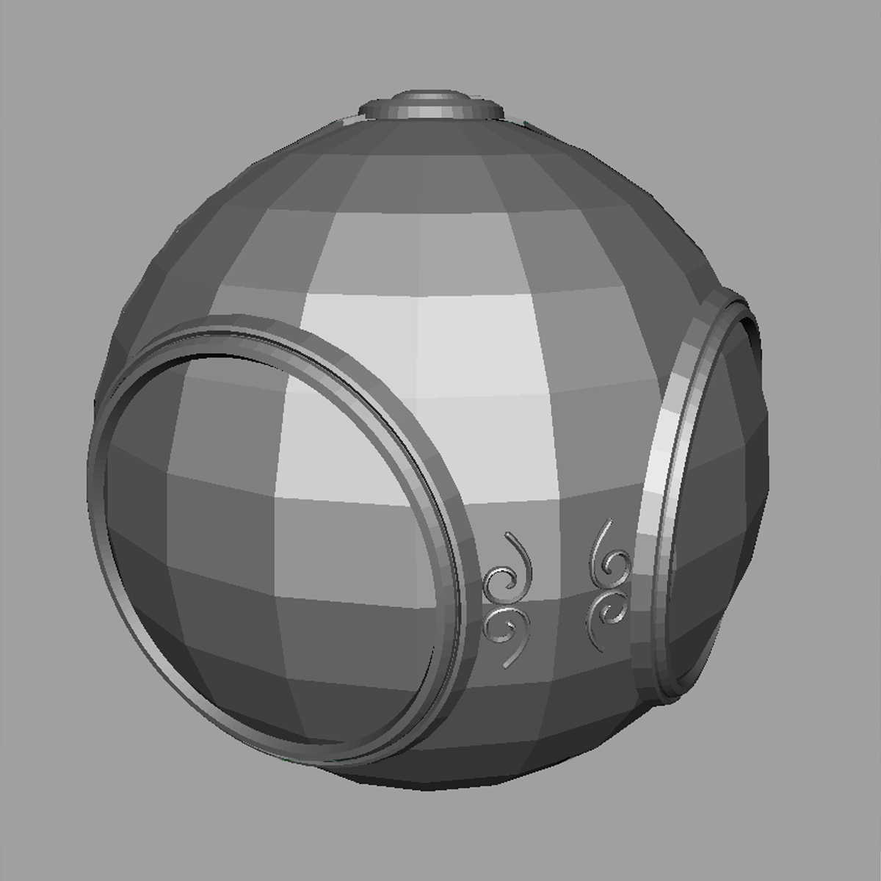
Raster Graphics
Allow us to go from lines and wireframes to filled polygons

Slide 21
PCs and Workstations
Although we no longer make the distinction between workstations and PCs, historically they evolved from different roots
  Early workstations were characterized by
    Networked connection: client-server
    High-level of interactivity
  Early PCs included the frame buffer as part of the user’s memory

Slide 22



Computer Graphics:
1980-1990
Realism comes to computer graphics
smooth shading
environmental
mapping
bump mapping

Slide 23
Computer Graphics:
1980-1990
Special purpose hardware
  Silicon Graphics geometry engine
    VLSI implementation of graphics pipeline
Industry-based standards emerged
  PHIGS
  RenderMan
Networked graphics: X Window System
Human-Computer Interface (HCI)

Slide 24
Computer Graphics:
1990-2000
OpenGL API – see definition next slide
Completely computer-generated feature-length movies (Toy Story) are successful
New hardware capabilities
  Texture mapping
  Blending
  Accumulation, stencil buffer

Slide 25
APIs
Application program interface, a set of routines, protocols, and tools for building software applications.
A good API makes it easier to develop a program by providing all the building blocks.
A programmer puts the blocks together.
Most operating environments, such as MS-Windows, provide an API so that programmers can write applications consistent with the operating environment.

Slide 26
Computer Graphics:
2000-
Photorealism
Graphics cards for PCs dominate market
Game boxes and game players push the market
Use of computer graphics software becomes routine in movie industry: Maya, Lightwave (Bryce is not used in the industry, but it shares many features with Maya and Lightwave.)

Slide 27
What This Course Will Not Do
We will not do any image generating with pre-built software such as Maya, Lightwave, or Bryce.
Those programs will allow you to produce more spectacular images faster than the approach we will take.
However, as computer scientists doing graphics, you may be called upon to generate some images by programming the image generation as existing software can not handle what is desired!
Example:
    The vines in Time Machine
    The horses in Fellowship of the Ring

Slide 28
What the Course Will Stress
The image formation process used by different approaches to graphics.
The typical algorithms used to generate images on the screen.
How modeling is performed.
How objects are represented internally.
Various methods for rendering.
Color generation.
Animation techniques.

Slide 29
Objectives of Image Formation
Look at the fundamental imaging notions
Consider the physical basis for image formation
  Light
  Color
  Perception
Introduce the synthetic camera model
Survey other models

Slide 30
Image Formation
In computer graphics, we form images which are generally two dimensional using a process analogous to how images are formed by physical imaging systems
  Cameras
  Microscopes
  Telescopes
  Human visual system

Slide 31
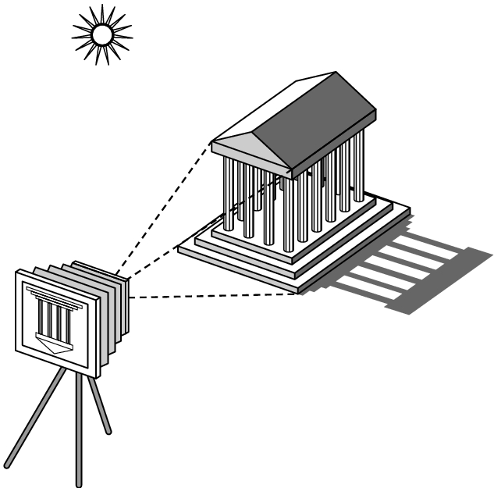
Elements of Image Formation
Objects
Viewer
Light source(s)
Attributes that govern how light interacts with the materials in the scene
Note the independence of the objects, viewer, and light source(s)

Slide 32
Light
Light is the part of the electromagnetic spectrum that causes a reaction in our visual systems
Generally these are wavelengths in the range of about 350-750 nm (nanometers)
Long wavelengths appear as reds and short wavelengths as blues

Slide 33
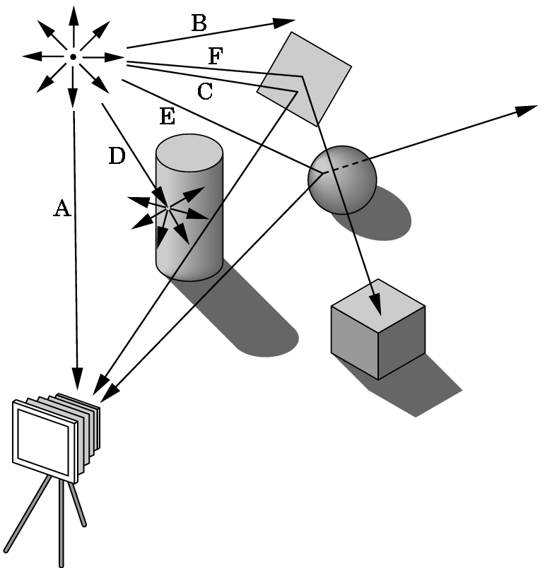
Ray Tracing and Geometric Optics
One way to form an image is to
follow rays of light from a
point source and determine
which rays enter the lens of
the camera.
However, each ray of light
may have multiple interactions
with objects before being absorbed
or going to infinity.

Slide 34
Luminance and Color Images
Luminance
  Monochromatic
  Values are gray levels
  Analogous to working with black and white film or television
Color
  Has perceptional attributes of hue, saturation, and lightness
  Do we have to match every frequency in visible spectrum? No!

Slide 35
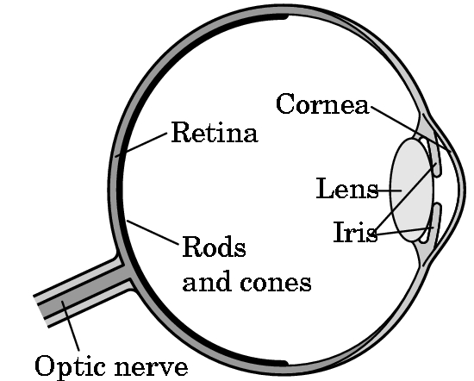
Three-Color Theory
Human visual system has two types of sensors
  Rods: monochromatic, night vision
  Cones
    Color sensitive
    Three types of cone
    Only three values (the
    tristimulus values) are
    sent to the brain
Need only match these three values
  Need only three primary colors

Slide 36
Additive and Subtractive Color
Additive color
  Form a color by adding amounts of three primaries
    CRTs, projection systems, positive film
  Primaries are Red (R), Green (G), Blue (B)
Subtractive color
  Form a color by filtering white light with cyan (C), Magenta (M), and Yellow (Y) filters
    Light-material interactions
    Printing
    Negative film

Slide 37
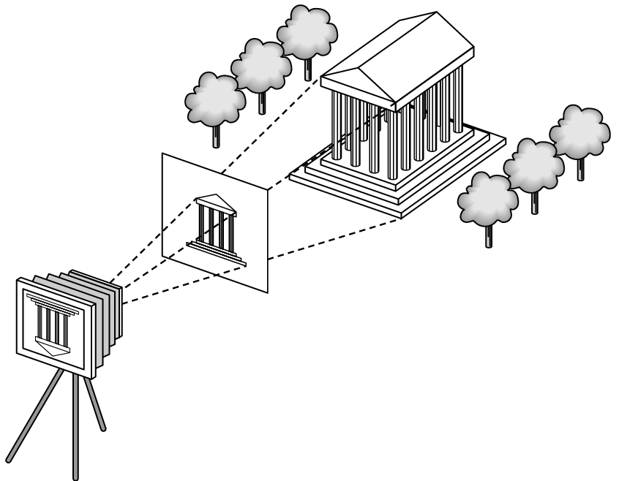
Synthetic Camera Model
p
projection of p
image plane

Slide 38
Advantages
Separation of objects, viewer, light sources
Two-dimensional graphics is a special case of three-dimensional graphics
Leads to simple software API
  Specify objects, lights, camera, attributes
  Let implementation determine image
Leads to fast hardware implementation

Slide 39
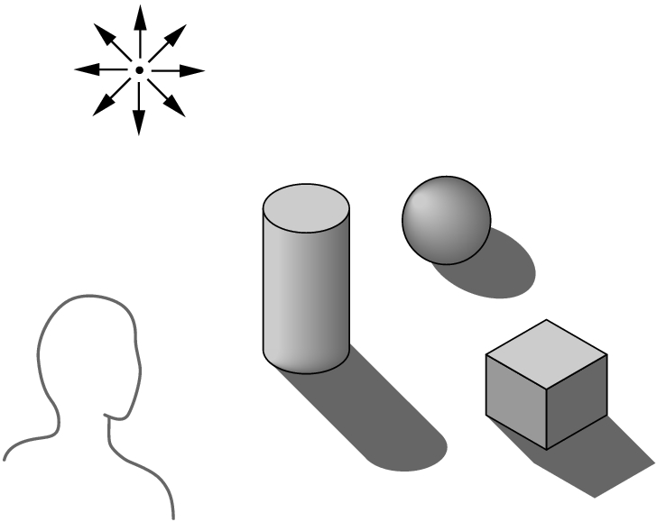
Global vs Local Lighting
Cannot compute color or shade of each object independently
  Some objects are blocked from light
  Light can reflect from object to object
  Some objects might be translucent

Slide 40
We Will Study Various Lighting Models
Most lighting models require that normals be calculated for objects.
Normals are vectors of length 1 that are perpendicular to a surface.
Understanding how the normals work will be critical for producing lighting that works properly.

