Slide 1
INTRODUCTION TO GRAPHICS
Part 3

Slide 2
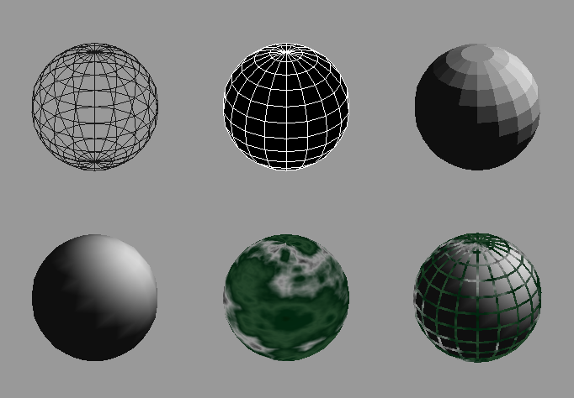
Controlling Rendering Appearance
From Wireframe to Texture Mapped
Notes:
OpenGL can render from a simple line-based wireframe to complex multi-pass texturing algorithms to simulate bump mapping or Phong lighting.

Slide 3
OpenGL’s State Machine
All rendering attributes are encapsulated in the OpenGL State
  rendering styles
  shading
  lighting
  texture mapping
Notes:
Each time OpenGL processes a vertex, it uses data stored in its internal state tables to determine how the vertex should be transformed, lit, textured or any of OpenGL’s other modes.

Slide 4
Manipulating OpenGL State
Appearance is controlled by current state
  for each ( primitive to render ) {
    update OpenGL state
    render primitive
  }
Manipulating vertex attributes is most
common way to manipulate state
    glColor*() / glIndex*()
    glNormal*()
    glTexCoord*()
Notes:
The general flow of any OpenGL rendering is to set up the required state, then pass the primitive to be rendered, and repeat for the next primitive.
In general, the most common way to manipulate OpenGL state is by setting vertex attributes, which include color, lighting normals, and texturing coordinates.

Slide 5
Controlling Current State
Setting State
    glPointSize( size );
    glLineStipple( repeat, pattern );
    glShadeModel( GL_SMOOTH );
Enabling Features
    glEnable( GL_LIGHTING );
    glDisable( GL_TEXTURE_2D );
Notes:
Setting OpenGL state usually includes modifying the rendering attribute, such as loading a texture map, or setting the line width. Also for some state changes, setting the OpenGL state also enables that feature ( like setting the point size or line width ).
Other features need to be turned on. This is done using glEnable(), and passing the token for the feature, like GL_LIGHT0 or GL_POLYGON_STIPPLE.

Slide 6
Transformations in OpenGL
Modeling
Viewing
  orient camera
  projection
Animation
Map to screen
Notes:
Transformations are used both by the applications programmer to move and orient objects (either statically or dynamically) and by OpenGL to implement the viewing pipeline.
Three transformations (model-view, perspective, texture) are part of the state. Their matrices can be set by application programs but the operations are carried out within the viewing pipeline.

Slide 7

Camera Analogy
3D is just like taking a photograph (lots of photographs!)
viewing
volume
camera
model
tripod
Notes:
This model has become know as the synthetic camera model.
Note that both the objects to be viewed and the camera are three-dimensional while the resulting image is two dimensional.

Slide 8
Coordinate Systems and Transformations
Steps in Forming an Image
  specify geometry (world coordinates)
  specify camera (camera coordinates)
  project (window coordinates)
  map to viewport (screen coordinates)
Each step uses transformations
Every transformation is equivalent to a change in coordinate systems (frames)
Notes:
Every transformation can be thought of as changing the representation of a vertex from one coordinate system or frame to another. Thus, initially vertices are specified in world or application coordinates. However, to view them, OpenGL must convert these representations to ones in the reference system of the camera. This change of representations is described by a transformation matrix (the model-view matrix). Similarly, the projection matrix converts from camera coordinates to window coordinates.

Slide 9
Camera Analogy and Transformations
Projection transformations
  adjust the lens of the camera
Viewing transformations
  tripod–define position and orientation of the viewing volume in the world
Modeling transformations
  moving the model
Viewport transformations
  enlarge or reduce the physical photograph
Notes:
Note that human vision and a camera lens have cone-shaped viewing volumes. OpenGL (and almost all computer graphics APIs) describe a pyramid-shaped viewing volume. Therefore, the computer will “see” differently from the natural viewpoints, especially along the edges of viewing volumes. This is particularly pronounced for wide-angle “fish-eye” camera lenses.

Slide 10
Affine Transformations
Want transformations which preserve geometry
  lines, polygons, quadrics
Affine = line preserving
  Rotation, translation, scaling
  Projection
  Concatenation (composition)
Notes:
The transformations supported by OpenGL are a special class that is important for graphical applications and for problems in science and engineering. In particular, affine transformations will not alter the type of object. A transformed line (polygon, quadric) is still a line (polygon, quadric).
Any composition of affine transformations is still affine. For example, a rotation followed by a translation followed by a projection preserves lines and polygons.

Slide 11
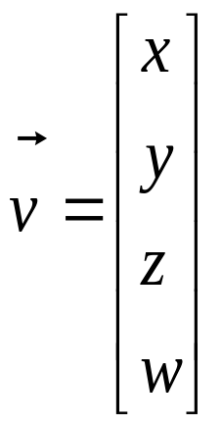
Homogeneous Coordinates
  each vertex is a column vector
  w is usually 1.0
  all operations are matrix multiplications
  directions (directed line segments) can be represented with w = 0.0
Notes:
A 3D vertex is represented by a 4-tuple vector (homogeneous coordinate system).
Why is a 4-tuple vector used for a 3D (x, y, z) vertex? To ensure that all matrix operations are multiplications.
If w is changed from 1.0, we can recover x, y and z by division by w. Generally, only perspective transformations change w and require this perspective division in the pipeline.

Slide 12

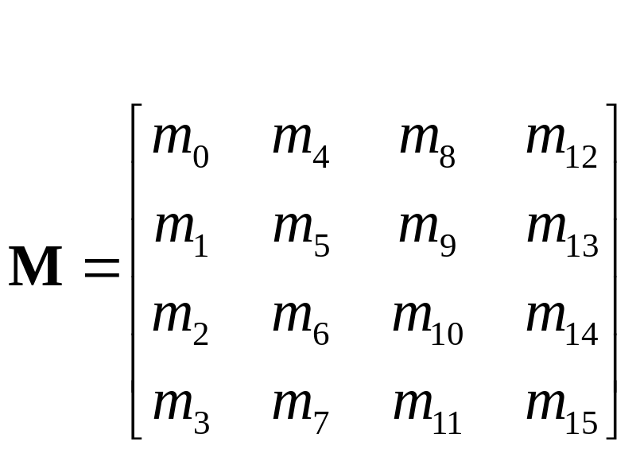
3D Transformations
A vertex is transformed by 4 x 4 matrices
  all affine operations are matrix multiplications
  all matrices are stored column-major in OpenGL
  matrices are multiplied
  product of matrix and vector is
Notes:
Perspective projection and translation require 4th row and column, or operations would require addition, as well as multiplication.
For operations other than perspective projection, the fourth row is always
(0, 0, 0, 1) which leaves w unchanged..
Because OpenGL only multiplies a matrix on the right, the programmer must remember that the last matrix specified is the first applied.

Slide 13
Specifying Transformations
Programmer has two styles of specifying transformations
  specify matrices (glLoadMatrix, glMultMatrix)
  specify operation (glRotate, glOrtho)
Programmer does not have to remember the exact matrices, but you will need to learn their form- we’ll develop all the necessary forms
Notes:
Generally, a programmer can obtain the desired matrix by a sequence of simple transformations that can be concatenated together, e.g. glRotate(), glTranslate(), and glScale().
For the basic viewing transformations, OpenGL and the Utility library have supporting functions.

Slide 14
Programming Transformations
Prior to rendering, view, locate, and orient:
  eye/camera position
  3D geometry
Manage the matrices
  including matrix stack
Combine (composite) transformations for positioning objects
Notes:
Because transformation matrices are part of the state, they must be defined prior to any vertices to which they are to apply.
In modeling, we often have objects specified in their own coordinate systems and must use OpenGL transformations to bring the objects into the scene.
OpenGL provides matrix stacks for each type of supported matrix (model-view, projection, texture) to store matrices.

Slide 15
Transformation
Pipeline
object
eye
clip
normalized
device
window
v
e
r
t
e
x
Modelview
Matrix
Projection
Matrix
Perspective
Division
Viewport
Transform
Modelview
Projection
other calculations here
  material ➔ color
  shade model (flat)
  polygon rendering mode
  polygon culling
  clipping
Modelview
●
●
●
Notes:
The depth of matrix stacks are implementation-dependent, but the Modelview matrix stack is guaranteed to be at least 32 matrices deep, and the Projection matrix stack is guaranteed to be at least 2 matrices deep.
The material-to-color, flat-shading, and clipping calculations take place after the Modelview matrix calculations, but before the Projection matrix. The polygon culling and rendering mode operations take place after the Viewport operations.
There is also a texture matrix stack, which is outside the scope of this course. It is an advanced texture mapping topic.

Slide 16
Matrix Operations
Specify Current Matrix Stack
glMatrixMode( GL_MODELVIEW or GL_PROJECTION )
Other Matrix or Stack Operations
  glLoadIdentity()
  glPushMatrix()
  glPopMatrix()
Viewport
  usually same as window size
  viewport aspect ratio should be same as projection transformation or resulting image may be distorted
  glViewport( x, y, width, height )
Notes:
glLoadMatrix*() replaces the matrix on the top of the current matrix stack. glMultMatrix*(), post-multiples the matrix on the top of the current matrix stack. The matrix argument is a column-major 4 x 4 double or single precision floating point matrix.
Matrix stacks are used because it is more efficient to save and restore matrices than to calculate and multiply new matrices. Popping a matrix stack can be said to “jump back” to a previous location or orientation.
glViewport() clips the vertex or raster position. For geometric primitives, a new vertex may be created. For raster primitives, the raster position is completely clipped.
There is a per-fragment operation, the scissor test, which works in situations where viewport clipping doesn’t. The scissor operation is particularly good for fine clipping raster (bitmap or image) primitives.

Slide 17
Forming the Projection Matrix
Shape of viewing frustum
Perspective projection
  gluPerspective( fovy, aspect, zNear, zFar )
  glFrustum( left, right, bottom, top, zNear, zFar )
Orthographic parallel projection
  glOrtho( left, right, bottom, top, zNear, zFar )
  gluOrtho2D( left, right, bottom, top )
    calls glOrtho with z values near zero
Notes:
For perspective projections, the viewing volume is shaped like a truncated pyramid (frustum). There is a distinct camera (eye) position, and vertexes of objects are “projected” to camera. Objects which are further from the camera appear smaller. The default camera position at (0, 0, 0), looks down the z-axis, although the camera can be moved by other transformations.
For gluPerspective(), fovy is the angle of field of view (in degrees) in the y direction. fovy must be between 0.0 and 180.0, exclusive. aspect is x/y and should be same as the viewport to avoid distortion. zNear and zFar define the distance to the near and far clipping planes.
glFrustum() is rarely used.
Warning: for gluPerspective() or glFrustum(), don’t use zero
for zNear!
For glOrtho(), the viewing volume is shaped like a rectangular parallelepiped (a box). Vertexes of an object are “projected” towards infinity. Distance does not change the apparent size of an object. Orthographic projection is used for drafting and design (such as blueprints).

Slide 18
Viewing Transformations
Position the camera/eye in the scene
  place the tripod down; aim camera
To “fly through” a scene
  change viewing transformation and
  redraw scene
gluLookAt( eye_{x}, eye_{y}, eye_{z},
aim_{x}, aim_{y}, aim_{z},
up_{x}, up_{y}, up_{z} )
  up vector determines unique orientation
  careful of degenerate positions
tripod
Notes:
gluLookAt() multiplies itself onto the current matrix, so it usually comes after glMatrixMode(GL_MODELVIEW) and glLoadIdentity().
Because of degenerate positions, gluLookAt() is not recommended for most animated fly-over applications.
An alternative is to specify a sequence of rotations and translations that are concatenated with an initial identity matrix.
Note: that the name modelview matrix is appropriate since moving objects in the model front of the camera is equivalent to moving the camera to view a set of objects.

Slide 19
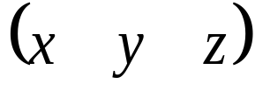
Modeling Transformations
Move object
  glTranslate{fd}( x, y, z )
Rotate object around arbitrary axis
  glRotate{fd}( angle, x, y, z )
  angle is in degrees
Dilate (stretch or shrink) or mirror object
  glScale{fd}( x, y, z )
Notes:
glTranslate(), glRotate(), and glScale() multiplies itself onto the current matrix, so it usually comes after glMatrixMode(GL_MODELVIEW). There are many situations where the modeling transformation is multiplied onto a non-identity matrix.
A vertex’s distance from the origin changes the effect of glRotate() or glScale(). These operations have a fixed point for the origin. Generally, the further from the origin, the more pronounced the effect. To rotate (or scale) with a different fixed point, we must first translate, then rotate (or scale) and then undo the translation with another translation.

Slide 20
Double
Buffering
1
2
1
2
Front
Buffer
4
4
Back
Buffer
8
8
16
16
Display
Notes:
Double buffer is a technique for tricking the eye into seeing smooth animation of rendered scenes. The color buffer is usually divided into two equal halves, called the front buffer and the back buffer.
The front buffer is displayed while the application renders into the back buffer. When the application completes rendering to the back buffer, it requests the graphics display hardware to swap the roles of the buffers, causing the back buffer to now be displayed, and the previous front buffer to become the new back buffer.

Slide 21
Animation Using Double Buffering
Request a double buffered color buffer
    glutInitDisplayMode( GLUT_RGB | GLUT_DOUBLE );
Clear color buffer
    glClear( GL_COLOR_BUFFER_BIT );
Render scene
Request swap of front and back buffers
    glutSwapBuffers();
Repeat steps 2 - 4 for animation
Notes:
Requesting double buffering in GLUT is simple. Adding GLUT_DOUBLE to your glutInitDisplayMode() call will cause your window to be double buffered.
When your application is finished rendering its current frame, and wants to swap the front and back buffers, the glutSwapBuffers() call will request the windowing system to update the window’s color buffers.

Slide 22
Depth Buffering and
Hidden Surface Removal
1
2
1
2
Color
Buffer
4
4
Depth
Buffer
8
8
16
16
Display
Notes:
Depth buffering is a technique to determine which primitives in your scene are occluded by other primitives. As each pixel in a primitive is rasterized, its distance from the eyepoint (depth value), is compared with the values stored in the depth buffer. If the pixel’s depth value is less than the stored value, the pixel’s depth value is written to the depth buffer, and its color is written to the color buffer.
The depth buffer algorithm is:
if ( pixel->z < depthBuffer(x,y)->z ) {
depthBuffer(x,y)->z = pixel->z;
colorBuffer(x,y)->color = pixel->color;
}
OpenGL depth values range from [0, 1], with one being essentially infinitely far from the eyepoint. Generally, the depth buffer is cleared to one at the start of a frame.

Slide 23
Depth Buffering Using OpenGL
Request a depth buffer
    glutInitDisplayMode( GLUT_RGB | GLUT_DOUBLE | GLUT_DEPTH );
Enable depth buffering
    glEnable( GL_DEPTH_TEST );
Clear color and depth buffers
    glClear( GL_COLOR_BUFFER_BIT | GL_DEPTH_BUFFER_BIT );
Render scene
Swap color buffers
Notes:
Enabling depth testing in OpenGL is very straightforward.
A depth buffer must be requested for your window, once again using the glutInitDisplayMode(), and the GLUT_DEPTH bit.
Once the window is created, the depth test is enabled using
glEnable( GL_DEPTH_TEST ).

Slide 24
An Updated Program Template
void main( int argc, char** argv )
{
  glutInit( &argc, argv );
  glutInitDisplayMode( GLUT_RGB |
  GLUT_DOUBLE | GLUT_DEPTH );
  glutCreateWindow( “Tetrahedron” );
  init();
  glutIdleFunc( idle );
  glutDisplayFunc( display );
  glutMainLoop();
}
Notes:
In main(),
1) GLUT initializes and creates a window named “Tetrahedron”
2) set OpenGL state which is enabled through the entire life of the program
in init()
3) set GLUT’s idle function, which is called when there are no user events
to process.
4) enter the main event processing loop of the program.

Slide 25
An Updated Program Template (cont.)
void init( void )
{
glClearColor( 0.0, 0.0, 1.0, 1.0 );
}
void idle( void )
{
glutPostRedisplay();
}
Notes:
In init() the basic OpenGL state to be used throughout the program is initialized. For this simple program, all we do is set the background (clear color) for the color buffer. In this case, we’ve decided that instead of the default black background, we want a blue background.
Additionally, our glutIdleFunc(), which we’ve set to the function idle() above, requests that GLUT re-render our scene again. The function glutPostRedisplay() requests that GLUT call our display function (this was set with glutDisplayFunc()) at the next convenient time. This method provides better event processing response from the application.

Slide 26
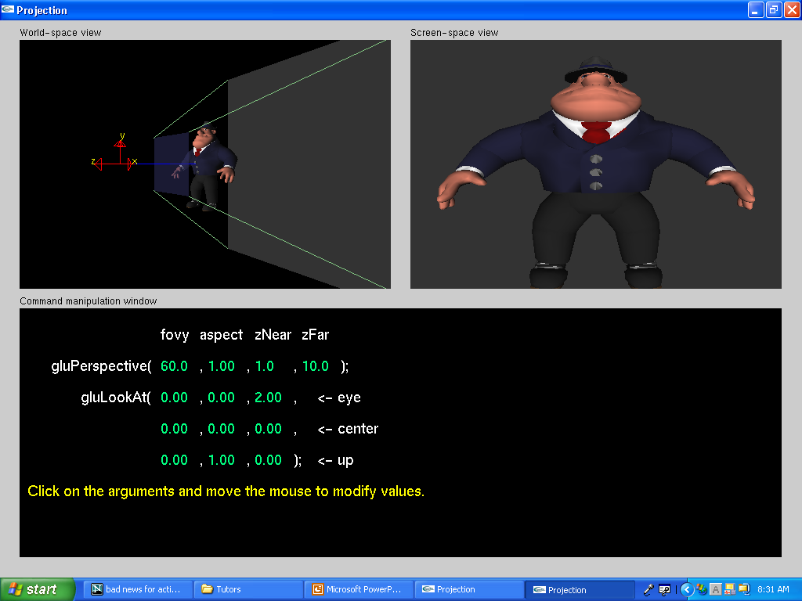
We will work later with projection.exe to obtain a better feel for the projection commands.

