Slide 1
ECE204
Advanced Computer Graphics
Radiosity I
Joerg Meyer
jmeyer@uci.edu
University of California at Irvine
http://www.eng.uci.edu/~jmeyer

Slide 2
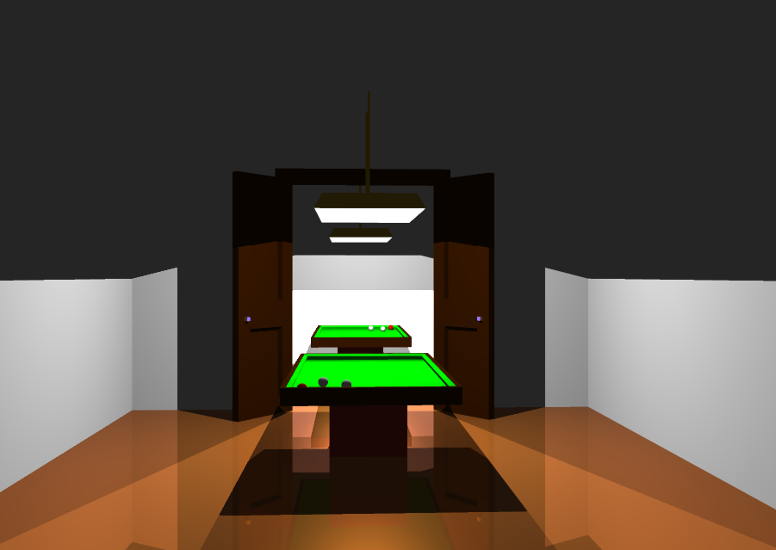
Raytracing

Slide 3
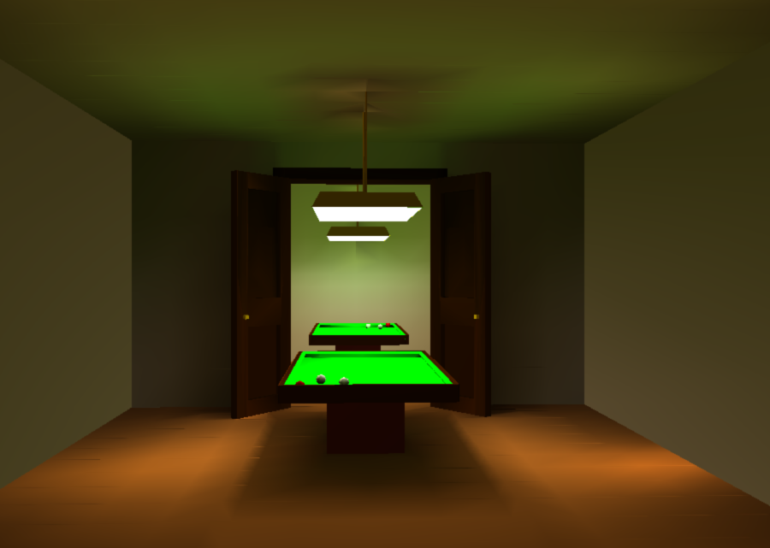
Radiosity

Slide 4
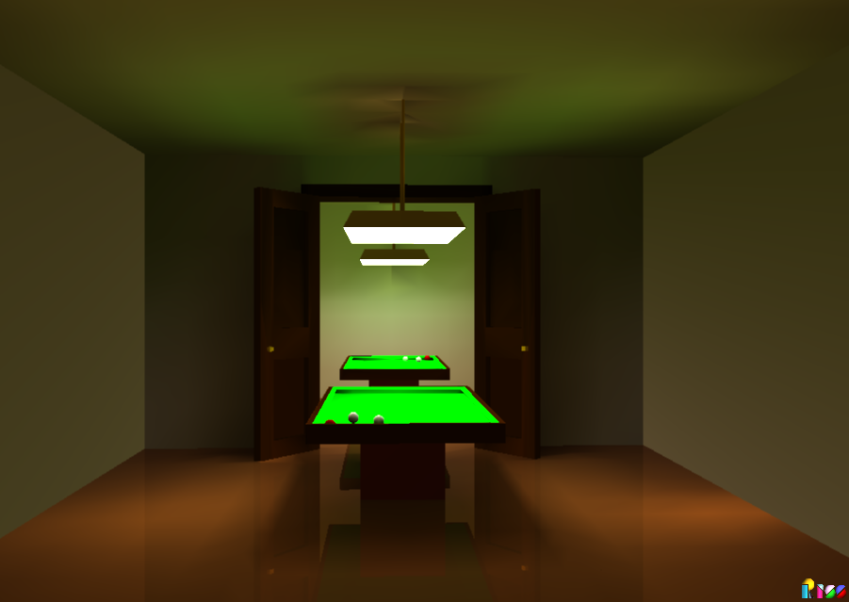
Combined Method
Combined method

Slide 5
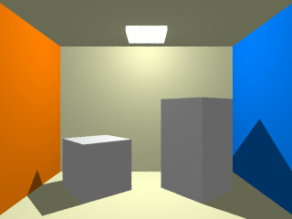
Radiosity
Radiosity off

Slide 6
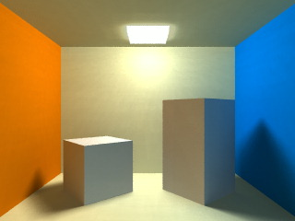
Radiosity
Radiosity on

Slide 7
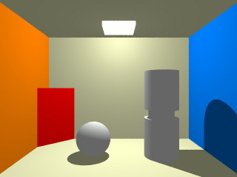
Radiosity
Radiosity off

Slide 8
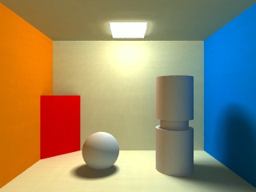
Radiosity
Radiosity on

Slide 9
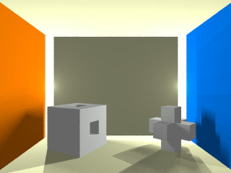
Radiosity
Radiosity off

Slide 10
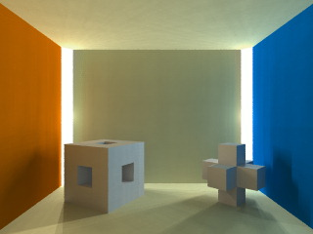
Radiosity
Radiosity on

Slide 11
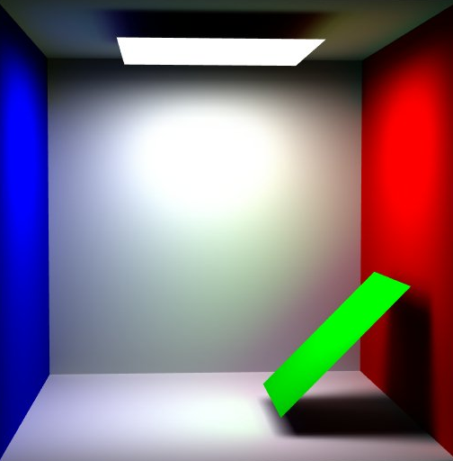
Radiosity
Light sources: 1

Slide 12
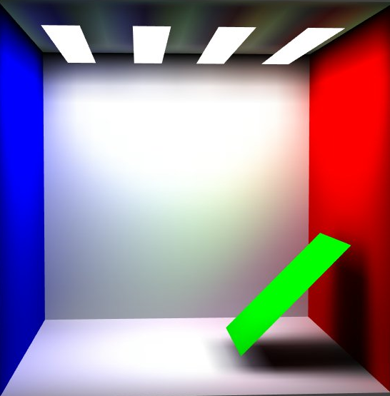
Radiosity
Light sources: 4

Slide 13
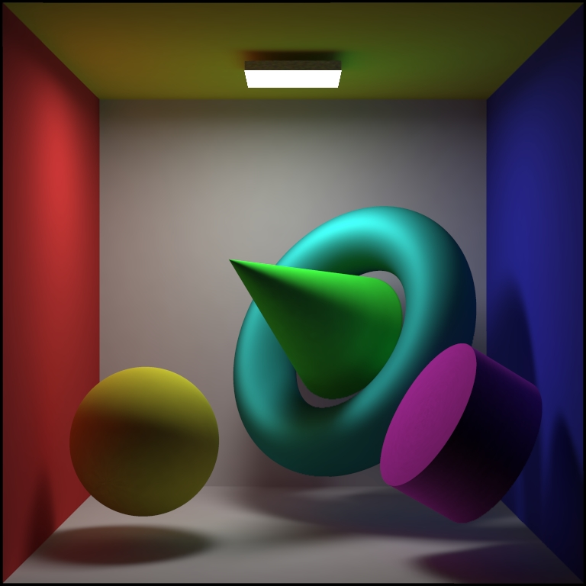
Radiosity
Diffuse

Slide 14
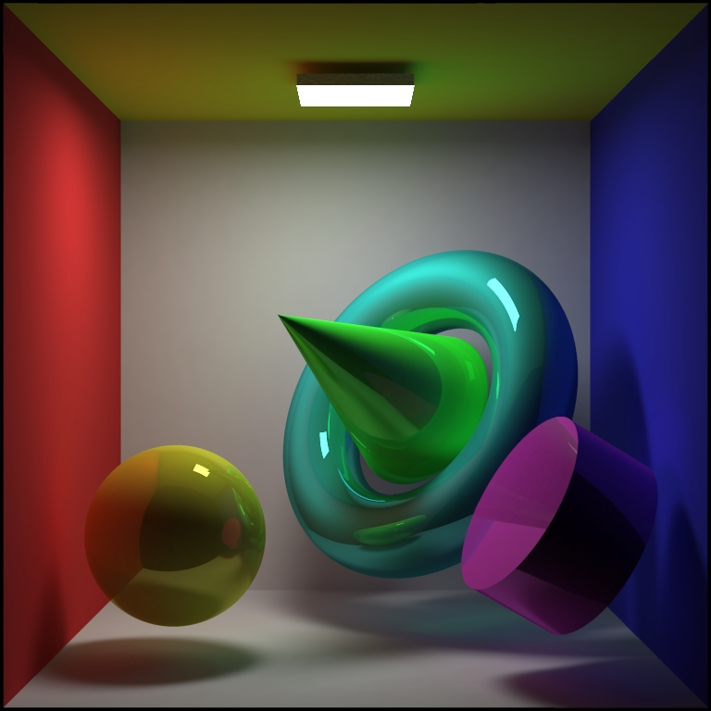
Radiosity
Specular

Slide 15
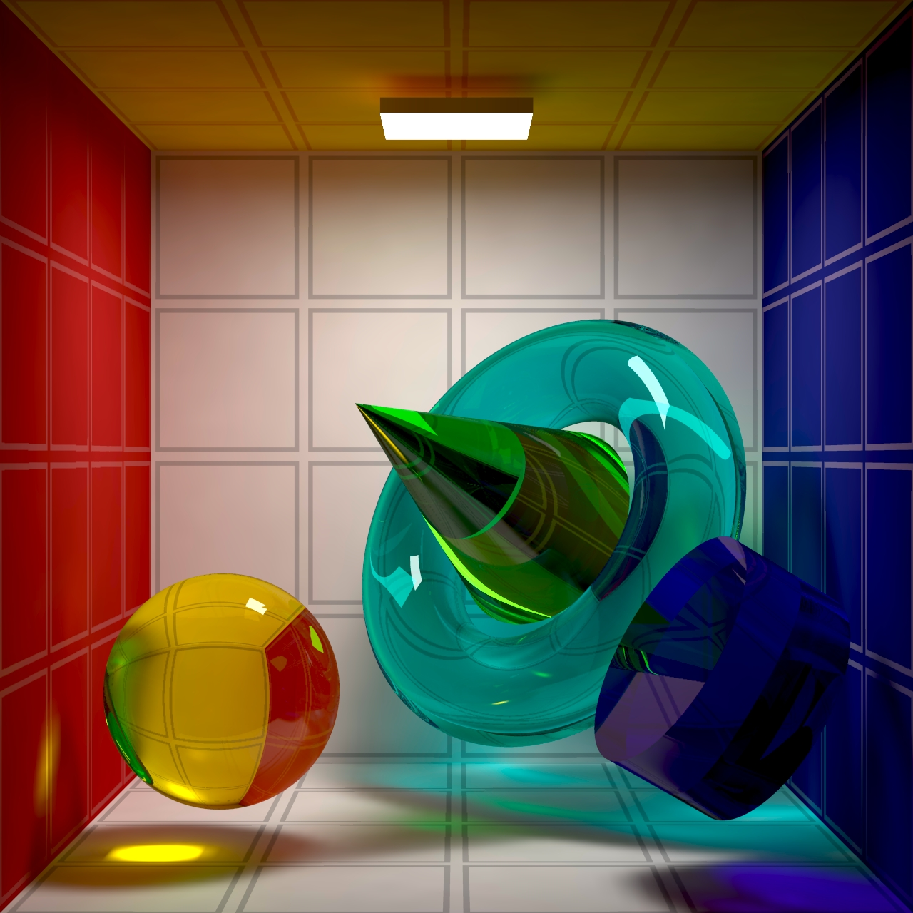
Radiosity
Transparent

Slide 16
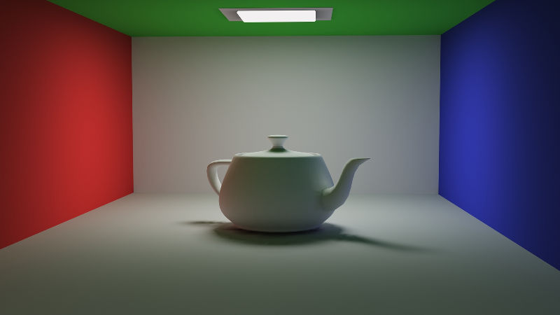
Radiosity
Teapot

Slide 17
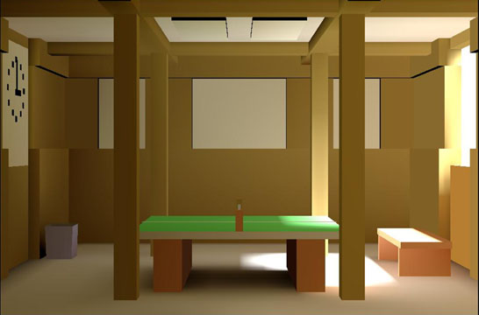
Radiosity
Standard

Slide 18
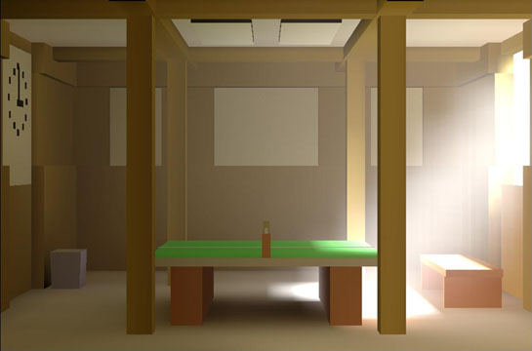
Radiosity
Smoke

Slide 19
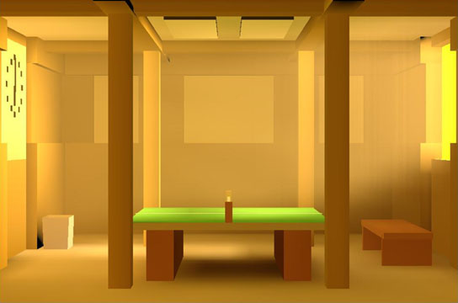
Radiosity
Evening (6pm)

Slide 20
Radiosity
Afternoon (3pm)

Slide 21
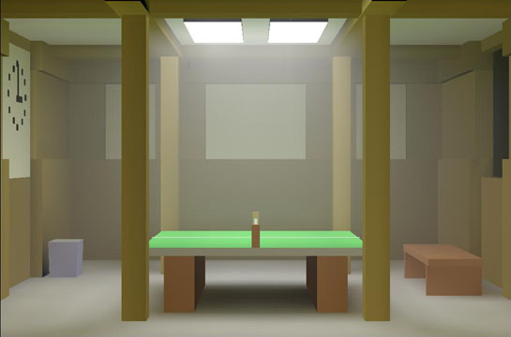
Radiosity
Ceiling light (3am)

Slide 22
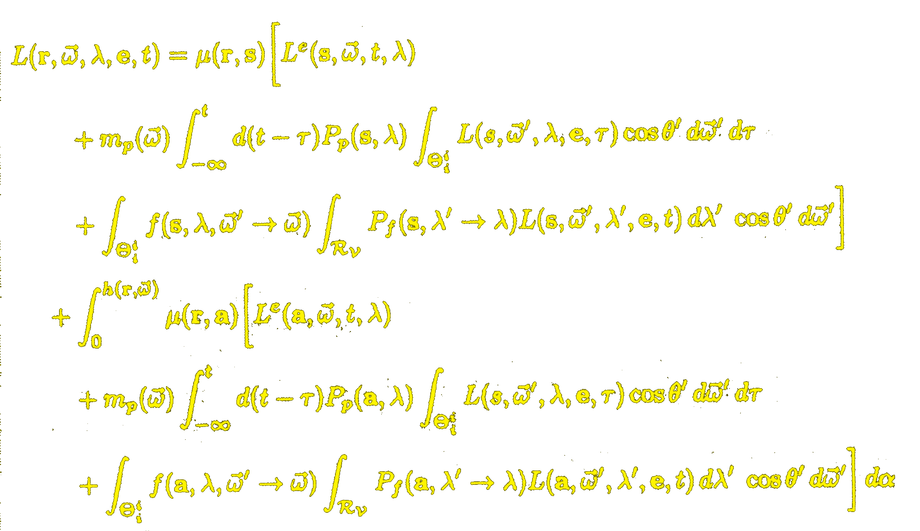
Radiosity
Radiance equation
Radiance L leaving point r in direction ω at wavelength λ at time t:

