Slide 1
CHAPTER 1
Fundamental Tools

Slide 2
Definition of an algorithm
(from CPSC 171):
An algorithm is a well-ordered collection of unambiguous and effectively computable operations that, when executed, produces a result and halts in a finite amount of time.
The textbook has a similar definition:
.

Slide 3
Textbook Definitions
  An algorithm is a step-by-step procedure for performing some task in a finite about of time.
  A data structure is a systematic way of organizing and accessing data.

Slide 4
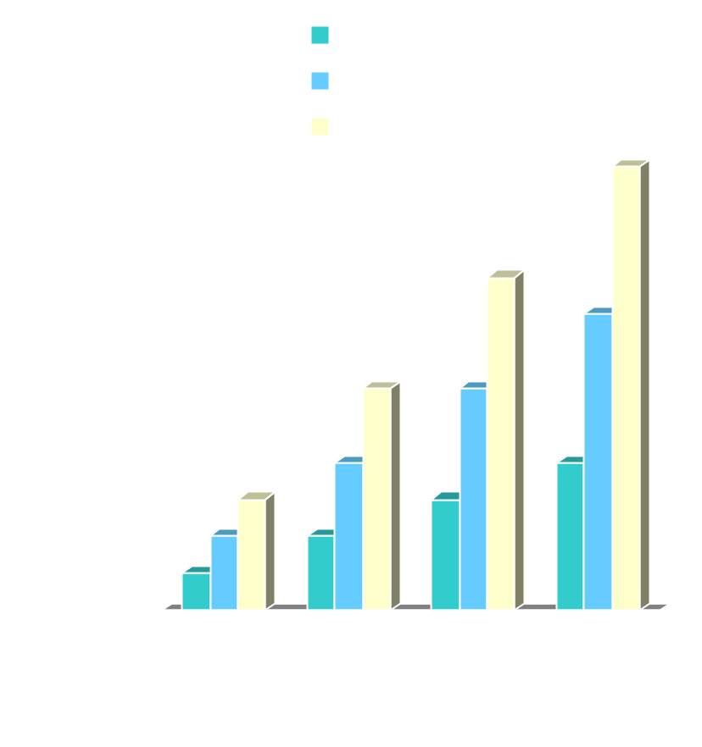
Running Time (§1.1)
Most algorithms transform input objects into output objects.
The running time of an algorithm typically grows with the input size.
Average case time is often difficult to determine.
We often focus on the worst case running time.
  Easier to analyze
  Crucial to applications such as games, finance and robotics

Slide 5
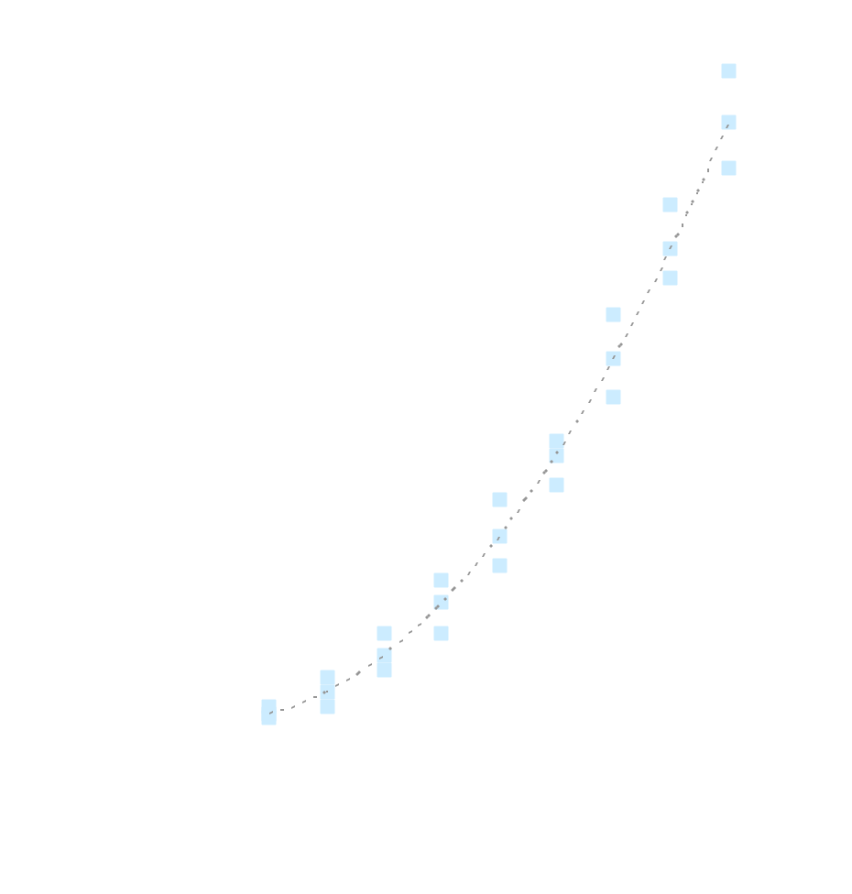
Experimental Studies (§ 1.6)
Write a program implementing the algorithm
Run the program with inputs of varying size and composition
Use a method like System.currentTimeMillis() to get an accurate measure of the actual running time
Plot the results

Slide 6
Limitations of Experiments
It is necessary to implement the algorithm, which may be difficult
Results may not be indicative of the running time on other input not included in the experiment.
In order to compare two algorithms, the same hardware and software environments must be used
Different programmers have different abilities to write “good, efficient” code.
We can’t examine all cases.

Slide 7

Theoretical Analysis
Uses a high-level description of the algorithm instead of an implementation
Characterizes running time as a function of the input size, n.
Takes into account all possible inputs
Allows us to evaluate the speed of an algorithm independent of the hardware/software environment

Slide 8
Pseudocode (§1.1)
Example: find max element of an array
High-level description of an algorithm
More structured than English prose
Less detailed than a program
Preferred notation for describing algorithms
Hides program design issues
Algorithm arrayMax(A, n)
Input array A of n integers
Output maximum element of A
currentMax ← A[0]
for i ← 1 to n − 1 do
if A[i] > currentMax then
currentMax ← A[i]
return currentMax

Slide 9
Pseudocode Details
Control flow
  if … then … [else …]
  while … do …
  repeat … until …
  for … do …
  Indentation replaces braces
Method declaration
  Algorithm method (arg [, arg…])
  Input …
  Output …
Method call
  var.method (arg [, arg…])
Return value
  return expression
Expressions
  Assignment
  (like = in Java)
  Equality testing
  (like == in Java)
  n² Superscripts and other mathematical formatting allowed

Slide 10
The Random Access Machine (RAM) Model
A CPU
An potentially unbounded bank of memory cells, each of which can hold an arbitrary number or character
2
1
0
Memory cells are numbered and accessing any cell in memory takes unit time.

Slide 11
Primitive Operations
Basic computations performed by an algorithm
Identifiable in pseudocode
Largely independent from the programming language
Exact definition not important (we will see why later)
Assumed to take a constant amount of time in the RAM model
Examples:
  Assigning a value to a variable
  Calling a method
  Performing an arithmetic operation such as addition
  Comparing two numbers
  Indexing into an array
  Following an object reference
  Returning from a method

Slide 12
Counting Primitive Operations (§1.1)
By inspecting the pseudocode, we can determine the maximum number of primitive operations executed by an algorithm, as a function of the input size
Algorithm arrayMax(A,n); # operations
currentMax ← A[0] 2 [index into array; assign value]
for i ← 1 to n − 1 do 1 + n [n comparisons; initialization]
if A[i] > currentMax then 2(n − 1) [n-1 loops-index; compare]
currentMax ← A[i] 2(n − 1) [n-1 loops-index; assign]
{ increment counter i } 2(n − 1) [n-1 loops- add; assign]
return currentMax 1
5n (at least) Total 7n − 2 (worst case)

Slide 13
Estimating Running Time
Algorithm arrayMax executes 7n − 2 primitive operations in the worst case. Define:
  a = Time taken by the fastest primitive operation
  b = Time taken by the slowest primitive operation
Let T(n) be worst-case time of arrayMax. Then
a (7n − 2) ≤ T(n) ≤ b(7n − 2)
Hence, the running time T(n) is bounded by two linear functions

Slide 14
Growth Rate of Running Time
Changing the hardware/ software environment
  Affects T(n) by a constant factor, but
  Does not alter the growth rate of T(n)
The linear growth rate of the running time T(n) is an intrinsic property of the algorithm arrayMax

Slide 15
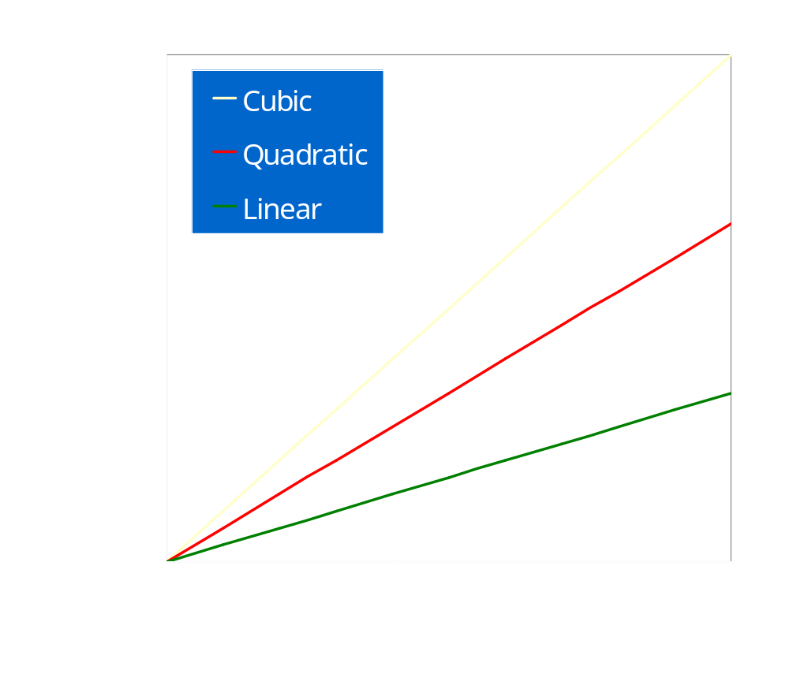
Growth Rates
Growth rates of functions:
  Linear ≈ n
  Quadratic ≈ n²
  Cubic ≈ n³
In a log-log chart, the slope of the line corresponds to the growth rate of the function

Slide 16
Constant Factors
The growth rate is not affected by
  constant factors or
  lower-order terms
Examples
  10²n + 10⁵ is a linear function
  10⁵n² + 10⁸n is a quadratic function

Slide 17
Big-Oh Notation (§1.2)
Important definition: Given functions f(n) and g(n), we say that f(n) is O(g(n)) if there are positive constants c and n₀ such that
f(n) ≤ cg(n) for n ≥ n₀
O(n) is read as big-oh of n.
Example:
Prove: 2n + 10 is O(n)
  We want to find c and n₀ such that
  2n + 10 ≤ cn for n ≥ n₀
Realize the values found will not be unique!

Slide 18
Prove: 2n + 10 is O(n)
We want to find c and n₀ such that
2n + 10 ≤ cn for n ≥ n₀
The yellow work below is scratch work to find a c and n₀ that works.
    Start with 2n + 10 ≤ cn and try to solve for n
    (c − 2) n ≥ 10
    n ≥ 10/(c − 2)
So, one possible choice (but not the only one) would be to let c = 3 and n₀ = 10.
This is not handed in when a proof is requested.
Now we can construct a proof!

Slide 19
Prove: 2n + 10 is O(n)
We want to find c and n₀ such that
2n + 10 ≤ cn for n ≥ n₀
  Proof: Pick c = 3 and n₀ = 10. Then, for n ≥ n₀ = 10,
  n ≥ 10/1 = 10/(3-2) = 10/(c - 2)
  Thus, (c - 2) n ≥ 10 and
  cn - 2n ≥ 10
  or 2n + 10 ≤ cn
  So, we have found c = 3 and n₀ = 10 such that
  2n + 10 ≤ cn for n ≥ n₀
  Consequently, 2n + 10 is O(n)

Slide 20
Big-Oh Example
Example: the function n² is not O(n)
  We want
    n² ≤ cn
    n ≤ c
  The above inequality cannot be satisfied since c must be a constant

Slide 21
More Big-Oh Examples
7n-2
  Claim: 7n-2 is O(n)
  need c > 0 and n₀ ≥ 1 such that 7n-2 ≤ cn for n ≥ n₀
  this is true for c = 7 and n₀ = 1
3n³ + 20n² + 5
  3n³ + 20n² + 5 is O(n³)
  need c > 0 and n₀ ≥ 1 such that 3n³ + 20n² + 5 ≤ cn³ for n ≥ n₀
  this is true for c = 4 and n₀ = 21
3 log n + log log n
  3 log n + log log n is O(log n)
  need c > 0 and n₀ ≥ 1 such that 3 log n + log log n ≤ clog n for n ≥ n₀
  this is true for c = 4 and n₀ = 2

Slide 22
More Big-Oh Examples
7n-2
  Claim: 7n-2 is O(n)
  need c > 0 and n₀ ≥ 1 such that 7n-2 ≤ cn for n ≥ n₀
  this is true for c = 7 and n₀ = 1
3n³ + 20n² + 5
  3n³ + 20n² + 5 is O(n³)
  need c > 0 and n₀ ≥ 1 such that 3n³ + 20n² + 5 ≤ cn³ for n ≥ n₀
  this is true for c = 4 and n₀ = 21
3 log n + log log n
  3 log n + log log n is O(log n)
  need c > 0 and n₀ ≥ 1 such that 3 log n + log log n ≤ clog n for n ≥ n₀
  this is true for c = 4 and n₀ = 2

Slide 23
More Big-Oh Examples
7n-2
  Claim: 7n-2 is O(n)
  Scratchwork: Need c > 0 and n₀ ≥ 1 such that 7n-2 ≤ cn for n ≥ n₀
  7n-2 ≤ cn
  7n - cn ≤ 2
  (7-c) n ≤ 2
  this is true for c = 7 and n₀ = 1

Slide 24
Big-Oh and Growth Rate
The big-Oh notation gives an upper bound on the growth rate of a function
The statement “f(n) is O(g(n))” means that the growth rate of f(n) is no more than the growth rate of g(n)
We can use the big-Oh notation to rank functions according to their growth rate
Assume: | f(n) is O(g(n)) | g(n) is O(f(n))
g(n) grows more | Yes | No
f(n) grows more | No | Yes
Same growth | Yes | Yes

Slide 25
Big-Oh Rules
If is f(n) a polynomial of degree d, then f(n) is O(n^{d}), i.e.,
  Drop lower-order terms
  Drop constant factors
Use the smallest possible class of functions
  Say “2n is O(n)” instead of “2n is O(n²)”
Use the simplest expression of the class
  Say “3n + 5 is O(n)” instead of “3n + 5 is O(3n)”

Slide 26
Asymptotic Algorithm Analysis
The asymptotic analysis of an algorithm determines the running time in big-Oh notation
To perform the asymptotic analysis
  We find the worst-case number of primitive operations executed as a function of the input size
  We express this function with big-Oh notation
Example:
  We determine that algorithm arrayMax executes at most 7n − 2 primitive operations
  We say that algorithm arrayMax “runs in O(n) time”
Since constant factors and lower-order terms are eventually dropped anyhow, we can disregard them when counting primitive operations. This means a bit of slop is OK as long as you don’t mess up the counts involving n

Slide 27

Computing Prefix Averages
We further illustrate asymptotic analysis with two algorithms for prefix averages
The i-th prefix average of an array X is the average of the first (i + 1) elements of X:
A[i] = (X[0] + X[1] + … + X[i])/(i+1)
Computing the array A of prefix averages of another array X has many applications.

Slide 28
Computing Prefix Averages
One application of the prefix average calculation:
  Given the year-by-year returns on a stock, see what the stock’s average annual returns were for last year, the last three years, the last ten years, etc.
As you can see by the previous graph, it has the effect of smoothing out the data especially when that data is varying a lot.

Slide 29
Prefix Averages (Quadratic)
The following algorithm computes prefix averages in quadratic time by applying the definition rather directly
Algorithm prefixAverages1(X, n)
Input array X of n integers
Output array A of prefix averages of X #operations
A ← new array of n integers
for i ← 0 to n − 1 do n
s ← X[0] n
for j ← 1 to i do 1 + 2 + …+ (n − 1)
s ← s + X[j] 1 + 2 + …+ (n − 1)
A[i] ← s / (i + 1) n
return A 1

Slide 30
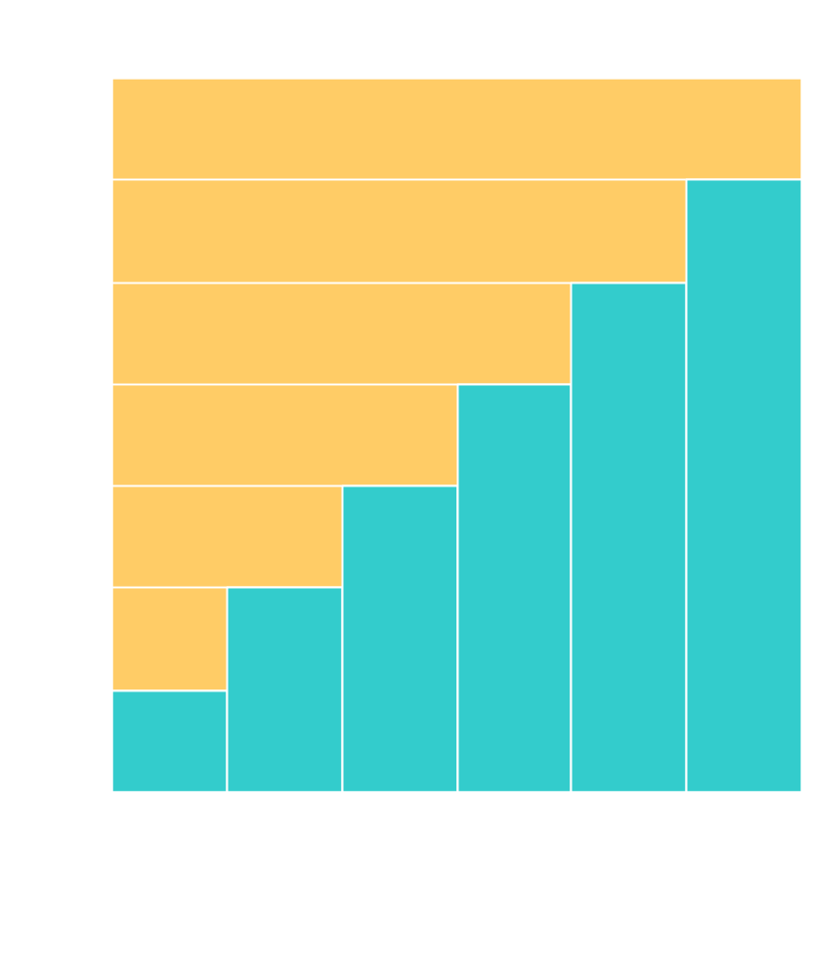
Arithmetic Progression
The running time of prefixAverages1 is
O(1 + 2 + …+ n)
The sum of the first n integers is n(n + 1) / 2
  There is a simple visual proof of this fact
Thus, algorithm prefixAverages1 runs in O(n²) time
Recall this sum is Gauss’ formula that was discussed in cpsc 171!

Slide 31
Prefix Averages (Linear)
The following algorithm computes prefix averages in linear time by keeping a running sum
Algorithm prefixAverages2(X, n)
Input array X of n integers
Output array A of prefix averages of X #operations
A ← new array of n integers
s ← 0 1
for i ← 0 to n − 1 do n
s ← s + X[i] n
A[i] ← s / (i + 1) n
return A 1
Algorithm prefixAverages2 runs in O(n) time

Slide 32
Some math you will need
Summations (Sec. 1.3.1)
These often arise in analysis of algorithms because they arise when loops are examined.
Some of these are standard ones seen (but probably forgotten) in Algebra II in high school.
One, of course, is Gauss’ formula.
Another is the geometric summation
n
  Σi=0 a^{i =} (1-a^{n+1})/(1-a)
You should know the special case of
1 + 2 + 4 + 8 +...+ 2^{n-1} = 2^{n}-1, the largest interger representable in n bits.

Slide 33
Logarithms and Exponents (Sec. 1.3.2)
Definition: log_{b}a = c of a = b^{c}
properties of logarithms:
  log_{b}(xy) = log_{b}x + log_{b}y
  log_{b} (x/y) = log_{b}x - log_{b}y
  log_{b}xª = alog_{b}x
  log_{b}a = log_{x}a/log_{x}b
properties of exponentials:
  a^{(b+c)} = a^{b}a ^{c}
  a^{bc} = (a^{b})^{c}
  a^{b} /a^{c} = a^{(b-c)}
  b = a ^{log}_{a}^{b}
  b^{c} = a ^{c} ^{log}_{a}^{b}

Slide 34
Relatives of Big-Oh
big-Omega
  f(n) is Ω(g(n)) if there is a constant c > 0
  and an integer constant n₀ ≥ 1 such that
  f(n) ≥ cg(n) for n ≥ n₀
  Intuitively, this says up to a constant factor, f(n) asymptotically is greater than or equal to g(n)
big-Theta
  f(n) is Θ(g(n)) if there are constants c’ > 0 and c’’ > 0 and an integer constant n₀ ≥ 1 such that c’g(n) ≤ f(n) ≤ c’’•g(n) for n ≥ n₀
  Intuitively, this says up to a constant factor, f(n) and g(n) are asymptotically the same.
  Note: This is the concept I introduced in cpsc 171.

Slide 35
Relatives of Big-Oh
little-oh
  f(n) is o(g(n)) if, for any constant c > 0, there is an integer constant n₀ ≥ 0 such that f(n) ≤ cg(n) for n ≥ n₀
  Intuitively, this says f(n) is, up to a constant, asymptotically strictly less than g(n).
little-omega
  f(n) is ω(g(n)) if, for any constant c > 0, there is an integer constant n₀ ≥ 0 such that f(n) ≥ cg(n) for n ≥ n₀
  Intuitively, this says f(n) is, up to a constant, asymptotically strictly greater than g(n).
  These are not used as much as the earlier definitions, but they round out the picture.

Slide 36
Summary for Intuition for Asymptotic Notation
Big-Oh
  f(n) is O(g(n)) if f(n) is asymptotically less than or equal to g(n)
big-Omega
  f(n) is Ω(g(n)) if f(n) is asymptotically greater than or equal to g(n)
big-Theta
  f(n) is Θ(g(n)) if f(n) is asymptotically equal to g(n)
little-oh
  f(n) is o(g(n)) if f(n) is asymptotically strictly less than g(n)
little-omega
  f(n) is ω(g(n)) if is asymptotically strictly greater than g(n)

Slide 37
Example Uses of the Relatives of Big-Oh
5n² is Ω(n²)
  f(n) is Ω(g(n)) if there is a constant c > 0 and an integer constant n₀ ≥ 1 such that f(n) ≥ cg(n) for n ≥ n₀
  let c = 5 and n₀ = 1
5n² is Ω(n)
  f(n) is Ω(g(n)) if there is a constant c > 0 and an integer constant n₀ ≥ 1 such that f(n) ≥ cg(n) for n ≥ n₀
  let c = 1 and n₀ = 1
5n² is ω(n)
  f(n) is ω(g(n)) if, for any constant c > 0, there is an integer constant n₀ ≥ 0 such that f(n) ≥ cg(n) for n ≥ n₀
  need 5n₀² ≥ c•n₀ → given c, the n₀ that satisfies this is n₀ ≥ c/5 ≥ 0

Slide 38
A MORE PRECISE DEFINITION OF O, Θ
(only for those with calculus backgrounds)
Definition: Let f and g be functions defined on the positive real numbers with real values.
We say g is in O(f) if and only if
lim g(n)/f(n) = c
n -> ∞
for some nonnegative real number c--- i.e. the limit exists and is not infinite.
We say f is in Θ(g) if and only if
f is in O(g) and g is in O(f)
Note: Often to calculate these limits you need L'Hopital's Rule.

Slide 39
Why Asymptotic Behavior is Important
1) Allows us to compare two algorithms with respect to running time on large data sets.
2) Helps us understand the maximum size of input that can be handled in a given time, provided we know the environment in which we are running.
3) Stresses the fact that even dramatic speedups in hardware do not overcome the handicap of an asymtotically slow algorithm.

Slide 40
ORDER WINS OUT
The TRS-80
Main language support: BASIC - typically a slow running language
For more details on TRS-80 see:
http://mate.kjsl.com/trs80/
The CRAY-YMP
Language used in example: FORTRAN- a fast running language
For more details on CRAY-YMP see:
http://ds.dial.pipex.com/town/park/abm64/CrayWWWStuff/Cfaqp1.html#TOC3

Slide 41
CRAY YMP TRS-80
with FORTRAN with BASIC
complexity is 3n³ complexity is 19,500,000n
microsecond (abbr µsec) One-millionth of a second.
millisecond (abbr msec) One-thousandth of a second.
n is:
10
100
1000
2500
10000
1000000
3 microsec
200 millisec
3 millisec
2 sec
3 sec
20 sec
50 sec
50 sec
49 min
3.2 min
95 years
5.4 hours

Slide 42
Proof techniques (Sec. 1.3.3)
By example
  You often hear profs say “you can’t prove by an example”.
  That is true unless you have some very special situations.
Situation 1: Prove that there is an element x in a set S that has property P.
  To prove this, you need to
    Define one element x
    Show x is in the set S
    Show x has property P

Slide 43
Proof techniques (Sec. 1.3.3)
Situation 2: Show that the claim “Every element x in a set S has property P” is false.
  Now all you have to do is produce one counterexample to the statement.
  i.e. define an element x
  Show x is in the set S
  Show x does NOT have property P
Example: Prove that the statement every number of the form 2^{i} – 1, for i >= 1, is prime is false.
  Let i= 4. Then 2⁴ -1 = 15 = (3)(5) is not prime.
  Note- the choice of i is not unique. You need only find one i which makes the statement false.

Slide 44
Proof techniques (Sec. 1.3.3)
Many theorems are of the form
  If P, then Q.
There are several approaches for proving this.
A direct proof does the following:
  Assume P is true.
  Using that information, deduce using known facts that Q is true.
  Students often wonder why you assume P is true.
    Logic dictates the following truth table:
      P Q P ➔ Q
      T T T The last two entries often seem
      T F F strange to students. See class demo
      F T T which shows why those entries are
      F F T specified.

Slide 45
Proof techniques (Sec. 1.3.3)
A contrapositive proof does the following:
  The contrapositive of “If P, then Q” is
If not Q, then not P
  The contrapositive is logically equivalent to the original, i.e. both have the same truth table:
    P Q not Q not P not Q -> not P
    T T F F T
    T F T F F
    F T F T T
    F F T T T
  Now, assume not Q and deduce not P.

Slide 46
Proof techniques (Sec. 1.3.3)
A proof by contradiction does the following:
  Assume P is true and Q is false.
  With these assumptions, try to reach a contradiction--- i.e. logically deduce some statement R and the statement not R.
  As we would always assume P is true when proving “If P, then Q”, then our assumption that Q is false must be wrong --- i.e. Q must be true

Slide 47
Proof techniques (Sec. 1.3.3)
Which is approach is best?
  Direct proof
  Contrapositive proof
  Proof by contradiction
None of these- all are logically equivalent.
Which you choose depends upon the way you see the proof.
Remember, a proof just tries to show others what (acceptable) reasoning you used to draw a conclusion. Therefore, any of these approaches are fine.

Slide 48
Proof techniques (Sec. 1.3.3)
The age old question is, “What can I assume is true when I am doing a proof?”
Normally, you don’t start from Peano’s axioms for the integers and build everything else from those (although, that is an interesting approach to try sometime in your lifetime!)
You need to use some judgment as to what the course is assuming and what I am asking you to prove.

Slide 49
Proof techniques (Sec. 1.3.3)
Many analyzes of complexity involve statements of the form
  Q(n) is true for all n ≥ 1 (or for all n ≥ k, for some k where n is an integer.
  This is a claim about an infinite set of numbers.
  When the integers are defined using Peano’s axioms, one of the axioms is the Induction Principle which is assumed in one of two equivalent forms:

Slide 50
Induction Principle
Let Q(n) be a statement about integers n and we are to prove that “Q(n) is true for all integers n ≥ k, where k is an integer.”
One form of the Induction Principle says the above is true if we can prove the following:
  1) Q(k) is true
  2) If Q(n) is true for i < n, then Q(n) is true.
An alternate form replaces (2) with
  2) If Q(n) is true, then Q(n + 1) is true.
These forms are logically equivalent even though the first form is called (unfortunately) strong induction and the second form is called weak induction.

Slide 51
Induction and Proofs Involving Recursion
Many algorithms use recursion instead of iteration for control.
Analyzing these algorithms often entail a timing function that is expressed as a recurrence relation.
Example: (A recursive solution for finding the maximum number in an array)
  Details are on page 12, but the basic step is
    if n = 1 then
      return A[0]
    else return max {recursiveMax(A,n-1), A[n-1]}
    where max is the maximum function for two elements.

Slide 52
Analyze the recursiveMax algorithm
Count every comparison, array reference, recursive call, max calculation, or return as a single primitive.
T(n) = 3 if n = 1 [check, access, return]
    T(n-1) + 7 otherwise
    [T(n-1) is the timing for the recursive call;
    check n<> 1, access A[n-1], compute max (4 operations- if a < b return b else return a), return ]
This formula is called a recurrence relation.

Slide 53
Induction and Proofs Involving Recursion
Often we want a closed form (i.e. an explicit formula) for the recurrence relation.
Finding the closed form MAY be difficult.
But, after finding a possible candidate, we often have to prove it is correct.
For example, we claim that the recurrence relation derived for recursiveMax is the closed form T(n) = 7n -4.
To show this is correct, an induction proof is often used.

Slide 54
Proof techniques (Sec. 1.3.3)
Loop Invariants- a technique used to prove statements about loops.
To prove some statement S about a loop, define S in terms of a series of simpler statements S₀, S₁, ..., S_{k} where
  1) The initial claim S₀ is true before the loop begins
  2) If S_{i-1} is true before iteration i begins, then one can show that S_{i} is true after iteration is is over
  3) The final statement, S_{k}, implies the statement S is true.
Use this technique to prove that the arrayMax algorithm is correct.

Slide 55
Basic probability (Sec. 1.3.4)
We will introduce these concepts later as needed.
They are used predominately when we use random data to analyze average cases.
The average case analysis is almost always much more difficult than the worst case or best case analysis.
  Some algorithms have not had there average cases analyzed yet--- an example is an interesting sort called the Shell Sort.

Slide 56
Amortization Techniques (Sect. 1.5)
We will postpone these, also, for a bit later.
They are just now coming into use in computer science.
The techniques come from financial analysis and provide a way of performing average-case analysis without using probability theory.

Slide 57
Experimentation (Sect 1.6)
Asymptotic analysis is powerful, but does have some limitations.
It does not provide insight into the constant factors hiding behind the big-oh notation.
Another problem is that most analysis deals with the worst case, as the average case is often unbelievably difficult to analyze.
There may be other questions we wish to answer about the algorithm other than what its worst case is.
Some algorithms are just too complicated to even find bounds for their performance.

Slide 58
First, focus on what question you want to answer
Do we want to estimate the asymptotic running time for the average case?
Do we wish to see which of two algorithms is faster for a given range of values?
If an algorithm has constants that affect its behavior, can we determine which ones yield the best performance?
If a function is supposed to minimize or maximize its input, can we see how close it comes to its optimal value?
You may choose different experiments depending on the question.

Slide 59
Second, decide what you want to measure
Running time is often one of the poorest choices as it is affected by so many factors.
  However, this is a useful measure in some cases.
Other possibilities:
  Count memory references
  Count comparisons
  Count arithmetic operations
  Count any operation (or operations) that seem to contribute to the work of the algorithm.

Slide 60
Third, use good practices in choosing test data
You want data that covers your possible input space well.
Do not assume random data is what you always need for average data.
You may need to analyze your input space and determine the probability of certain kinds of data occuring.
  Ex. How likely is it that quicksort will encounter already sorted data?

Slide 61
Fourth, code the algorithm(s) and record environmental data
A common problem with experimental data is a poor implementation.
  Ex. Quicksort
You need to record carefully the environmental data:
  CPU type and speed
  Number of CPUs
  Memory size (including main and cache)
  Disk speed (if external input from disk is used)
  Memory bus speed

Slide 62
Fifth, present the resulting data in a useful manner--- i.e. perform good data analysis and visualization
A basic principle: Viewing data in tables is not as useful as showing graphical plots.
Two useful methods are:
  The ratio test –
    Tries to derive a function f(n) = n^{c} for the main term in the algorithm’s running time, for some constant c > 0.
    Only useful for polynomial running times.
  The power test –
    Can produce a good estimate for the running time t(n) of an algorithm without producing a good guess for that running time in advance.
Both these tests can at best achieve an accurate c in the range [c=0.5, c+0.5], but no better. Such a range, however, is not guaranteed.

Slide 63
The Ratio Test
Derive a function f(n) = n^{c}, for c > 0, for the main term in the algorithm.
We will test experimentally whether the algorithm is Θ(n^{c}) or not.
Let t(n) be the actual running time of the algorithm on a specific problem instance of size n. (You might want this to be the average over several different types of data of size n).
Plot the ratio r(n) = t(n)/f(n).

Slide 64
The Ratio Test- plotting r(n) = t(n)/f(n)
If r(n) increases as n increases, then
  f(n) underestimates the running time t(n)
If r(n) converges to 0, then
  f(n) is an overestimate.
If r(n) converges to some constant b >0, then
  we have a good estimate for the growth rate of t(n),
  Moreover, the constant b is a good estimate for the constant factor in the running time t(n).
See example.

Slide 65
The Ratio Test- plotting r(n) = t(n)/f(n)
Problems
Can mislead you- for example, may look like it is converging to 0, but with small data sets, you may not see this.
In the selection sort example, working with n², the constant is ½, but on a small data set, it looked as if convergence was to 0
  Recall- even with the best possibility, a 0.5 error is possible.
We can rule out Θ(n) and Θ(n³) as possibilities, however.
With a non-polynomial algorithm, all you will get is an upper bound.
  Is it useful to know that quicksort is not Θ(n), but could be Θ(n²) ?

Slide 66
The Power Test
With this approach, we don’t need to make an estimate in advance of the complexity.
Given a collection of data points (x,y) where x is the input size and y is t(x) from experimental runs, plot (log x, log y).
If t(n) = bn^{c} and (log x, log y) is (x’,y’), then y’ = cx’ + b.
So, if we plot on log-log paper, we can roughly determine b and c, if the plot is a straight line.
If the pairs grow without appearing to be a line, then t(n) is most likely super-polynomial.
If the pairs converge to a constant, then t(n) is most likely sublinear.

Slide 67
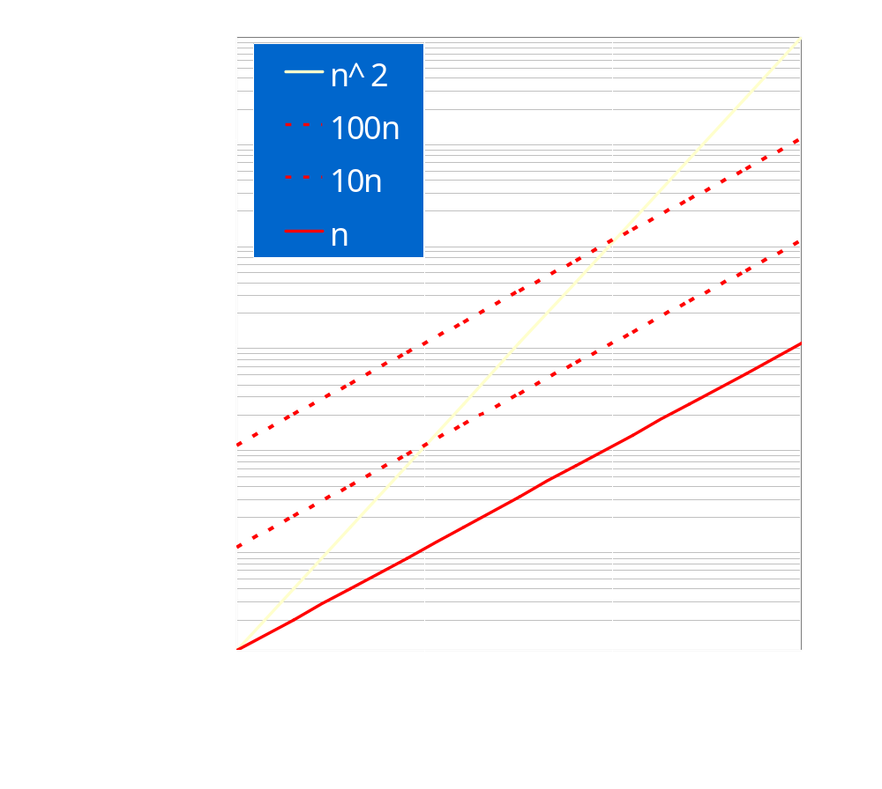
Example

Slide 68
Cautions on Using Experimental Analysis
You must choose good input test cases.
For a given value n, it is often wise to average over different types of data.
You must plot enough points to see if something is converging or not.
Even with the best of data, the accuracy is not exact.
Nevertheless, the ratio test and the power test are better than trying statistically to fit a polynomial to data points by regression methods which are very sensitive to noise.

