Slide 1
NP-Completeness
x
1
x
1
x
2
x
2
x
3
x
3
x
4
x
4
12
22
32
11
13
21
23
31
33

Slide 2
Outline and Reading
P and NP (§13.1)
  Definition of P
  Definition of NP
  Alternate definition of NP
NP-completeness (§13.2)
  Definition of NP-hard and NP-complete
  The Cook-Levin Theorem

Slide 3
Running Time Revisited
Input size, n
  To be exact, let n denote the number of bits in a nonunary encoding of the input
All the polynomial-time algorithms studied so far in this course run in polynomial time using this definition of input size.
  Exception: any pseudo-polynomial time algorithm
849
PVD
1843
ORD
SFO
142
802
LGA
337
1743
HNL
1387
2555
1099
LAX
1233
DFW
1120
MIA

Slide 4

Dealing with Hard Problems
What to do when we find a problem that looks hard…
I couldn’t find a polynomial-time algorithm;
I guess I’m too dumb.

Slide 5

Dealing with Hard Problems
Sometimes we can prove a strong lower bound… (but not usually)
I couldn’t find a polynomial-time algorithm,
because no such algorithm exists!

Slide 6





Dealing with Hard Problems
NP-completeness let’s us show collectively that a problem is hard.
I couldn’t find a polynomial-time algorithm,
but neither could all these other smart people.

Slide 7
Polynomial-Time
Decision Problems
To simplify the notion of “hardness,” we will focus on the following:
  Polynomial-time as the cut-off for efficiency
  Decision problems: output is 1 or 0 (“yes” or “no”)
    Examples:
    Does a given graph G have an Euler tour?
    Does a text T contain a pattern P?
    Does an instance of 0/1 Knapsack have a solution with benefit at least K?
    Does a graph G have an MST with weight at most K?

Slide 8
Problems and Languages
A language L is a set of strings defined over some alphabet Σ
Every decision algorithm A defines a language L
  L is the set consisting of every string x such that A outputs “yes” on input x.
  We say “A accepts x’’ in this case
    Example:
    If A determines whether or not a given graph G has an Euler tour, then the language L for A is all graphs with Euler tours.

Slide 9

The Complexity Class P
A complexity class is a collection of languages
P is the complexity class consisting of all languages that are accepted by polynomial-time algorithms
For each language L in P there is a polynomial-time decision algorithm A for L.
  If n=|x|, for x in L, then A runs in p(n) time on input x.
  The function p(n) is some polynomial

Slide 10

The Complexity Class NP
We say that an algorithm is non-deterministic if it uses the following operation:
  Choose(b): chooses a bit b
  Can be used to choose an entire string y (with |y| choices)
We say that a non-deterministic algorithm A accepts a string x if there exists some sequence of choose operations that causes A to output “yes” on input x.
NP is the complexity class consisting of all languages accepted by polynomial-time non-deterministic algorithms.

Slide 11
NP example
Problem: Decide if a graph has an MST of weight K
Algorithm:
  Non-deterministically choose a set T of n-1 edges
  Test that T forms a spanning tree
  Test that T has weight at most K
Analysis: Testing takes O(n+m) time, so this algorithm runs in polynomial time.

Slide 12
The Complexity Class NP Alternate Definition
We say that an algorithm B verfies the acceptance of a language L if and only if, for any x in L, there exists a certificate y such that B outputs “yes” on input (x,y).
NP is the complexity class consisting of all languages verified by polynomial-time algorithms.
We know: P is a subset of NP.
Major open question: P=NP?
Most researchers believe that P and NP are different.

Slide 13
NP example (2)
Problem: Decide if a graph has an MST of weight K
Verification Algorithm:
  Use as a certificate, y, a set T of n-1 edges
  Test that T forms a spanning tree
  Test that T has weight at most K
Analysis: Verification takes O(n+m) time, so this algorithm runs in polynomial time.

Slide 14
Equivalence of the
Two Definitions
Suppose A is a non-deterministic algorithm
  Let y be a certificate consisting of all the outcomes of the choose steps that A uses
  We can create a verification algorithm that uses y instead of A’s choose steps
  If A accepts on x, then there is a certificate y that allows us to verify this (namely, the choose steps A made)
  If A runs in polynomial-time, so does this verification algorithm
Suppose B is a verification algorithm
  Non-deterministically choose a certificate y
  Run B on y
  If B runs in polynomial-time, so does this non-deterministic algorithm

Slide 15
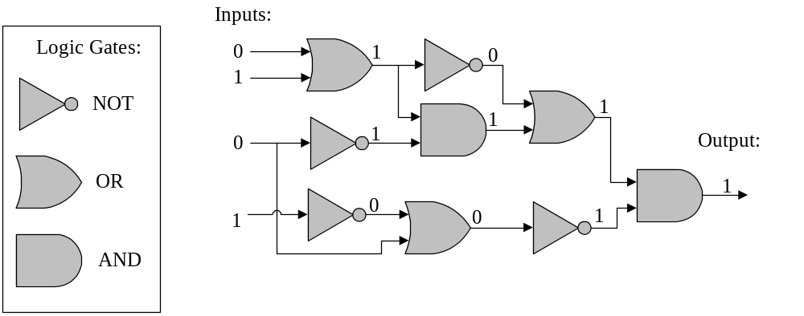
An Interesting Problem
A Boolean circuit is a circuit of AND, OR, and NOT gates; the CIRCUIT-SAT problem is to determine if there is an assignment of 0’s and 1’s to a circuit’s inputs so that the circuit outputs 1.

Slide 16
CIRCUIT-SAT is in NP
Non-deterministically choose a set of inputs and the outcome of every gate, then test each gate’s I/O.

Slide 17
NP-Completeness
A problem (language) L is NP-hard if every problem in NP can be reduced to L in polynomial time.
That is, for each language M in NP, we can take an input x for M, transform it in polynomial time to an input x’ for L such that x is in M if and only if x’ is in L.
L is NP-complete if it’s in NP and is NP-hard.
NP
poly-time
L

Slide 18
Cook-Levin Theorem
CIRCUIT-SAT is NP-complete.
  We already showed it is in NP.
To prove it is NP-hard, we have to show that every language in NP can be reduced to it.
  Let M be in NP, and let x be an input for M.
  Let y be a certificate that allows us to verify membership in M in polynomial time, p(n), by some algorithm D.
  Let S be a circuit of size at most O(p(n)²) that simulates a computer (details omitted…)
NP
M
poly-time
CIRCUIT-SAT

Slide 19
Cook-Levin Proof
We can build a circuit that simulates the verification of x’s membership in M using y.
  Let W be the working storage for D (including registers, such as program counter); let D be given in RAM “machine code.”
  Simulate p(n) steps of D by replicating circuit S for each step of D. Only input: y.
  Circuit is satisfiable if and only if x is accepted by D with some certificate y
  Total size is still polynomial: O(p(n)³).
D
D
D
< p(n)
W
W
W
cells
S
S
S
Output
0/1
from D
Inputs
y
y
y
n
x
x
x
p(n)
steps

Slide 20
Some Thoughts about P and NP
NP
NP-complete here
P
CIRCUIT-SAT
Belief: P is a proper subset of NP.
Implication: the NP-complete problems are the hardest in NP.
Why: Because if we could solve an NP-complete problem in polynomial time, we could solve every problem in NP in polynomial time.
That is, if an NP-complete problem is solvable in polynomial time, then P=NP.
Since so many people have attempted without success to find polynomial-time solutions to NP-complete problems, showing your problem is NP-complete is equivalent to showing that a lot of smart people have worked on your problem and found no polynomial-time algorithm.

Slide 21
Outline and Reading
Definitions (§13.1-2)
  NP is the set of all problems (languages) that can be
    accepted non-deterministically (using “choose” operations) in polynomial time.
    verified in polynomial-time given a certificate y.
Some NP-complete problems (§13.3)
  Problem reduction
  SAT (and CNF-SAT and 3SAT)
  Vertex Cover
  Clique
  Hamiltonian Cycle

Slide 22
Problem Reduction
A language M is polynomial-time reducible to a language L if an instance x for M can be transformed in polynomial time to an instance x’ for L such that x is in M if and only if x’ is in L.
  Denote this by M→L.
A problem (language) L is NP-hard if every problem in NP is polynomial-time reducible to L.
A problem (language) is NP-complete if it is in NP and it is NP-hard.
CIRCUIT-SAT is NP-complete:
  CIRCUIT-SAT is in NP
  For every M in NP,
  M → CIRCUIT-SAT.
Inputs:
0
1
0
1
1
1
0
1
Output:
1
1
0
0
1

Slide 23
Transitivity of Reducibility
If A → B and B → C, then A → C.
  An input x for A can be converted to x’ for B, such that x is in A if and only if x’ is in B. Likewise, for B to C.
  Convert x’ into x’’ for C such that x’ is in B iff x’’ is in C.
  Hence, if x is in A, x’ is in B, and x’’ is in C.
  Likewise, if x’’ is in C, x’ is in B, and x is in A.
  Thus, A → C, since polynomials are closed under composition.
Types of reductions:
  Local replacement: Show A → B by dividing an input to A into components and show how each component can be converted to a component for B.
  Component design: Show A → B by building special components for an input of B that enforce properties needed for A, such as “choice” or “evaluate.”

Slide 24
SAT
A Boolean formula is a formula where the variables and operations are Boolean (0/1):
  (a+b+¬d+e)(¬a+¬c)(¬b+c+d+e)(a+¬c+¬e)
  OR: +, AND: (times), NOT: ¬
SAT: Given a Boolean formula S, is S satisfiable, that is, can we assign 0’s and 1’s to the variables so that S is 1 (“true”)?
  Easy to see that CNF-SAT is in NP:
    Non-deterministically choose an assignment of 0’s and 1’s to the variables and then evaluate each clause. If they are all 1 (“true”), then the formula is satisfiable.

Slide 25
SAT is NP-complete
Reduce CIRCUIT-SAT to SAT.
  Given a Boolean circuit, make a variable for every input and gate.
  Create a sub-formula for each gate, characterizing its effect. Form the formula as the output variable AND-ed with all these sub-formulas:
    Example: m((a+b)↔e)(c↔¬f)(d↔¬g)(e↔¬h)(ef↔i)…
Inputs:
a
e
h
The formula is satisfiable
if and only if the
Boolean circuit
is satisfiable.
b
i
k
c
f
Output:
m
g
j
n
d

Slide 26
3SAT
The SAT problem is still NP-complete even if the formula is a conjunction of disjuncts, that is, it is in conjunctive normal form (CNF).
The SAT problem is still NP-complete even if it is in CNF and every clause has just 3 literals (a variable or its negation):
  (a+b+¬d)(¬a+¬c+e)(¬b+d+e)(a+¬c+¬e)
Reduction from SAT (See §13.3.1).

Slide 27
Vertex Cover
A vertex cover of graph G=(V,E) is a subset W of V, such that, for every edge (a,b) in E, a is in W or b is in W.
VERTEX-COVER: Given an graph G and an integer K, is does G have a vertex cover of size at most K?
VERTEX-COVER is in NP: Non-deterministically choose a subset W of size K and check that every edge is covered by W.

Slide 28
Vertex-Cover is NP-complete
Reduce 3SAT to VERTEX-COVER.
  Let S be a Boolean formula in CNF with each clause having 3 literals.
  For each variable x, create a node for x and ¬x, and connect these two:
  For each clause (a+b+c), create a triangle and connect these three nodes.
x
¬x
a
c
b

Slide 29
Vertex-Cover is NP-complete
Completing the construction
  Connect each literal in a clause triangle to its copy in a variable pair.
  E.g., a clause (¬x+y+z)
  Let n=# of variables
  Let m=# of clauses
  Set K=n+2m
x
¬x
y
¬y
z
¬z
a
c
b

Slide 30
Vertex-Cover is NP-complete
Example: (a+b+c)(¬a+b+¬c)(¬b+¬c+¬d)
Graph has vertex cover of size K=4+6=10 iff formula is satisfiable.
a
¬a
b
¬b
c
¬c
d
¬d
12
22
32
11
13
21
23
31
33

Slide 31
Clique
A clique of a graph G=(V,E) is a subgraph C that is fully-connected (every pair in C has an edge).
CLIQUE: Given a graph G and an integer K, is there a clique in G of size at least K?
CLIQUE is in NP: non-deterministically choose a subset C of size K and check that every pair in C has an edge in G.
This graph has
a clique of size 5

Slide 32
CLIQUE is NP-Complete
Reduction from VERTEX-COVER.
A graph G has a vertex cover of size K if and only if it’s complement has a clique of size n-K.
G
G’

Slide 33
Some Other NP-Complete Problems
SET-COVER: Given a collection of m sets, are there K of these sets whose union is the same as the whole collection of m sets?
  NP-complete by reduction from VERTEX-COVER
SUBSET-SUM: Given a set of integers and a distinguished integer K, is there a subset of the integers that sums to K?
  NP-complete by reduction from VERTEX-COVER

Slide 34
Some Other NP-Complete Problems
0/1 Knapsack: Given a collection of items with weights and benefits, is there a subset of weight at most W and benefit at least K?
  NP-complete by reduction from SUBSET-SUM
Hamiltonian-Cycle: Given an graph G, is there a cycle in G that visits each vertex exactly once?
  NP-complete by reduction from VERTEX-COVER
Traveling Saleperson Tour: Given a complete weighted graph G, is there a cycle that visits each vertex and has total cost at most K?
  NP-complete by reduction from Hamiltonian-Cycle.

Slide 35
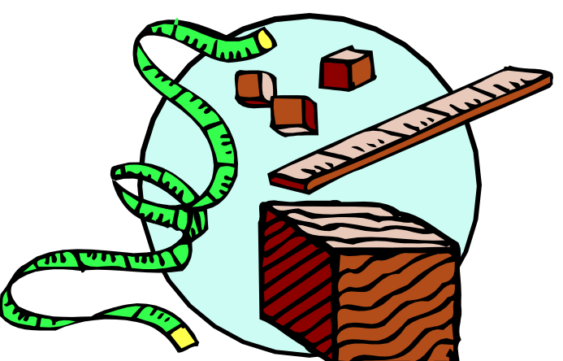
Approximation Algorithms

Slide 36
Outline and Reading
Approximation Algorithms for NP-Complete Problems (§13.4)
  Approximation ratios
  Polynomial-Time Approximation Schemes (§13.4.1)
  2-Approximation for Vertex Cover (§13.4.2)
  2-Approximation for TSP special case (§13.4.3)
  Log n-Approximation for Set Cover (§13.4.4)

Slide 37
Approximation Ratios
Optimization Problems
  We have some problem instance x that has many feasible “solutions”.
  We are trying to minimize (or maximize) some cost function c(S) for a “solution” S to x. For example,
    Finding a minimum spanning tree of a graph
    Finding a smallest vertex cover of a graph
    Finding a smallest traveling salesperson tour in a graph

Slide 38
Approximation Ratios
An approximation produces a solution T
  T is a k-approximation to the optimal solution OPT if c(T)/c(OPT) < k (assuming a min. prob.; a maximization approximation would be the reverse)

Slide 39
Polynomial-Time Approximation Schemes
A problem L has a polynomial-time approximation scheme (PTAS) if it has a polynomial-time (1+ε)-approximation algorithm, for any fixed ε >0 (this value can appear in the running time).
0/1 Knapsack has a PTAS, with a running time that is O(n³/ ε). Please see §13.4.1 in Goodrich-Tamassia for details.

Slide 40
Vertex Cover
A vertex cover of graph G=(V,E) is a subset W of V, such that, for every (a,b) in E, a is in W or b is in W.
OPT-VERTEX-COVER: Given an graph G, find a vertex cover of G with smallest size.
OPT-VERTEX-COVER is NP-hard.

Slide 41
A 2-Approximation for Vertex Cover
Every chosen edge e has both ends in C
But e must be covered by an optimal cover; hence, one end of e must be in OPT
Thus, there is at most twice as many vertices in C as in OPT.
That is, C is a 2-approx. of OPT
Running time: O(m)
Algorithm VertexCoverApprox(G)
Input graph G
Output a vertex cover C for G
C ← empty set
H ← G
  while H has edges
  e ← H.removeEdge(H.anEdge()) v ← H.origin(e)
  w ← H.destination(e)
  C.add(v)
  C.add(w)
  for each f incident to v or w
  H.removeEdge(f)
  return C

Slide 42
Special Case of the Traveling Salesperson Problem
OPT-TSP: Given a complete, weighted graph, find a cycle of minimum cost that visits each vertex.
  OPT-TSP is NP-hard
  Special case: edge weights satisfy the triangle inequality (which is common in many applications):
    w(a,b) + w(b,c) > w(a,c)
b
5
4
a
c
7

Slide 43
A 2-Approximation for TSP Special Case
Algorithm TSPApprox(G)
Input weighted complete graph G, satisfying the triangle inequality
Output a TSP tour T for G
M ← a minimum spanning tree for G
P ← an Euler tour traversal of M, starting at some vertex s
T ← empty list
  for each vertex v in P (in traversal order)
  if this is v’s first appearance in P then T.insertLast(v)
  T.insertLast(s)
  return T
Euler tour
P
of MST
M
Output tour
T

Slide 44
A 2-Approximation for TSP Special Case - Proof
The optimal tour is a spanning tour; hence |M|<|OPT|.
The Euler tour P visits each edge of M twice; hence |P|=2|M|
Each time we shortcut a vertex in the Euler Tour we will not increase the total length, by the triangle inequality (w(a,b) + w(b,c) > w(a,c)); hence, |T|<|P|.
Therefore, |T|<|P|=2|M|<2|OPT|
Output tour
T
Euler tour
P
of MST
M
Optimal tour
OPT
(at most the cost of
P
)
(twice the cost of
M
)
(at least the cost of MST
M
)

Slide 45
Set Cover
Algorithm SetCoverApprox(G)
Input a collection of sets S₁…S_{m} Output a subcollection C with same union
F ← {S₁,S₂,…,S_{m}}
C ← empty set
U ← union of S₁…S_{m}
while U is not empty
  S_{i} ← set in F with most elements in U
  F.remove(S_{i})
  C.add(S_{i})
  Remove all elements in S_{i} from U
  return C
OPT-SET-COVER: Given a collection of m sets, find the smallest number of them whose union is the same as the whole collection of m sets?
  OPT-SET-COVER is NP-hard
Greedy approach produces an O(log n)-approximation algorithm. See §13.4.4 for details.

