Slide 1
Binary Search Trees
<
6
2
>
9
1
4
=
8

Slide 2

Ordered Dictionaries
Keys are assumed to come from a total order.
New operations:
  closestKeyBefore(k)
  closestElemBefore(k)
  closestKeyAfter(k)
  closestElemAfter(k)

Slide 3

Binary Search (§3.1.1)
Binary search performs operation findElement(k) on a dictionary implemented by means of an array-based sequence, sorted by key
  similar to the high-low game
  at each step, the number of candidate items is halved
  terminates after O(log n) steps
Example: findElement(7)
0
1
3
4
5
7
8
9
11
14
16
18
19
l
m
h
0
1
3
4
5
7
8
9
11
14
16
18
19
l
m
h
0
1
3
4
5
7
8
9
11
14
16
18
19
l
m
h
0
1
3
4
5
7
8
9
11
14
16
18
19
l=m =h

Slide 4

Lookup Table (§3.1.1)
A lookup table is a dictionary implemented by means of a sorted sequence
  We store the items of the dictionary in an array-based sequence, sorted by key
  We use an external comparator for the keys
Performance:
  findElement takes O(log n) time, using binary search
  insertItem takes O(n) time since in the worst case we have to shift n/2 items to make room for the new item
  removeElement take O(n) time since in the worst case we have to shift n/2 items to compact the items after the removal
The lookup table is effective only for dictionaries of small size or for dictionaries on which searches are the most common operations, while insertions and removals are rarely performed (e.g., credit card authorizations)

Slide 5

Binary Search Tree (§3.1.2)
A binary search tree is a binary tree storing keys (or key-element pairs) at its internal nodes and satisfying the following property:
  Let u, v, and w be three nodes such that u is in the left subtree of v and w is in the right subtree of v. We have
  key(u) ≤ key(v) ≤ key(w)
External nodes do not store items
An inorder traversal of a binary search trees visits the keys in increasing order
6
2
9
1
4
8

Slide 6
Search (§3.1.3)
To search for a key k, we trace a downward path starting at the root
The next node visited depends on the outcome of the comparison of k with the key of the current node
If we reach a leaf, the key is not found and we return NO_SUCH_KEY
Example: findElement(4)
Algorithm findElement(k, v)
if T.isExternal (v)
  return NO_SUCH_KEY
  if k < key(v)
  return findElement(k, T.leftChild(v))
  else if k = key(v)
  return element(v)
  else { k > key(v) }
  return findElement(k, T.rightChild(v))
<
6
2
>
9
1
4
=
8

Slide 7
Insertion (§3.1.4)
<
6
To perform operation insertItem(k, o), we search for key k
Assume k is not already in the tree, and let let w be the leaf reached by the search
We insert k at node w and expand w into an internal node
Example: insert 5
2
>
9
1
4
>
8
w
6
2
9
1
4
8
w
5

Slide 8
Deletion (§3.1.5)
To perform operation removeElement(k), we search for key k
Assume key k is in the tree, and let let v be the node storing k
If node v has a leaf child w, we remove v and w from the tree with operation removeAboveExternal(w)
Example: remove 4
<
6
2
>
9
1
4
v
8
w
5
6
2
9
1
5
8

Slide 9
Deletion (cont.)
1
v
We consider the case where the key k to be removed is stored at a node v whose children are both internal
  we find the internal node w that follows v in an inorder traversal
  we copy key(w) into node v
  we remove node w and its left child z (which must be a leaf) by means of operation removeAboveExternal(z)
Example: remove 3
3
2
8
6
9
w
5
z
1
v
5
2
8
6
9

Slide 10
Performance (§3.1.6)
Consider a dictionary with n items implemented by means of a binary search tree of height h
  the space used is O(n)
  methods findElement , insertItem and removeElement take O(h) time
The height h is O(n) in the worst case and O(log n) in the best case

Slide 11
AVL Trees
6
v
3
8
z
4

Slide 12
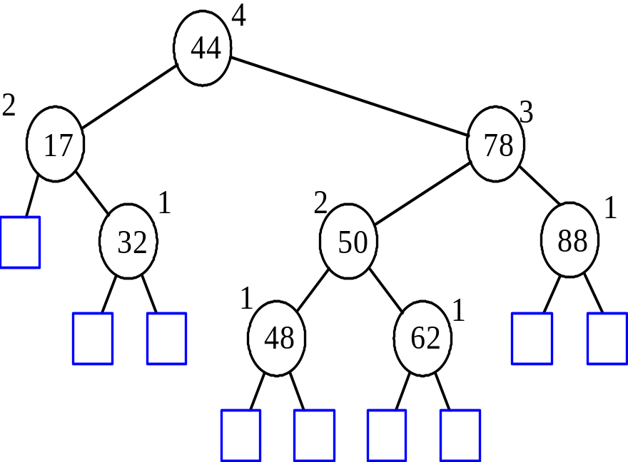
AVL Tree Definition
AVL trees are balanced.
An AVL Tree is a binary search tree such that for every internal node v of T, the heights of the children of v can differ by at most 1.
An example of an AVL tree where the heights are shown next to the nodes:
Fact: The height of an AVL tree storing n keys is O(log n).

Slide 13
Insertion in an AVL Tree
Insertion is as in a binary search tree
Always done by expanding an external node.
Example:
44
44
17
78
17
78
c=z
a=y
32
50
88
32
50
88
48
62
48
62
b=x
54
w
before insertion
after insertion

Slide 14
Trinode Restructuring
let (a,b,c) be an inorder listing of x, y, z
perform the rotations needed to make b the topmost node of the three
(other two cases are symmetrical)
a=z
a=z
case 2: double rotation
(a right rotation about c, then a left rotation about a)
T₀
T₀
c=y
b=y
T₁
b=x
T₃
c=x
T₂
T₃
b=y
T₁
T₂
b=x
a=z
c=x
a=z
c=y
T₀
T₁
T₂
T₃
T₀
T₁
T₂
T₃
case 1: single rotation
(a left rotation about a)

Slide 15
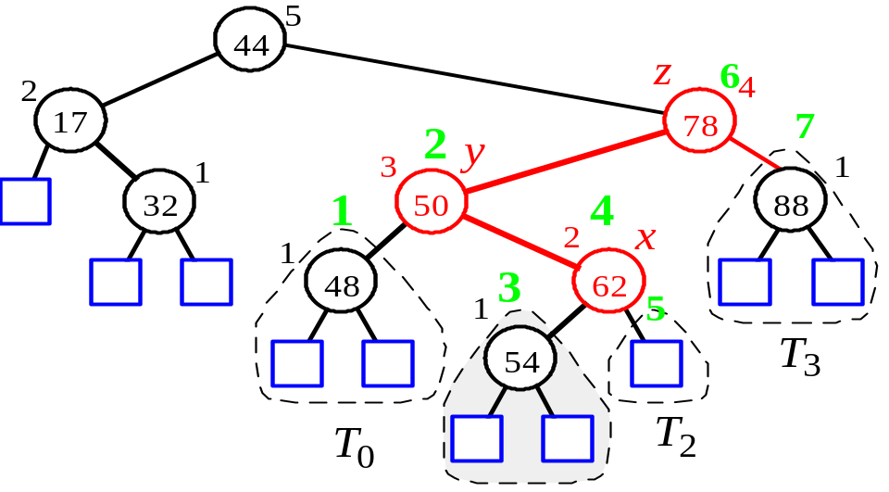
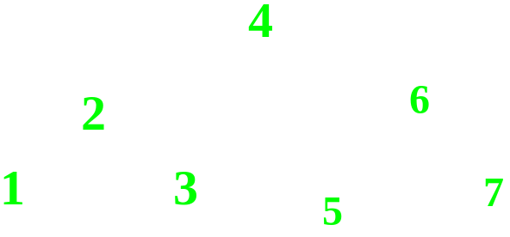
Insertion Example, continued
unbalanced...
T
4
1
44
2
3
x
17
y
62
z
1
2
2
32
50
78
1
1
1
...balanced
48
54
88
T
2
T
0
T
1
T
3

Slide 16
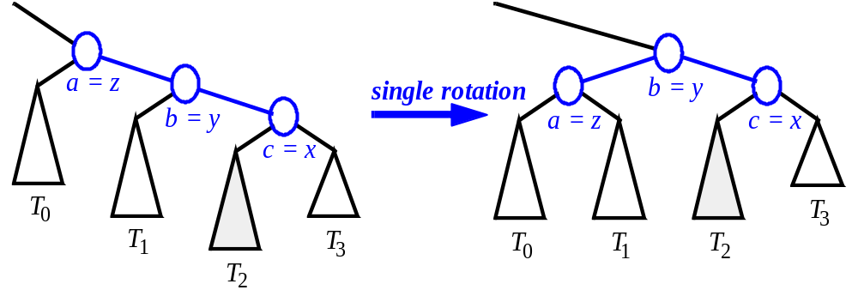
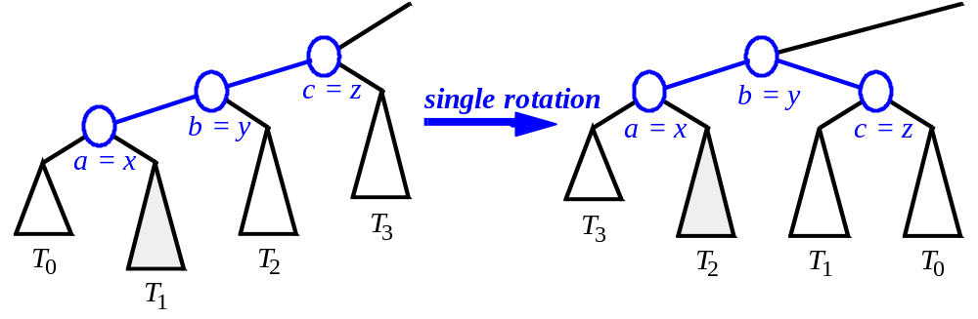
Restructuring (as Single Rotations)
Single Rotations:

Slide 17
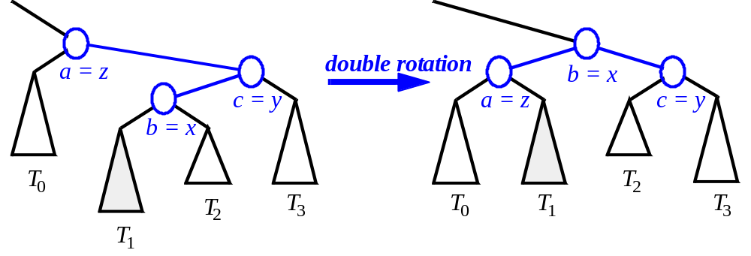
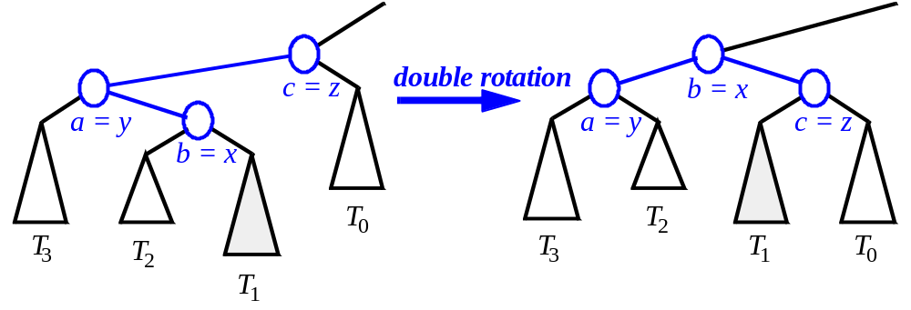
Restructuring (as Double Rotations)
double rotations:

Slide 18
Removal in an AVL Tree
Removal begins as in a binary search tree, which means the node removed will become an empty external node. Its parent, w, may cause an imbalance.
Example:
44
44
17
62
17
62
32
50
78
50
78
48
54
88
48
54
88
before deletion of 32
after deletion

Slide 19
Rebalancing after a Removal
Let z be the first unbalanced node encountered while travelling up the tree from w. Also, let y be the child of z with the larger height, and let x be the child of y with the larger height.
We perform restructure(x) to restore balance at z.
As this restructuring may upset the balance of another node higher in the tree, we must continue checking for balance until the root of T is reached
62
a=z
44
44
78
w
17
62
b=y
17
50
88
50
78
c=x
48
54
48
54
88

Slide 20

Running Times for AVL Trees
a single restructure is O(1)
  using a linked-structure binary tree
find is O(log n)
  height of tree is O(log n), no restructures needed
insert is O(log n)
  initial find is O(log n)
  Restructuring up the tree, maintaining heights is O(log n)
remove is O(log n)
  initial find is O(log n)
  Restructuring up the tree, maintaining heights is O(log n)

Slide 21
(2,4) Trees
9
2 5 7
10 14

Slide 22
Multi-Way Search Tree
A multi-way search tree is an ordered tree such that
  Each internal node has at least two children and stores d −1 key-element items (k_{i}, o_{i}), where d is the number of children
  For a node with children v₁ v₂ … v_{d} storing keys k₁ k₂ … k_{d−1}
    keys in the subtree of v₁ are less than k₁
    keys in the subtree of v_{i} are between k_{i−1} and k_{i} (i = 2, …, d − 1)
    keys in the subtree of v_{d} are greater than k_{d−1}
  The leaves store no items and serve as placeholders
11 24
2 6 8
15
27 32
30

Slide 23
Multi-Way Inorder Traversal
We can extend the notion of inorder traversal from binary trees to multi-way search trees
Namely, we visit item (k_{i}, o_{i}) of node v between the recursive traversals of the subtrees of v rooted at children v_{i} and v_{i} ₊ ₁
An inorder traversal of a multi-way search tree visits the keys in increasing order
11 24
8
12
2 6 8
15
27 32
2
4
6
10
14
18
30
1
3
5
7
9
11
13
16
19
15
17

Slide 24
Multi-Way Searching
Similar to search in a binary search tree
A each internal node with children v₁ v₂ … v_{d} and keys k₁ k₂ … k_{d−1}
  k = k_{i} (i = 1, …, d − 1): the search terminates successfully
  k < k₁: we continue the search in child v₁
  k_{i−1} < k < k_{i} (i = 2, …, d − 1): we continue the search in child v_{i}
  k > k_{d−1}: we continue the search in child v_{d}
Reaching an external node terminates the search unsuccessfully
Example: search for 30
11 24
2 6 8
15
27 32
30

Slide 25
(2,4) Tree
A (2,4) tree (also called 2-4 tree or 2-3-4 tree) is a multi-way search with the following properties
  Node-Size Property: every internal node has at most four children
  Depth Property: all the external nodes have the same depth
Depending on the number of children, an internal node of a (2,4) tree is called a 2-node, 3-node or 4-node
10 15 24
2 8
12
18
27 32

Slide 26
Height of a (2,4) Tree
Theorem: A (2,4) tree storing n items has height O(log n)
Proof:
  Let h be the height of a (2,4) tree with n items
  Since there are at least 2^{i} items at depth i = 0, … , h − 1 and no items at depth h, we have
  n ≥ 1 + 2 + 4 + … + 2^{h−1} = 2^{h} − 1
  Thus, h ≤ log (n + 1)
Searching in a (2,4) tree with n items takes O(log n) time
depth
items
0
1
1
2
h−1
2^{h−1}
h
0

Slide 27
Insertion
We insert a new item (k, o) at the parent v of the leaf reached by searching for k
  We preserve the depth property but
  We may cause an overflow (i.e., node v may become a 5-node)
Example: inserting key 30 causes an overflow
10 15 24
v
2 8
12
18
27 32 35
10 15 24
v
2 8
12
18
27 30 32 35

Slide 28
Overflow and Split
We handle an overflow at a 5-node v with a split operation:
  let v₁ … v₅ be the children of v and k₁ … k₄ be the keys of v
  node v is replaced nodes v' and v"
    v' is a 3-node with keys k₁ k₂ and children v₁ v₂ v₃
    v" is a 2-node with key k₄ and children v₄ v₅
  key k₃ is inserted into the parent u of v (a new root may be created)
The overflow may propagate to the parent node u
u
u
15 24
15 24 32
v
v'
v"
12
18
27 30 32 35
12
18
27 30
35
v₁
v₂
v₃
v₄
v₅
v₁
v₂
v₃
v₄
v₅

Slide 29
Analysis of Insertion
Algorithm insertItem(k, o)
1. We search for key k to locate the insertion node v
2. We add the new item (k, o) at node v
3. while overflow(v)
  if isRoot(v)
  create a new empty root above v
  v ← split(v)
Let T be a (2,4) tree with n items
  Tree T has O(log n) height
  Step 1 takes O(log n) time because we visit O(log n) nodes
  Step 2 takes O(1) time
  Step 3 takes O(log n) time because each split takes O(1) time and we perform O(log n) splits
Thus, an insertion in a (2,4) tree takes O(log n) time

Slide 30
Deletion
We reduce deletion of an item to the case where the item is at the node with leaf children
Otherwise, we replace the item with its inorder successor (or, equivalently, with its inorder predecessor) and delete the latter item
Example: to delete key 24, we replace it with 27 (inorder successor)
10 15 24
2 8
12
18
27 32 35
10 15 27
2 8
12
18
32 35

Slide 31
Underflow and Fusion
Deleting an item from a node v may cause an underflow, where node v becomes a 1-node with one child and no keys
To handle an underflow at node v with parent u, we consider two cases
Case 1: the adjacent siblings of v are 2-nodes
  Fusion operation: we merge v with an adjacent sibling w and move an item from u to the merged node v'
  After a fusion, the underflow may propagate to the parent u
u
u
9 14
9
w
v
v'
2 5 7
10
2 5 7
10 14

Slide 32
Underflow and Transfer
To handle an underflow at node v with parent u, we consider two cases
Case 2: an adjacent sibling w of v is a 3-node or a 4-node
  Transfer operation:
  1. we move a child of w to v
  2. we move an item from u to v
  3. we move an item from w to u
  After a transfer, no underflow occurs
u
u
4 9
4 8
w
v
w
v
2
6 8
2
6
9

Slide 33
Analysis of Deletion
Let T be a (2,4) tree with n items
  Tree T has O(log n) height
In a deletion operation
  We visit O(log n) nodes to locate the node from which to delete the item
  We handle an underflow with a series of O(log n) fusions, followed by at most one transfer
  Each fusion and transfer takes O(1) time
Thus, deleting an item from a (2,4) tree takes O(log n) time

Slide 34
Implementing a Dictionary
Comparison of efficient dictionary implementations
 | Search | Insert | Delete | Notes
Hash Table | 1 expected | 1 expected | 1 expected | no ordered dictionary methods simple to implement
Skip List | log n high prob. | log n high prob. | log n high prob. | randomized insertion simple to implement
(2,4) Tree | log n worst-case | log n worst-case | log n worst-case | complex to implement

Slide 35
Splay Trees
6
v
3
8
z
4

Slide 36
Splay Trees are Binary Search Trees
(20,Z)
all the keys in the blue region are ≥ 20
note that two keys of equal value may be well-separated
(10,A)
(35,R)
BST Rules:
  items stored only at internal nodes
  keys stored at nodes in the left subtree of v are less than or equal to the key stored at v
  keys stored at nodes in the right subtree of v are greater than or equal to the key stored at v
An inorder traversal will return the keys in order
(7,T)
(14,J)
(21,O)
(37,P)
(1,Q)
(8,N)
(36,L)
(40,X)
(1,C)
(5,H)
(7,P)
(10,U)
(2,R)
(5,G)
all the keys in the yellow region are ≤ 20
(5,I)
(6,Y)

Slide 37
Searching in a Splay Tree: Starts the Same as in a BST
(20,Z)
Search proceeds down the tree to found item or an external node.
Example: Search for time with key 11.
(10,A)
(35,R)
(7,T)
(14,J)
(21,O)
(37,P)
(1,Q)
(8,N)
(36,L)
(40,X)
(1,C)
(5,H)
(7,P)
(10,U)
(2,R)
(5,G)
(5,I)
(6,Y)

Slide 38
Example Searching in a BST, continued
(20,Z)
search for key 8, ends at an internal node.
(10,A)
(35,R)
(7,T)
(14,J)
(21,O)
(37,P)
(1,Q)
(8,N)
(36,L)
(40,X)
(1,C)
(5,H)
(7,P)
(10,U)
(2,R)
(5,G)
(5,I)
(6,Y)

Slide 39
Splay Trees do Rotations after Every Operation (Even Search)
new operation: splay
  splaying moves a node to the root using rotations
right rotation
  makes the left child x of a node y into y’s parent; y becomes the right child of x
left rotation
  makes the right child y of a node x into x’s parent; x becomes the left child of y
y
x
a right rotation about y
a left rotation about x
x
T₃
T₁
y
x
y
T₁
T₂
T₁
T₂
T₃
y
x
T₃
T₂
T₃
T₁
T₂
(structure of tree above y is not modified)
(structure of tree above x is not modified)

Slide 40
Splaying:
“x is a left-left grandchild” means x is a left child of its parent, which is itself a left child of its parent
p is x’s parent; g is p’s parent
start with node x
is x a left-left grandchild?
is x the root?
yes
zig-zig
stop
yes
right-rotate about g, right-rotate about p
no
is x a right-right grandchild?
is x a child of the root?
zig-zig
no
yes
left-rotate about g, left-rotate about p
yes
is x a right-left grandchild?
is x the left child of the root?
zig-zag
no
yes
left-rotate about p, right-rotate about g
is x a left-right grandchild?
zig
zig
zig-zag
yes
right-rotate about the root
left-rotate about the root
yes
right-rotate about p, left-rotate about g

Slide 41
Visualizing the Splaying Cases
zig-zag
x
z
z
T₄
y
z
y
T₁
y
T₄
T₁
T₂
T₃
T₄
T₃
x
x
T₂
T₃
T₁
T₂
zig-zig
x
y
zig
T₁
T₄
x
y
x
T₂
T₃
w
y
z
w
T₃
T₄
T₁
T₂
T₃
T₄
T₁
T₂

Slide 42
Splaying Example
(20,Z)
(10,A)
(35,R)
let x = (8,N)
  x is the right child of its parent, which is the left child of the grandparent
  left-rotate around p, then right-rotate around g
g
1.
(before rotating)
p
(7,T)
(14,J)
(21,O)
(37,P)
(1,Q)
(8,N)
(36,L)
(40,X)
x
(1,C)
(5,H)
(7,P)
(10,U)
(2,R)
(5,G)
(20,Z)
(5,I)
(6,Y)
g
(10,A)
(35,R)
(20,Z)
x
(8,N)
(14,J)
(21,O)
(37,P)
x
(8,N)
(35,R)
g
p
(7,T)
(10,U)
(36,L)
(40,X)
p
(7,T)
(10,A)
(21,O)
(37,P)
(1,Q)
(7,P)
(1,Q)
(7,P)
(14,J)
(36,L)
(40,X)
2.
(after first rotation)
(1,C)
(5,H)
(1,C)
(5,H)
(10,U)
3.
(after second rotation)
(2,R)
(5,G)
(2,R)
(5,G)
(5,I)
(6,Y)
(5,I)
(6,Y)
x is not yet the root, so we splay again

Slide 43
Splaying Example, Continued
now x is the left child of the root
  right-rotate around root
(20,Z)
x
(8,N)
(35,R)
(7,T)
(10,A)
(21,O)
(37,P)
(1,Q)
(7,P)
(14,J)
(36,L)
(40,X)
(8,N)
x
2.
(after rotation)
(1,C)
(5,H)
(10,U)
1.
(before applying rotation)
(7,T)
(20,Z)
(2,R)
(5,G)
(1,Q)
(7,P)
(10,A)
(35,R)
(5,I)
(6,Y)
(1,C)
(5,H)
(14,J)
(21,O)
(37,P)
(2,R)
(5,G)
(10,U)
(36,L)
(40,X)
(5,I)
(6,Y)
x is the root, so stop

Slide 44
Example Result of Splaying
(20,Z)
(10,A)
(35,R)
before
(7,T)
(14,J)
(21,O)
(37,P)
tree might not be more balanced
e.g. splay (40,X)
  before, the depth of the shallowest leaf is 3 and the deepest is 7
  after, the depth of shallowest leaf is 1 and deepest is 8
(1,Q)
(8,N)
(36,L)
(40,X)
(1,C)
(5,H)
(7,P)
(10,U)
(2,R)
(5,G)
(40,X)
(5,I)
(6,Y)
(20,Z)
(20,Z)
(10,A)
(40,X)
(10,A)
(37,P)
(14,J)
(37,P)
(7,T)
(14,J)
(35,R)
(7,T)
(1,Q)
(8,N)
(35,R)
(1,Q)
(8,N)
(21,O)
(36,L)
(1,C)
(10,U)
(21,O)
(36,L)
(1,C)
(5,H)
(7,P)
(10,U)
(5,H)
(7,P)
(2,R)
(5,G)
(2,R)
(5,G)
after first splay
after second splay
(6,Y)
(5,I)
(6,Y)
(5,I)

Slide 45

Splay Tree Definition
a splay tree is a binary search tree where a node is splayed after it is accessed (for a search or update)
  deepest internal node accessed is splayed
  splaying costs O(h), where h is height of the tree – which is still O(n) worst-case
    O(h) rotations, each of which is O(1)

Slide 46

Splay Trees & Ordered Dictionaries
which nodes are splayed after each operation?
method
splay node
if key found, use that node
if key not found, use parent of ending external node
findElement
insertElement
use the new node containing the item inserted
use the parent of the internal node that was actually removed from the tree (the parent of the node that the removed item was swapped with)
removeElement

Slide 47
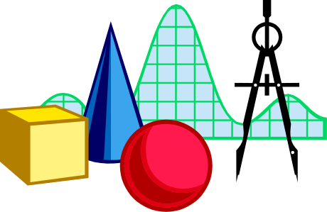
Amortized Analysis of Splay Trees
Running time of each operation is proportional to time for splaying.
Define rank(v) as the logarithm (base 2) of the number of nodes in subtree rooted at v.
Costs: zig = $1, zig-zig = $2, zig-zag = $2.
Thus, cost for playing a node at depth d = $d.
Imagine that we store rank(v) cyber-dollars at each node v of the splay tree (just for the sake of analysis).

Slide 48

Cost per zig
y
zig
T₄
x
x
T₃
w
y
w
T₁
T₂
T₃
T₄
T₁
T₂
Doing a zig at x costs at most rank’(x) - rank(x):
  cost = rank’(x) + rank’(y) - rank(y) - rank(x) < rank’(x) - rank(x).

Slide 49
Cost per zig-zig and zig-zag
z
T₄
T₁
x
y
T₃
zig-zig
y
T₂
T₁
x
T₂
z
T₃
T₄
Doing a zig-zig or zig-zag at x costs at most 3(rank’(x) - rank(x)) - 2.
  Proof: See Theorem 3.9, Page 192.
z
zig-zag
x
T₁
y
z
y
T₄
T₁
T₂
T₃
T₄
x
T₂
T₃

Slide 50
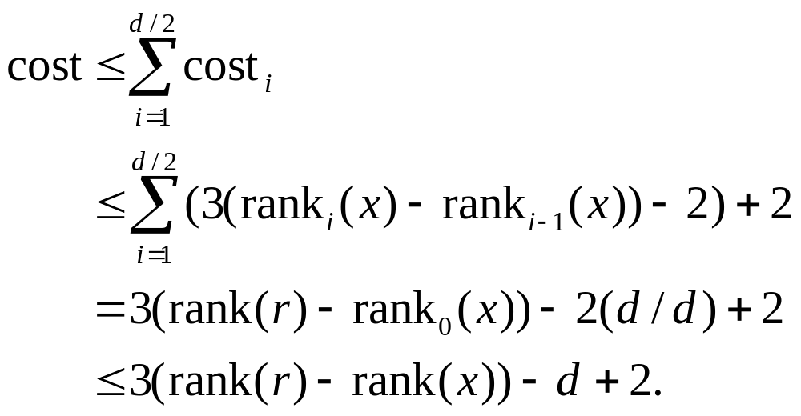
Cost of Splaying
Cost of splaying a node x at depth d of a tree rooted at r:
  at most 3(rank(r) - rank(x)) - d + 2:
  Proof: Splaying x takes d/2 splaying substeps:

Slide 51

Performance of Splay Trees
Recall: rank of a node is logarithm of its size.
Thus, amortized cost of any splay operation is O(log n).
In fact, the analysis goes through for any reasonable definition of rank(x).
This implies that splay trees can actually adapt to perform searches on frequently-requested items much faster than O(log n) in some cases. (See Theorems 3.10 and 3.11.)

Slide 52
Skip Lists
S₃
−∞
+∞
S₂
−∞
15
+∞
S₁
−∞
15
23
+∞
S₀
−∞
10
15
23
36
+∞

Slide 53
Outline and Reading
What is a skip list (§3.5)
Operations
  Search (§3.5.1)
  Insertion (§3.5.2)
  Deletion (§3.5.2)
Implementation
Analysis (§3.5.3)
  Space usage
  Search and update times

Slide 54
What is a Skip List
A skip list for a set S of distinct (key, element) items is a series of lists S₀, S₁ , … , S_{h} such that
  Each list S_{i} contains the special keys +∞ and −∞
  List S₀ contains the keys of S in nondecreasing order
  Each list is a subsequence of the previous one, i.e.,
  S₀ ⊇ S₁ ⊇ … ⊇ S_{h}
  List S_{h} contains only the two special keys
We show how to use a skip list to implement the dictionary ADT
S₃
−∞
+∞
S₂
−∞
31
+∞
S₁
−∞
23
31
34
64
+∞
S₀
−∞
12
23
26
31
34
44
56
64
78
+∞

Slide 55
Search
We search for a key x in a a skip list as follows:
  We start at the first position of the top list
  At the current position p, we compare x with y ← key(after(p))
  x = y: we return element(after(p))
  x > y: we “scan forward”
  x < y: we “drop down”
  If we try to drop down past the bottom list, we return NO_SUCH_KEY
Example: search for 78
S₃
−∞
+∞
S₂
−∞
31
+∞
S₁
−∞
23
31
34
64
+∞
S₀
−∞
12
23
26
31
34
44
56
64
78
+∞

Slide 56
Randomized Algorithms
A randomized algorithm performs coin tosses (i.e., uses random bits) to control its execution
It contains statements of the type
  b ← random()
  if b = 0
  do A …
  else { b = 1}
  do B …
Its running time depends on the outcomes of the coin tosses
We analyze the expected running time of a randomized algorithm under the following assumptions
  the coins are unbiased, and
  the coin tosses are independent
The worst-case running time of a randomized algorithm is often large but has very low probability (e.g., it occurs when all the coin tosses give “heads”)
We use a randomized algorithm to insert items into a skip list

Slide 57
Insertion
To insert an item (x, o) into a skip list, we use a randomized algorithm:
  We repeatedly toss a coin until we get tails, and we denote with i the number of times the coin came up heads
  If i ≥ h, we add to the skip list new lists S_{h+1}, … , S_{i +1}, each containing only the two special keys
  We search for x in the skip list and find the positions p₀, p₁ , …, p_{i} of the items with largest key less than x in each list S₀, S₁, … , S_{i}
  For j ← 0, …, i, we insert item (x, o) into list S_{j} after position p_{j}
Example: insert key 15, with i = 2
S₃
−∞
+∞
p₂
S₂
−∞
+∞
S₂
−∞
15
+∞
p₁
S₁
−∞
23
+∞
S₁
−∞
15
23
+∞
p₀
S₀
−∞
10
23
36
+∞
S₀
−∞
10
15
23
36
+∞

Slide 58
Deletion
To remove an item with key x from a skip list, we proceed as follows:
  We search for x in the skip list and find the positions p₀, p₁ , …, p_{i} of the items with key x, where position p_{j} is in list S_{j}
  We remove positions p₀, p₁ , …, p_{i} from the lists S₀, S₁, … , S_{i}
  We remove all but one list containing only the two special keys
Example: remove key 34
S₃
−∞
+∞
p₂
S₂
−∞
34
+∞
S₂
−∞
+∞
p₁
S₁
−∞
23
34
+∞
S₁
−∞
23
+∞
p₀
S₀
−∞
12
23
34
45
+∞
S₀
−∞
12
23
45
+∞

Slide 59
Implementation
We can implement a skip list with quad-nodes
A quad-node stores:
  item
  link to the node before
  link to the node after
  link to the node below
  link to the node after
Also, we define special keys PLUS_INF and MINUS_INF, and we modify the key comparator to handle them
quad-node
x

Slide 60
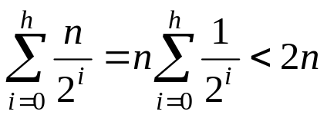
Space Usage
Consider a skip list with n items
  By Fact 1, we insert an item in list S_{i} with probability 1/2^{i}
  By Fact 2, the expected size of list S_{i} is n/2^{i}
The expected number of nodes used by the skip list is
The space used by a skip list depends on the random bits used by each invocation of the insertion algorithm
We use the following two basic probabilistic facts:
  Fact 1: The probability of getting i consecutive heads when flipping a coin is 1/2^{i}
  Fact 2: If each of n items is present in a set with probability p, the expected size of the set is np
Thus, the expected space usage of a skip list with n items is O(n)

Slide 61
Height
The running time of the search an insertion algorithms is affected by the height h of the skip list
We show that with high probability, a skip list with n items has height O(log n)
We use the following additional probabilistic fact:
  Fact 3: If each of n events has probability p, the probability that at least one event occurs is at most np
Consider a skip list with n items
  By Fact 1, we insert an item in list S_{i} with probability 1/2^{i}
  By Fact 3, the probability that list S_{i} has at least one item is at most n/2^{i}
By picking i = 3log n, we have that the probability that S_{3log n} has at least one item is
at most
n/2^{3log n} = n/n³ = 1/n²
Thus a skip list with n items has height at most 3log n with probability at least 1 − 1/n²

Slide 62
Search and Update Times
The search time in a skip list is proportional to
  the number of drop-down steps, plus
  the number of scan-forward steps
The drop-down steps are bounded by the height of the skip list and thus are O(log n) with high probability
To analyze the scan-forward steps, we use yet another probabilistic fact:
  Fact 4: The expected number of coin tosses required in order to get tails is 2
When we scan forward in a list, the destination key does not belong to a higher list
  A scan-forward step is associated with a former coin toss that gave tails
By Fact 4, in each list the expected number of scan-forward steps is 2
Thus, the expected number of scan-forward steps is O(log n)
We conclude that a search in a skip list takes O(log n) expected time
The analysis of insertion and deletion gives similar results

Slide 63
Summary
A skip list is a data structure for dictionaries that uses a randomized insertion algorithm
In a skip list with n items
  The expected space used is O(n)
  The expected search, insertion and deletion time is O(log n)
Using a more complex probabilistic analysis, one can show that these performance bounds also hold with high probability
Skip lists are fast and simple to implement in practice

Slide 64
Red-Black Trees
6
v
3
8
z
4

Slide 65
Outline and Reading
From (2,4) trees to red-black trees (§3.3.3)
Red-black tree (§ 3.3.3)
  Definition
  Height
  Insertion
    restructuring
    recoloring
  Deletion
    restructuring
    recoloring
    adjustment

Slide 66
From (2,4) to Red-Black Trees
A red-black tree is a representation of a (2,4) tree by means of a binary tree whose nodes are colored red or black
In comparison with its associated (2,4) tree, a red-black tree has
  same logarithmic time performance
  simpler implementation with a single node type
4
3 5
2 6 7
4
5
3
6
OR
3
5
2
7

Slide 67
Red-Black Tree
A red-black tree can also be defined as a binary search tree that satisfies the following properties:
  Root Property: the root is black
  External Property: every leaf is black
  Internal Property: the children of a red node are black
  Depth Property: all the leaves have the same black depth
9
4
15
2
6
12
21
7

Slide 68
Height of a Red-Black Tree
Theorem: A red-black tree storing n items has height O(log n)
Proof:
  The height of a red-black tree is at most twice the height of its associated (2,4) tree, which is O(log n)
The search algorithm for a binary search tree is the same as that for a binary search tree
By the above theorem, searching in a red-black tree takes O(log n) time

Slide 69
Insertion
To perform operation insertItem(k, o), we execute the insertion algorithm for binary search trees and color red the newly inserted node z unless it is the root
  We preserve the root, external, and depth properties
  If the parent v of z is black, we also preserve the internal property and we are done
  Else (v is red ) we have a double red (i.e., a violation of the internal property), which requires a reorganization of the tree
Example where the insertion of 4 causes a double red:
6
6
v
v
3
8
3
8
z
z
4

Slide 70
Remedying a Double Red
Consider a double red with child z and parent v, and let w be the sibling of v
Case 1: w is black
  The double red is an incorrect replacement of a 4-node
  Restructuring: we change the 4-node replacement
Case 2: w is red
  The double red corresponds to an overflow
  Recoloring: we perform the equivalent of a split
w
4
v
w
4
v
2
z
7
2
z
7
6
6
4 6 7
2 4 6 7
.. 2 ..

Slide 71
Restructuring
A restructuring remedies a child-parent double red when the parent red node has a black sibling
It is equivalent to restoring the correct replacement of a 4-node
The internal property is restored and the other properties are preserved
z
4
6
w
v
v
2
7
4
7
z
w
6
2
4 6 7
4 6 7
.. 2 ..
.. 2 ..

Slide 72
Restructuring (cont.)
There are four restructuring configurations depending on whether the double red nodes are left or right children
2
6
6
2
6
2
4
4
4
4
2
6
4
2
6

Slide 73
Recoloring
A recoloring remedies a child-parent double red when the parent red node has a red sibling
The parent v and its sibling w become black and the grandparent u becomes red, unless it is the root
It is equivalent to performing a split on a 5-node
The double red violation may propagate to the grandparent u
w
4
v
w
4
v
2
z
7
2
z
7
6
6
… 4 …
2 4 6 7
2
6 7

Slide 74
Analysis of Insertion
Algorithm insertItem(k, o)
1. We search for key k to locate the insertion node z
2. We add the new item (k, o) at node z and color z red
3. while doubleRed(z)
if isBlack(sibling(parent(z)))
  z ← restructure(z)
  return
else { sibling(parent(z) is red }
  z ← recolor(z)
Recall that a red-black tree has O(log n) height
Step 1 takes O(log n) time because we visit O(log n) nodes
Step 2 takes O(1) time
Step 3 takes O(log n) time because we perform
  O(log n) recolorings, each taking O(1) time, and
  at most one restructuring taking O(1) time
Thus, an insertion in a red-black tree takes O(log n) time

Slide 75
Deletion
To perform operation remove(k), we first execute the deletion algorithm for binary search trees
Let v be the internal node removed, w the external node removed, and r the sibling of w
  If either v of r was red, we color r black and we are done
  Else (v and r were both black) we color r double black, which is a violation of the internal property requiring a reorganization of the tree
Example where the deletion of 8 causes a double black:
6
6
v
r
3
8
3
r
w
4
4

Slide 76
Remedying a Double Black
The algorithm for remedying a double black node w with sibling y considers three cases
Case 1: y is black and has a red child
  We perform a restructuring, equivalent to a transfer , and we are done
Case 2: y is black and its children are both black
  We perform a recoloring, equivalent to a fusion, which may propagate up the double black violation
Case 3: y is red
  We perform an adjustment, equivalent to choosing a different representation of a 3-node, after which either Case 1 or Case 2 applies
Deletion in a red-black tree takes O(log n) time

Slide 77
Red-Black Tree Reorganization
Insertion | remedy double red
Red-black tree action | (2,4) tree action | result
restructuring | change of 4-node representation | double red removed
recoloring | split | double red removed or propagated up
Deletion | remedy double black
Red-black tree action | (2,4) tree action | result
restructuring | transfer | double black removed
recoloring | fusion | double black removed or propagated up
adjustment | change of 3-node representation | restructuring or recoloring follows

