Slide 1
Chapter 5
Fundamental Techniques

Slide 2
Acknowledges
In addition to the textbook slides and my slides, I used some from Dr. Ying Lu of University of Nebraska at Lincoln, especially on dynamic programming solution of the 0/1 Knapsack Problem.

Slide 3
We’ll look at 3 very fundamental design paradigms:
Greedy method
  Often used in problems involving
    weighted graphs
    data compression problems
Divide and conquer method
  Already seen this is merge-sort and quick-sort
  Here we’ll concentrate on the analyzing of problems solved by this method by solving recurrence relations
Dynamic programming
  Very powerful technique IF we can build a certain characterization
  Used in solving many problems that superficially do not seem to have much in common.
There are other paradigms, but these are really quite basic.

Slide 4
Note:
Because Microsoft PowerPoint is a pain to use for subscripts and superscripts, we will use the following convention often in these slides:
1) When variables are single letters, such as x, we'll use xi to denote x_{i}.
2) When possible, exponentials will be marked with a ^, i.e. 2^(a + b) is 2^{a+b}
For expressions involving log_{b}a, we’ll use log(b,a) i.e. what do you raise b to in order to obtain a.

Slide 5
The Greedy Method

Slide 6
The Greedy Method Technique- summary
The greedy method is a general algorithm design paradigm, built on the following elements:
  configurations: different choices, collections, or values to find
  an objective function: a score assigned to configurations, which we want to either maximize or minimize
It works best when applied to problems with the greedy-choice property:
  A globally-optimal solution can always be found by a series of local improvements from a starting configuration.

Slide 7
Problems That Can Be Solved by the Greedy Method
A game like chess can be won by thinking ahead.
But, a player focusing entirely on their immediate advantage is usually easy to defeat.
In some games, this is not the case.
For example, in Scrabble, the player can do quite well by simply making whatever move seems best at the moment and not worrying about future consequences.

Slide 8
Problems That Can Be Solved by the Greedy Method
If this myopic behavior can be used, then it is easy to use and convenient.
Thus, when applicable, using the greedy method where algorithms are built up a solution piece by piece, can be quite attractive.
Although this technique can be quite disastrous for some computational tasks, there are many problems for which the technique yields an optimal algorithm.

Slide 9
On each step in the algorithm, the choice must be:
Feasible - i.e. it satisfies the problems constraints
Locally optimal – i.e. it has to be the best local choice among all feasible choices available at the step
Irrevocable – i.e. once made, it cannot be changed on subsequent steps of the algorithm
“Greed, for lack of a better word, is good! Greed is right! Greed works!”
Gordon Gecko played by Michael Douglas in film Wall Street (1987)

Slide 10
Theory Behind the Technique That Justifies It.
Actually rather sophisticated.
Based on an abstract combinatorial structure called a matroid.
We won’t go into that here, but, if interested, see
Cormen, T.H., Leiserson, C.E., Rivest, R.L. and C. Stein, Introduction to Algorithms, 2nd edition, MIT Press, Cambridge, MA, 2001.
Note: The above book is often used in many graduate level algorithm courses.

Slide 11
When using a greedy algorithm, if we want to guarantee an optimal solution we must prove that our method of choosing the next item works.
There are times, as we will see later, when we are willing to settle for a good approximation to an optimal solution.
The greedy technique is often useful in those cases even when we don’t obtain optimality.

Slide 12
Example: Making Change
Problem: A dollar amount to reach and a collection of coin amounts to use to get there.
Configuration: A dollar amount to return to a customer plus the coins already returned
Objective function: Minimize number of coins returned.
Greedy solution: Always return the largest coin you can
Example 1: Coins are valued $.32, $.08, $.01
  Has the greedy-choice property, since no amount over $.32 can be made with a minimum number of coins by omitting a $.32 coin (similarly for amounts over $.08, but under $.32 etc.).
Example 2: Coins are valued $.30, $.20, $.05, $.01
  Does not have greedy-choice property, since $.40 is best made with two $.20’s, but the greedy solution will pick three coins (which ones?)
  Note that not all problems as posed above have the greedy solution.

Slide 13
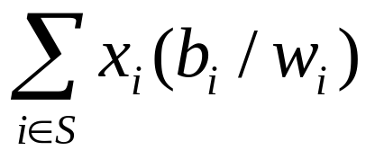
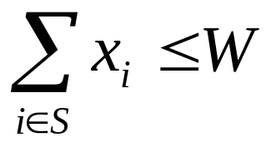
The Fractional Knapsack Problem
Given: A set S of n items, with each item i having
  b_{i} - a positive benefit
  w_{i} - a positive weight
Goal: Choose items with maximum total value but with weight at most W.
  The value of an item is its benefit/weight ratio.
If we are allowed to take fractional amounts, then this is the fractional knapsack problem.
  In this case, we let x_{i} denote the amount we take of item i
  0 ≤ x_{i} ≤ w_{i}
  Objective: maximize
  Constraint:

Slide 14

Example
Given: A set S of n items, with each item i having
  b_{i} - a positive benefit
  w_{i} - a positive weight
Goal: Choose items with maximum total value but with weight at most W.
“knapsack”
Solution:
1 ml of 5
2 ml of 3
6 ml of 4
1 ml of 2
Items:
1
2
3
4
5
Weight:
4 ml
8 ml
2 ml
6 ml
1 ml
Benefit:
$12
$32
$40
$30
$50
10 ml
Value:
3
4
20
5
50
($ per ml)

Slide 15
The Fractional Knapsack Algorithm
Algorithm fractionalKnapsack (S, W)
Input: set S of items with benefit b_{i} and weight w_{i}; max. weight W
Output: amount x_{i} of each
item i to maximize benefit with weight at most W
for each item i in S
  x_{i} ← 0
  v_{i} ← b_{i} / w_{i} {value}
  w ← 0 {total weight}
  while w < W
  remove item i with highest v_{i}
  x_{i} ← min{w_{i} , W - w}
  w ← w + min{w_{i} , W - w}
Greedy choice: Keep taking item with highest value (benefit to weight ratio b_{i} / w_{i} )
Run time: O(n log n). Why?
Use a max-heap priority queue

Slide 16
Need to Prove This Type of Strategy Works For This Type of Problem to Yield an Optimal Solution
Theorem: Given a collection S of n items, such that each item i has a benefit b_{i} and a weight w_{i}, we can construct a maximum-benefit subset of S, allowing for fractional amounts, that has a total weight W by choosing at each step x_{i} of the item with the largest ratio b_{i}/w_{i}. The last choice usually will choose a fraction of the item. Moreover, this can be done in O(nlogn) time.
Proof: A maximum-benefit subset of S is one which maximizes

Slide 17
Proof Continued
The fractional knapsack problem satisfies the greedy choice property using the algorithm given on slide 11 (Alg 5.1 in text).
Suppose there are two items, i and j, such that xi < wi , xj > 0, and vi > vj (see errata for the last inequality.)
Let y = min{wi - xi, xj}
We could then replace an amount y of item j with an equal amount of item i, thus increasing the total benefit without changing the total weight.
Therefore, we can compute optimal amounts for the items by greedily choosing items with the largest value index.
Using a max-heap priority queue, this can be clearly done in O(nlogn) time.

Slide 18
0/1 Knapsack
This is the case when either an entire item is not taken (0) or taken (1).
This problem does not have the greedy property.
As we will see, this is a much harder problem.
The Fractional Knapsack Problem has the greedy-choice property because on the last choice, a fraction of an item can be taken.

Slide 19
Other Problems That Can Use the Greedy Method
There are many as we will see later:
Here are a few:
  You are to network a collection of computers by linking selected pairs of them. Each link as a maintenance cost, reflected in a weight attached to the link. What is the cheapest possible network?
  The MP3 audio compression scheme encodes a sound signal by using something called a Huffman encoding. In simple terms, given symbols A, B, C, and D, what is the shortest way that a binary string can encode the letters so any string can be decoded unambiguously?

Slide 20
Other Problems That Use the Greedy Method
Horn formulas lie at the heart of the language Prolog ("programming by logic"). The workhorse of the Prolog interpreter is a greedy algorithm called the Horn Clause Satisfiability Algorithm.
Find the cheapest route from city A to city B given a cost associated with each road between various cities on a map - i.e. find the minimum-weight path between two vertices on a graph.
Change the last problem to ask for the minimum-weight path between A and every city reachable from A by a series of roads.

Slide 21
Not Optimal, But a Good Approximation
Sometimes the greedy method can be used even when the greedy-choice property doesn't hold.
That will often lead to a pretty good approximation to the optimal solution.
An Example: A county is in its early stages of planning and deciding where to put schools. A set of towns is given with the distance between towns given by road length. There are two constraints: each school should be in a town (not in a rural area) and no one should have to travel more than 30 miles to reach one of the schools. What is the minimum number of schools needed.

Slide 22
Task Scheduling
Given: a set T of n tasks, each having:
  A start time, s_{i}
  A finish time, f_{i} (where s_{i} < f_{i})
Goal: Perform all the tasks using a minimum number of “machines.”
Two tasks can execute on the same machine only if
fi<=sj or fj <=si. (called non-conflicting)
Machine 3
Machine 2
Machine 1
1
2
3
4
5
6
7
8
9

Slide 23
Example
Given: a set T of n tasks, each having:
  A start time, s_{i}
  A finish time, f_{i} (where s_{i} < f_{i})
  Goal: Perform all tasks on min. number of machines
  Assume T is [4,7],[7,8],[1,4],[1,3],[2,5],[3,7],[6,9]
Machine 3
Machine 2
Machine 1
1
2
3
4
5
6
7
8
9
  Order by the start time:
  [1,4], [1,3], [2,5], [3,7], [4,7], [6,9], [7,8]

Slide 24
Task Scheduling Algorithm
Greedy choice: consider tasks by their start time and use as few machines as possible with this order.
  Run time: O(n log n). Why?
Correctness: Suppose there is a better schedule.
  We can use k-1 machines
  The algorithm uses k
  Let i be first task scheduled on machine k
  Machine i must conflict with k-1 other tasks
  But that means there is no non-conflicting schedule using k-1 machines
Algorithm taskSchedule(T)
Input: set T of tasks w/ start time s_{i} and finish time f_{i}
Output: non-conflicting schedule with minimum number of machines
m ← 0 {no. of machines}
  while T is not empty
  remove task i w/ smallest s_{i}
  if there’s a machine j for i then
  schedule i on machine j
  else
  m ← m + 1
  schedule i on machine m

Slide 25
Divide-and-Conquer
7 2 ⏐ 9 4 → 2 4 7 9
7 ⏐ 2 → 2 7
9 ⏐ 4 → 4 9
7 → 7
2 → 2
9 → 9
4 → 4

Slide 26
Divide-and-Conquer
Divide-and conquer is a general algorithm design paradigm:
  Divide: divide the input data S in two or more disjoint subsets S₁, S₂, …
  Recur: solve the subproblems recursively
  Conquer: combine the solutions for S₁, S₂, …, into a solution for S
The base case for the recursion are subproblems of constant size
Analysis can be done using recurrence equations

Slide 27
Merge-Sort
Algorithm mergeSort(S, C)
Input sequence S with n elements, comparator C
Output sequence S sorted
  according to C
  if S.size() > 1
  (S₁, S₂) ← partition(S, n/2)
  mergeSort(S₁, C)
  mergeSort(S₂, C)
  S ← merge(S₁, S₂)
Merge-sort on an input sequence S with n elements consists of three steps:
  Divide: partition S into two sequences S₁ and S₂ of about n/2 elements each
  Recur: recursively sort S₁ and S₂
  Conquer: merge S₁ and S₂ into a unique sorted sequence

Slide 28
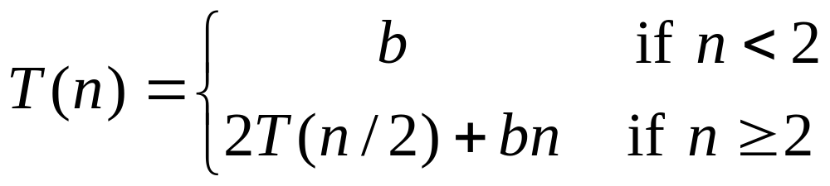
Recurrence Equation Analysis
The conquer step of merge-sort consists of merging two sorted sequences, each with n/2 elements and implemented by means of a doubly linked list, takes at most bn steps, for some constant b.
Likewise, the basis case (n < 2) will take at b most steps.
Therefore, if we let T(n) denote the running time of merge-sort:
We can therefore analyze the running time of merge-sort by finding a closed form solution to the above equation.
  That is, a solution that has T(n) only on the left-hand side.

Slide 29
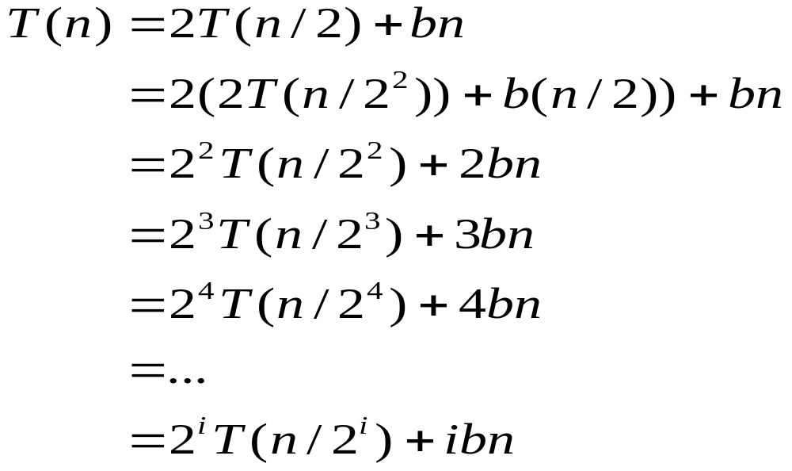
Iterative Substitution
In the iterative substitution, or “plug-and-chug,” technique, we iteratively apply the recurrence equation to itself and see if we can find a pattern:
Note that base, T(n)=b, case occurs when 2^{i}=n. That is, i = log n.
It looks like T(n) = bn + bnlogn is a possible closed form.
Thus, T(n) is O(n log n) if we can prove this equals the recurrence relation previously developed. How: by induction.

Slide 30
Another approach- examine the recursion tree to find a closed form
Draw the recursion tree for the recurrence relation and look for a pattern:
depth | T’s | size
0 | 1 | n
1 | 2 | n/2
i | 2^{i} | n/2^{i}
… | … | …
time
bn
bn
bn
…
Total time = bn+ bn lgn
(last level plus all previous levels)

Slide 31
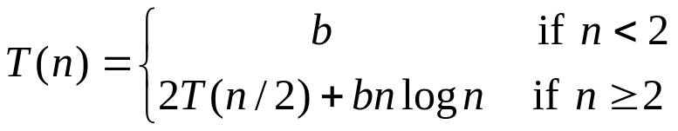
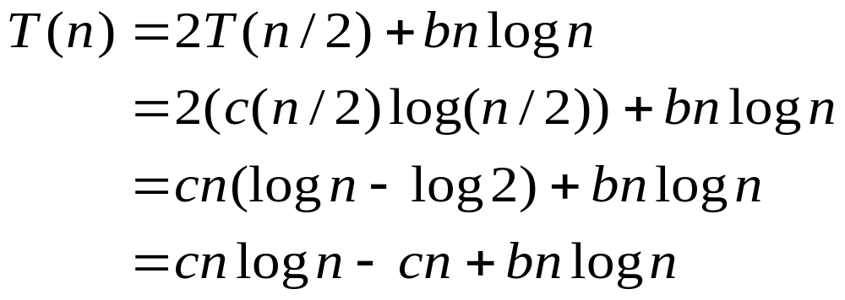
Still another method – “The Guess-and-Test Method”
In the guess-and-test method, we guess a closed form solution and then try to prove it is true by induction:
Guess: T(n) < cn log n for some c > 0 and n > n0
Wrong: we cannot make this last line be less than cnlog n

Slide 32
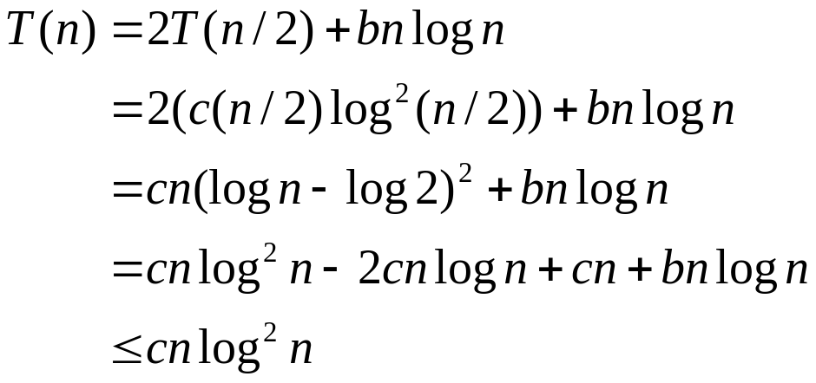
Guess-and-Test Method, Part 2
Recall the recurrence equation:
Guess #2: T(n) < cn log² n. If c > b,
So, T(n) is O(n log² n) which can be proved by induction.
In general, to use this method, you need to have a good guess and you need to be good at induction proofs.
Note: This often doesn't produce an optimal class.

Slide 33
The Master Method
Each of the methods explored in the earlier slides are very ad hoc.
They require some mathematical sophistication as well as the ability to do induction proofs easily.
There is a method, called the Master Method, which can be used for solving recurrence relations and does not require induction to prove what is correct.
The use of recursion trees and the Master Theorem are based on work by Cormen, Leiserson, and Rivest, Introduction to Algorithms, 1990, McGraw Hill
More methods are discussed in Aho, Hopcroft, and Ullman, Data Structures and Algorithms, Addison-Wesley, 1983

Slide 34
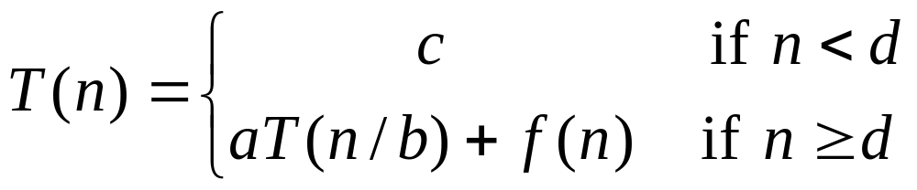
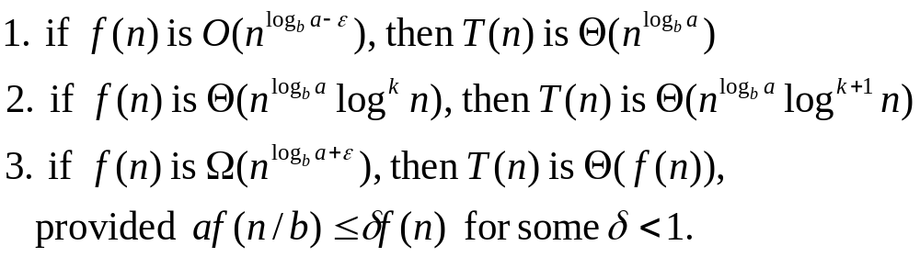
Master Method
Many divide-and-conquer recurrence equations have the form:
The Master Theorem: Let f(n) and T(n) be defined as above.

Slide 35



Using Master Method, Example 1
The form:
The Master Theorem:
Example:
Solution: Let a = 4, b = 2, ε=1, and f(n) = n.
and f(n) is O(n) clearly. So, by Case 1 of the Master Method,
T(n) is

Slide 36
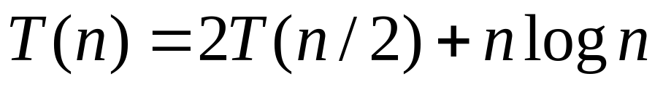


Master Method, Example 2
The form:
The Master Theorem:
Example:
Solution: Let a=2, b = 2, k =1, and f(n) = nlog n.
is
and,clearly, f(n) is Θ(nlogn). Thus, by Case 2 of the Master Method, T(n) is Θ(n log² n).

Slide 37
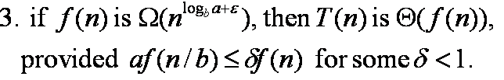

Master Method, Example 3
The form:
The Master Theorem:
Example:
Solution: Let a=1, b=3, ε =1, δ=1/3, and f(n) = n
and f(n) = n is clearly in Ω(n). Moreover, af(n/3) = 1*n/3 = (1/3)n=(1/3)*f(n). Thus, the second condition is met. By the 3rd case of the Master Method, T(n) is Θ(n).

Slide 38
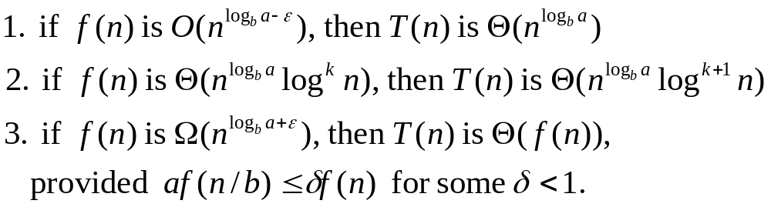
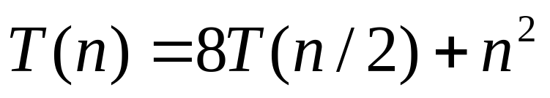
Master Method, Example 4
The form:
The Master Theorem:
Example:
Solve this one for homework.

Slide 39
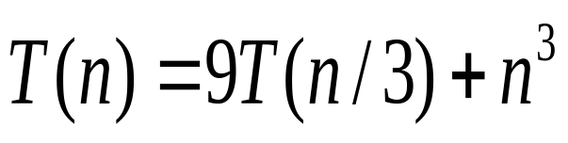
Master Method, Example 5
The form:
The Master Theorem:
Example:
  Solve this for homework.

Slide 40

Master Method, Example 6
The form:
The Master Theorem:
Example:
(binary search)
Solve for homework.

Slide 41
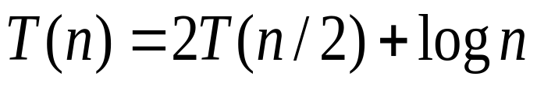
Master Method, Example 7
The form:
The Master Theorem:
Example:
Solve for homework.
(heap construction)

Slide 42
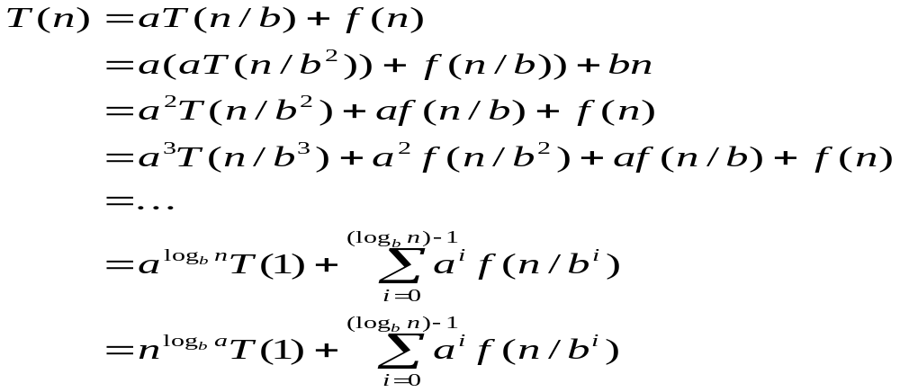
Iterative “Proof” of the Master Theorem
Using iterative substitution, let us see if we can find a pattern:
The last substitution comes from the identity
a^log_{b}n = n^log_{b}a. (thm 1.14.5, pg 23)

Slide 43
Iterative “Proof” of the Master Theorem (Continued)
We then distinguish the three cases as
  1- The first term is dominant and f(n) is small.
  2- Each part of the summation is equally dominant and proportional to the others. Thus, T(n) is f(n) times a logarithmic factor.
  3- The summation is a geometric series with decreasing terms starting with f(n) and the first term is smaller than the second. Then T(n) is proportional to f(n).

Slide 44
Proving the Master Theorem
The previous work just hints at the fact that the Master Theorem could be true.
An induction proof would be needed to prove it.
Because of the 3 cases and the complicated algebra, rather than rigorously proving the Master Theorem, we’ll utilize it to develop algorithms and assume it is true.

Slide 45
Problem: Big Integer Multiplication
Problem: Given two n-bit integers, I and J, that can’t be handled by the hardware of a machine, devise an algorithm with good complexity that multiplies these two numbers.
Applications:
Encryption schemes used in security work.
Note: Common grade school algorithm is Θ(n²) when multiplications are counted.
Can we do better?
We will assume n is a power of 2; otherwise, pad with zeroes.
Note: This provides an alternate way of doing what we did in the first homework assignment which tacitly assumed the hardware could handle the products.

Slide 46
Some Neat Observations:
Multiplying a binary number I by a power of two is trivial
  Just shift left k bits for 2^{k}.
  So, assuming a shift takes constant time, multiplying a binary number by 2^{k} can be done in O(k) time.
Notation: If we split an integer I into two parts, we let I_{h} be the high order bits and I_{l} be the low order bits.

Slide 47
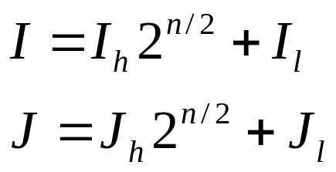
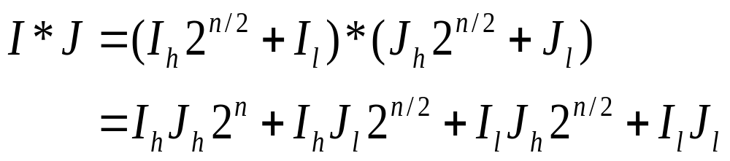
Integer Multiplication
Algorithm: Multiply two n-bit integers I and J.
  Divide step: Split I and J into high-order and low-order bits
  We can then define I*J by multiplying the parts and adding:
  We use this as a basis of a recursive algorithm.

Slide 48
Idea of algorithm:
Divide the bit representations of I and J in half.
Recursively compute the 4 products of n/2 bits each as above and merge the solutions to these subproducts in O(n) time using addition and multiplication by powers of 2.
Terminate the recursion when we need to multiply two 1-bit numbers.
Recurrence relation for running time is
  T(n) = 4T(n/2) + cn

Slide 49
Complexity of T(n)
So, T(n) = 4T(n/2) + n,
Unfortunately, using The Master Theorem,
we note log₂4 = 2
So T(n) is Θ(n²)...no good!
That is no better than the algorithm we learned in grade school.
But, The Master Theorem tells us we can do better if we can reduce the number of recursive calls.
But, how to do that? Can we be REALLY clever?

Slide 50
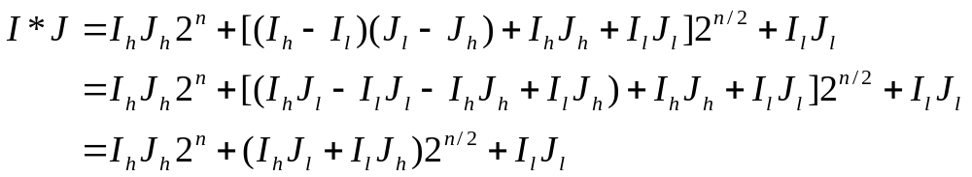
An Improved Integer Multiplication Algorithm
Algorithm: Multiply two n-bit integers I and J.
  Divide step: Split I and J into high-order and low-order bits
  Observe that there is a different way to multiply parts:

Slide 51
An Improved Integer Multiplication Algorithm
  The recursion on the last slide requires 3 products of n/2 bits each plus O(n) additional work.
  So, T(n) = 3T(n/2) + n, which implies T(n) is Θ(n^{log}₂³), by the Master Theorem.
  Thus, T(n) is Θ(n^{1.585}).
  That's where we obtained the complexity for the algorithm introduced in the Introduction slides.

Slide 52
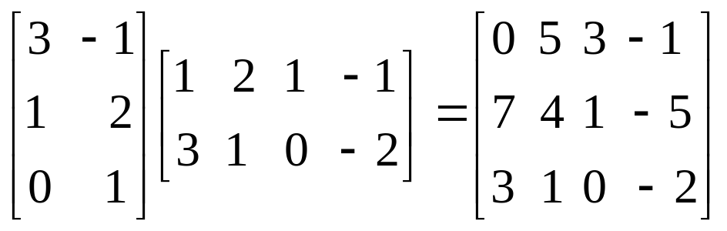
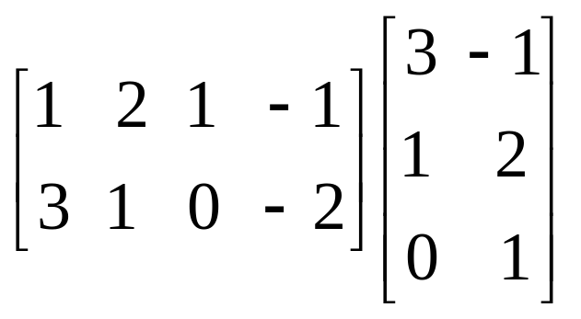
MATRIX OPERATIONS: Example
Matrix-matrix multiplication: Given: A is n X r and B is r X m
r
Then, C = AB = [c(i,j)] where c[i,j] = ∑ a[i,k] b[k,j]
k=1
For example,c[2,3]=
a[2,1]b[1,3] +
a[2,2]b[2,3]=
1*1 + 2*0 = 1
Note that the following is undefined:
because a 2 X 4 matrix can't
be multiplied by a 3 X 2 matrix.
A 4 X m matrix is required.

Slide 53
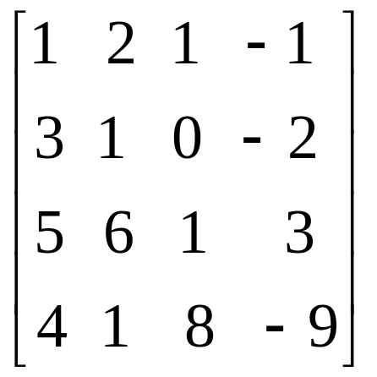
Matrix Multiplication
The brute force algorithm for multiplying two matrices is O(n^3).
In trying to improve this, a first pass would look at the following:
Assume n is a power of 2 and view an array as made up of submatrices, i.e.
These can be handled
recursively by viewing this as
a 4 X 4 matrix as shown
and then breaking the 4 X 4
matrices into 2 X 2 matrices.

Slide 54
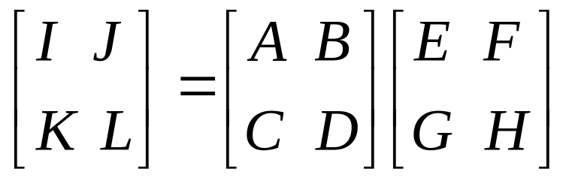
Matrix Multiplication
Thus,
where
I= AE + BG
J = AF + BH
K = CE + DG
L = CF + DH
Then, use this idea to divide and conquer.

Slide 55
Matrix Multiplication
With this approach,
T(n) = 8T(n/2) + bn^2
Unfortunately, the master theorem only gives us that T(n) is O(n^3), which isn't any improvement.
However, there is an algorithm called Strassen's Algorithm which is able to handle the multiplication in just seven recursive calls.
The technique can be verified (see pgs 272-273) although the algebra is messy.

Slide 56
Strassen's Algorithm
Using 7 recursive calls, Strassen's Algorithm yields a timing function of
    T(n) = 7T(n/2) + bn^2
Then the Master Theorem applies and the multiplication of two n x n matrices
can be shown to be
Θ(n^log 7) = Θ(n^2.808)
Using a=7, b=2, and
f(n)=2n^2 is O(n^(log(7)-ε) for ε=3.

Slide 57
Matrix Multiplication
If you look at the discussion in the text, you can see the algorithm is quite complicated.
A German , Volker Strassen, in 1969 presented the algorithm in a 15 page paper, but he did not indicate how he discovered the method although it uses some clever algebra manipulations.
In fact, there are other much more complicated matrix multiplication algorithms that run in O(n^2.376).

Slide 58
Many Problems Fall to Divide and Conquer
Mergesort and quicksort were mentioned earlier.
Compute gcd (greatest common divisor) of two positive integers.
Compute the median of a list of numbers.
Multiplying two polynomials of degree 2d
i.e. (1 + 2x + 3x^2) * (5 -4x + 8x^2)
FFT - Fast Fourier Transform used in signal processing.
(Closest Pair) Given points in the plane, find two that have the minimum distance between them.

Slide 59
Dynamic Programming

Slide 60
A Gentle Introduction to Dynamic Programming – An Interesting History
Invented by a mathematician, Richard Bellman, in 1950s as a method for optimizing multistage decision processes.
So the word programming refers to planning (as in programming for KC), not computer programming.
Later computer scientists realized it was a technique that could be applied to problems that were not special types of optimization problems.

Slide 61
The Basic Idea
The technique solves problems with overlapping subproblems.
Typically the subproblems arise through a recursive solution to a problem.
Rather than solve the subproblems repeatedly, we solve the smaller subproblem and save the results in a table from which we can form a solution to the original problem.
Although this suggests a space-time tradeoff, in reality when you see a dynamic programming solution you often find you do not need much extra space if you are careful.

Slide 62
A Simple Example
Consider the calculation of the Fibonacci numbers using the simple recurrence
  F(n) = F(n-1) + F(n-2) for n ≥ 2 and the two initial conditions
  F(0) = 0 and
  F(1) = 1.
If we blindly use recursion to solve this, we will be recomputing the same values many times.
In fact, the recursion tree suggests a simpler solution:

Slide 63
F(5)
F(4) F(3)
F(3) F(2) F(2) F(1)
F(2) F(1) F(1) F(0) F(1) F(0)
F(1) F(0)
So, one solution, a dynamic programming one, would be to keep an array and record each F(k) as it is computed.
But, we notice we don’t even need to maintain all of the entries, only the last two. So, in truth, looking at the solution this other way provides us with a very efficient solution that utilizes only 2 variables for the storage.
Not all problems that fall to dynamic programming are this simple, but this is a good one to remember of how the technique works.

Slide 64
Outline and Reading
0-1 Knapsack Problem (§5.3.3)
Matrix Chain-Product (§5.3.1)
The General Technique (§5.3.2)
Other examples for using dynamic programming are:
Compute the binormial coefficients
Floyd-Warshall Algorithm ((§6.4.2)- determining the pairs of nodes (v,w) in a directed graph such that w is reachable from v.

Slide 65
Other Examples for Using Dynamic Programming:
Biologists need to measure how similar strands of DNA are to determine how closely related an organism is to another.
They do this by considering DNA as strings of letters A,C,G,T and then comparing similarities in the strings.
Formally they look at common subsequences in the strings.
Example X = AGTCAACGTT, Y=GTTCGACTGTG
Both S = AGTG and S’=GTCACGT are subsequences
How to do find these efficiently?

Slide 66
Longest Common Subsequence Probem
Longest Common Subsequence: Give two strings [a₁ a₂… a_{m}] and [b₁ b₂… b_{n}], what is the largest value P such that:
For indices 1≤ i₁ ≤ i₂ ≤ … ≤ i_{p} ≤ m, and
1≤ j₁ ≤ j₂ ≤ … ≤ j_{p} ≤ n,
We have a_{ix} = b_{jx}, for 1≤ x≤ P
Example:
So P = 4, i = {1, 2, 3, 5}, j = {3, 4, 5, 6}
b a a b a c b
a c b a a a

Slide 67
Longest Common Subsequence (LCS) Problem
if |X| = m, |Y| = n, then there are 2^{m} subsequences of x; we must compare each with Y (n comparisons)
So the running time of the brute-force algorithm is O(n 2^{m})
Notice that the LCS problem has optimal substructure: solutions of subproblems are parts of the final solution.
Subproblems: “find LCS of pairs of prefixes of X and Y” using dynamic programming.

Slide 68
Other examples for using dynamic programming are: Edit Distance
When a spell checker encounters a possible misspelling or google is given words it doesn't recognize, they look in their dictionaries for other words that are close by.
What is an appropriate note of closeness in this case?
The edit distance is the minimum number of edits (insertions, deletions, and substitutions) of characters needed to transform one string into a second one.

Slide 69
Edit Distance
Define the cost of an alignment to be the number of columns where the strings differ. We can place a gap, _, in any string which is like a wildcard.
Example 1: Cost is 3 (insert U, substitute O with N, delete W.
  S _ N O W Y
  S U N N _ Y
Example 2: Cost is 5
  _ S N O W _ Y
  S U N _ _ N Y

Slide 70
Edit Distance - another LCD Problem
  In general, there are so many possible alignments between two strings that it would be terribly inefficient to search through all of them for the best one.
  The formula for the longest increasing subsequence (LCD) is L(j) = 1 + max{L(1), L(2), ..., L(j-1)} which, at first glance suggests recursion.
  But, at second glance that doesn't look like a good ideas as each L(i) would have to be recalculated repeatedly if it wasn't saved for later use.
  This is a typical situation for a problem that can be solved with dynamic programming.

Slide 71
Other Examples for Using Dynamic Programming:
(O. Slotterbeck, J. W. Baker and R. Aron)"An Algorithm for Computing the Tsirelson's Space Norm", published as Appendix B (44 pages) in Tsirelson's Space by P. Casazza and T. Shura, Lecture Notes in Mathematics, 1989.
(O. Slotterbeck, J. W. Baker and R. Aron) "Computing the Tsirelson Space Norm", Computer Aided Proofs in Analysis, edited by K. R. Meyer and D. S. Schmidt, IMA Volumes in Mathematics and its Applications (Volume 28), Springer-Verlag, 1991, p. 12-21.

Slide 72
The General Dynamic Programming Technique
Applies to a problem that at first seems to require a lot of time (possibly exponential), provided we have:
  Simple subproblems: the subproblems can be defined in terms of a few variables, such as j, k, l, m, and so on.
  Subproblem optimality: the global optimum value can be defined in terms of optimal subproblems
  Subproblem overlap: the subproblems are not independent, but instead they overlap (hence, should be constructed bottom-up).

Slide 73
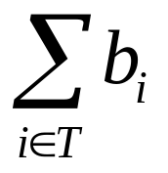
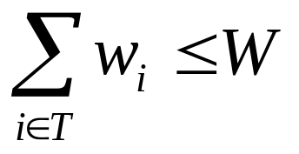
The 0/1 Knapsack Problem
Given: A set S of n items, with each item i having
  b_{i} - a positive benefit
  w_{i} - a positive weight
Goal: Choose items with maximum total benefit but with weight at most W.
If we are not allowed to take fractional amounts, then this is the 0/1 knapsack problem.
  In this case, we let T denote the set of items we take
  Objective: maximize
  Constraint:

Slide 74

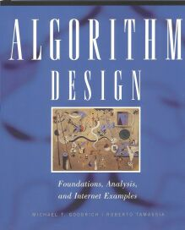
Example
Given: A set S of n items, with each item i having
  b_{i} - a positive benefit
  w_{i} - a positive weight
Goal: Choose items with maximum total benefit but with weight at most W.
“knapsack”
Solution:
5 ($80, 2 in)
3 ($6, 2 in)
1 ($20, 4 in)
Items:
1
2
3
4
5
Weight:
4 in
2 in
2 in
6 in
2 in
Benefit:
9 in
$20
$3
$6
$25
$80

Slide 75
Characterizing Subproblems
A brute force solution for the 0/1 knapsack considers all subsets of the items and selects the one with the highest total benefit from those with total weight not exceeding W.
However, it is obvious Θ(2^n).
The hardest part of designing a dynamic programming solution is to find a nice characterization of subproblems so that we satisfy the three properties needed.
We try to define subproblems using a parameter k (or two) so that subproblem k is the best way to fill the knapsack using only items from the set.
Unfortunately, for each choice we make, we need to check the three properties or we won't obtain optimality.

Slide 76
Divide and Conquer vs Dynamic Programming
With divide and conquer we can draw a recursion tree showing the recursive calls that are made.
The subproblems that are represented by the nodes on the tree are substantially smaller than the parent subproblem - i.e. half the size as in mergesort.
The tree representing these problems as a recursion tree is typically logarithmic in depth with a polynomial number of nodes because of this sharp drop in problem size as the algorithm digs deeper.
Moreover, there are no repeated nodes as the subproblems are independent of each other.

Slide 77
Divide and Conquer vs Dynamic Programming
In contrast, in a typical dynamic programming problem, a problem is reduced to subproblems that are only slightly smaller.
Thus, the recursion tree is typically of polynomial depth with an exponential number of nodes.
The key is to find subproblems so that many are repeated, but there not too many distinct subproblems.
Thus we can enumerate the distinct subproblems in some way that allows us to solve them in an order that yields an optimal solution, if it exists.

Slide 78
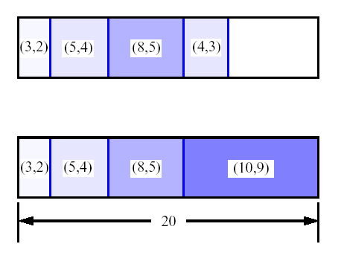
A 0/1 Knapsack Algorithm, First Attempt
S_{k}: Set of items numbered 1 to k.
Define B[k] = best selection from S_{k}.
Problem: does not have subproblem optimality:
  Subproblem optimality: the global optimum value can be defined in terms of optimal subproblems
  Consider S={(3,2),(5,4),(8,5),(4,3),10,9)} benefit-weight pairs (pg 279, 3 lines from bottom)
  Maximum total weight is W = 20
Best for S₄:
Best for S₅:

Slide 79
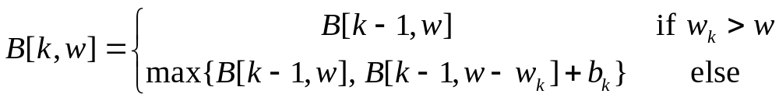
A 0/1 Knapsack Algorithm, Second Attempt
S_{k}: Set of items numbered 1 to k.
Define B[k,w] = best selection from S_{k} with weight at most w (Note: 2 errors on pg 280)
Good news: this does have subproblem optimality:
i.e., best subset of S_{k} with weight at most w is either the best subset of S_{k-1} with weight w or the best subset of S_{k-1} with weight w-w_{k} plus item k.

Slide 80
Overview of Dynamic Programming
Basic idea:
  Optimal substructure: optimal solution to problem consists of optimal solutions to subproblems
  Overlapping subproblems: few subproblems in total, many recurring instances of each
  Solve bottom-up, building a table of solved subproblems that are used to solve larger ones
Variations:
  “Table” could be 3-dimensional, triangular, a tree, etc.

Slide 81
Knapsack problem (Review)
Given some items, pack the knapsack to get the maximum
total value. Each item has some weight and some
value/benefit. The total weight that we can carry is no
more than some fixed number W.
So we must consider weights of items as well as
their values.
      Item # Weight Value
      1 1 8
      2 3 6
      3 5 5

Slide 82
Knapsack problem
There are two versions of the problem:
  “0-1 knapsack problem” and
  “Fractional knapsack problem”
Items are indivisible; you either take an item or not. Solved with dynamic programming
Items are divisible: you can take any fraction of an item. Solved with a greedy algorithm as we saw.

Slide 83
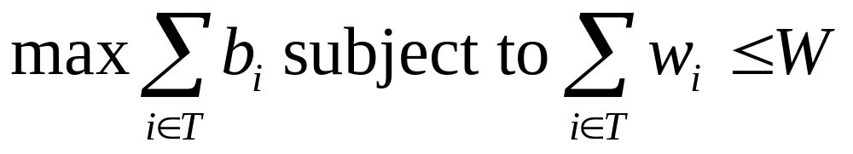

0-1 Knapsack problem
Problem, in other words, is to find
The problem is called a “0-1” problem, because each item must be entirely accepted or rejected.

Slide 84
0-1 Knapsack problem: brute-force approach
Let’s first solve this problem with a straightforward algorithm
Since there are n items, there are 2^{n} possible combinations of items.
We go through all combinations and find the one with maximum value and with total weight less or equal to W
Running time will be O(2^{n})

Slide 85
0-1 Knapsack problem: brute-force approach
Can we do better?
Yes, with an algorithm based on dynamic programming
We need to carefully identify the subproblems
Let’s try this:
If items are labeled 1..n, then a subproblem
would be to find an optimal solution for
S_{k} = {items labeled 1, 2, .. k}

Slide 86
Defining a Subproblem
If items are labeled 1..n, then a subproblem would be to find an optimal solution for S_{k} = {items labeled 1, 2, .. k}
This is a reasonable subproblem definition.
The question is: can we describe the final solution (S_{n} ) in terms of subproblems (S_{k})?
Unfortunately, we can’t do that.

Slide 87
Defining a Subproblem (textbook example but pg 279 says (weight,benefit) pairs and they should be (benefit,weight) pairs
w₁ =2
b₁ =3
w₂ =4
b₂ =5
w₃ =5
b₃ =8
w₄ =3
b₄ =4
Weight
Benefit
Item
#
w_{i}
b_{i}
1
2
3
Max weight: W = 20
For S₄:
Total weight: 14;
Maximum benefit: 20
S₄
2
4
5
S₅
3
5
8
4
3
4
5
9
10
w₁ =2
b₁ =3
w₂ =4
b₂ =5
w₃ =5
b₃ =8
w₅ =9
b₅ =10
Solution for S₄ is not part of the solution for S₅!!!
For S₅:
Total weight: 20
Maximum benefit: 26

Slide 88
Defining a Subproblem (continued)
As we have seen, the solution for S₄ is not part of the solution for S₅
So our definition of a subproblem is flawed and we need another one!
Let’s add another parameter: w, which will represent the maximum weight for each subset of items
The subproblem then will be to compute B[k,w], i.e., to find an optimal solution for S_{k} = {items labeled 1, 2, .. k} in a knapsack of size w

Slide 89
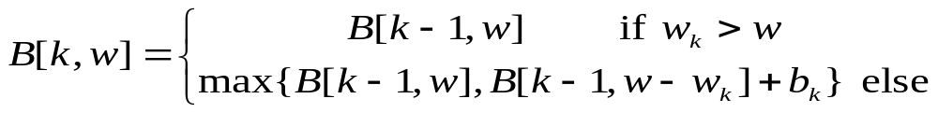
Recursive Formula for subproblems
Recursive formula for subproblems:
It means, that the best subset of S_{k} that has total weight w is:
  1) the best subset of S_{k-1} that has total weight ≤ w, or
  2) the best subset of S_{k-1} that has total weight ≤ w-w_{k} plus the item k

Slide 90

Recursive Formula
The best subset of S_{k} that has the total weight ≤ w, either contains item k or not.
First case: w_{k}>w. Item k can’t be part of the solution, since if it was, the total weight would be > w, which is unacceptable.
Second case: w_{k} ≤ w. Then the item k can be in the solution, and we choose the case with greater value.

Slide 91
Slight change from one in text on pg 280. This uses a 2-dimensional array that illustrates what is going on better.
for w = 0 to W
B[0,w] = 0
for i = 1 to n
B[i,0] = 0
for i = 1 to n
for w = 0 to W
if w_{i} <= w // item i can be part of the solution
if b_{i} + B[i-1,w-w_{i}] > B[i-1,w]
B[i,w] = b_{i} + B[i-1,w- w_{i}]
else
B[i,w] = B[i-1,w]
else B[i,w] = B[i-1,w] // w_{i} > w
Algorithm 01Knapsack(S,W)
Input: Set S of n items such that each item i has benefit b_{i} and weight w_{i} and a positive integer maximum weight of W
Output: The maximum benefit B[n,W] of a subset of S with total weight ≤ W

Slide 92
Running time
for w = 0 to W
B[0,w] = 0
for i = 1 to n
B[i,0] = 0
for i = 1 to n
for w = 0 to W
< the rest of the code >
O(W)
Repeat n times
O(W)
What is the running time of this algorithm?
O(n*W) We can't discount the W as it may be
very large.
Remember that the brute-force algorithm
takes O(2^{n})

Slide 93
Example Trace-1
Let’s run our algorithm on the
following data:
n = 4 (# of elements)
W = 5 (max weight)
Elements (weight, benefit):
(2,3), (3,4), (4,5), (5,6)
Note: This is in order given in text on page 279.

Slide 94
Example Trace-2
i\w
0
1
2
3
4
5
0
0
0
0
0
0
0
1
Answer will appear here
2
3
4
for w = 0 to W
B[0,w] = 0
n = 4 (# of elements)
W = 5 (max weight)
Elements (weight, benefit):
(2,3), (3,4), (4,5), (5,6)

Slide 95
Example Trace-3
i\w
0
1
2
3
4
5
0
0
0
0
0
0
0
1
0
2
0
3
0
4
0
for i = 1 to n
B[i,0] = 0
n = 4 (# of elements)
W = 5 (max weight)
Elements (weight, benefit):
(2,3), (3,4), (4,5), (5,6)

Slide 96
Example Trace-4
Items:
1: (2,3)
2: (3,4)
3: (4,5)
4: (5,6)
i\w
0
1
2
3
4
5
i=1
b_{i}=3
w_{i}=2
w=1
w-w_{i} =-1
0
0
0
0
0
0
0
1
0
0
2
0
3
0
4
0
if w_{i} <= w // item i can be part of the solution
if b_{i} + B[i-1,w-w_{i}] > B[i-1,w]
B[i,w] = b_{i} + B[i-1,w- w_{i}]
else
B[i,w] = B[i-1,w]
else B[i,w] = B[i-1,w] // w_{i} > w

Slide 97
Example Trace-5
Items:
1: (2,3)
2: (3,4)
3: (4,5)
4: (5,6)
i\w
0
1
2
3
4
5
i=1
b_{i}=3
w_{i}=2
w=2
w-w_{i} =0
0
0
0
0
0
0
0
1
0
0
3
2
0
3
0
4
0
if w_{i} <= w // item i can be part of the solution
if b_{i} + B[i-1,w-w_{i}] > B[i-1,w]
B[i,w] = b_{i} + B[i-1,w- w_{i}]
else
B[i,w] = B[i-1,w]
else B[i,w] = B[i-1,w] // w_{i} > w

Slide 98
Example Trace-6
Items:
1: (2,3)
2: (3,4)
3: (4,5)
4: (5,6)
i\w
0
1
2
3
4
5
i=1
b_{i}=3
w_{i}=2
w=3
w-w_{i} =1
0
0
0
0
0
0
0
1
0
0
3
3
2
0
3
0
4
0
if w_{i} <= w // item i can be part of the solution
if b_{i} + B[i-1,w-w_{i}] > B[i-1,w]
B[i,w] = b_{i} + B[i-1,w- w_{i}]
else
B[i,w] = B[i-1,w]
else B[i,w] = B[i-1,w] // w_{i} > w

Slide 99
Example Trace-7
Items:
1: (2,3)
2: (3,4)
3: (4,5)
4: (5,6)
i\w
0
1
2
3
4
5
i=1
b_{i}=3
w_{i}=2
w=4
w-w_{i} =2
0
0
0
0
0
0
0
1
0
0
3
3
3
2
0
3
0
4
0
if w_{i} <= w // item i can be part of the solution
if b_{i} + B[i-1,w-w_{i}] > B[i-1,w]
B[i,w] = b_{i} + B[i-1,w- w_{i}]
else
B[i,w] = B[i-1,w]
else B[i,w] = B[i-1,w] // w_{i} > w

Slide 100
Example Trace-8
Items:
1: (2,3)
2: (3,4)
3: (4,5)
4: (5,6)
i\w
0
1
2
3
4
5
i=1
b_{i}=3
w_{i}=2
w=5
w-w_{i} =3
0
0
0
0
0
0
0
1
0
0
3
3
3
3
2
0
3
0
4
0
if w_{i} <= w // item i can be part of the solution
if b_{i} + B[i-1,w-w_{i}] > B[i-1,w]
B[i,w] = b_{i} + B[i-1,w- w_{i}]
else
B[i,w] = B[i-1,w]
else B[i,w] = B[i-1,w] // w_{i} > w

Slide 101
Example Trace-9
Items:
1: (2,3)
2: (3,4)
3: (4,5)
4: (5,6)
i\w
0
1
2
3
4
5
i=2
b_{i}=4
w_{i}=3
w=1
w-w_{i} =-2
0
0
0
0
0
0
0
1
0
0
3
3
3
3
2
0
0
3
0
4
0
if w_{i} <= w // item i can be part of the solution
if b_{i} + B[i-1,w-w_{i}] > B[i-1,w]
B[i,w] = b_{i} + B[i-1,w- w_{i}]
else
B[i,w] = B[i-1,w]
else B[i,w] = B[i-1,w] // w_{i} > w

Slide 102
Example Trace-10
Items:
1: (2,3)
2: (3,4)
3: (4,5)
4: (5,6)
i\w
0
1
2
3
4
5
i=2
b_{i}=4
w_{i}=3
w=2
w-w_{i} =-1
0
0
0
0
0
0
0
1
0
0
3
3
3
3
2
0
0
3
3
0
4
0
if w_{i} <= w // item i can be part of the solution
if b_{i} + B[i-1,w-w_{i}] > B[i-1,w]
B[i,w] = b_{i} + B[i-1,w- w_{i}]
else
B[i,w] = B[i-1,w]
else B[i,w] = B[i-1,w] // w_{i} > w

Slide 103
Example Trace-11
Items:
1: (2,3)
2: (3,4)
3: (4,5)
4: (5,6)
i\w
0
1
2
3
4
5
i=2
b_{i}=4
w_{i}=3
w=3
w-w_{i} =0
0
0
0
0
0
0
0
1
0
0
3
3
3
3
2
0
0
3
4
3
0
4
0
if w_{i} <= w // item i can be part of the solution
if b_{i} + B[i-1,w-w_{i}] > B[i-1,w]
B[i,w] = b_{i} + B[i-1,w- w_{i}]
else
B[i,w] = B[i-1,w]
else B[i,w] = B[i-1,w] // w_{i} > w

Slide 104
Example Trace-12
Items:
1: (2,3)
2: (3,4)
3: (4,5)
4: (5,6)
i\w
0
1
2
3
4
5
i=2
b_{i}=4
w_{i}=3
w=4
w-w_{i} =1
0
0
0
0
0
0
0
1
0
0
3
3
3
3
2
0
0
3
4
4
3
0
4
0
if w_{i} <= w // item i can be part of the solution
if b_{i} + B[i-1,w-w_{i}] > B[i-1,w]
B[i,w] = b_{i} + B[i-1,w- w_{i}]
else
B[i,w] = B[i-1,w]
else B[i,w] = B[i-1,w] // w_{i} > w

Slide 105
Example Trace-13
Items:
1: (2,3)
2: (3,4)
3: (4,5)
4: (5,6)
i\w
0
1
2
3
4
5
i=2
b_{i}=4
w_{i}=3
w=5
w-w_{i} =2
0
0
0
0
0
0
0
1
0
0
3
3
3
3
2
0
0
3
4
4
7
3
0
4
0
if w_{i} <= w // item i can be part of the solution
if b_{i} + B[i-1,w-w_{i}] > B[i-1,w]
B[i,w] = b_{i} + B[i-1,w- w_{i}]
else
B[i,w] = B[i-1,w]
else B[i,w] = B[i-1,w] // w_{i} > w

Slide 106
Example Trace-14
Items:
1: (2,3)
2: (3,4)
3: (4,5)
4: (5,6)
i\w
0
1
2
3
4
5
i=3
b_{i}=5
w_{i}=4
w= 1..3
0
0
0
0
0
0
0
1
0
0
3
3
3
3
2
0
0
3
4
4
7
3
0
0
3
4
4
0
if w_{i} <= w // item i can be part of the solution
if b_{i} + B[i-1,w-w_{i}] > B[i-1,w]
B[i,w] = b_{i} + B[i-1,w- w_{i}]
else
B[i,w] = B[i-1,w]
else B[i,w] = B[i-1,w] // w_{i} > w

Slide 107
Example Trace-15
Items:
1: (2,3)
2: (3,4)
3: (4,5)
4: (5,6)
i\w
0
1
2
3
4
5
i=3
b_{i}=5
w_{i}=4
w= 4
w- w_{i}=0
0
0
0
0
0
0
0
1
0
0
3
3
3
3
2
0
0
3
4
4
7
3
0
0
3
4
5
4
0
if w_{i} <= w // item i can be part of the solution
if b_{i} + B[i-1,w-w_{i}] > B[i-1,w]
B[i,w] = b_{i} + B[i-1,w- w_{i}]
else
B[i,w] = B[i-1,w]
else B[i,w] = B[i-1,w] // w_{i} > w

Slide 108
Example Trace-16
Items:
1: (2,3)
2: (3,4)
3: (4,5)
4: (5,6)
i\w
0
1
2
3
4
5
i=3
b_{i}=5
w_{i}=4
w= 5
w- w_{i}=1
0
0
0
0
0
0
0
1
0
0
3
3
3
3
2
0
0
3
4
4
7
3
0
0
3
4
5
7
4
0
if w_{i} <= w // item i can be part of the solution
if b_{i} + B[i-1,w-w_{i}] > B[i-1,w]
B[i,w] = b_{i} + B[i-1,w- w_{i}]
else
B[i,w] = B[i-1,w]
else B[i,w] = B[i-1,w] // w_{i} > w

Slide 109
Example Trace-17
Items:
1: (2,3)
2: (3,4)
3: (4,5)
4: (5,6)
i\w
0
1
2
3
4
5
i=4
b_{i}=6
w_{i}=5
w= 1..4
0
0
0
0
0
0
0
1
0
0
3
3
3
3
2
0
0
3
4
4
7
3
0
0
3
4
5
7
4
0
0
3
4
5
if w_{i} <= w // item i can be part of the solution
if b_{i} + B[i-1,w-w_{i}] > B[i-1,w]
B[i,w] = b_{i} + B[i-1,w- w_{i}]
else
B[i,w] = B[i-1,w]
else B[i,w] = B[i-1,w] // w_{i} > w

Slide 110
Example Trace-18
Items:
1: (2,3)
2: (3,4)
3: (4,5)
4: (5,6)
i\w
0
1
2
3
4
5
i=4
b_{i}=6
w_{i}=5
w= 5
w- w_{i}=0
0
0
0
0
0
0
0
1
0
0
3
3
3
3
2
0
0
3
4
4
7
3
0
0
3
4
5
7
4
0
0
3
4
5
7
if w_{i} <= w // item i can be part of the solution
if b_{i} + B[i-1,w-w_{i}] > B[i-1,w]
B[i,w] = b_{i} + B[i-1,w- w_{i}]
else
B[i,w] = B[i-1,w]
else B[i,w] = B[i-1,w] // w_{i} > w
Maximum weight possible

Slide 111
Comments
This algorithm only finds the max possible value that can be carried in the knapsack
  i.e., the value in B[n,W]
To know the items that make this maximum value, an addition to this algorithm is necessary

Slide 112
How to Find Actual Knapsack Items
All of the information we need is in the table.
B[n,W] is the maximal value of items that can be placed in the Knapsack.
Let i=n and k=W
  if B[i,k] ≠ B[i−1,k] then
  mark the i^{th} item as in the knapsack
  i = i−1, k = k-w_{i}
  else
  i = i−1 // Assume the i^{th} item is not in the //knapsack
  // Could it be in the optimally packed knapsack?

Slide 113
Finding the Items-1
Items:
1: (2,3)
2: (3,4)
3: (4,5)
4: (5,6)
i\w
0
1
2
3
4
5
i=4
k= 5
b_{i}=6
w_{i}=5
B[i,k] = 7
B[i−1,k] =7
0
0
0
0
0
0
0
1
0
0
3
3
3
3
2
0
0
3
4
4
7
3
0
0
3
4
5
7
4
0
0
3
4
5
7
i=n, k=W
while i,k > 0
  if B[i,k] ≠ B[i−1,k] then
  mark the i^{th} item as in the knapsack
  i = i−1, k = k-w_{i}
  else
  i = i−1

Slide 114
Finding the Items-2
Items:
1: (2,3)
2: (3,4)
3: (4,5)
4: (5,6)
i\w
0
1
2
3
4
5
i=4
k= 5
b_{i}=6
w_{i}=5
B[i,k] = 7
B[i−1,k] =7
0
0
0
0
0
0
0
1
0
0
3
3
3
3
2
0
0
3
4
4
7
3
0
0
3
4
5
7
4
0
0
3
4
5
7
i=n, k=W
while i,k > 0
  if B[i,k] ≠ B[i−1,k] then
  mark the i^{th} item as in the knapsack
  i = i−1, k = k-w_{i}
  else
  i = i−1

Slide 115
Finding the Items-3
Items:
1: (2,3)
2: (3,4)
3: (4,5)
4: (5,6)
i\w
0
1
2
3
4
5
i=3
k= 5
b_{i}=5
w_{i}=4
B[i,k] = 7
B[i−1,k] =7
0
0
0
0
0
0
0
1
0
0
3
3
3
3
2
0
0
3
4
4
7
3
0
0
3
4
5
7
4
0
0
3
4
5
7
i=n, k=W
while i,k > 0
  if B[i,k] ≠ B[i−1,k] then
  mark the i^{th} item as in the knapsack
  i = i−1, k = k-w_{i}
  else
  i = i−1

Slide 116
Finding the Items-4
Items:
1: (2,3)
2: (3,4)
3: (4,5)
4: (5,6)
i\w
0
1
2
3
4
5
i=2
k= 5
b_{i}=4
w_{i}=3
B[i,k] = 7
B[i−1,k] =3
k − w_{i}=2
0
0
0
0
0
0
0
1
0
0
3
3
3
3
2
0
0
3
4
4
7
7
3
0
0
3
4
5
7
4
0
0
3
4
5
7
i=n, k=W
while i,k > 0
  if B[i,k] ≠ B[i−1,k] then
  mark the i^{th} item as in the knapsack
  i = i−1, k = k-w_{i}
  else
  i = i−1

Slide 117
Finding the Items-5
Items:
1: (2,3)
2: (3,4)
3: (4,5)
4: (5,6)
i\w
0
1
2
3
4
5
i=1
k= 2
b_{i}=3
w_{i}=2
B[i,k] = 3
B[i−1,k] =0
k − w_{i}=0
0
0
0
0
0
0
0
1
0
0
3
3
3
3
3
2
0
0
3
4
4
7
3
0
0
3
4
5
7
4
0
0
3
4
5
7
i=n, k=W
while i,k > 0
  if B[i,k] ≠ B[i−1,k] then
  mark the i^{th} item as in the knapsack
  i = i−1, k = k-w_{i}
  else
  i = i−1

Slide 118
Finding the Items-6
Items:
1: (2,3)
2: (3,4)
3: (4,5)
4: (5,6)
i\w
0
1
2
3
4
5
i=0
k= 0
0
0
0
0
0
0
0
1
0
0
3
3
3
3
2
0
0
3
4
4
7
3
0
0
3
4
5
7
The optimal knapsack should contain {1, 2}
4
0
0
3
4
5
7
i=n, k=W
while i,k > 0
  if B[i,k] ≠ B[i−1,k] then
  mark the n^{th} item as in the knapsack
  i = i−1, k = k-w_{i}
  else
  i = i−1

Slide 119
Finding the Items-7
Items:
1: (2,3)
2: (3,4)
3: (4,5)
4: (5,6)
i\w
0
1
2
3
4
5
0
0
0
0
0
0
0
1
0
0
3
3
3
3
3
2
0
0
3
4
4
7
7
3
0
0
3
4
5
7
The optimal knapsack should contain {1, 2}
4
0
0
3
4
5
7
i=n, k=W
while i,k > 0
  if B[i,k] ≠ B[i−1,k] then
  mark the n^{th} item as in the knapsack
  i = i−1, k = k-w_{i}
  else
  i = i−1

Slide 120
Conclusion
Dynamic programming is a useful technique of solving certain kind of problems
When the solution can be recursively described in terms of partial solutions, we can store these partial solutions and re-use them as necessary (memoization)
Running time of dynamic programming algorithm vs. naïve algorithm:
  0-1 Knapsack problem: O(W*n) vs. O(2^{n})

Slide 121
The 0/1 Knapsack Algorithm - Textbook
Recall definition of B[k,w]:
Since B[k,w] is defined in terms of B[k-1,*], we can reuse the same array.
We didn't do this so you can see the algorithm behavior easier.
Running time: O(nW).
Not a polynomial-time algorithm if W is large
This is a pseudo-polynomial time algorithm
Algorithm 01Knapsack(S, W):
Input: set S of items w/ benefit b_{i} and weight w_{i}; max. weight W
Output: benefit of best subset with weight at most W
for w ← 0 to W do
  B[w] ← 0
  for k ← 1 to n do
  for w ← W downto w_{k} do
  if B[w-w_{k}]+b_{k} > B[w] then
  B[w] ← B[w-w_{k}]+b_{k}

Slide 122
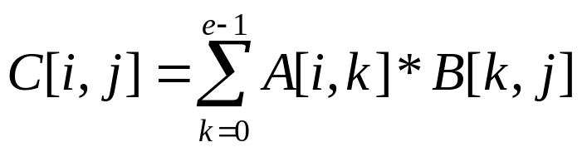
Matrix Chain-Products
Dynamic Programming is a general algorithm design paradigm.
  The Matrix Chain-Products Problem:
Recall: Matrix Multiplication.
  C = A*B
  A is d × e and B is e × f
Counting multiplications,
we have d*e*f of them.
f
B
j
e
e
A
C
d
i
i,j
d
f

Slide 123
Matrix Chain-Products
Observe that we obtain the result if we compute, for compatible matrices, A, B, and C either
  (A*B)*C or A*(B*C)
  because matrix multiplication is associative.
However, they do not necessarily commute i.e. there are compatible matrices A and B such that
  A*B ≠ B*A

Slide 124
Matrix Chain-Products Problem
Matrix Chain-Product:
  Compute A=A₀*A₁*…*A_{n-1}
  A_{i} is d_{i} × d_{i+1}
  Problem: How to parenthesize to minimize the number of multiplications?
Example shows not all attempts are equal: Assume that
  B is 3 × 100
  C is 100 × 5
  D is 5 × 5
  (B*C)*D takes 1500 + 75 = 1575 ops
  because B*C is 3 x 5
  B*(C*D) takes 1500 + 2500 = 4000 ops
  because C*D is 100 X 5

Slide 125
An Enumeration Approach
Matrix Chain-Product Alg.:
  Try all possible ways to parenthesize A=A₀*A₁*…*A_{n-1}
  Calculate number of ops for each one
  Pick the one that is best
Running time:
  The number of possibilities is equal to the number of binary trees with n external nodes
Example: Consider associating a binary tree with a unique parenthesis scheme (actually pull the idea from compiler writing!)
(Without proof) The number of binary trees with n external nodes is the (n-1) Catalan number (The book said n, but that is the number of binary trees with n nodes- this association scheme is easy to see so we’ll use that one)

Slide 126
The Running Time
  The nth Catalan number is given by
  C(n) = (( 2n)! /n!n! )( 1 /(n+1) for n > 0 and
  with C(0) = 1
  The growth is quite fast,
    C(2) = 2
    C(3) = 5
    C(4) = 14
  In fact, it can be shown that C(n) is Ω(4^{n}/n^{3/2}) ie this is exponential!
  This is a terrible algorithm (as you might have suspected)!

Slide 127
A Greedy Approach (#1)
Idea #1: Repeatedly select the product that uses the most operations.
Counter-example to this approach:
  A is 10 × 5
  B is 5 × 10
  C is 10 × 5
  D is 5 × 10
  Greedy idea #1 gives (A*B)*(C*D), which takes 500+1000+500 = 2000 ops
  A*((B*C)*D) takes 500+250+250 = 1000 ops
Note- this doesn’t tell us there is NO greedy approach only that this approach doesn’t work.

Slide 128
Another Greedy Approach (#2)
Idea #2: repeatedly select the product that uses the fewest operations.
Counter-example:
  A is 101 × 11
  B is 11 × 9
  C is 9 × 100
  D is 100 × 99
  Greedy idea #2 gives A*((B*C)*D)), which takes 109989+9900+108900=228789 ops
  (A*B)*(C*D) takes 9999+89991+89100=189090 ops
The greedy approach is not seeming to give us an optimal value.

Slide 129
A “Recursive” Approach
Define subproblems:
  Find the best parenthesization of A_{i}*A_{i+1}*…*A_{j}.
  Let M_{i,j} denote the number of operations done by this subproblem.
  The optimal solution for the whole problem is
  M_{1,n}.
An arithmetic-expression tree can be defined for this type of problem which helps explain the basic idea, just as we saw with the Fibonacci calculation.

Slide 130
Example
Consider matrices
A1 : 30 x 1 A2 : 1 x 40
A3 : 40 x 10 A4 : 10 x 25
((A1*A2)*A3)*A4 20,700 ops
A1*(A2*(A3*A4)) 11,750 ops
(A1*A2)*(A3*A4) 41,200 ops
A1*((A2*A3)*A4) 1,400 ops
As only the dimensions of the various matrices are involved in the calculation, we will identify a problem as positive integers d1, ..., dn.
For the above problem, 30, 1, 40, 10, 25

Slide 131
Example - Continued
(Not showing how this is constructed yet) The tree below assumes (i,j) means compute Ai*...*Aj
A solution to 30, 1, 40, 10, 25 is provided by the arithmetic-expression tree
(0,4)
A1 (1,4)
(0,1) *
(1,3) A4
* (3,4)
A2 A3
(1,2) (2,3)
i.e. A1*((A2*A3)*A4) or 1400 ops

Slide 132
Note this property holds:
Subproblem optimality: The optimal solution can be defined in terms of optimal subproblems
  There has to be a final multiplication (root of the expression tree) for the optimal solution.
  Say, the final multiply is at index i: (A₀*…*A_{i})*(A_{i+1}*…*A_{n-1}).
  Then the optimal solution M_{0,n-1} is the sum of two optimal subproblems, M_{0,i} and M_{i+1,n-1} plus the time for the last multiply.
  If the global optimum did not have these optimal subproblems, we could define an even better “optimal” solution.

Slide 133
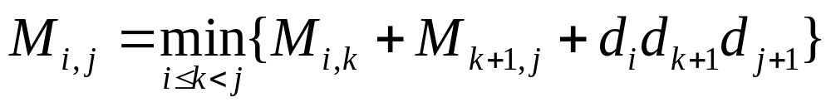
A Characterizing Equation
The global optimal has to be defined in terms of optimal subproblems, depending on where the final multiply is.
Let us consider all possible places for that final multiply:
  Recall that A_{i} is a d_{i} × d_{i+1} dimensional matrix.
  So, a characterizing equation for N_{i,j} is the following:
where M_{i,i} = 0.
Note that subproblems are not independent--the subproblems overlap.

Slide 134
Step 1: Develop a Recursive Solution
Define M(i,j) to be the minimum number of multiplications needed to compute
A_{i}· A_{i+1} ·… · A_{j}
Goal: Find M(1,n).
Basis: M(i,i) = 0.
Recursion: How to define M(i,j) recursively?

Slide 135
Defining M(i,j) Recursively
Consider all possible ways to split A_{i} through A_{j} into two pieces.
Compare the costs of all these splits:
  best case cost for computing the product of the two pieces
  plus the cost of multiplying the two products
Take the best one
M(i,j) = min_{k}(M(i,k) + M(k+1,j) + d_{i-1}d_{k}d_{j})

Slide 136
Defining M(i,j) Recursively
(A_{i} ·…· A_{k})·(A_{k+1} ·… · A_{j})
P₁
P₂
minimum cost to compute P₁ is M(i,k)
minimum cost to compute P₂ is M(k+1,j)
cost to compute P₁· P₂ is d_{i-1}d_{k}d_{j}

Slide 137
Step 2: Find Dependencies Among Subproblems
M:
 | 1 | 2 | 3 | 4 | 5
1 | 0
2 | n/a | 0
3 | n/a | n/a | 0
4 | n/a | n/a | n/a | 0
5 | n/a | n/a | n/a | n/a | 0
GOAL!
Computing the red
square requires the
blue ones: to the
left and below.

Slide 138
Defining the Dependencies
Computing M(i,j) uses
  everything in same row to the left:
  M(i,i), M(i,i+1), …, M(i,j-1)
  and everything in same column below:
  M(i,j), M(i+1,j),…,M(j,j)

Slide 139
Step 3: Identify Order for Solving Subproblems
Recall the dependencies between subproblems just found
Solve the subproblems (i.e., fill in the table entries) this way:
  Go along the diagonal
  Start just above the main diagonal
  End in the upper right corner (goal)

Slide 140
Order for Solving Subproblems
M:
 | 1 | 2 | 3 | 4 | 5
1 | 0
2 | n/a | 0
3 | n/a | n/a | 0
4 | n/a | n/a | n/a | 0
5 | n/a | n/a | n/a | n/a | 0

Slide 141
Example
Let m_{ij} be the number of multiplications performed using an optimal parenthesization of M_{i}M_{i+1}…M_{j-1}M_{j}.
m_{ii} = 0
m_{ij} = min_{k}{m_{ik} + m_{k+1,j} + d_{i-1}d_{k}d_{j}, 1 ≤ i ≤ k < j ≤ n}

Slide 142
Example 2. Matrix chain multiplication
Now you see another difference between dynamic programming and Divide&Conquer --- dynamic programming is always bottom-up!
j
1
2
3
4
i
1
0
10000
3500
2
0
2500
4000
3
0
7500
Pass 2
4
0
Pass 1
m_{ii} = 0
m_{ij} = min_{k}{m_{ik} + m_{k+1,j} + d_{i-1}d_{k}d_{j}, 1 ≤ i ≤ k < j ≤ n}
Pass 0

Slide 143
Example
j
m[1,4] contains the value of the optimal solution.
1
2
3
4
i
1
0
10000
3500
6500
2
0
2500
4000
3
0
7500
4
0
m_{ii} = 0
m_{ij} = min_{k}{m_{ik} + m_{k+1,j} + d_{i-1}d_{k}d_{j}, 1 ≤ i ≤ k < j ≤ n}

Slide 144
Another Example
M:
 | 1 | 2 | 3 | 4
1 | 0 | 1200 | 700 | 1400
2 | n/a | 0 | 400 | 650
3 | n/a | n/a | 0 | 10,000
4 | n/a | n/a | n/a | 0
1: A is 30x1
2: B is 1x40
3: C is 40x10
4: D is 10x25

Slide 145
Keeping Track of the Order
It's fine to know the cost of the cheapest order, but what is that cheapest order?
Keep another array S and update it when computing the minimum cost in the inner loop.
Whenever M[i,j] changes for a value of k, save k in that location.
After M and S have been filled in, then call a recursive algorithm on S to print out the actual order

Slide 146
Modified Pseudocode
for i := 1 to n do M[i,i] := 0
for d := 1 to n-1 do // diagonals
for i := 1 to n-d do // rows with an entry on d-th diagonal
j := i + d // column corresponding to row i on // d-th diagonal
M[i,j] := infinity
for k := i to j-1 to
M[i,j] := min (M[i,j], (M[i,k]+M[k+1,j]+d_{i}d_{k+1}d_{j+1})
if previous line changed value of M[i,j] then S[i,j] := k
endfor
endfor
endfor
i.e.keep track of cheapest split point
found so far:between A_{k} and A_{k+1})

Slide 147
Order for Solving Subproblems -General Idea
M:
 | 1 | 2 | 3 | 4 | 5
1 | 0
2 | n/a | 0
3 | n/a | n/a | 0
4 | n/a | n/a | n/a | 0
5 | n/a | n/a | n/a | n/a | 0

Slide 148
Trace of M - 1
1: A is 30x1
2: B is 1x40
3: C is 40x10
4: D is 10x25
 | 1 | 2 | 3 | 4
1 | 0
2 | n/a | 0
3 | n/a | n/a | 0
4 | n/a | n/a | n/a | 0
for i := 1 to n do M[i,i] := 0

Slide 149
Trace of M - 2
1: A is 30x1
2: B is 1x40
3: C is 40x10
4: D is 10x25
 | 1 | 2 | 3 | 4
1 | 0 | ∞
2 | n/a | 0
3 | n/a | n/a | 0
4 | n/a | n/a | n/a | 0
d=1 (loop to 3)
i=1 (loop to 4-1=3)
j = i+d = 2
M[1,2] = ∞
for d := 1 to n-1 do // diagonals
for i := 1 to n-d do // rows with an entry on d-th //diagonal
j := i + d // column corresponding to row i on the d-th diagonal
M[i,j] := infinity

Slide 150
Trace of M - 3
1: A is 30x1
2: B is 1x40
3: C is 40x10
4: D is 10x25
 | 1 | 2 | 3 | 4
1 | 0 | 1200
2 | n/a | 0
3 | n/a | n/a | 0
4 | n/a | n/a | n/a | 0
d=1 (lloop to 3)
i=1 (loop to 4-1=3), j = i+d = 2
k=1 to 1
M[1,2]=min(M[1,2], M[1,1]+M[2,2]+
20*1*40 = 1200
for d := 1 to n-1 do // diagonals
for i := 1 to n-d do // rows with an entry on d-th //diagonal
j := i + d // column corresponding to row i on the d-th diagonal
M[i,j] := infinity
for k := i to j-1 to
M[i,j] := min(M[i,j], M[i,k]+M[k+1,j]+d_{i}d_{k+1}d_{j+1})

Slide 151
Trace of M - 4
1: A is 30x1
2: B is 1x40
3: C is 40x10
4: D is 10x25
 | 1 | 2 | 3 | 4
1 | 0 | 1200
2 | n/a | 0 | ∞
3 | n/a | n/a | 0
4 | n/a | n/a | n/a | 0
d=1 (loop to 3)
i=2 (loop to 4-1=3), j = i+d = 3
M[2,3] = ∞
for d := 1 to n-1 do // diagonals
for i := 1 to n-d do // rows with an entry on d-th //diagonal
j := i + d // column corresponding to row i on the d-th diagonal
M[i,j] := infinity
for k := i to j-1 to
M[i,j] := min(M[i,j], M[i,k]+M[k+1,j]+d_{i}d_{k+1}d_{j+1})

Slide 152
Trace of M - 6
1: A is 30x1
2: B is 1x40
3: C is 40x10
4: D is 10x25
 | 1 | 2 | 3 | 4
1 | 0 | 1200
2 | n/a | 0 | 400
3 | n/a | n/a | 0
4 | n/a | n/a | n/a | 0
d=1 (loop to 3)
i=2 (loop to 4-1=3), j = i+d = 3
k = 2 (loop to 2)
M[2,3]= min(M[2,3], M[2,2]+ M[3,3]+1*40*10) = 400
for i := 1 to n do M[i,i] := 0
for d := 1 to n-1 do // diagonals
for i := 1 to n-d do // rows with an entry on d-th //diagonal
j := i + d // column corresponding to row i on the d-th diagonal
M[i,j] := infinity
for k := i to j-1 to
M[i,j] := min(M[i,j], M[i,k]+M[k+1,j]+d_{i}d_{k+1}d_{j+1})

Slide 153
Trace of M - 7
1: A is 30x1
2: B is 1x40
3: C is 40x10
4: D is 10x25
 | 1 | 2 | 3 | 4
1 | 0 | 1200
2 | n/a | 0 | 400
3 | n/a | n/a | 0 | ∞
4 | n/a | n/a | n/a | 0
d=1 (loop to 3)
i=3 (loop to 4-1=3), j = i+d = 4
k = 3 (loop to 3)
M[3,4] = ∞
for i := 1 to n do M[i,i] := 0
for d := 1 to n-1 do // diagonals
for i := 1 to n-d do // rows with an entry on d-th //diagonal
j := i + d // column corresponding to row i on the d-th diagonal
M[i,j] := infinity
for k := i to j-1 to
M[i,j] := min(M[i,j], M[i,k]+M[k+1,j]+d_{i}d_{k+1}d_{j+1})

Slide 154
Trace of M - 8
1: A is 30x1
2: B is 1x40
3: C is 40x10
4: D is 10x25
 | 1 | 2 | 3 | 4
1 | 0 | 1200
2 | n/a | 0 | 400
3 | n/a | n/a | 0 | 10000
4 | n/a | n/a | n/a | 0
d=1 (loop to 3)
i=3 (loop to 4-1=3), j = i+d = 4
k = 3 (loop to 3)
M[3,4] = min(M[3,4],M[3,3]+M[4,4]+
40*10*250=10,000
for i := 1 to n do M[i,i] := 0
for d := 1 to n-1 do // diagonals
for i := 1 to n-d do // rows with an entry on d-th //diagonal
j := i + d // column corresponding to row i on the d-th diagonal
M[i,j] := infinity
for k := i to j-1 to
M[i,j] := min(M[i,j], M[i,k]+M[k+1,j]+d_{i}d_{k+1}d_{j+1})

Slide 155
Trace of M - 9
1: A is 30x1
2: B is 1x40
3: C is 40x10
4: D is 10x25
 | 1 | 2 | 3 | 4
1 | 0 | 1200 | ∞
2 | n/a | 0 | 400
3 | n/a | n/a | 0 | 10000
4 | n/a | n/a | n/a | 0
d=2 (loop to 3)
i=1 (loop to 4-2=2), j = i+d = 3
k = 1 (loop to 3)
M[1,3]=∞
for i := 1 to n do M[i,i] := 0
for d := 1 to n-1 do // diagonals
for i := 1 to n-d do // rows with an entry on d-th //diagonal
j := i + d // column corresponding to row i on the d-th diagonal
M[i,j] := infinity
for k := i to j-1 to
M[i,j] := min(M[i,j], M[i,k]+M[k+1,j]+d_{i}d_{k+1}d_{j+1})

Slide 156
Completed Example - Except for Knowing Where to Put Parenthesis
M:
 | 1 | 2 | 3 | 4
1 | 0 | 1200 | 700 | 1400
2 | n/a | 0 | 400 | 650
3 | n/a | n/a | 0 | 10,000
4 | n/a | n/a | n/a | 0
1: A is 30x1
2: B is 1x40
3: C is 40x10
4: D is 10x25

Slide 157
Finding the Final Answer
Every time that
M[i,j] := min(M[i,j], M[i,k] +M[k+1,j]
+ d_{i}d_{k+1}dj+1) changes, record k in S[i,j]
S:
 | 1 | 2 | 3 | 4
1 | n/a | 1 | 1 | 1
2 | n/a | n/a | 2 | 3
3 | n/a | n/a | n/a | 3
4 | n/a | n/a | n/a | n/a

Slide 158
Using S to Print Best Ordering
Call Print(S,1,n) to get the entire ordering.
Print(S,i,j):
if i = j then output "A" + i //+ is string concatenation
else
k := S[i,j]
output "(" + Print(S,i,k) + Print(S,k+1,j) + ")"

Slide 159
Example - Continued
A solution to 30, 1, 40, 10, 25 is provided by the arithmetic-expression tree
(0,4)
A1 (1,4)
(0,1) *
(1,3) A4
* (3,4)
A2 A3
(1,2) (2,3)
i.e. A1*((A2*A3)*A4) or 1400 ops
Print does a postorder of this tree, printing only the interior nodes.

Slide 160
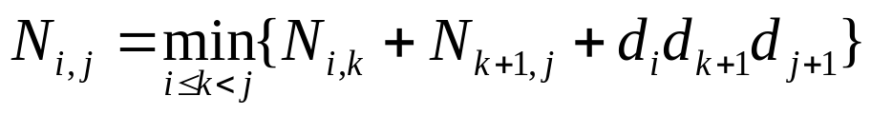
A Dynamic Programming Algorithm Visualization - A Summary
A bottom-up construction fills in the N array by diagonals
N_{i,j} gets values from pervious entries in i-th row and j-th column
Filling in each entry in the N table takes ? time. See next slide.
Getting actual parenthesization can be done by remembering “k” for each N entry as we will see.
answer
N
0
1
2
j
…
n-1
0
1
…
i
n-1

Slide 161
A Dynamic Programming Algorithm for Matrix Chains
Since subproblems overlap, we don’t use recursion.
Instead, we construct optimal subproblems “bottom-up.”
N_{i,i}’s are easy, so start with them
Then do length 2,3,… subproblems, and so on.
Look at loops for timing
Running time: O(n³)
Algorithm matrixChain(S):
Input: sequence S of n matrices to be multiplied
Output: number of operations in an optimal paranethization of S
  for i ← 1 to n-1 do
  N_{i,i} ← 0
  for b ← 1 to n-1 do
  for i ← 0 to n-b-1 do
  j ← i+b
  N_{i,j} ← +infinity
  for k ← i to j-1 do
  N_{i,j} ← min{N_{i,j} , N_{i,k} +N_{k+1,j} +d_{i} d_{k+1} d_{j+1}}

