Slide 1
Weighted Graphs
0
8
A
4
2
8
7
2
1
3
B
C
D
5
3
9
8
2
E
F
5

Slide 2
Outline and Reading
Weighted graphs (§7.1)
  Shortest path problem
  Shortest path properties
Dijkstra’s algorithm (§7.1.1)
  Algorithm
  Edge relaxation
The Bellman-Ford algorithm (§7.1.2)
Shortest paths in dags (§7.1.3)
All-pairs shortest paths (§7.2.1)

Slide 3
Weighted Graphs
In a weighted graph, each edge has an associated numerical value, called the weight of the edge
Edge weights may represent, distances, costs, etc.
Example:
  In a flight route graph, the weight of an edge represents the distance in miles between the endpoint airports
849
PVD
1843
ORD
142
SFO
802
LGA
1743
1205
337
1387
HNL
2555
1099
LAX
1233
DFW
1120
MIA

Slide 4
Shortest Path Problem
Given a weighted graph and two vertices u and v, we want to find a path of minimum total weight between u and v.
  Length of a path is the sum of the weights of its edges.
Example:
  Shortest path between Providence and Honolulu
Applications
  Internet packet routing
  Flight reservations
  Driving directions
849
PVD
1843
ORD
142
SFO
802
LGA
1743
1205
337
1387
HNL
2555
1099
LAX
1233
DFW
1120
MIA

Slide 5
Shortest Path Properties
Property 1:
A subpath of a shortest path is itself a shortest path
Property 2:
There is a tree of shortest paths from a start vertex to all the other vertices
Example:
Tree of shortest paths from Providence
849
PVD
1843
ORD
142
SFO
802
LGA
1743
1205
337
1387
HNL
2555
1099
LAX
1233
DFW
1120
MIA

Slide 6
Dijkstra’s Algorithm
Grow a “cloud” of vertices, beginning with s and eventually covering all the vertices
Store with each vertex v a label d(v) representing the distance of v from s in the subgraph consisting of the cloud and its adjacent vertices
At each step
  Add to the cloud the vertex u outside the cloud with the smallest distance label, d(u)
  Update the labels of the vertices adjacent to u
The distance of a vertex v from a vertex s is the length of a shortest path between s and v
Dijkstra’s algorithm computes the distances of all the vertices from a given start vertex s
Assumptions:
  the graph is connected
  the edges are undirected
  the edge weights are nonnegative

Slide 7
Edge Relaxation
Consider an edge e = (u,z) such that
  u is the vertex most recently added to the cloud
  z is not in the cloud
The relaxation of edge e updates distance d(z) as follows:
d(z) ← min{d(z),d(u) + weight(e)}
d(u) = 50
10
d(z) = 75
u
e
s
z
d(u) = 50
10
d(z) = 60
u
e
s
z

Slide 8
Example
0
0
8
A
4
8
A
4
2
2
8
7
2
1
4
8
7
2
1
3
B
C
D
B
C
D
∞
3
9
∞
5
3
9
8
2
E
F
5
2
E
F
5
0
0
8
A
4
8
A
4
2
2
8
7
2
1
3
7
7
2
1
3
B
C
D
B
C
D
5
3
9
11
5
3
9
8
2
E
F
5
2
E
F
5

Slide 9
Example (cont.)
0
8
A
4
2
7
7
2
1
3
B
C
D
5
3
9
8
2
E
F
5
0
8
A
4
2
7
7
2
1
3
B
C
D
5
3
9
8
2
E
F
5

Slide 10
Dijkstra’s Algorithm
A priority queue stores the vertices outside the cloud
  Key: distance
  Element: vertex
Locator-based methods
  insert(k,e) returns a locator
  replaceKey(l,k) changes the key of an item
We store two labels with each vertex:
  Distance (d(v) label)
  locator in priority queue
Algorithm DijkstraDistances(G, s)
Q ← new heap-based priority queue
for all v ∈ G.vertices()
if v = s
setDistance(v, 0)
else
setDistance(v, ∞)
l ← Q.insert(getDistance(v), v)
  setLocator(v,l)
  while ¬Q.isEmpty()
  u ← Q.removeMin()
  for all e ∈ G.incidentEdges(u)
  { relax edge e }
  z ← G.opposite(u,e)
  r ← getDistance(u) + weight(e)
  if r < getDistance(z)
  setDistance(z,r)
  Q.replaceKey(getLocator(z),r)

Slide 11
Analysis
Graph operations
  Method incidentEdges is called once for each vertex
Label operations
  We set/get the distance and locator labels of vertex z O(deg(z)) times
  Setting/getting a label takes O(1) time
Priority queue operations
  Each vertex is inserted once into and removed once from the priority queue, where each insertion or removal takes O(log n) time
  The key of a vertex in the priority queue is modified at most deg(w) times, where each key change takes O(log n) time

Slide 12
Dijkstra’s Algorithm
Dijkstra’s algorithm runs in O((n + m) log n) time provided the graph is represented by the adjacency list structure
  Recall that Σ_{v} deg(v) = 2m
The running time can also be expressed as O(m log n) since the graph is connected

Slide 13
Extension
Using the template method pattern, we can extend Dijkstra’s algorithm to return a tree of shortest paths from the start vertex to all other vertices
We store with each vertex a third label:
  parent edge in the shortest path tree
In the edge relaxation step, we update the parent label
Algorithm DijkstraShortestPathsTree(G, s
  …
for all v ∈ G.vertices()
  …
setParent(v, ∅)
  …
  for all e ∈ G.incidentEdges(u)
  { relax edge e }
  z ← G.opposite(u,e)
  r ← getDistance(u) + weight(e)
  if r < getDistance(z)
  setDistance(z,r)
  setParent(z,e)
  Q.replaceKey(getLocator(z),r)

Slide 14
Why Dijkstra’s Algorithm Works
Dijkstra’s algorithm is based on the greedy method. It adds vertices by increasing distance.
  Suppose it didn’t find all shortest distances. Let F be the first wrong vertex the algorithm processed.
  When the previous node, D, on the true shortest path was considered, its distance was correct.
  But the edge (D,F) was relaxed at that time!
  Thus, so long as d(F)>d(D), F’s distance cannot be wrong. That is, there is no wrong vertex.
0
8
A
4
2
7
7
2
1
3
B
C
D
5
3
9
8
2
E
F
5

Slide 15
Why It Doesn’t Work for Negative-Weight Edges
Dijkstra’s algorithm is based on the greedy method. It adds vertices by increasing distance.
0
8
A
4
  If a node with a negative incident edge were to be added late to the cloud, it could mess up distances for vertices already in the cloud.
6
7
7
5
1
4
B
C
D
5
0
-8
9
2
E
F
5
C’s true distance is 1, but it is already in the cloud with d(C)=5!

Slide 16
Bellman-Ford Algorithm
Works even with negative-weight edges
Must assume directed edges (for otherwise we would have negative-weight cycles)
Iteration i finds all shortest paths that use i edges.
Running time: O(nm).
Can be extended to detect a negative-weight cycle if it exists
  How?
Algorithm BellmanFord(G, s)
for all v ∈ G.vertices()
if v = s
setDistance(v, 0)
else
setDistance(v, ∞)
for i ← 1 to n-1 do
  for each e ∈ G.edges()
  { relax edge e }
  u ← G.origin(e)
  z ← G.opposite(u,e)
  r ← getDistance(u) + weight(e)
  if r < getDistance(z)
  setDistance(z,r)

Slide 17
Bellman-Ford Example
Nodes are labeled with their d(v) values. At the end of the
algorithm each d(v) is shortest distance from the 0 node to v.
8
0
4
8
0
4
-2
-2
7
1
8
7
-2
1
4
∞
∞
∞
∞
∞
∞
3
9
3
9
-2
∞
∞
5
-2
∞
∞
5
8
0
4
8
0
4
-2
-2
5
8
7
-2
1
4
-1
5
7
-2
1
-1
1
3
9
3
9
-2
6
9
5
-2
4
5
∞
∞
1
9

Slide 18
DAG-based Algorithm
Algorithm DagDistances(G, s)
for all v ∈ G.vertices()
if v = s
setDistance(v, 0)
else
setDistance(v, ∞)
Perform a topological sort of the vertices
for u ← 1 to n do {in topological order}
  for each e ∈ G.outEdges(u)
  { relax edge e }
  z ← G.opposite(u,e)
  r ← getDistance(u) + weight(e)
  if r < getDistance(z)
  setDistance(z,r)
Works even with negative-weight edges
Uses topological order
Doesn’t use any fancy data structures
Is much faster than Dijkstra’s algorithm
Running time: O(n+m).

Slide 19
DAG Example
1
Nodes are labeled with their d(v) values
1
1
8
0
4
8
0
4
-2
-2
3
7
2
1
4
3
8
7
2
-2
1
4
4
∞
∞
∞
∞
∞
∞
3
9
3
9
-5
∞
∞
5
-5
∞
∞
5
6
5
6
5
1
1
8
0
4
8
0
4
-2
-2
3
5
7
2
1
4
-1
3
7
2
1
4
8
-2
4
5
-2
-1
3
9
3
9
-5
1
7
5
-5
0
4
5
∞
∞
1
7
6
5
6
5
(two steps)

Slide 20
All-Pairs Shortest Paths
Find the distance between every pair of vertices in a weighted directed graph G.
We can make n calls to Dijkstra’s algorithm (if no negative edges), which takes O(nmlog n) time.
Likewise, n calls to Bellman-Ford would take O(n²m) time.
We can achieve O(n³) time using dynamic programming (similar to the Floyd-Warshall algorithm).
Algorithm AllPair(G) {assumes vertices 1,…,n}
for all vertex pairs (i,j)
if i = j
D₀[i,i] ← 0
else if (i,j) is an edge in G
D₀[i,j] ← weight of edge (i,j)
else
D₀[i,j] ← + ∞
for k ← 1 to n do
for i ← 1 to n do
for j ← 1 to n do
D_{k}[i,j] ← min{D_{k-1}[i,j], D_{k-1}[i,k]+D_{k-1}[k,j]}
return D_{n}
i
Uses only vertices numbered 1,…,k
(compute weight of this edge)
Uses only vertices
numbered 1,…,k-1
j
k
Uses only vertices
numbered 1,…,k-1

Slide 21
Minimum Spanning Trees
2704
867
BOS
849
PVD
ORD
740
187
144
1846
621
JFK
802
184
1258
SFO
1391
BWI
337
1464
1090
LAX
1235
DFW
946
1121
MIA
2342

Slide 22
Outline and Reading
Minimum Spanning Trees (§7.3)
  Definitions
  A crucial fact
The Prim-Jarnik Algorithm (§7.3.2)
Kruskal's Algorithm (§7.3.1)
Baruvka's Algorithm (§7.3.3)

Slide 23
Minimum Spanning Tree
Spanning subgraph
  Subgraph of a graph G containing all the vertices of G
Spanning tree
  Spanning subgraph that is itself a (free) tree
Minimum spanning tree (MST)
  Spanning tree of a weighted graph with minimum total edge weight
Applications
  Communications networks
  Transportation networks
ORD
10
1
PIT
DEN
6
7
9
3
DCA
4
STL
8
5
2
DFW
ATL

Slide 24
Cycle Property
Cycle Property:
  Let T be a minimum spanning tree of a weighted graph G
  Let e be an edge of G that is not in T and let C be the cycle formed by e with T
  For every edge f of C, weight(f) ≤ weight(e)
  Proof:
  By contradiction
  If weight(f) > weight(e) we can get a spanning tree of smaller weight by replacing e with f
f
8
4
C
9
2
6
3
e
8
7
7
Replacing f with e yields
a better spanning tree
f
8
4
C
9
2
6
3
e
8
7
7

Slide 25
Partition Property
Partition Property:
  Consider a partition of the vertices of G into subsets U and V
  Let e be an edge of minimum weight across the partition
  There is a minimum spanning tree of G containing edge e
  Proof:
  Let T be an MST of G
  If T does not contain e, consider the cycle C formed by e with T and let f be an edge of C across the partition
  By the cycle property,
  weight(f) ≤ weight(e)
  Thus, weight(f) = weight(e)
  We obtain another MST by replacing f with e
U
V
f
7
4
9
2
5
8
8
e
3
7
Replacing f with e yields
another MST
U
V
f
7
4
9
2
5
8
8
e
3
7

Slide 26
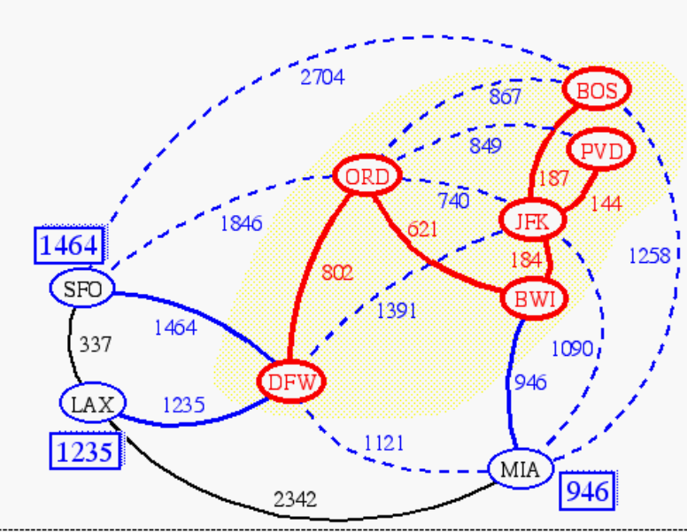
Prim-Jarnik’s Algorithm
Similar to Dijkstra’s algorithm (for a connected graph)
We pick an arbitrary vertex s and we grow the MST as a cloud of vertices, starting from s
We store with each vertex v a label d(v) = the smallest weight of an edge connecting v to a vertex in the cloud
At each step:
  We add to the cloud the vertex u outside the cloud with the smallest distance label
  We update the labels of the vertices adjacent to u

Slide 27
Prim-Jarnik’s Algorithm (cont.)
A priority queue stores the vertices outside the cloud
  Key: distance
  Element: vertex
Locator-based methods
  insert(k,e) returns a locator
  replaceKey(l,k) changes the key of an item
We store three labels with each vertex:
  Distance
  Parent edge in MST
  Locator in priority queue
Algorithm PrimJarnikMST(G)
Q ← new heap-based priority queue
s ← a vertex of G
for all v ∈ G.vertices()
if v = s
setDistance(v, 0)
else
setDistance(v, ∞)
setParent(v, ∅)
l ← Q.insert(getDistance(v), v)
  setLocator(v,l)
  while ¬Q.isEmpty()
  u ← Q.removeMin()
  for all e ∈ G.incidentEdges(u)
  z ← G.opposite(u,e)
  r ← weight(e)
  if r < getDistance(z)
  setDistance(z,r)
  setParent(z,e)
  Q.replaceKey(getLocator(z),r)

Slide 28
Example
∞
7
2
7
D
2
7
D
B
4
B
4
8
9
∞
5
9
∞
2
5
F
2
5
F
C
8
C
8
8
3
8
3
E
E
A
7
7
A
7
7
0
0
7
7
2
7
D
7
D
B
4
2
B
4
5
9
∞
9
4
2
5
F
5
5
C
2
F
8
C
8
8
3
3
E
8
A
7
E
0
7
A
7
7
0

Slide 29
Example (contd.)
7
2
7
D
B
4
5
9
4
2
5
F
C
8
8
3
E
A
7
3
7
0
7
D
2
B
4
5
9
4
2
5
F
C
8
8
3
E
A
7
3
0

Slide 30
Analysis
Graph operations
  Method incidentEdges is called once for each vertex
Label operations
  We set/get the distance, parent and locator labels of vertex z O(deg(z)) times
  Setting/getting a label takes O(1) time
Priority queue operations
  Each vertex is inserted once into and removed once from the priority queue, where each insertion or removal takes O(log n) time
  The key of a vertex w in the priority queue is modified at most deg(w) times, where each key change takes O(log n) time

Slide 31
Analysis
Prim-Jarnik’s algorithm runs in O((n + m) log n) time provided the graph is represented by the adjacency list structure
  Recall that Σ_{v} deg(v) = 2m
The running time is O(m log n) since the graph is connected

Slide 32
Kruskal’s Algorithm
A priority queue stores the edges outside the cloud
  Key: weight
  Element: edge
At the end of the algorithm
  We are left with one cloud that encompasses the MST
  A tree T which is our MST
Algorithm KruskalMST(G)
for each vertex V in G do
define a Cloud(v) of ← {v}
let Q be a priority queue.
Insert all edges into Q using their weights as the key
T ← ∅
while T has fewer than n-1 edges do edge e = T.removeMin()
Let u, v be the endpoints of e
if Cloud(v) ≠ Cloud(u) then
Add edge e to T
Merge Cloud(v) and Cloud(u)
return T

Slide 33
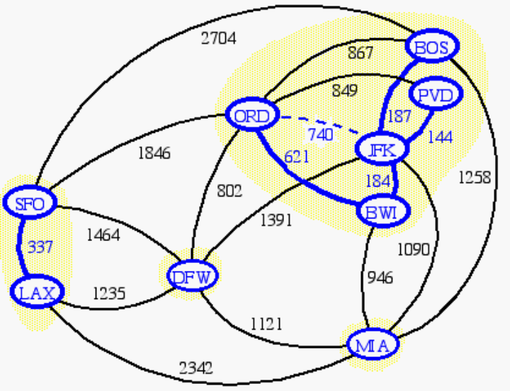
Data Structure for Kruskal Algortihm
The algorithm maintains a forest of trees
An edge is accepted it if connects distinct trees
We need a data structure that maintains a partition, i.e., a collection of disjoint sets, with the operations:
-find(u): return the set storing u
-union(u,v): replace the sets storing u and v with their union

Slide 34
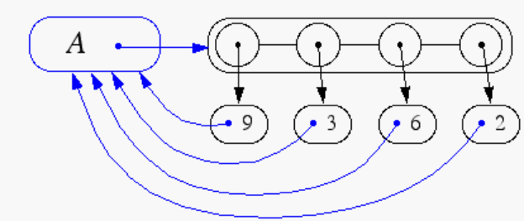
Representation of a Partition
Each set is stored in a sequence
Each element has a reference back to the set
  operation find(u) takes O(1) time, and returns the set of which u is a member.
  in operation union(u,v), we move the elements of the smaller set to the sequence of the larger set and update their references
  the time for operation union(u,v) is min(n_{u},n_{v}), where n_{u} and n_{v} are the sizes of the sets storing u and v
Whenever an element is processed, it goes into a set of size at least double, hence each element is processed at most log n times

Slide 35
Partition-Based Implementation
A partition-based version of Kruskal’s Algorithm performs cloud merges as unions and tests as finds.
Algorithm Kruskal(G):
Input: A weighted graph G.
Output: An MST T for G.
Let P be a partition of the vertices of G, where each vertex forms a separate set.
Let Q be a priority queue storing the edges of G, sorted by their weights
Let T be an initially-empty tree
while Q is not empty do
(u,v) ← Q.removeMinElement()
if P.find(u) != P.find(v) then
Add (u,v) to T
P.union(u,v)
return T
Running time: O((n+m)log n)

Slide 36
Kruskal Example
2704
867
BOS
849
PVD
ORD
187
740
144
1846
621
JFK
184
1258
802
SFO
BWI
1391
1464
337
1090
DFW
946
LAX
1235
1121
MIA
2342

Slide 37
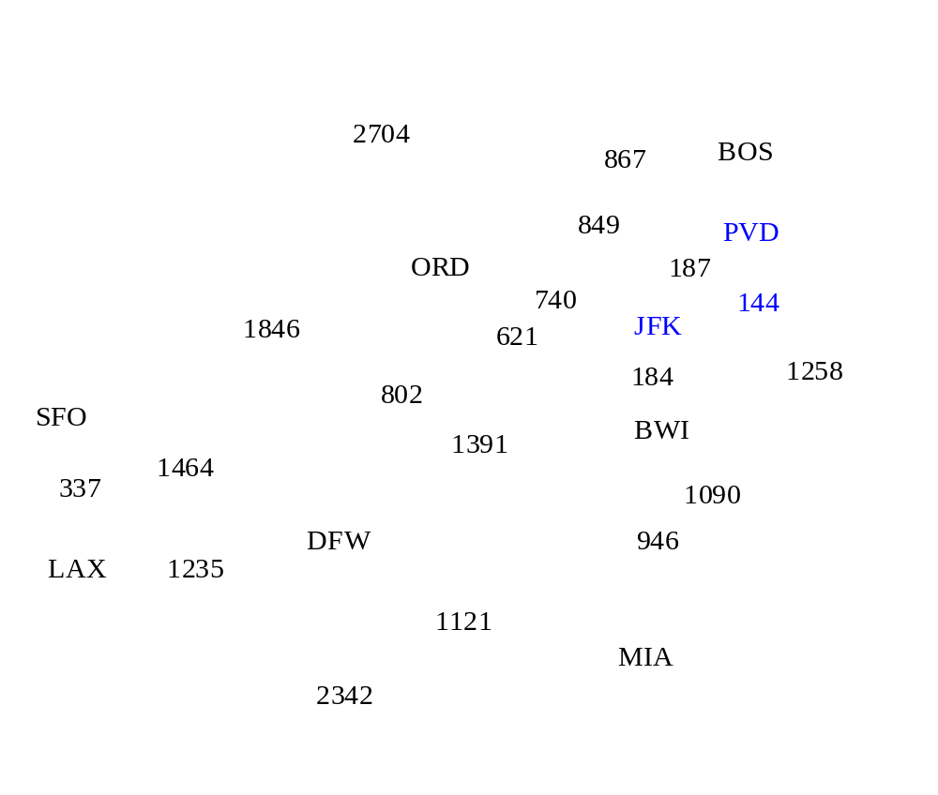
Example

Slide 38
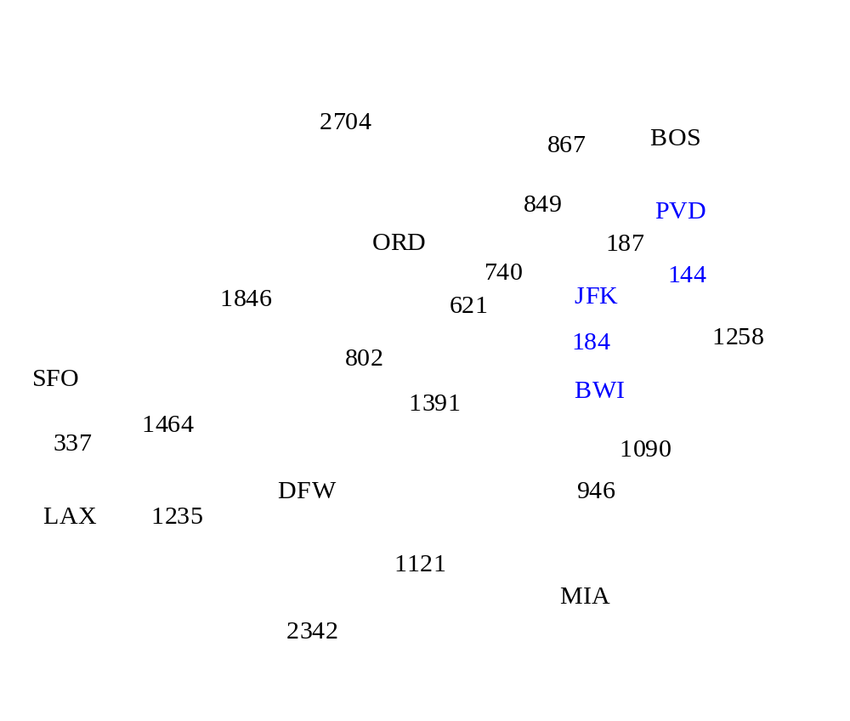
Example

Slide 39
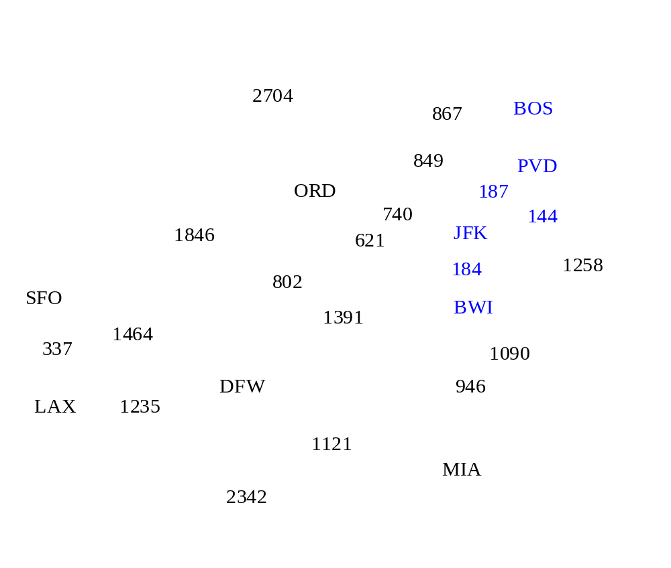
Example

Slide 40
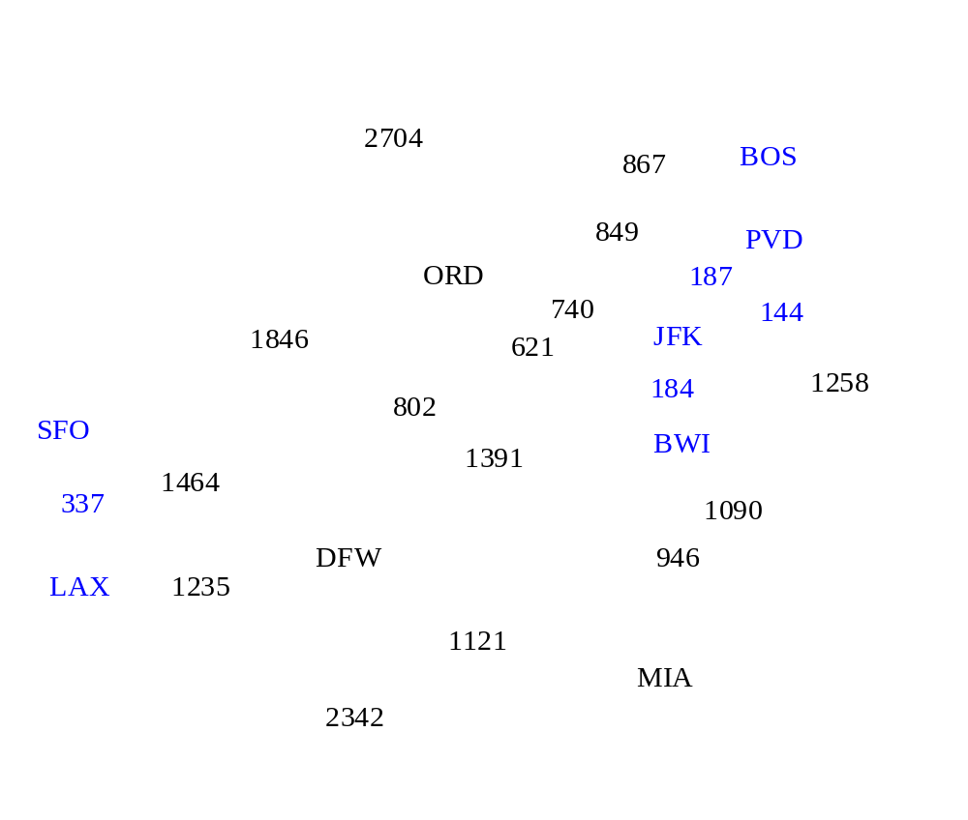
Example

Slide 41
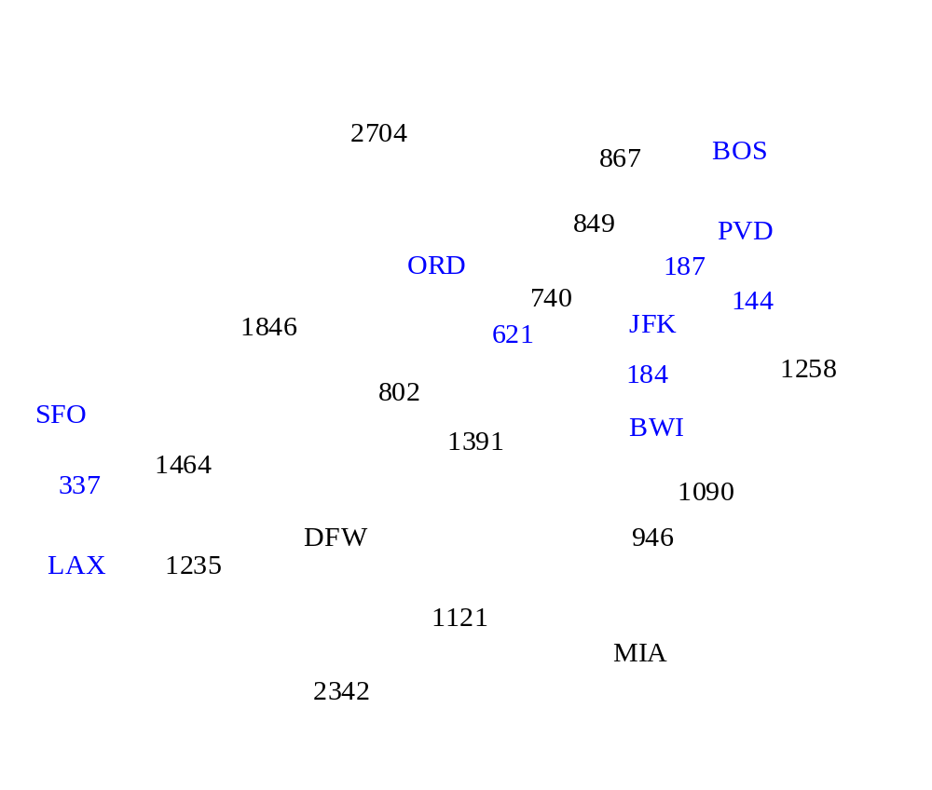
Example

Slide 42
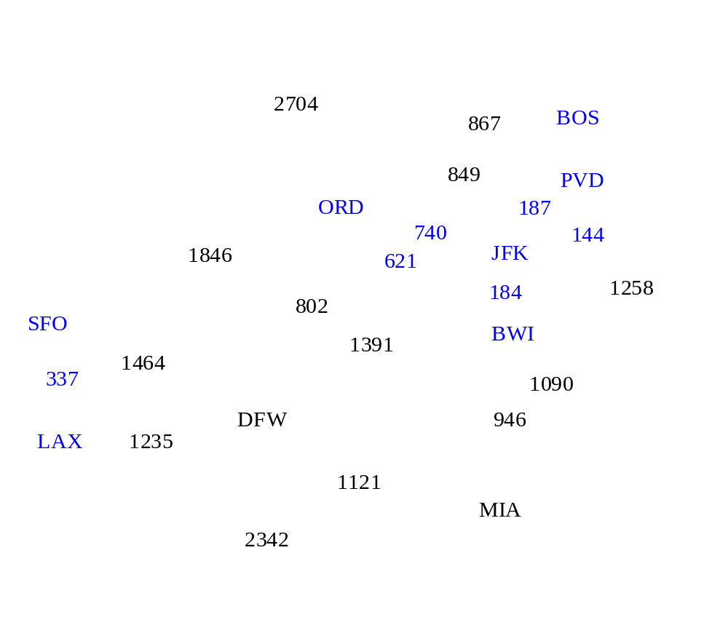
Example

Slide 43
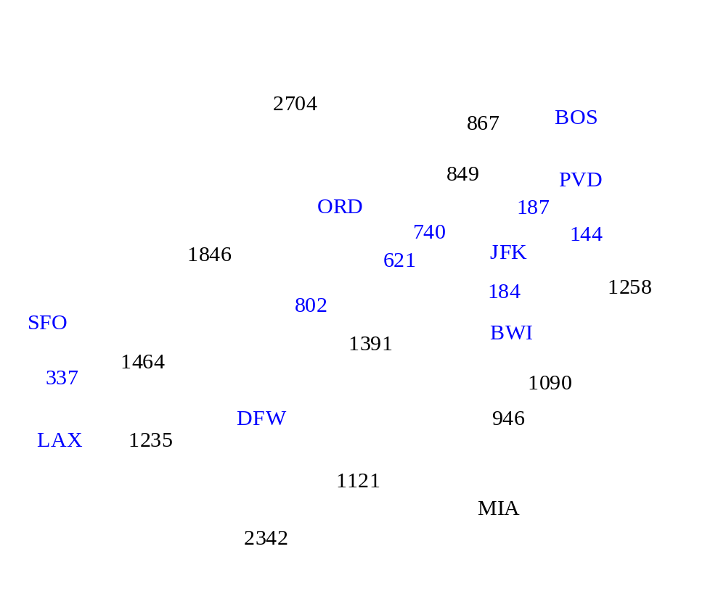
Example

Slide 44
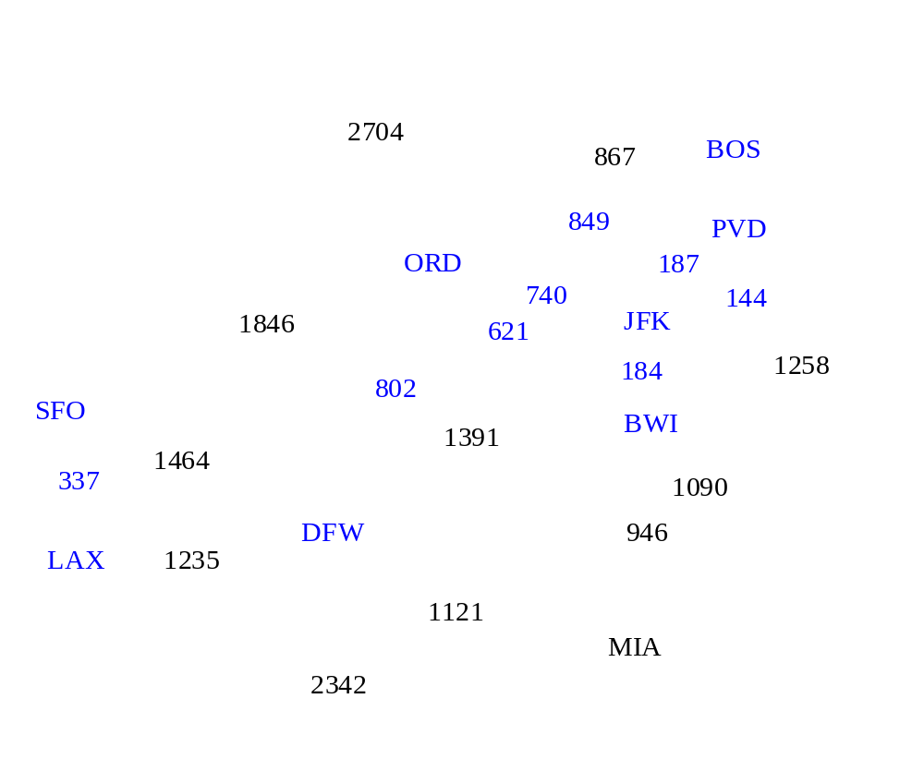
Example

Slide 45
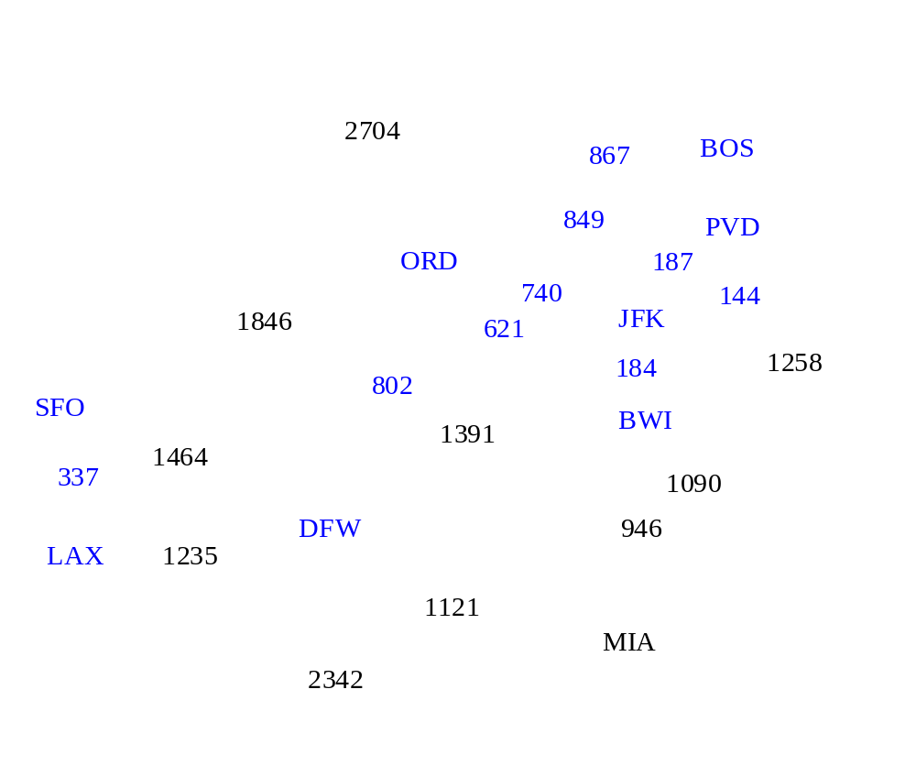
Example

Slide 46

Example

Slide 47
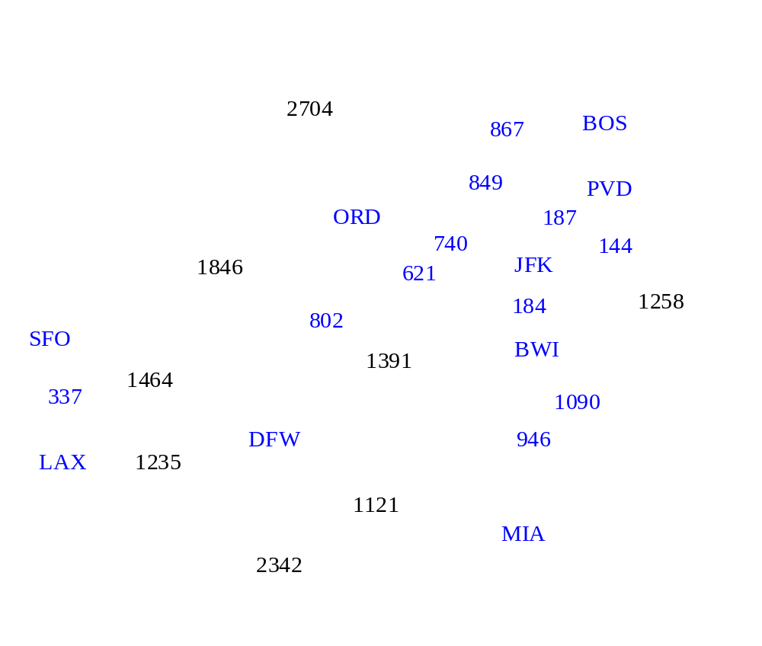
Example

Slide 48

Example

Slide 49
Example
2704
867
BOS
849
PVD
ORD
187
740
144
1846
621
JFK
184
1258
802
SFO
BWI
1391
1464
337
1090
DFW
946
LAX
1235
1121
MIA
2342

Slide 50
Baruvka’s Algorithm
Like Kruskal’s Algorithm, Baruvka’s algorithm grows many “clouds” at once.
Each iteration of the while-loop halves the number of connected compontents in T.
  The running time is O(m log n).
Algorithm BaruvkaMST(G)
T ← V {just the vertices of G}
while T has fewer than n-1 edges do
for each connected component C in T do
Let edge e be the smallest-weight edge from C to another component in T.
if e is not already in T then
Add edge e to T
return T

Slide 51
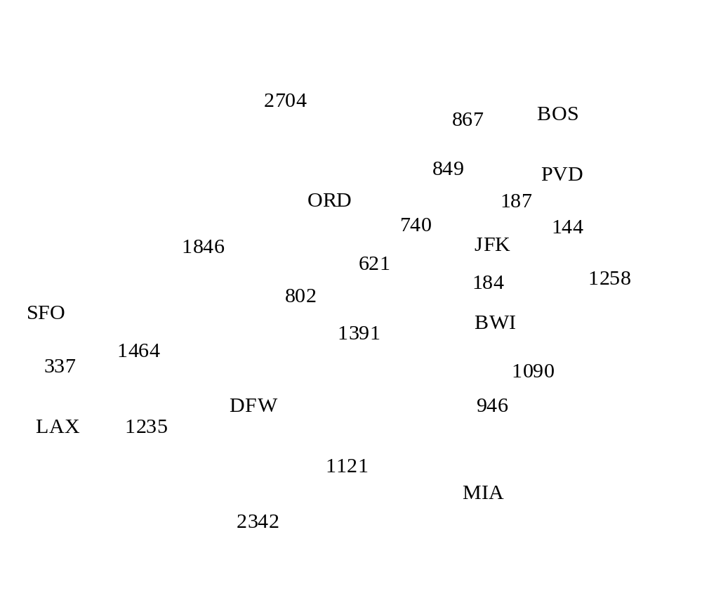
Baruvka Example

Slide 52
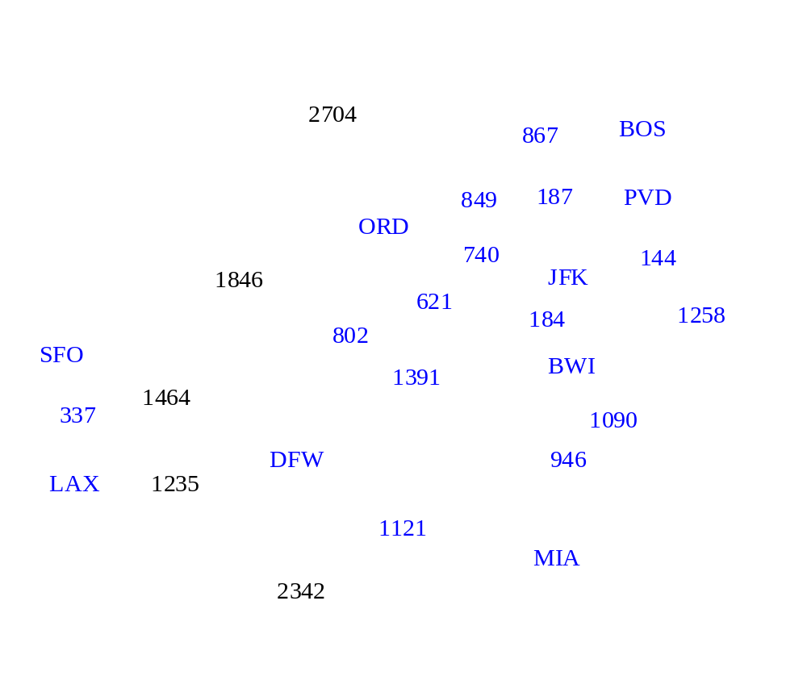
Example

Slide 53
Example
2704
867
BOS
849
187
PVD
ORD
740
144
1846
JFK
621
184
1258
802
SFO
BWI
1391
1464
337
1090
DFW
946
LAX
1235
1121
MIA
2342

