Slide 1
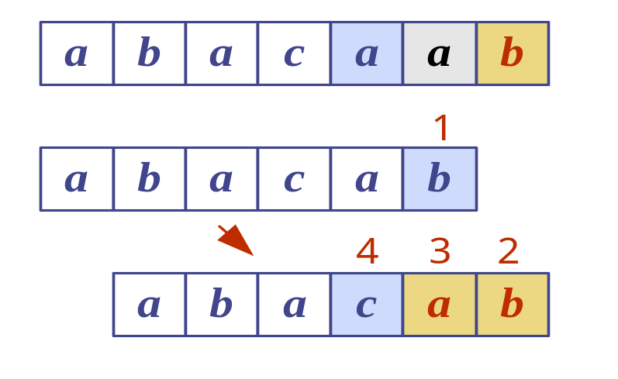
Pattern Matching

Slide 2
Outline and Reading
Strings (§9.1.1)
Pattern matching algorithms
  Brute-force algorithm (§9.1.2)
  Boyer-Moore algorithm (§9.1.3)
  Knuth-Morris-Pratt algorithm (§9.1.4)

Slide 3

Strings
A string is a sequence of characters
Examples of strings:
  Java program
  HTML document
  DNA sequence
  Digitized image
An alphabet S is the set of possible characters for a family of strings
Example of alphabets:
  ASCII
  Unicode
  {0, 1}
  {A, C, G, T}

Slide 4
Definitions for Strings
Let P be a string of size m
  A substring P[i .. j] of P is the subsequence of P consisting of the characters with ranks between i and j
  A prefix of P is a substring of the type P[0 .. i]
  A suffix of P is a substring of the type P[i ..m - 1]
Given strings T (text) and P (pattern), the pattern matching problem consists of finding a substring of T equal to P
Applications:
  Text editors
  Search engines
  Biological research

Slide 5
Brute-Force Algorithm
The brute-force pattern matching algorithm compares the pattern P with the text T for each possible shift of P relative to T, until either
  a match is found, or
  all placements of the pattern have been tried
Brute-force pattern matching runs in time O(nm)
Example of worst case:
  T = aaa … ah
  P = aaah
  May occur in images and DNA sequences
  Unlikely in English text
Algorithm BruteForceMatch(T, P)
Input text T of size n and pattern
P of size m
Output starting index of a
substring of T equal to P or −1
if no such substring exists
  for i ← 0 to n − m
  { test shift i of the pattern }
  j ← 0
  while j < m ∧ T[i + j] = P[j]
  j ← j + 1
  if j = m
  return i {match at i}
  else
  break while loop {mismatch}
  return -1 {no match anywhere}

Slide 6
Boyer-Moore Algorithm
The brute force algorithm works on unbounded alphabets.
The Boyer-Moore Algorithm requires a finite, fixed sized alphabet.
It works best when the alphabet is moderately sized and the pattern is relatively long.
The main idea is to use two heuristics that make the matching easier.

Slide 7
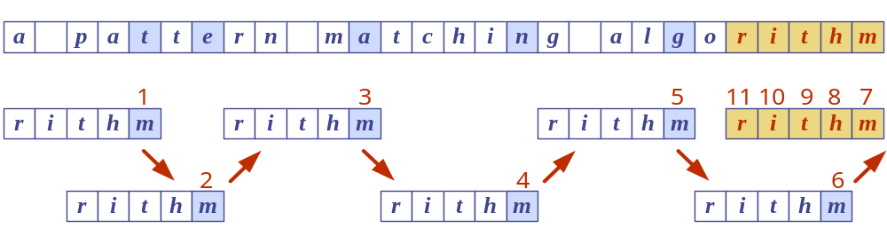
Boyer-Moore Heuristics
The Boyer-Moore’s pattern matching algorithm is based on two heuristics
Looking-glass heuristic: Compare P with a subsequence of T moving backwards
Character-jump heuristic: When a mismatch occurs at T[i] = c
  If P contains c, shift P to align the last occurrence of c in P with T[i]
  Else, shift P to align P[0] with T[i + 1]
Example

Slide 8
Last-Occurrence Function
Boyer-Moore’s algorithm preprocesses the pattern P and the alphabet S to build the last-occurrence function L mapping S to integers, where L(c) is defined as
  the largest index i such that P[i] = c or
  -1 if no such index exists
Example:
  S = {a, b, c, d}
  P = abacab
The last-occurrence function can be represented by an array indexed by the numeric codes of the characters
The last-occurrence function can be computed in time
O(m + s), where m is the size of P and s is the size of S
c | a | b | c | d
L(c) | 4 | 5 | 3 | −1

Slide 9
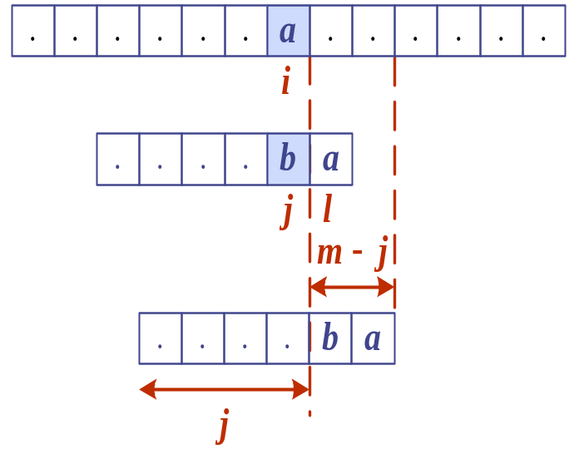
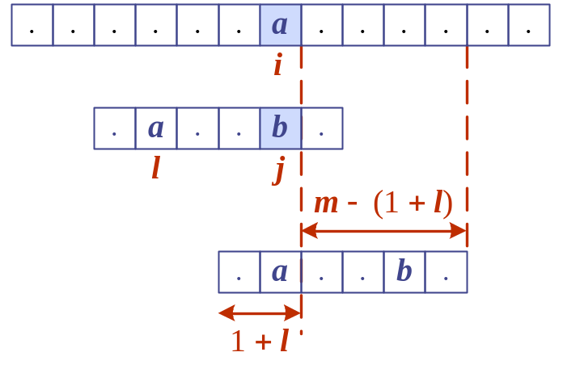
The Boyer-Moore Algorithm
Algorithm BoyerMooreMatch(T, P, Σ)
L ← lastOccurenceFunction(P, Σ )
i ← m − 1
j ← m − 1
repeat
  if T[i] = P[j]
  if j = 0
  return i { match at i }
  else
  i ← i − 1
  j ← j − 1
  else
  { character-jump }
  l ← L[T[i]]
  i ← i + m – min(j, 1 + l)
  j ← m − 1
  until i > n − 1
  return −1 { no match }
Case 1: j ≤ 1 + l
Case 2: 1 + l ≤ j

Slide 10
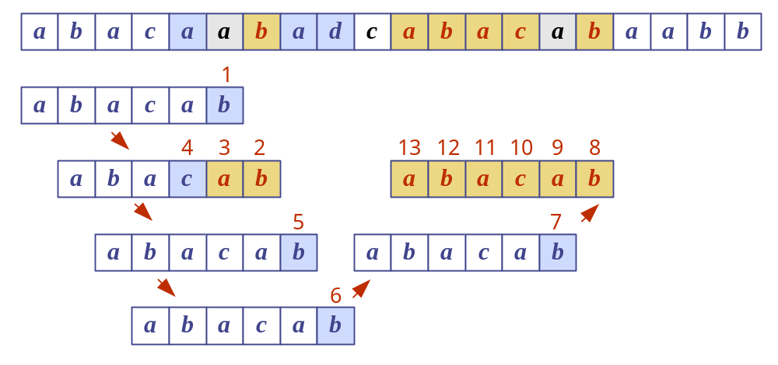
Example

Slide 11
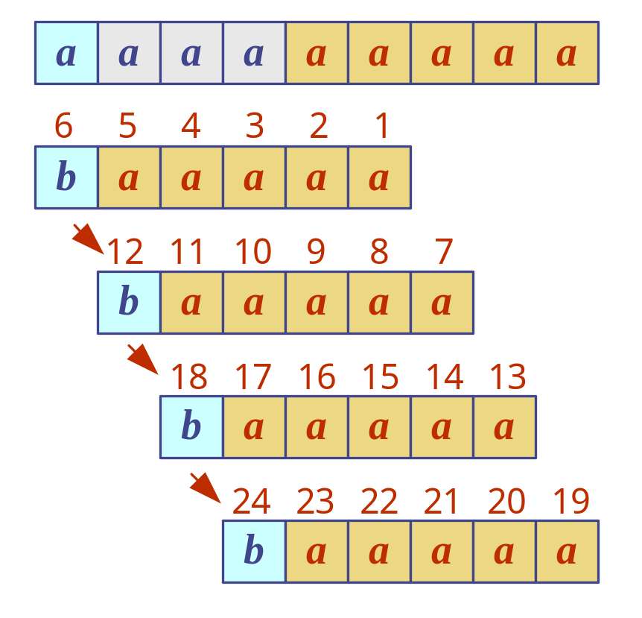
Analysis
Boyer-Moore’s algorithm runs in time O(nm + s)
Example of worst case:
  T = aaa … a
  P = baaa
The worst case may occur in images and DNA sequences but is unlikely in English text
Boyer-Moore’s algorithm is significantly faster than the brute-force algorithm on English text

Slide 12
Why Another Algorithm for the Same Problem
The worst case in both the brute-force and BM pattern matching algorithms yield a major inefficiency.
We may perform many comparisons, yet if the comparison doesn't yield a match, we throw away all the information gained by these comparisons and start all over again.
The Knuth-Morris-Pratt (KMP) avoids the waste of information.
It runs in O(n+m) time, which is optimal in the worst case.

Slide 13
The KMP Algorithm - Motivation
Knuth-Morris-Pratt’s algorithm compares the pattern to the text in left-to-right, but shifts the pattern more intelligently than the brute-force algorithm.
When a mismatch occurs, what is the most we can shift the pattern so as to avoid redundant comparisons?
Answer: the largest prefix of P[0..j] that is a suffix of P[1..j]
.
.
a
b
a
a
b
x
.
.
.
.
.
a
b
a
a
b
a
j
a
b
a
a
b
a
No need to
repeat these
comparisons
Resume
comparing
here

Slide 14
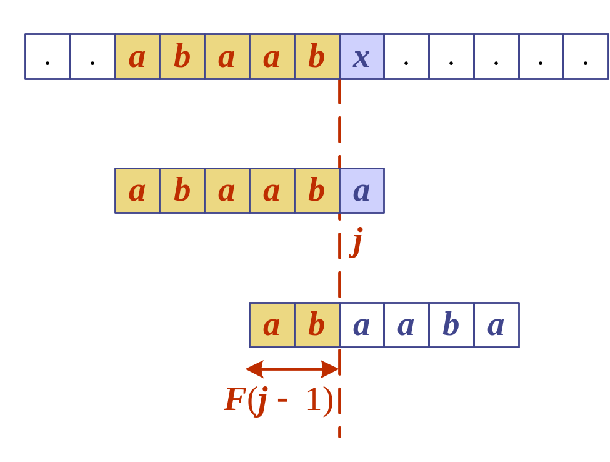
KMP Failure Function
Knuth-Morris-Pratt’s algorithm preprocesses the pattern to find matches of prefixes of the pattern with the pattern itself
The failure function F(j) is defined as the size of the largest prefix of P[0..j] that is also a suffix of P[1..j]
Knuth-Morris-Pratt’s algorithm modifies the brute-force algorithm so that if a mismatch occurs at P[j] ≠ T[i] we set
j ← F(j − 1) i.e. shift rest right
j | 0 | 1 | 2 | 3 | 4 | 5
P[j] | a | b | a | a | b | a
F(j) | 0 | 0 | 1 | 1 | 2 | 3

Slide 15
The KMP Algorithm
The failure function can be represented by an array and can be computed in O(m) time
At each iteration of the while-loop, either
  i increases by one, or
  the shift amount i - j increases by at least one (observe that F(j - 1) < j)
Hence, there are no more than 2n iterations of the while-loop
Thus, KMP’s algorithm runs in optimal time O(m + n)
Algorithm KMPMatch(T, P)
F ← failureFunction(P)
i ← 0
j ← 0
while i < n
  if T[i] = P[j]
  if j = m − 1
  return i − j { match }
  else
  i ← i + 1
  j ← j + 1
  else
  if j > 0
  j ← F[j − 1]
  else
  i ← i + 1
  return −1 { no match }

Slide 16
Computing the Failure Function
The failure function can be represented by an array and can be computed in O(m) time
The construction is similar to the KMP algorithm itself
At each iteration of the while-loop, either
  i increases by one, or
  the shift amount i - j increases by at least one (observe that F(j - 1) < j)
Hence, there are no more than 2m iterations of the while-loop
Algorithm failureFunction(P)
F[0] ← 0
i ← 1
j ← 0
while i < m
  if P[i] = P[j]
  {we have matched j + 1 chars}
  F[i] ← j + 1
  i ← i + 1
  j ← j + 1
  else if j > 0 then
  {use failure function to shift P}
  j ← F[j − 1]
  else
  F[i] ← 0 { no match }
  i ← i + 1

Slide 17
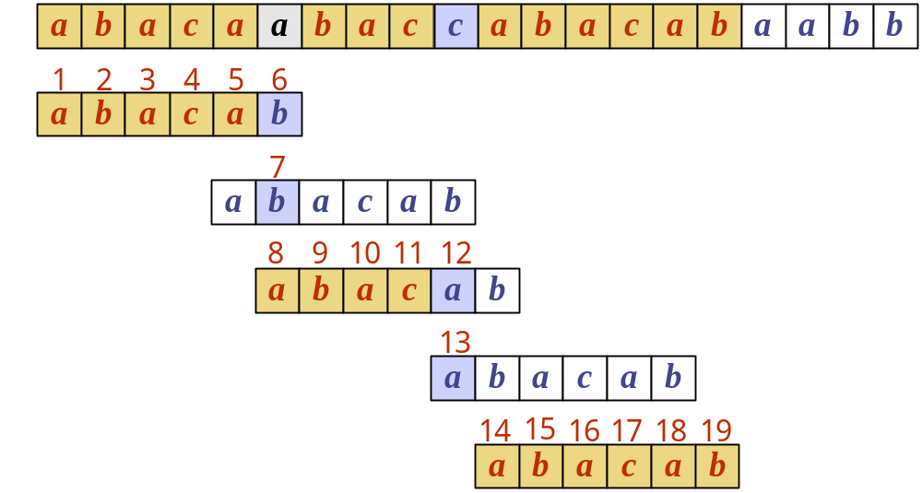
Example
j | 0 | 1 | 2 | 3 | 4 | 5
P[j] | a | b | a | c | a | b
F(j) | 0 | 0 | 1 | 0 | 1 | 2

Slide 18
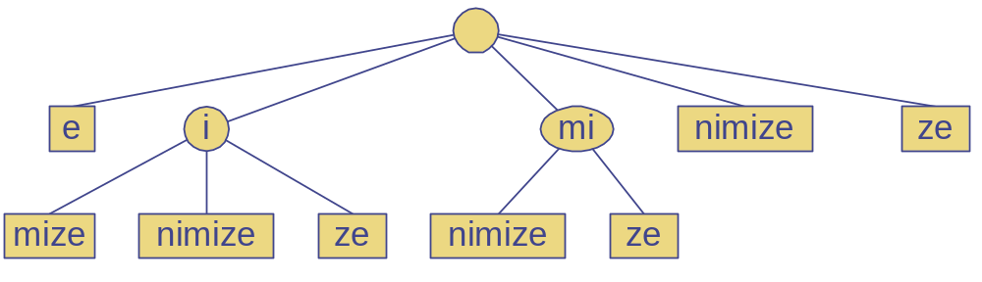
Tries (pronounced "trys")

Slide 19
Outline and Reading
Standard tries (§9.2.1)
Compressed tries (§9.2.2)
Suffix tries (§9.2.3)
Huffman encoding tries (§9.3.1)

Slide 20
Preprocessing Strings
Preprocessing the pattern speeds up pattern matching queries
  After preprocessing the pattern, KMP’s algorithm performs pattern matching in time proportional to the text size
If the text is large, immutable and searched for often (e.g., works by Shakespeare), we may want to preprocess the text instead of the pattern
A trie is a compact data structure for representing a set of strings, such as all the words in a text
  A tries supports pattern matching queries in time proportional to the pattern size

Slide 21
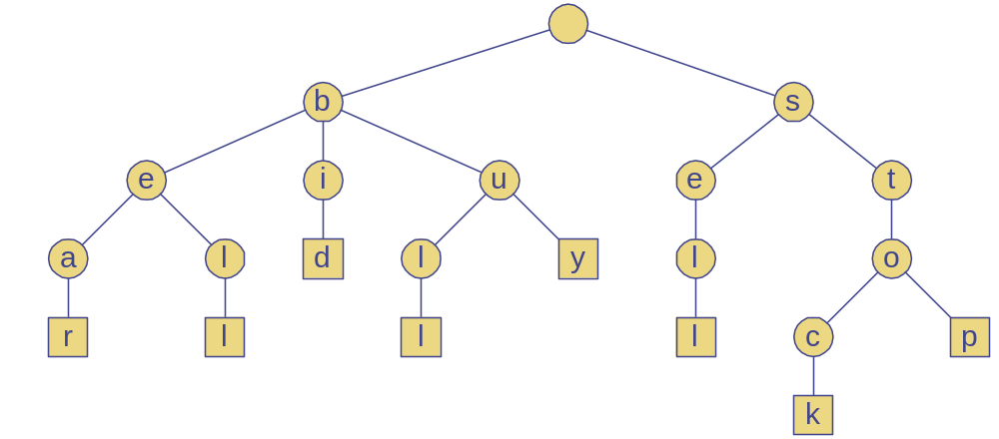
Standard Trie (1)
The standard trie for a set of strings S is an ordered tree such that:
  Each node but the root is labeled with a character
  The children of a node are alphabetically ordered
  The paths from the external nodes to the root yield the strings of S
Example: standard trie for the set of strings
  S = { bear, bell, bid, bull, buy, sell, stock, stop }

Slide 22
Standard Trie (2)
A standard trie uses O(n) space and supports searches, insertions and deletions in time O(dm), where:
  n total size of the strings in S
  m size of the string parameter of the operation
  d size of the alphabet

Slide 23
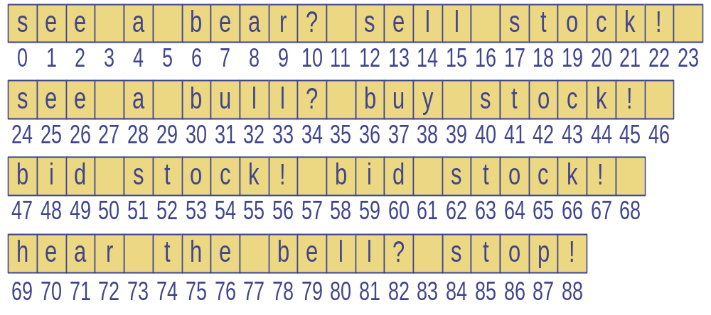
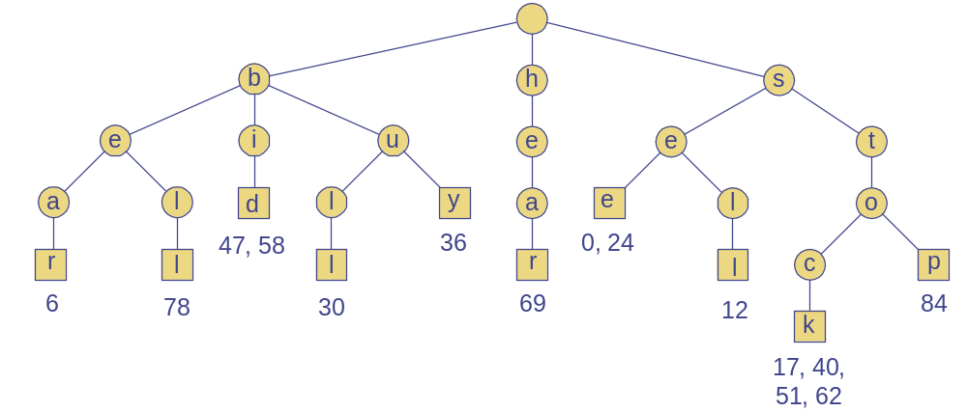
Word Matching with a Trie
We insert the words of the text into a trie
Each leaf stores the occurrences of the associated word in the text

Slide 24
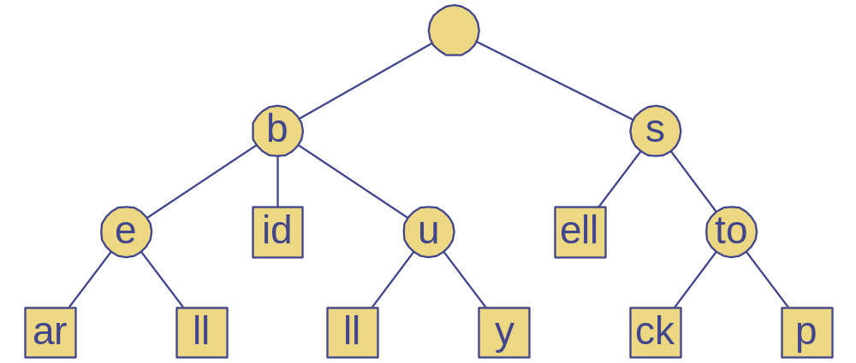
Compressed Trie
A compressed trie has internal nodes of degree at least two
It is obtained from standard trie by compressing chains of “redundant” nodes

Slide 25
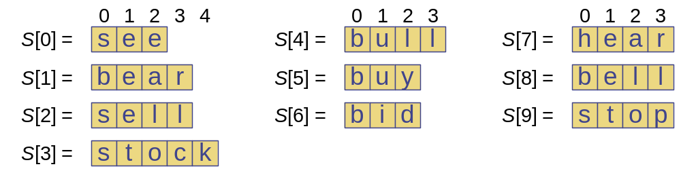
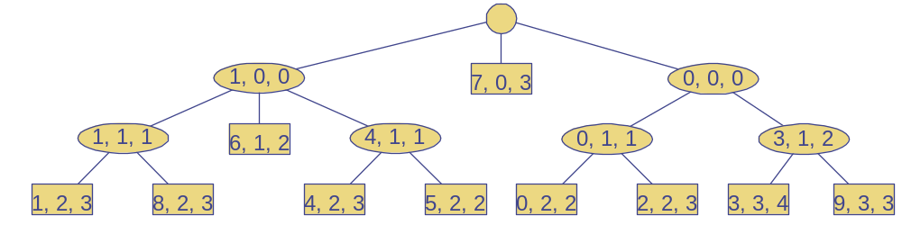
Compact Representation
Compact representation of a compressed trie for an array of strings:
  Stores at the nodes ranges of indices instead of substrings
  Uses O(s) space, where s is the number of strings in the array
  Serves as an auxiliary index structure
i,j,k means
ith string
Index j to k

Slide 26
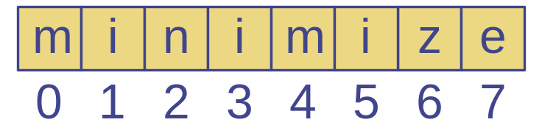
Suffix Trie (1)
The suffix trie of a string X is the compressed trie of all the suffixes of X

Slide 27
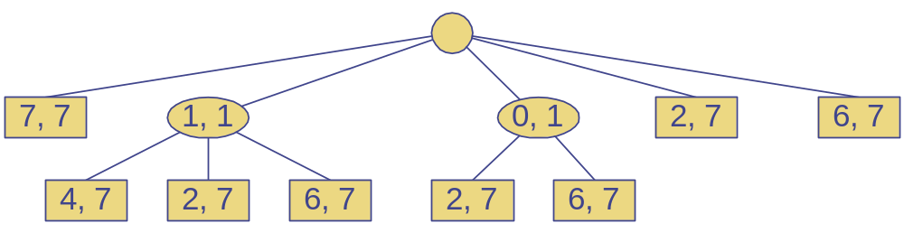
Suffix Trie (2)
Compact representation of the suffix trie for a string X of size n from an alphabet of size d
  Uses O(n) space
  Supports arbitrary pattern matching queries in X in O(dm) time, where m is the size of the pattern

Slide 28
Encoding Trie (1)
A code is a mapping of each character of an alphabet to a binary code-word
A prefix code is a binary code such that no code-word is the prefix of another code-word
An encoding trie represents a prefix code
  Each leaf stores a character
  The code word of a character is given by the path from the root to the leaf storing the character (0 for a left child and 1 for a right child
00 | 010 | 011 | 10 | 11
a | b | c | d | e
a
d
e
b
c

Slide 29
Encoding Trie (2)
Given a text string X, we want to find a prefix code for the characters of X that yields a small encoding for X
  Frequent characters should have long code-words
  Rare characters should have short code-words
Example
  X = abracadabra
  T₁ encodes X into 29 bits
  T₂ encodes X into 24 bits
T₁
T₂
c
d
b
a
b
r
a
r
c
d

Slide 30
Huffman’s Algorithm
Given a string X, Huffman’s algorithm construct a prefix code the minimizes the size of the encoding of X
It runs in time
O(n + d log d), where n is the size of X and d is the number of distinct characters of X
A heap-based priority queue is used as an auxiliary structure
Algorithm HuffmanEncoding(X)
Input string X of size n
Output optimal encoding trie for X
C ← distinctCharacters(X)
computeFrequencies(C, X)
Q ← new empty heap
for all c ∈ C
T ← new single-node tree storing c
Q.insert(getFrequency(c), T)
while Q.size() > 1
f₁ ← Q.minKey()
T₁ ← Q.removeMin()
f₂ ← Q.minKey()
T₂ ← Q.removeMin()
T ← join(T₁, T₂)
Q.insert(f₁ + f₂, T)
return Q.removeMin()

Slide 31
Example
11
X = abracadabra
a
6
Frequencies
2
4
a | b | c | d | r
5 | 2 | 1 | 1 | 2
c
d
b
r
6
2
4
a
b
c
d
r
5
2
1
1
2
a
c
d
b
r
5
2
2
4
a
b
c
d
r
a
c
d
b
r
5
2
2
5

