Slide 1
Introduction
Thinking about Algorithms Abstractly
So you want to be a computer scientist?
Grade School Revisited: How To Multiply Two Numbers
By Jeff Edmonds
York University
Lecture 1
COSC 3101

Slide 2

So you want to be a computer scientist?

Slide 3

Is your goal to be a mundane programmer?

Slide 4

Or a great leader and thinker?

Slide 5
Original Thinking

Slide 6


Boss assigns task:
  Given today’s prices of pork, grain, sawdust, …
  Given constraints on what constitutes a hotdog.
  Make the cheapest hotdog.
Everyday industry asks these questions.

Slide 7
Your answer:
Um? Tell me what to code.
With more suffocated software engineering systems,
the demand for mundane programmers will diminish.

Slide 8

Your answer:
I learned this great algorithm that will work.
Soon all known algorithms
will be available in libraries.

Slide 9
Your answer:
I can develop a new algorithm for you.
Great thinkers
will always be needed.

Slide 10

The future belongs to the computer scientist who has
  Content: An up to date grasp of fundamental problems and solutions
  Methods: Principles and techniques to solve the vast array of unfamiliar problems that arise in a rapidly changing field
Rudich www.discretemath.com

Slide 11
Course Content
A list of algorithms.
  Learn their code.
  Trace them until you are convinced that they work.
  Implement them.
class InsertionSortAlgorithm extends SortAlgorithm {
void sort(int a[]) throws Exception {
for (int i = 1; i < a.length; i++) {
int j = i;
int B = a[i];
while ((j > 0) && (a[j-1] > B)) {
a[j] = a[j-1];
j--; }
a[j] = B;
}}

Slide 12




Course Content
A survey of algorithmic design techniques.
Abstract thinking.
How to develop new algorithms for any problem that may arise.

Slide 13
Still, need to do some of this in order to know what is known
A list of algorithms.
  Learn their code.
  Trace them until you are convinced that they work.
  Implement
class InsertionSortAlgorithm extends SortAlgorithm {
void sort(int a[]) throws Exception {
for (int i = 1; i < a.length; i++) {
int j = i;
int B = a[i];
while ((j > 0) && (a[j-1] > B)) {
a[j] = a[j-1];
j--; }
a[j] = B;
}}

Slide 14

Study:
Many experienced programmers were asked to code up binary search.

Slide 15

Study:
Many experienced programmers were asked to code up binary search.
80% got it wrong
Good thing is was not for a nuclear power plant.

Slide 16

What did they lack?

Slide 17

What did they lack?
Formal proof methods?

Slide 18
What did they lack?
Formal proof methods?
Yes, likely
Industry is starting to realize that formal methods are important.
But even without formal methods …. ?

Slide 19

What did they lack?
Fundamental understanding of the algorithmic design techniques.
Abstract thinking.

Slide 20
Course Content
Notations, analogies, and abstractions
for developing,
thinking about,
and describing algorithms
so correctness is transparent

Slide 21
A survey of fundamental ideas and algorithmic design techniques
For example . . .

Slide 22

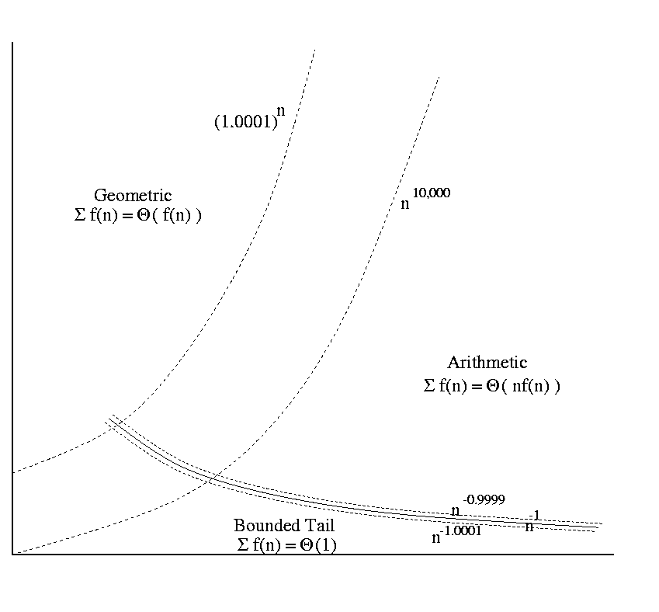
Start With Some Math
Classifying Functions
Time Complexity
f(i) = n^{Θ(n)}
t(n) = Θ(n²)
Time
Input Size
Adding Made Easy
Recurrence Relations
∑_{i=1} f(i).
T(n) = a T(n/b) + f(n)

Slide 23




Iterative Algorithms
Loop Invariants
<preCond>
codeA
loop
<loop-invariant>
exit when <exit Cond>
codeB
codeC
<postCond>
T+1
0
5 km
i-1
i
9 km
i
i
One step at a time
Code
Relay Race

Slide 24
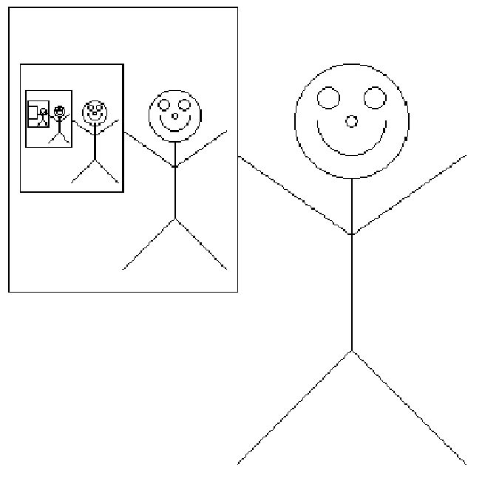
Recursive Algorithms
?
?

Slide 25
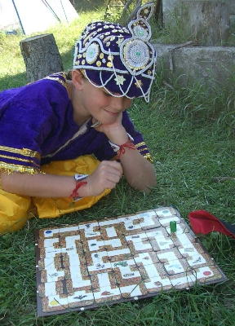
Graph Search Algorithms

Slide 26
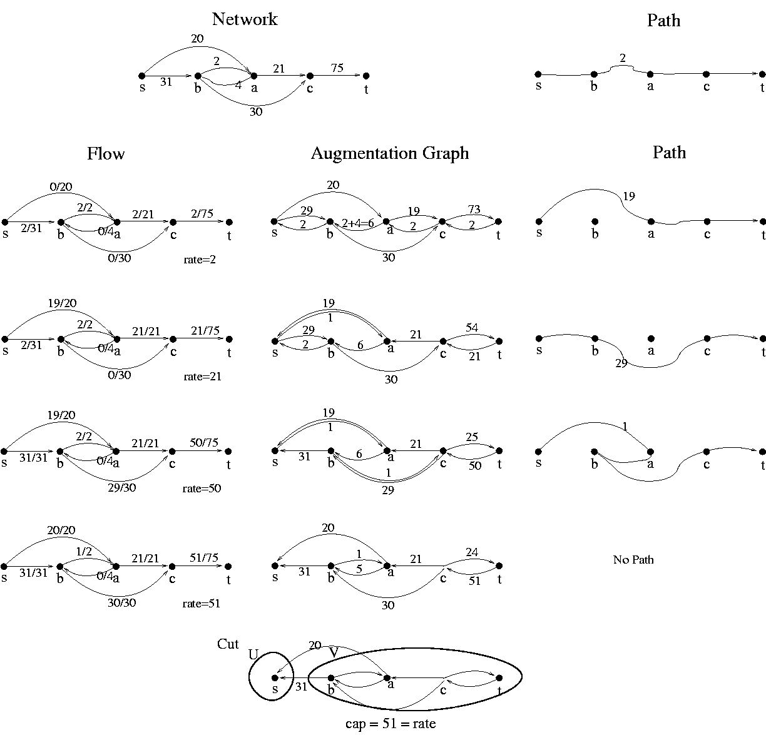
Network Flows

Slide 27
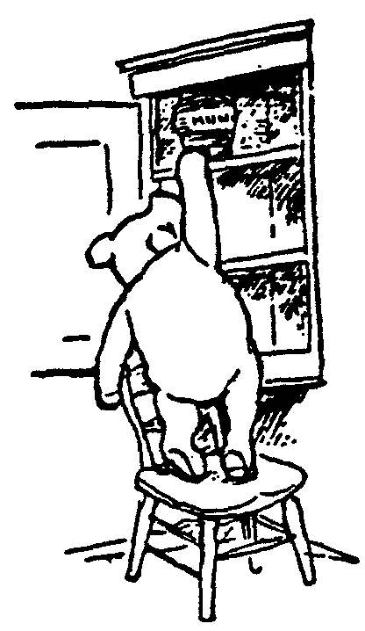
Greedy Algorithms

Slide 28
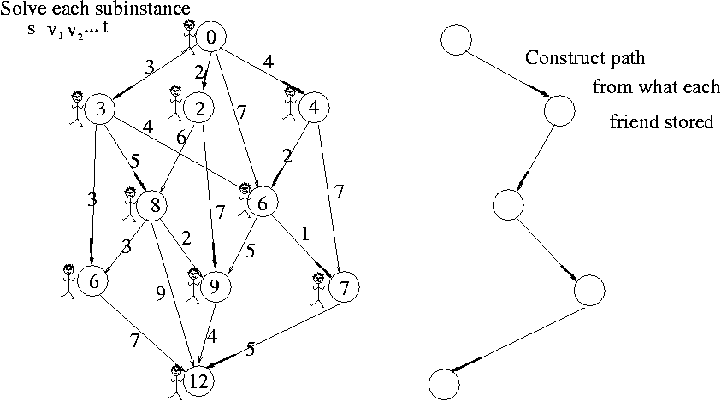
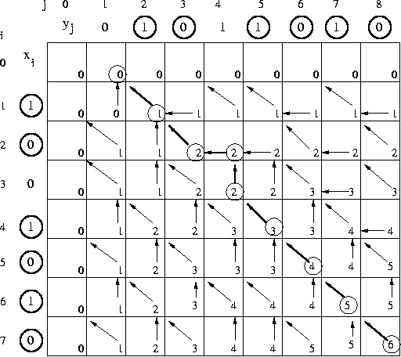
Dynamic Programing

Slide 29
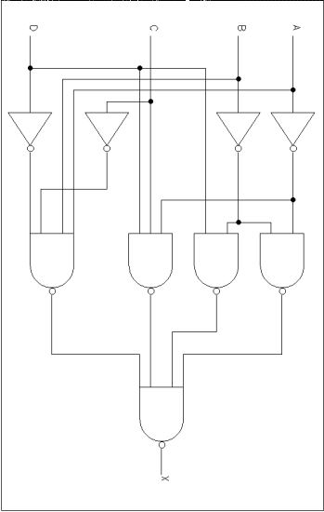
Reduction
=
Rudich www.discretemath.com

Slide 30
Useful Learning Techniques

Slide 31

Read Ahead
You are expected to read the lecture notes before the lecture.
This will facilitate more productive discussion during class.
Also please
proof read
assignments
& tests.
Like in an
English class

Slide 32
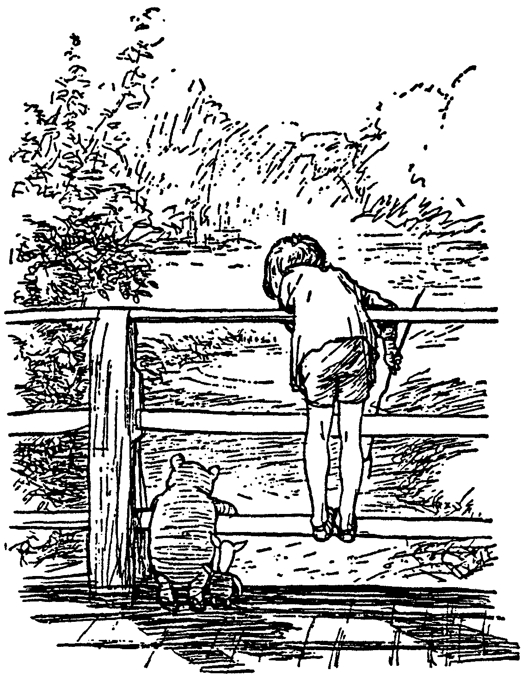
Explaining
We are going to test you on your ability to explain the material.
Hence, the best way of studying is to explain the material over and over again out loud to yourself, to each other, and to your stuffed bear.

Slide 33
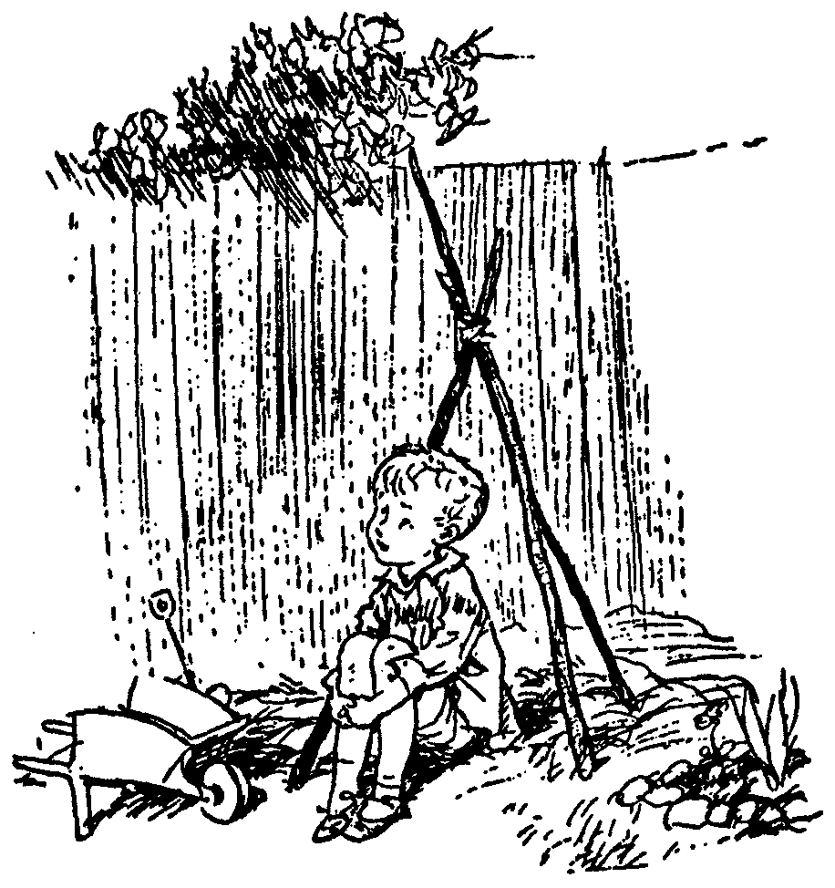
Day Dream
While going along with your day
Mathematics is not all linear thinking.
Allow the essence of the material to seep into your subconscious
Pursue ideas that percolate up and flashes of inspiration that appear.

Slide 34

Be Creative
Ask questions.
Why is it done this way and not that way?

Slide 35
Guesses and Counter Examples
Guess at potential algorithms for solving a problem.
Look for input instances for which your algorithm gives the wrong answer.
Treat it as a game between these two players.

Slide 36

Refinement:
The best solution comes from a process of repeatedly refining and inventing alternative solutions
Rudich www.discretemath.com

Slide 37

Grade School Revisited:
How To Multiply Two Numbers
A Few Example Algorithms
2 X 2 = 5
Rudich www.discretemath.com

Slide 38
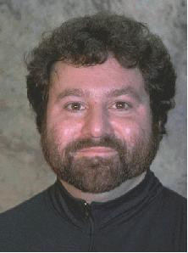
Slides in this next section produced by
Steven Rudich
from Carnegie Mellon University
Individual Slides
will be marked
Rudich www.discretemath.com

Slide 39
Complex Numbers
Remember how to multiply 2 complex numbers?
(a+bi)(c+di) = [ac –bd] + [ad + bc] i
Input: a,b,c,d Output: ac-bd, ad+bc
If a real multiplication costs $1 and an addition cost a penny. What is the cheapest way to obtain the output from the input?
Can you do better than $4.02?

Slide 40
Gauss’ $3.05 Method:
Input: a,b,c,d Output: ac-bd, ad+bc
m₁ = ac
m₂ = bd
A₁ = m₁ – m₂ = ac-bd
m₃ = (a+b)(c+d) = ac + ad + bc + bd
A₂ = m₃ – m₁ – m₂ = ad+bc

Slide 41
Question:
The Gauss “hack” saves one multiplication out of four. It requires 25% less work.
Could there be a context where performing 3 multiplications for every 4 provides a more dramatic savings?

Slide 42

Odette
Bonzo

Slide 43
How to add 2 n-bit numbers.
*
*
*
*
*
*
*
*
*
*
*
*
*
*
*
*
*
*
*
*
*
*
+

Slide 44
How to add 2 n-bit numbers.
*
*
*
*
*
*
*
*
*
*
*
*
*
*
*
*
*
*
*
*
*
*
*
*
+

Slide 45
How to add 2 n-bit numbers.
*
*
*
*
*
*
*
*
*
*
*
*
*
*
*
*
*
*
*
*
*
*
*
*
*
*
+

Slide 46
How to add 2 n-bit numbers.
*
*
*
*
*
*
*
*
*
*
*
*
*
*
*
*
*
*
*
*
*
*
*
*
*
*
*
*
+

Slide 47
How to add 2 n-bit numbers.
*
*
*
*
*
*
*
*
*
*
*
*
*
*
*
*
*
*
*
*
*
*
*
*
*
*
*
*
*
*
+

Slide 48
How to add 2 n-bit numbers.
*
*
*
*
*
*
*
*
*
*
*
*
*
*
*
*
*
*
*
*
*
*
*
*
*
*
*
*
*
*
*
*
*
*
*
*
*
*
*
*
*
*
*
*
*
+

Slide 49
Time complexity of grade school addition
*
*
*
*
*
*
*
*
*
*
*
*
*
*
*
*
*
*
*
*
*
*
*
*
*
*
*
*
*
*
*
*
*
*
*
*
*
*
*
*
*
*
*
*
*
On any reasonable computer adding 3 bits can be done in constant time.
+
T(n) = The amount of time grade school addition uses to add two n-bit numbers
= θ(n) = linear time.

Slide 50
f = θ(n) means that f can be sandwiched between two lines
t
ime
# of bits in numbers

Slide 51
Please feel free
to ask questions!
Rudich www.discretemath.com

Slide 52
Is there a faster way to add?
QUESTION: Is there an algorithm to add two n-bit numbers whose time grows sub-linearly in n?

Slide 53
Any algorithm for addition must read all of the input bits
  Suppose there is a mystery algorithm that does not examine each bit
  Give the algorithm a pair of numbers. There must be some unexamined bit position i in one of the numbers
  If the algorithm is not correct on the numbers, we found a bug
  If the algorithm is correct, flip the bit at position i and give the algorithm the new pair of numbers. It give the same answer as before so it must be wrong since the sum has changed

Slide 54
So any algorithm for addition must use time at least linear in the size of the numbers.
Grade school addition is essentially as good as it can be.

Slide 55
How to multiply 2 n-bit numbers.
X
* * * * * * * *
* * * * * * * *
* * * * * * * *
* * * * * * * *
* * * * * * * *
n²
* * * * * * * *
* * * * * * * *
* * * * * * * *
* * * * * * * *
* * * * * * * *
* * * * * * * * * * * * * * * *

Slide 56
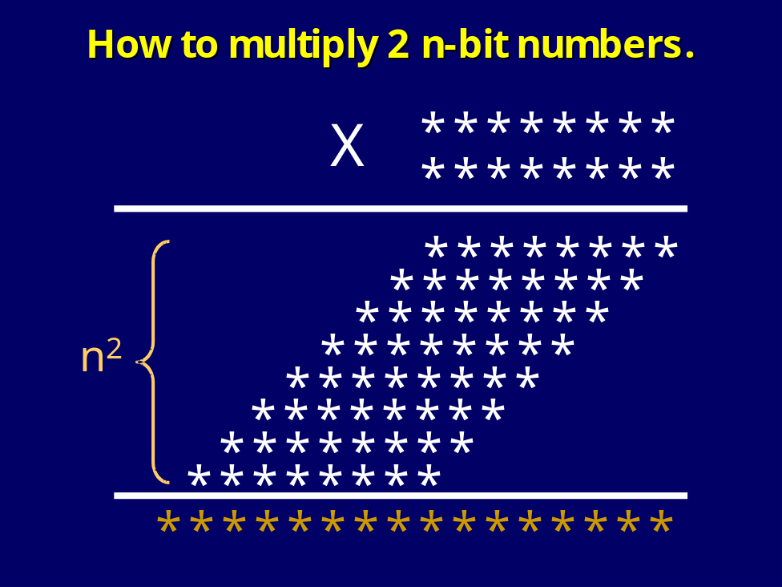
I get it! The total time is bounded by cn².

Slide 57
Grade School Addition: Linear time
Grade School Multiplication: Quadratic time
t
ime
# of bits in numbers
No matter how dramatic the difference in the constants the quadratic curve will eventually dominate the linear curve

Slide 58
Neat! We have demonstrated that as things scale multiplication is a harder problem than addition.
Mathematical confirmation of our common sense.

Slide 59
Don’t jump to conclusions!
We have argued that grade school multiplication uses more time than grade school addition. This is a comparison of the complexity of two algorithms.
To argue that multiplication is an inherently harder problem than addition we would have to show that no possible multiplication algorithm runs in linear time.

Slide 60
Grade School Addition: θ(n) time
Grade School Multiplication: θ(n²) time
Is there a clever algorithm to multiply two numbers in linear time?

Slide 61
Despite years of research, no one knows! If you resolve this question, York will give you a PhD!

Slide 62
Is there a faster way to multiply two numbers than the way you learned in grade school?

Slide 63
Divide And Conquer
(an approach to faster algorithms)
DIVIDE my instance to the problem into smaller instances to the same problem.
Have a friend (recursively) solve them.
Do not worry about it yourself.
GLUE the answers together so as to obtain the answer to your larger instance.

Slide 64
Multiplication of 2 n-bit numbers
X =
Y =
X = a 2^{n/2} + b Y = c 2^{n/2} + d
XY = ac 2^{n} + (ad+bc) 2^{n/2} + bd
a
b
c
d

Slide 65
Multiplication of 2 n-bit numbers
X =
Y =
XY = ac 2^{n} + (ad+bc) 2^{n/2} + bd
a
b
c
d
MULT(X,Y):
If |X| = |Y| = 1 then RETURN XY
Break X into a;b and Y into c;d
RETURN
MULT(a,c) 2^{n} + (MULT(a,d) + MULT(b,c)) 2^{n/2} + MULT(b,d)

Slide 66
Time required by MULT
T(n) = time taken by MULT on two n-bit numbers
What is T(n)?
What is its growth rate?
Is it θ(n²)?

Slide 67
Recurrence Relation
T(1) = k for some constant k
T(n) = 4 T(n/2) + k’ n + k’’ for some constants k’ and k’’
MULT(X,Y):
If |X| = |Y| = 1 then RETURN XY
Break X into a;b and Y into c;d
RETURN
MULT(a,c) 2^{n} + (MULT(a,d) + MULT(b,c)) 2^{n/2} + MULT(b,d)

Slide 68
Let’s be concrete
T(1) = 1
T(n) = 4 T(n/2) + n
How do we unravel T(n) so that we can determine its growth rate?

Slide 69

Technique 1
Guess and Verify
Recurrence Relation:
T(1) = 1 & T(n) = 4T(n/2) + n
Guess: G(n) = 2n² – n
Verify:
Left Hand Side | Right Hand Side
T(1) = 2(1)² – 1 T(n) = 2n² – n | 1 4T(n/2) + n = 4 [2(^{n}/₂)² – (^{n}/₂)] + n = 2n² – n

Slide 70
Technique 2: Decorate The Tree
T(1) = 1
T(1)
=
1
T(n) = n + 4 T(n/2)
T(n) = n + 4 T(n/2)
T(n)
T(n)
n
=
n
=
T(n/2)
T(n/2)
T(n/2)
T(n/2)
T(n/2)
T(n/2)
T(n/2)
T(n/2)

Slide 71
T(n)
=
n
T(n/2)
T(n/2)
T(n/2)
T(n/2)

Slide 72
T(n)
=
n
n/2
T(n/2)
T(n/2)
T(n/2)
T(n/4)
T(n/4)
T(n/4)
T(n/4)

Slide 73
T(n)
=
n
n/2
n/2
n/2
n/2
T(n/4)
T(n/4)
T(n/4)
T(n/4)
T(n/4)
T(n/4)
T(n/4)
T(n/4)
T(n/4)
T(n/4)
T(n/4)
T(n/4)
T(n/4)
T(n/4)
T(n/4)
T(n/4)

Slide 74
T(n)
=
n
n/2
n/2
n/2
n/2
n/4
n/4
n/4
n/4
n/4
n/4
n/4
n/4
n/4
n/4
n/4
n/4
n/4
n/4
n/4
n/4
11111111111111111111111111111111 . . . . . . 111111111111111111111111111111111

Slide 75

n
n/2 + n/2 + n/2 + n/2
Level i is the sum of 4^{i} copies of n/2^{i}
. . . . . . . . . . . . . . . . . . . . . . . . . .
1+1+1+1+1+1+1+1+1+1+1+1+1+1+1+1+1+1+1+1+1+1+1+1+1+1+1+1+1+1+1+1+1+1+1+1+1+1+1+1+1+1+1+1
0
1
2
n/4 + n/4 + n/4 + n/4 + n/4 + n/4 + n/4 + n/4 + n/4 + n/4 + n/4 + n/4 + n/4 + n/4 + n/4 + n/4
i

Slide 76
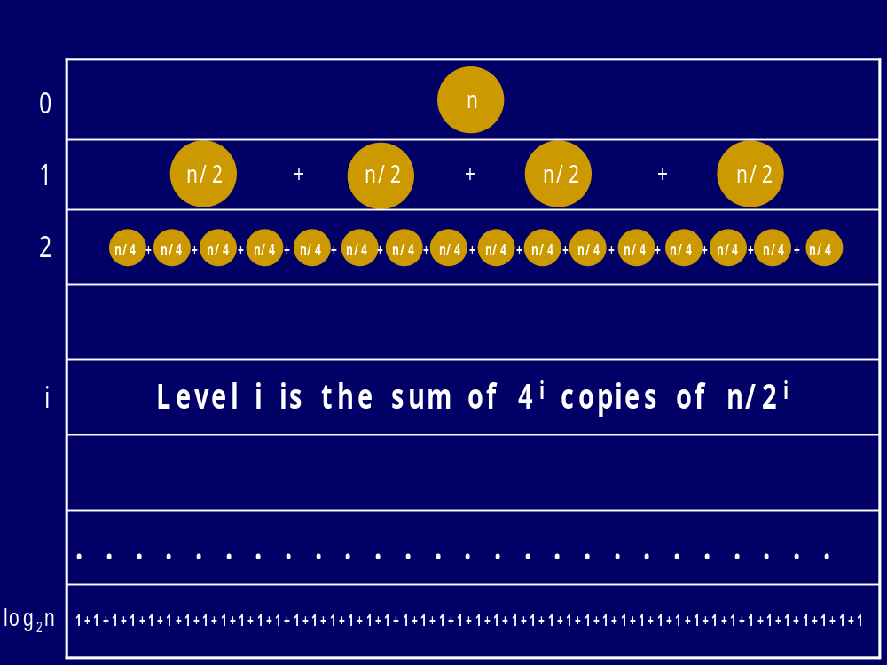
=1⋅n
= 4⋅n/2
= 16⋅n/4
= 4^{i} ⋅n/2^{i}
= 4^{logn}⋅n/2^{logn} =n^{log4}⋅1
Total: θ(n^{log4}) = θ(n²)

Slide 77
Divide and Conquer MULT: θ(n²) time
Grade School Multiplication: θ(n²) time
All that work for nothing!

Slide 78
MULT revisited
MULT(X,Y):
If |X| = |Y| = 1 then RETURN XY
Break X into a;b and Y into c;d
RETURN
MULT(a,c) 2^{n} + (MULT(a,d) + MULT(b,c)) 2^{n/2} + MULT(b,d)
MULT calls itself 4 times. Can you see a way to reduce the number of calls?

Slide 79
Gauss’ Hack:
Input: a,b,c,d Output: ac, ad+bc, bd
A₁ = ac
A₃ = bd
m₃ = (a+b)(c+d) = ac + ad + bc + bd
A₂ = m₃ – A₁- A₃ = ad + bc

Slide 80
Gaussified MULT
(Karatsuba 1962)
MULT(X,Y):
If |X| = |Y| = 1 then RETURN XY
Break X into a;b and Y into c;d
e = MULT(a,c) and f =MULT(b,d)
RETURN e2^{n} + (MULT(a+b, c+d) – e - f) 2^{n/2} + f
T(n) = 3 T(n/2) + n
Actually: T(n) = 2 T(n/2) + T(n/2 + 1) + kn

Slide 81
T(n)
=
n
n/2
n/2
n/2
n/2
T(n/4)
T(n/4)
T(n/4)
T(n/4)
T(n/4)
T(n/4)
T(n/4)
T(n/4)
T(n/4)
T(n/4)
T(n/4)
T(n/4)
T(n/4)
T(n/4)
T(n/4)
T(n/4)

Slide 82
T(n)
=
n
T(n/2)
T(n/2)
T(n/2)

Slide 83
T(n)
=
n
n/2
T(n/2)
T(n/2)
T(n/4)
T(n/4)
T(n/4)

Slide 84
T(n)
=
n
n/2
n/2
n/2
T(n/4)
T(n/4)
T(n/4)
T(n/4)
T(n/4)
T(n/4)
T(n/4)
T(n/4)
T(n/4)

Slide 85
n
n/2 + n/2 + n/2
Level i is the sum of 3^{i} copies of n/2^{i}
. . . . . . . . . . . . . . . . . . . . . . . . . .
1+1+1+1+1+1+1+1+1+1+1+1+1+1+1+1+1+1+1+1+1+1+1+1+1+1+1+1+1+1+1+1+1+1+1+1+1+1+1+1+1+1+1+1
0
1
2
n/4 + n/4 + n/4 + n/4 + n/4 + n/4 + n/4 + n/4 + n/4
i

Slide 86
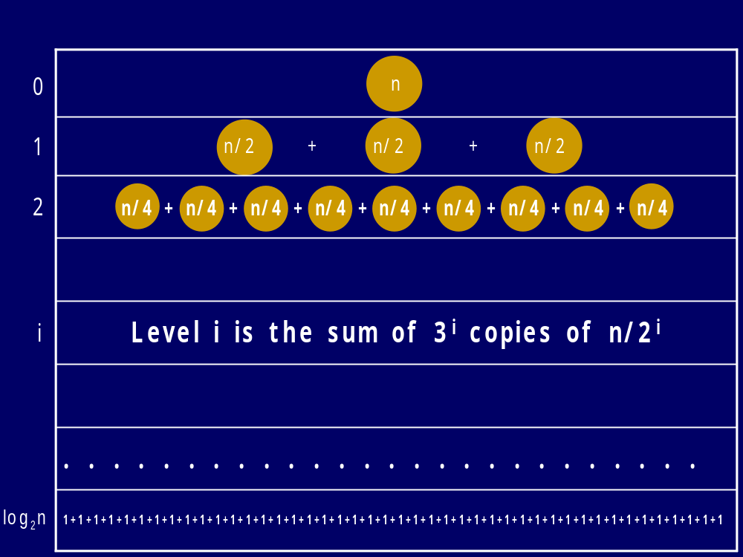
=1⋅n
= 3⋅n/2
= 9⋅n/4
= 3^{i} ⋅n/2^{i}
= 3^{logn}⋅n/2^{logn} =n^{log3}⋅1
Total: θ(n^{log3}) = θ(n^{1.58..})

Slide 87
Dramatic improvement for large n
Not just a 25% savings!
θ(n²) vs θ(n^{1.58..})

Slide 88
Multiplication Algorithms
Kindergarten ? | n2^{n}
Grade School | n²
Karatsuba | n^{1.58…}
Fastest Known | n logn loglogn
3*4=3+3+3+3

Slide 89
You’re cool! Are you free sometime this weekend?
Not interested, Bonzo.
I took the initiative and formed a study group for Algorithms
Studying done in groups
Assignments are done in pairs.

