Slide 1
Windows 2K/NT
CPU Scheduling
Synchronization

Slide 2
CPU Scheduling
Uses a multilevel feedback queue approach
Schedules kernel threads, not processes
32 run queues
  System-, Variable-, and Real-time-level queues

Slide 3
Time slice and Preemption
Time slice computed as a number of clock interrupts (e.g. 3 ticks on the system’s clock)
Different time slice exists for NT Server and NT Workstation
When time slice expires:
When time slice joins:

Slide 4
Avoiding Starvation
If thread hasn’t executed in 3 seconds, thread given anti-starvation boost
  Boost given to level 15 (the MAX)
  Time slice for thread also doubled
NT also provides a scheduler for multiprocessor systems

Slide 5
Sychronization Objects
Windows NT provides a multitasking, multithreading environment
Unfortunately, this means that whenever two or more threads try to access the same piece of data or shared resource at the same time, some type of synchronization is needed to control access to that data

Slide 6
Sychronization Objects
Win32 API provides a multitude of synch. objects
Each synch. object has its own advantages and disadvantages in terms of speed, functionality, and in ability to synchronize across processes
Varying levels of support among the Win32-based operating systems

Slide 7
Sychronization Objects
Unfortunately, no one synchronization object exists that is fast, works across processes, provides resource counting, and works on all Win32 platforms
The development and implementation of metered sections by Dan Chou has created a synch object that does all of the above

Slide 8
Summary of Win32 Synch Objects
Five main functions for Metered Sections
  Critical Section
  Mutex
  Semaphore
  Event
  Metered Section

Slide 9
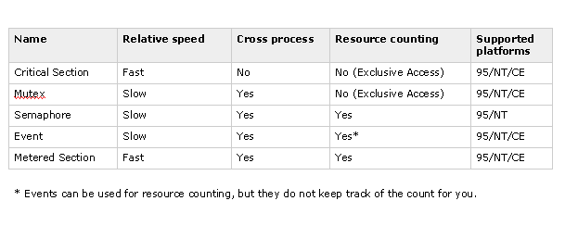
Comparison

Slide 10
Resources
http://msdn.microsoft.com
http://www.computerhope.com/winnt.htm
http://www.computerhope.com/win2000.htm

