Slide 1
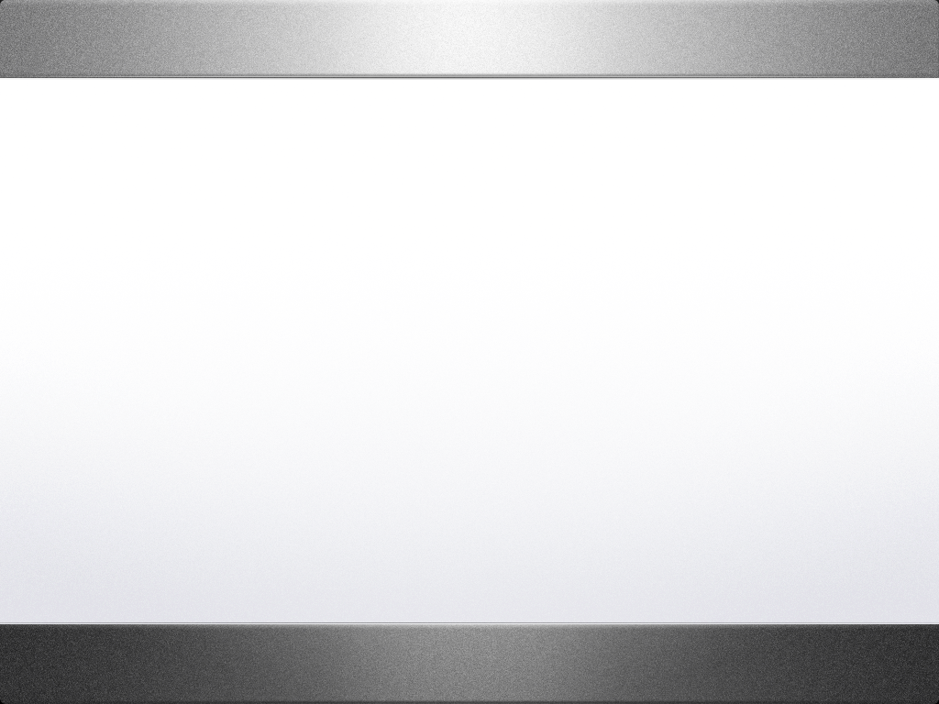
Mac OSX
By Rebecca Fischer
a Mac Convert

Slide 2
A Brief History
The original Macintosh OS
one of the first GUI operating systems
single-user
single-tasking
flat file system: all files were stored in a single directory
Images courtesy of Wikipedia

Slide 3
System 7 and Onward
Built-in networking (via AppleTalk) and file-sharing (via AppleShare)
HFS and HFS+ files system
Support for 32-bit memory addressing
A virtual memory (VM) implementation
AppleScript (system-level macro language for automating tasks),
WorldScript (system-level support for several languages
System 7 only did cooperative multi-tasking, and lacked memory protection
System 8 introduced better co-operative multi-tasking and multi-processing, and a preemption-safe memory
System 9 introdeced AppleTalk protocol over TCP/IP and pre-emptive multitasking
Images courtesy of Wikipedia

Slide 4
Images courtesy of http://www.kernelthread.com/

Slide 5
OSX
Unix Core
Protected Memory
Multi-Tasking
Many new usability features
Runs on Intels x86 architecture
Images courtesy of Wikipedia

Slide 6
References
http://en.wikipedia.org/wiki/Mac_OSX
Http://www.kernalthread.com
http://developer.apple.com/macosx/

