Slide 1

Mac OS X the second ppt
By Rebecca Fischer
Mac Convert

Slide 2
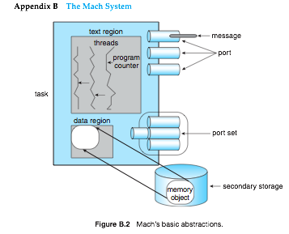
Process Creation
This part of OS X is implemented by the Mach OS.
Mach implements processes as a task with one thread of control. A task can be thought of as a traditional process that does not have an instruction pointer or a register set.
A task contains a virtual-address space, a set of port rights, and accounting information. A task is a passive entity that does nothing unless it has one or more threads executing in it.
Creating a new task is similar to a fork() call in Unix. The new task’s memory is a duplicate of the parent’s address space. The new task contains one thread, which is started at the same point as the creating fork call in the parent. kern_return_t task_create (task_t ledger_port_array_t int boolean_t task_t
The Unix BDS process model is used to reference tasks, so Mac OS X has processes that are actually tasks.
Because of the BSD you are able to use the POSIX fork() call to create a process
Image courtesy of Operating System Concepts

Slide 3
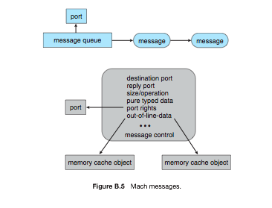
Interprocess Communication
This is also implemented by the Mach OS by using a Message Passing method.
The two components of Mach IPC are ports(mailboxes) and messages.
A port is implemented as a protected, bounded queue(8 messages) within the kernel of the system on which the object resides. If a queue is full, a sender may abort the send, wait for a slot to become available in the queue, or have the kernel deliver the message for it.
A message consists of a fixed-length header and a variable number of typed data objects.
Image courtesy of Operating System Concepts

Slide 4
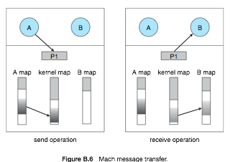
Interprocess communication Pt.2
Mach uses pointers to pass blocks of information on a system. This is more efficient than copying the information and sending the copy.
The use of pointers in a message makes it possible to transfer the entire address space of a task in one message.
The data referenced by a pointer in a message being sent to a port on the same system are not copied between the sender and the receiver. Instead, the address map of the receiving task is modified to include a copy-on-write copy of the pages of the message.
The kernel creates a data structure that would be a copy of the region if it were part of an address map. On receipt, this data structure is added to the receiver ’s map and becomes a copy accessible to the receiver. This is a form of virtual memory management.
Image courtesy of Operating System Concepts

Slide 5
Implementation of Threads
Kernal threads are implemented using the Mach OS and the I/O kit
Threads are not only supported, they are necessary. The Mach task requires at least one thread per task.
All threads within a task share the task’s resources (ports, memory, ect).
A POSIX thread (pthread) is a lightweight wrapper around a Mach thread that enables it to be used by user-level processes.
Cocoa threads (NSThread class) provide high-level abstraction for creating and managing threads.

Slide 6
Threads pt.2
Kernal threads are created using one of the following calls:
      thread_t kernel_thread(task_t task, void (*start)(void));-from Mach
      thread_t current_thread(void); - from Mach
      IOThread IOCreateThread(IOThreadFunc function, void *argument);
      IOThread IOThreadSelf(void); -wrapper around Mach call
      void IOExitThread(void);--wrapper around Mach call

Slide 7
References
Operating System Concepts
http://en.wikipedia.org/wiki/XNU
http://developer.apple.com/documentation/Darwin/Conceptual/KernelProgramming/boundaries/chapter_14_section_4.html
http://developer.apple.com/documentation/Darwin/Conceptual/KernelProgramming/scheduler/chapter_8_section_5.html#//apple_ref/doc/uid/TP30000905-CH211-BABBEEBI
http://developer.apple.com/documentation/Cocoa/Conceptual/Multithreading/articles/ThreadPackages.html#//apple_ref/doc/uid/TP40001474-124610

