Slide 1
Chapter 10: File-System Interface

Slide 2
So Far … We Have Explored How OS Handle the Following:
Processes
Threads
CPU Scheduling
Process Synchronization
Main Memory
Virtual Memory
Except for special topics such as Protection, Security, Real-time Systems, and Multimedia Systems, all that remains is
  File System Interfaces
  File System Implementation
  Mass-Storage Structure
  I/O Systems

Slide 3
Chapter 10: File-System Interface
File Concept
Access Methods
Directory Structure
File-System Mounting
File Sharing
Protection

Slide 4
Objectives
To explain the function of file systems
To describe the interfaces to file systems
To discuss file-system design tradeoffs, including access methods, file sharing, file locking, and directory structures
To explore file-system protection

Slide 5
File Concept
Contiguous logical address space
Types:
  Data
    numeric
    character
    binary
  Program

Slide 6
File Structure -Variety
None - sequence of words, bytes
Simple record structure
  Lines
  Fixed length
  Variable length
Complex Structures
  Formatted document
  Relocatable load file
Can simulate last two with first method by inserting appropriate control characters
Who decides:
  Operating system
  Program

Slide 7
File Attributes
Name – only information kept in human-readable form
Identifier – unique tag (number) identifies file within file system
Type – needed for systems that support different types
Location – pointer to file location on device
Size – current file size
Protection – controls who can do reading, writing, executing
Time, date, and user identification – data for protection, security, and usage monitoring
Information about files is kept in the directory structure, which is maintained on the disk

Slide 8
File Operations
File is an abstract data type with at least the following operations:
  Create
  Write
  Read
  Reposition within file
  Delete
  Truncate
Open(F_{i}) – search the directory structure on disk for entry F_{i}, and move the content of entry to memory
Close (F_{i}) – move the content of entry F_{i} in memory to directory structure on disk

Slide 9
Open Files
Several pieces of data are needed to manage open files:
  File pointer: pointer to last read/write location, per process that has the file open
  File-open count: counter of number of times a file is open – to allow removal of data from open-file table when last processes closes it
  Disk location of the file: cache of data access information
  Access rights: per-process access mode information

Slide 10
Open File Locking
Provided by some operating systems and file systems
Mediates access to a file
Mandatory or advisory:
  Mandatory – access is denied depending on locks held and requested
  Advisory – processes can find status of locks and decide what to do

Slide 11
File Locking Example – Java API
import java.io.*;
import java.nio.channels.*;
public class LockingExample {
public static final boolean EXCLUSIVE = false;
public static final boolean SHARED = true;
public static void main(String arsg[]) throws IOException {
FileLock sharedLock = null;
FileLock exclusiveLock = null;
try {
RandomAccessFile raf = new RandomAccessFile("file.txt", "rw");
// get the channel for the file
FileChannel ch = raf.getChannel();
// this locks the first half of the file - exclusive
exclusiveLock = ch.lock(0, raf.length()/2, EXCLUSIVE);
/** Now modify the data . . . */
// release the lock
exclusiveLock.release();

Slide 12
File Locking Example – Java API
// this locks the second half of the file - shared
sharedLock = ch.lock(raf.length()/2+1, raf.length(), SHARED);
/** Now read the data . . . */
// release the lock
exclusiveLock.release();
} catch (java.io.IOException ioe) {
System.err.println(ioe);
}finally {
if (exclusiveLock != null)
exclusiveLock.release();
if (sharedLock != null)
sharedLock.release();
}
}
}

Slide 13

File Types – Name, Extension
Most OS use an extension to designate the type of file being named.
These extensions are not required, but act as hints to application programs as to type of file involved.

Slide 14
Access Methods
Sequential Access – model was tape drive
read next
write next
reset (or rewind)
no read after last write
Direct Access (also called relative access) – model was hard disk
read n
write n
position to n
read next
write next
rewrite n
n = relative block number

Slide 15

Sequential-access File

Slide 16
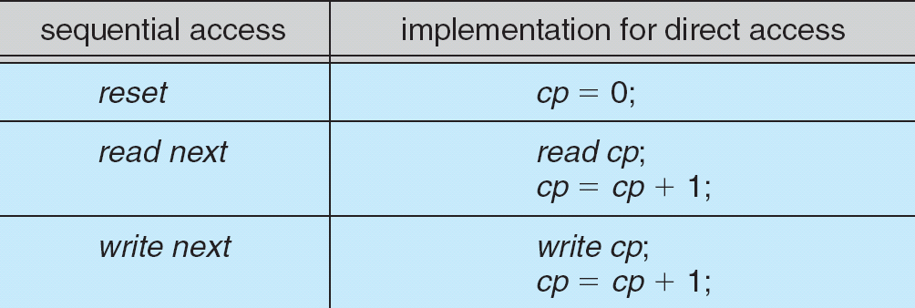
Simulation of Sequential Access on a Direct-access File
cp = current position

Slide 17

Example of Index and Relative Files
Index is kept sorted by some key such as last name.

Slide 18
Directory Structure
A collection of nodes containing information about all files
Directory
Files
F 1
F 2
F 3
F 4
F n
Both the directory structure and the files reside on disk
Backups of these two structures are kept

Slide 19

A Typical File-system Organization

Slide 20
Operations Performed on Directory
Search for a file
Create a file
Delete a file
List a directory
Rename a file
Traverse the file system

Slide 21
Organize the Directory (Logically) to Obtain
Efficiency – locating a file quickly
Naming – convenient to users
  Two users can have same name for different files
  The same file can have several different names
Grouping – logical grouping of files by properties, (e.g., all Java programs, all games, …)

Slide 22

Single-Level Directory
A single directory for all users
Naming problem
Grouping problem

Slide 23

Two-Level Directory
Separate directory for each user
Path name
Can have the same file name for different users
Efficient searching
No grouping capability

Slide 24

Tree-Structured Directories
Most common structure.

Slide 25
Tree-Structured Directories
Efficient searching
Grouping Capability
Current directory (working directory)
  cd /spell/mail/prog
Absolute or relative path names
  Absolute names start at the root and specify the entire path.
  Relative names start at the current directory and specify the path to a file from that location.

Slide 26
Tree-Structured Directories
Creating a new file is done in current directory
Delete a file
rm <file-name>
Creating a new subdirectory is done in current directory
  mkdir <dir-name>
Example: if in current directory /mail
mkdir count
mail
prog
copy
prt
exp
count
Deleting “mail” ⇒ deleting the entire subtree rooted by “mail” or should the directory be empty first? (Depends on OS)

Slide 27

Acyclic-Graph Directories
Allow shared subdirectories and files
Useful when two or more individuals are working on the same project.
Shared means only one copy of file – count is shared; list is not
Traversing the entire file structure is now more difficult.

Slide 28
Acyclic-Graph Directories
Two different names (aliasing)
If dict deletes count ⇒ dangling pointer created
Solutions:
  Backpointers, so we can delete all pointers
  Variable size records a problem
  Backpointers using a daisy chain organization – can chew a lot of space
  Entry-hold-count solution – i.e. keep only a count of how many links point to the file- physically delete only when count becomes 0.
Can use a new directory entry type called a link
  Link – another name (pointer) to an existing file
  Resolve the link – follow pointer to locate the file

Slide 29

General Graph Directory

Slide 30
General Graph Directory
Advantages of keeping cycles out of the directory structure
  The algorithms to traverse the graph are simpler and more efficient
  If not careful, may loop forever through a cycle.
How do we guarantee no cycles?
  Allow only links to files not subdirectories
  Use garbage collection
    Traverse the directory marking each file when encountered.
    Walk through file space and delete everything that is not marked.
  Every time a new link is added use a cycle detection algorithm to determine whether it is OK

Slide 31
General Graph Directory
Another problem is when we can delete a file physically.
In some graph directories, a reference count of non-zero may occur even when it is no longer possible to refer to the directory or file.
This happens because a file can be self-referencing or because there is a cycle in the directory structure.
This is when garbage collection is required in order to delete files.
Consequently, many OS try to allow only acyclic directories.
There are algorithms for detecting cycles in graphs, however they are computationally expensive especially when the graph is a structure on disk storage.

Slide 32
File System Mounting
Just as a file must be opened before it is used, a
file system must be mounted before it can be accessed
An unmounted file system (i.e. Fig. 11-11(b) or next two slides) is mounted at a mount point.
Mounting is a straightforward procedure:
  The OS is given the name of the device and the mount point which is a location within the file structure where the file system is to be attached.
  Typically, a mount point is an empty directory.
  The OS verifies that the device contains a valid file system by asking the device driver to read the device directory and verifying that directory has the expected format.
  If all is OK, the mounted file system becomes part of the directory structure.

Slide 33

(a) Existing. (b) Unmounted Partition

Slide 34
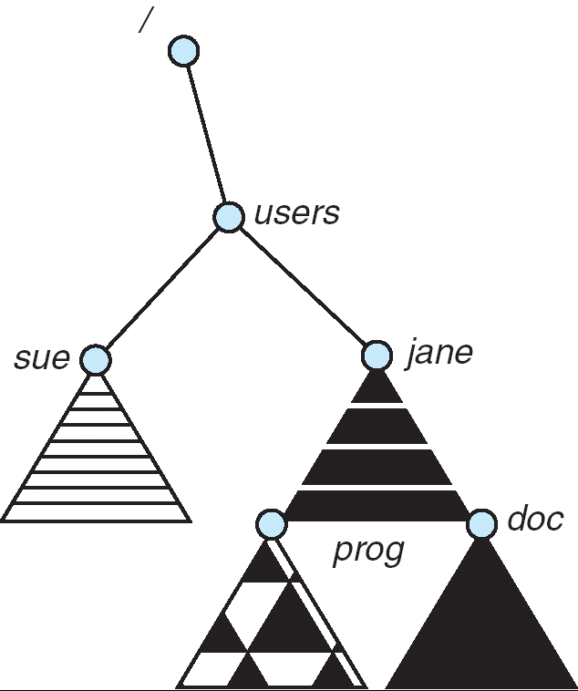
Mount Point in users

Slide 35
File Sharing
Sharing of files on multi-user systems is desirable
Sharing may be done through a protection scheme
On distributed systems, files may be shared across a network
Network File System (NFS) is a common distributed file-sharing method

Slide 36
File Sharing – Multiple Users
Multiple users force the issues of file sharing, file naming, and file protection become preeminent.
User IDs identify users, allowing permissions and protections to be per-user
Group IDs allow users to be in groups, permitting group access rights

Slide 37
File Sharing – Remote File Systems
Uses networking to allow file system access between systems
  Manually via programs like FTP
  Automatically, seamlessly using distributed file systems
  Semi automatically via the world wide web
Client-server model allows clients to mount remote file systems from servers
  Server can serve multiple clients
  Client and user-on-client identification is insecure or complicated
  NFS is standard UNIX client-server file sharing protocol
  CIFS is standard Windows protocol
  Standard operating system file calls are translated into remote calls

Slide 38
File Sharing – Remote File Systems
Distributed Information Systems (distributed naming services) such as LDAP, DNS, NIS, Active Directory implement unified access to information needed for remote computing

Slide 39
File Sharing – Failure Modes
Remote file systems add new failure modes, due to network failure, server failure
Recovery from failure can involve state information about status of each remote request
Stateless protocols such as NFS include all information in each request, allowing easy recovery but less security

Slide 40
File Sharing – Consistency Semantics
Consistency semantics specify how multiple users are to access a shared file simultaneously
  Similar to Ch 7 process synchronization algorithms
    Tend to be less complex due to disk I/O and network latency (for remote file systems
  Andrew File System (AFS) implemented complex remote file sharing semantics
  Unix file system (UFS) implements:
    Writes to an open file visible immediately to other users of the same open file
    Sharing file pointer to allow multiple users to read and write concurrently
  AFS has session semantics
    Writes only visible to sessions starting after the file is closed

Slide 41
Protection
Reliability vs protection-
  Making files safe from physical damage is usually called reliability, not protection.
  Protection deals with the prevention of improper access whether it is intentional or accidental.
Reliability if usually provided by maintaining copies of files, both on a system and physically removed from the system.
Protection on a single user system is often provided by physically removing the file and storing it in a secure desk, cabinet, or even vault.
On multi-user systems, protection must be provided by OS mechanism.
The need to protect files is a direct result on a multi-user system of the ability to access a file.
Thus, protection consists of restricting access in various ways.

Slide 42
Protection
File owner/creator should be able to control:
  what can be done
  by whom
Types of access usually restricted to these low level functions:
  Read
  Write
  Execute
  Append
  Delete
  List
High-level functions such as renaming, copying, and editing a file have rarely been provided with protection.

Slide 43
Access Lists and Groups – A Common Method of Protection
Mode of access: read, write, execute
Three classes of users
RWX
a) owner access 7 ⇒ 1 1 1
RWX
b) group access 6 ⇒ 1 1 0
RWX
c) public access 1 ⇒ 0 0 1
Ask manager to create a group (unique name), say G, and add some users to the group.
For a particular file (say game) or subdirectory, define an appropriate access.
owner
group
public
Attach a group to a file
chgrp G game
chmod
761
game

Slide 44

Windows XP Access-control List Management

Slide 45

A Sample UNIX Directory Listing

Slide 46
Other Methods of File Protection
Another commonly used method is to associate a password with a file.
Disadvantages are obvious:
  May have too many passwords to remember.
  If the same password is used on multiple files, when one is discovered, all these files are compromised.
  If passwords are not encrypted, the file in which they are stored could be found and used to break the security.
  Over the years, various encryption schemes have been used (and broken).

Slide 47
Directory Protections
Although directories are files on most systems today, the protections needed for directories are different than those needed for files.
Directory protection:
  Restrict ability to read and write as before.
  Restrict ability to delete or create in the directory.
  Restrict ability to even know the existence of a file in a directory – i.e. restrict ability to list files in a directory.
In systems with acyclic or general graph directories, users may have different access rights to a file depending on the path name used to access the file.

