Slide 1
Chapter 11: File System Implementation

Slide 2
Chapter 11: File System Implementation
File-System Structure
File-System Implementation
Directory Implementation
Allocation Methods
Free-Space Management
Efficiency and Performance
Recovery
Log-Structured File Systems
NFS
Example: WAFL File System

Slide 3
Objectives
To describe the details of implementing local file systems and directory structures
To describe the implementation of remote file systems
To discuss block allocation and free-block algorithms and trade-offs

Slide 4
Secondary Storage
Today the bulk of secondary storage on which a file system is maintained is a disk.
Two characteristics make disks convenient for storing multiple files:
  A disk can be rewritten in place – i.e. a block can be read, modified, and written back to the same place.
  A disk can access directly any given block of information. Thus, a disk can be read either sequentially or randomly.
To improve I/O efficiency, transfers between a disk and memory are in terms of blocks.
Blocks vary between 32 and 4096 bytes with 512 being one of the most common sizes.

Slide 5
File Systems
File systems provide efficient and convenient access to the disk by the OS.
Designing a file system must take into account:
  1) How does the system look to the user? (Logical structure)
    How is a file defined?
    What attributes can a file have?
    What operations are allowed on a file?
    What directory structure is used for storing the files?
  2) What algorithms and data structures will be used to map the logical file structure onto the physical secondary-storage devices?

Slide 6
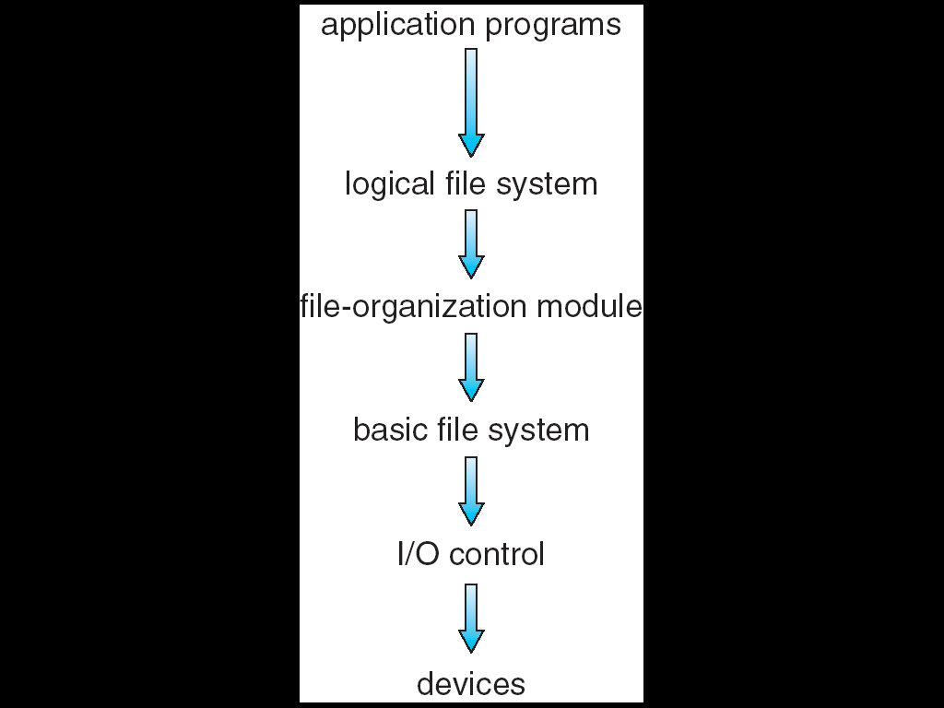
Layered File System
Each level uses features from the lower level to create new features.
I/O control consists of the device drivers and interrupt handlers to transfer information between the main memory and the disk
Think of these as translators.
Ex: Retrieve block 123 is translated into low level hardware commands.

Slide 7
Layered File System
The basic file system issues generic commands to the appropriate device driver to read and write physical blocks on the disk.
Physical blocks are identified by a disk address giving, typically, drive, cylinder, track, sector.

Slide 8
Layered File System
The file-organization module understands files and their logical blocks and physical blocks.
Thus, it translates the logical block addresses to the physical block addresses for the basic file system to do the transfer.
This module also keeps track of unallocated blocks and provides those blocks to the basic file system.

Slide 9
Layered File System
The logical file system manages what is called the metadata – all of the file system structure information except for the actual data in the files.
It manages the directory structure to provide the file-organization module with the necessary information.
A file-control block (FCB) contains information about ownership, protection, and location and manages these.

Slide 10
Layered File System
Finally, application programs access the file system by utilizing services provided in the logical file system.
This layered approach minimizes the duplication of code as these can be used by multiple file systems.

Slide 11
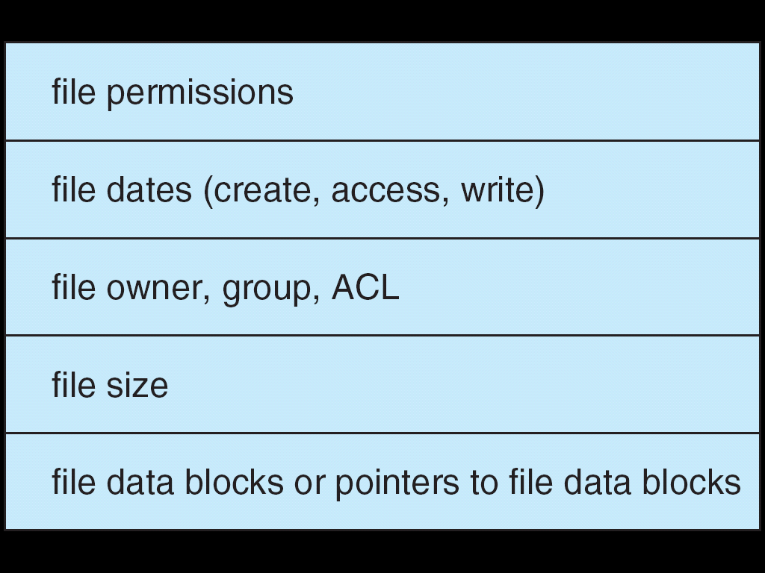
A Typical File Control Block (FCB)
ACL = access control list

Slide 12
Other Structures Needed Besides the FCB
See the list provided on page 414 which includes various tables and blocks that are needed.
The next slides shows a few for opening and reading a file.

Slide 13

In-Memory File System Structures
The following figure illustrates the necessary file system structures provided by the operating systems. (a) opening and b) reading
Opening:
Directory structure is memory resident and searched by name to locate a pointer for FCB.
Using the FCB information, the file is located on disk directory structure and its location is stored in the memory-resident per-process-open-file table.

Slide 14
In-Memory File System Structures
The following figure illustrates the necessary file system structures provided by the operating systems. (a) opening and b) reading
Reading: The open call returned a pointer to the current location of the file and stored it in the system-wide-open-file table. All subsequent file operations are then performed with this pointer.
The entry in this table is called a file descriptor (UNIX) or file handle (Windows).

Slide 15
There are Many Things to Consider
The organization of the many tables to allow for fast searching and changing.
The use of caching in high speed memory to allow for fast access to data – remember, disk accesses are very slow.
Some OS complicate the situation by using the file system as an interface for other system aspects such as networking – i.e. some of the tables used in maintaining the file system are used to maintain information about network connections and devices.

Slide 16
Partitions
A disk can be distributed between multiple partitions.
A partition can be raw – i.e. no file system is appropriate or cooked – i.e. can contain a file system.
  Example: Some OS swap spaces and some databases.
Typically, boot information is stored in a separate partition and can have its own format.
  During a boot, the system doesn't know about file systems and therefore can't use one.
  A boot image is typically stored in a partition and when a boot is requested, execution starts at a predefined location.

Slide 17
Dual Booting
Multiple OS can be stored on a disk in different partitions.
A boot loader that understands multiple file systems and multiple OS occupies the boot space.
After the boot loader is loaded, it boots one of the OS by starting execution at a predefined location in the root partition of OS.
The root partition contains the OS kernel and sometimes other system files which are mounted at boot time.
The file system must be verified and if there is a problem, it must be corrected before the boot proceeds.
Finally, the OS notes in its mount table structure that the system is mounted and what the type of file system is there.
In your discussions of the file systems for the various OS, be sure to list some of the possible file systems.

Slide 18
Virtual File Systems
Virtual File Systems (VFS) provide an object-oriented way of implementing file systems.
VFS allows the same system call interface (the API) to be used for different types of file systems.
The API is to the VFS interface, rather than any specific type of file system.

Slide 19

Schematic View of Virtual File System

Slide 20
Directory Implementation
Linear list of file names with pointer to the data blocks.
  simple to program
  time-consuming to execute
Hash Table – linear list with hash data structure.
  decreases directory search time
  collisions (situations where two file names hash to the same location) must be kept small
  fixed size and dependence on that is a problem

Slide 21
Allocation Methods
An allocation method refers to how disk blocks are allocated for files:
Contiguous allocation
Linked allocation
Indexed allocation

Slide 22
Contiguous Allocation
Each file occupies a set of contiguous blocks on the disk
Simple – only starting location (block #) and length (number of blocks) are required
Random access
Wasteful of space (dynamic storage-allocation problem)
Files cannot grow

Slide 23

Contiguous Allocation of Disk Space

Slide 24
Extent-Based Systems
Many newer file systems (i.e. Veritas File System) use a modified contiguous allocation scheme
VxFS is used as the primary filesystem of the HP-UX OS, although HP-UX calls it JFS. A variant with on-line defragmentation and resize support is known as OJFS. It is also supported on AIX, Linux, Solaris, SINIX/Reliant UNIX and UnixWare. VxFS was originally developed for AT&T's Uni System Laboratory.
Extent-based file systems allocate disk blocks in extents
An extent is a contiguous block of disks
  Extents are allocated for file allocation
  A file consists of one or more extents.

Slide 25
Linked Allocation
Each file is a linked list of disk blocks: blocks may be scattered anywhere on the disk.
Simple – need only starting address
Free-space management system – no waste of space
No random access
  Block to be accessed is the Qth block in the linked chain of blocks representing the file.
  Displacement into block = R + 1
File-allocation table (FAT) – disk-space allocation used by MS-DOS and OS/2.

Slide 26

Linked Allocation

Slide 27

File-Allocation Table

Slide 28
Linked Allocation vs Contiguous Allocation
Linked allocation solves all the problems of contiguous allocation.
However, problems still remain:
  It can be used only for sequential access files.
  Pointers always take up additional space.
Often blocks are collected into clusters.
    Then the cluster is stored contiguously.
    But, picking the cluster size to be optimal is difficult if the system has a wide variety of file sizes.
Reliability is a problem.
  Think what would happen if a pointer is lost or damaged.
    One solution for this is to use doubly linked lists.
    Another solution is to store the file name and relative block number in each block.
    But, both of these solutions just increase the overhead!

Slide 29
Indexed Allocation
Brings all pointers together into the index block.
Logical view.
index table
Need index table
Random access
Dynamic access without external fragmentation, but have overhead of index block.
Mapping from logical to physical in a file of maximum size of 256K words and block size of 512 words. We need only 1 block for index table.

Slide 30

Example of Indexed Allocation

Slide 31
Indexed Allocation – Mapping With an Index File for the Index File

outer-index
index table
file

Slide 32
Free-Space Management
Disk space is limited so we need to reuse space when files ae deleted.
Another concern is how to keep track of free disk space.
Typically, the file system maintains a free-space list.
When a file is created, the list is searched for the required amount of space and then it is allocated to the file.
Naturally, the entry must be removed from the free-space list.
When the file is physically deleted, the space must be returned to the list.
Interestingly, although it is called a list, it is rarely implemented by typical list data structures.

Slide 33
Free-Space List Implemented as a Bit Map or Bit Vector
0
1
2
n-1
Bit vector (n blocks)
…
0 ⇒ block[i] free
1 ⇒ block[i] occupied
bit[i] =

Block number calculation
(number of bits per word) *
(number of 0-value words) +
offset of first 1 bit

Slide 34
Free-Space Management
So, one approach is to use a bit map.
Bit map requires extra space
  Example:
block size = 2¹² bytes
disk size = 2³⁰ bytes (1 gigabyte)
n = 2³⁰/2¹² = 2¹⁸ bits (or 32K bytes)
Relatively easy method of finding the first free block or n contiguous blocks if desired.
This approach is extremely easy to implement.

Slide 35
Free-Space Management
Linked list (free list) – another approach
  Cannot get contiguous space easily
    Need to traverse the list reading block by block
    However, this rarely is required as often the OS just needs a free block.
Grouping – another approach
  Store the addresses of n free blocks in the first free block. Then the first n-1 of these blocks are free and can be used.
Counting – still another approach
  Each entry in the list of free space contains an address and the number of blocks that are free and contiguous with this block.
  Note if the count is generally greater than 1, the overall list is shorter.
Note how many of these schemes require some clever twist to provide what is needed quickly and efficiently.

Slide 36

Linked Free Space List on Disk

Slide 37
Free-Space Management
Need to protect:
  Pointer to free list
  Bit map
    Must be kept on disk
    Copy in memory and disk may differ
    Cannot allow for block[i] to have a situation where bit[i] = 1 in memory and bit[i] = 0 on disk
  Solution: do in the following order (remember time slicing can occur!)
    Set bit[i] = 1 in disk
    Allocate block[i]
    Set bit[i] = 1 in memory

Slide 38
Efficiency and Performance
Disks are still a major bottleneck to system performance as they are the slowest component of a system.
Efficiency is dependent on:
  Disk allocation methods
  Directory algorithms
  Types of data kept in a file’s directory entry
  Even such seemingly mundane things such as the size of the pointers used to access files and directories can affect system performance.

Slide 39
Performance
Performance is dependent upon many things
Various schemes are used to try and improve performance such as:
  Maintaining various caches
    For example, keeping a separate section of main memory for frequently used blocks
  Use of free-behind and read-ahead – techniques to optimize sequential access
    Free-behind – removes a page from a buffer as soon as the next page is requested
    Read-ahead – a requested page and several subsequent pages are read and cached.
  Improve PC performance by dedicating section of memory as virtual disk, or RAM disk

Slide 40
Recovery – Another Consideration
Consistency checking – compares data in directory structure with data blocks on disk, and tries to fix inconsistencies
Example: fsck in UNIX
Use system programs to back up data from disk to another storage device (floppy disk, magnetic tape, other magnetic disk, optical)
Recover lost file or disk by restoring data from backup
Every computer user and center needs a backup plan (that includes off-site storage).

Slide 41
Consistency Checking
A system can crash and cause inconsistencies between
  On disk file system data structures
  Directory structures
  Free block pointers
  Free FCB pointers
Most operations on file systems require physical changes that, if interrupted, could lead to inconsistencies.
One technique for consistency checking that is used with file systems was originally developed as database recovery algorithms.

Slide 42
Log Structured File Systems
Log structured (or journaling) file systems record each update to the file system as a transaction
All transactions are written to a log
  A transaction is considered committed once it is written to the log
  However, the file system may not yet be updated
The transactions in the log are asynchronously written to the file system
  When the file system is modified, the transaction is removed from the log
If the file system crashes, all remaining transactions in the log must still be performed

Slide 43
Another Area- Network File Systems
Today, network file systems are common.
Most are integrated with the overall directory structure and interface with the client system.
NFS (Network File System) introduced by Sun is both an implementation and a specification of a software system for accessing remote files that is supported by Solaris (obviously), most UNIX systems, and some PC OS support.
Details are shown in Section 11.9

Slide 44
NFS
Interconnected workstations viewed as a set of independent machines with independent file systems, which allows sharing among these file systems in a transparent manner
  A remote directory is mounted over a local file system directory
    The mounted directory looks like an integral subtree of the local file system, replacing the subtree descending from the local directory
  Specification of the remote directory for the mount operation is nontransparent; the host name of the remote directory has to be provided
    Files in the remote directory can then be accessed in a transparent manner
  Subject to access-rights accreditation, potentially any file system (or directory within a file system), can be mounted remotely on top of any local directory

Slide 45
NFS
NFS is designed to operate in a heterogeneous environment of different machines, operating systems, and network architectures; the NFS specifications independent of these media
This independence is achieved through the use of RPC primitives built on top of an External Data Representation (XDR) protocol used between two implementation-independent interfaces
The NFS specification distinguishes between the services provided by a mount mechanism and the actual remote-file-access services

Slide 46
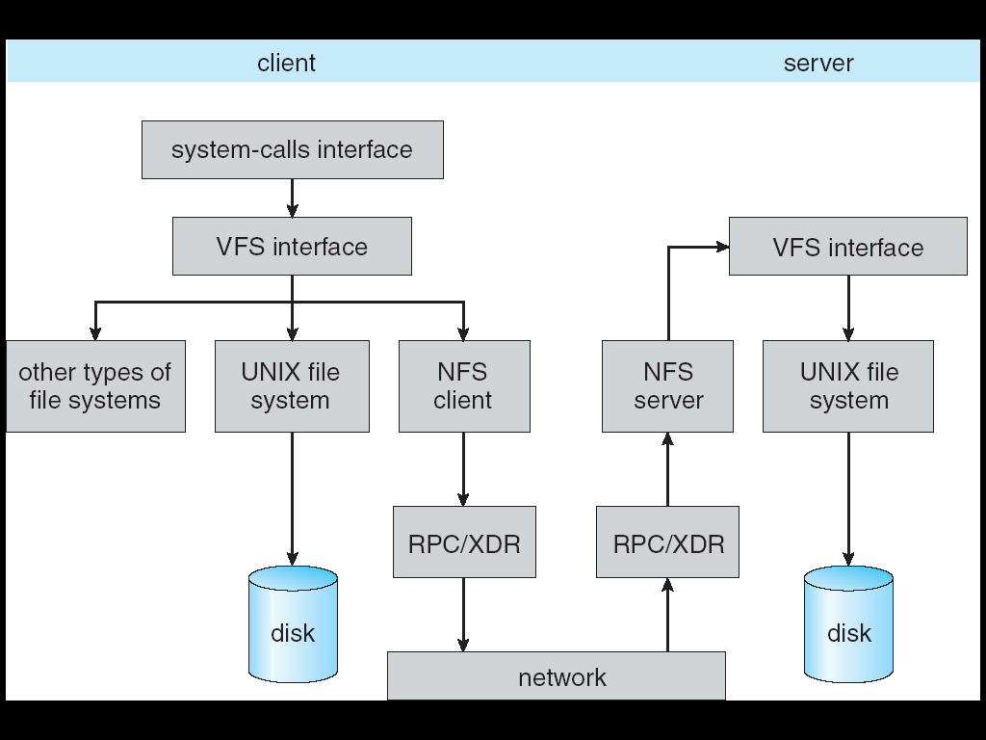
Schematic View of NFS Architecture Overview

Slide 47
NFS Remote Operations
Nearly one-to-one correspondence between regular UNIX system calls and the NFS protocol RPCs (except opening and closing files)
NFS adheres to the remote-service paradigm, but employs buffering and caching techniques for the sake of performance
File-blocks cache – when a file is opened, the kernel checks with the remote server whether to fetch or revalidate the cached attributes
  Cached file blocks are used only if the corresponding cached attributes are up to date
File-attribute cache – the attribute cache is updated whenever new attributes arrive from the server
Clients do not free delayed-write blocks until the server confirms that the data have been written to disk

