Slide 1
Chapter 3: Processes

Slide 2
Chapter 3: Processes
Process Concept
Process Scheduling
Operations on Processes
Cooperating Processes
Interprocess Communication
Communication in Client-Server Systems

Slide 3
Process Concept
An operating system executes a variety of programs:
  Batch systems execute jobs
  Time-shared systems execute user programs or tasks
  Single-user systems may be able to run several programs at once.
  Even on a system where only one user may execute a program, the OS may need to its own internal programs such as a job scheduling program.
Over the years, instead of naming all these things differently, the term process has been introduced to include all of the above.

Slide 4
Definition of the word process
Textbook uses the terms job and process almost interchangeably
(Definition) Process – a program in execution; process execution must progress in sequential fashion
A process includes not just code, but information about the current activity – i.e.
  a program counter
  a process stack (containing temporary data such as function parameters, return addresses, local variables)
  a data section (containing global variables)
  a heap which is memory dynamically allocated at run time
  other information we will see in a minute

Slide 5

Process in Memory
executable code

Slide 6
Program vs Process
Program-
  A static, passive entity
  A file containing executable code often stored on disk.
Process-
  A dynamic, active entity
  Contains the program code plus resource information needed when the program is running.
  More than one process can be associated with the same program.
    For example, you invoke several copies of a web browser.

Slide 7
Process State
As a process executes, it changes its state
The states of a process are:
  new: The process is being created
  running: Instructions are being executed
  waiting: The process is waiting for some event to occur
  ready: The process is waiting to be assigned to a processor
  terminated: The process has finished execution

Slide 8

Diagram of Process State Changes
Note: The diagram above is a finite state machine of the process state changes.

Slide 9
Process Control Block (PCB)
The PCB is a data structure which holds the information associated with each process
Process state
Program counter
CPU registers
CPU scheduling information
Memory-management information
Accounting information
I/O status information

Slide 10

Process Control Block (PCB)
Sometimes called a task control block.

Slide 11

How the CPU Switches From Process to Process

Slide 12
Digress Again For Another Data Structure
A queue is a list with two distinguished ends – front (head) and rear (tail)
Entities enter at the rear and exit at the front.
Pictorially,
dequeue
(or remove)
enqueue
(or insert)
rear
front
Note: While push, pop, and top are always used with stacks, the names of the operations and ends for a queue are many. Only two are shown here.

Slide 13
A Queue Can Be Implemented in Various Ways
As an array that is circular.
As a linked list.
If a queue holds entities a, b, c, d, with a at the front and d at the rear, the sequence
enqueue e
enqueue f
dequeue
dequeue
would leave c, d, e, f in the queue, with c at the front.
Queues are called FIFO (First In First Out) lists.
Queues, like stacks, are used extensively in OS.

Slide 14
Entities in Queues
Processes are represented in the various queues by their PCB.
Although the queues shown in the various diagrams are singly linked lists, it is not uncommon for some OS (such as Linux) to use a doubly linked list for the job queue with a pointer to the PCB for the process that is currently executing. (See Figure 3.4, pg 86).

Slide 15
Common Representations for Queues
Singly linked list:
head
head
head
head
head
PCB4
PCB12
tail
tail
tail
Doubly linked list:
head
PCB4
PCB12
tail
What is the advantage of using a doubly linked list instead of a singly linked list?

Slide 16
Process Scheduling Queues
Job queue – set of all processes in the system
Ready queue – set of all processes residing in main memory, ready and waiting to execute
Device queues – set of processes waiting for an I/O device
Processes migrate among the various queues by removing them from one queue and linking them into another queue.

Slide 17

Example: Ready Queue And Various I/O Device Queues

Slide 18

Representation of Process Scheduling

Slide 19
Schedulers
Long-term scheduler (or job scheduler) – selects which processes should be brought into the ready queue
Short-term scheduler (or CPU scheduler) – selects which process should be executed next and allocates the CPU
Note: We are assuming for now a single CPU although for some multiprocessors, this same model would work.

Slide 20
Schedulers
Main difference between the long-term and short-term schedulers is the frequency of execution of each.
CPU scheduler- runs every ~100 milliseconds
  Executes frequently – think of a process with a string of I/O requests. It may run only a few milliseconds before it must relinquish the CPU.
  Thus, it must be fast or a lot of CPU time is wasted on its execution.
Job scheduler- runs approximately every minute or so
  Controls how many processes can be in memory.
  It is invoked only when a process enter or leaves the system.
  Thus, it must be designed to be make a good selection with a good mix between CPU-bound (or compute-bound) and I/O-bound jobs.

Slide 21
Schedulers
Processes can be described as either:
  I/O-bound process –
    spends more time doing I/O than computations
    many short CPU bursts
  CPU-bound process –
    spends more time doing computations
    few very long CPU bursts
The long-term scheduler controls the degree of multiprogramming supported by the system.

Slide 22
Schedulers
Some OS do not have a job-scheduler or have only a minimal one – everything is handled by CPU-scheduler.
  Typically timesharing systems do this as the balance is maintained in an ad hoc manner- users leave the system when upset with it being too slow.
  Examples: UNIX, MS Windows
Others have a medium-term scheduler
  Swaps processes between a hard disk and memory.
  Again, often find in timesharing systems.

Slide 23

Addition of Medium Term Scheduling

Slide 24
Context Switch
When CPU switches to another process, the system must save the state of the old process and load the saved state for the new process.
This procedure is called a context-switch.
The current PCB is saved which suspends the process and a process is given to the CPU by loading from its PCB.
The context-switch time is overhead; the system does no useful work while switching
Therefore, it must be fast.
The time needed is dependent on the hardware support. We'll investigate this further in Chpt 8.

Slide 25
Process Creation
Parent processes create children processes, which, in turn create other processes, forming a tree of processes
Resource sharing possibilities
  Parent and children share all resources
  Children share subset of parent’s resources
  Parent and child share no resources
Execution possibilities
  Parent and children execute concurrently
  Parent waits until children terminate

Slide 26
Process Creation (Cont.)
Address space possibilities
  Child duplicate of parent
  Child has a program loaded into it
UNIX examples:
  fork system call creates new process
  exec system call used after a fork to replace the process’ memory space with a new program

Slide 27

Process Creation

Slide 28

A Tree of Processes on a Typical Solaris
Most OS identify a process with a PID – a unique integer assigned by the OS.

Slide 29
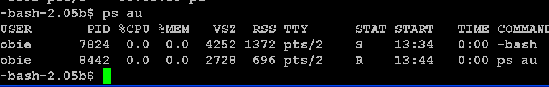
In Linux, typing ps au lists all of your processes:
USER, PID, %CPU, %MEM, START should be obvious
VSZ – virtual set size – size of image process
RSS – resident set size – size of program in memory
TTY pts= pseudo terminal
STAT – state – S=sleeping; R = currently running
TIME – is cumulative time

Slide 30
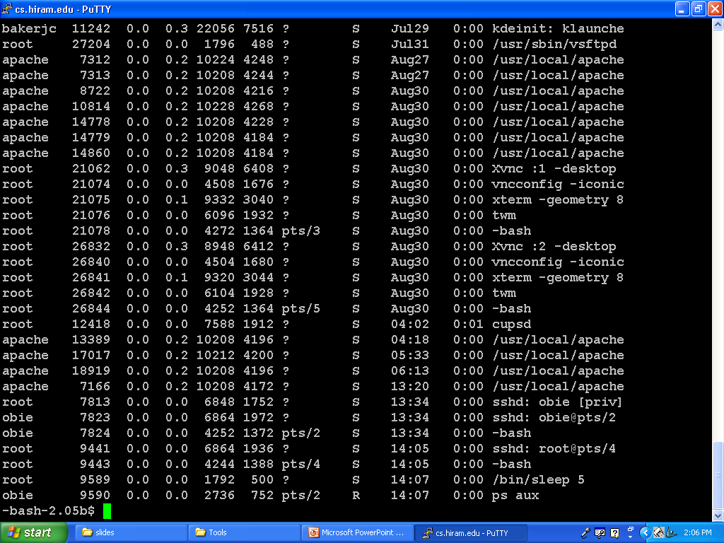

Slide 31
C Program Forking a Separate Process in UNIX
#include <sys/types.h>
#include <stdio.h>
#include <unistd.h>
int main()
{Pid_t pid;
/* fork another process */
pid = fork();
if (pid < 0) { /* error occurred */
fprintf(stderr, "Fork Failed");
exit(-1);}
else if (pid == 0) { /* child process */
execlp("/bin/ls", "ls", NULL);}
else { /* parent process */
/* parent will wait for the child to complete */
wait (NULL);
printf ("Child Complete");
exit(0);}
}
The fork command creates a child which is a clone of the parent, but with a pid=0.
Normally after the fork, the exec() system call is issued and the memory of the process issuing the call is overlayed with another program.
Thus, two different processes will exist, but share memory.
The call execlp is a Linux variant that runs the specified program (to list the directory bin) and then exits.
In the meantime, the parent waits until the child finishes.

Slide 32
See Figure 3.12 for Creating a Child Under Win32API
The function used instead of fork() is CreateProcess().
CreateProcess(), unlike fork() takes parameters, even though most are NULL in the example.
The code spawns a process named mspaint.exe which is specified as a command line in the 2nd parameter.
Just as in the UNIX example, the parent will wait for the child to finish using WaitForSingleObject() where the child's handle, pi.hProcess, is passed to the function.
One major difference from UNIX example:
  In UNIX, the child and parent share the address state after creation with fork and then the parent must ask for the program to be loaded into the child after creation.
  In Win32, the program to be loaded into the child is passed as a parameter to the creation function.

Slide 33
Different OS Handle the Following Differently
Execution of parent
  Continues to execute concurrently with its children.
  Must wait for its children to terminate
Address space allocation
  Child is a true clone of its parent – runs with the same program and data as parent.
  A new program is loaded into the child's space.
Parameter passing
  Could be in the call to create a child
  May be none because the address space of the child and parent are shared.
Resource sharing possibilities
  Parent and child share all resources
  Children share subset of parent’s resources
  Parent and child share no resources

Slide 34
Process Termination
Process executes last statement and asks the operating system to delete it (exit)
  Output any data from child to parent (during wait)
  Process’ resources are deallocated by operating system
Parent may terminate execution of children processes (abort)
  Child has exceeded allocated resources
  Task assigned to child is no longer required
  If parent is exiting
Some OSs do not allow a child to continue if its parent terminates
  All children terminated when parent exits – called cascading termination
Some allow the children to continue, but they are assigned to another process (i.e. init in UNIX)

Slide 35
Interprocess Communication
Independent processes cannot affect or be affected by the execution of another process
  These processes do not share data
Cooperating process can affect or be affected by the execution of another process
  These processes share data
Advantages of process cooperation
  Information sharing
  Computation speed-up by exploiting parallelism
  Modularity
  Convenience – user can work on many tasks at once

Slide 36
Producer-Consumer Problem
This is a paradigm for cooperating processes:
  producer process produces information that is consumed by a consumer process
  unbounded-buffer places no practical limit on the size of the buffer
  bounded-buffer assumes that there is a fixed buffer size

Slide 37
Bounded-Buffer – Shared-Memory Solution
Solution is correct, but can only use BUFFER_SIZE-1 elements
Data below reside in memory shared by both the consumer and the producer processes.
Shared data – queue implemented as a circular array
#define BUFFER_SIZE 10
Typedef struct {
…
} item; // defines a record called item
item buffer[BUFFER_SIZE]; //an array of items
int in = 0; //indicates the next free position in //buffer
int out = 0; //indicates the first full position //in buffer
// The buffer is empty when in == out and
// full when ((in+1)%BUFFER_SIZE ) == out

Slide 38
insert at in
remove at out
0
1
item
7
2
6
3
item
5
4
item
item
in = 6
out = 2
Circular array which will hold 7 items – one less than number of array elements.

Slide 39
A full buffer because (in+1) %7 = 0
insert at in
remove at out
item
item
0
1
item
7
2
6
item
3
item
5
4
item
item
in = 6
out = 0
Circular array which will hold 7 items – one less than number of array elements.

Slide 40
Bounded-Buffer – Insert() Method i.e. producer
item nextProduced;
while (true) {
/* Produce an item */
while (((in = (in + 1) % BUFFER SIZE count) == out)
; /* do nothing -- no free buffers */
buffer[in] = nextProduced;
in = (in + 1) % BUFFER SIZE; //increment array index
}

Slide 41
Bounded Buffer – Remove() Method i.e. consumer method
item nextConsumed;
while (true) {
while (in == out)
; // do nothing -- nothing to consume
// remove an item from the buffer
nextConsumed = buffer[out];
out = (out + 1) % BUFFER SIZE; //increment array index
return item;
}
One problem: What happens when the consumer and the producer try to access the same memory address? We will see in Chpt 6 how we can handle the necessary synchronization.

Slide 42
Interprocess Communication (IPC)
Mechanism for processes to communicate and to synchronize their actions
Message system – processes communicate with each other without resorting to shared variables
IPC facility provides two operations:
  send(message) – message size fixed or variable
  receive(message)
If P and Q wish to communicate, they need to:
  establish a communication link between them
  exchange messages via send/receive
Implementation of communication link possibilities
  physical (e.g., shared memory, hardware bus)
  logical (e.g., logical properties)

Slide 43
Implementation Questions
How are links established?
Can a link be associated with more than two processes?
How many links can there be between every pair of communicating processes?
What is the capacity of a link?
Is the size of a message that the link can accommodate fixed or variable?
Is a link unidirectional or bi-directional?
Right now we are concerned with the logical implementation of the links, not the physical implementation which we will deal with later.

Slide 44

Communications Models
(a) No shared memory (b) shared memory

Slide 45
Different Methods for Logically Implementing Links
Direct or indirect communication
Synchronous or asynchronous communication
Automatic or explicit buffering

Slide 46
Direct Communication Properties
Processes must name each other explicitly:
  send (P, message) – send a message to process P
  receive(Q, message) – receive a message from process Q
Properties of communication link
  Links are established automatically
  A link is associated with exactly one pair of communicating processes
  Between each pair there exists exactly one link
  The link may be unidirectional, but is usually bi-directional
Note: The above is called a symmetric scheme as both processes name the other.
An asymmetric scheme allows only the sender to name a process and all others listen.

Slide 47
Disadvantages of Direct Communication
The process definitions require hard-coding of the process name.
This means any changes will require searching the code for references and making the necessary change.
This is considered to be an undesirable practice.

Slide 48
Indirect Communication Properties
Messages are directed and received from mailboxes (also referred to as ports)
  Each mailbox has a unique id
  Processes can communicate only if they share a mailbox
Properties of communication link
  Link established only if processes share a common mailbox
  A link may be associated with many processes
  Each pair of processes may share several communication links
  Link may be unidirectional or bi-directional

Slide 49
Indirect Communication Properties
Operations required
  create a new mailbox
  send and receive messages through mailbox
  destroy a mailbox
Primitives are defined as:
send(A, message) – send a message to mailbox A
receive(A, message) – receive a message from mailbox A

Slide 50
Indirect Communication Properties
Mailbox sharing
  P₁, P₂, and P₃ share mailbox A
  P₁, sends; P₂ and P₃ receive
  Who gets the message?
Solutions
  Allow a link to be associated with at most two processes
  Allow only one process at a time to execute a receive operation
  Allow the system to select arbitrarily the receiver. Sender is notified who the receiver was.

Slide 51
Mailboxes – Who Owns Them?
Can be owned by a process.
  Means it will be implemented in the address space of the process.
  If a process terminates, then its mailbox ceases to exist and an error message must be sent if some process tries to send to it.
Can be owned by the OS

Slide 52
Synchronization
Message passing may be either blocking or non-blocking
Blocking is considered synchronous
  Blocking send has the sender block until the message is received
  Blocking receive has the receiver block until a message is available
Non-blocking is considered asynchronous
  Non-blocking send has the sender send the message and continue
  Non-blocking receive has the receiver receive a valid message or null

Slide 53
Buffering
Queue of messages attached to the link; implemented in one of three ways
  1. Zero capacity – 0 messages
  Sender must wait for receiver (called a rendezvous)
  2. Bounded capacity – finite length of n messages
  Sender must wait if link full
  3. Unbounded capacity – infinite length
  Sender never waits

Slide 54
Examples
The textbook shows how specific OS implement communication:
  POSIX (Portable Operating System Interface for UNIX ) API for shared memory
  MACH message passing
  Windows XP shared memory for message passing
Read these although details will be discussed by presenters when you choose an OS to study.

Slide 55
Client-Server Communication
Sockets
Remote Procedure Calls
Remote Method Invocation (Java)
Note: This situation is a communication between two different computers.

Slide 56
Sockets and Ports
A socket is defined as an endpoint for communication
In TCP/IP networks, an endpoint to a logical connection is given a port number which represents an endpoint or "channel" for network communications.
Port numbers allow different applications on the same computer to utilize network resources without interfering with each other.
Port numbers below 1024 are considered "known" and are used regularly for certain services.
For example,
  telnet listens on 23
  ftp listens on 21
  web or http server listens on 80
  To see others, check http://webopedia.internet.com/quick_ref/portnumbers.asp

Slide 57
Establishing Sockets
When a process requests a connection, the host computer assigns it a port.
That port is an arbitrary number greater than 1024.
The socket is named as the concatenation of its IP address and port
  Example: The socket 146.86.5.20:1625 refers to port 1625 on host 161.25.19.8
Communication between processes consists of communication between a pair of sockets.
If the web server is listening on port 80, its socket will be named similarly – perhaps 161.25.19.8:80
All connections must be unique.

Slide 58
Examples
Most of the textbook examples are in C or C++, but Java is particularly powerful for sockets since it provides a lot of methods for networking.
Figure 3.19 (page 109) is a date server which allows clients to request the current date and time from the server.
The server listens to port 6013.
When a connection is established, the server returns the date and time to the client.
Figure 3.20 (page 110) is the date client code.
Socket communication is common and efficient, but it is a very low level form of communication because the stream that is passed is unstructured bytes.

Slide 59
You Should Walk Through the Code
But This is a Summary of It.
The server creates a ServerSocket that specifies it will listen to port 6013.
  ServerSocket sock = new ServerSocket(6013);
The server begins listening to the port with the accept method and blocks on the method waiting for a client to request a connection.
while (true) {
Socket client = sock.accept();
When a connection request is received, accept returns a socket that the server can use to communicate with the client.
It uses a PrintWriter object to communicate so that print and println can be used. (see next slide)

Slide 60
Summary Continued
Continuing the while loop from the last slide:
PrintWriter pout = new
PrintWriter(client.getOutputStream(), true);
//write Date to the socket
pout.println(new java.util.Date().tostring());
//close socket and resume
client.close();
} //end while loop
Note the code is in a try section with a catch to handle exceptions.

Slide 61
Client Code
Rather straight forward except for the reference to IP address 127.0.0.1
This address is called a loopback which means the computer is referring to itself.
Using this allows communication between two computers on the same network.
Where it appears in the code, you can use the actual host code or even the host name like cs.hiram.edu.

Slide 62

Socket Communication

Slide 63
Remote Procedure Calls
A remote procedure call (RPC) abstracts function calls between processes on networked systems.
Stubs – client-side proxy for the actual procedure on the server.
The client-side stub locates the server and marshalls the parameters (i.e. it packages the parameters in a form that can be transmitted over the network).
The server-side stub receives this message, unpacks the marshalled parameters, and performs the procedure on the server.

Slide 64
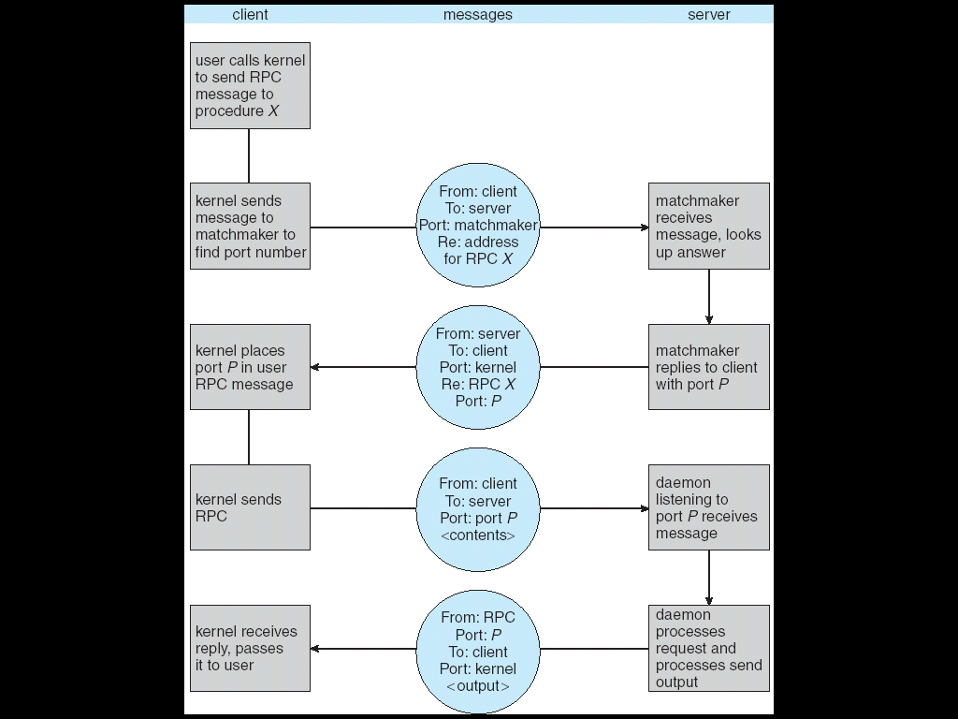
Execution of RPC

Slide 65

Remote Method Invocation
Remote Method Invocation (RMI) is a Java mechanism similar to RPCs.
RMI allows a Java program on one machine to invoke a method on a remote object.

Slide 66
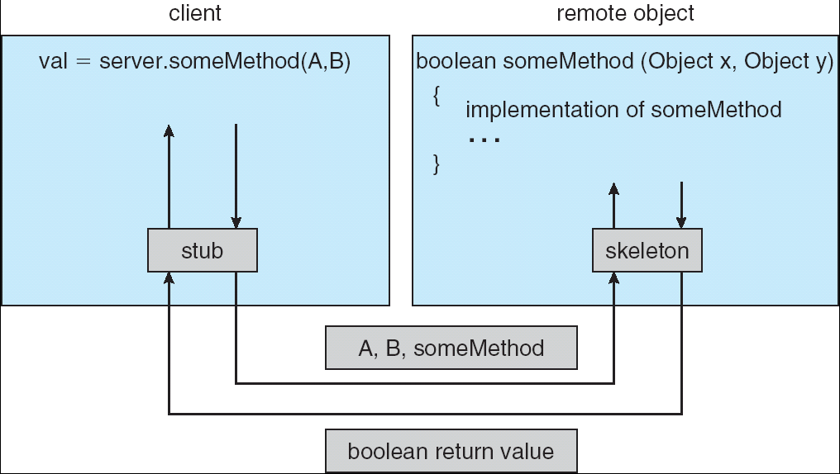
Marshalling Parameters

