Slide 1
From Processes to Threads

Slide 2
Processes and Threads
Process abstraction combines two concepts
  Concurrency
    Each process is a sequential execution stream of instructions
  Protection
    Each process defines an address space
    Address space identifies all addresses that can be touched by the program
Threads
  Key idea: separate the concepts of concurrency from protection
  A thread represents a sequential execution stream of instructions
  A process defines the address space that may be shared by multiple threads

Slide 3
The Case for Threads
Consider the following code fragment
for(k = 0; k < n; k++)
a[k] = b[k] * c[k] + d[k] * e[k];
Is there a missed opportunity here? On a Uni-processor?
On a Multi-processor?

Slide 4
The Case for Threads
Consider a Web server
get network message from client
get URL data from disk
compose response
send response
How well does this web server perform?

Slide 5
Introducing Threads
A thread represents an abstract entity that executes a sequence of instructions
  It has its own set of CPU registers
  It has its own stack
  There is no thread-specific heap or data segment (unlike process)
Threads are lightweight
  Creating a thread is more efficient than creating a process.
  Communication between threads easier than btw. processes.
  Context switching between threads requires fewer CPU cycles and memory references than switching processes.
  Threads only track a subset of process state (share list of open files, pid, …)
Examples:
  OS-supported: Sun’s LWP, POSIX’s threads
  Language-supported: Modula-3, Java

Slide 6
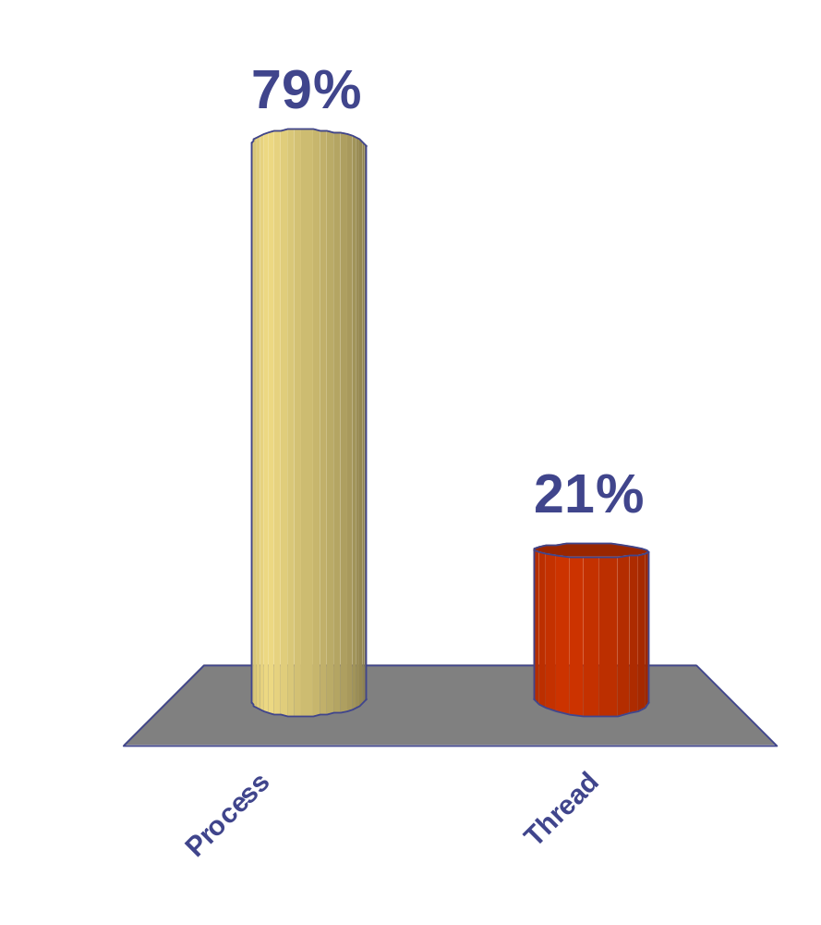
Context switch time for which entity is greater?
65
Process
Thread
47

Slide 7
Programmer’s View
void fn1(int arg0, int arg1, …) {…}
main() {
…
tid = CreateThread(fn1, arg0, arg1, …);
…
}
At the point CreateThread is called, execution continues in parent thread in main function, and execution starts at fn1 in the child thread, both concurrently

Slide 8
How Can it Help?
Consider the following code fragment
  for(k = 0; k < n; k++)
  a[k] = b[k] * c[k] + d[k] * e[k];
Rewrite this code fragment as:
  CreateThread(fn, 0, n/2);
  CreateThread(fn, n/2, n);
  fn(l, m) {
  for(k = l; k < m; k++)
  a[k] = b[k] * c[k] + d[k] * e[k];
  }
What did we gain?

Slide 9
How Can it Help?
Consider a Web server
Create a number of threads, and for each thread do
    get network message from client
    get URL data from disk
    compose response
    send response
What did we gain?

Slide 10
Overlapping Requests (Concurrency)
Request 1
Request 2
    get network message from client
    get URL data from disk
    compose response
    send response
    get network message from client
    get URL data from disk
    compose response
    send response
Time

Slide 11
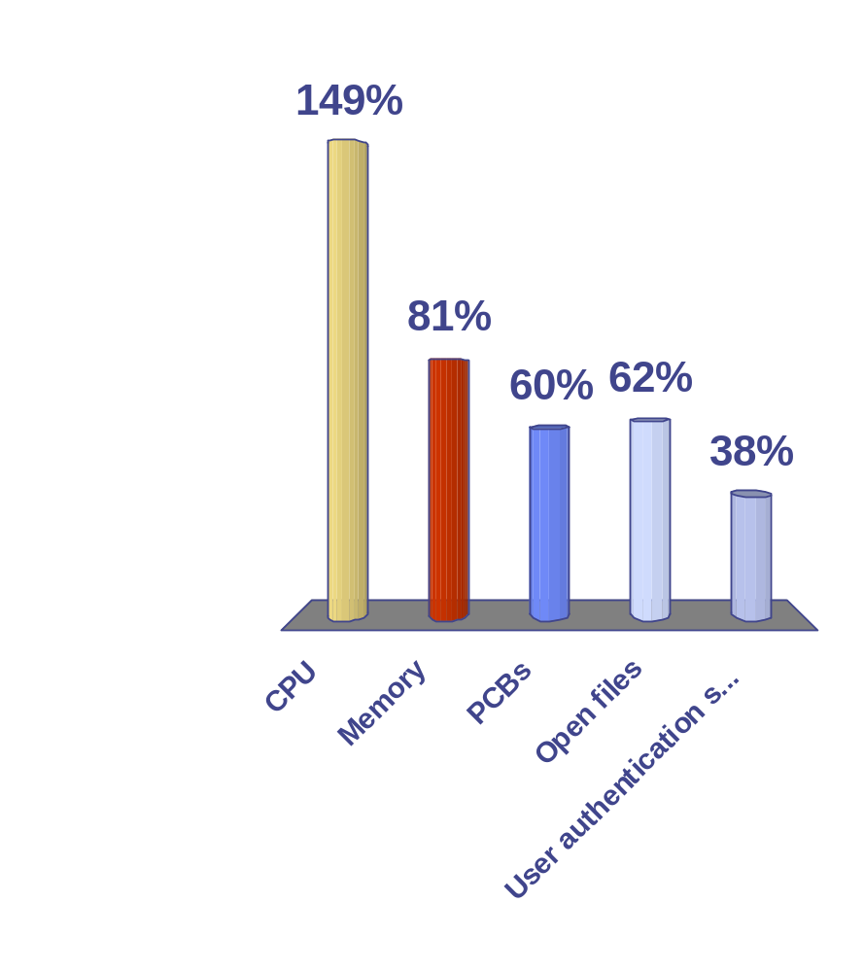
Threads allow you to multiplex which resources?
65
47
of
65
CPU
Memory
PCBs
Open files
User authentication structures
0

Slide 12
Threads vs. Processes
Threads
A thread has no data segment or heap
A thread cannot live on its own, it must live within a process
There can be more than one thread in a process, the first thread calls main & has the process’s stack
Inexpensive creation
Inexpensive context switching
If a thread dies, its stack is reclaimed
Inter-thread communication via memory.
Processes
A process has code/data/heap & other segments
There must be at least one thread in a process
Threads within a process share code/data/heap, share I/O, but each has its own stack & registers
Expensive creation
Expensive context switching
If a process dies, its resources are reclaimed & all threads die
Inter-process communication via OS and data copying.

Slide 13
Implementing Threads
Processes define an address space; threads share the address space
Process Control Block (PCB) contains process-specific information
  Owner, PID, heap pointer, priority, active thread, and pointers to thread information
Thread Control Block (TCB) contains thread-specific information
  Stack pointer, PC, thread state (running, …), register values, a pointer to PCB, …
Process’s
address space
TCB for
Thread1
mapped segments
PC
SP
State
Registers
…
DLL’s
Heap
TCB for
Thread2
Stack – thread2
PC
SP
State
Registers
…
Stack – thread1
Initialized data
Code

Slide 14
Implementing Threads (Cont’d.)
CreateThread(pointer_to_procedure, arg0, …) {
// allocate a new TCB and stack
TCB tcb = new TCB();
Stack stack = new Stack();
// initialize TCB and stack with initial register values and address of first instruction
tcb.pc = Stub;
tcb.stack = stack;
tcb.arg0reg = pointer_to_procedure;
tcb.arg1reg = arg0;
…
// Tell the dispatcher about the newly created thread
ReadyQ.add(tcb);
}
Stub(proc, arg0, arg1, …) {
(*proc)(arg0, arg1, …);
DeleteCurrentThread();
}

Slide 15
Threads’ Life Cycle
Threads (just like processes) go through a sequence of start, ready, running, waiting, and done states
Start
Done
Ready
Running
Waiting
Notes:
Besides memory state and processor state, there’s also execution state.
In this class we’ll use a simple 3-state model of process execution.
— At all times a process is always in one of these three states.
— We assume a single processor so there’s only ever one process in the running state.
There are queues associated w/ the waiting and ready states.
— More later.
Do an example of a process making state transitions upon performing I/O.
— Note that the READ operation causes two process transitions: one from the running to the waiting state, and one from the ready to the running state.

Slide 16
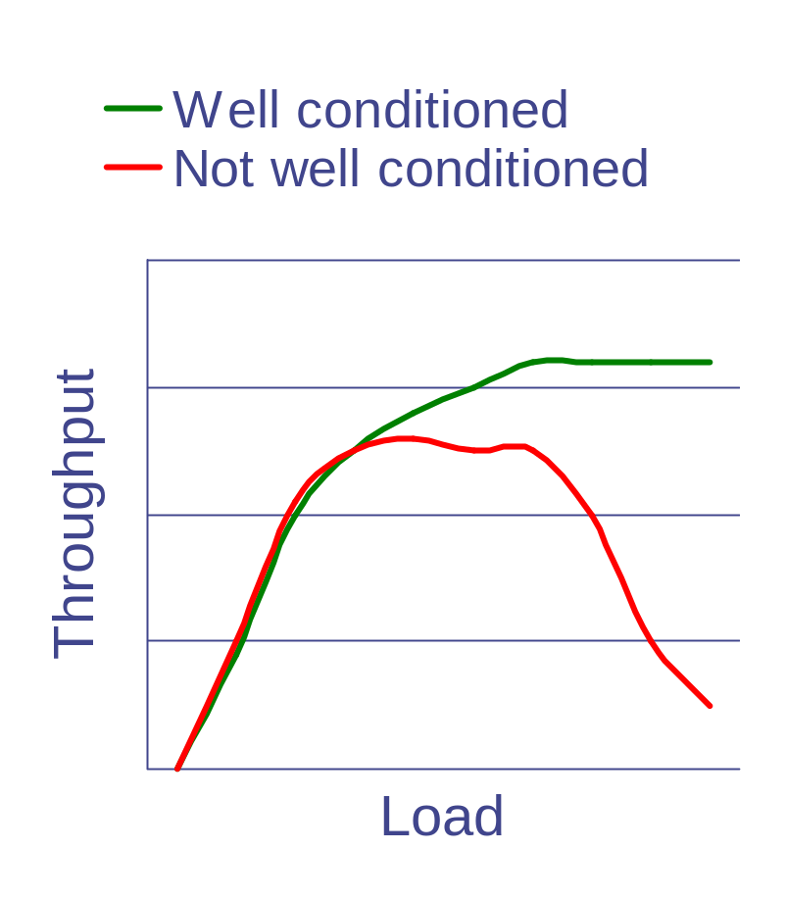
Thread or Process Pool
Creating a thread or process for each unit of work (e.g., user request) is dangerous
  High overhead to create & delete thread/process
  Can exhaust CPU & memory resource
Thread/process pool controls resource use
  Allows service to be well conditioned.

Slide 17
User-level Threads
Motivation
  Threads are a useful programming abstraction
  Calling OS to manage threads is expensive.
  Implement thread creation/scheduling using procedure calls to a user-level library rather than system calls
User-level threads
  User-level library implementations for
    CreateThread()
    DestroyThread()
    Yield()
    …
  User-level library performs the same set of actions as the corresponding system calls
  Main difference: thread management is under the control of user-level library
  What happens if a user-level thread makes a system call?

Slide 18
Kernel Threads vs. User-level Threads
Kernel threads
  A kernel thread, aka lightweight process (LWP), is a thread that the OS knows about
    Some OSes have LWPs (e.g., IRIX, HP-UX)
    Most do not (Linux, Windows)
  Switching between kernel threads of the same process only slightly less expensive than switching processes.
    Do not need to change addressing context.
  Trend is toward efficient processes and avoid LWPs.
Kernel processes that share memory
  Linux clone() starts new process sharing old process space
  int clone(int(*fn)(void*), void* child_stack, int flags, void* arg);
  Flags control sig handlers, file system root, parent pid, etc.

Slide 19
User-level threads
  OS does not know about user-level threads (e.g., pthreads)
  OS does know about the process which contains the threads
  OS schedules processes, not threads
  Programmer uses a threads library to manage threads (create, delete, synchronize and schedule)

Slide 20
User-level Threads (Cont’d.)
Benefits:
  Small context for switching between threads of a process
  Thread scheduling is more flexible
    Can use application-specific scheduling policy
    Each process can use a different scheduling algorithm
    Threads voluntarily give up CPU
Drawbacks:
  OS is unaware of the existence of user-level threads
    Poor scheduling decisions
    If a user-level thread waits for I/O – entire process waits
  OS schedules processes independent of number of threads within a process

Slide 21
Scheduler Activations (best of both worlds)
Why not a user level thread scheduler that spawns a kernel thread for blocking operations?
  Forget spawning, use a pool of kernel threads.
  But how do we know if an operation will block?
    read might block, or data might be in page cache.
    Any memory reference might cause a page fault to disk.
Solution : Scheduler Activations
Kernel tells user when a thread is going to block, via an upcall.
  Kernel can provide a kernel thread to run the user-level upcall handler (or preempt user thread).
  User-level scheduler suspends blocking thread and can give back kernel thread it was running on.

Slide 22
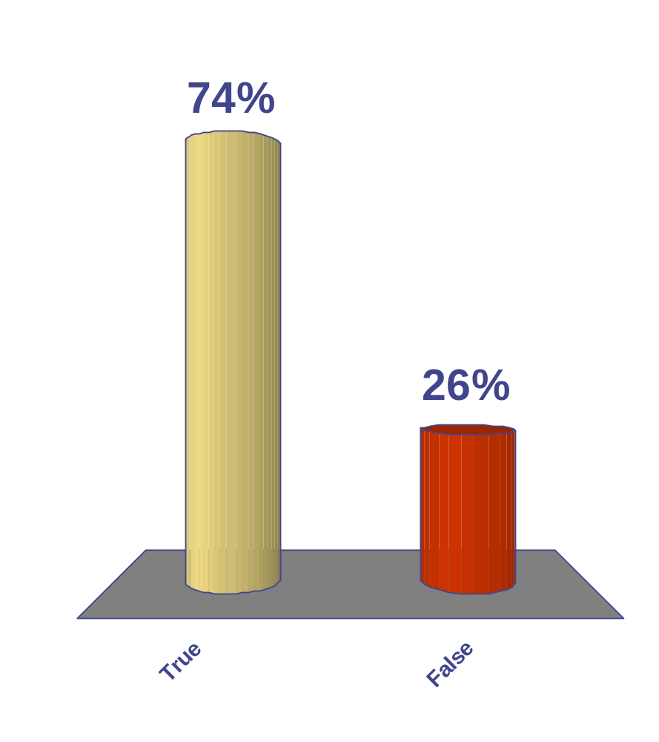
When a user level thread does I/O it blocks the entire process.
True
False
43 of 65

Slide 23
Sharing among threads is great …
int a = 1, b = 2;
main() {
CreateThread(fn1, 4);
CreateThread(fn2, 5);
}
fn1(int arg1) {
if(a) b++;
}
fn2(int arg1) {
a = arg1;
}
What are the values of a & b
at the end of execution?

Slide 24
… But it can lead to problems!!
int a = 1, b = 2;
main() {
CreateThread(fn1, 4);
CreateThread(fn2, 5);
}
fn1(int arg1) {
if(a) b++;
}
fn2(int arg1) {
a = 0;
}
What are the values of a & b
at the end of execution?

Slide 25
Some More Examples
What are the possible values of x in these cases?
Thread1: x = 1; Thread2: x = 2;
Initially y = 10;
Thread1: x = y + 1; Thread2: y = y * 2;
Initially x = 0;
Thread1: x = x + 1; Thread2: x = x + 2;

Slide 26
This is because …
Order of thread execution is non-deterministic
  Multiprocessing
    A system may contain multiple processors ➔ cooperating threads/processes can execute simultaneously
  Multi-programming
    Thread/process execution can be interleaved because of time-slicing

Slide 27
Operations are often not “atomic”
  Example: x = x + 1 is not atomic!
Goal:
  Ensure that your concurrent program works under ALL possible interleaving
Challenge
  Enumerating all cases is not possible!
  Need to define synchronization constructs and programming style for developing concurrent programs

